Slide 1


Causes of Skin Conditions

Slide 2
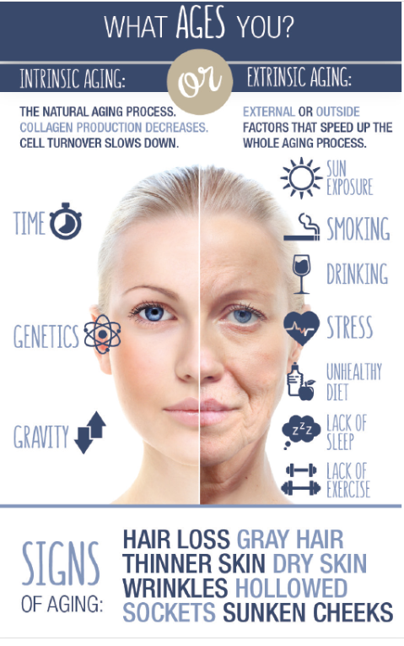

Slide 3
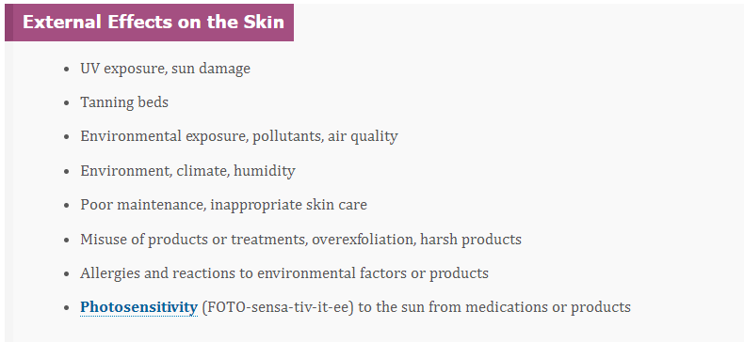
External Factors That Affect the Skin

Slide 4
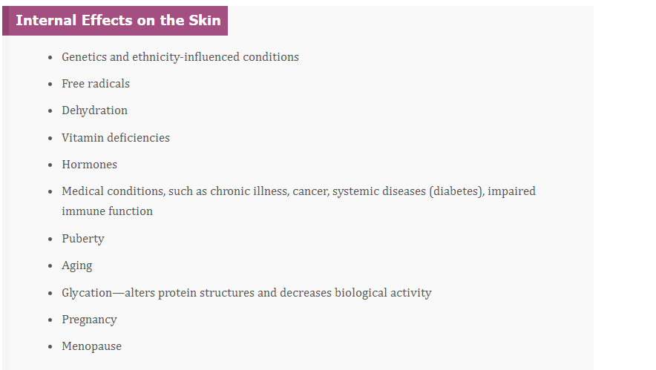
Internal Factors That Affect the Skin

Slide 5
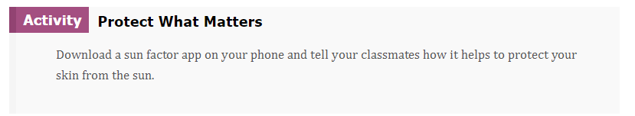
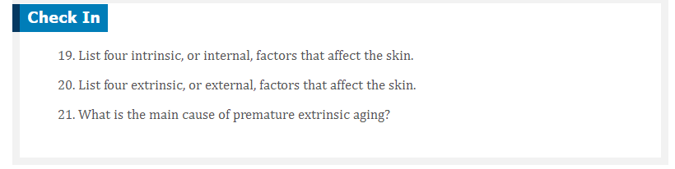

Slide 6

QUESTIONS?

