Slide 1
Bony Thorax
Ribs, Sternum and
Sterno-Clavicular Joints

Slide 2
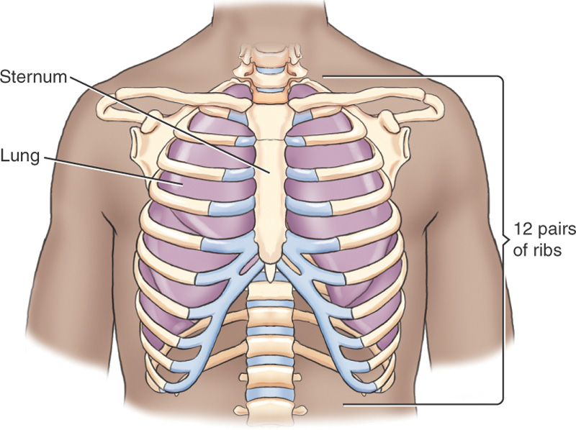
Bony Thorax

Slide 3
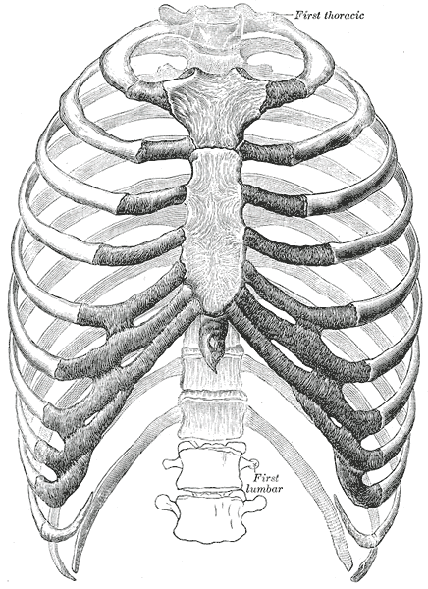
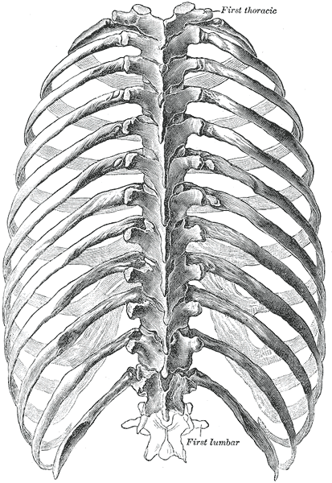

Slide 4
Bony Thorax
Protective cage around vital organs
Expandable chamber, wherein the interior capacity expands and contracts during inspiration and expiration
Sternum anteriorly
Thoracic vertebrae posteriorly
12 pairs of ribs that connect the sternum to the vertebral column
Protects the important organs of the respiratory system and vital structures within the mediastinum, the heart and great vessels
Notes:
Vital organs – heart, lungs, great vessels
Expandable – intercostal muscles lift and depress allowing us to breath

Slide 5
Sternum
Thin, narrow, flat bone
Highly vascular, cancellous tissue covered by compact bone
Consists of 3 portions:
  manubrium
  body
  xiphoid process

Slide 6
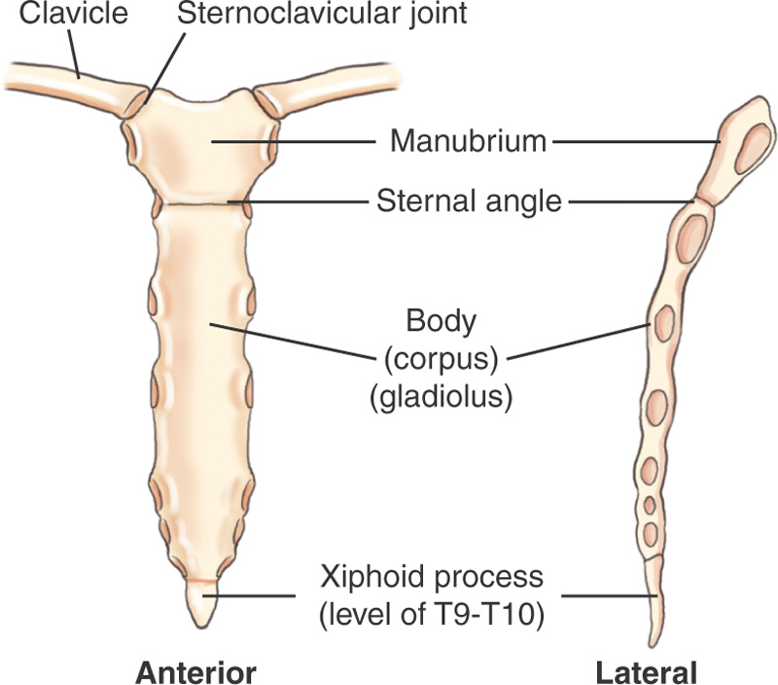
Sternum

Slide 7
Manubrium
Upper portion, thickest and widest part of the sternum
2 inches or 5cm in length
Found at T2-3 to T4

Slide 8
Body (corpus gladiolus)
long and narrow shape
4 inches or 10 cm in length
Found at T4-5, ends at T9-10
Formed by the union of 4 segments, which begins during puberty and ends around age 25

Slide 9
Xiphoid Process
Small, inferior portion
Level of T9-10
Composed of cartilage and does not ossify until age 40

Slide 10
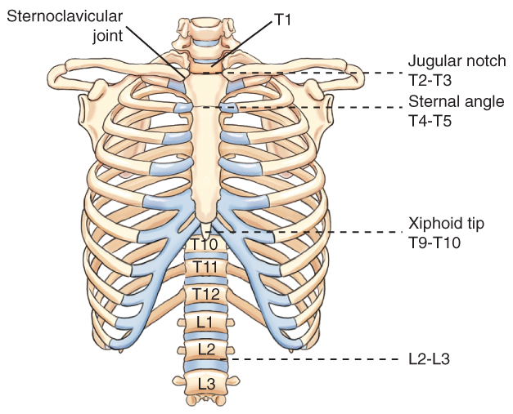
Topographic Landmarks

Slide 11
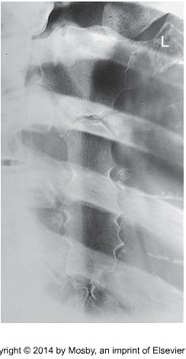
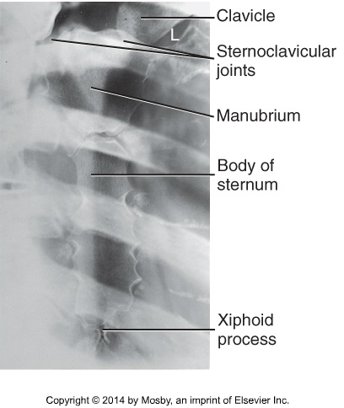

Slide 12
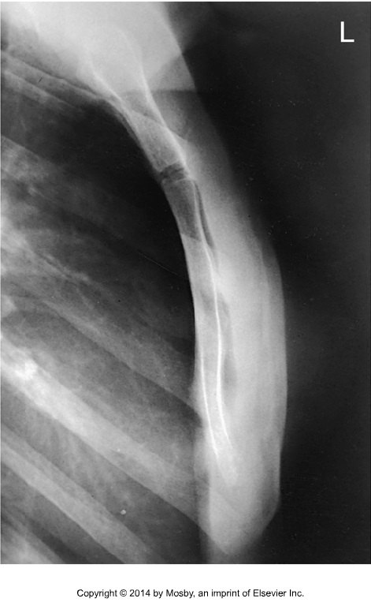
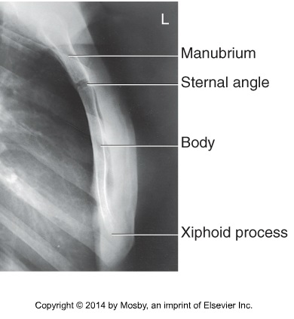

Slide 13
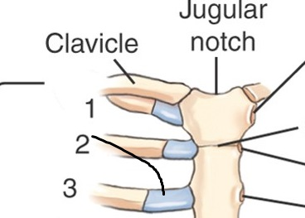
Sternoclavicular Articulation
Each clavicle articulates with the manubrium laterally at the clavicular notch
Called the sternoclavicular joint, the only bony connection between each shoulder girdle and the bony thorax

Slide 14
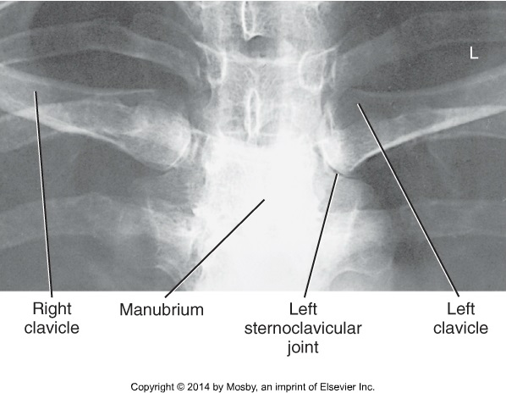
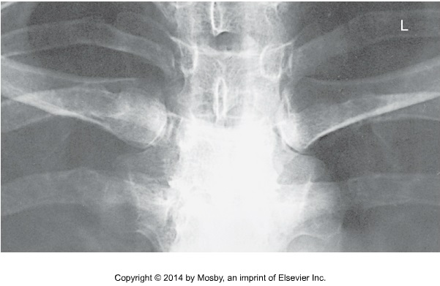

Slide 15
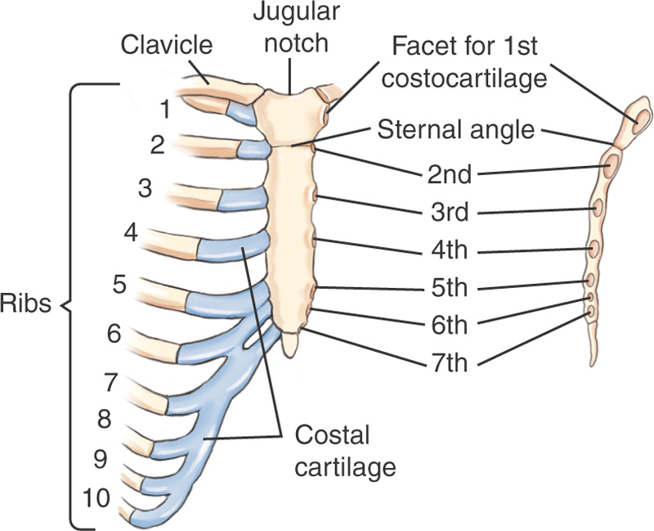
Sternal Rib Articulations

Slide 16
the clavicles and the cartilages of the first seven pairs of ribs connect directly to the sternum
the anterior ribs do not connect directly to the sternum, but are attached to it by the costocartilage
the first rib connects to the manubrium, the second rib connects to the sternal angle
the 3rd through 7th rib connect to the sternum
the 8th through 10th rib costocartilage connect to the 7th rib costocartilage, which connects to the sternum

Slide 17
Ribs
Each rib is numbered according to the thoracic vertebra that it attaches to, ribs are numbered from the top down
The first 7 pairs of ribs are called true ribs, attaching to the sternum by its costcartilage
Rib pairs 8-12 are called false ribs, because they don’t attach directly to the sternum
The last 2 pairs of false ribs are called floating ribs because they are not connected anteriorly, and have no costocartilage

Slide 18
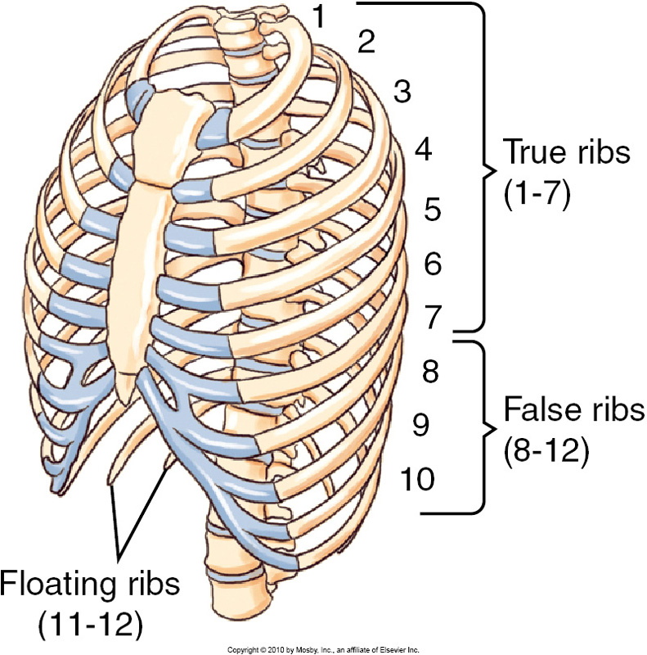

Slide 19
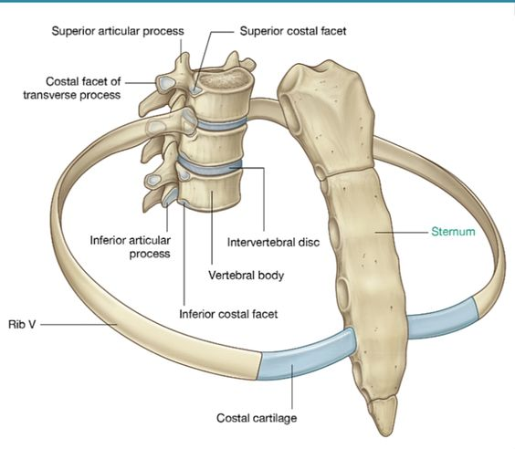

Slide 20
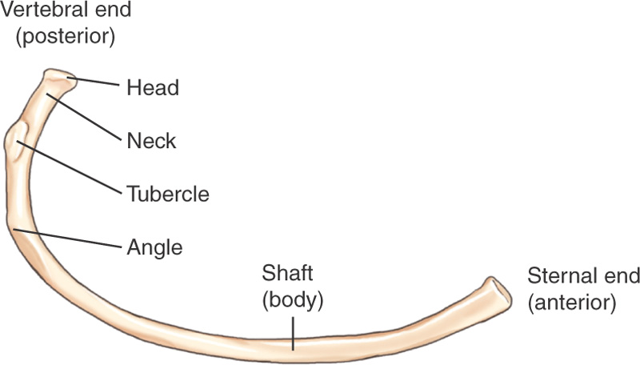
Typical Rib

Slide 21
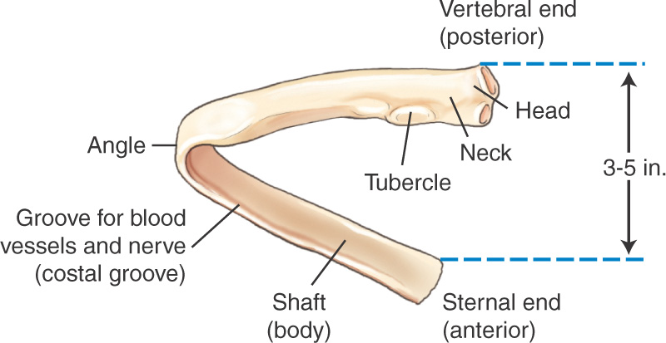
Typical Rib Posterior View
-The posterior, vertebral end of a typical rib is 8-13 cm higher than the anterior sternal end
the lower inside margin of each rib is a costal groove, which contains an artery, vein and a nerve.

Slide 22
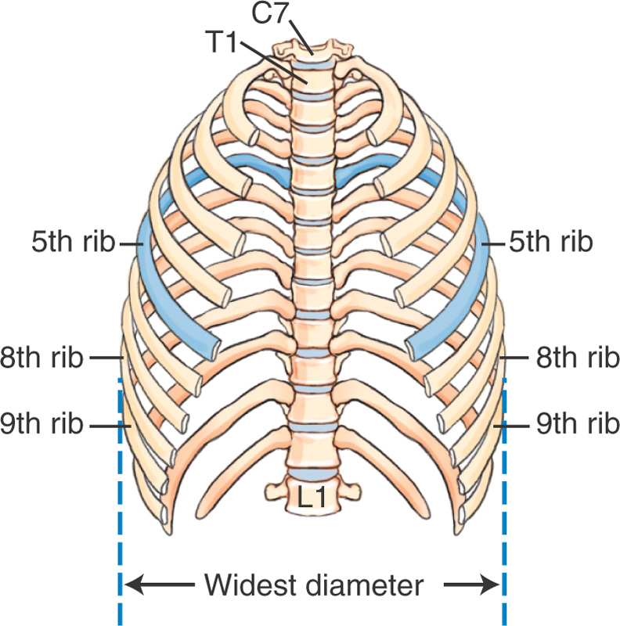
Ribs Without Sternum and Costocartilage

Slide 23
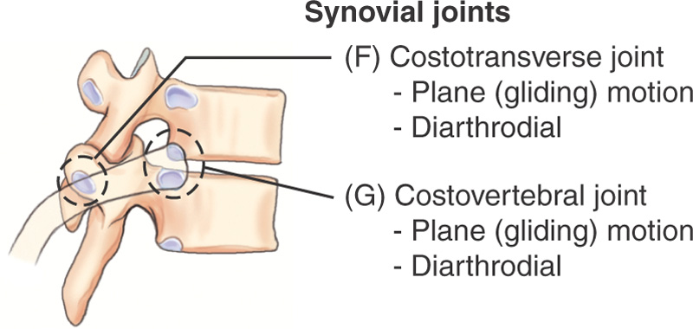
Posterior Bony Thorax Articulations: Synovial Type with Plane Movement

