Slide 1
INFC 215 Infection Prevention and Control
Donning/Doffing Face Protection – Face Shield

Slide 2
Donning
Putting ON

Slide 3
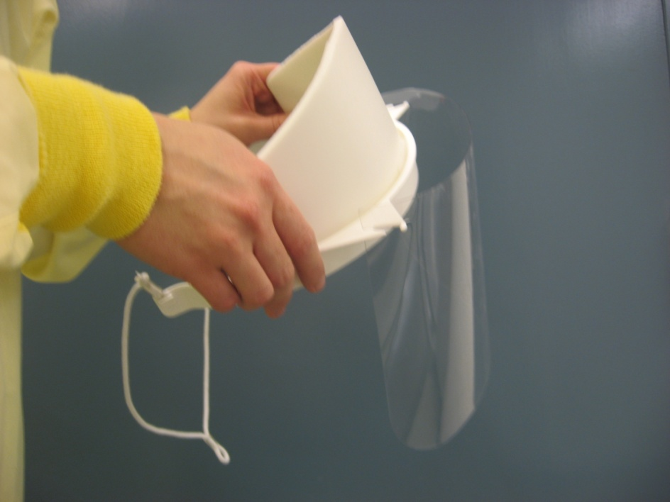
1. Select Face Shield
When?
Anticipating aerosols or splashes

Slide 4
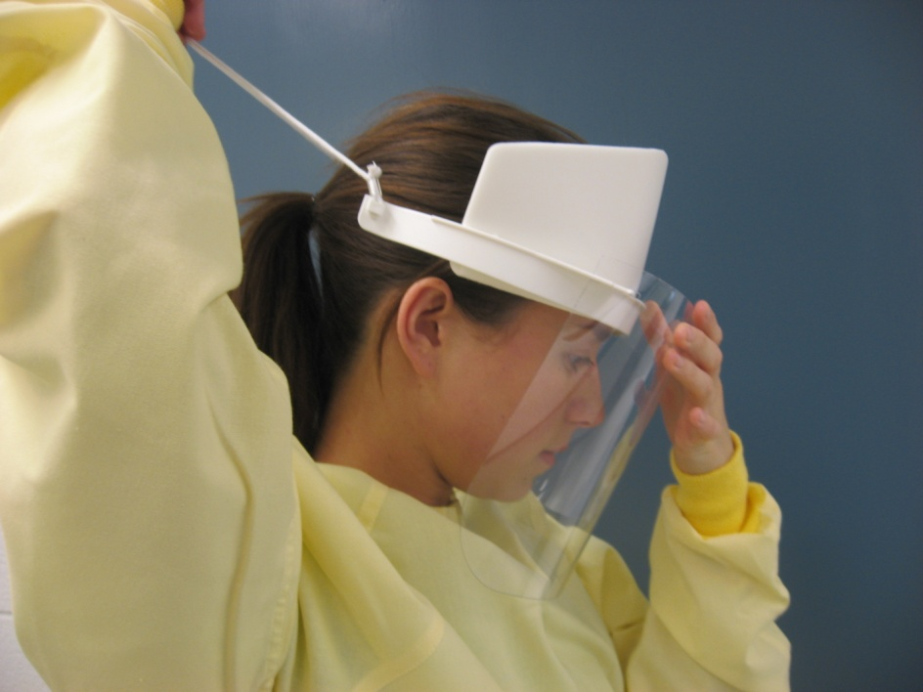
2. Put on
Hold shield in front of your face
Slide the elastic over your head

Slide 5
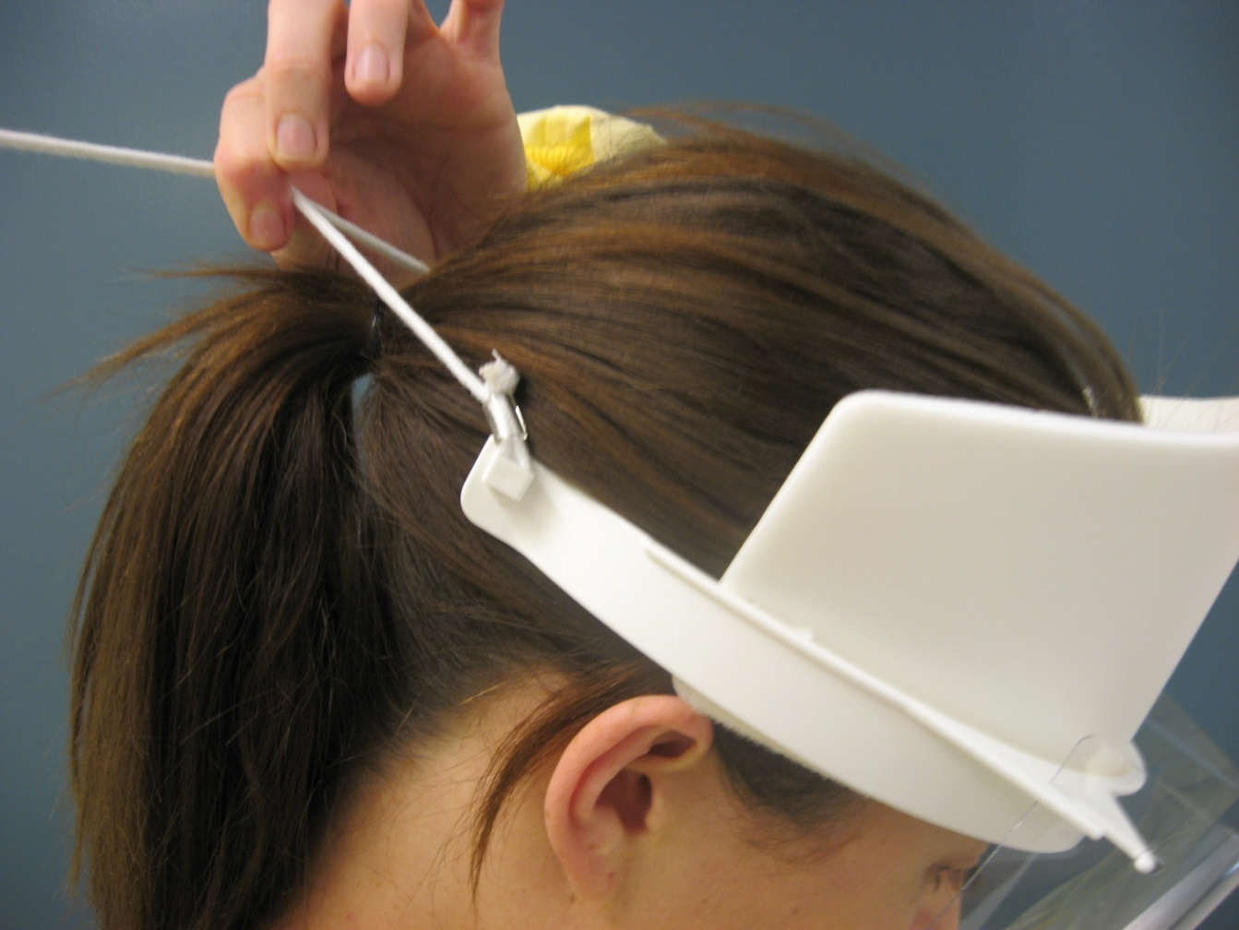
3. Adjust to fit

Slide 6
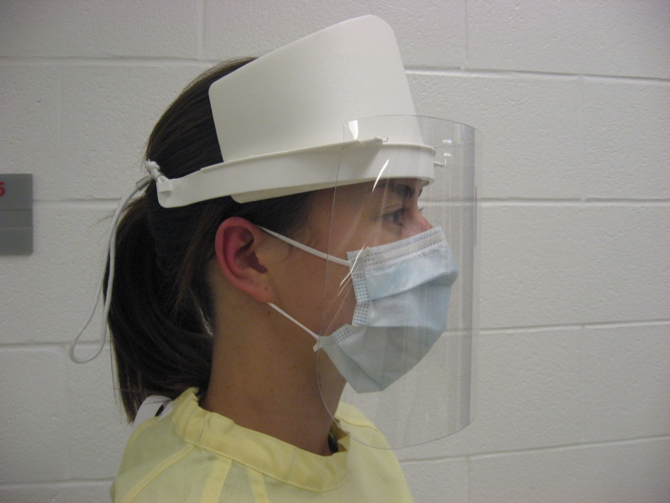
4. Check appearance
Use one hand to place over your nose, mouth and chin

Slide 7
Doffing
Taking OFF

Slide 8
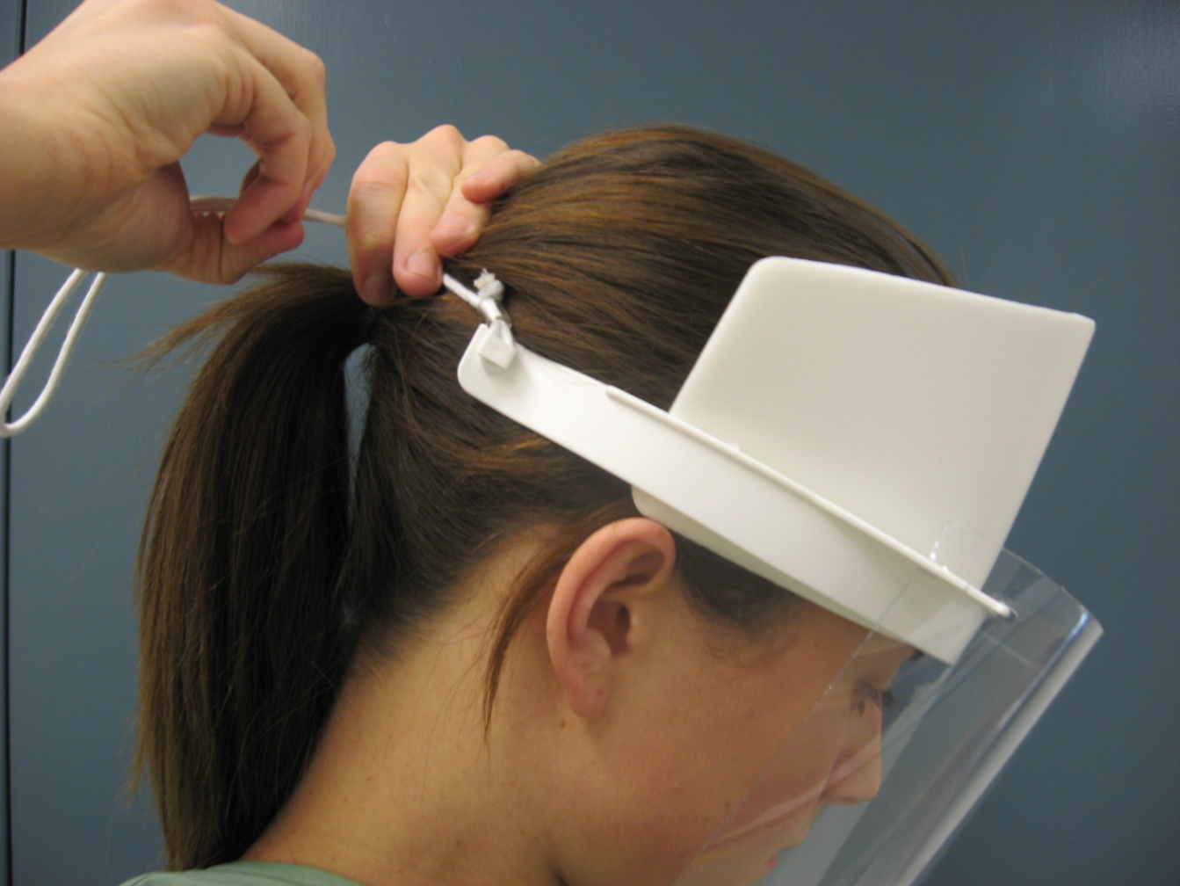
1. Loosen tie

Slide 9
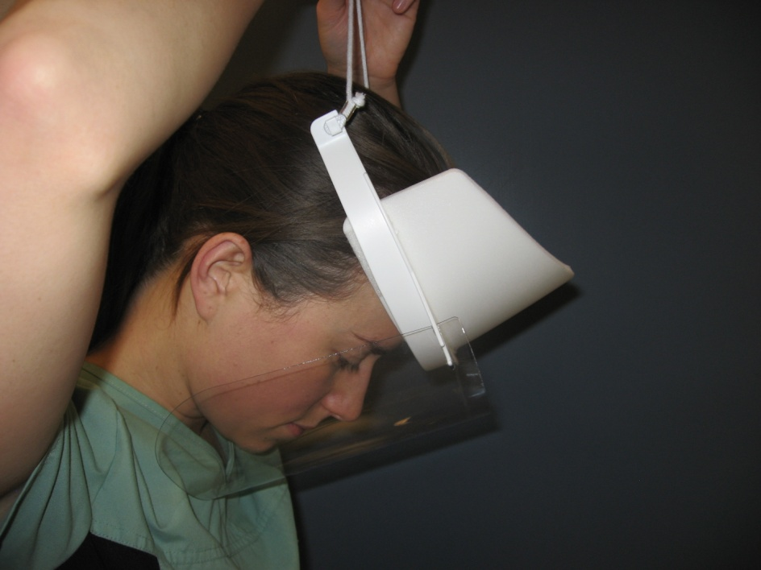
2. Grasp by elastic cord
Carefully pull over your head and away from your face

Slide 10
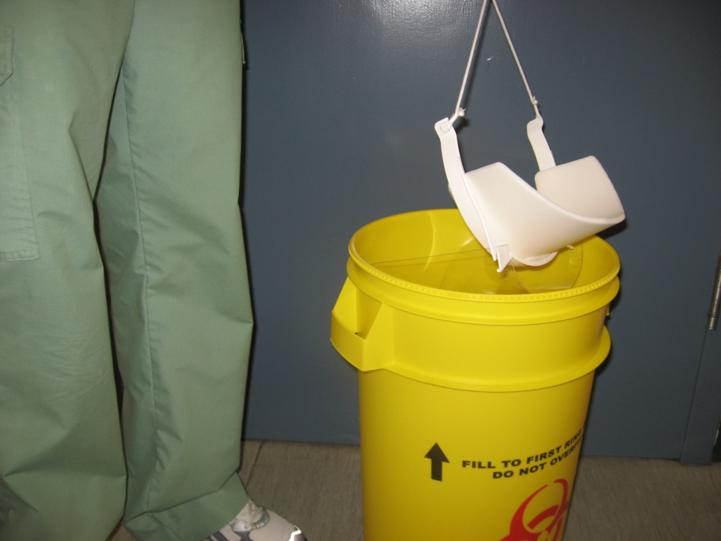
3. Discard in to disposal container
Do not touch outer surface of shield
Use elastic to handle shield

Slide 11

QUESTIONS?

