Slide 1


High Frequency

Slide 2
Tesla High-Frequency Current
This is characterized by high rate of oscillation or vibration and commonly called the violet ray
This is used for scalp and facial treatments
Used to treat thinning hair, itchy scalp, excessively oily or dry skin and scalp
Effects are stimulating or soothing

Slide 3
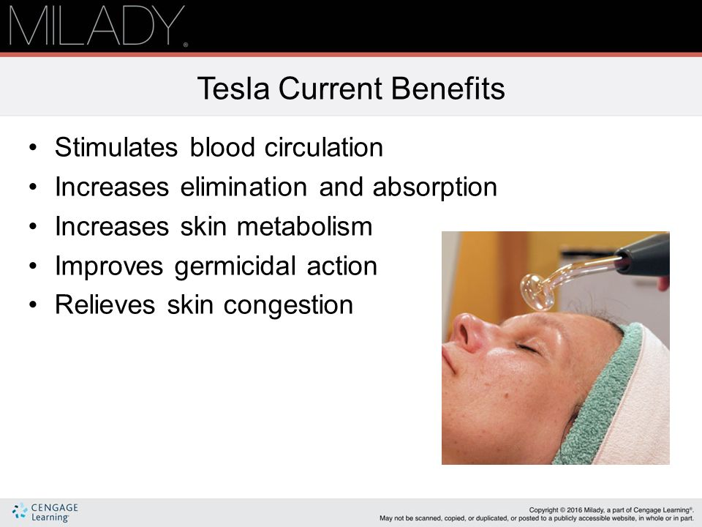

Slide 4
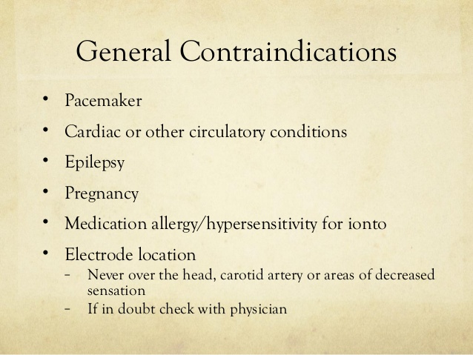

Slide 5
Diabetes
metal dental or facial implants
Recent laser resurfacing/chemical peels
Opens cuts, sores, pustular acne, abrasions
Client uses Accutane or retinoids

Slide 6
High-Frequency Application Methods
Direct surface application → the esthetician holds the hand piece where the glass electrode is inserted and applied it to the client’s skin, moving it slowly over the entire face
Treatment is good for acne and disinfecting

Slide 7
Benefits of High Frequency used in a facial Treatment
Stimulates circulation of blood
Generates heat inside tissues
Aids in deeper penetration of products into the skin
Antiseptic and healing effect
Has a relaxing effect on skin

Slide 8
Indirect Application→ the client holds the tube electrode while esthetician massages face with her hands
Esthetician does not hold electrode
Current is turned on only after client has firmly grasped the electrode
Treatment is good for sensitive, dehydrated skin

Slide 9

QUESTIONS?

