Slide 1


Medical Esthetics
Excretory System

Slide 2
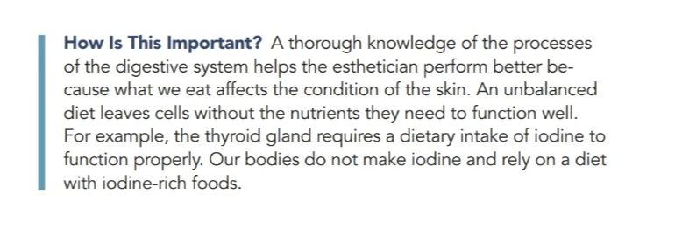
OUR JOURNEY TODAY

Slide 3
Functions
· Eating, or ingestion taking food into the body
· Moving food along the digestive tract known as peristalsis
· Breakdown of food by mechanical and chemical means, with the use of enzymes known as digestion
· Absorption of the digested food into the circulatory systems for transportation to the tissues and cells
· Elimination of solid waste from the body known as defecation

Slide 4
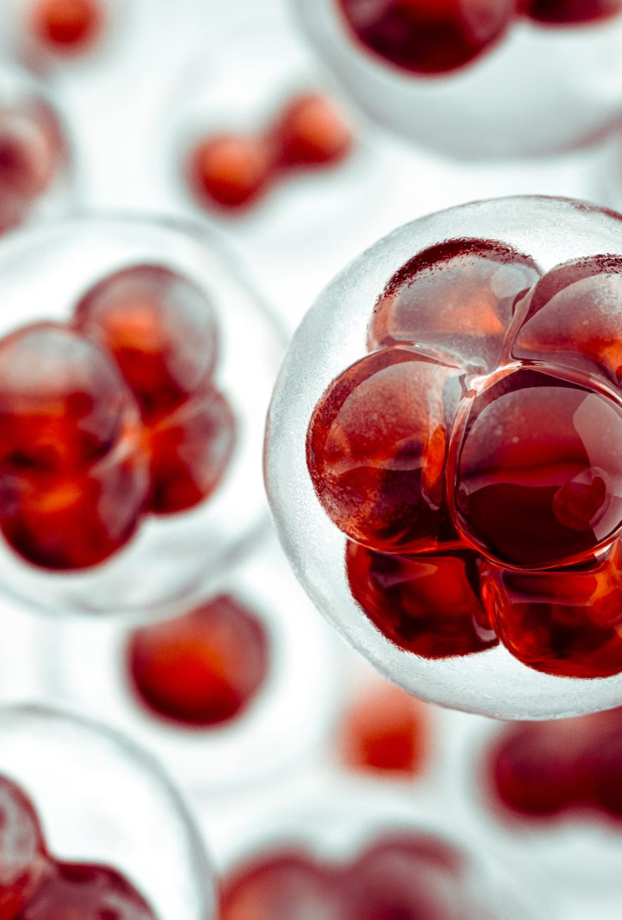
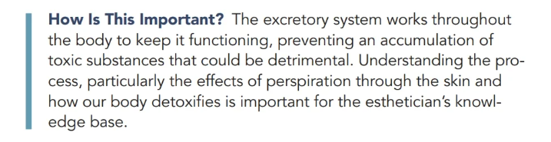
Five Organs That Comprise the Excretory System
The excretory system is responsible for purifying the body by eliminating waste matter
The metabolism of body cells creates various toxic substances that, if retained, could poison the body.

Slide 5

Functions
The organs work in other body systems, but each of the following organs plays a crucial role in the excretory system.
· The kidneys excrete urine; eliminating water and waste products.
· The liver discharges bile, which breaks down digestive fat.
· The skin eliminates salts and minerals through perspiration.
· The large intestine eliminates decomposed and undigested food.
· The lungs exhale carbon dioxide

Slide 6

Lets Watch !

Slide 7
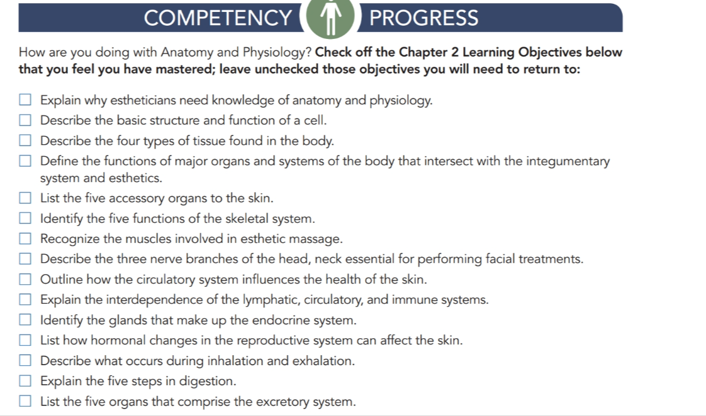

Slide 8

QUESTIONS?

