Slide 1


Treatment of Acne Scars With a Combination of Chemical Peels and Microneedling

Slide 2
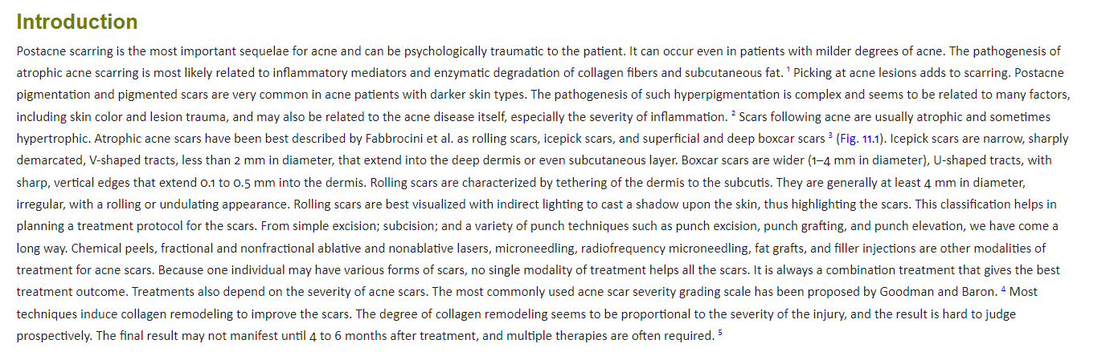

Slide 3
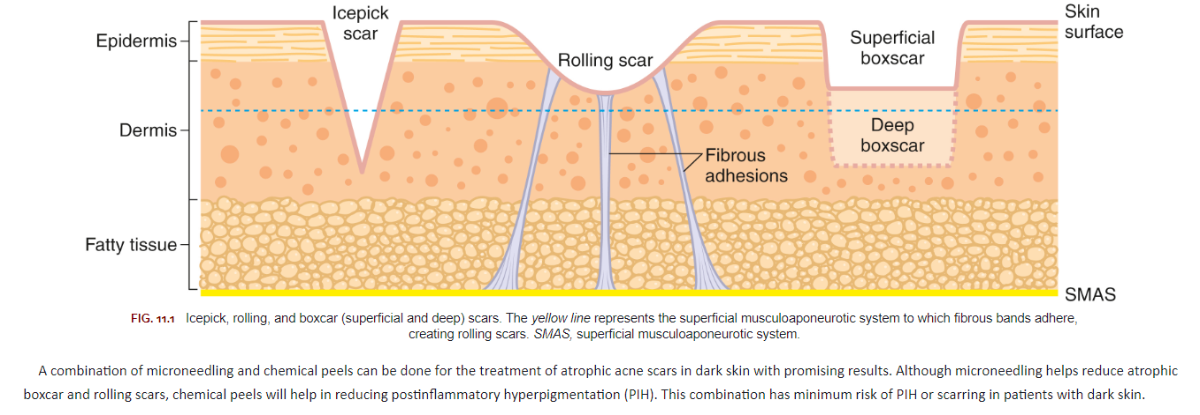

Slide 4
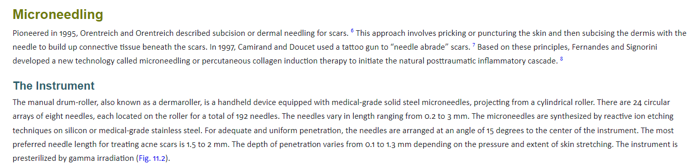

Slide 5
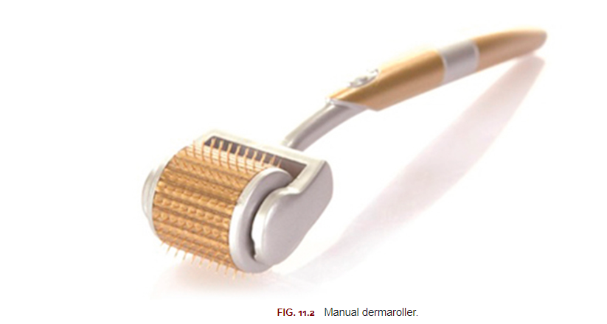

Slide 6


Slide 7
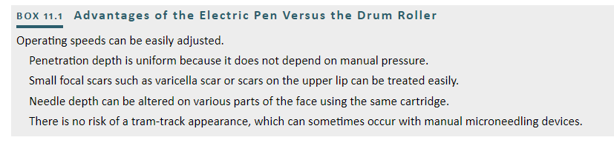

Slide 8
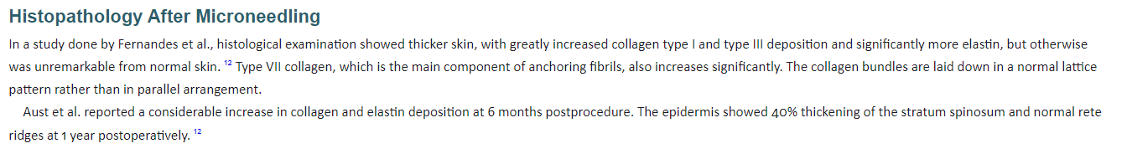

Slide 9
Chemical Peels
• Glycolic acid peels can be done in the same session as microneedling safely. Concentrations of 20% to 35% GA are preferable for dark skin.
• A concentration of 20% to 50% Mandelic acid peels can be done in the same session as microneedling, but there are no studies supporting it yet.
• Salicylic 20% peel can be done in combination with microneedling in alternate sessions in patients with seborrhea or in those who have a mild, active acne along with scar
TCA peel in concentrations of 15% to 20% should be done with precaution and care in patients with dark skin.
Tretinoin peels have keratolytic, sebolytic, comedogenic, and antiinflammatory properties.. They should be done alternately with microneedling rather than on the same session.

Slide 10
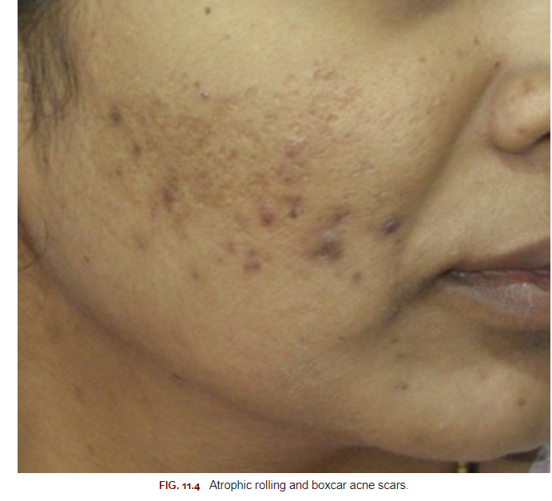

Slide 11
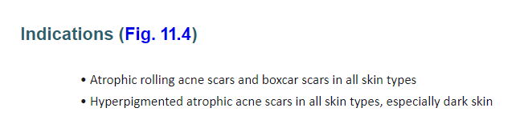

Slide 12
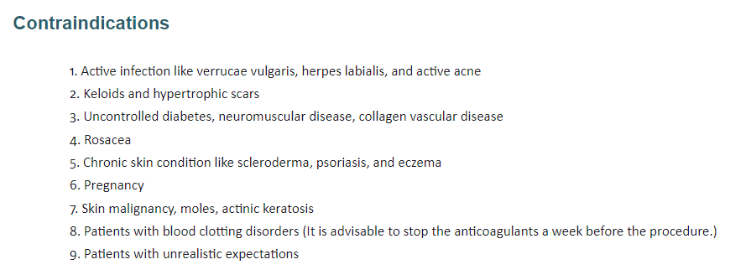

Slide 13


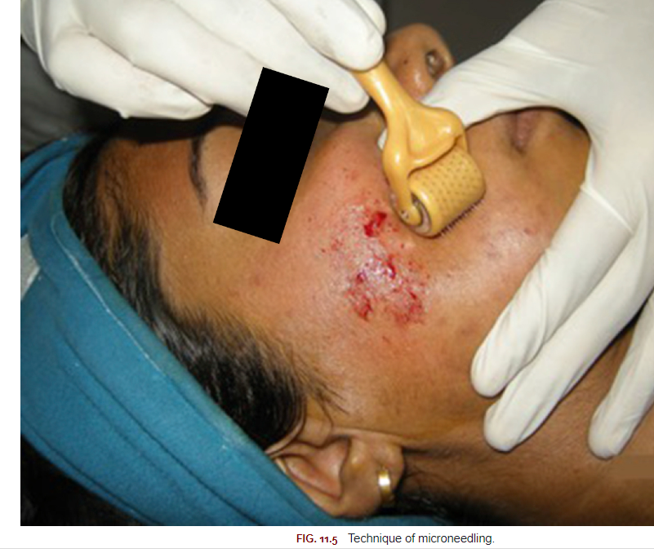

Slide 14
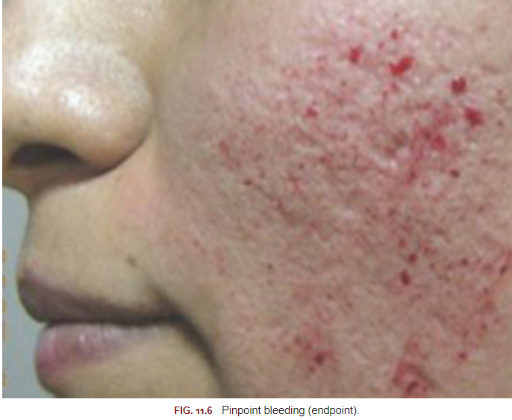

Slide 15
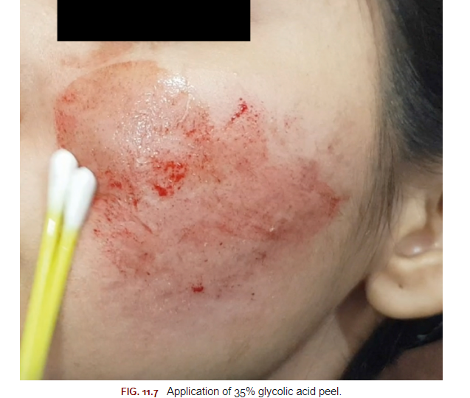

Slide 16
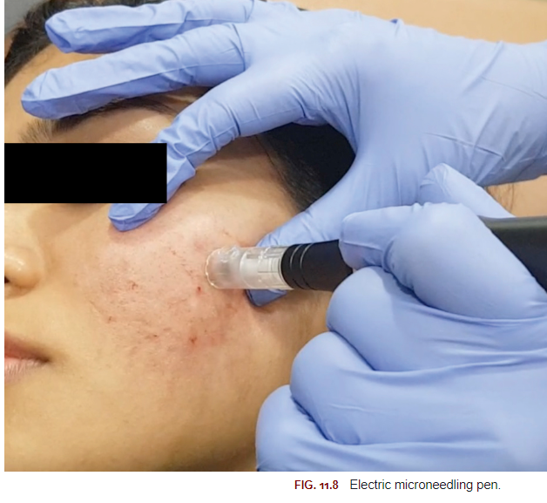

Slide 17
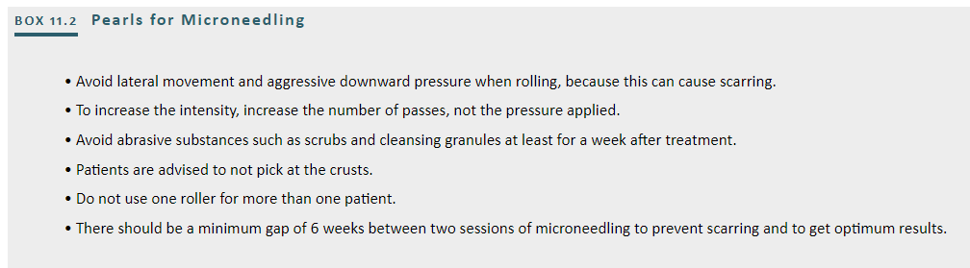

Slide 18
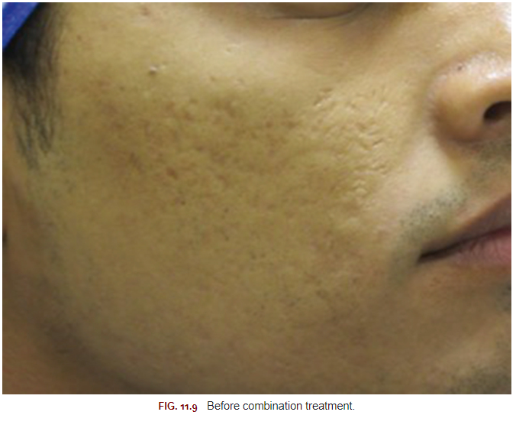

Slide 19
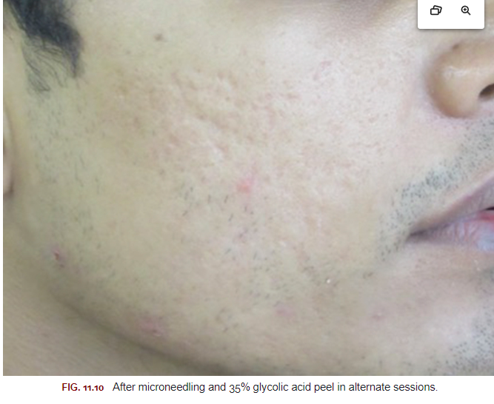

Slide 20
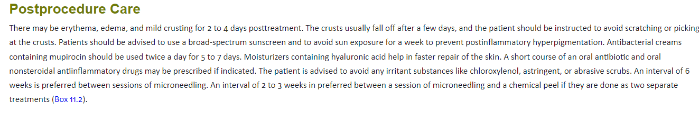

Slide 21
1. Bruising
2. Mild scabbing for a few days after the procedure
3. Hematoma on the bony areas
4. Secondary bacterial infection
5. Milia formation
6. Postinflammatory hyperpigmentation
7. Tram track effect seen mainly on bony prominences
8. Allergic and foreign body granulomatous reaction
9. Reactivation of herpes simplex and activation of acne

Slide 22
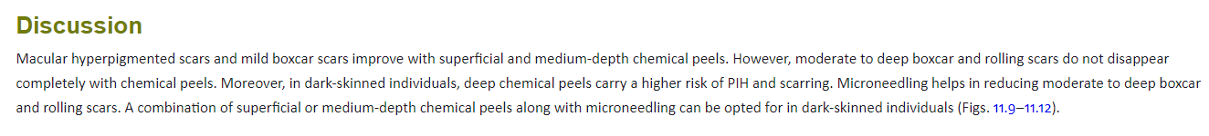

Slide 23
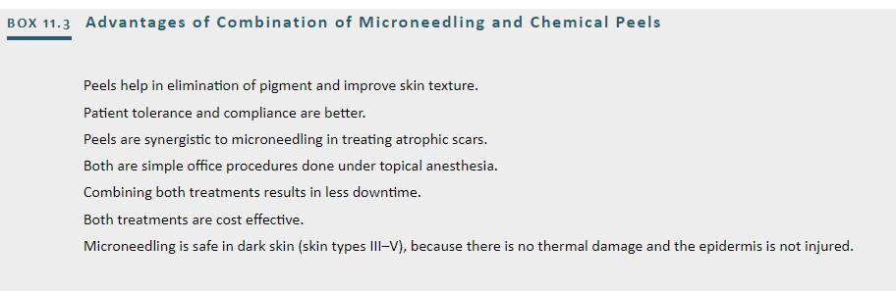

Slide 24
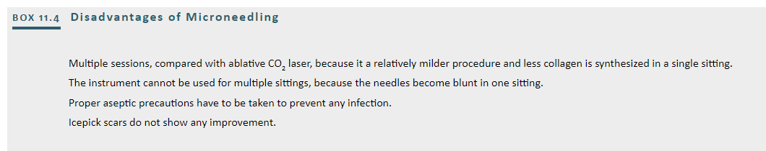

Slide 25
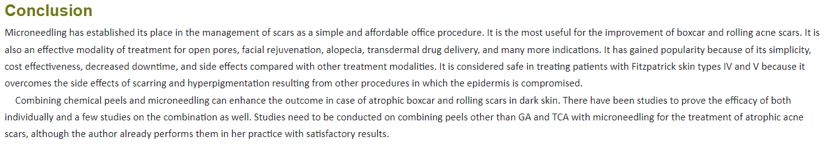

Slide 26

QUESTIONS?

