Slide 1


A Skin Review

Slide 2
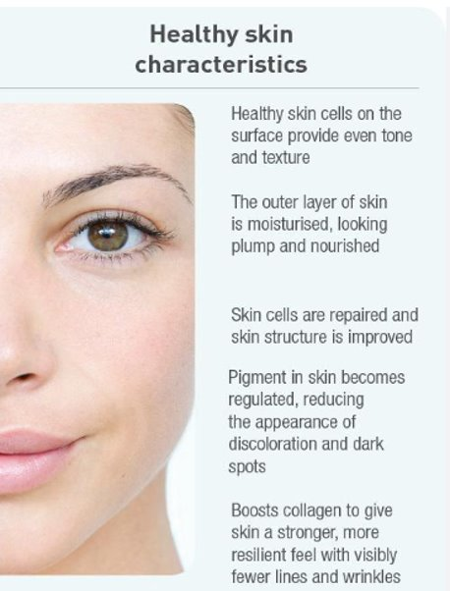

Slide 3
The Integumentary System
Is the largest organ in the body.
It is a strong barrier designed to protect us from the outside elements.
Skin layers, nerves, cellular functions, hair follicles, and glands all work together harmoniously to regulate temperature and protect the body.
Hormones, growth factors, and other biochemicals control the skin’s intricate functions
Our skin is an industrious manufacturer, with miles (kilometers) of blood vessels, millions of sweat glands, and an array of nerves within a network of fibers. Appendages of the skin include hair, nails, sweat glands, and oil glands. Healthy skin is slightly moist, soft, smooth, and somewhat acidic.

Slide 4
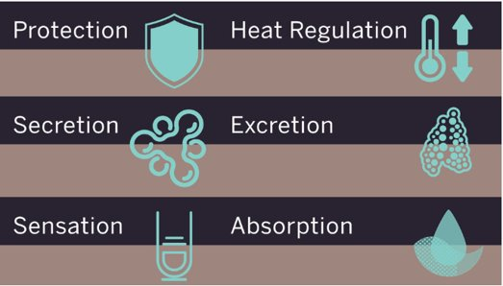

Slide 5
Sometimes, the perfectly balanced system is compromised

Slide 6
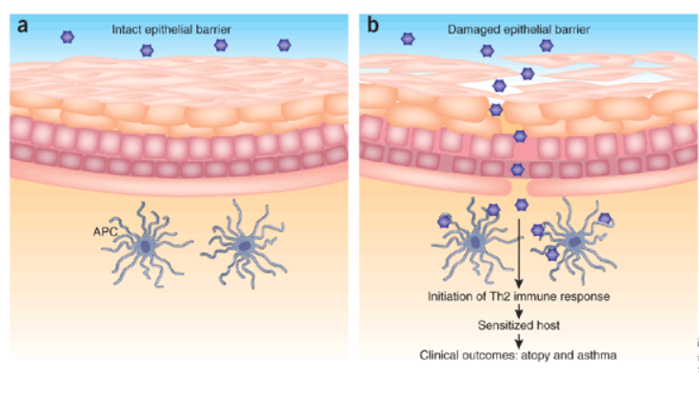

Slide 7
What is compromised skin?
When the skin layers no longer function properly to protect and maintain itself.
A condition has affected the integrity of the skin
Specifically, when talking about compromised skin, we are talking about the epidermal layer, which has been compromised

Slide 8
Let’s Imagine the Epidermis as a layer of plastic, nothing can penetrate and is protecting everything that is in the inner layers
Now let's imagine this plastic blanket has holes that do not heal properly, now the skin is permeable and vulnerable
The skin can no longer hold onto moisture as well, causing dryness, flaking, itching, and redness
The skin can’t protect itself as well, making it more vulnerable to environmental toxins, harmful UV rays, bacteria, allergens, and harsh chemical ingredients in personal care products.

Slide 9
What causes compromised skin?
Genetics
Medications
Cancer Treatments
Wrong usage of products
Using products that are within the wrong ph to the skin
Hormones
Environment
Poor nutrition
Alcohol consumption
Smoking

Slide 10
Let’s Watch!
Eczema
Contact Dermatitis
Psoriasis

Slide 11

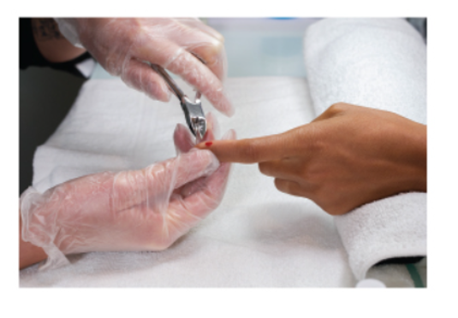
Can Clients With This Conditions Get Manicures And Pedicures
No. Because the products used can make the conditions worse.
Clients with compromised skin are more susceptible to infection and reactions, the best is to treat them when the condition is cleared or not in an active stage.

Slide 12
Group Discussion
Why you think is important to learn this conditions for manicuring and pedicuring

Slide 13

QUESTIONS?

