Slide 1


Business Operations
Unit 5

Slide 2

The only way to guarantee that you will stay in business and have a prosperous business is to take excellent care of your clients. Clients visiting your shop should feel that they are being well taken care of, and they should always have reason to look forward to their next visit. To accomplish this, your salon, spa, or barbershop must be physically attractive, well organized, smoothly run, and, above all, sparkling clean

Slide 3
Planning the Layout
One of the most exciting opportunities ahead of you is planning and constructing the best physical layout for the type of business you envision. Maximum efficiency should be the primary concern. For example, if you are opening a low-budget establishment offering quick service, you will need several stations and a small- to medium-sized reception area because clients will be moving in and out fairly quickly. Retail sales are essential to a profitable beauty business. Make sure the products you carry and the space you design reflect the importance of high retail sales.

Slide 4
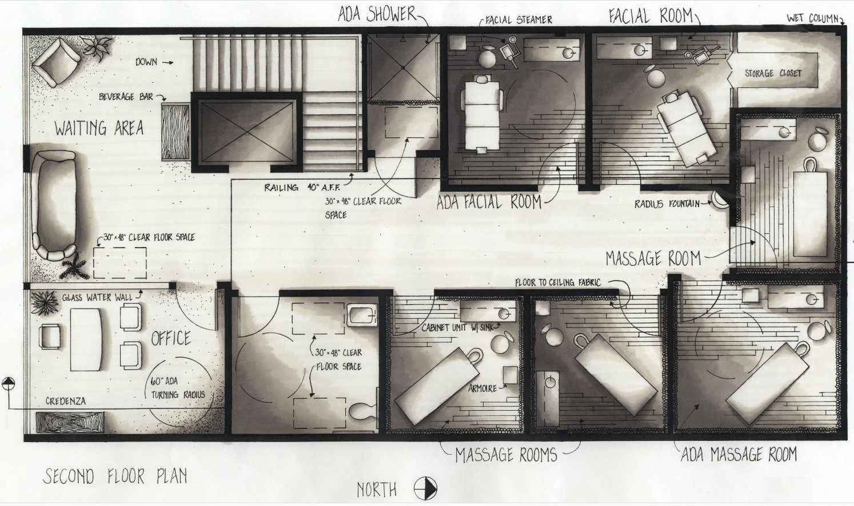

Slide 5
However, if you are opening a high-end business, where clients expect the quality of the service to be matched by the environment, you may want to plan for more room in the waiting area. In fact, you might choose to have several areas in which clients can lounge and enjoy light snacks or beverages—from soda and coffee to alcoholic beverages. Most salons, spas, and barbershops also provide complimentary Wi-Fi access to their guests

Slide 6
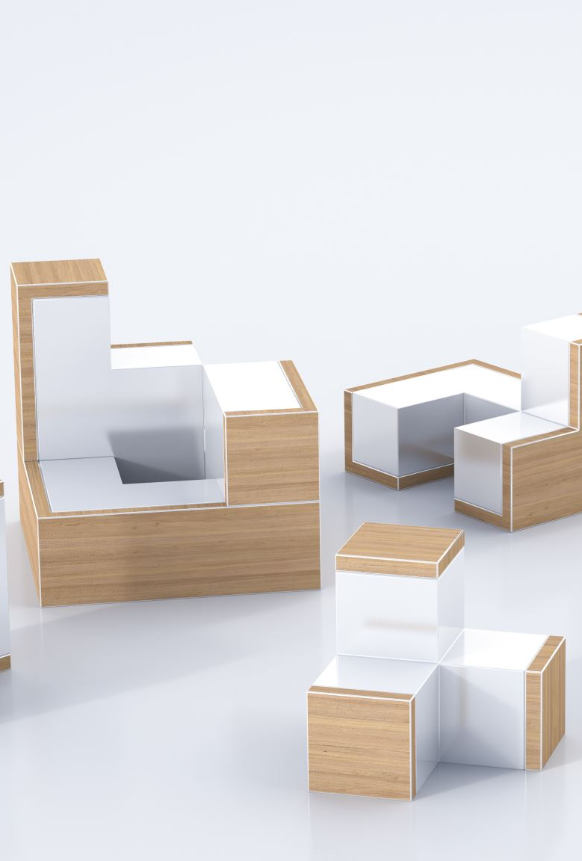
The Layout
Layout is crucial to the smooth operation of a salon, spa, or barbershop. Once you have decided on the type of business that you wish to run, seek the advice of an architect with plenty of experience in designing for the beauty industry. For renovations, a professional equipment and furniture supplier will be able to help you

Slide 7

Ideally, the design you develop should include the following
Ample aisle space
Space for each piece of equipment
Quality mirrors
Fixtures, furniture, and equipment chosen on the basis of cost, durability, utility and appearance
Decoration and paint that is thematic and pleasing to the eye
Restrooms for clients and employees
Handicap-accessible facilities and doors
Good plumbing and lighting for services
Heating, ventilation, and air-conditioning
Sufficient electrical outlets and current adequate to service all equipment
Storage areas
Display areas
Attractive, furnished and comfortable reception or waiting area

Slide 8
Costs to create even a small salon, spa, or barbershop in an existing space can range from $75 to $125 per square foot, if not more. Renovating existing space requires familiarity with building codes and the landlord’s restrictions before you do anything.

Slide 9

Calculating Costs
Try to estimate how much each area in the business will earn, so you can use space efficiently. An inviting retail display in your reception area is a good investment; on the other hand, an employee break area produces no income. In addition to start-up costs for creating your business, you’ll need financing for operational expenses. Realistically, you should plan to have at least several months and up to one year of expenses available to help get you up and running. It takes most new shops about six months to begin operating at full capacity.

Slide 10
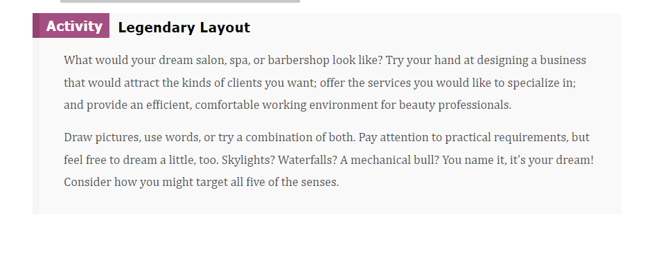

Slide 11
Let’s Start Designing
You can use many free 3D sites to plan your layout
You can try it for free here: <Click on the link>
Free 3D layout editor

Slide 12

QUESTIONS?

