Slide 1
MRAD 256
Radiographic Technique 2
Chest Anatomy and Positioning
MRT Program

Slide 2
Chest x-rays are the most common of all radiographic procedures
© MRT Program,

Slide 3
Divisions of Chest Anatomy
The chest (thorax) is divided into 3 sections:
Bony thorax
Respiratory system
Mediastinum
© MRT Program,

Slide 4
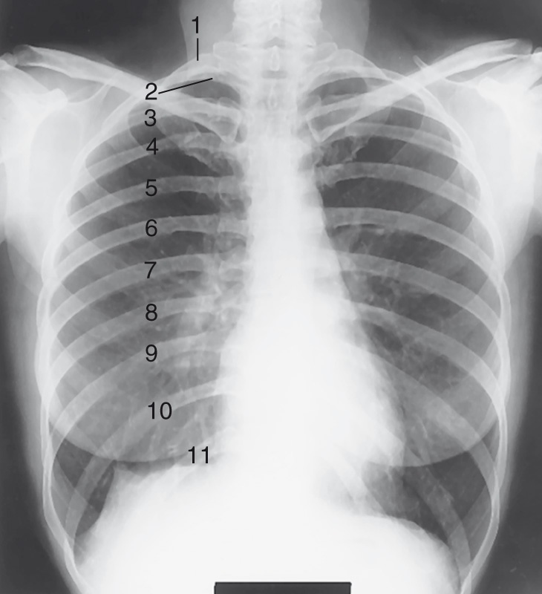
Divisions of Chest Anatomy
Bony thorax
  Protective framework
Respiratory system
  Lungs and airways
Mediastinum
  Space between lungs
© MRT Program,

Slide 5
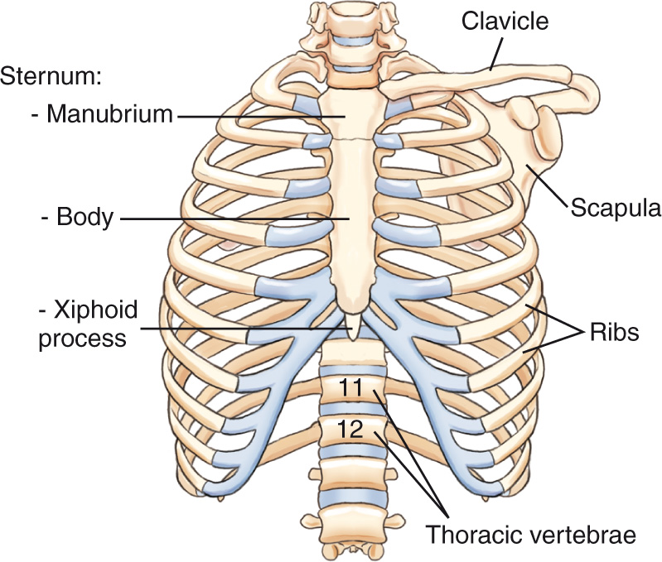
Bony Thorax
Consists of sternum, ribs, thoracic spine and shoulder girdle
Provides a protective framework
Contains some important bony landmarks for positioning
© MRT Program,

Slide 6
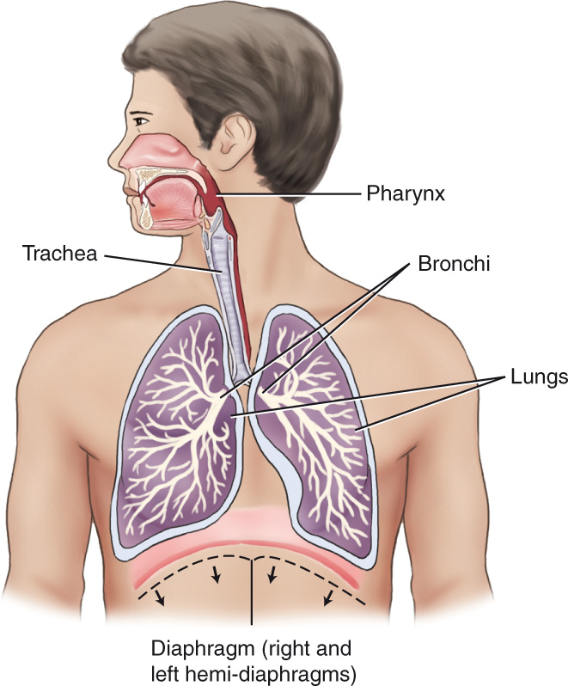
Respiratory System
Purpose
  Exchange of gaseous substances between air and blood
Four divisions
  Larynx
  Trachea
  Bronchi
  Lungs
© MRT Program,

Slide 7
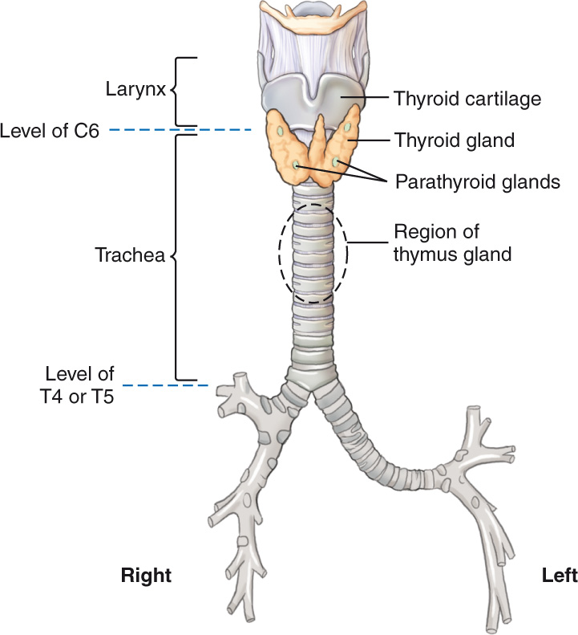
Trachea
© MRT Program,

Slide 8
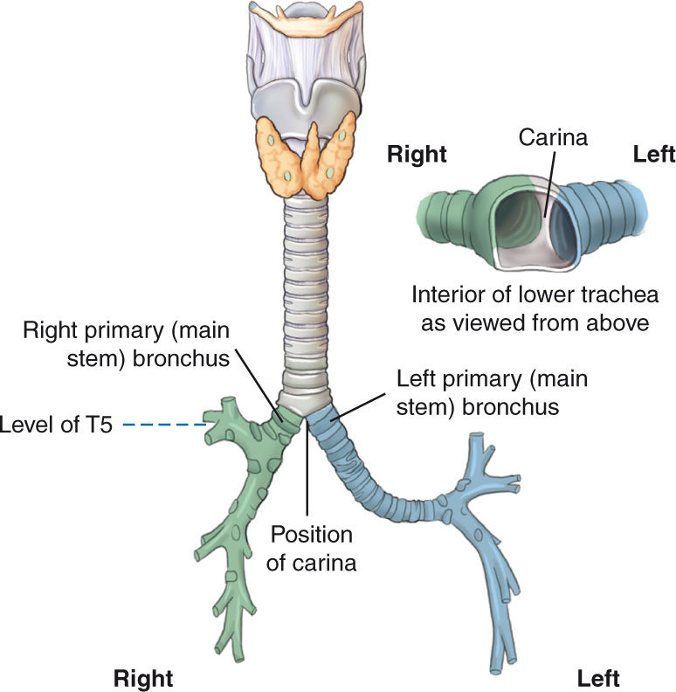
Bronchi
© MRT Program,

Slide 9
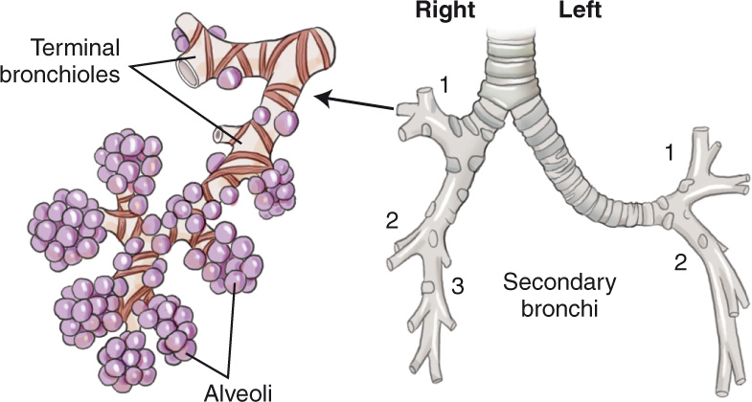
Secondary Bronchi and Alveoli
© MRT Program,

Slide 10
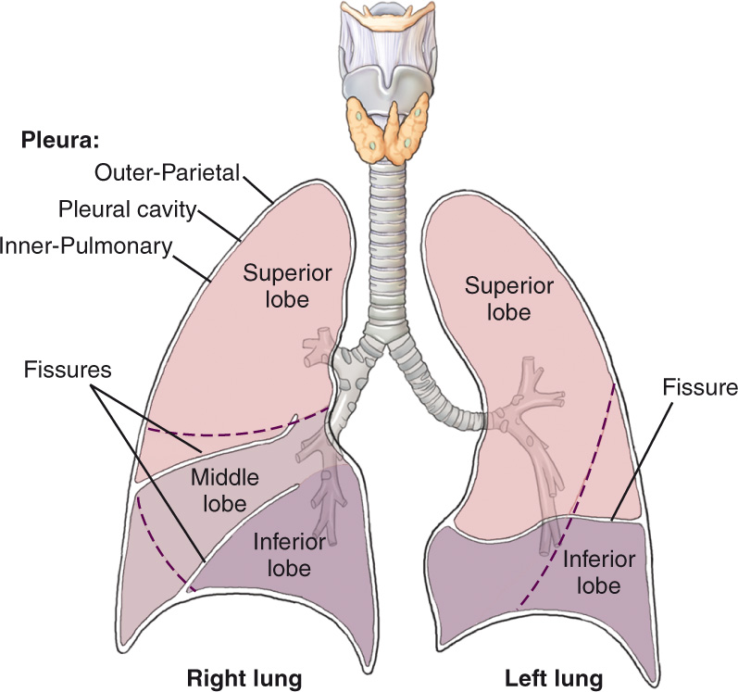
Lungs
© MRT Program,

Slide 11
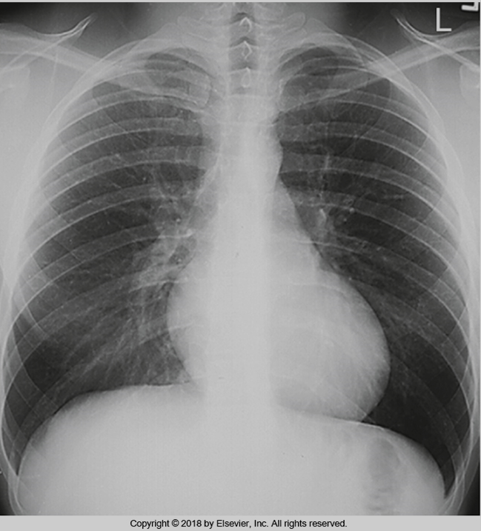
More about the diaphragm
Hemidiaphragms
Bontrager
Bontrager
© MRT Program,

Slide 12
Which structures of the respiratory system are seen on a PA chest x-ray?
Bontrager
Bontrager
?
© MRT Program,

Slide 13
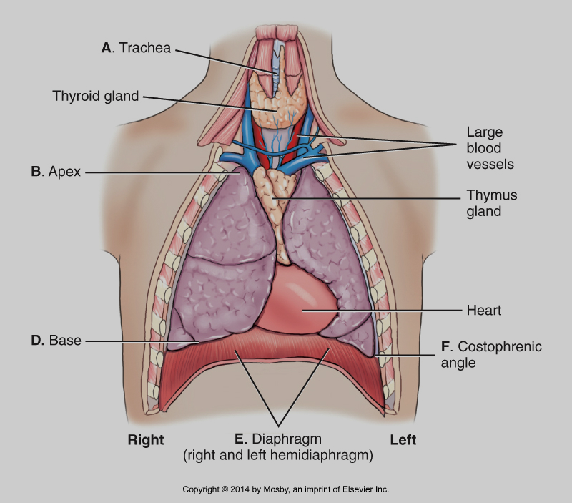
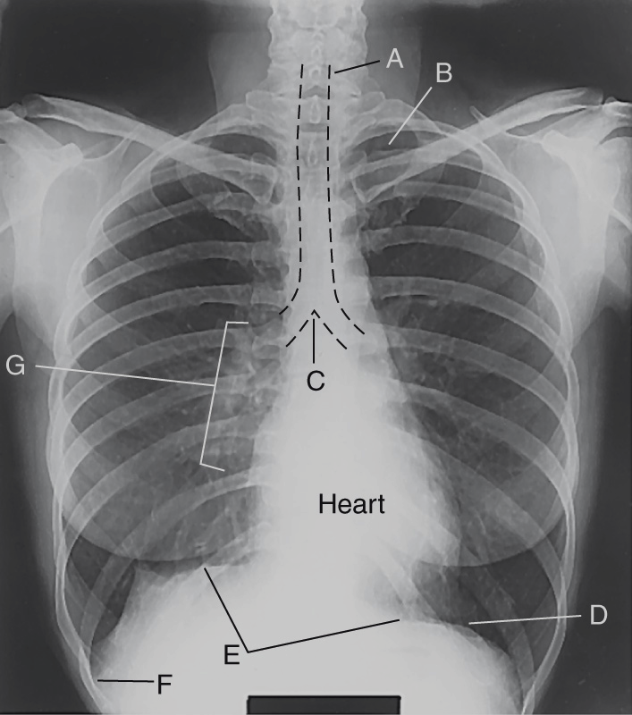
Bontrager
© MRT Program,

Slide 14
Pleura
Delicate double-walled sac or membrane
Outer layer lines the inner surface of the chest wall and diaphragm and is called the parietal pleura
Inner layer that covers the surface of the lungs is called the pulmonary or visceral pleura
The potential space between the double-walled pleura is called the pleural cavity
© MRT Program,

Slide 15
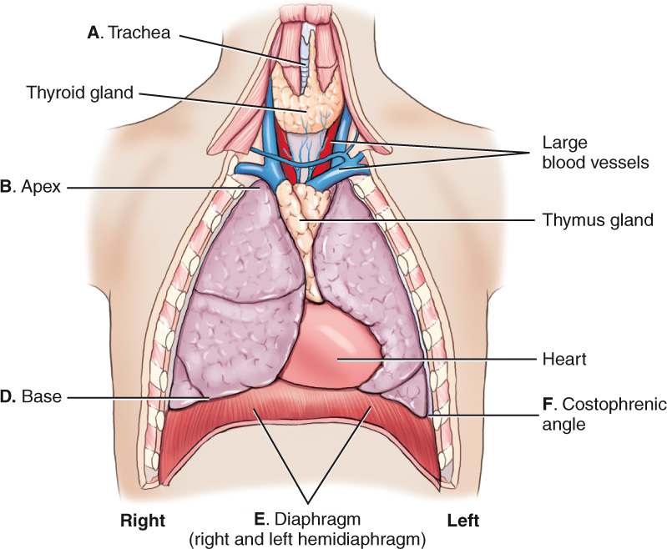
Mediastinum
Medial portion of thoracic cavity between lungs
Four structures
  Trachea
  Esophagus
  Thymus gland
  Heart and great vessels
© MRT Program,

Slide 16
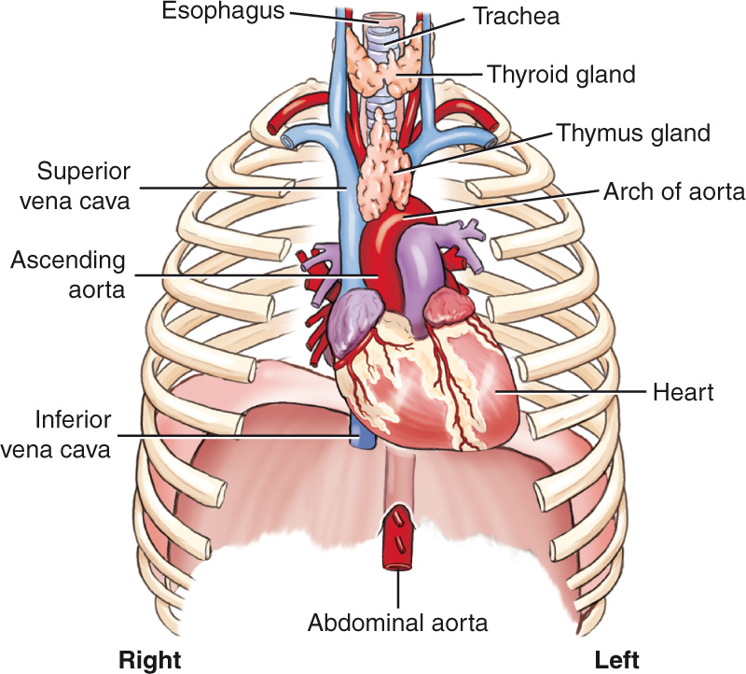
Mediastinum
© MRT Program,

Slide 17
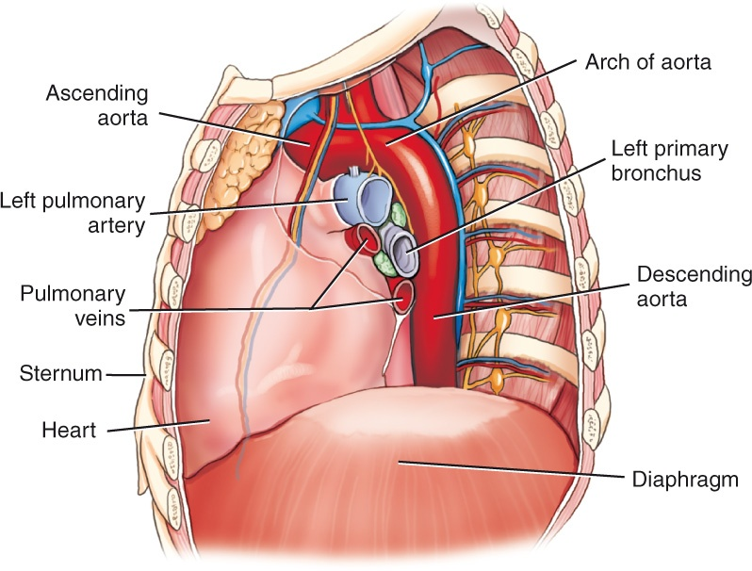
Mediastinal Relationships
© MRT Program,

Slide 18
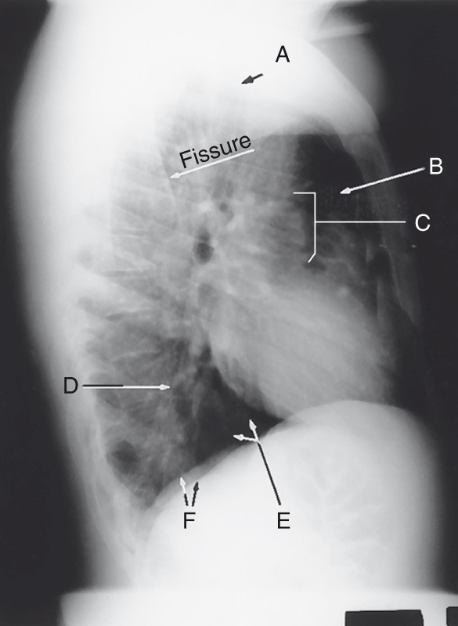
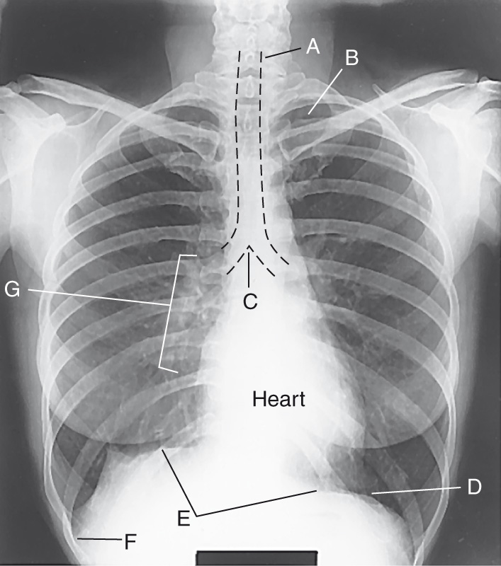
Radiographic Anatomy
© MRT Program,

Slide 19
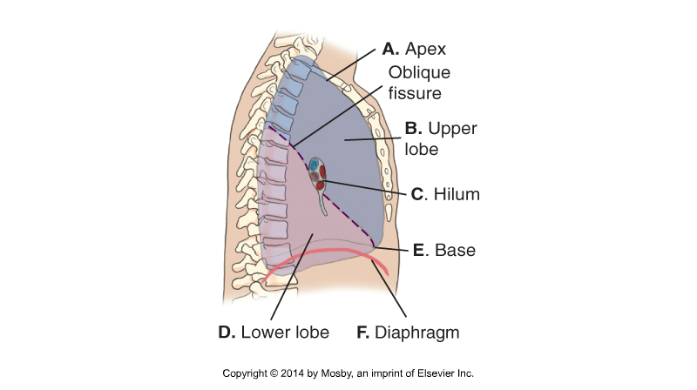
Structures seen on a lateral chest x-ray
Bontrager
© MRT Program,

Slide 20
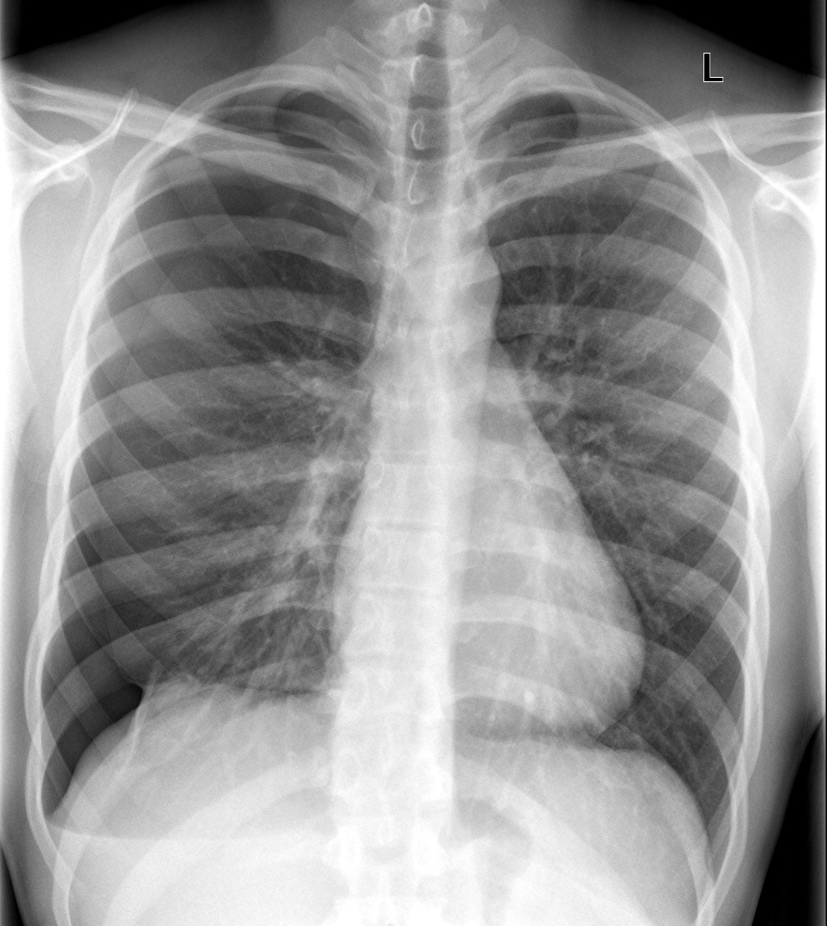
© MRT Program,

Slide 21
© MRT Program,

Slide 22
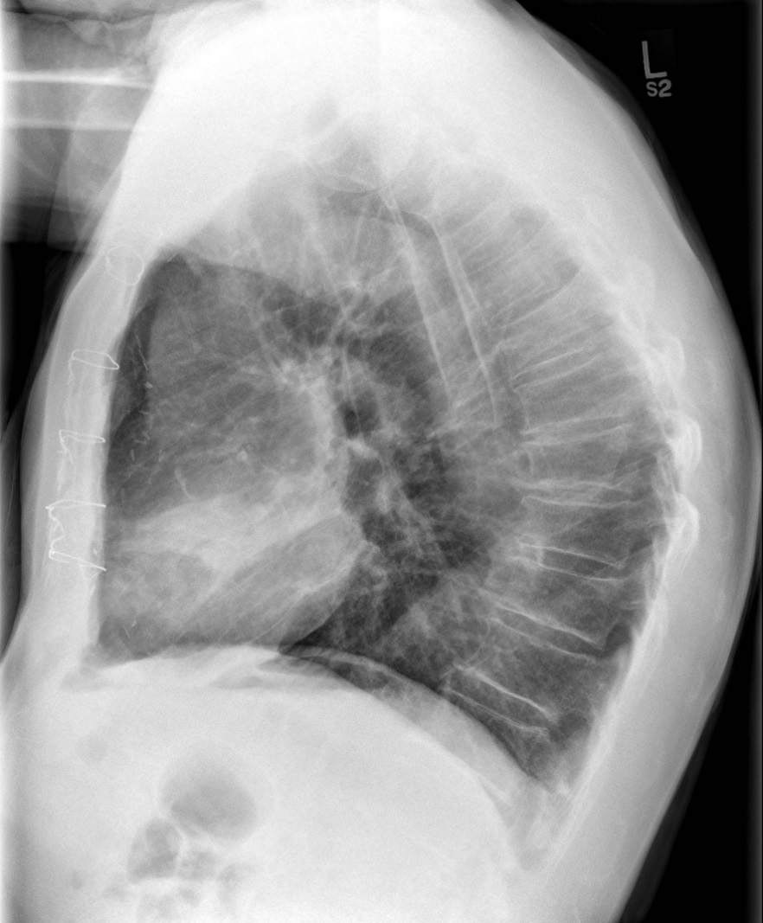
© MRT Program,

Slide 23
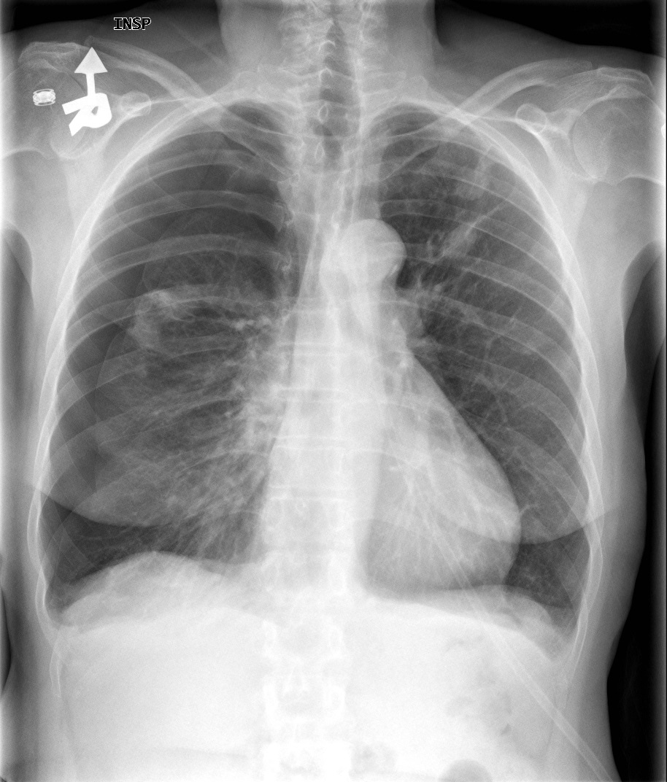
© MRT Program,

Slide 24
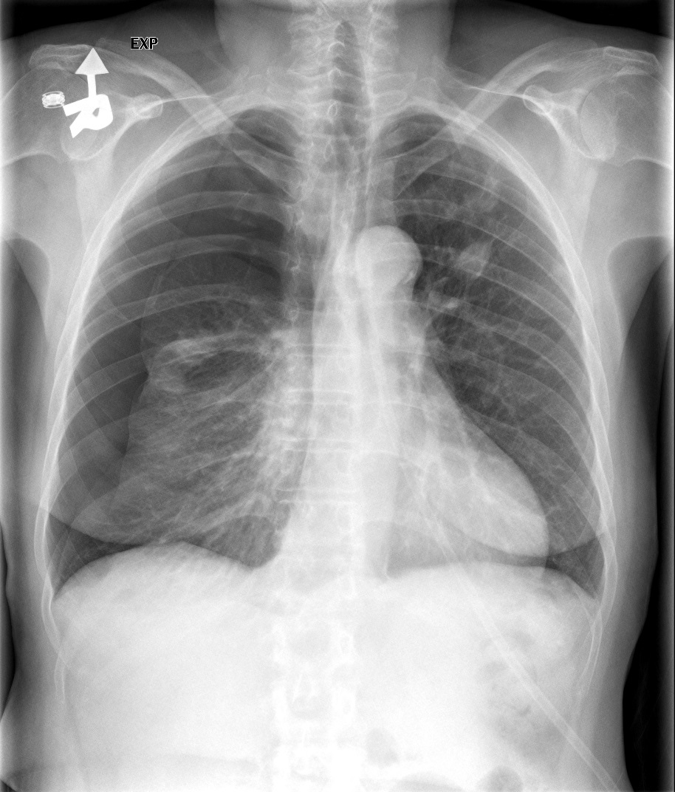
© MRT Program,

Slide 25
Whenever possible chest routines should be done upright to:
  Prevent blood from pooling in the pulmonary vessels
  Allow gravity to pull the diaphragm inferiorly
  Demonstrate air fluid levels
Bontrager
© MRT Program,

Slide 26
Routine Chest Protocol
Always taken at 180cm SID to reduce magnification of the heart:
PA
Lateral
© MRT Program,

Slide 27
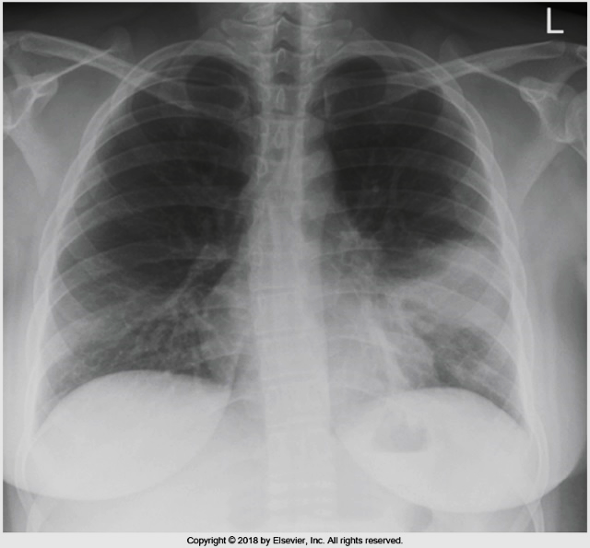
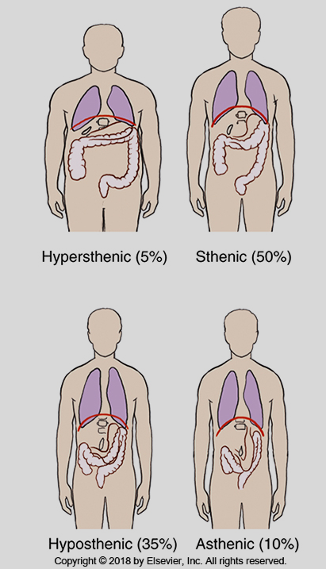
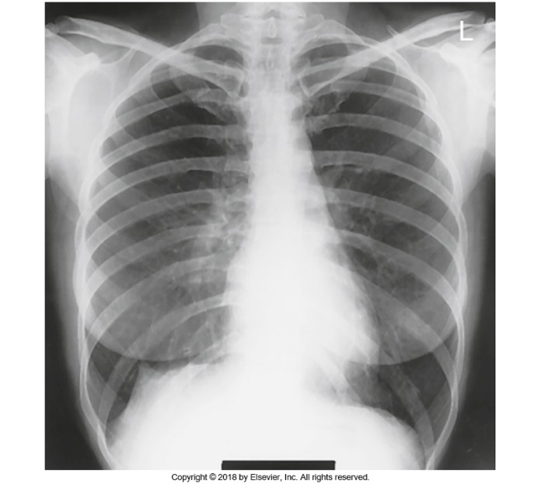
Portrait or landscape?
Bontrager
© MRT Program,

Slide 28
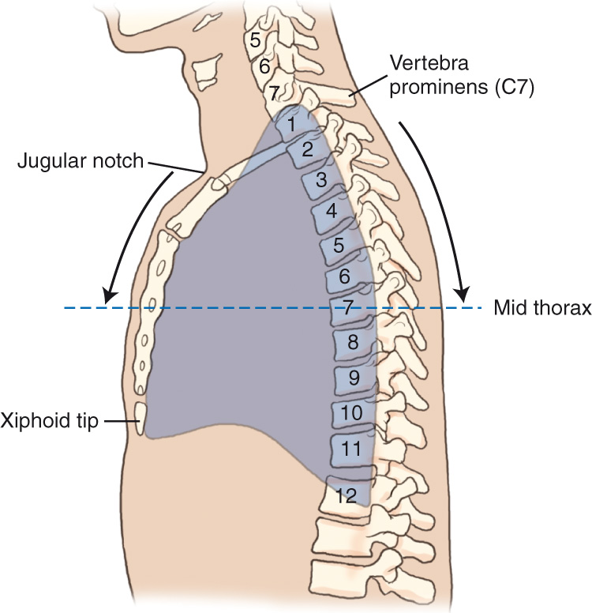
Positioning Landmarks
© MRT Program,

Slide 29
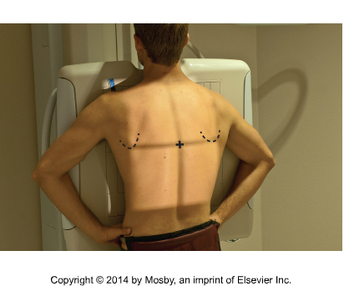
PA Chest
Top of light field should be just above the shoulders on average patient
The top margin of the posterior lightfield (depending on body habitus) is at C7 (vertebra prominens)
CR should be located near T7
Lower costal margin
Bontrager
© MRT Program,

Slide 30
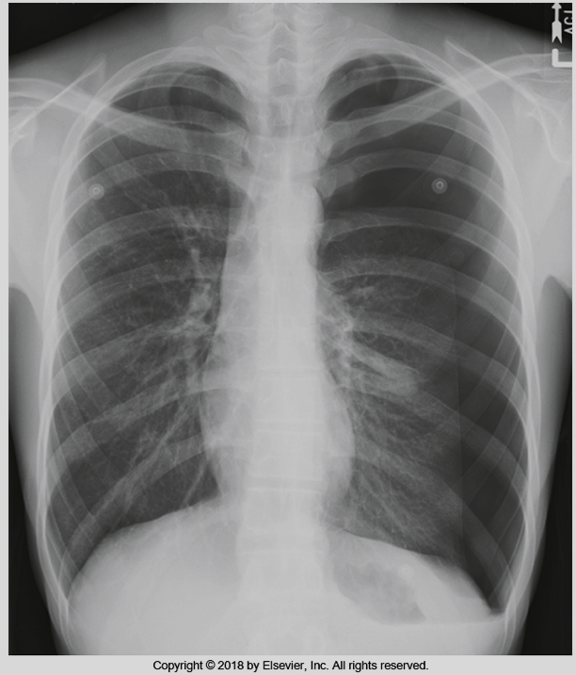
Evaluation Criteria: Anatomy Demonstrated
Entire lung field
Air filled trachea
Hilar region markings
Heart and great vessels
Bony thorax
Bontrager
© MRT Program,

Slide 31
Evaluation Criteria: Positioning
Chin and scapulae off of lung field
Sternoclavicular joints equidistant from spine
Distance from right and left lateral rib margins to spine are equal
10 posterior ribs above diaphragm
Bontrager
© MRT Program,

Slide 32
Image Technical Evaluation - PA
The entire lung fields should be visible from the apices down to the lateral costophrenic angles.
the chin should not be superimposing any structures
arms are not superimposed over lateral chest wall (this can mimic pleural thickening)
minimal to no superimposition of the scapulae borders on the lung fields
Sternoclavicular joints are equidistant from the spinous process
the clavicle is in the same horizontal plane
a maximum of ten posterior ribs are visualized above the diaphragm
The 5th-7th anterior ribs should intersect the diaphragm at midclavicular line
the ribs and thoracic cage are seen only faintly over the heart
clear vascular markings of the lungs should be visible
© MRT Program,

Slide 33
Evaluation Criteria: Positioning
Note that on all chest x-rays you need an arrow indicating whether it was taken upright or supine.
Bontrager
© MRT Program,

Slide 34
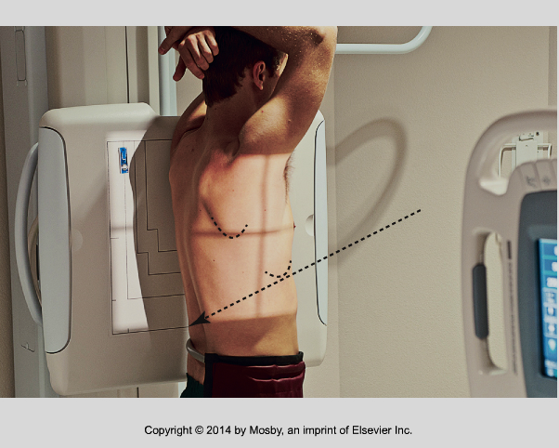
Lateral Chest
Ensure there is no “tilt”:
1) spine parallel to the IR
2) MCP parallel to the front edge of the detector
Bontrager
© MRT Program,

Slide 35
Lateral Chest
Use the overhead bar if one is available
Center so that the top of the light field is at C7 and extends to the lower costal margin
Rotate MCP 5 degrees anteriorly to ensure that the posterior ribs will appear superimposed in the radiograph
Bontrager
© MRT Program,

Slide 36
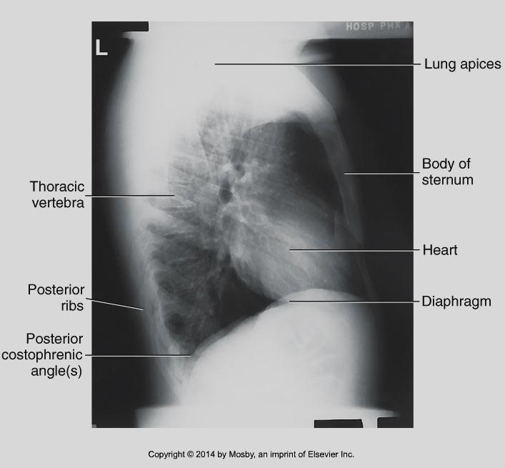
Evaluation Criteria: Anatomy Demonstrated
Entire lung field from apices to costophrenic angles, and from sternum to posterior ribs
Bontrager
© MRT Program,

Slide 37
Image Technical Evaluation -Lateral
The entire lung fields should be visible superior from the apices inferior to the posterior costophrenic angle
the chin should not be superimposing any structures
there is superimposition of the anterior ribs
the sternum is seen in profile
superimposition of the posterior costophrenic recess
a minimum of ten posterior ribs are visualized above the diaphragm
the ribs and thoracic cage are seen only faintly over the heart
clear vascular markings of the lungs should be visible
© MRT Program,

Slide 38
What if the patient can’t stand?
© MRT Program,

Slide 39
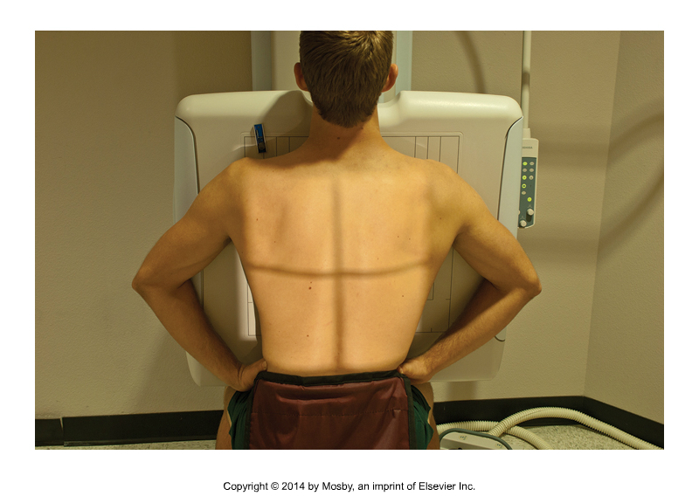
Sitting on edge of stretcher
Bontrager
© MRT Program,

Slide 40
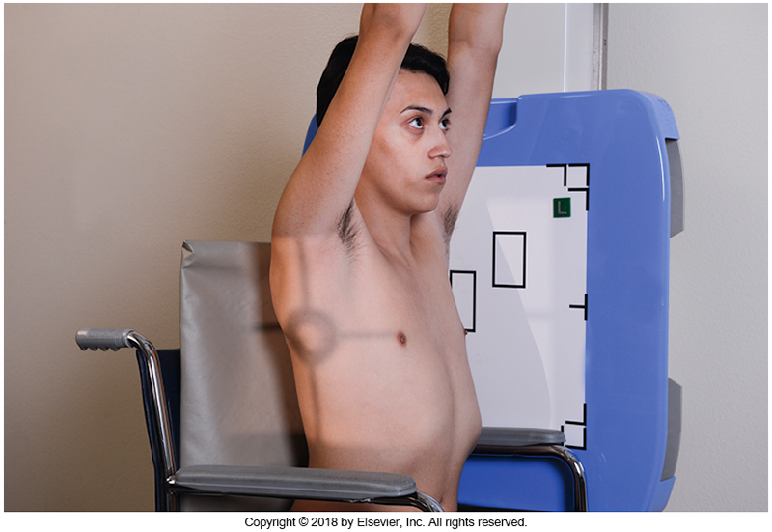
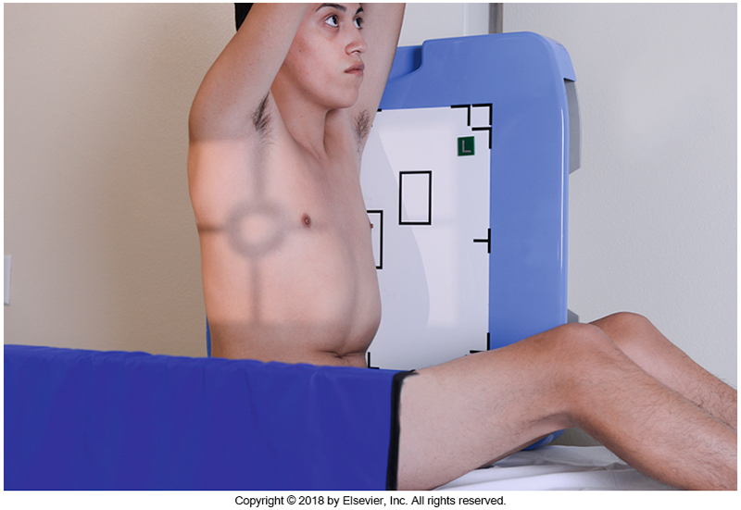
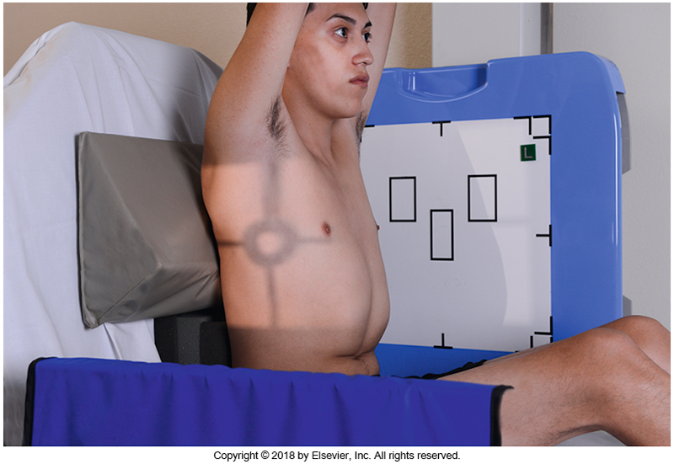
Other options
Why is a sponge needed here?
Bontrager
© MRT Program,

Slide 41
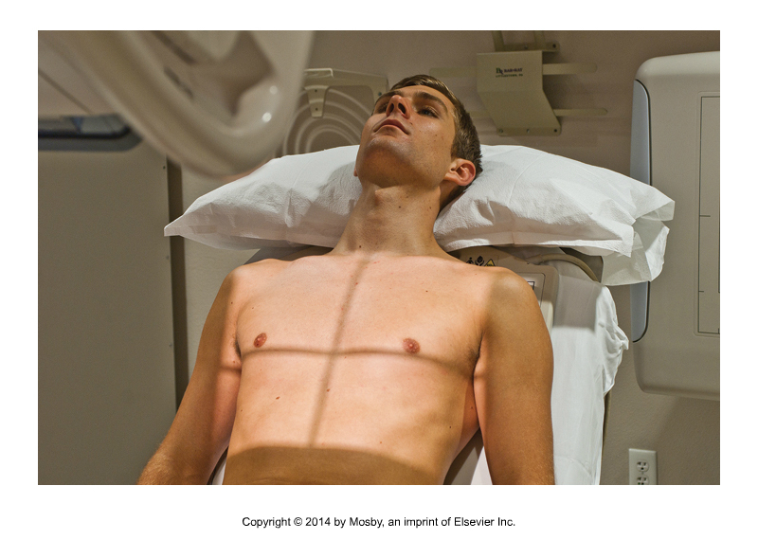
Semi-erect is better than supine
Bontrager
© MRT Program,

Slide 42
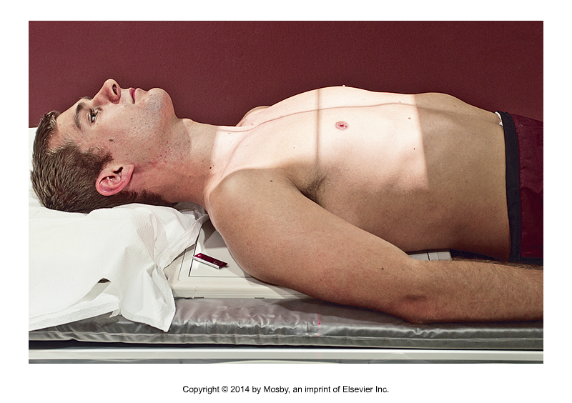
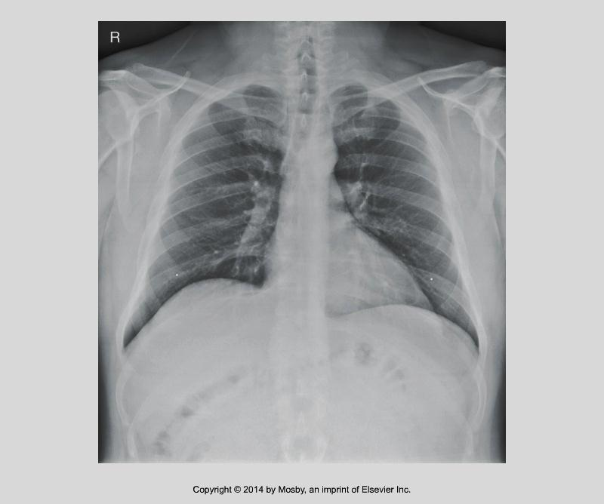
AP Chest
Why would landscape usually be a better choice here?
Supine marker or downward arrow must be included!
Maximize SID by lowering table and raising tube
Bontrager
© MRT Program,

Slide 43
How to tell that a chest x-ray was taken as an AP supine projection…
Heart appears larger because of short SID and increased OID
The lung markings will be more pronounced; the lung fields will appear “whiter”
Only 8-9 posterior ribs may be visualized above diaphragm, as inspiration is rarely as full when the patient is supine
Ribs appear less curved
Scapula may be superimposing the lung fields, as patient condition may prevent them from be moved aside.
Bontrager
© MRT Program,

Slide 44
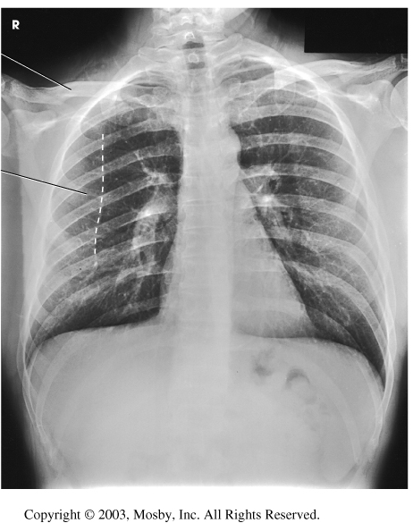
Which of these images was taken AP?
© MRT Program,

Slide 45
Summary of breathing instructions
Full inspiration
for routine chests
Inspiration/expiration:
foreign bodies
pneumothorax
movement of diaphragm
lesion localization
Expiration
post lung biopsies
© MRT Program,

Slide 46
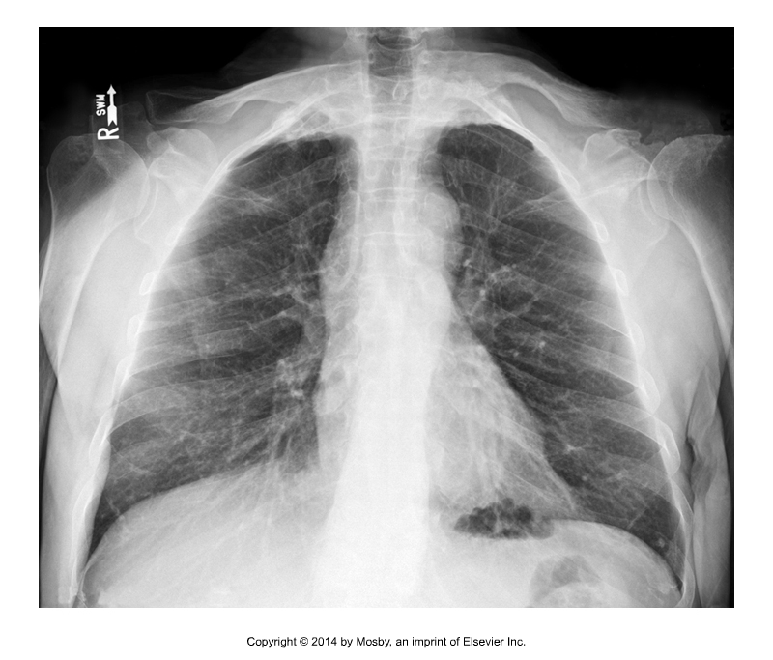
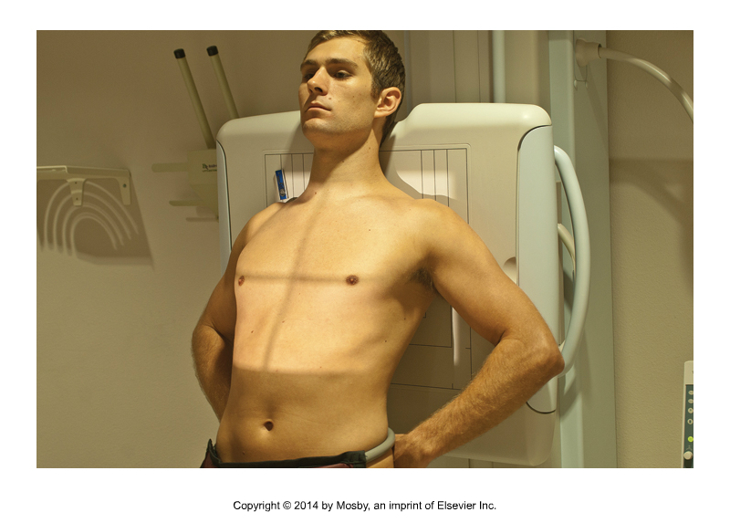
Special requests - Lordotic Chest
Bontrager
© MRT Program,

