Slide 1


Approaches to Massage Care

Slide 2
OUR JOURNEY TODAY
Define the terms indication and contraindication.
Explain palliative care, restorative care, condition management, and therapeutic change as therapeutic approaches.
Define pathology, and explain the causes of disease.

Slide 3
Indications for Massage
(Slide 1 of 2)
Indication
  Condition for which an approach would be beneficial
Contraindication
  Condition for which an approach could be harmful
Types of contraindications
  General avoidance of application
  Regional avoidance of application
  Application with caution
Based on objective and subjective health-enhancing benefits or results
  Objective results can be measured and observed
  Subjective results are assumed effective based on experience
  Effects of massage are physical (objective) and mental (subjective)
Notes:
What is a caution? (A caution is a condition that requires the massage therapist to adapt the massage process so that the client’s safety is maintained.)
What are some examples of each type of contraindication?
(General avoidance: Infectious diseases, pulmonary embolism, uncontrolled hypertension)
(Regional avoidance: Open wounds, bruises, athlete’s foot)
(Application with caution: Rheumatoid arthritis, hyperthyroidism, diabetes mellitus)

Slide 4
Approaches to Care:
Palliative Care
Palliative care
  Attempts to relieve and reduce the intensity of uncomfortable symptoms, but does not produce a cure
Massage is aimed at reducing suffering
Notes:
Palliative care is provided when the client’s condition is most likely going to worsen and degenerative processes will continue (e.g., terminal illness, dementia).
Palliative care is also appropriate when the condition should not be changed or the person does not desire a specific outcome other than pleasure and relaxation. What are some examples of this type of palliative care? (Examples may include providing massage to a woman during labor, receiving a massage while on vacation, supporting an athlete during training for an event, providing massage at a public event such as a health fair, giving a massage to someone just before surgery, and providing massage to a wedding party the day before the event.)
4

Slide 5
Approaches to Care:
Restorative Care
Restorative care
  Supports normal rest and restorative function
  Helps restore the body to a state of calm and allows it to relax and repair
Supports parasympathetic and enteric ANS function
Client is generally healthy and has adaptive capacity
Notes:
A restorative approach should be the main reason people seek massage therapy.
5

Slide 6
Approaches to Care:
Condition Management
(Slide 1 of 2)
Condition management
  Support for clients unable to undergo therapeutic change process for various reasons
    Chronic health condition
    Life circumstances that create chronic stress
    A situation for which change is not viable
    Need to postpone time frame for change
Notes:
What are some examples of situations that might call for a postponement of therapeutic change with condition management until change is again a viable option? (Clients in many life situations, such as pregnancy, a long-term illness like cancer, or even a change of job, might prefer condition management until they are able to devote more time and energy to a therapeutic change process.)
6

Slide 7
Approaches to Care:
Condition Management
(Slide 2 of 2)
Massage benefits
  Physical
    Managing existing physical compensation patterns
    Sometimes slowing progression of chronic conditions
    Preventing a situation from becoming worse
  Emotional
    Can assist in the management of physical stress symptoms, allowing client to cope better
    Accounts for the largest client base for therapeutic massage
Notes:
Why do you think condition management is the largest client base for massage therapy? (Dysfunction and chronic health conditions and pain are widespread, and most people want relief from discomfort but don’t have the necessary time or resources for therapeutic change.)
7

Slide 8
Approaches to Care:
Therapeutic Change
(Slide 1 of 2)
Therapeutic change
  Modification of physical form or function
Requirements
  Practitioner
    Must have appropriate knowledge and skills and network of support from other professionals
  Client
    Must have the motivation and resources to complete a change process
Notes:
What are some questions a therapist might ask to determine whether a client is a good candidate for a therapeutic process?
Do you feel supported at home?
Can you make time for the necessary exercises?
Are there any positive aspects to the situation as it exists?

Slide 9
Approaches to Care:
Therapeutic Change
(Slide 2 of 2)
Therapeutic change might be unrealistic at a particular time or under a certain set of circumstances
Condition management or palliative care can be offered instead
  Example: Athletes
    Because athletes are looking to improve their physical qualities to compete, massage could improve flexibility, enabling them to push off more efficiently and run faster
Notes:
Even when change is indicated by a client’s condition, it is not always realistic.
The constraints of each individual’s situation determine the approach the massage therapist should take.
9

Slide 10
Approaches to Care: Determining the Type and Timing of an Approach
Questions to ask
  When is change appropriate?
  When is change not desirable and condition management and palliative support are more appropriate?
  How does the massage professional determine what type of care is appropriate: Therapeutic change, restorative care, condition management, or palliative care?
  How does the massage professional know when transitions occur in types of care?
Notes:
Palliative care can progress to condition management, and with the gradual restoration of energy, the client may even progress to a therapeutic change process.
Eventually a therapeutic change process ends or transforms, and condition management, such as stress management, becomes the professional focus once again.
10

Slide 11
Pathology
(Slide 1 of 5)
Pathology
  Study of disease
Trauma
  Abrupt shock or injury to the body or psyche
A basic understanding of pathologic processes and pharmacology is helpful for the following reasons:
  Refer appropriately
  Recognize contraindicating symptoms
  Recognize general types of disorders, specific signs and symptoms, and the development of disease processes
  Understand possible interactions between medications and massage
Notes:
To practice safely, massage practitioners need a basic understanding of pathologic processes.
11

Slide 12
Health
  Optimal functioning with freedom from disease or abnormal processes
Factors that influence health
  Inherited (genetic) and constitutional traits
  Lifestyle (diet, exercise, rest, stress level)
  Beliefs and attitudes, self-esteem, loving relationships
  Authentic personality and freedom from self-hindering patterns
Dysfunction
  In-between state of “not healthy” but “not sick”
Prepathological states often are not apparent using Western diagnostics
Effective approaches to dysfunction include mind/body medicine, stress management, and prevention methods
Active pathologic processes often require more aggressive treatment
Peak performance
  Maximal conditioning and function to a particular action
    Physical or mental
    Energy consuming and stressful
Injury, depletion, and illness can result if:
  The lifestyle does not support recuperation time
  Anatomic or physiologic limits are exceeded

Slide 13
Disease
(Slide 1 of 2)
Homeostasis
  Relative constancy of the body’s internal environment
Disease conditions
  Acute
    Homeostasis is restored quickly
  Chronic
    Homeostasis may never be restored; compensation develops
Notes:
Compensation is the process of counterbalancing a defect in body structure or function.
13

Slide 14
Functioning Limits
Limits may be anatomical and physiological
The body signals fatigue, pain, or strain when limits are reached
Extraordinary events can push the body’s limits
Functioning reserves are available and are replaced by the body

Slide 15
Functioning Limits
Dysfunction results from depleted reserves
  Early massage intervention may support healing and restoration
  Pathology requires a multidisciplinary approach
Dysfunction is related to attempts to maintain a higher energy reserve
  Overstretched muscle patterns are reset to prevent further strain, slightly limiting range of motion
  Continuing dysfunction leads to compensatory habits
Notes:
What are some specific signs of physiologic fatigue and strain? (Sore muscles, cramps, trembling, shortness of breath, profuse perspiration, weakness, and dizziness can all signal that a person is nearing functioning limits.)
15

Slide 16
Functioning Limits
(Slide 3 of 3)
Massage intervention right after a first event can be an effective support for repair and restoration of function
  Client cooperation in developing new habits is important
After dysfunction has set in, an intervention should be applied at the point where range of motion limits were first observed
  A more complex intervention plan is necessary
Notes:
Why is the supervision of an athletic trainer important when working with a professional athlete? (A trainer’s considerations, such as the athlete’s training and game or meet schedules, must be considered when preparing a massage care plan. The trainer may also share valuable information for the therapist about injuries or medications.)
How can a regular massage therapist assist professional athletes? (Answers will vary.)
16

Slide 17
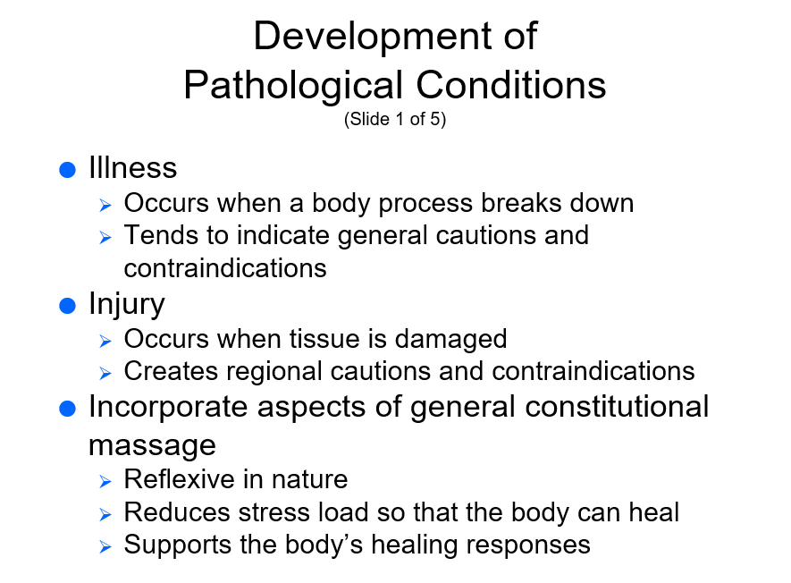

Slide 18
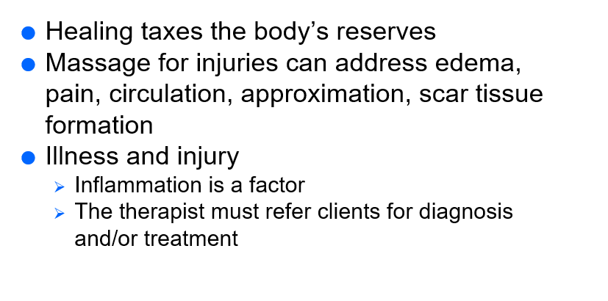

Slide 19
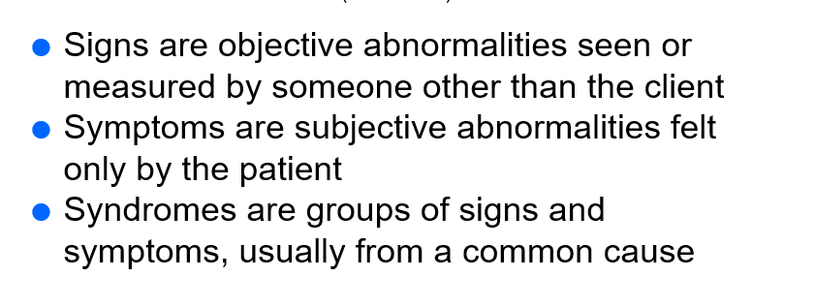

Slide 20
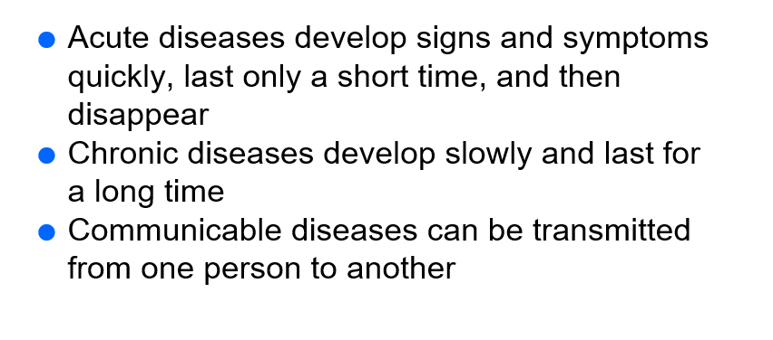

Slide 21
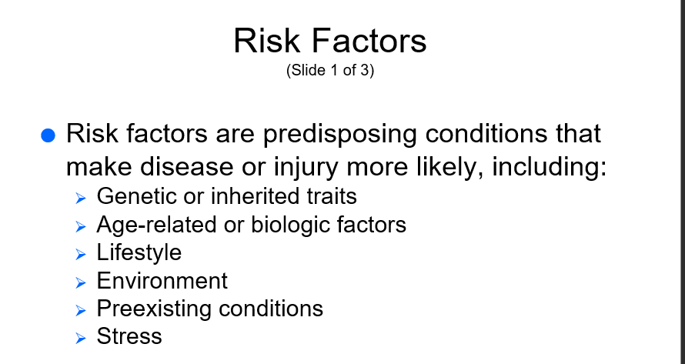

Slide 22
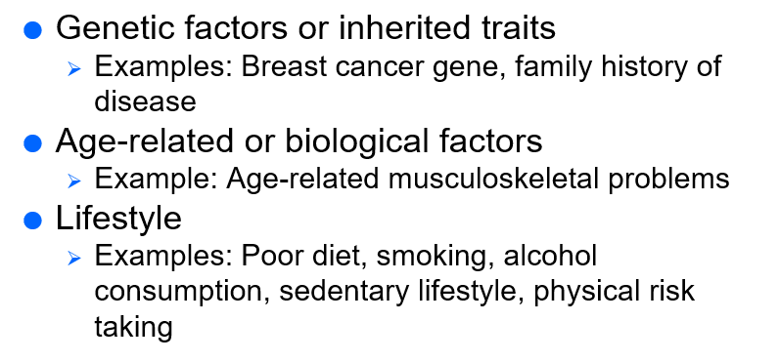
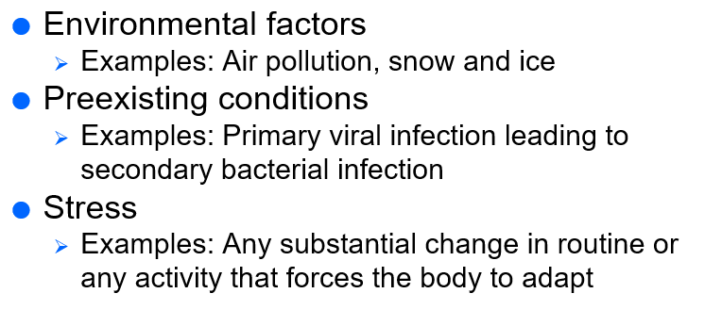

Slide 23

QUESTIONS?

