Slide 1


Medical Esthetics
Anatomy and Physiology

Slide 2

Cells and their functions

Slide 3
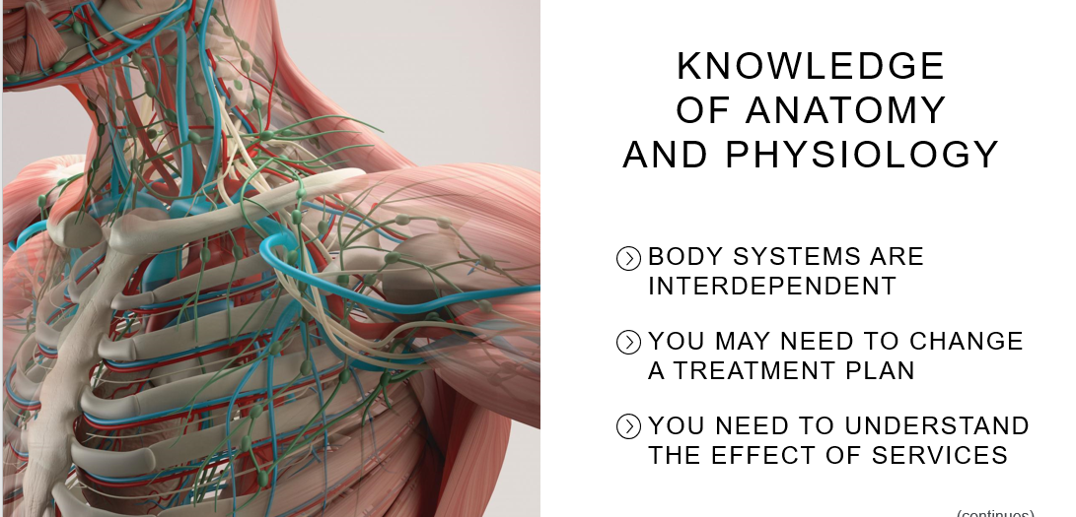

Slide 4
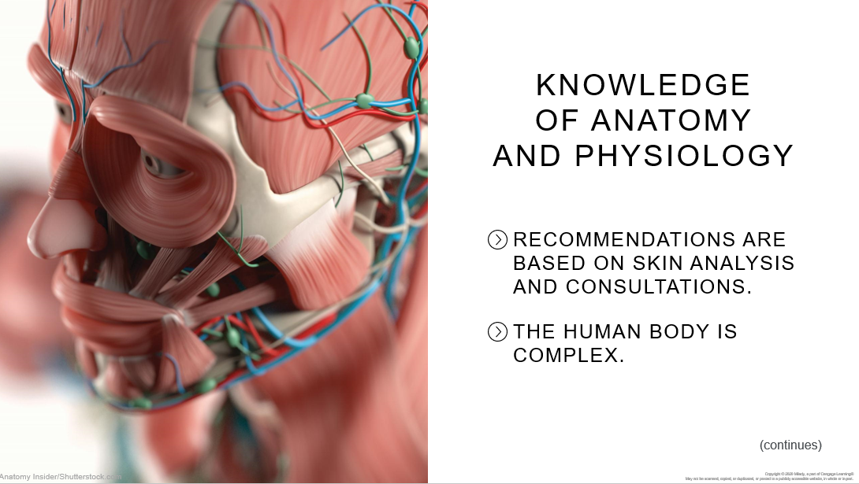
THIS IS A NEW SECTION

Slide 5
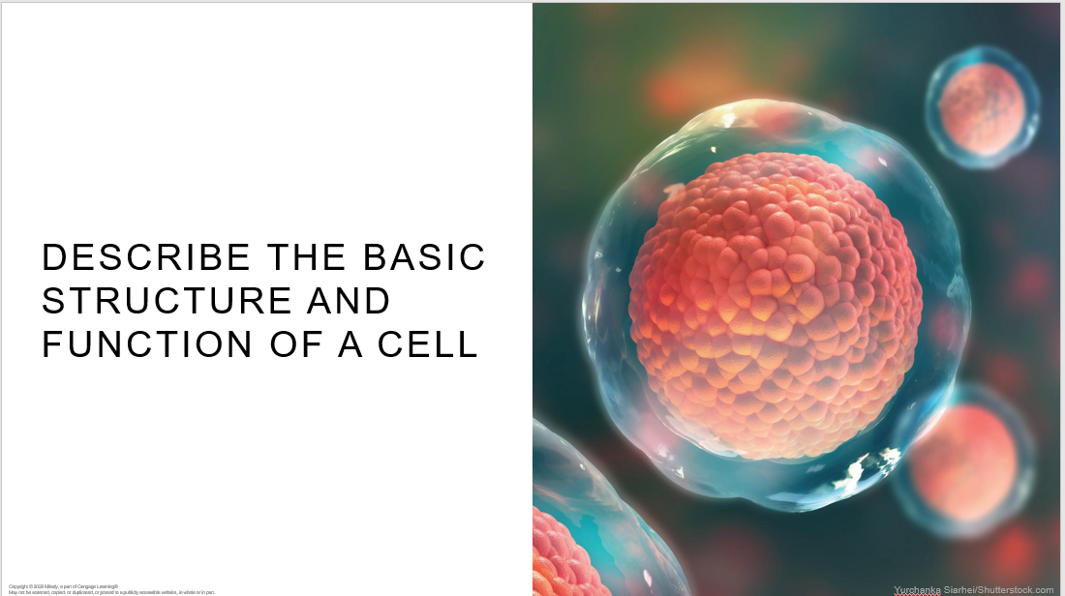
THIS IS A NEW SECTION

Slide 6
Basic Structure of the Cell
The cells of all living things are composed of a substance called protoplasm , a colorless, jellylike substance in which nutrients such as proteins, fats, carbohydrates, mineral salts, and water are present. These nutrient materials are necessary for cell growth, reproduction, and self-repair. You can visualize the protoplasm of a cell as being similar to the clear gel of a raw egg. In addition to protoplasm, most cells also include a nucleus, organelles (small organs), and the cell membrane

Slide 7
Let’s Take a Look !
Click Here

Slide 8
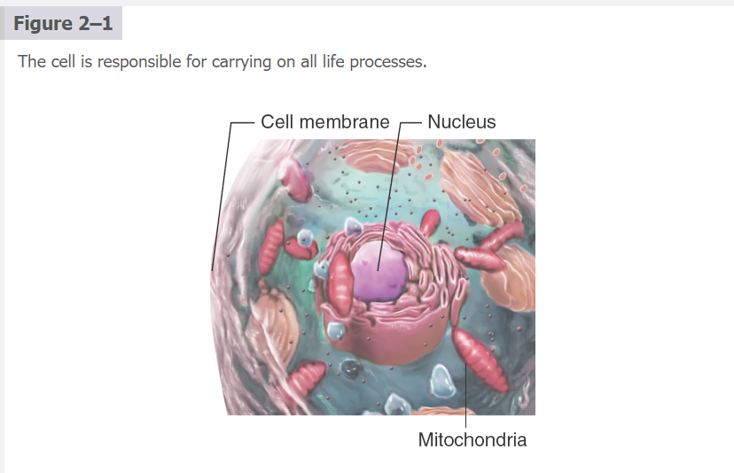

Slide 9
Nucleus : dense, active protoplasm found in the center of the cell. It plays an important part in cell reproduction and metabolism,
Nucleoplasm: fluid that contains proteins, and a very important acid known as deoxyribonucleic acid (DNA). DNA is what determines our genetic makeup,
Protoplasm: is a watery gel-like fluid containing the nutrient material necessary for cell growth, reproduction, and self-repair.
Mitochondria: take in nutrients, break them down, and create energy for the cell. throughout the cell. Some cells have several thousand mitochondria, such as muscle cells, while others have none, like red blood cells. Muscle cells need a lot of energy, so they have many mitochondria.
Neurons: or nerve cells (cells that transmit nerve impulses) don’t need as many.
Cell membrane: is the part of the cell that encloses the protoplasm and permits soluble substances to enter and leave. It is selectively permeable, controlling the introduction of beneficial substances into the cell and the removal of waste and other substances that do not benefit the life of the cell. The cell membrane protects the cell from its surroundings. It also communicates with other cells, linking like cells together to form tissues.

Slide 10
Cell Reproduction and Division
Mitosis
How it works

Slide 11
Cell Metabolism
Metabolism is a chemical process that takes place in living organisms. Metabolism converts nutrients to energy so the cell can function. Metabolism also eliminates waste. These functions allow organisms to grow and reproduce, respond to their environments, and maintain their structures.

Slide 12
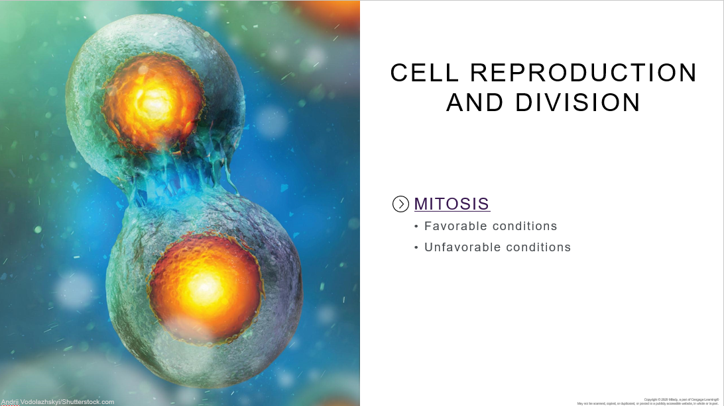
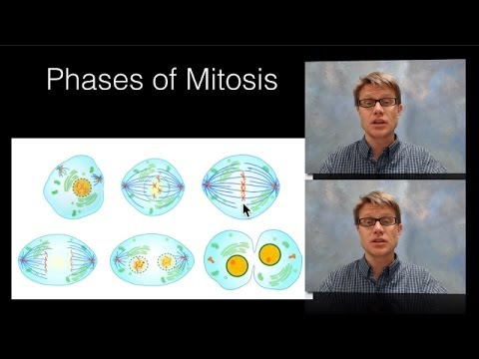

Slide 13
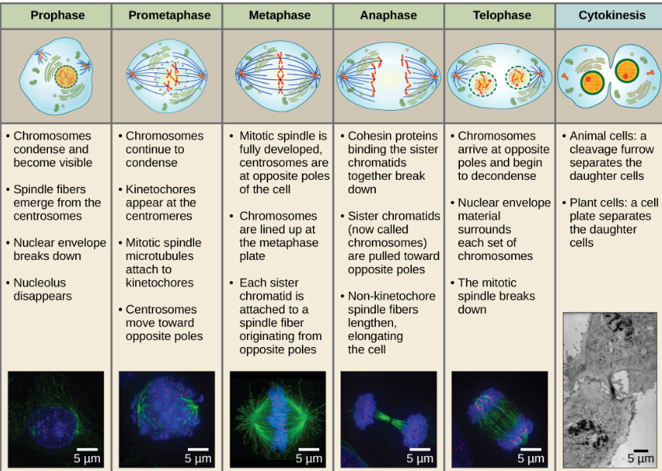
Favorable

Slide 14
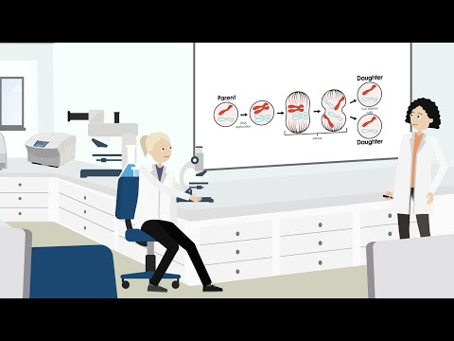
UNFAVORABLE

Slide 15
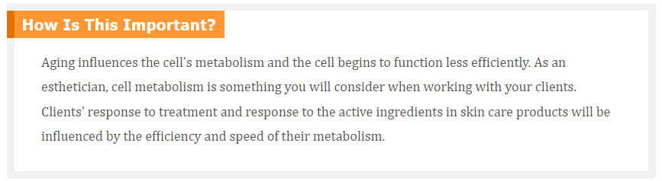

Slide 16
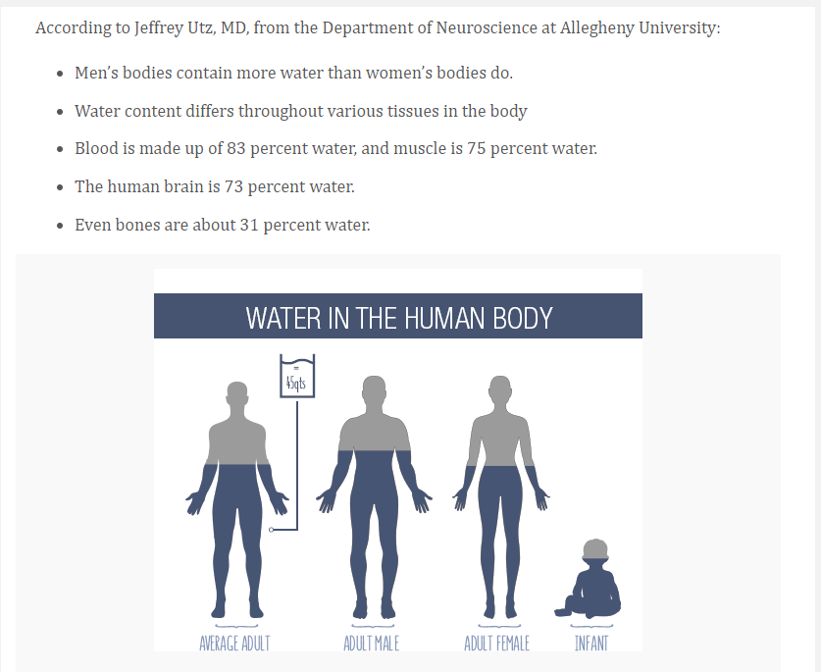

Slide 17
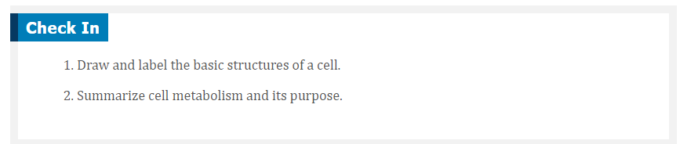
ACTIVITY TIME

Slide 18
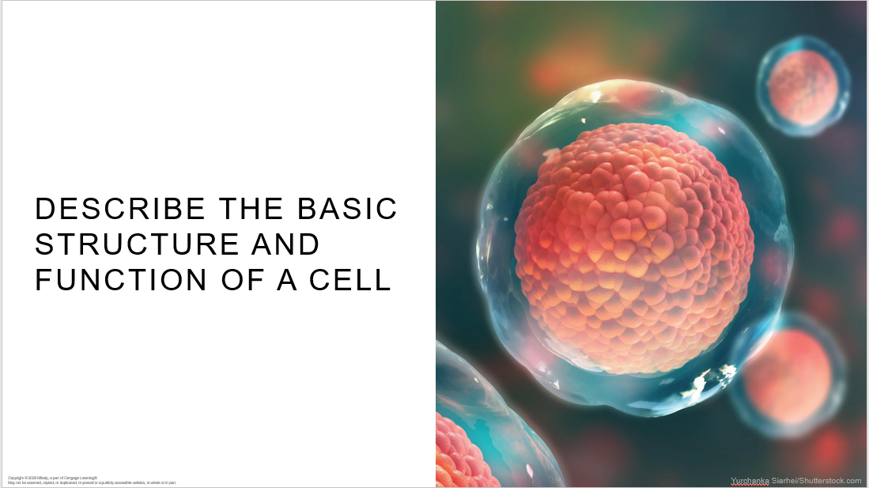

Slide 19

RECAP
Nucleus plays an important part in cell reproduction and metabolism
Cells are basic unit of all living things
Mitosis , cell divides into two identical cells called daughter cells

Slide 20

QUESTIONS?

