Slide 1


The Spray Machine

Slide 2
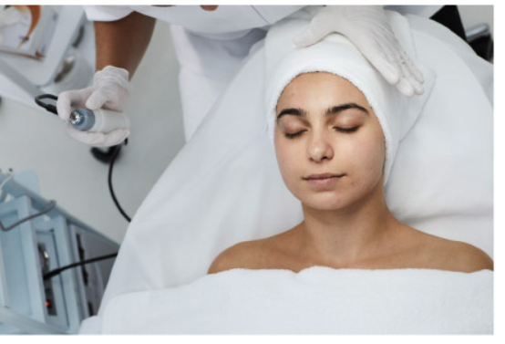
How to Safely and Effectively Use Spray Machines

Slide 3
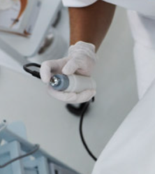
Spray Machines can be attached to vacuum machines or other devices, and they can be used to infuse toners, and other beneficial skin cocktails into the skin.

Slide 4
When and How to Use It
This bottle with the spray nozzle can be filled with a freshener solution or toner (one part toner, two parts distilled water) to gently mist the client’s face after cleansing or another treatment step, such as massage.
The spray machine affects the skin by adding moisture during or after a treatment and is used to calm and hydrate the skin.

Slide 5
Contraindications and Best Practices for the Spray Machine
Do not use on clients who have respiratory issues where the spray may cause breathing irritation.
Do not allow the spray to drip into a client’s eyes, ears, or mouth or run down their neck. Use eye pads for a safety precaution if using the mist extensively.
Do not leave toners and other liquids in the spray bottle for extended periods of time or overnight. This may cause the plastic to break down.
Do not use the spray machine in a room that is not well ventilated.

Slide 6
Safety and Maintenance for the Spray Machine
Here are some general guidelines for spray machine maintenance.
After use, clean the spray bottle, cords and machine with disinfectant and follow the cleaning directions supplied by the manufacturer. Flush with distilled water regularly.
Mineral buildup in the nozzle of the sprayer should be cleaned monthly or more often.

Slide 7


Slide 8

QUESTIONS?

