Slide 1


Medical Esthetics
Electricity and Electrical Safety

Slide 2

01
Explain electricity and electrical safety.
02
Outline electrical theory.
03
Practice electrical equipment safety.
04
Identify electrotherapy modalities.
05
Discuss light energy.
Notes:
WHY STUDY ELECTRCITY & ELECTRICAL SAFETY?
Beauty professionals rely upon a variety of electrical appliances. Knowing what electricity and electrical safety devices are and how they work will allow professionals to use their tools wisely and safely.
A basic understanding of electricity will enable them to properly use and care for their equipment and tools.
Electricity use impacts other aspects of the salon, spa, or barbershop environment, such as lighting and the temperature of heating tools. It impacts all of the services beauty professionals offer their clients.
Advanced electrical and light therapy machines require a foundational understanding of electrical theory to be operated safely and effectively.

Slide 3

Explain
Electricity
and
Electrical Safety
Notes:
You decided to enter this field because you love beauty and wellness and all of the services it offers to clients, from hairstyling and haircoloring, to facials, massages and nail wraps. How many of these services could you offer without using electricity? As you study this chapter, you will learn how important it is for beauty professionals to have a basic working knowledge of electricity.

Slide 4
ACTIVITY: THE LIFE ELECTRIC
Working in small groups, discuss and record everything you did between waking up this morning and arriving for school, beginning with the alarm clock going off. After you have completed your list, indicate which tasks or events used electricity. For example: Alarm went off—electricity; charged phone—electricity; took shower—electricity (if your hot water heater is electric).
After you have completed your group’s list, discuss as a class how electricity has affected your life today.
Notes:
Divide students into small groups. Ask them to discuss and record everything they did between waking up this morning and arriving for school, beginning with the alarm clock going off. After they have completed their list, have them indicate which tasks or events used electricity. For example: Alarm went off—electricity; charged phone—electricity; took shower—electricity (if their hot water heater is electric). After they have completed their group assignment, conduct a discussion about how during their first two hours or so of being awake today nearly every aspect of their lives was affected by electricity.

Slide 5
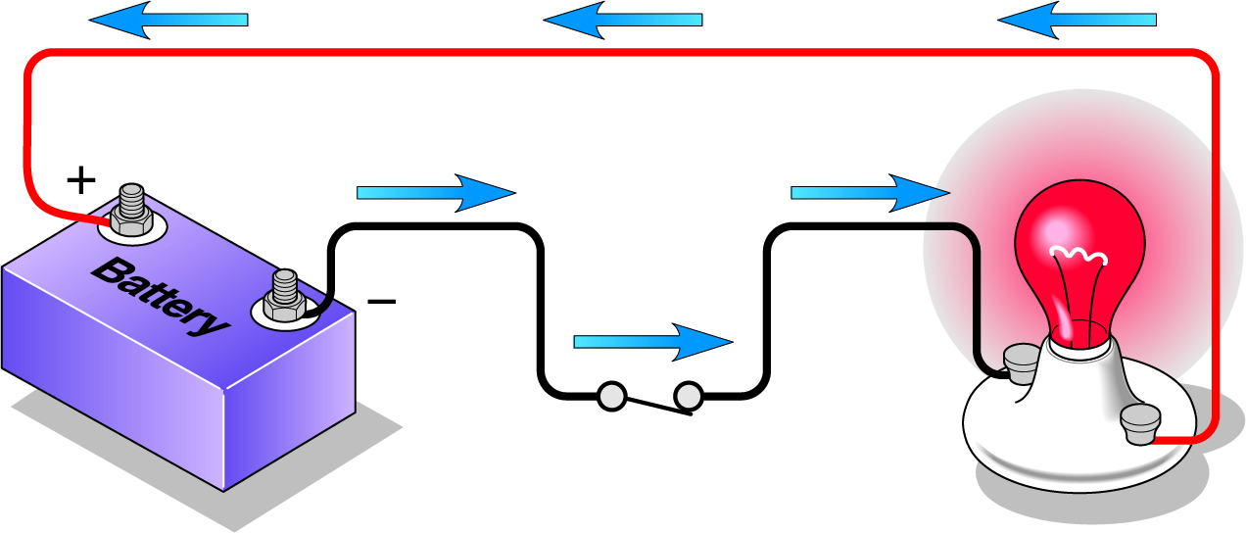
OUTLINE ELECTRICAL THEORY
ELECTRICITY
Electric current
Conductor
Nonconductor
Complete electric circuit
Notes:
Electricity does not occupy space or have mass (weight), so it is not matter. If it is not matter, then what is it? Electricity is the movement of electrons from one atom to another along a conductor. Electricity is a form of energy that, when in motion, exhibits magnetic, chemical, or thermal effects.
An electric current is the flow of electricity along a conductor. All materials can be classified as conductors or nonconductors depending on the ease with which an electric current can be transmitted through them.
A conductor is any material that conducts electricity. Most metals are good conductors. This means that electricity will pass through the material easily. Copper is a particularly good conductor and is used in electric wiring and electric motors. Pure (distilled) water is a poor conductor, but the ions usually found in ordinary water, such as tap water or a river or a lake, make it a good conductor. This explains why you should not swim in a lake during an electrical storm.
A nonconductor, also known as an insulator, is a material that does not transmit electricity. Rubber, silk, wood, glass, and cement are good insulators. Electric wires are composed of twisted metal threads (the conductor) covered with a rubber or plastic coating (the nonconductor or insulator). A complete electric circuit is the path that negative and positive electric currents take from the generating source through the conductors and back to the generating source.

Slide 6
TYPES OF ELECTRIC CURRENT
DIRECT CURRENT (DC) | ALTERNATING CURRENT (AC)
Constant, even flow | Rapid and interrupted flow
Travels in one direction | Travels in two directions
Produced by chemical means | Produced by mechanical means
Notes:
There are two types of electric current:
Direct current, abbreviated as DC, is a constant, even-flowing current that travels in one direction only and is produced by chemical means. Flashlights, cellphones, and cordless tools use the direct current produced by batteries. The battery in your car stores electric energy. Without it, your car would not start. An inverter is an apparatus that changes direct current to alternating current. Inverters usually have a plug and a cord. They allow you to use appliances outside of your salon, spa, barbershop, or home that normally would have to be plugged into an electric wall outlet. The phone charger in a car is an example of an inverter.
Alternating current, abbreviated as AC, is a rapid and interrupted current, flowing first in one direction and then in the opposite direction; it is produced by mechanical means and changes directions 60 times per second. Corded hair dryers, curling irons, electric files, and table lamps that plug into a wall outlet use alternating current. A rectifier is an apparatus that changes alternating current to direct current. Cordless electric clippers and phone chargers use a rectifier to change the AC from an electric wall outlet to the DC needed to recharge their batteries.

Slide 7
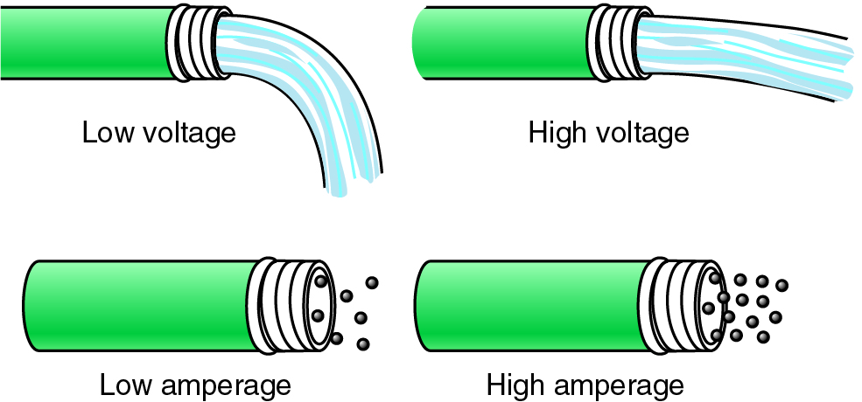
ELECTRICAL MEASUREMENTS
VOLT (V)
AMPERE (A)
MILIAMPERE (MA)
OHM (O)
WATT (W)
KILOWATT (KW)
(continues)
Notes:
The flow of an electric current can be compared to water flowing through a hose. Without pressure, neither water nor electricity would flow.
A volt, abbreviated as V and also known as voltage, is the unit that measures the pressure or force that pushes electric current forward through a conductor. Car batteries are 12 volts. Normal electric wall sockets that power your tools are 120 volts. Most air conditioners and clothes dryers run on 240 volts. A higher voltage indicates more power.
An ampere, abbreviated as A and also known as amp, is the unit that measures the strength of an electric current. Just as a hose must be large enough to carry the amount of water flowing through it, a wire must be large enough to carry the amount of electricity (amps) flowing through it. A hair dryer rated at 12 amps must have a cord that is twice as thick as one rated at 6 amps; otherwise, the cord might overheat and start a fire. A higher amp rating indicates a greater number of electrons and a stronger current.
A milliampere, abbreviated as mA, is 1⁄1,000 of an ampere. The current used for facial and scalp treatments is measured in milliamperes; an ampere current would be much too strong. If used for facials and scalp treatments, an ampere current would damage the skin or body.

Slide 8
ELECTRICAL MEASUREMENTS
VOLT (V)
AMPERE (A)
MILIAMPERE (MA)
OHM (O)
WATT (W)
KILOWATT (KW)
Notes:
An ohm, abbreviated as O, is a unit that measures the resistance of an electric current. Current will not flow through a conductor unless the force (volts) is stronger than the resistance (ohms).
A watt, abbreviated as W, is a unit that measures how much electric energy is being used in one second. A 40-watt light bulb uses 40 watts of energy per second.
A kilowatt, abbreviated as kw, is 1,000 watts. The electricity in your house is measured in kilowatts per hour (kwh). A 1,000-watt (1-kilowatt) hair dryer uses 1,000 watts of energy per second.

Slide 9

Define the two types of electric current.
Check-in
Notes:
Answer: Direct current (DC) is a constant, even-flowing current that travels in one direction only and is produced by chemical means. Alternating current (AC) is a rapid and interrupted current, flowing first in one direction and then in the opposite direction, that is produced by mechanical means.

Slide 10
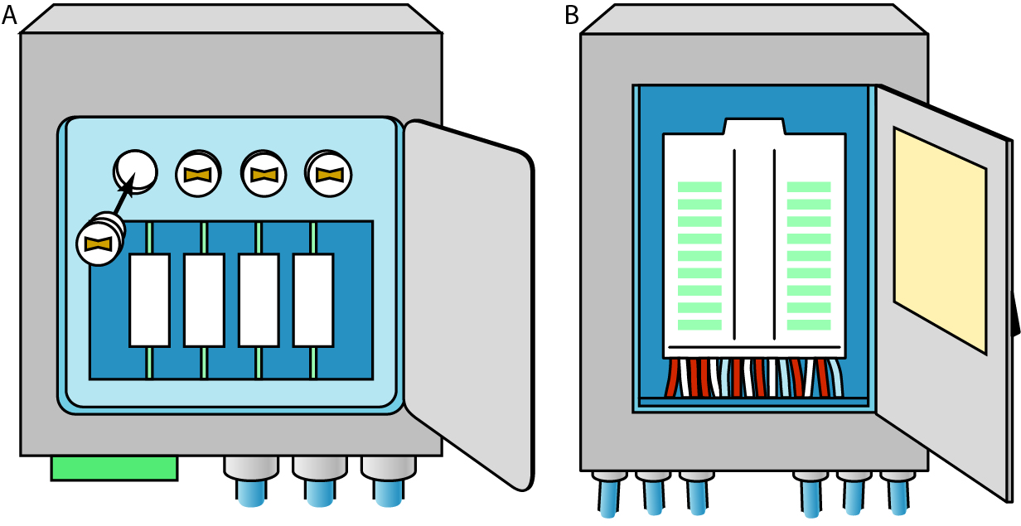
PRACTICE ELECTRICAL
EQUIPMENT SAFETY
SAFETY DEVICES
Fuse
Circuit breaker
(continues)
Notes:
A wire that is not large enough to carry the electrical current passing through it will overheat. The heating element in a hair dryer or curling iron heats up because it is not large enough to carry the electric current. Heating elements are designed to overheat and are safe when used properly; however, when the electrical wires in a wall overheat, they can cause a fire. If excessive current passes through a circuit or a fuse, the circuit breaker turns off the circuit to prevent overheating.
These are the electrical safety devices that you may encounter when working in a salon, spa, or barbershop:
A fuse prevents excessive current from passing through a circuit. It is designed to blow out or melt when the wire becomes too hot from overloading the circuit with too much current, such as when faulty equipment or too many appliances are connected to an electric source. To reestablish the circuit, disconnect the appliance, check all connections and insulation, insert a new fuse, then reconnect the appliance. Fuses are often found in older buildings that have not been renovated or modernized.
A circuit breaker is a switch that automatically interrupts or shuts off an electric circuit at the first indication of an overload. Circuit breakers have replaced fuses in modern electric circuits. They have all the safety features of fuses but do not require replacement and can simply be reset by switching the circuit breaker back on. A hair dryer has a circuit breaker located in the electric plug that is designed to protect both professional and client in case of an overload or short circuit. When a circuit breaker shuts off, you should disconnect the appliance and check all connections and insulation before resetting it.

Slide 11
ACTIVITY: BREAKER! BREAKER!
Take a trip as a class to the circuit breaker in your school. If all the breakers are not marked, your instructor will guide you in making a project of determining which switches relate to which areas of the facility and labeling them properly. Then you demonstrate how a breaker can be thrown and reset.
Notes:
Take students to the circuit breaker in your school. If all breakers are not marked, have students make a project of determining which switches relate to which areas of the facility and labeling them properly. Demonstrate how a breaker can be thrown and reset.

Slide 12
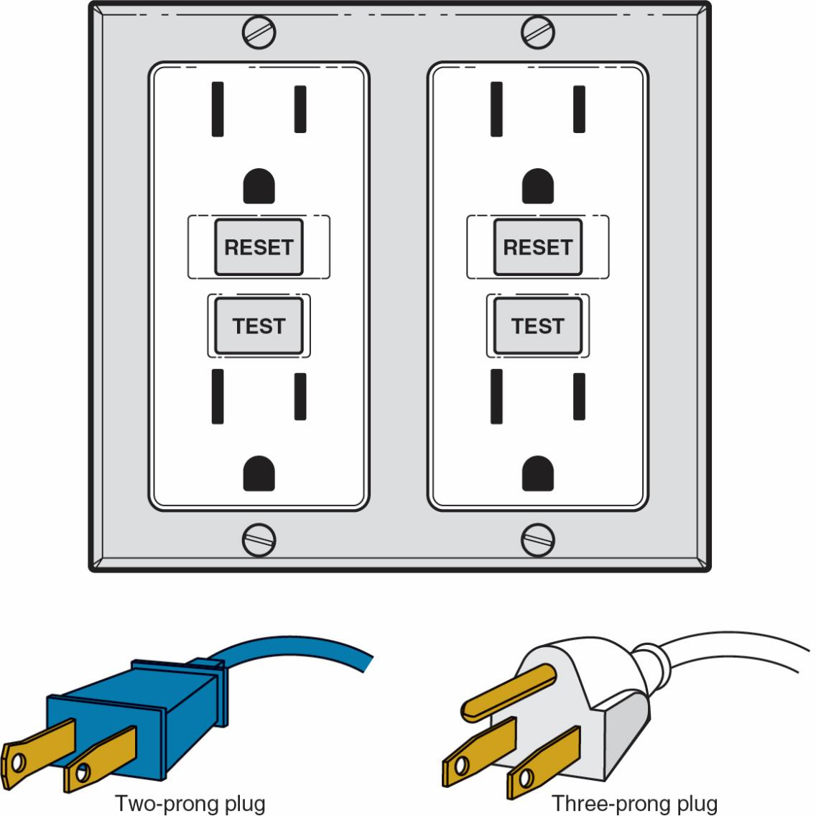
PRACTICE ELECTRICAL
EQUIPMENT SAFETY
SAFETY DEVICES
Grounding
Ground fault interrupter (GFI)
Underwriters Laboratories (UL)
(continues)
Notes:
Grounding completes an electric circuit and carries the current safely away. It is another important way to promote electrical safety. All electrical appliances must have at least two rectangular electrical connections, or prongs, on the plug. This is called a two-prong plug. The two prongs supply electric current to the circuit. If you look closely at the two prongs, you will see that one is slightly larger than the other. This guarantees that the plug can be inserted into an outlet only one way and protects you and your client from an electric shock in the event of a short circuit.
For added protection, some appliances (especially ones with metal casings) have a third circular electric connection that is a grounding pin. This is called a three-prong plug. The grounding pin is designed to guarantee a safe path for electricity and protect the user from electrical shock even if a wire comes loose. Appliances with a third circular grounding pin offer the most protection for you and your clients.
A ground fault interrupter (GFI) is designed to protect from electrical shock by interrupting a household circuit when there is a leak in the circuit. GFIs are required by the electrical code for receptacles in bathrooms, kitchens, and some outside receptacles. A GFI is designed to detect currents of a few milliamperes and trip a breaker at the receptacle or at the breaker panel to avoid a shock hazard. When it is working properly, a GFI has a green light that turns red when it trips. Once the appliance is removed from the socket, it can be reset with a “reset” button on the panel.

Slide 13
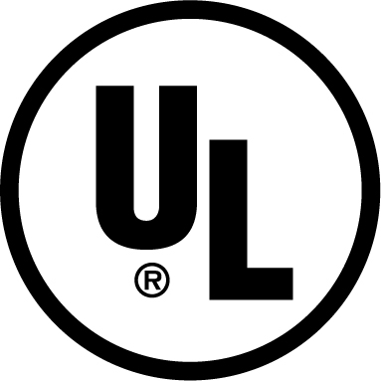
PRACTICE ELECTRICAL
EQUIPMENT SAFETY
SAFETY DEVICES
Grounding
Ground fault interrupter (GFI)
Underwriters Laboratories (UL)
Notes:
Underwriters Laboratories (UL) certifies the safety of electrical appliances. Curling irons, hair dryers, electric clippers, UV lamps, pedicure chairs, heating mitts, electric files, and more should be UL approved. This certifies that they are safe when used according to the manufacturer’s directions. Always look for the UL symbol on electric appliances and take the time to read and follow the manufacturer’s directions.

Slide 14
ACTIVITY: GADGET INSPECTION
Inspect any electric items in your kit or equipment in the classroom for UL approval. Also look for any labels, precautions, and warnings on these tools and take notes on what you find. Discuss your observations as a class.
Notes:
Have students inspect any electric items in their kit or equipment in the classroom for UL approval. They should also look for any labels, precautions, and warnings on these tools and take notes on what they find. Discuss their observations as a class.

Slide 15
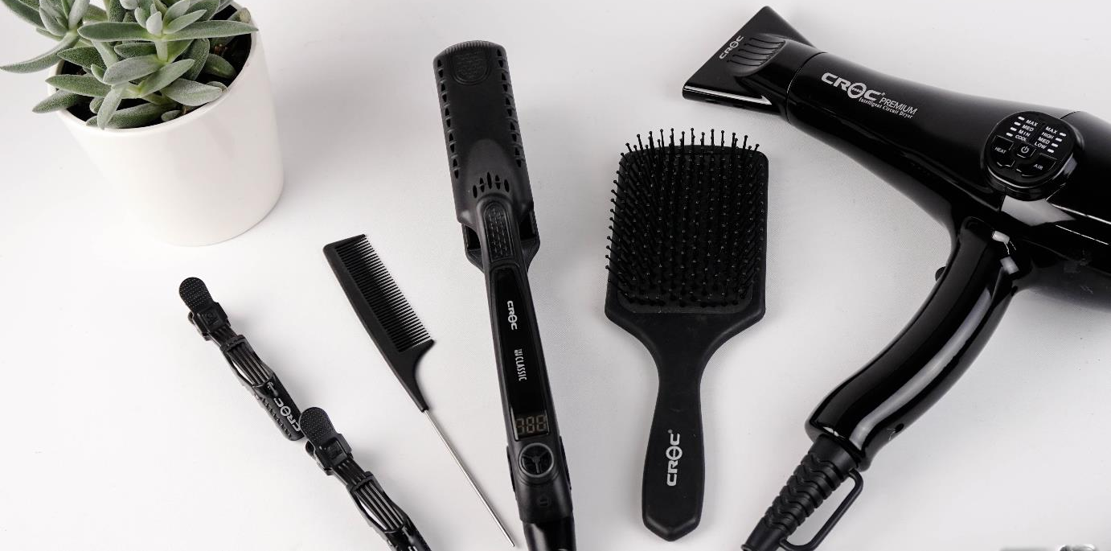
GUIDELINES FOR THE SAFE
USE OF ELECTRICAL EQUIPMENT
UL CERTIFICATION
READ ALL INSTRUCTIONS
REGISTER APPLIANCES
DISCONNECT UNUSED APPLIANCES
DISCONNECT APPLIANCES TO CLEAN
(continues)
Notes:
Shop fires are often caused by electrical problems, such as shorts in the wiring of the building or improper use of appliances, extension cords, and plugs. Careful attention to electrical safety involves following recommended UL guidelines, manufacturer’s directions, and the safety instructions and policies of your establishment.
All the electrical appliances you use should be UL certified.
Read all instructions carefully before using any piece of electrical equipment.
Always register electrical appliances with the manufacturer so that you will be notified of any safety recalls immediately.
Disconnect all appliances when not in use; pull on the plug, not the cord, to disconnect.
Disconnect all electrical appliances prior to cleaning them.

Slide 16
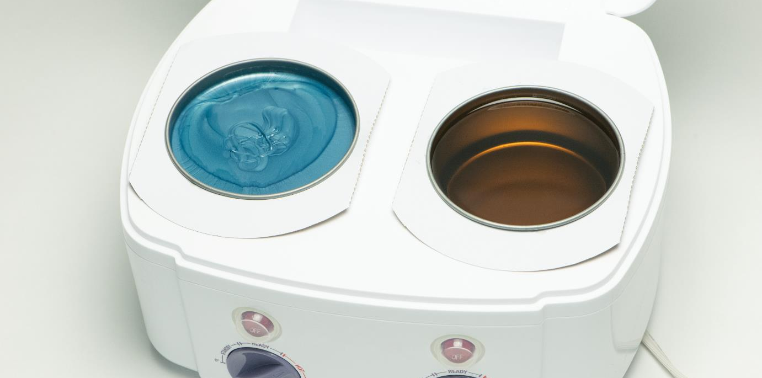
GUIDELINES FOR THE SAFE
USE OF ELECTRICAL EQUIPMENT
NEVER TAMPER WITH APPLIANCES
INSPECT EQUIPMENT
MAINTAIN CORDS AND PLUGS
DO NOT OVERLOAD
(continues)
Notes:
Never poke hairpins or wires through any part of an appliance, including lint screens.
Inspect all electrical equipment regularly.
Keep all wires, plugs, and electrical equipment in good repair. Do not use cords that have exposed wiring in any part of the cord or where it attaches to the appliance.
Use only one plug in each outlet; overloading may cause the circuit breaker to pop. If more than one plug is needed in an area, use a power strip with a surge protector.

Slide 17
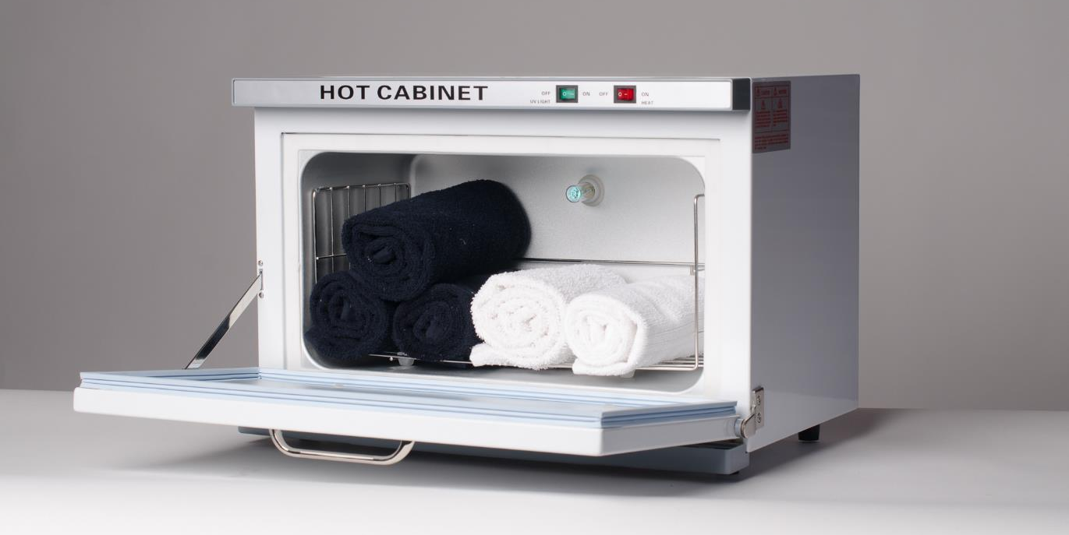
GUIDELINES FOR THE SAFE
USE OF ELECTRICAL EQUIPMENT
DO NOT LEAVE CLIENT UNATTENDED
DO NOT CLEAN AROUND PLUGGED IN EQUIPMENT
DO NOT TOUCH TWO METAL OBJECTS IF POWERED
DO NOT STEP ON CORDS
DO NOT TWIST CORDS
DO NOT ALTER A PLUG
(continues)
Notes:
Avoid contact, for both you and your client, with water and metal surfaces when using electricity and do not handle electrical equipment with wet hands or while standing on a wet floor.
Keep electrical cords off the floor and away from everyone’s feet; getting tangled in a cord could cause you or your client to trip.
Do not leave your client unattended while the client is connected to an electrical device.
Do not attempt to clean around electric outlets while equipment is plugged in.
Do not touch two metal objects at the same time if either is connected to an electric current.
Do not step on or place objects on electrical cords.
Do not allow electrical cords to become twisted; this can cause a short circuit.
Do not alter a three-prong plug to fit into a two-prong outlet.

Slide 18
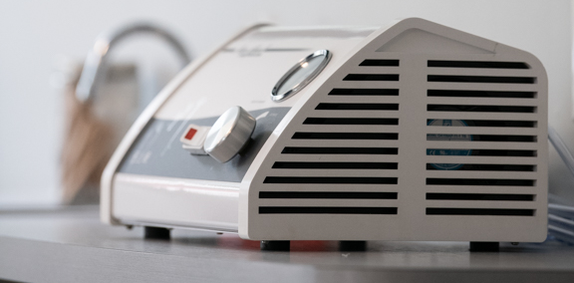
GUIDELINES FOR THE SAFE
USE OF ELECTRICAL EQUIPMENT
DO NOT REPAIR APPLIANCES
AVOID METAL + WATER
KEEP CORDS OFF FLOOR
DON’T USE A SPARKING APPLIANCE OR OUTLET
CHECK FIRE EXTINGUISHERS
REMOVE LINT FROM DRYERS REGULARLY
Notes:
Do not attempt to repair electrical appliances.
If you see sparks when plugging or unplugging an appliance, do not use the appliance or outlet until it has been approved by a certified electrician as safe to use.
Verify regularly that fire extinguishers are appropriate for electrical fires, are not expired, and that you are comfortable with using one.
Remove lint from clothes dryers before each load to reduce the chance of fire.

Slide 19
ACTIVITY: HAZARD SWEEP
Evaluate the electrical safety of your home or classroom. What safety devices can you find (GFI, circuit breakers, surge protectors, etc.)? What are some potential hazards? How might you address or minimize these electrical hazards? Share your findings as a class.
Notes:
Instruct students to evaluate the electrical safety of their home or classroom. What safety devices can they find (GFI, circuit breakers, surge protectors, etc.)? What are some potential hazards? How might they address or minimize these electrical hazards? Have them share their findings as a class.

Slide 20
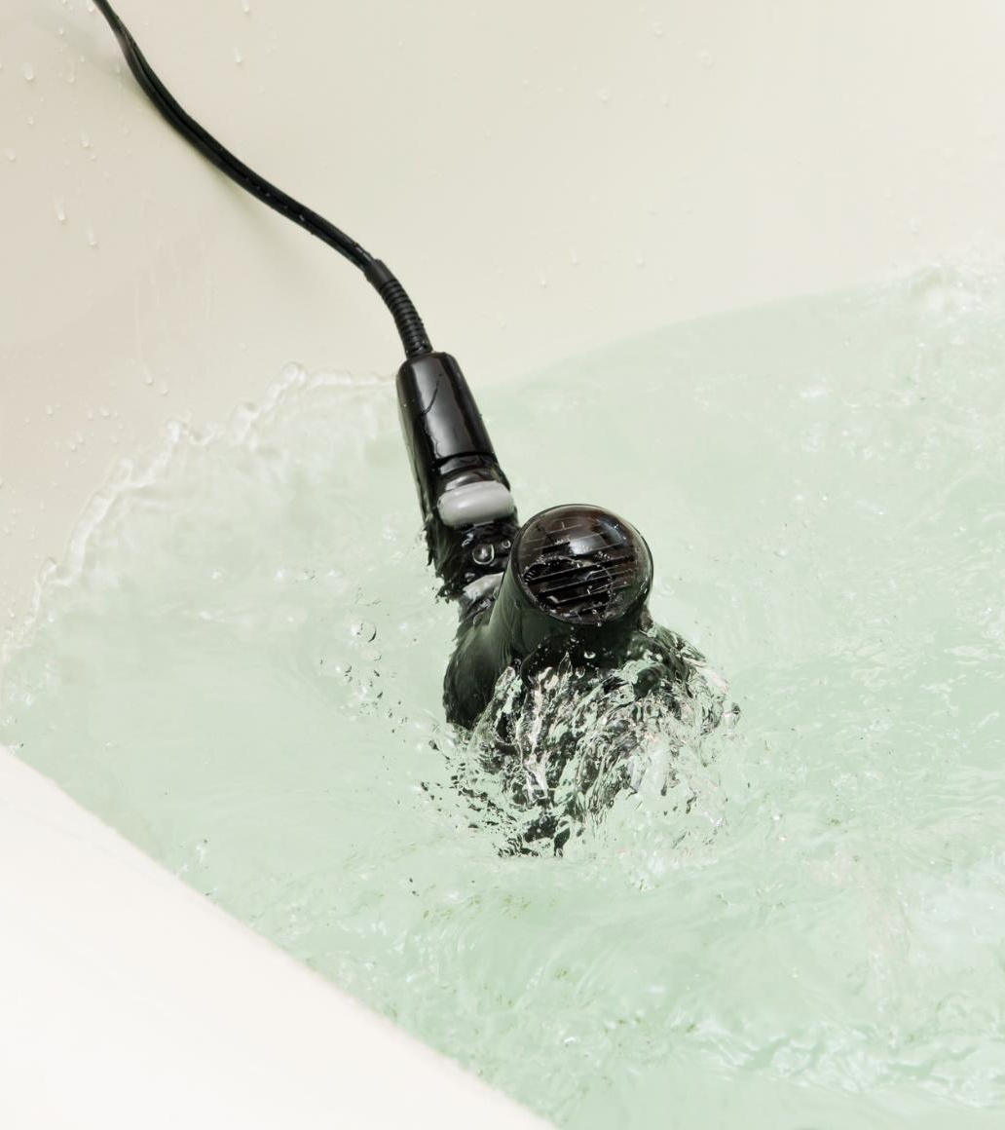
WHAT TO DO
IN AN ELECTRICAL
EMERGENCY
WERE YOU LIGHTLY SHOCKED?
DID AN APPLIANCE FALL INTO WATER?
(continues)
iStockPhoto.com/BanksPhotos
Notes:
Low voltage shocks are rarely critical, but they can be quite painful and dangerous to some individuals. If you receive a light shock sensation while using, turning on or off, or plugging or unplugging an electrical appliance:
Stop using the appliance immediately and turn it completely off.
Unplug it from the wall or turn off the circuit breaker to that outlet.
Replace the appliance or have it repaired by an authorized repair representative.
If similar issues occur with other appliances in the same outlet, discontinue use of that outlet until approved for use by a certified electrician.
If you drop an electrical appliance in water:
If the outlet is GFI protected, it will kill the circuit immediately and you may unplug the appliance from the wall, after releasing the appliance. Do NOT have one hand in the water and one at the outlet – if the outlet is still live, your body will conduct the electricity.
If the outlet is not GFI protected, go to the breaker box and flip the circuit off. If you are unsure which circuit controls that outlet, it is better to momentarily shut off power to the entire shop while you fix the situation. Once the power is off, unplug the item and then restore power.
Never use an appliance that has been dropped in water.

Slide 21
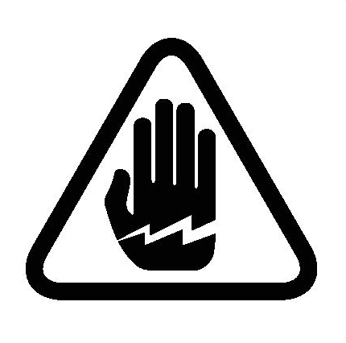
WHAT TO DO
IN AN ELECTRICAL
EMERGENCY
WHEN TO SEEK
MEDICAL ATTENTION
Are you or your client pregnant?
Do you or your client have burns on the skin?
Are you or your client current on your tetanus shots?
iStockPhoto.com/bubaone
Notes:
When to seek medical care after an electrical shock:
Anytime during pregnancy
If you have burns on the skin, particularly those that are open or do not heal well over time
If you are not current on your tetanus immunizations (given every five years to adults)

Slide 22
Check-in
What are at least five steps to take for electrical safety?
Notes:
Answer: Answers will vary, but may include these and more:
All the electrical appliances you use should be UL certified.
Read all instructions carefully before using any piece of electrical equipment.
Always register electrical appliances with the manufacturer so that you will be notified of any safety recalls immediately.
Disconnect all appliances when not in use; pull on the plug, not the cord, to disconnect.
Disconnect all electrical appliances prior to cleaning them.
Never poke hairpins or wires through any part of an appliance, including lint screens.
Inspect all electrical equipment regularly.
Keep all wires, plugs, and electrical equipment in good repair. Do not use cords that have exposed wiring in any part of the cord or where it attaches to the appliance.
Use only one plug in each outlet; overloading may cause the circuit breaker to pop. If more than one plug is needed in an area, use a power strip with a surge protector.
Avoid contact, for both you and your client, with water and metal surfaces when using electricity and do not handle electrical equipment with wet hands or while standing on a wet floor.

Slide 23
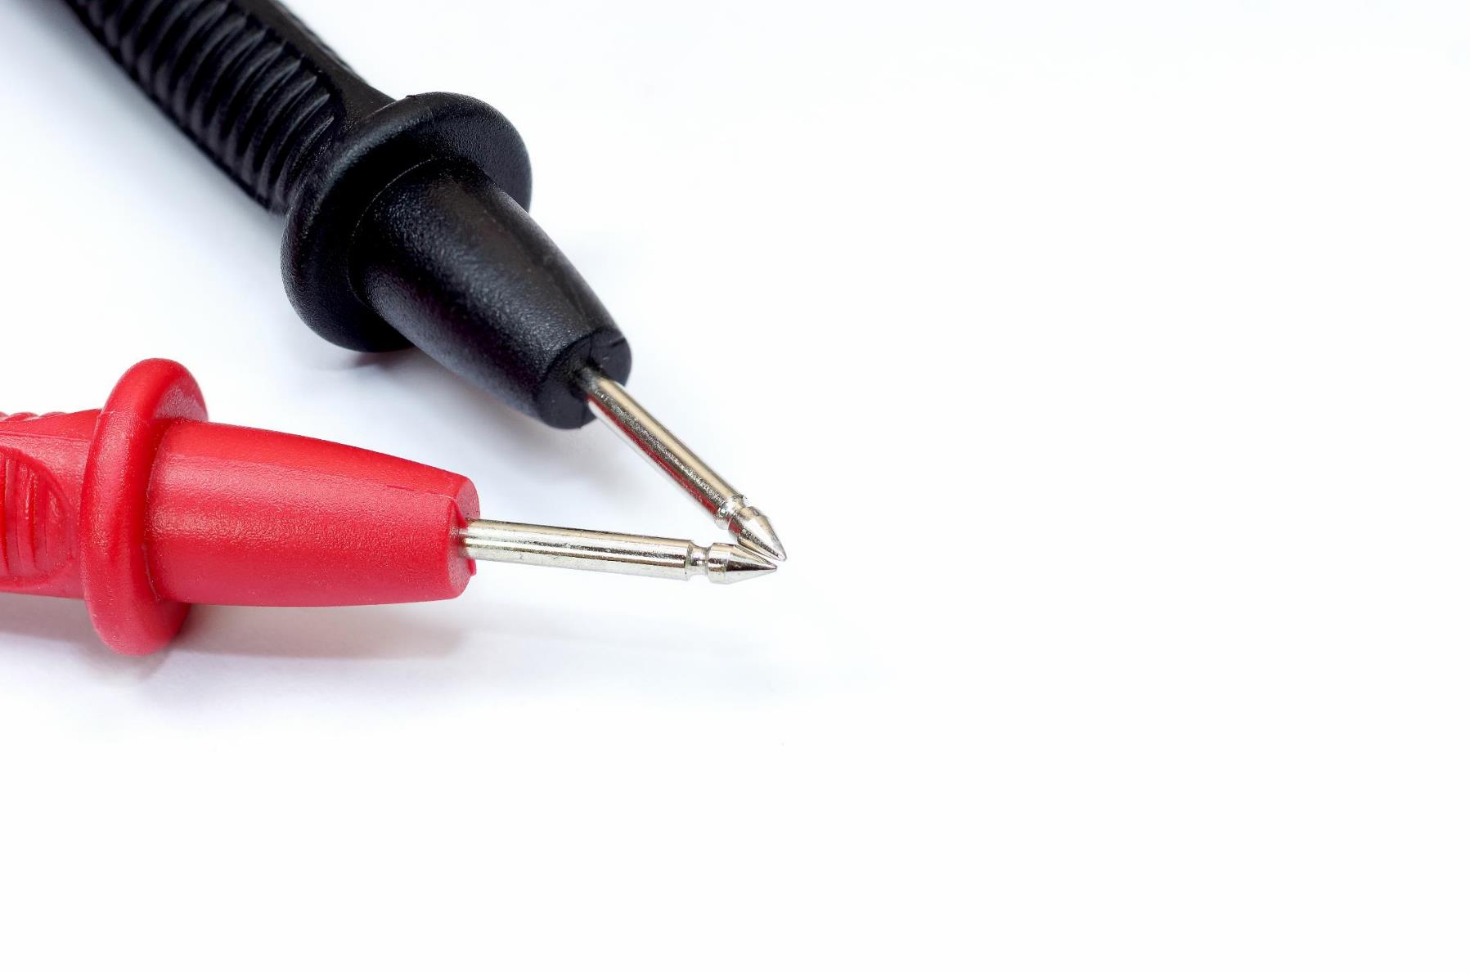
IDENTIFY ELECTROTHERAPY
MODALITIES
ELECTROTHERAPY
Modalities
  Galvanic current
  Microcurrent
  Tesla high-frequency current
Electrode
Polarity
  Anode (+)
  Cathode (-)
Notes:
The use of electrical currents to treat the skin is commonly referred to as electrotherapy. Currents used in electrical facial and scalp treatments are called modalities. Each modality produces a different effect on the skin.
An electrode, also known as a probe, is an applicator for directing electric current from an electrotherapy device to the client’s skin. It is usually made of carbon, glass, or metal. Each modality requires two electrodes—one negative and one positive—to conduct the flow of electricity through the body. The only exception to this rule is the Tesla high-frequency current, which uses a single electrode.
POLARITY
Polarity refers to the poles of an electric current, either positive or negative. The electrodes on many electrotherapy devices have one negatively charged pole and one positively charged pole. The positive electrode is called an anode; the anode is usually red and is marked with a P or a plus (+) sign. The negative electrode is called a cathode; it is usually black and is marked with an N or a minus (–) sign. The negatively charged electrons from the cathode flow to the positively charged anode. If the electrodes are not marked, ask your instructor, manager, or supervisor to help you determine the positive and negative poles.

Slide 24
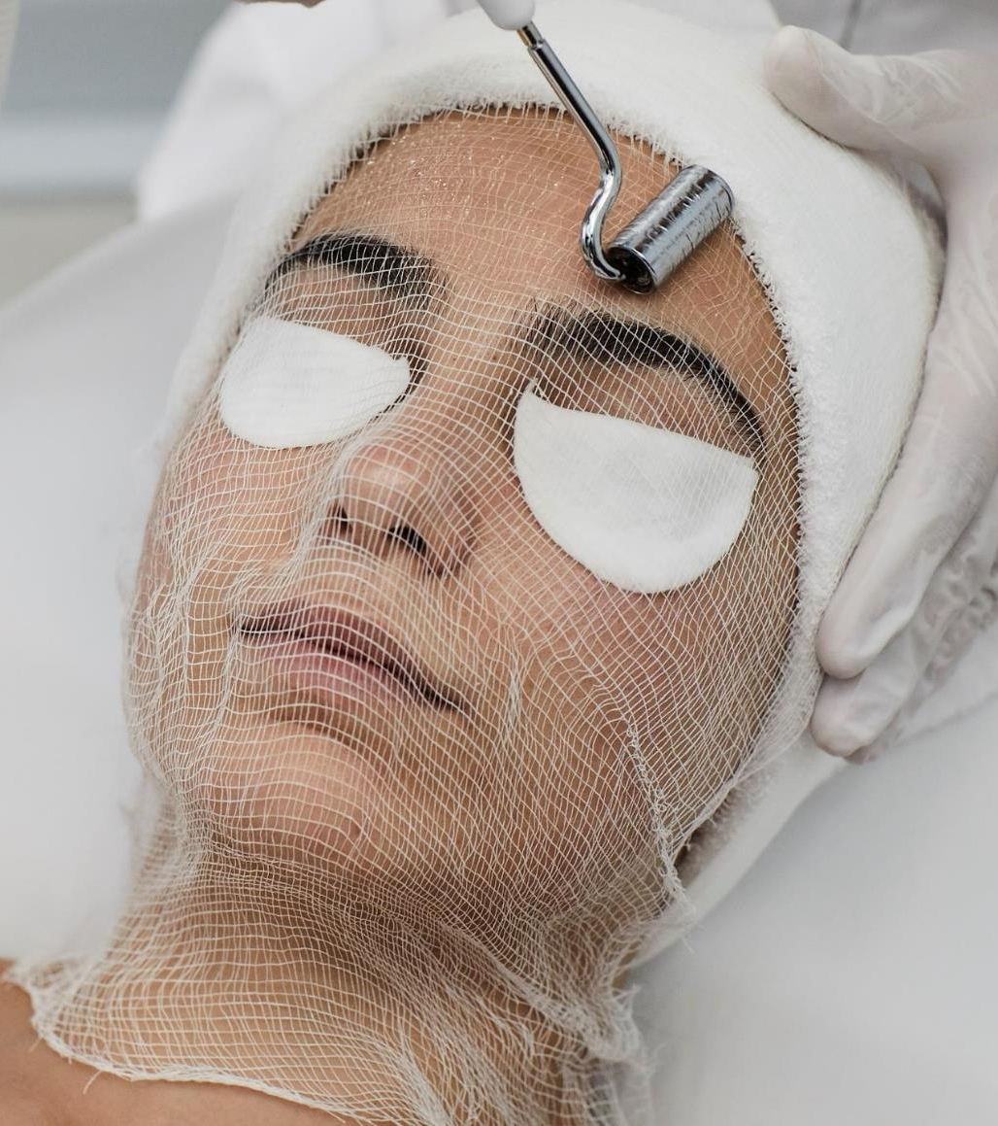
MODALITIES
GALVANIC CURRENT
Active / inactive electrodes
Iontophoresis
  Cataphoresis
  Anaphoresis
  Desincrustation
(continues)
Notes:
Galvanic current is a constant and direct current, having a positive and negative pole, that produces chemical changes when it passes through the tissues and fluids of the body.
Two different chemical reactions are possible with galvanic current, depending on the polarity (positive or negative) that is used. The active electrode is the electrode used on the area to be treated. The inactive electrode is the opposite pole from the active electrode. The effects produced by the positive pole are the exact opposite of those produced by the negative pole. Galvanic current is used to infuse water-soluble products into unbroken skin (the scientific term for this is phoresis).
Iontophoresis is the process of infusing water-soluble products into the skin with the use of electric current, such as the use of the positive and negative poles of a galvanic machine.
Cataphoresis infuses an acidic (positive) product into deeper tissues, using galvanic current from the positive pole toward the negative pole.
Anaphoresis infuses an alkaline (negative) product into the tissues from the negative pole toward the positive pole. Desincrustation, a form of anaphoresis, is a process used to soften and emulsify grease deposits (oil) and blackheads in the hair follicles. Desincrustation is frequently used to treat acne, milia (small, white cyst-like pimples), and comedones (blackheads and whiteheads).

Slide 25

MODALITIES
POSITIVE POLE (ANODE) CATAPHORESIS | NEGATIVE POLE (CATHODE) ANAPHORESIS
Produces acidic reactions | Produces alkaline reactions
Closes the pores | Opens the pores
Soothes nerves | Stimulates and irritates the nerves
Decreases blood supply | Increases blood supply
Contracts blood vessels | Expands blood vessels
Hardens and firms tissues | Softens tissues
(continues)
Notes:
EFFECTS OF GALVANIC CURRENT
Positive Pole (Anode) Cataphoresis Negative Pole (Cathode) Anaphoresis
Produces acidic reactions Produces alkaline reactions
Closes the pores Opens the pores
Soothes nerves Stimulates and irritates the nerves
Decreases blood supply Increases blood supply
Contracts blood vessels Expands blood vessels
Hardens and firms tissues Softens tissues
CAUTION
Do not use negative galvanic current on skin with broken capillaries or pustular acne conditions or on clients with high blood pressure or metal implants.

Slide 26
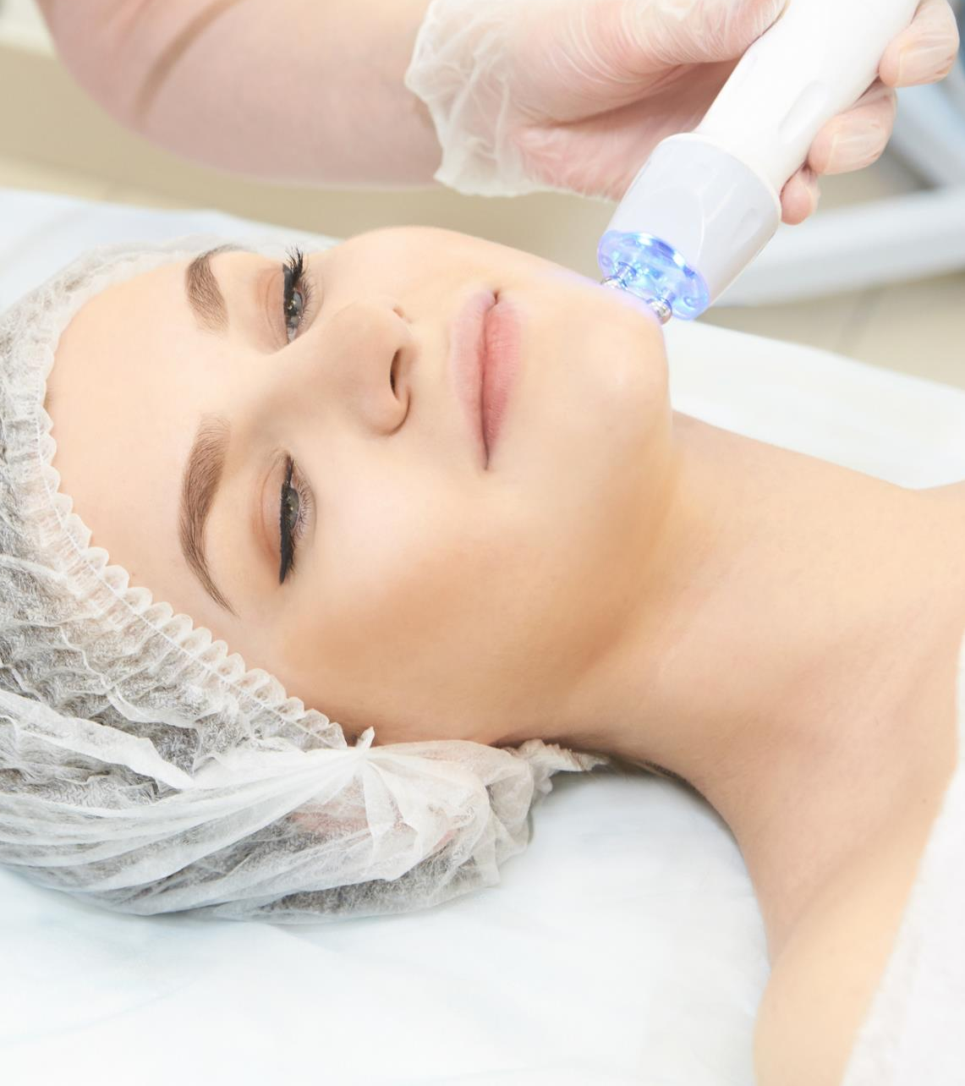
MODALITIES
MICROCURRENT
Iontophoresis
Firming
Toning
Soothing skin
Healing inflamed tissue
(continues)
iStockPhoto.com/Elena Volf
Notes:
Microcurrent is an extremely low level of electricity that mirrors the body’s natural electrical impulses. Microcurrent can be used for iontophoresis, firming, toning, and soothing skin. It also can help heal inflamed tissue, such as acne. Newer microcurrent devices have negative and positive polarity in one probe, not two probes. This allows the client to relax rather than having to hold on to a probe during the service or treatment.
Microcurrent does not travel throughout the entire body; it serves only the specific area being treated. Microcurrent can be effective in the following ways:
Improves blood and lymph circulation
Produces acidic and alkaline reactions
Opens and closes hair follicles and pores
Increases muscle tone
Restores elasticity
Reduces redness and inflammation
Minimizes healing time for acne lesions
Improves the natural protective barrier of the skin
Increases metabolism
When microcurrent is used during aging-skin treatments, it may give your client’s skin a softer, firmer, more hydrated appearance.

Slide 27
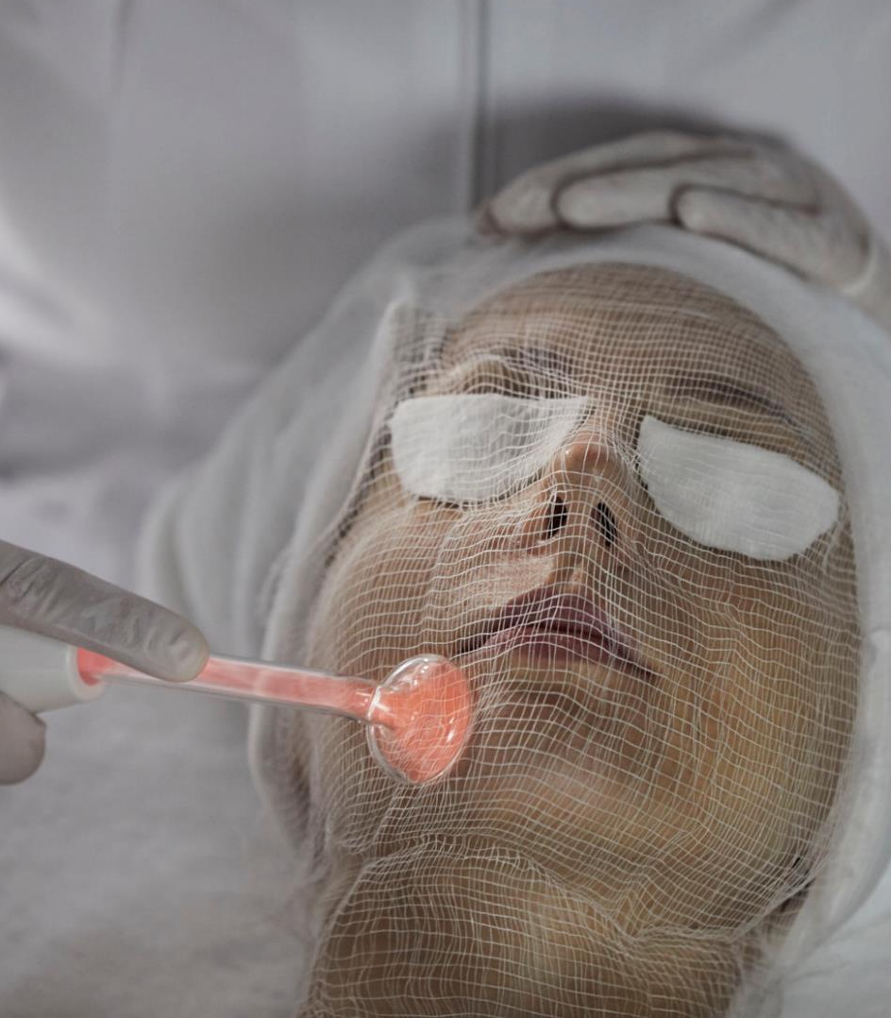
MODALITIES
TESLA HIGH-FREQUENCY CURRENT
Stimulates blood circulation
Increases elimination and absorption
Increases skin metabolism
Improves germicidal action
Relieves skin congestion
CONTRAINDICATIONS
Notes:
The Tesla high-frequency current, also known as violet ray, is a thermal or heat-producing current with a high rate of oscillation or vibration that is commonly used for scalp and facial treatments. Tesla current does not produce muscle contractions, and the effects can be either stimulating or soothing, depending on the method of application. The electrodes are made from either glass or metal, and only one electrode is used to perform a service.
The benefits of the Tesla high-frequency current are:
Stimulates blood circulation
Increases elimination and absorption
Increases skin metabolism
Improves germicidal action
Relieves skin congestion
As you learn more about specific treatments, you will become familiar with the term contraindication, referring to a condition that requires avoiding certain treatments, procedures, or products to prevent undesirable side effects. For example, Tesla high-frequency current should not be used on clients who are pregnant or who have epilepsy or any other seizure disorder, asthma, high blood pressure, a sinus blockage, a pacemaker, or metal implants. Additionally, clients should avoid contact with metal, such as chair arms, jewelry, and metal bobby pins, during the treatment, as a burn may occur if contact is made.

Slide 28
Check-in
Briefly describe three electrical modalities used in beauty and wellness services.
Notes:
Answer: Direct current (DC) is a constant, even-flowing Answer:
Galvanic current is a constant DC with a negative and positive pole, which is reduced to a safe, low-voltage level. Galvanic current produces chemical changes when passed through body tissues and fluids and is used to create chemical and ionic reactions in the skin.
Microcurrent is an extremely low level of electricity that is directed only to the specific area being treated and that does not travel throughout the entire body. Microcurrent can be used for iontophoresis, firming, toning, and soothing the skin and can help to heal inflamed tissue.
Tesla high-frequency current is characterized by a high rate of oscillation that produces heat. It is commonly called the violet ray and is used for both scalp and facial treatments. Tesla current does not cause muscular contractions but creates either stimulating or soothing effects.

Slide 29
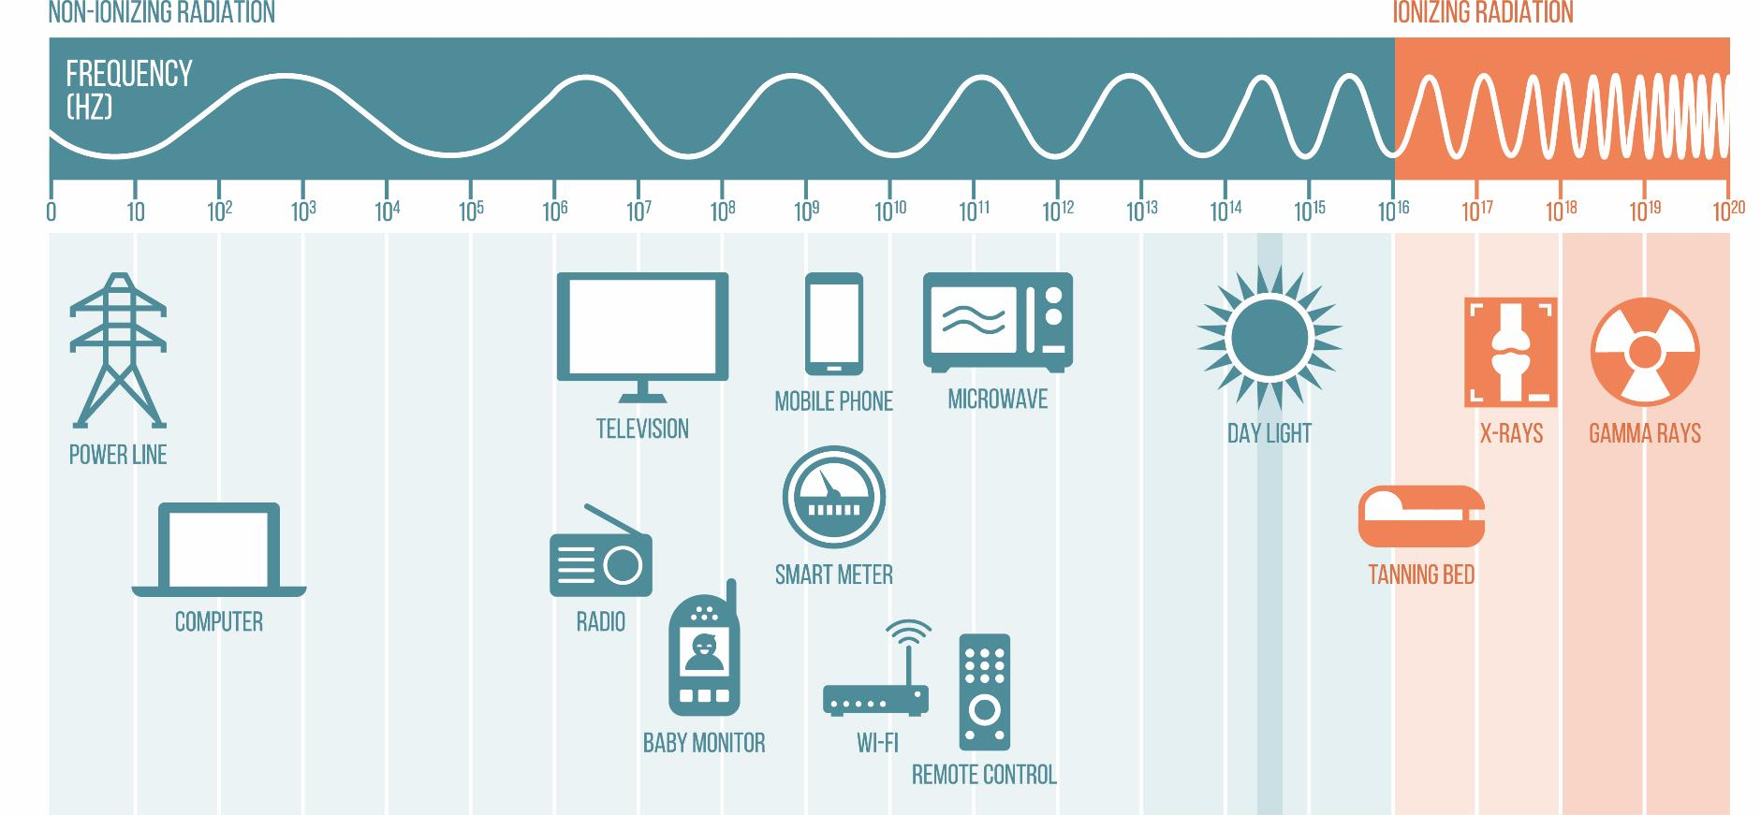
DISCUSS LIGHT ENERGY
elenabsl/Shutterstock.com
THE ELECTROMAGNETIC SPECTRUM
Notes:
The electromagnetic spectrum, also known as electromagnetic spectrum of radiation, is the name given to all of the forms of energy (or radiation) that exist. The forms of energy in the electromagnetic spectrum are radio waves (used by radios and televisions), microwaves (used in microwave ovens), light waves (infrared light, visible light, and ultraviolet light used for light therapy services), X-rays (used by physicians and dentists), and gamma rays (used for nuclear power plants).
Energy moves through space in waves. These waves are similar to the waves caused when a stone is dropped on the surface of water. Each type of energy has its own wavelength, the distance between successive peaks of electromagnetic waves. A waveform is the measurement of the distance between two wavelengths. Some wavelengths are long and some are short. Long wavelengths have low frequency, meaning that the number of waves is less frequent (fewer waves) within a waveform pattern. Short wavelengths have higher frequency because the number of waves is more frequent (more waves) within a waveform pattern.
LONG WAVELENGTHS COMPARED WITH SHORT WAVELENGTHS
Long Wavelengths Short Wavelengths
Low frequency High frequency
Deeper penetration Less penetration
Less energy More energy

Slide 30
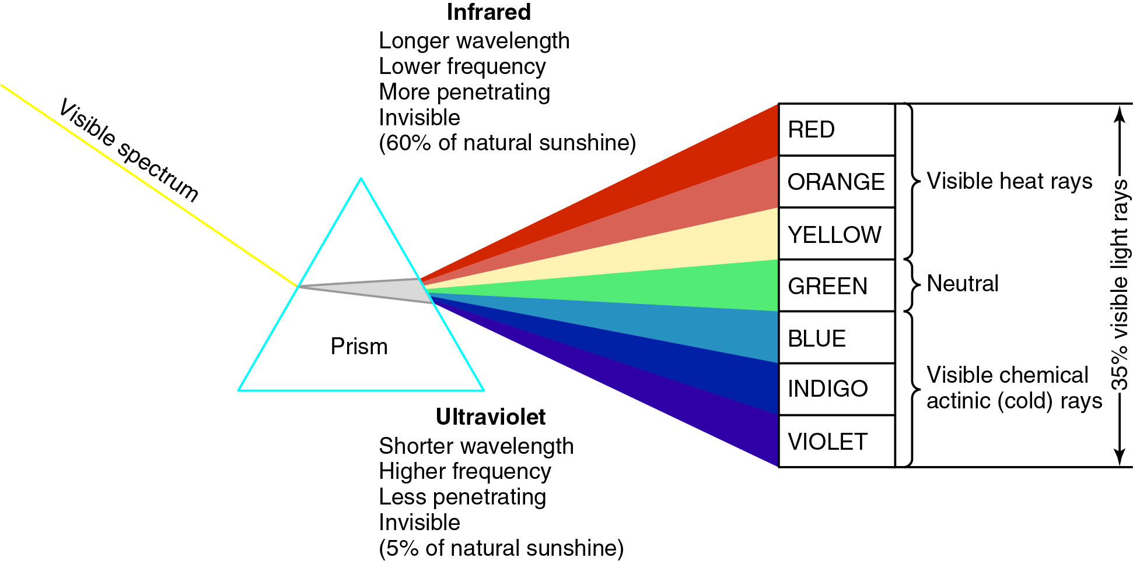
VISIBLE SPECTRUM OF LIGHT
Notes:
Visible light is the part of the electromagnetic spectrum that can be seen. The visible spectrum of light makes up only 35 percent of natural sunlight. Within the visible spectrum of light, violet has the shortest wavelength and red has the longest. The wavelength of infrared light is just below that of red light and the wavelength of ultraviolet light is just above that of violet light.
Although they are referred to as light, infrared light and ultraviolet light are not really light. Ultraviolet light and infrared light are also forms of electromagnetic energy but are invisible because their wavelengths are beyond the visible spectrum of light. Invisible light makes up 65 percent of natural sunlight.
Invisible light is the light at either end of the visible spectrum of light that is invisible to the naked eye. Before the visible violet light of the spectrum is ultraviolet light; it is the shortest and least-penetrating light of the spectrum. Beyond the visible red light of the spectrum is infrared light, which produces heat.

Slide 31
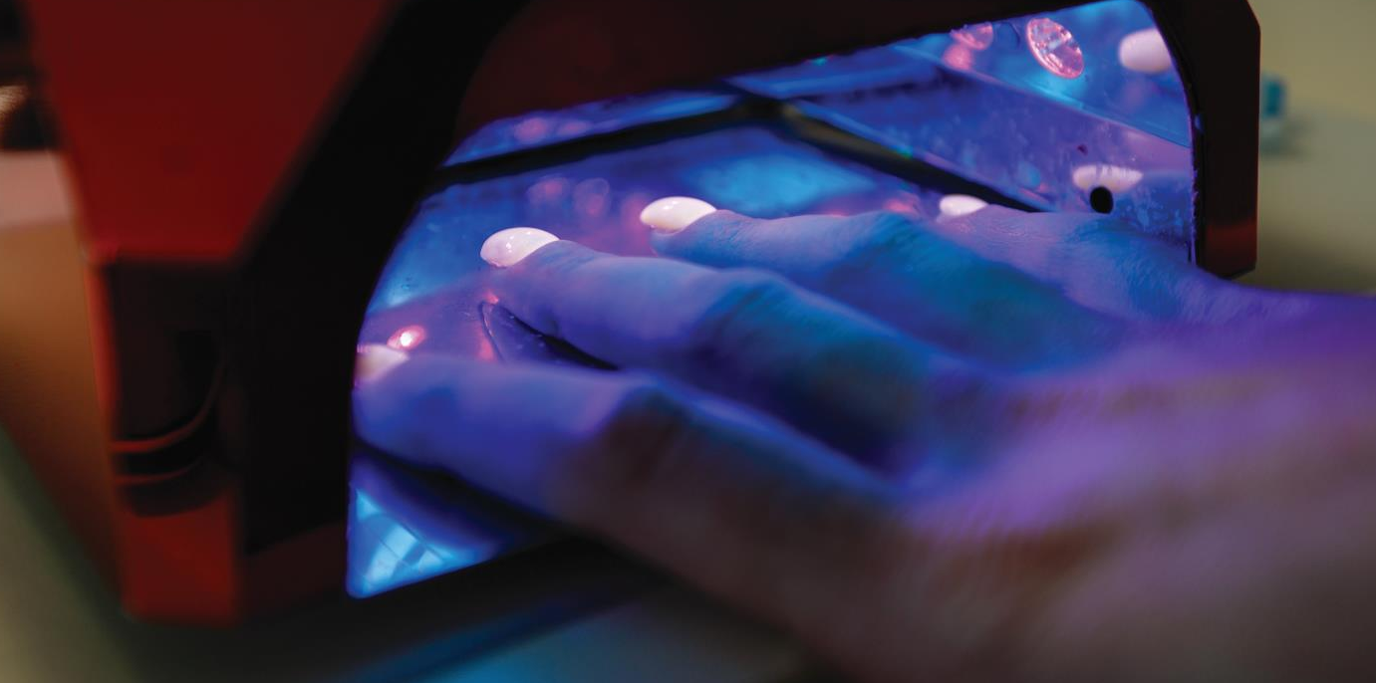
INVISIBLE LIGHT
ULTRAVIOLET LIGHT
UVA
UVB
UVC
Aleksey Korchemkin/Shutterstock.com
(continues)
Notes:
Ultraviolet light, abbreviated as UV light and also known as cold light or actinic light, is invisible light that has a short wavelength (giving it higher energy), is less penetrating than visible light, causes chemical reactions to happen more quickly than visible light, produces less heat than visible light, and kills some germs.
UV light prompts the skin to produce vitamin D, a fat-soluble vitamin that is good for bone growth and health. We need sunlight to survive on the planet; however, overexposure to UV light can cause premature aging of the skin and skin cancer. Incidence of skin cancer has reached a near-epidemic level, with over one million new cases being diagnosed each year. It is estimated that one in five Americans will develop skin cancer, and that 90 percent of those cancers will be the result of exposure to UV radiation from natural sunlight, sun lamps, and tanning beds.
There are three types of UV light:
Ultraviolet A (UVA). Ultraviolet A light has the longest wavelength of the UV light spectrum and penetrates directly into the dermis of the skin, damaging the collagen and elastin. UVA light is the light that is often used in tanning beds.
Ultraviolet B (UVB). Ultraviolet B light is often called the burning light because it is most associated with sunburns. Excessive use of both UVA and UVB light can cause skin cancers.
Ultraviolet C (UVC). Ultraviolet C light is blocked by the ozone layer. If the Earth loses its protective layer of ozone, life as we know it will no longer exist. UVC is effective at killing bacteria, viruses, mold and other pathogens.

Slide 32
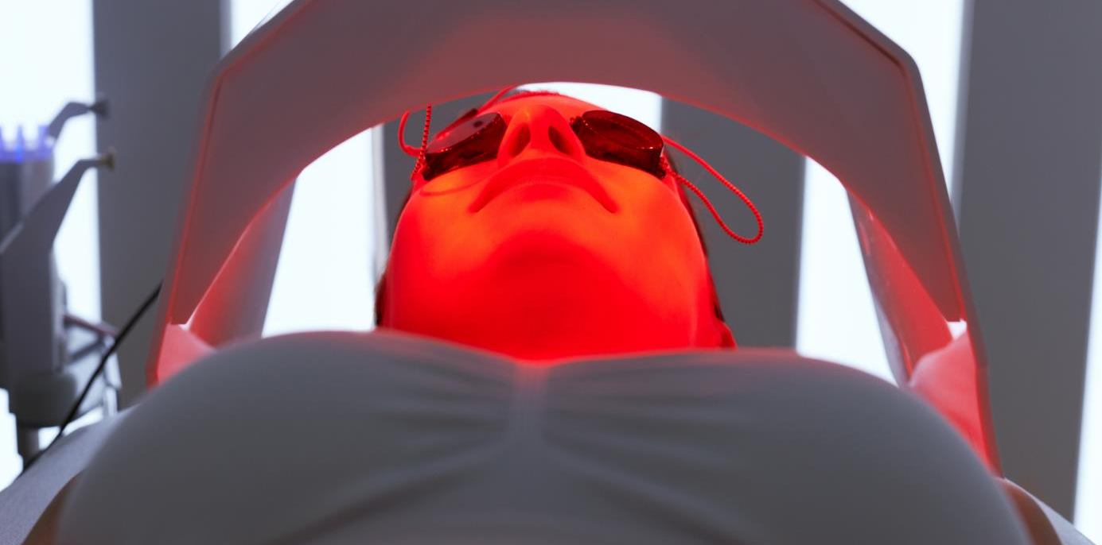
INVISIBLE LIGHT
INFRARED LIGHT
Diminishes signs of aging
Heals wounds
Increases circulation
Aids in relaxation and warms muscles
iStockPhoto.com/puhhha
Notes:
Infrared light has longer wavelengths, penetrates more deeply, has less energy, and produces more heat than visible light. Infrared light makes up 60 percent of natural sunlight.
Infrared lamps are used mainly during hair conditioning treatments and to process haircolor. They are also used in spas and saunas for relaxation and for warming up muscles. Infrared light has been used to diminish signs of aging such as wrinkles, to heal wounds, and to increase circulation.

Slide 33
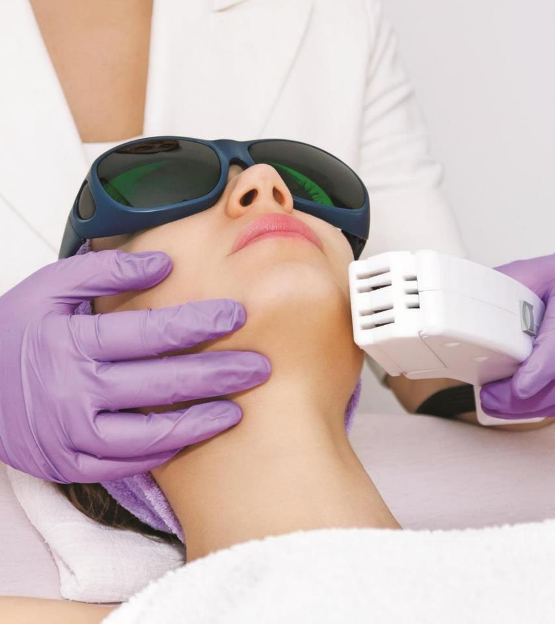
HARNESSING LIGHT ENERGY
CATALYSTS
LIGHT THERAPY
carol.anne/Shutterstock.com
Notes:
LIGHT INTO CHEMICAL ENERGY
Catalysts are substances that speed up chemical reactions. Some catalysts use heat as an energy source while others use light. Whatever the energy source, catalysts absorb energy like a battery. At the appropriate time, they pass this energy to the initiator and the reaction begins. Like other chemicals, a catalyst will not get consumed in a chemical reaction. For example, in hair coloring services, hydrogen peroxide (developer) is the catalyst that allows the hair color to penetrate the cortex of the hair, creating a permanent color. In acrylic nails, the monomers used are the catalyst that solidify the nails; in the application of gel nails, the UV light is the catalyst for hardening.
LIGHT THERAPY
Light therapy, also known as phototherapy, is the application of light rays to the skin for the treatment of wrinkles, capillaries, or pigmentation or for hair removal. Lasers and light therapy devices have been used for decades, yet some of the original techniques are still valid today. Lasers are designed to focus all light power to a specific depth and in one direction within the skin, using the same color of light. In contrast, other light therapies have multiple depths, colors, and wavelengths, and the light may be scattered. The most important point to remember about light therapy is that the equipment you use is selected based on the skin type and condition you are treating.

Slide 34
Check-in
Explain the difference between electromagnetic radiation, visible light, and invisible light.
Notes:
Answer: Electromagnetic radiation refers to all the forms of energy in the electromagnetic spectrum, including radio wave, microwaves, light waves (including both visible and invisible light), X-rays, and gamma rays. Visible light is the light we can see and makes up just 35 percent of sunlight. Invisible light is the light at either end of the electromagnetic spectrum that is visible to the naked eye – it includes infrared on one end and ultraviolet on the other.
Galvanic current is a constant DC with a negative and positive pole, which is reduced to a safe, low-voltage level. Galvanic current produces chemical changes when passed through body tissues and fluids and is used to create chemical and ionic reactions in the skin.
Microcurrent is an extremely low level of electricity that is directed only to the specific area being treated and that does not travel throughout the entire body. Microcurrent can be used for iontophoresis, firming, toning, and soothing the skin and can help to heal inflamed tissue.
Tesla high-frequency current is characterized by a high rate of oscillation that produces heat. It is commonly called the violet ray and is used for both scalp and facial treatments. Tesla current does not cause muscular contractions but creates either stimulating or soothing effects.

Slide 35
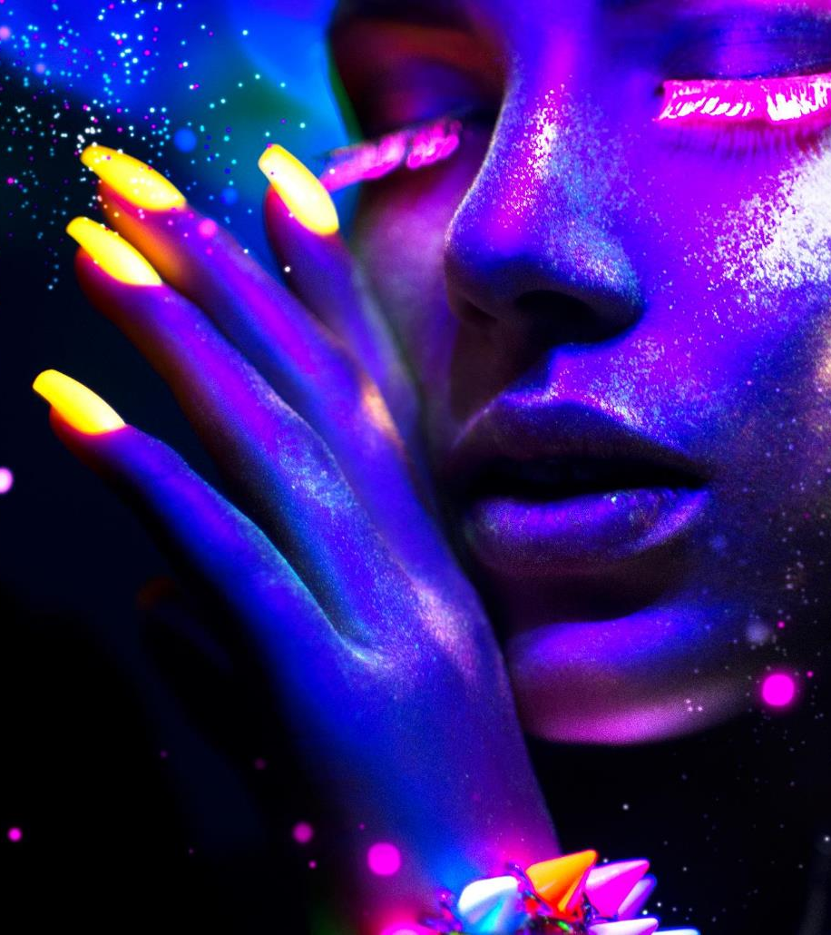
SUMMARY AND REVIEW
As many of the devices and pieces of equipment we use in beauty services are electrical, it is important to have a general understanding of the basics of electricity.
We cannot perform various skin care services safely and effectively without understanding which form of electrical current will give the best results for the desired service.
The two types of electrical current are direct current (DC) and alternating current (AC).
(continues)
Notes:
Because many of the devices and pieces of equipment we use in beauty services are electrical, it is important to have a general understanding of the basics of electricity.
We cannot perform various skin care services safely and effectively without understanding which form of electrical current will give the best results for the desired service.
The two types of electrical current are direct current (DC) and alternating current (AC).

Slide 36

SUMMARY AND REVIEW
Devices used for electrical safety include fuses, circuit breakers, and ground fault interrupters (GFIs).
Three electric modalities used in beauty and wellness services include galvanic current, microcurrent, and Tesla high-frequency current.
Light can be either visible or invisible; ultraviolet rays and infrared rays are forms of invisible light rays. Invisible light has a variety of therapeutic and aesthetic applications.
Notes:
Devices used for electrical safety include fuses, circuit breakers, and ground fault interrupters (GFIs).
Three electric modalities used in beauty and wellness services include galvanic current, microcurrent, and Tesla high-frequency current.
Light can be either visible or invisible; ultraviolet rays and infrared rays are forms of invisible light rays. Invisible light has a variety of therapeutic and aesthetic applications.

Slide 37

CASE STUDY:
ELECTRICITY &
ELECTRICAL SAFETY
Manny intends to purchase an established beauty business. However, before the closing is finalized, he has a walk-through with an electrical inspector. The inspector, Sami, will ensure the shop is wired properly and able to handle the special electrical needs that it requires.
(continues)
Kinga/Shutterstock.com

Slide 38

CASE STUDY:
ELECTRICITY &
ELECTRICAL SAFETY
They first inspect the outlets where the nail stations will be and where most of the hair drying and curling will take place. Next, they move to the facial rooms and discuss the special needs involved in providing esthetic services. Finally, Sami explains the fuse box and circuit breaker to Manny.
(continues)
Kinga/Shutterstock.com

Slide 39
CASE STUDY:
ELECTRICITY & ELECTRICAL SAFETY
1. Manny learns that the normal wall sockets that power hair dryers and curling irons are ___________ volts.
  (a) 120
  (b) 220
  (c) 320
  (d) 420
2. Sami explains that, due to its ___________ rating, a hair dryer cord must be twice as thick as an appliance with a lower rating in order to avoid overheating and starting a fire.
  (a) volt
  (b) amp
  (c) ohm
  (d) watt
(continues)
Notes:
a. 120
A volt is a unit that measures the pressure or force that pushes
the flow of electrons forward through a conductor. The normal rate
for voltage power blowdryers and other electrical apparatuses used
in the salon is 120.
b. amp
An amp or ampere is the unit of measurement that measures the
strength of an electric current.

Slide 40
CASE STUDY:
ELECTRICITY & ELECTRICAL SAFETY
3. To create an atmosphere that is relaxing in the facial room, Manny will use a 40-___________ bulb.
  (a) volt
  (b) amp
  (c) ohm
  (d) watt
4. If a fuse gets too hot and melts, Manny will know that a(n) _________.
  (a) appropriate amount of the current was prevented from passing through the circuit
  (b) excessive amount of current was allowed to pass through the circuit
  (c) deficit of current was prevented from passing through the circuit
  (d) excessive amount of current was prevented from passing through the circuit
(continues)
Notes:
d. watt
A watt is a measurement of how much electricity is being used in
a second.
d. excessive amount of current was prevented from passing
through the circuit
A fuse melts when a wire becomes too hot and overloads the
circuit with too much current from too many appliances or from
faulty equipment.

Slide 41
CASE STUDY:
ELECTRICITY & ELECTRICAL SAFETY
5. If too many appliances are operating on the same circuit and they all suddenly stop working, Manny will know that the ___________ has shut off to protect the building from a dangerous situation.
  (a) fuse
  (b) amp
  (c) circuit breaker
  (d) watt
6. Manny realizes that his establishment has several appliances that have a three-prong plug, which is evidence of ___________.
  (a) fusing
  (b) grounding
  (c) amping
  (d) breaking
Notes:
c. circuit breaker
A circuit breaker is a switch that automatically shuts off or
interrupts electric current at the first indication of overload.
b. grounding
Grounding completes an electric circuit and carries the current
safely away. It is another important way to promote electrical safety.

Slide 42

01
Explain electricity and electrical safety.
02
Outline electrical theory.
03
Practice electrical equipment safety.
04
Identify electrotherapy modalities.
05
Discuss light energy.
Notes:
Ask the class if they have any questions regarding the learning objectives. Are there any that are unclear or need to be reviewed?

