Slide 1


Non-ablative Fractional Laser Skin Rejuvenation

Slide 2
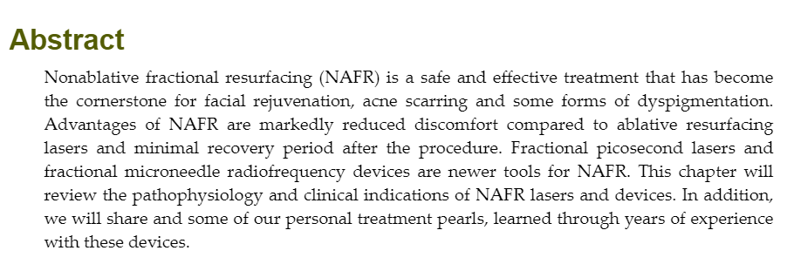

Slide 3
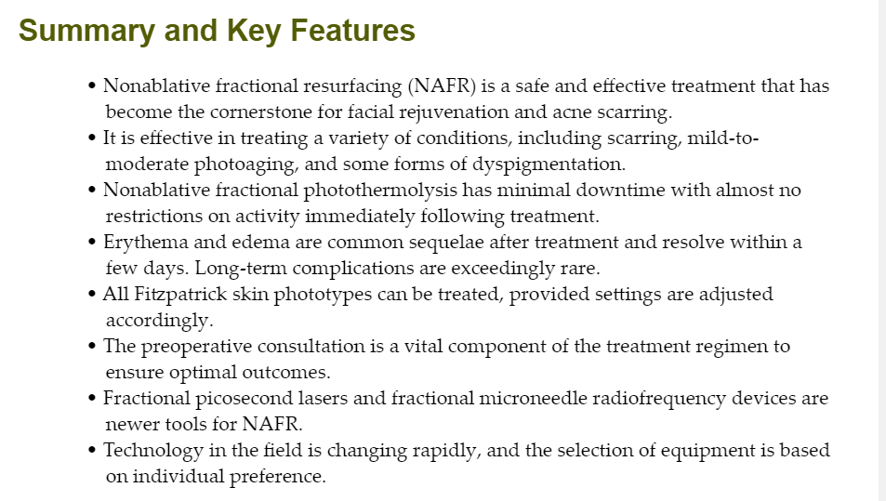

Slide 4
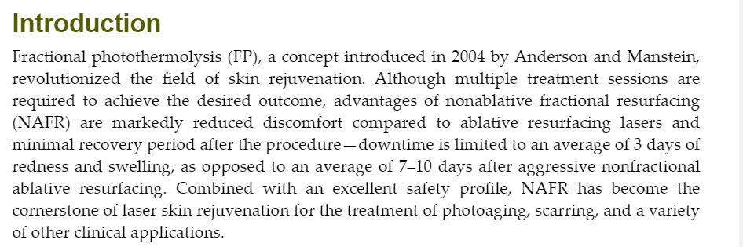

Slide 5
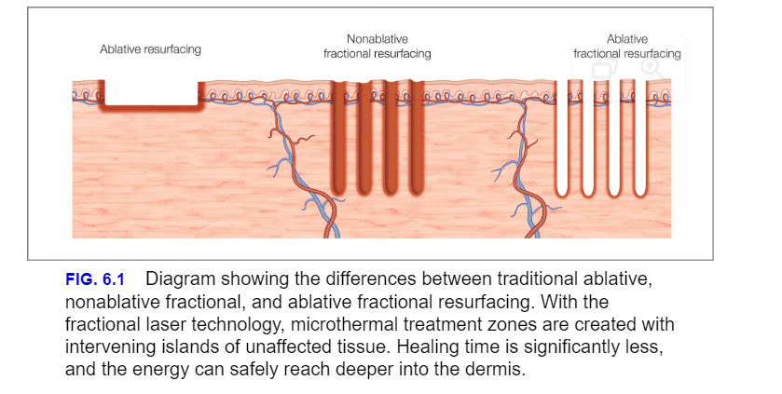

Slide 6
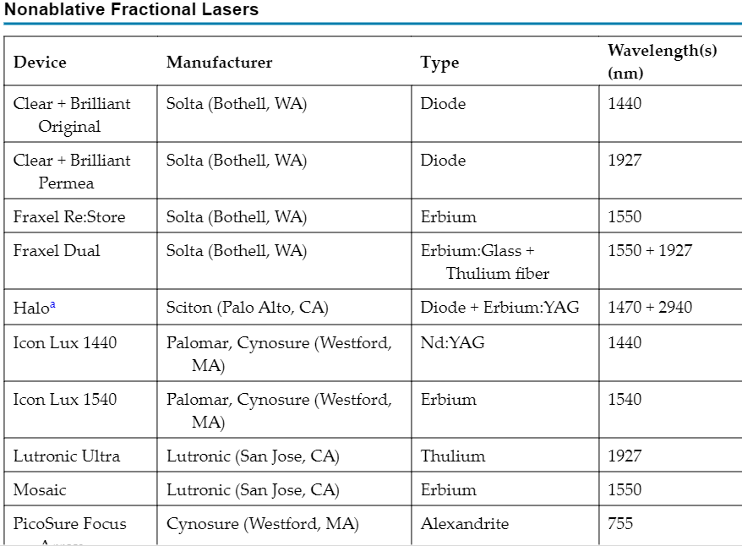

Slide 7
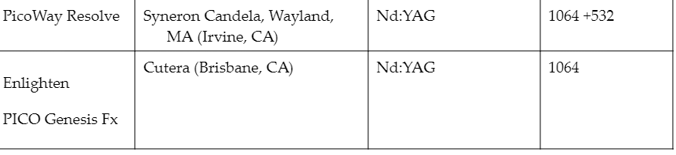

Slide 8
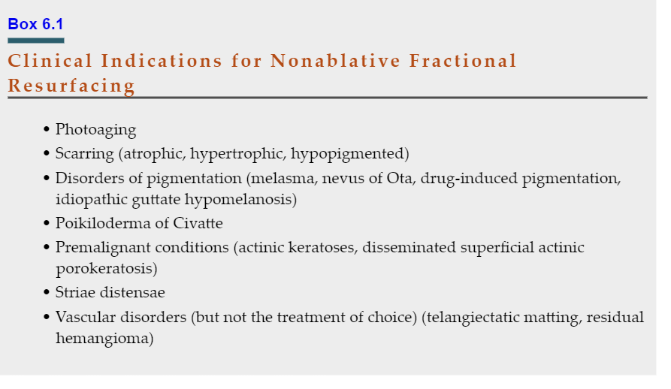

Slide 9
Photaging
Photoaging is the process by which ultraviolet radiation induces changes in the skin such as loss of elasticity, dyschromia, and rhytids. Fractional nonablative lasers provide an excellent treatment modality that can address, at least to some degree, nearly every sign of photoaging. While ablative lasers remain the gold standard for skin tightening, NAFR can provide modest improvement as demonstrated by the sentinel study of the prototype fractional 1550-nm laser in 200

Slide 10
Let’s do the Case Study Together !

Slide 11
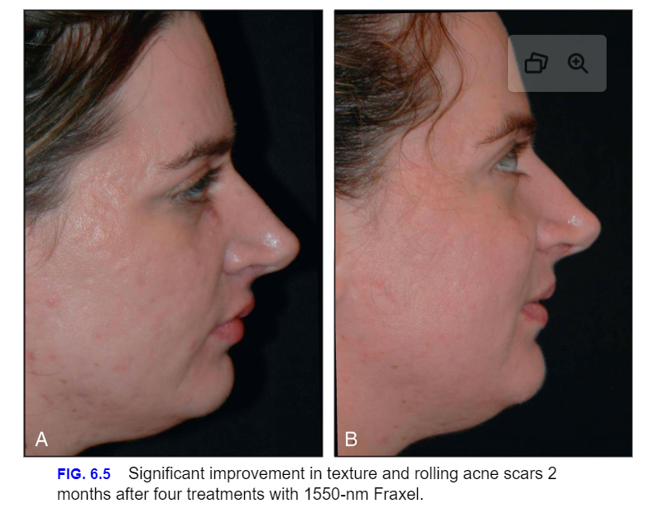
Scarring

Slide 12
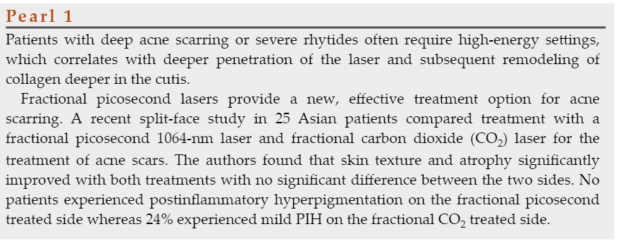

Slide 13
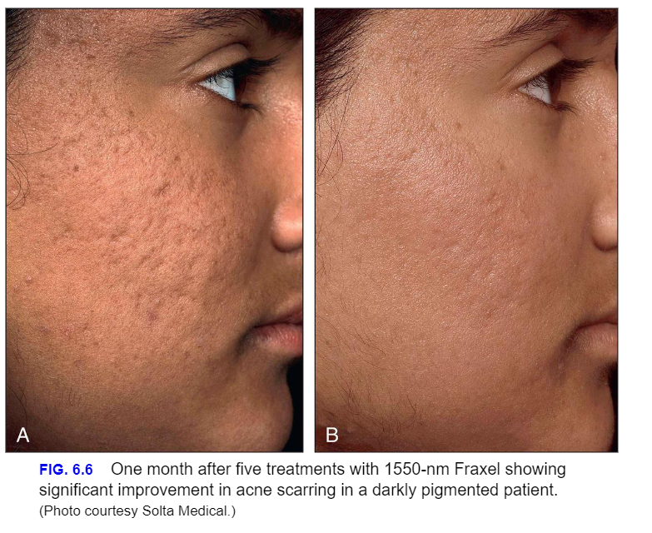

Slide 14
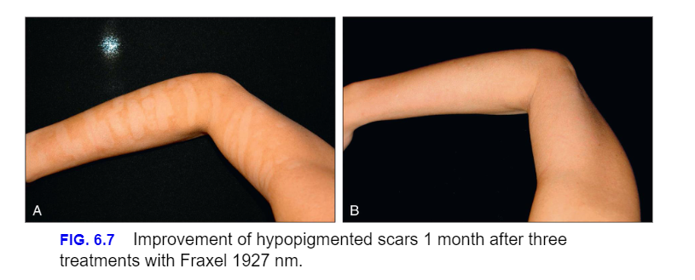
Hypopigmentation and Hyperpigmentation

Slide 15
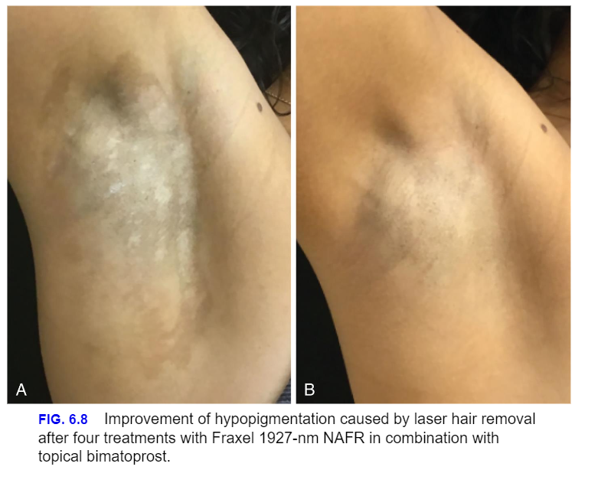

Slide 16
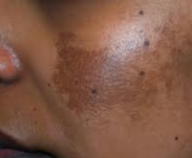
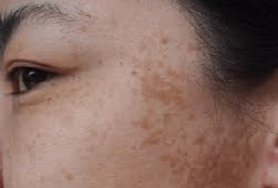
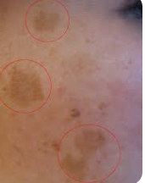
Melasma

Slide 17
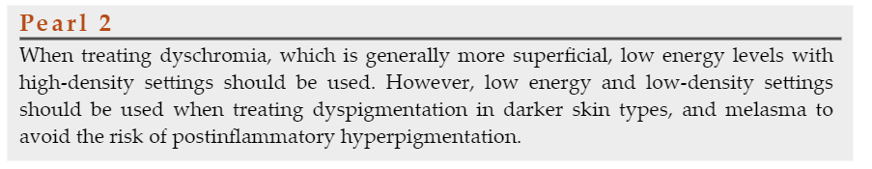

Slide 18
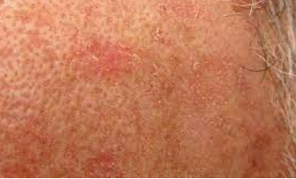
Actinic Keratoses

Slide 19
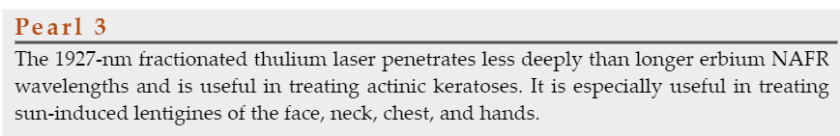

Slide 20
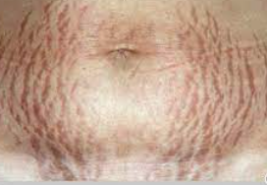
Striae

Slide 21
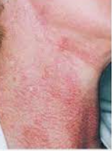
Poikiloderma of Civatte and Neck Dyspigmentation

Slide 22
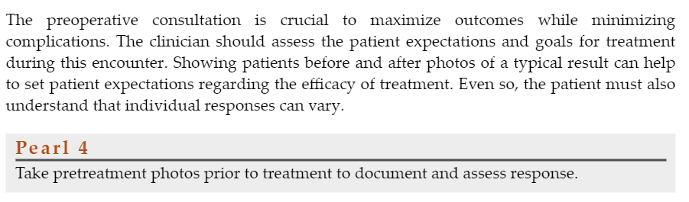
Patient Selection

Slide 23

QUESTIONS?

