Slide 1
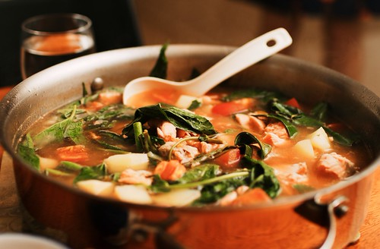
Sinigang
This Photo by Unknown Author is licensed under CC BY-SA

Slide 2
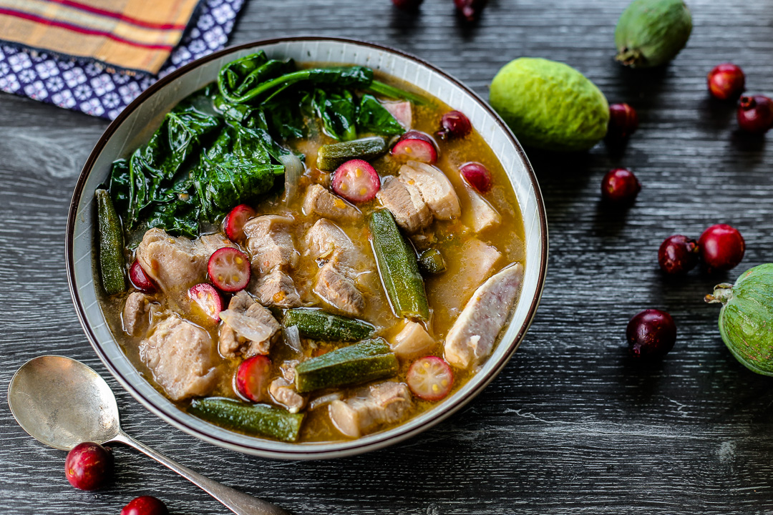
SINIGANG: The Heart of Filipino Comfort Food
A sour savory stew
Broth usually tamarind
Variety of vegetables
This Photo by Unknown Author is licensed under CC BY-NC-ND

Slide 3
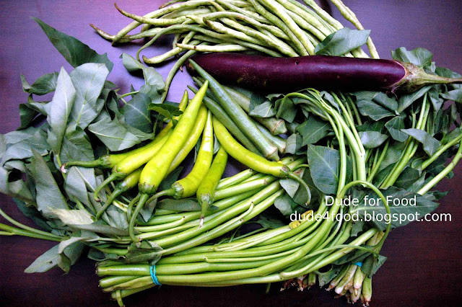

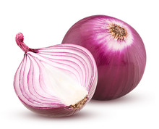

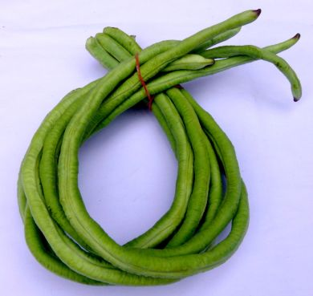

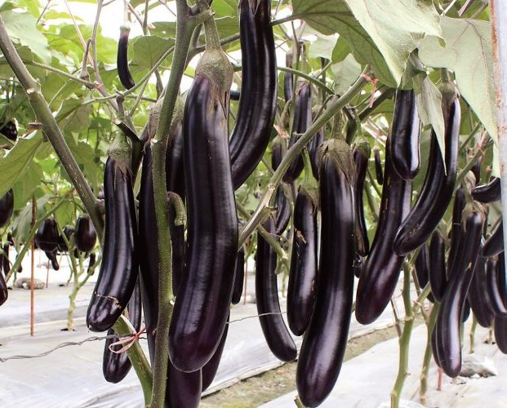
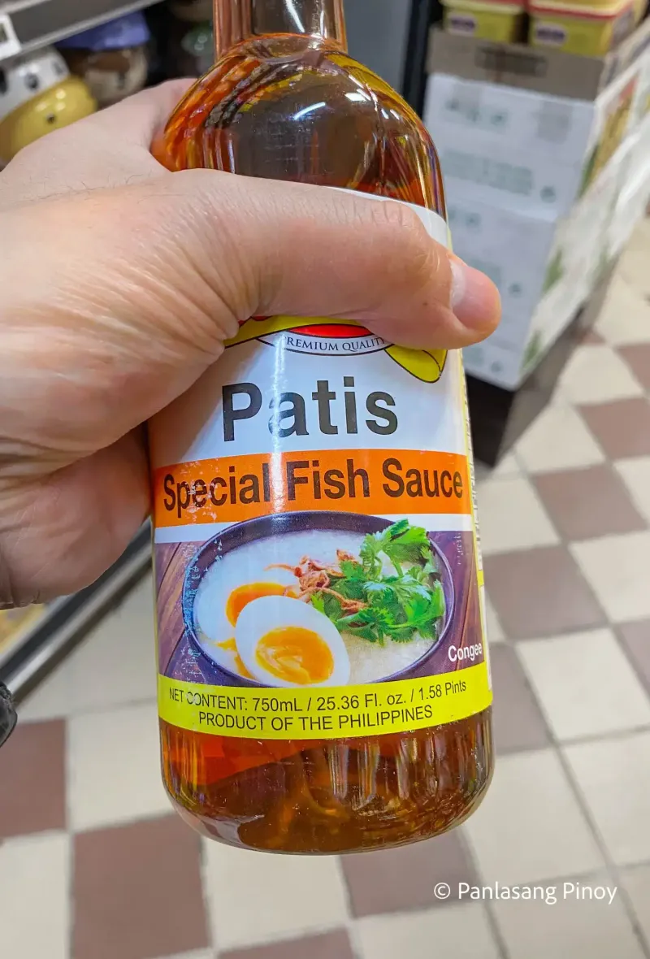

INGREDIENTS:
Pork/Shrimp/Fish
Oil
Onion
Tomato
Fish Sauce
Tamarind mix
Bok choy
Long green beans
Okra
Eggplant
Radish
This Photo by Unknown Author is licensed under CC BY-SA-NC
This Photo by Unknown Author is licensed under CC BY-ND
This Photo by Unknown Author is licensed under CC BY-NC-ND

Slide 4
Procedures on cooking:
Heat fan and add oil
Sauté onion, tomato and sear pork until brown add a little of fish sauce
Add water, if water is boiling add the sinigang mix powder. Simmer until meat is tender.
Add the vegetables except the Bok choy . Cook until vegetable's are cook and add the rest of the vegetables until cook and taste
Add more tamarind according to your preference on how sour your stew would be
Turn off stove and serve your sour savory soup.

Slide 5
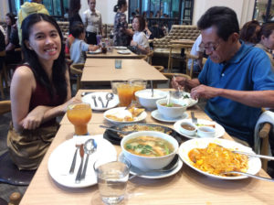
Enjoy.!
This Photo by Unknown Author is licensed under CC BY-NC-ND

