Slide 1


Material Safety Data Sheets (MSDS)

Slide 2

Considering all of the types of chemical used daily in the salon, spa, and barbershop, along with all of their potential actions and reactions, practicing chemical safety should be of primary concerns. From transporting to disposing of chemicals, you must be aware of the risk involving and the processes needed to ensure safety.
Practice chemical
safety

Slide 3
Manufacturing od chemicals that are registered with either the EPA or FDA are held to strict standers for their labels.
Labels

Slide 4
Transportation
It is important to pay attention to the labels, some may list warnings that will affect how you transport then
Examples: Do not storage at temperature above 78 degrees Fahrenheit or Avoid direct sun exposure.

Slide 5
Storage
The storage of chemical sin the salon, spa, or shop is also an area where safety and strict process be followed to prevent injury and fire.

Slide 6
Mixing
Mixing chemicals can created dangerous gases, such as chlorine, nitrogen trichoride, chloramine vapor, and hydrazine. Because these gases can be life threatening, processes concerning the mixing of chemicals should be clear to everyone who works in the salon.

Slide 7

Disposal
Many of the chemicals that go down the sink drain every day in a salon, spa, or barbershop are dangerous to the environment and create burdens on our wastewater system. Unfortunately, although many products have instruction for disposal on the container, few address disposal of the chemicals itself.

Slide 8
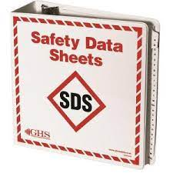
Interpret safety data sheets
These sheets provide valuable safety information about chemicals.
These sheets are used for emergencies.

Slide 9
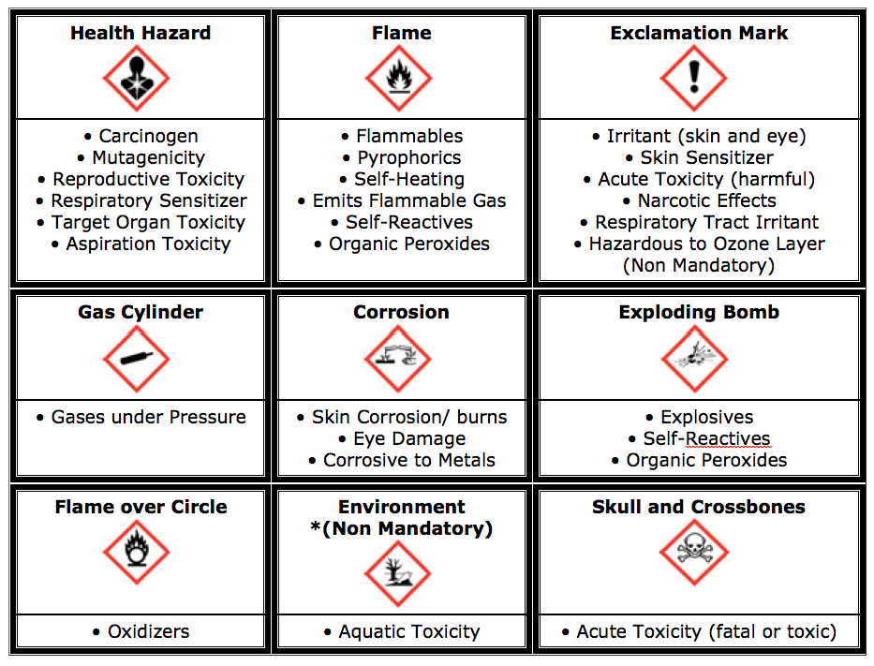

Slide 10
Practice chemical safety.
The storage of chemicals in the salon, spa, and barbershop is important. If safety and strict processes are not followed, injury or even fire can occur. Ensuring that all employees know how to properly store chemicals is imperative to preventing accidents. In this activity, you will create a poster designed to hang in a salon, spa, or barbershop, alerting workers of proper storage procedures.

Slide 11

QUESTIONS?

