Slide 1


The Rullan Two-Day Croton Oil–Phenol Chemabrasion Peel

Slide 2
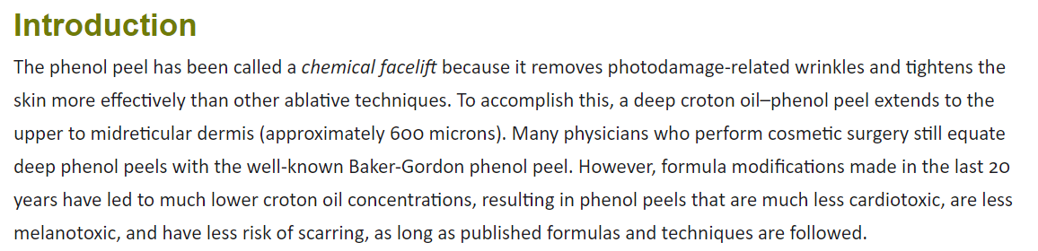

Slide 3
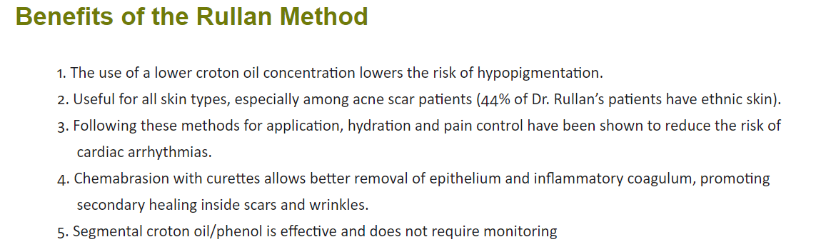

Slide 4
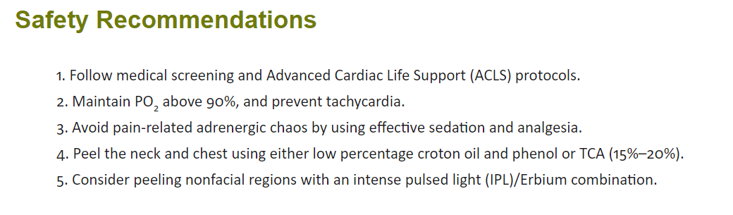

Slide 5
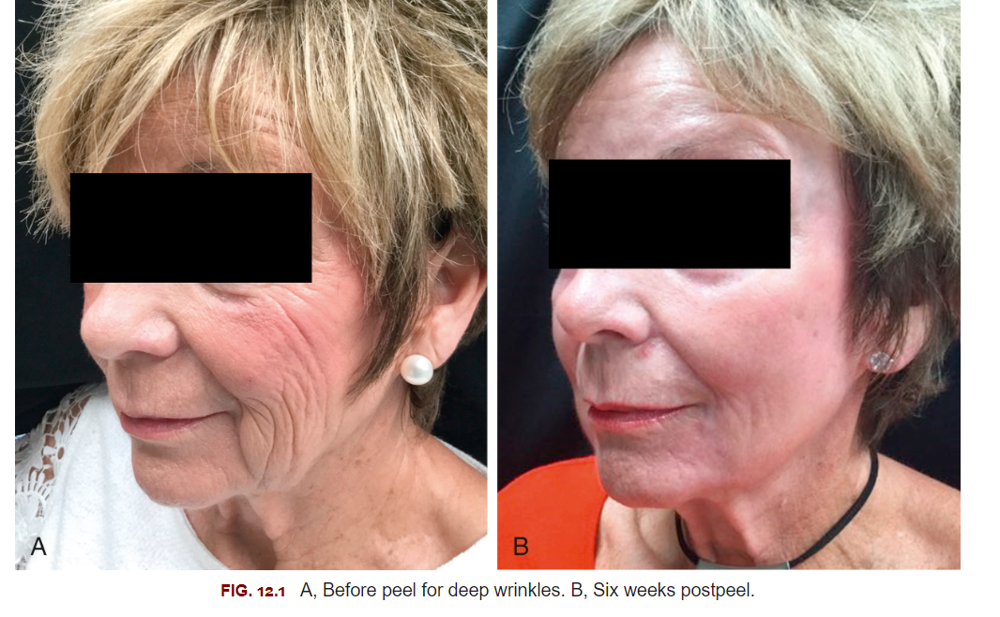
Patient Selection and Preoperative
Protocol

Slide 6
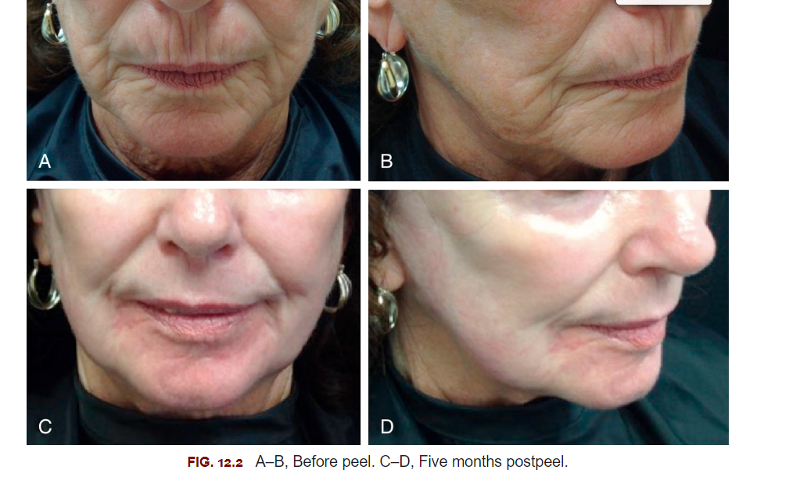

Slide 7
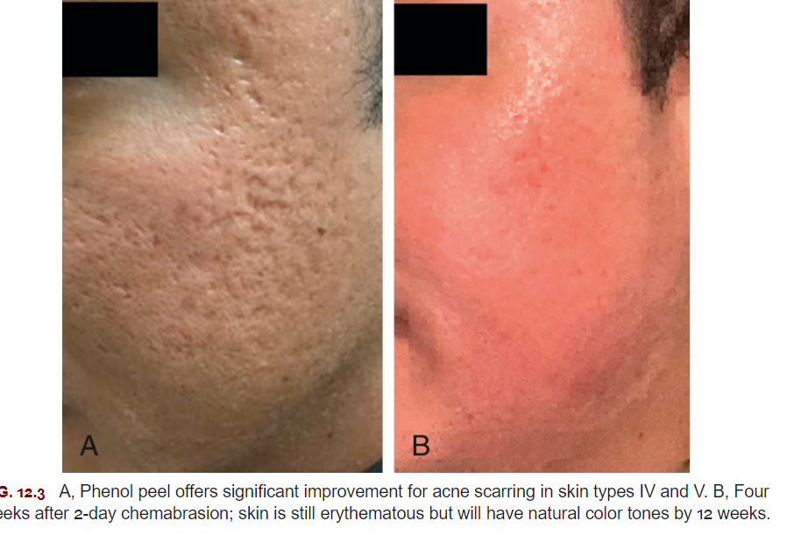

Slide 8
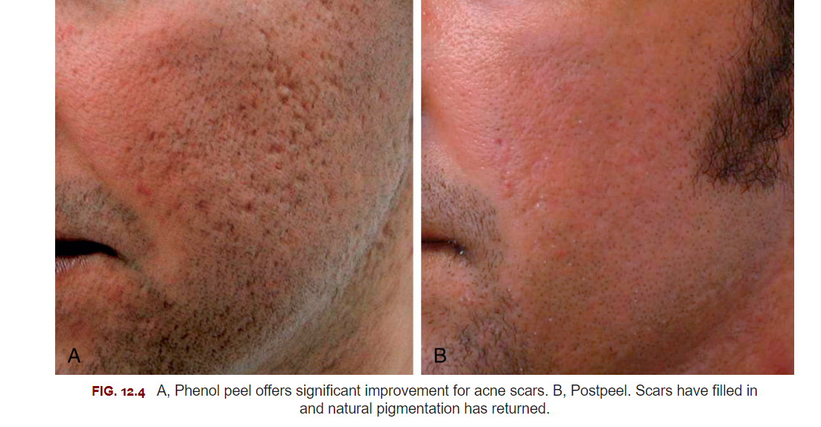

Slide 9
Protocols
Skin Prep
Instructions for anesthetcia and application
Post procedure

Slide 10
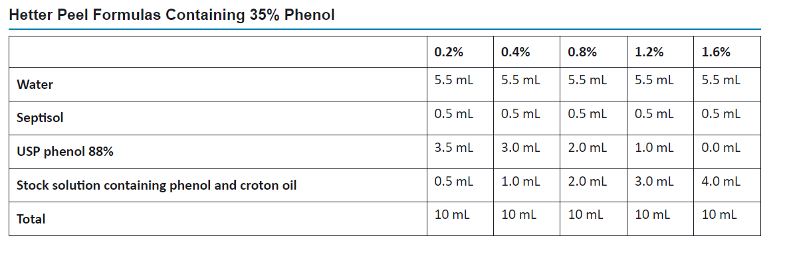

Slide 11
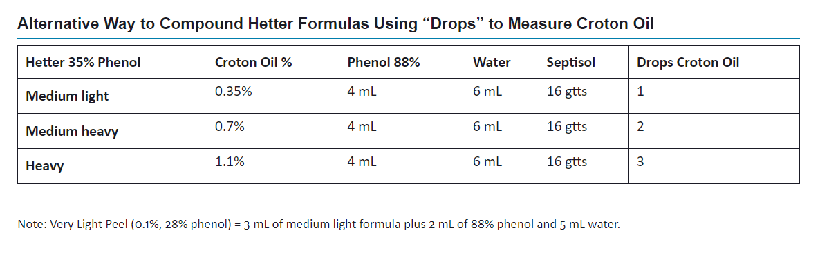

Slide 12
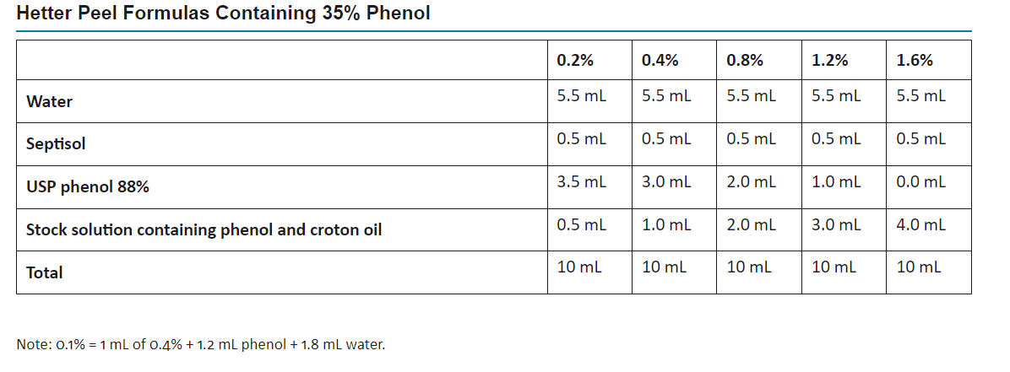
Croton Oil-Phenol Peel Formulas

Slide 13
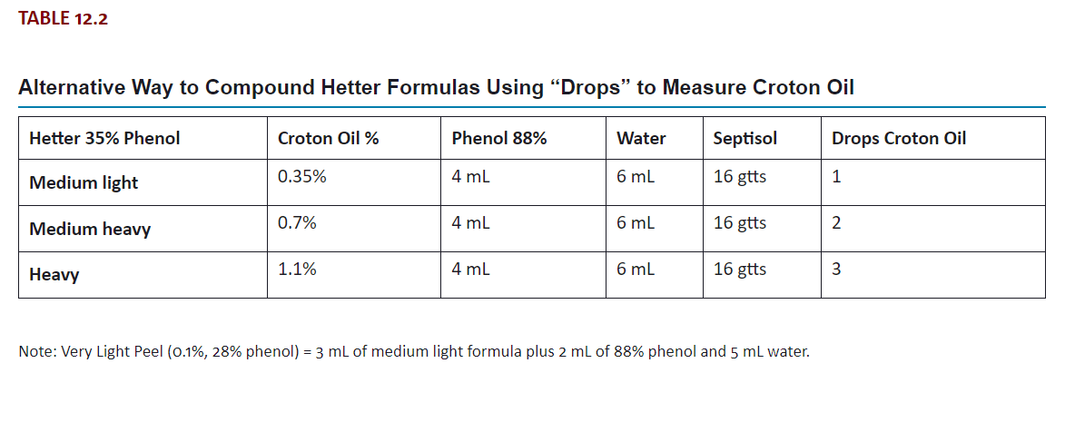

Slide 14
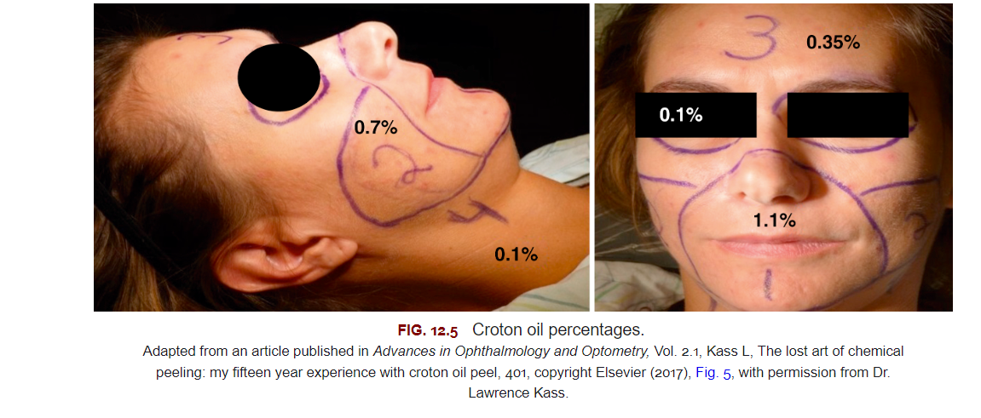
Dr. Rullan’s Two-Day Croton Oil-Phenol Chemabrasion Technique
Day 1

Slide 15
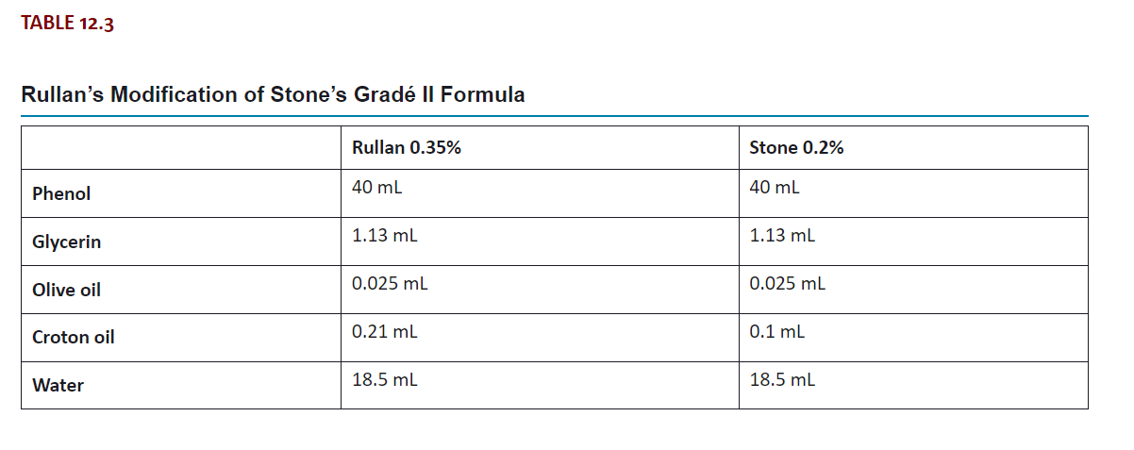

Slide 16
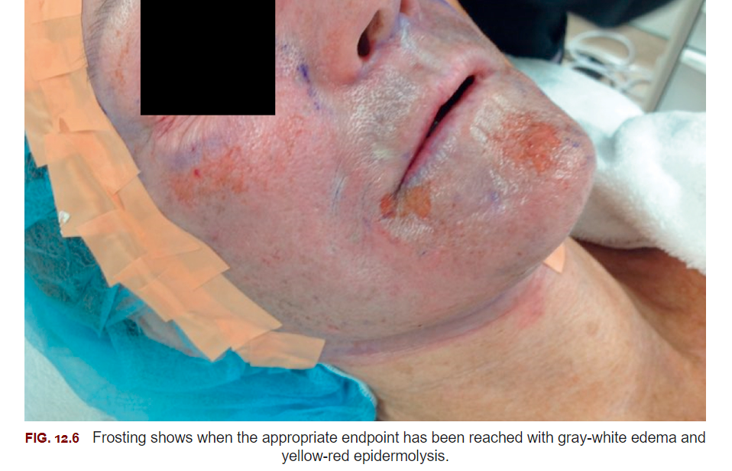
Day 2

Slide 17
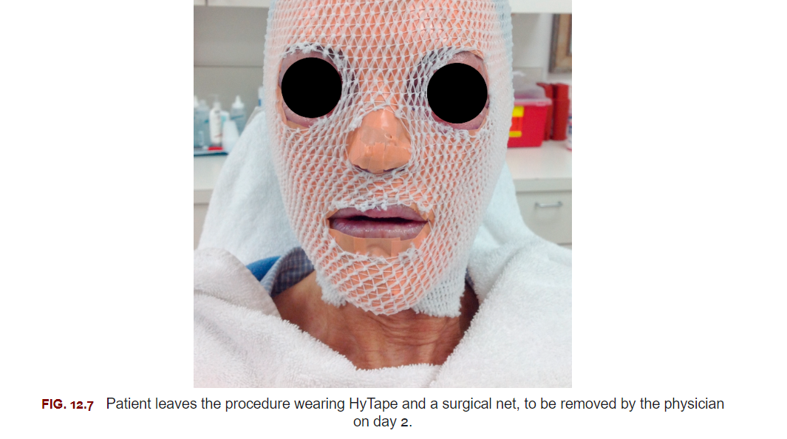

Slide 18
-Days 3-8
-Days 8-30 and Beyond
-Touchups
-Postoperative Skin Care

Slide 19
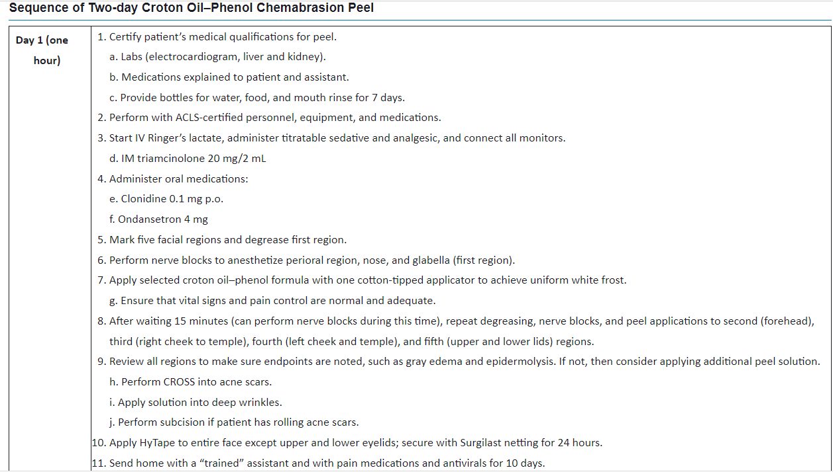

Slide 20
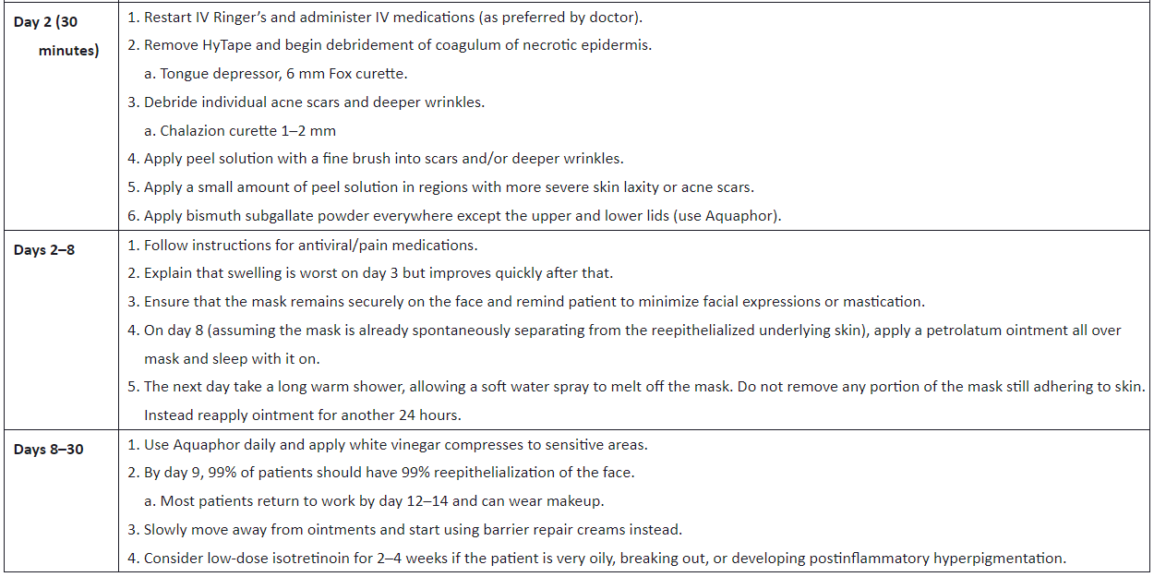

Slide 21
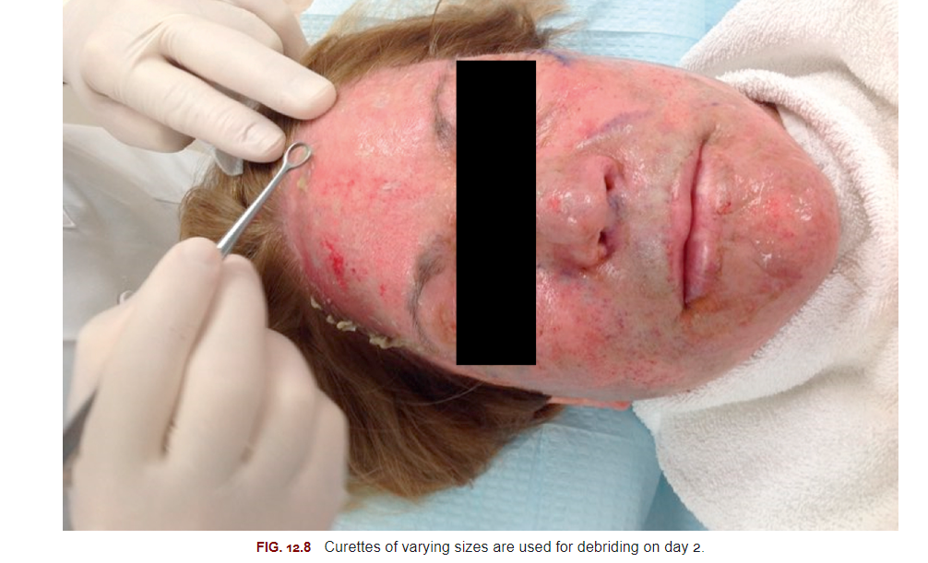

Slide 22
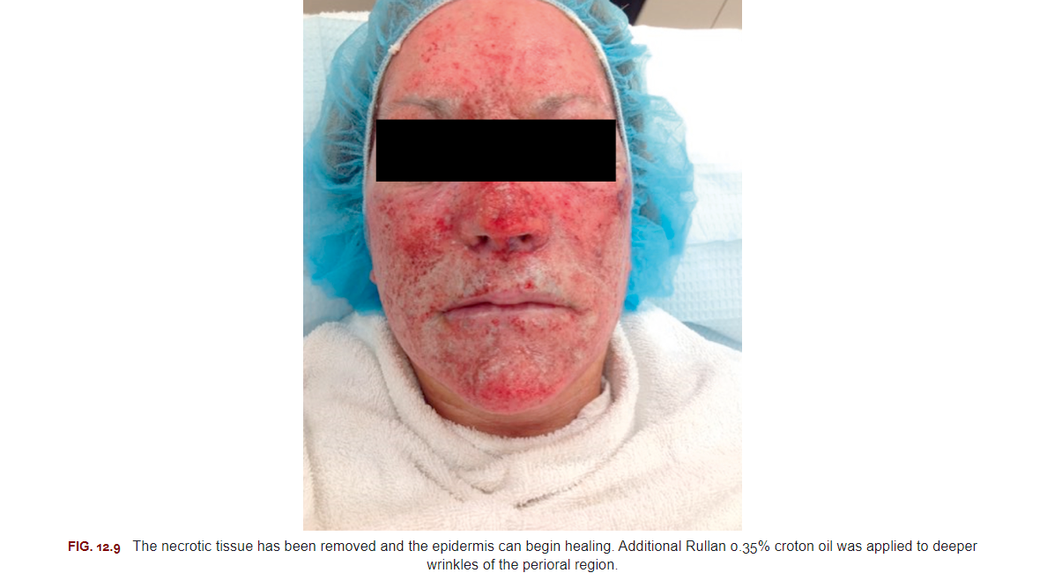

Slide 23
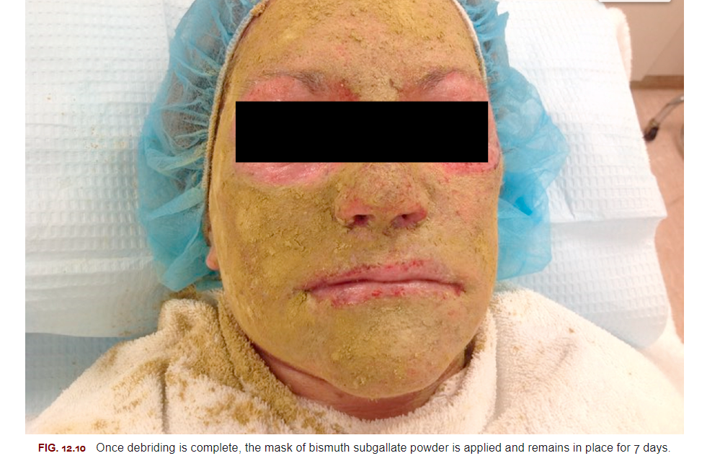

Slide 24
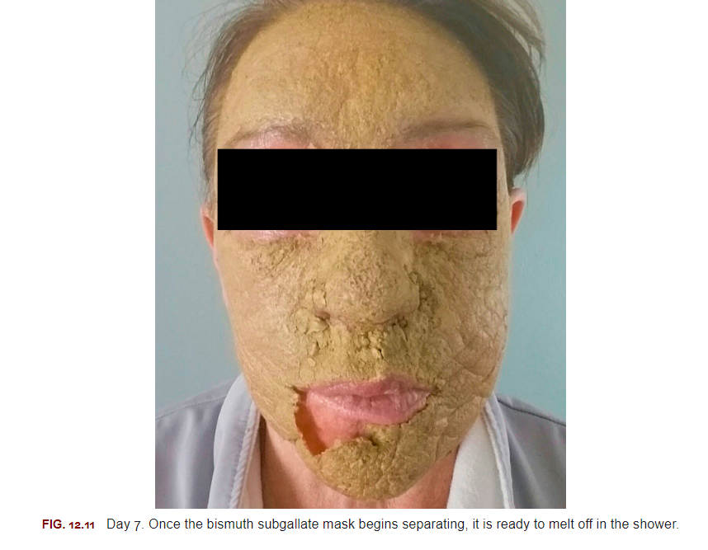

Slide 25
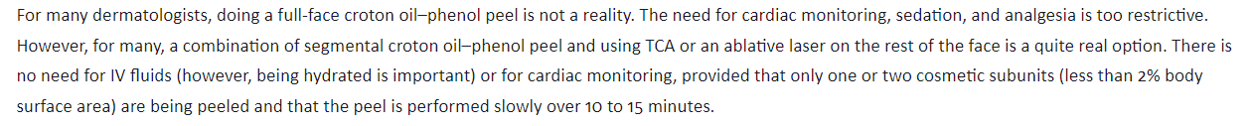

Slide 26

Herpes simplex virus (HSV)
Bacterial or yeast infection
Prolonged erythema
Contact dermatitis
Scarring
PIH
Hypopigmentation

Slide 27
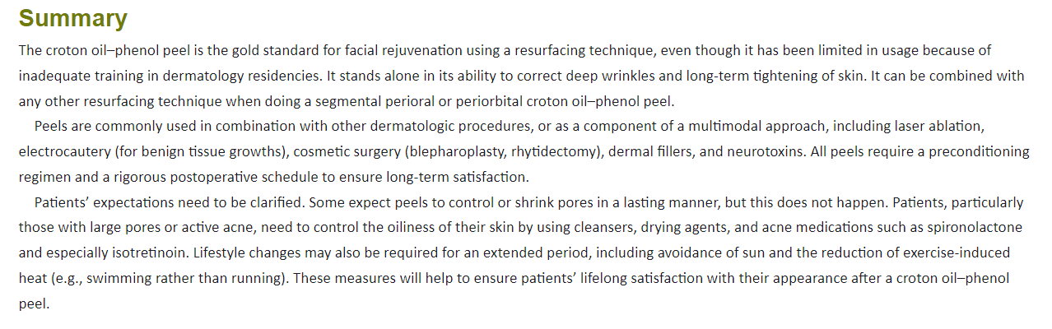

Slide 28
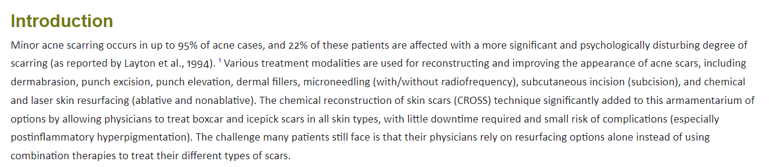
New Advances Combining the Chemical Reconstruction of Skin Scars (CROSS) and Subcision

Slide 29
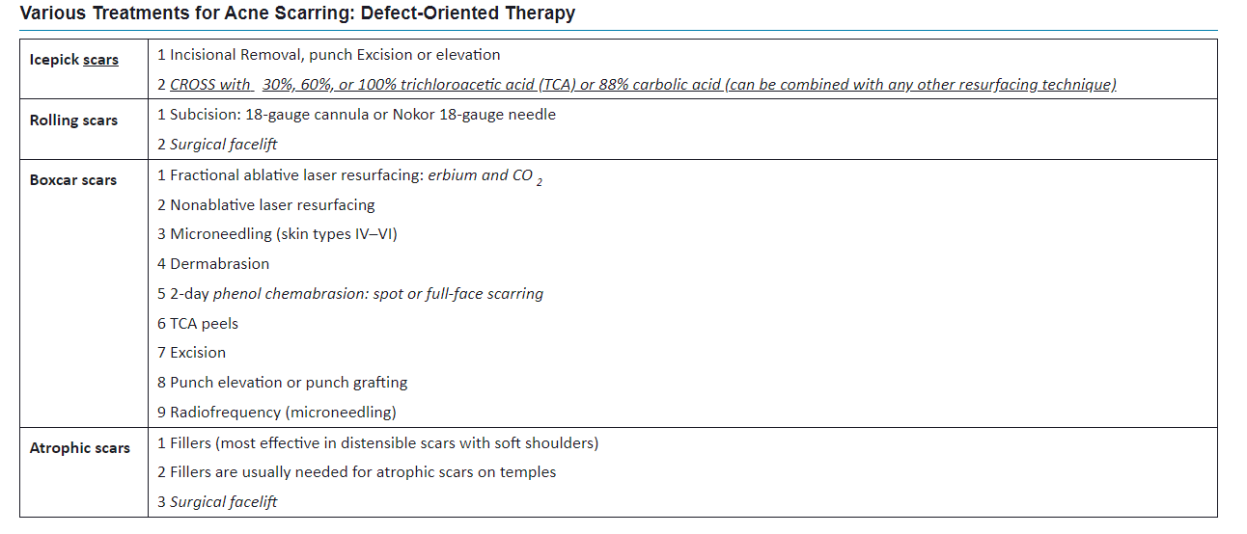
Triple Combination of Carbolic Cross, Cannula Subcision, and Microneedling

Slide 30
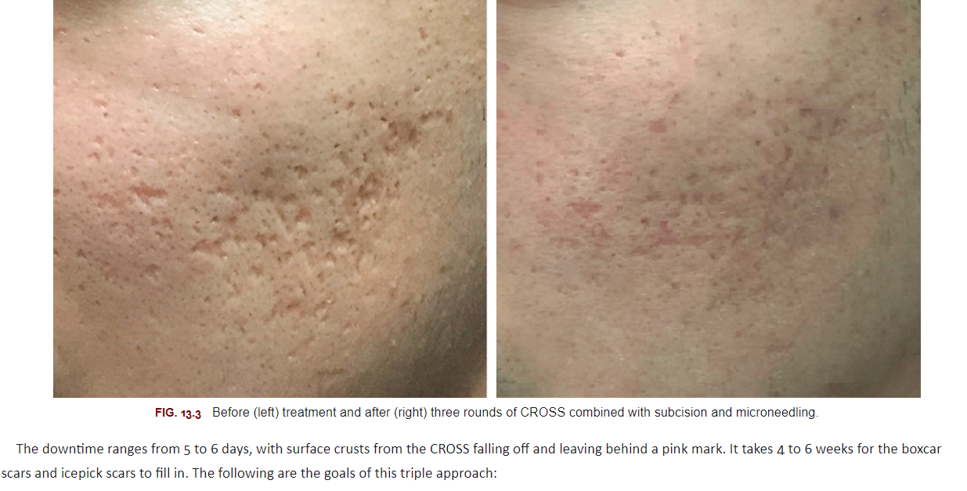

Slide 31
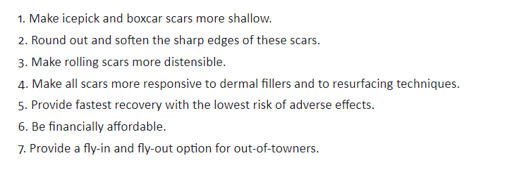

Slide 32
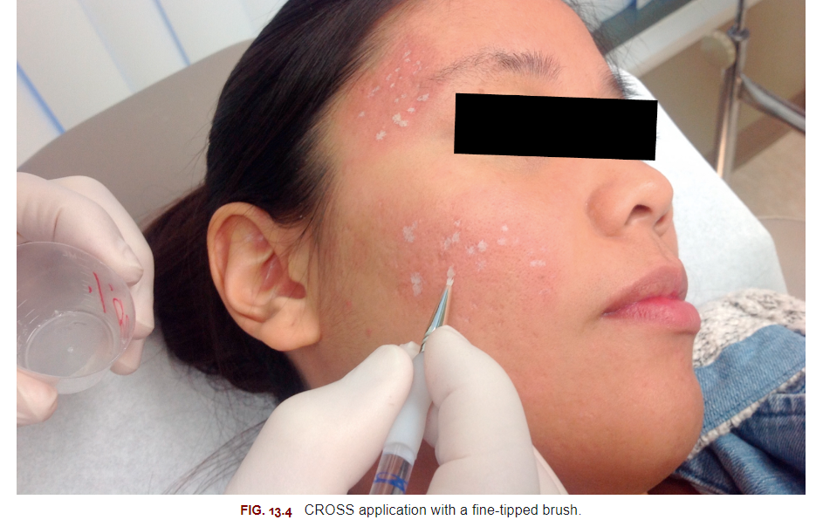

Slide 33
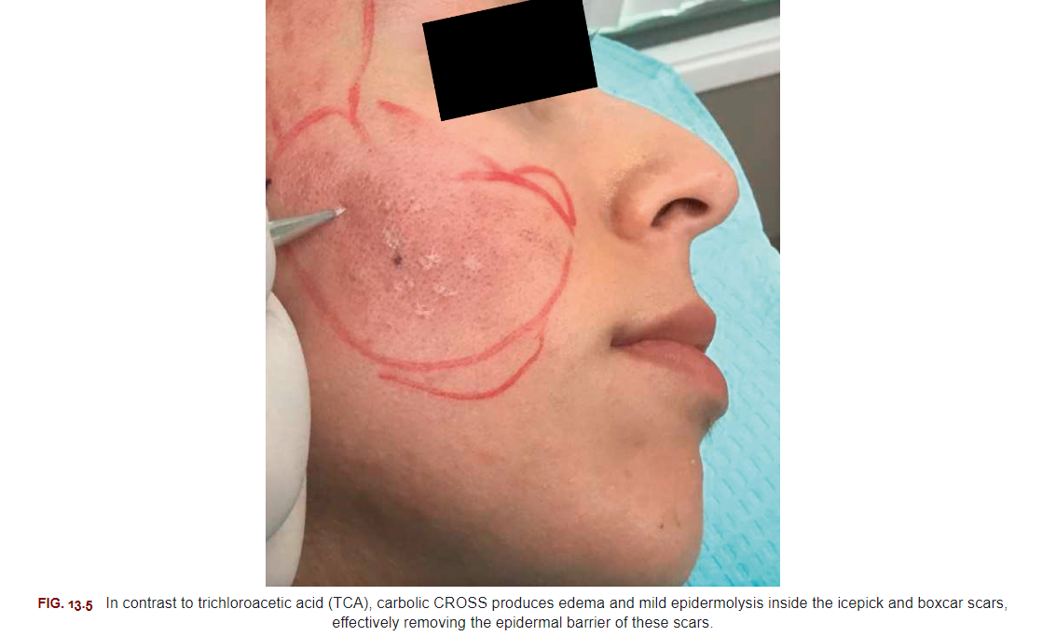

Slide 34
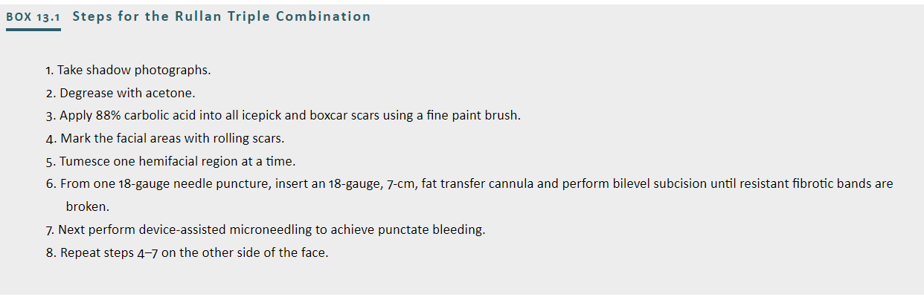

Slide 35

QUESTIONS?

