Slide 1
MRAD 204:
Radiographic Technique 1
Outcome 6-10:
Positioning – Pelvis & Hip

Slide 2
Affiliated Readings
Module Reading
Bontrager
Pgs: 281, 283→286
Pgs: 288→290

Slide 3
Overview
Guidelines/Considerations
Protocols
Positioning

Slide 4
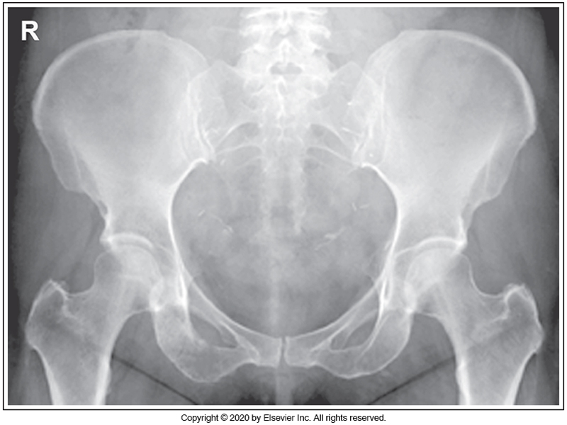
Guidelines/Considerations - Pelvis
Identify required anatomy
R
Pelvic radiographs require the entire pelvis AND both trochanters of the proximal femurs
McQuillen Martensen 5th Ed. Pg.430 Fig. 7.4

Slide 5
Guidelines/Considerations - Pelvis
2. Select appropriate equipment/technical factors
*Using the smallest field size possible, collimation
110cm SID, measured electronically using détentes (i.e. blue lock must be engaged)
On the console, select:
  “Table IR”
  AP Pelvis
Pelvis technique = 80→90 kVp

Slide 6
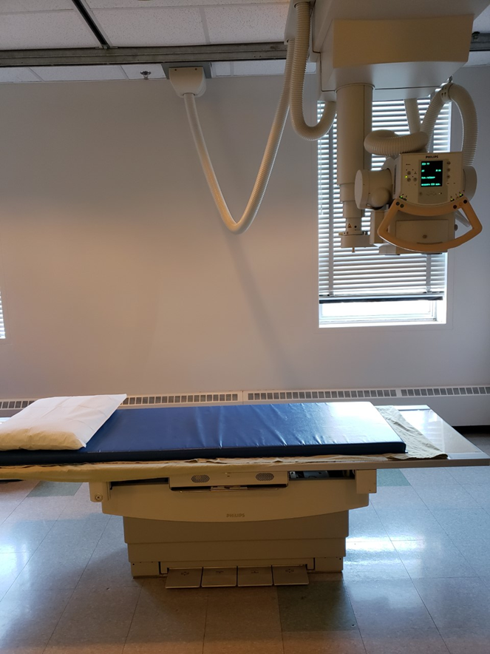
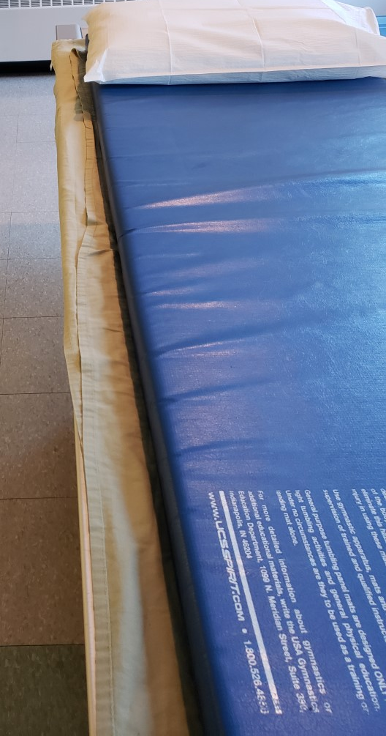
Guidelines/Considerations - Pelvis
For table imaging: All locks must be on
Setup room before bringing the patient in
Tube and IR aligned @ 110cm SID
  Lock(s): centers tube to IR laterally/medially
  Laser light: centers tube to IR superiorly/inferiorly
Correct anatomical marker selected
Patient drape/sheet cover ready for use
Ensure IR is covered completely prior to patient mount/dismount
*Locks engaged

Slide 7
Guidelines/Considerations - Pelvis
3. Artifact Removal
Any clothing or objects between the waist to the knees
  Marker placed under soft-tissue anatomy shadow
Notes: when the patient is in the room:
Use external landmarks when positioning
  *Bilateral ASIS must be palpated, to ensure:
    No patient tilt (i.e. midsagittal plane parallel to lateral edge of IR)
    No patient rotation (i.e. midcoronal plane parallel to anterior surface of IR)
Never rotate a leg medially, if you suspect a fracture!

Slide 8
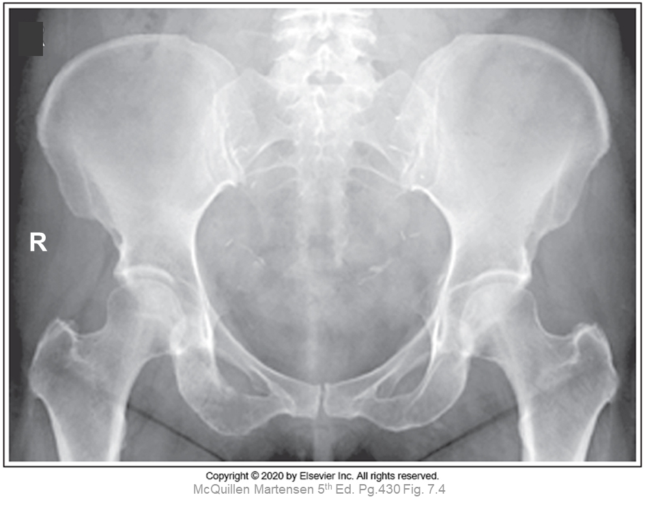
Guidelines/Considerations - Pelvis
For AP Pelvis Projections:
Make note of the relationship between these topographic landmarks:
Top of Crest
ASIS
Inferior edge of greater trochanter

Slide 9
Pelvis Protocol
Routine:
AP
Non-Routine/Special Request:
AP Axial Inlet & Outlet
AP Oblique’s (for acetabulum) – aka. Judet

Slide 10
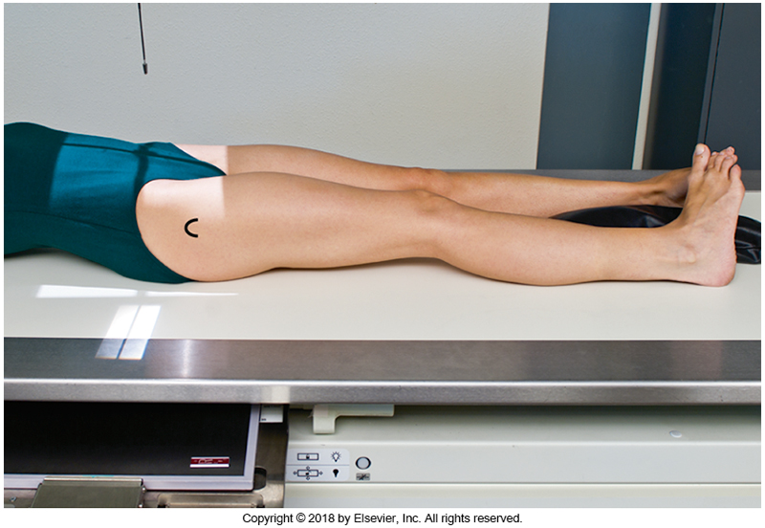
Positioning – AP Pelvis
Note: Check for Diverging rays! Light-fields on patient’s are smaller than they appear radiographically.
Ensure the patient is lying straight on the table (hips & shoulders parallel to long edge of table)
Use patient draping/sheet cover
ASIS’s should be level
Center anatomy in light-field
Lower limbs must be rotated 15-20º unless contraindicated
Place an anatomical marker (using Anderson Marker Rules), and make final adjustments
Bontrager pg. 281 (inset) Fig. 7.44
Note: suspend respiration

Slide 11
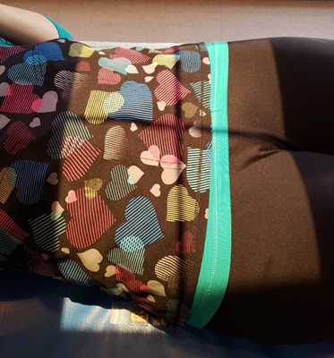
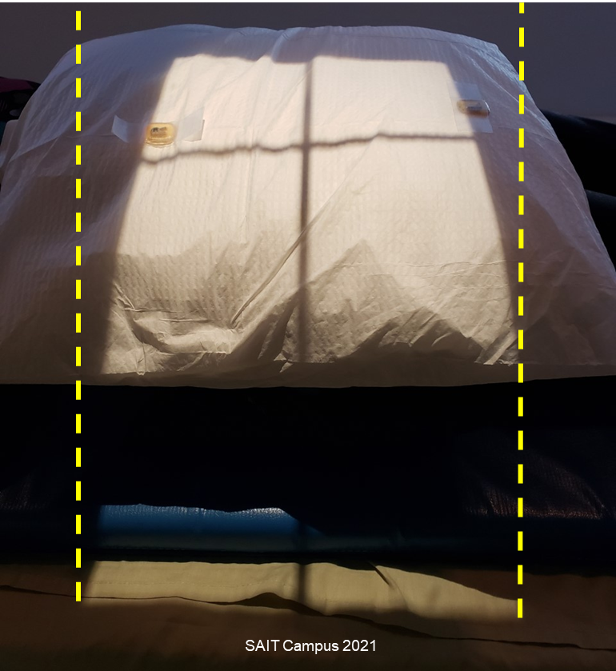
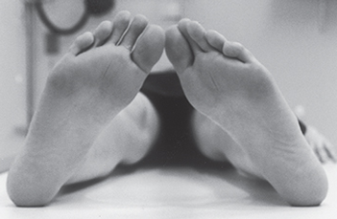
Positioning – AP Pelvis: Supine
Note: Check for Diverging rays!
Light-fields on patient’s are smaller than they appear radiographically.
CR located around ASIS
Lower Limbs internally rotated 15-20⁰
“Top” of light-field on IR
½ inch above top of crests
“Bottom” of light field on the IR 1-inch below inferior edge of greater trochanters
Lengthwise crosshair over MSP
(aka. ½ between the ASIS’s)
Marker between ASIS & greater trochanter laterally

Slide 12
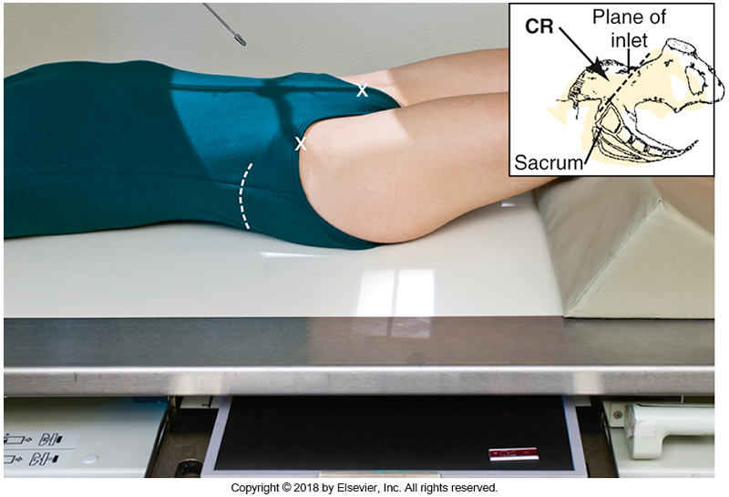
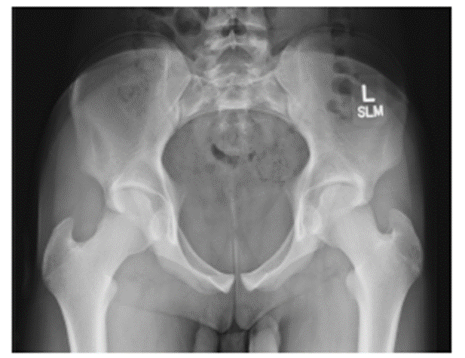
Non-Routine: AP Axial Inlet
CR parallel to body of pubis
Bontrager pg. 284 Fig. 7.52 & 7.53
Angle CR 40° degrees caudad
Center around level of ASIS
Ischial spines demonstrated

Slide 13
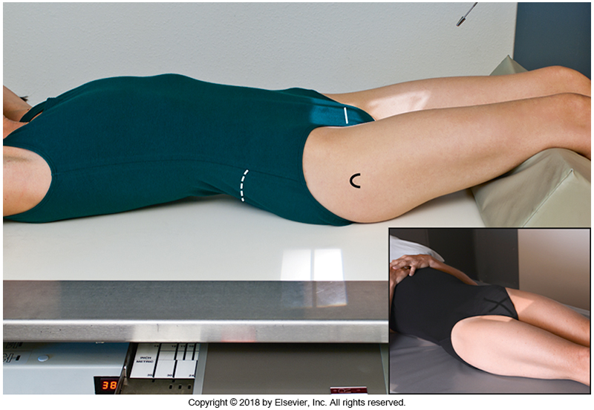
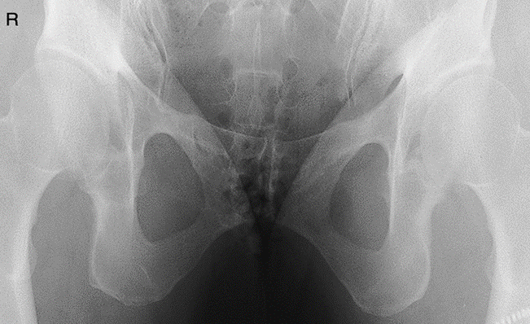
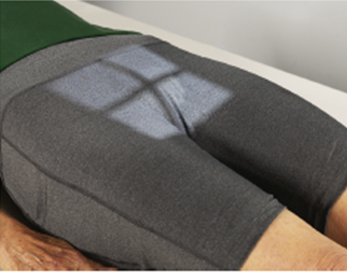
Non-Routine: AP Axial Outlet
CR perpendicular to body of pubis
Pubic & Ischial bones demonstrated
Bontrager pg. 283 Fig. 7.49 & 7.50 & Bontrager 9th Ed pg. 281 Fig. 7.50
Angle CR ~35° degrees cephalad
  *CR cephalad 20→35⁰ = males & 30→45⁰ = females
Center ~1→2inches distal to symphsis pubis

Slide 14
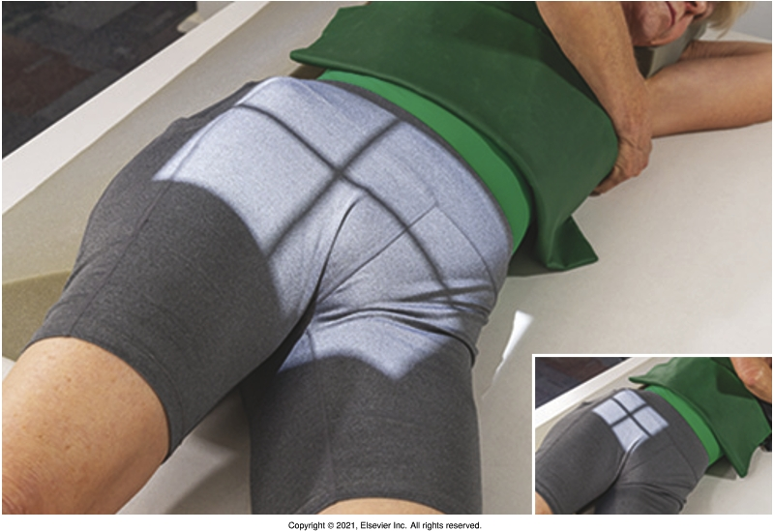
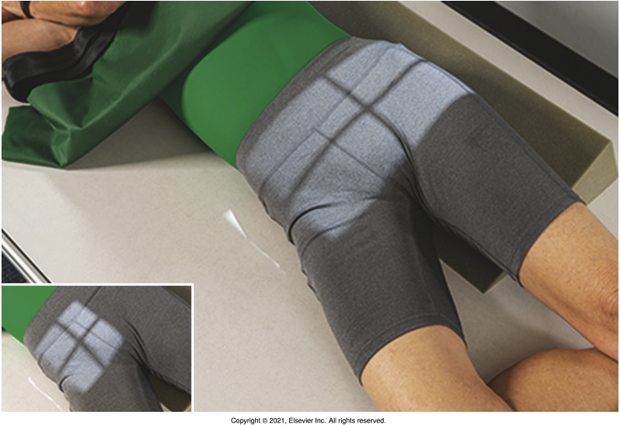
Non-Routine: AP Oblique's (45º post. Obl. Judet views)
Bontrager pg. 285 Fig. 7.55 & 7.56
Taken to visualize acetabular rims
RPO and LPO always done together
  i.e. 2 views of each side

Slide 15

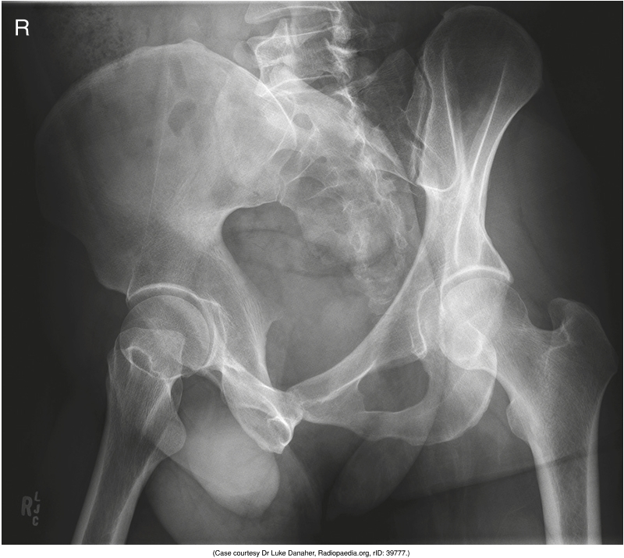
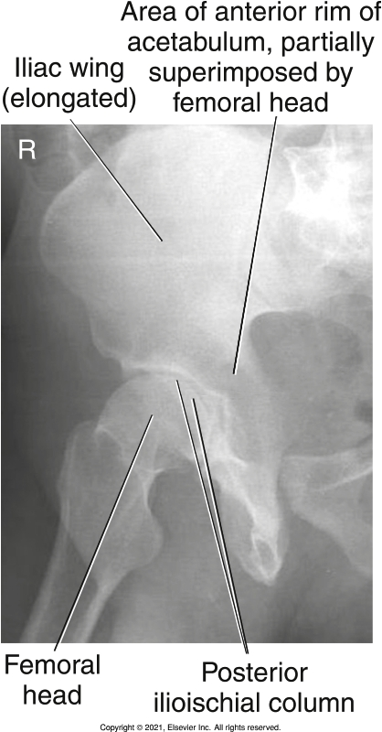
Positioning – RPO (“Right” Downside Acetabulum)
Aka. External Oblique
Bontrager pg. 285-286 Fig. 7.55, 7.58 & 7.62
Demonstrates:
anterior rim
Posterior (ilioischial) column
Illiac wing (or ala)

Slide 16
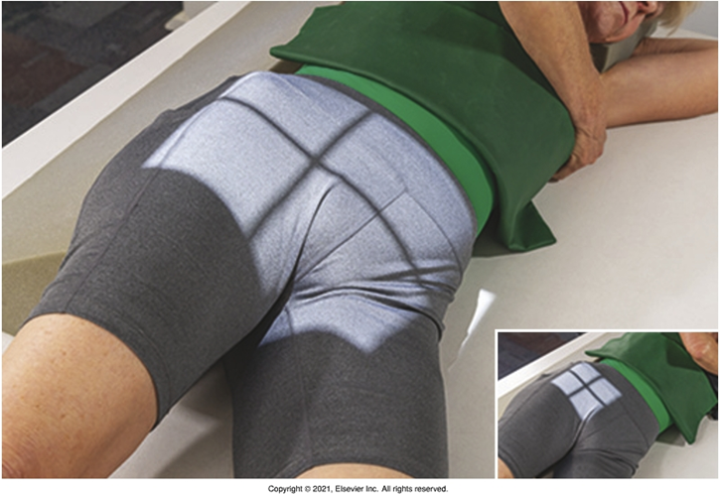
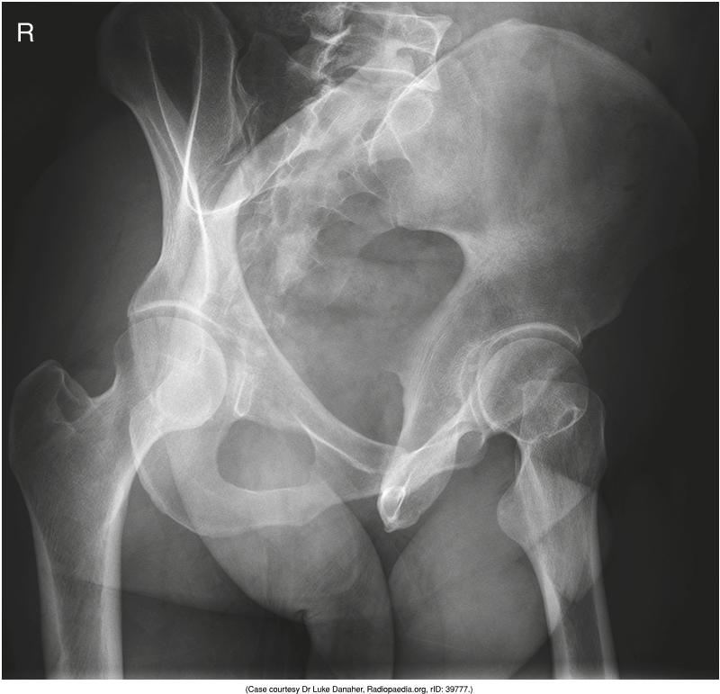
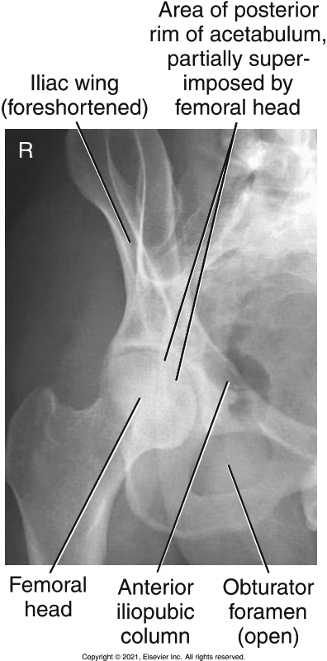
Positioning – LPO (“Right” Upside Acetabulum)
Aka. Internal Oblique
Bontrager pg. 285-286 Fig. 7.56, 7.60 & 7.61
Demonstrates:
posterior rim
Anterior (ilioipubic) column
Obturator foramen

Slide 17
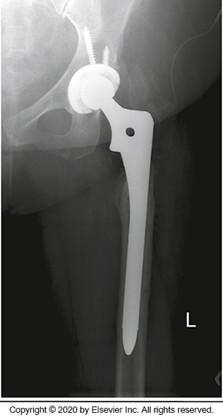
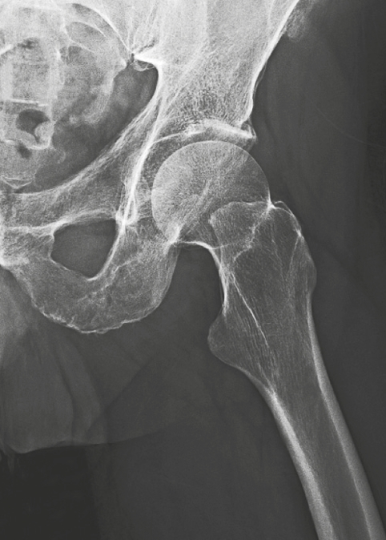
Guidelines/Considerations - Hip
Identify required anatomy
*Note: if present, entire ORIF must be included (i.e. field size will need to be extended for patients with long hip pins)
R
L
McQuillen Martensen 5th Ed. Pg.440 Fig. 7.34
Bontrager pg. 290 Fig. 7.73
AP Hip radiographs require 1/3rd of proximal femur, symphysis pubis & body of the ilium
Lateral Hip radiographs require 1/3rd of proximal femur, and surrounding pubis, ischium & ilium

Slide 18
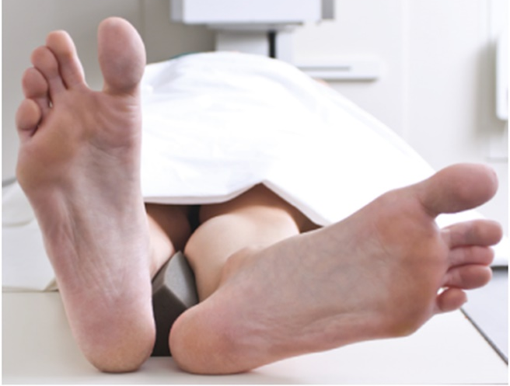
Guidelines/Considerations - Hip
2 & 3. Same as Pelvis except:
Hip technique = 80→85 kVp
*Axiolateral’s = 80→95kVp
Remember:
Never rotate a leg medially, if you suspect a fracture!
Bontrager pg. 274 Fig. 7.31

Slide 19
Protocol - Hip
Routine:
AP
Lateral (Lauenstein-Hickey Method) *Note 2: Bontrager pg. 290
Non-Routine:
Frog-leg (Modified Cleaves Method)
Adaptive Projections:
Axiolateral inferosuperior/x-table (Danelius-Miller)
Modified Axiolateral (Clements-Nakayama)

Slide 20
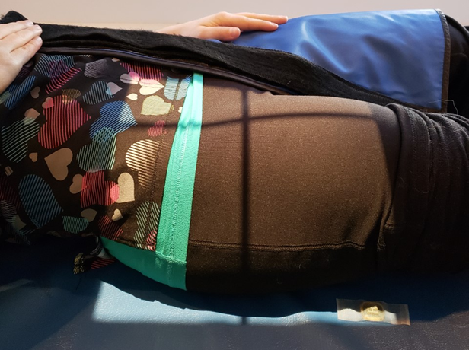
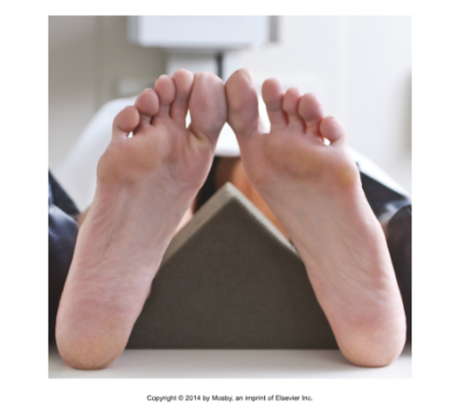
Positioning – AP Hip
Note: suspend respiration
Bontrager pg. 274 Fig. 7.27 & SAIT Campus 2021
Apply patient draping
Ensure affected leg is parallel to long edge of table
ASIS’s should be level (*i.e. ensure no patient tilt or rotation)
Leg rotated 15-20º medially unless contraindicated
Place an anatomical marker (using Anderson Marker Rules), and make final adjustments

Slide 21
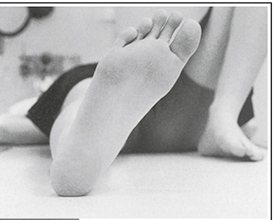
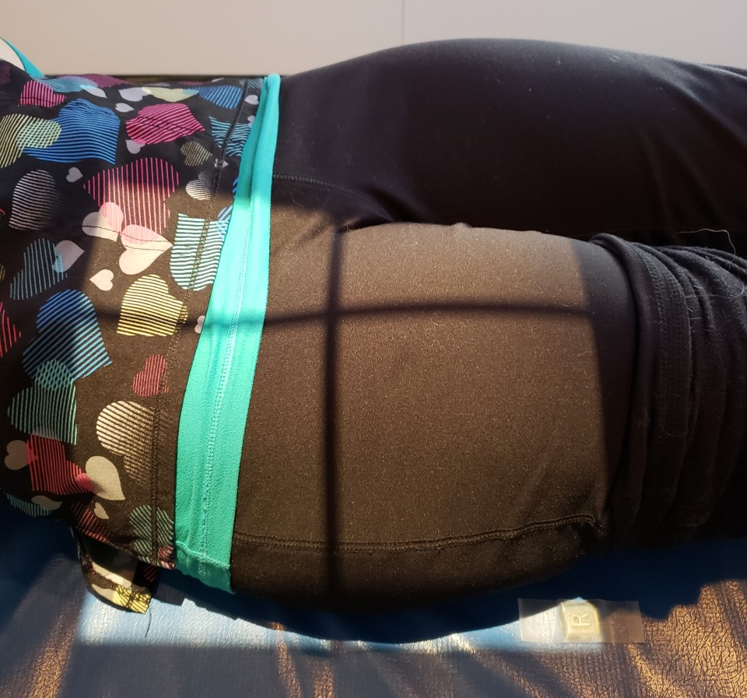
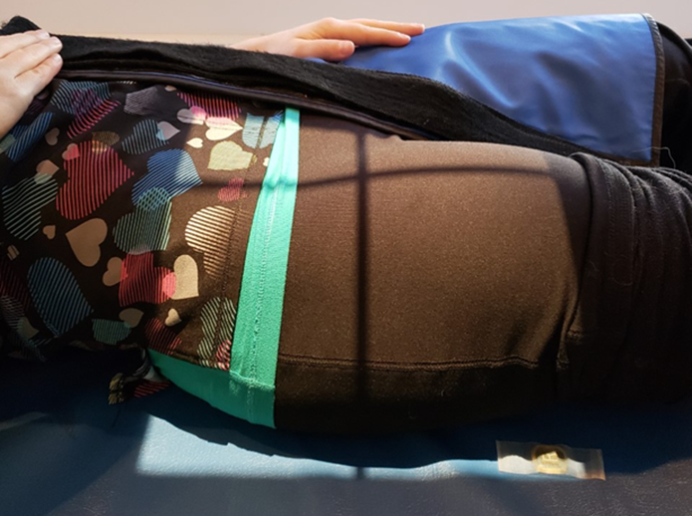
Positioning – AP Hip
Lengthwise crosshair around middle of knee
Medial edge of light-field @ symphysis
Lower Limb internally rotated 15-20⁰
CR should be located around femoral neck
Marker on inferior-lateral corner
“Top” of light-field on patient at ASIS
“Bottom” of light-field around 1/3rd of proximal femur
McQuillen Martensen 5th Ed. pg. 438Fig. 7.26

Slide 22
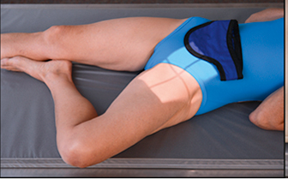

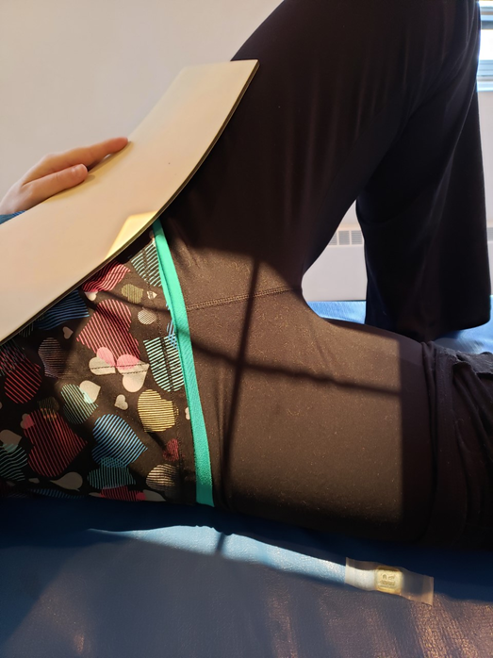
Positioning – Lateral Hip (Lauenstein-Hickey)
Ensure patient is “straight”
on the table
Ask patient to move to the
edge of the table (away from
side of interest)
Roll patient towards affected
side, and place a 45º
sponge under their hips &
shoulders
Note: suspend respiration
Flexing the knee & abducting the femur until it is “flat” against the table top ensures the proximal femur will be parallel to the IR
Flex the knee
Twist collimator head until light-field is parallel to length of
femur
Float table to center the crosshairs over the femoral neck
Place an anatomical marker (using Anderson Marker Rules), and make final adjustments
Bontrager 9th Ed. pg. 287 Fig. 7.71

Slide 23
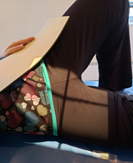
Positioning – Lateral Hip (Lauenstein-Hickey)
Lengthwise crosshair around middle of knee
“Top” of light field around upside ASIS
“Bottom” of light field around 1/3rd of proximal femur
Twist collimator to match angle of femur
Marker on inferior-lateral corner
CR should be located around femoral neck
Collimate side-side to width of bony anatomy of the knee
Bontrager 9th Ed. pg. 287 Fig. 7.71

Slide 24
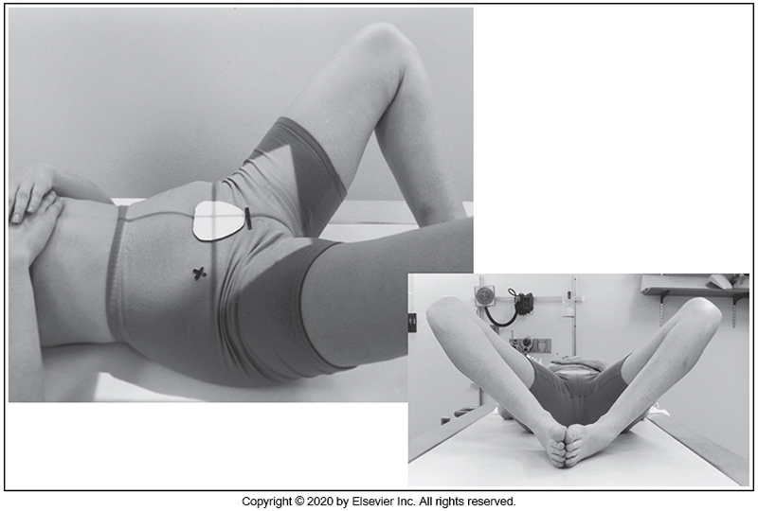
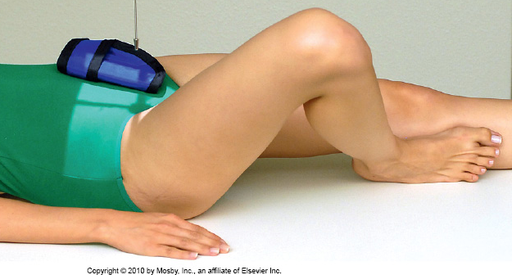
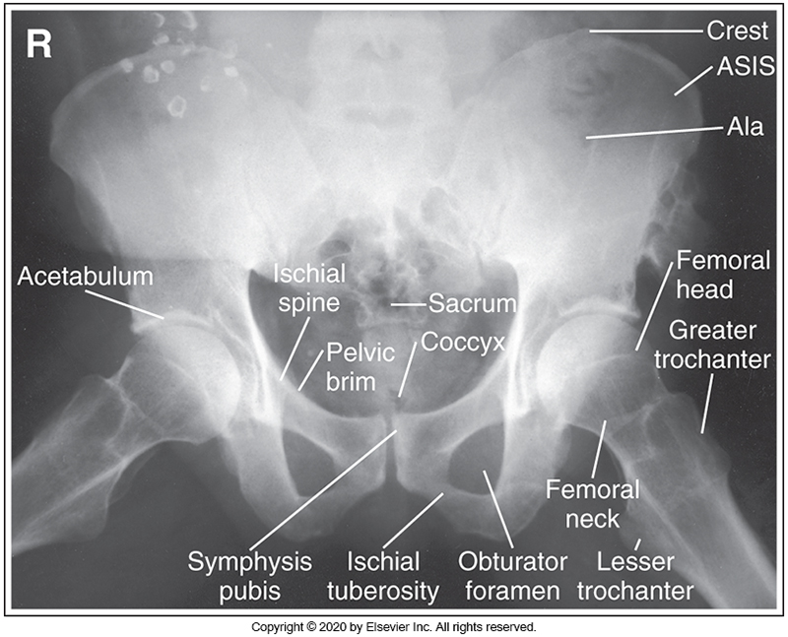
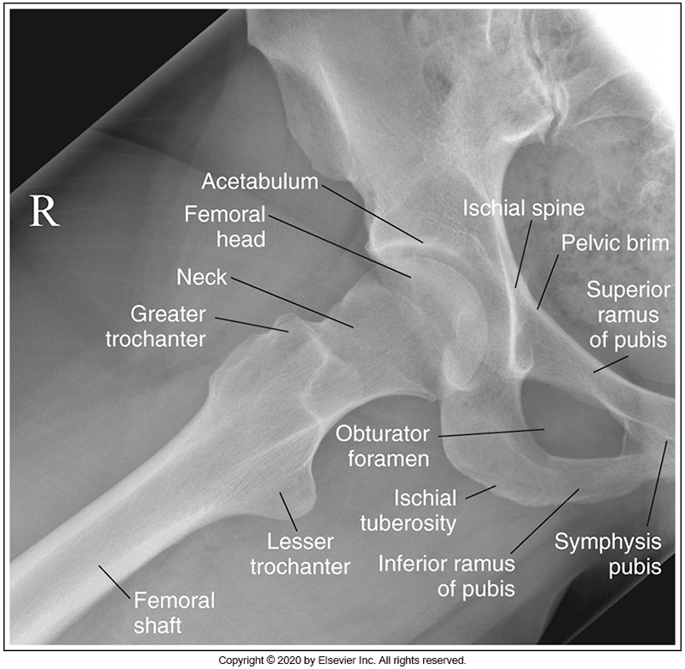
Non-Routine: Frog-leg (Modified Cleaves Method)
Same positioning as Lauenstein-Hickey except:
No rotation onto affected side (aka. proximal femur NOT parallel to IR)
Bontrager 8th ED Fig. 7.48
Femoral neck only partially foreshortened & Lesser Trochanter in profile medially
McQuillen Martensen 5th Ed. pg. 433,434 & 442 Fig. 7.13, 7.14 & 7.36

Slide 25
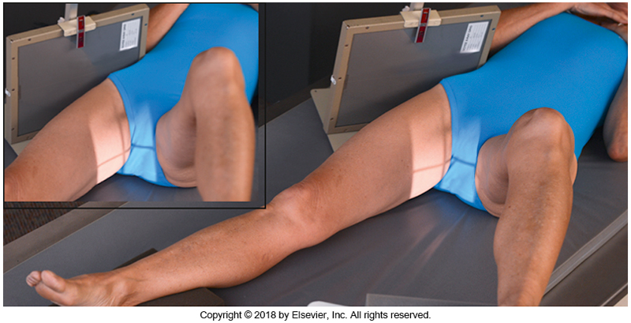
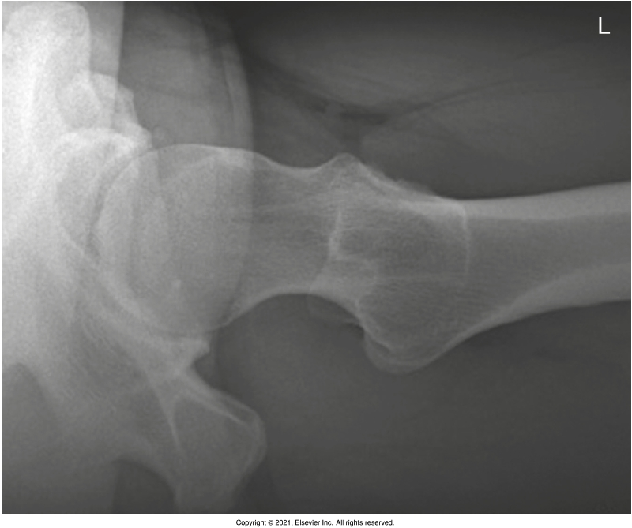
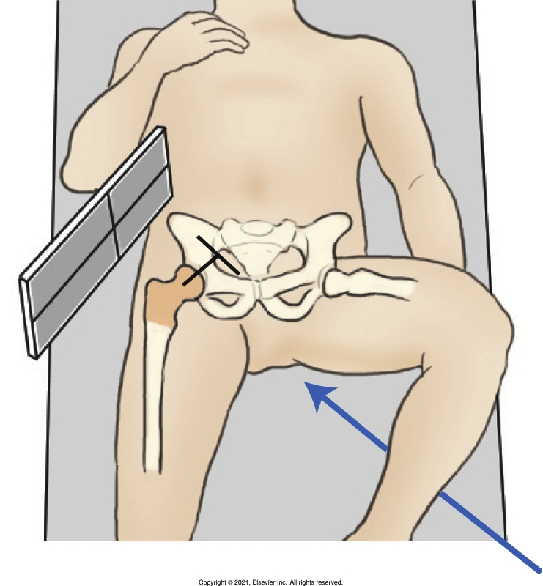
Adaptive – Axiolateral (x-table) Danelius-Miller
CR perpendicular to femoral neck & IR
Place patient’s arms high above chest
Aka. inferosuperior
Flex unaffected leg and place on a support that will not interfere with the CR
Bontrager pg. 289 Fig. 7.69-7.71

Slide 26
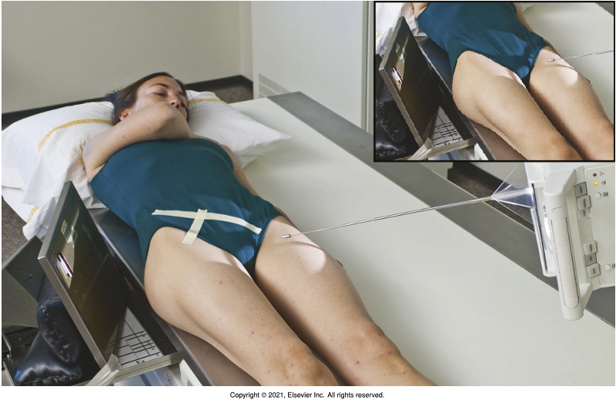
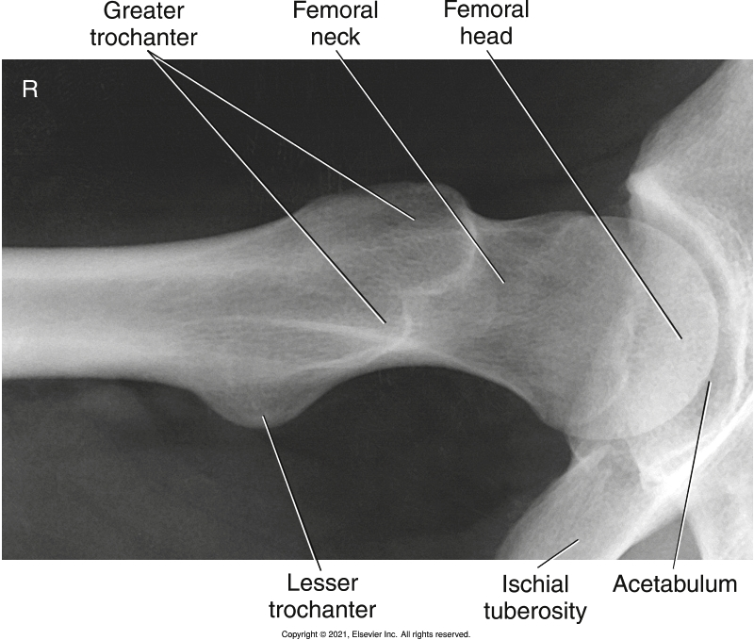
Adaptive – Modified Axiolateral (Clements-Nakayama)
Used in trauma situations when both legs are affected, or the unaffected leg cannot be moved effectively
Bontrager pg. 291 Fig. 7.75 & 7.77

