Slide 1


Anatomy of the Nail

Slide 2
Nail Technicians and Estheticians carry out physical and chemical procedures to beautify, extend and enhance the nail plate’s appearance; and as professionals we have a responsibility to maintain and enhance the nail plate’s health.
Overview

Slide 3
The purpose of manicures is to improve the appearance of the hands and nails
Pedicure is the cosmetic treatment of the toenails and feet. The care is often provided up to the knee, including exfoliation and massage,
The word manicure is derived from the Latin word Manus meaning hands and cura meaning care
The word pedicure is derived form the latin word Pedis, which means “of the foot” and cura which means care.
Fingernails grow about 1mm per week.
Toenails grow slower than fingernails
History of manicures and Pedicures

Slide 4
Some Variations of Manicure
Basic Manicure
French Manicure
Russian Manicure
Paraffin Wax Manicure
Hot Oil Manicure

Slide 5
History of manicures and Pedicures
Manicures and pedicures became particularly popular in France in the 1920/30. During this time it was fashionable to paint the nail tips whit and leave the rest of the fingernails in a natural rose –French manicure,
In 1932 the first covering nail varnish was developed by the Lachman brothers.
Around 1970, the first nail studios were opened and in the early 1980s the light curing technology was developed.

Slide 6
Types of pedicures and variations
Regular Pedicure: A simple treatment that includes foot soaking, foot scrubbing with a a pumice or stone or foot file, nail clipping, nail shaping, foot and calf massage, moisturizer and polishing.
Shanghai Pedicure: Involves soaking feet in hot water and using a scalpel (blade).
Spa Pedicure: Includes the regular pedicure and generally adds one of the following, paraffin dip, mud or seaweed treatment.
Dry or Waterless Pedicure: A regular pedicure often including callus smoothing, nail shaping and cuticle cleaning all performed with and electric file.
Athletic Pedicure: Similar to a regular pedicure for all genders. It includes either a clear polish or toenail buffing. Usually, the aromatics used will be more cooling such as peppermint, cucumber or eucalyptus.

Slide 7
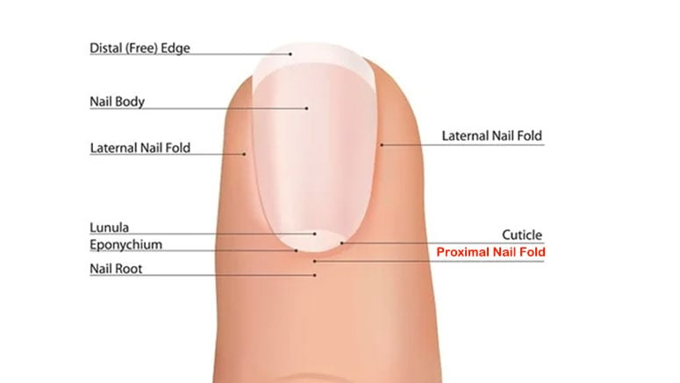
Structure of the Nail

Slide 8
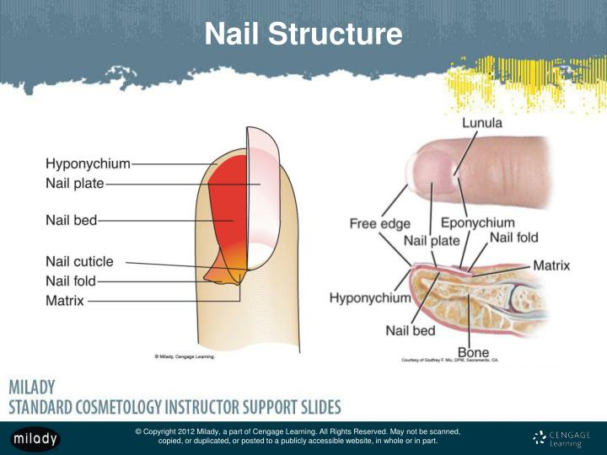

Slide 9
Structure of the Nail
Nail Matrix- the most important structure within the nail unit.
This is where new nail plate cells are created and as these new cells are created, older cells are pushed forward, and the nail plate grows.
The shape and size of the matrix determines the thickness and width of the nail. The longer the matrix, the thicker the nail, and vice versa. Damage to the matrix can cause a range of different nail imperfections, such as white spots or ridges, and weaken the nail plate as a whole.
The proximal nail fold- is a wedge of thickened skin at the base of the nail. The skin folds over the nail matrix and the base of the nail.
The proximal nail fold is a living skin, and it is often mistaken for the cuticle (dead skin cells).

Slide 10
What is the difference between the cuticle and the eponychium?
The eponychium is an area under the proximal nail fold where the dead skin cells of the proximal nail fold are shed and where they are bonded together with a sticky substance that also sticks them strongly to the nail plate. The strong seal between the nail plate, the cuticle and the PNF is what forms an important seal of the nail unit protecting the delicate matrix and the nail bed
Should you cut the eponychium?
The eponychium is not visible, it is underneath the proximal nail fold.

Slide 11
Structure of the Nail
. The cuticle is created by the eponychium on the ventral (on underside) surface of the proximal nail fold. The cuticle is formed of sticky dead skin cells that are shed by the living skin of the PNF just like the skin cells are from any surface of epidermis but instead of falling off in flakes, they are bound together with a very sticky substance, that sticks them firmly to the emerging nail plate beneath them and the frame of keratinized epidermis above them. This important part of the nail seal (or guardian) at the base of the nail is curated by the eponychium which ‘sticks’ the dead skin cells together.
This thin layer of dead skin, sticks fast to the nail plate and the proximal nail fold, forming an important seal that protects the important matrix that is behind and below the PNF. This is non-living skin, though, and is safely removed prior to manicures and pedicures, to avoid any lifting of artificial nails or nail polish for example.

Slide 12
Structure of the Nail
Should you push back your cuticles?
The answer to this is NO! The cuticle that is exposed and on the nail plate can be safely removed as it is non-living tissue, however, to prevent infection of the finger, stop when you reach the frame of keratinized epidermis at the edge of the proximal nail fold. If you go further, and push deep under the proximal nail fold, you open the area up to infection.
In reality, the cuticle needs to be lifted from the nail plate when it is softened and then removed.
What is the role of the cuticle?
With the proximal nail fold and the nail plate sealed together with the sticky cuticle in the middle, there is a very efficient first line of defense against all types of invaders from pathogens to chemicals to fungus spores. Any of these that reach the delicate matrix can very easily interrupt the growth of the nail plate and even stop growth altogether.

Slide 13
Structure of the Nail
How do you remove the cuticle?
Ideally, before you do anything to the cuticle on the nail plate, it needs to be softened. Historically, this has been achieved by soaking the nails in softened water. This WILL soften the cuticle very effectively BUT it will also create an unwanted effect to the nail plate.
The nail plate is hydrophilic, meaning it loves water and is very porous due to the tiny air spaces within it. If it is soaked in water for 1 minute or more, it will allow water to penetrate the structure, change the shape, temporarily, and make it very soft until the excess water has evaporated. Then it will return to its original shape and regain its hardness.
If an overlay of any kind is applied to a ‘waterlogged’ nail plate there is a good chance of lifting when the nail returns to its original shape.
Modern products and techniques have come away from a water soak and use much more efficient cuticle softening products.

Slide 14
Structure of the Nail
The nail bed- the area directly under the nail plate and consists of two structures: the nail bed epithelium and the underlying dermis. The nail bed epithelium is epithelial tissue and is extremely sticky, gluing itself onto the underside of the nail plate, and holding it in place. The dermis beneath it holds onto the nail bed epithelium by having a series of interlocking ridges and grooves which allow the nail plate to smoothly grow while ensuring it is firmly held in place. The dermis of the nail bed has a rich supply of blood, sebaceous glands and lymph vessels to keep the nail plate healthy and moisturized.

Slide 15
The nail plate is created in the nail matrix, where skin cells are modified and keratinised to become the hard, flat cells of the nail plate. It is the most visible part of the whole nail unit, covering the area from the nail matrix to the free edge and beyond. While it may appear to be one piece, it is constructed from multiple layers of nail cells. As it grows it moves across the nail bed, held in place to the dermis beneath by nail bed epithelium, and kept within the lateral nail folds by the nail grooves along each of the sidewalls.
The tough upper layers are slightly thicker than the lower layers and form a protective barrier. These upper layers should NEVER be buffed off during any nail service. Buffing the top layers off exposes softer layers below.
This can affect the adhesion of any artificial products, such as regular nail varnish, UV gels or powder polymer or liquid monomer. It also weakens the nail and opens it up to penetration by unwanted substances. The lower and younger layers are attached firmly to the nail bed epithelium which, in turn is attached to the nail bed by a series of grooves.

Slide 16
Structure of the Nail
What is the function of the nail plate?
The function of the nail plate is to create a rigidity for the end of the finger allowing the fingers to function efficiently in all their dexterity requirements e.g. picking up small objects. It is also a protection for the last bone of the fingers and toes which would otherwise get easily damaged
Will the nail plate continue to grow?
The nail plate is continuously formed from the matrix of the nail unit. Modified skin cells keratinize in the matrix and push older cells forward. The journey from the matrix (which is a delicate area under and behind the base of the nail) to the free edge takes approximately 5 months.
Do nails grow from the nail bed?
Nails do not grow from the nail bed. The nail bed is an area under the nail where it is attached to the end of the finger and provide the nail with essential oils and moisture to keep it healthy and flexible. Nails grow from an area under the skin at the base of the nail called the matrix

Slide 17
Hyponychium- This is the nail seal under the free edge of the nail plate at the distal edge of the finger. It forms a very tight seal that prevents bacteria and pathogens from entering the delicate and sensitive areas of the nail unit. There are many nerve endings within the hyponychium to act as a warning if this seal is broken.
How is hyponychium overgrowth treated?
This is called inverse pterygium. It will usually have blood and nerve endings and needs to be left alone. Regular applications of a good nail oil will help keep it supple and not become dry.
How do you push back the hyponychium?
You don’t push back the hyponychium. It is a important seal of the nail unit and should be left alone.
What is the difference between hyponychium and eponychium?
The hyponychium is a strong seal at the end of the finger and under the free edge. The eponychium is an area under the proximal nail fold that sheds the dead skin cells of the proximal nail fold called the cuticle. The cuticle and proximal nail fold form another strong and important seal of the nail unit.

Slide 18
The lunula is the distal edge of the nail matrix and is the half-moon shape by or under the proximal nail edge, occasionally, visible through the nail plate. Most prominent on the thumbs, this is an area vulnerable to damage as it is full of slightly soft nail cells which are not fully keratinized.
Why do I not have half-moons on my fingers?
If the half moons (lunula) cannot be seen it is because they are under the skin called the proximal nail fed. There are still there. They are a delicate area of the nail and easily damaged so are better hiding under this skin. They are more common on thumbs as thumbs only have 2 bones where fingers have 3.
Why is the lunula white?
They are lighter in color as the modified skin cells that create the nail are still under the transformation called keratinization. This is where living cells loose their cellular contents to become nonliving keratinized nail cells. The lunula is the edge of the matrix where this process is not quite complete.

Slide 19
Structure of the Nail
What is the purpose of the lunula?
It is the distal edge of the matrix where nail cells are created. Modified skin cells keratinise and become non living nail cells
Does the lunula mean my fingers are healthy?
No. The health of the nail is not dependent on the visible lunula. It will always be there just hidden under the skin on some fingers

Slide 20
The lateral nail folds or side walls, are the where the skin of the finger folds down along the side of the nail plate, providing protection as well as a groove to guide the growth of the nail. This seal along the edge of the nail stops invasion of unwanted substances or micro-organisms.
What are the common lateral nail fold problems?
Hangnails! Where little spikes of skin or the nail appear and catch on everything. These can be safely nipped off. DO NOT pull them as it damages the skin and this often leads to inflammation and infection.
What causes hard skin around the lateral nail fold?
It can be caused by general dryness, picking the skin or constantly using an implement like a pen. It is easily rectified by massaging in a good nail oil or hand cream to counteract the dryness and keep the skin moisturized and supple.

Slide 21
What's the pain I'm feeling around the lateral nail fold?
This is usually due to an infection and inflammation, maybe from catching or pulling a hangnail or localized skin damage. Keep it clean and dry and apply antiseptic cream if necessary.
Can I remove hangnails?
Yes, you can, but it must be done carefully. Use a clean pair of nippers. Place the blades around the hangnail, squeeze and release. Never pull the hangnail as this can damage the skin.

Slide 22
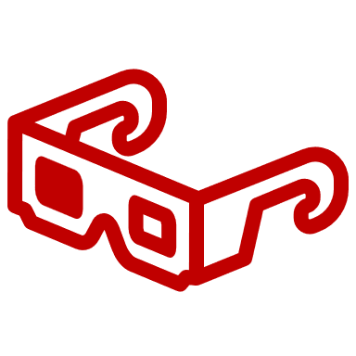
Lets Watch

Slide 23

QUESTIONS?

