Slide 1
MRAD 204:
Radiographic Technique 1
Outcome 1-5:
Anatomy of the Hand and Wrist
MRT Program
Anderson College

Slide 2
Affiliated Readings
Module 1
Bontrager
Pgs: 8 → 9
Pgs: 126→129

Slide 3
Overview
Bony groups of the hand and wrist
Bony anatomy of the hand
Hand joints
Carpal bones
Labelling

Slide 4
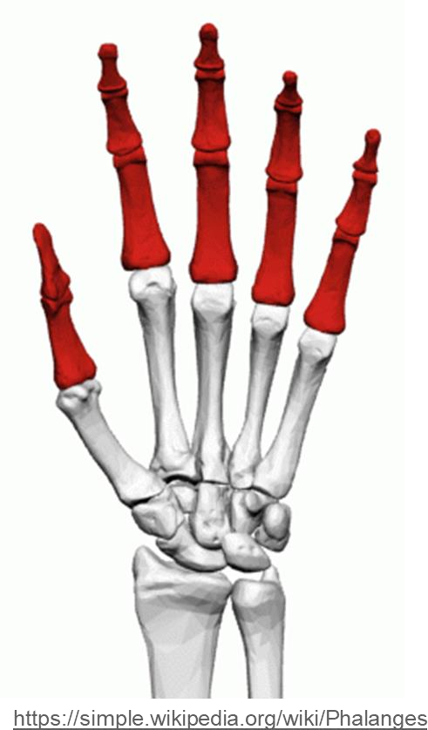
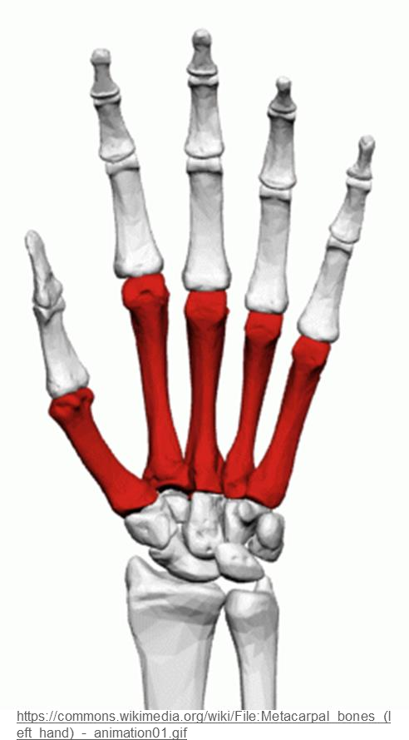
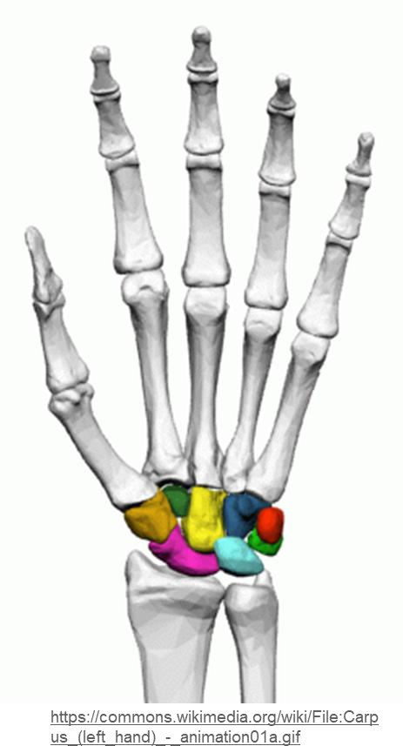
Bony Groups of the Hand & Wrist
The bones of the hand and wrist are divided into three groups:
1. Phalanges (fingers & thumb)
14
2. Metacarpals (palm)
5
3. Carpals (wrist)
8
TOTAL = 27 bones

Slide 5
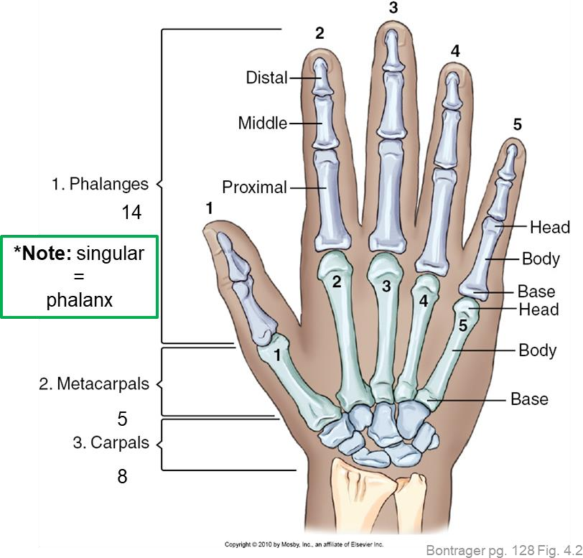
Phalanges
Fingers are also
known as “digits”
Digits (and metacarpals) are numbered 1→5 starting with the thumb (aka. lateral side)
Bontrager pg. 126 Fig. 4.2

Slide 6
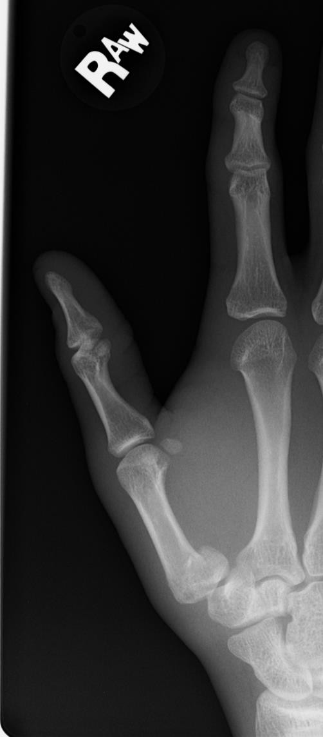
Phalanges & Metacarpals
Fingers (2nd→5th digit)
Consist of three phalanges
Distal
Middle
Proximal
THUMB (aka. 1st digit)
Only has two phalanges
Each phalanx and
Metacarpal has a:
Distal
distal rounded head
body (shaft)
Base
Considered long bones, having a base (proximal end), body, and head (distal end)
Proximal
SAIT imaging library

Slide 7
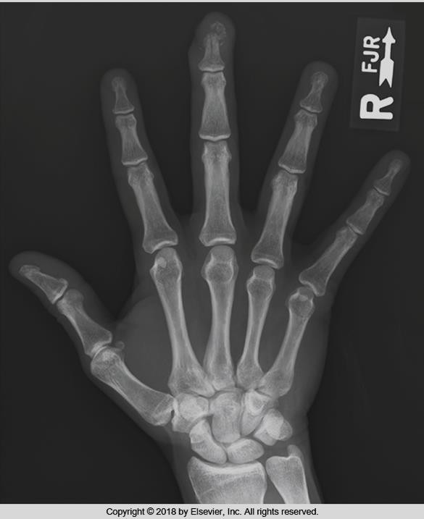
Bony Anatomy of the Hand
Radiographic Appearance
3
2
4
5
1
Bontrager pg. 126 Fig. 4.2
Bontrager 9th Ed. pg. 150 Fig. 4.68

Slide 8
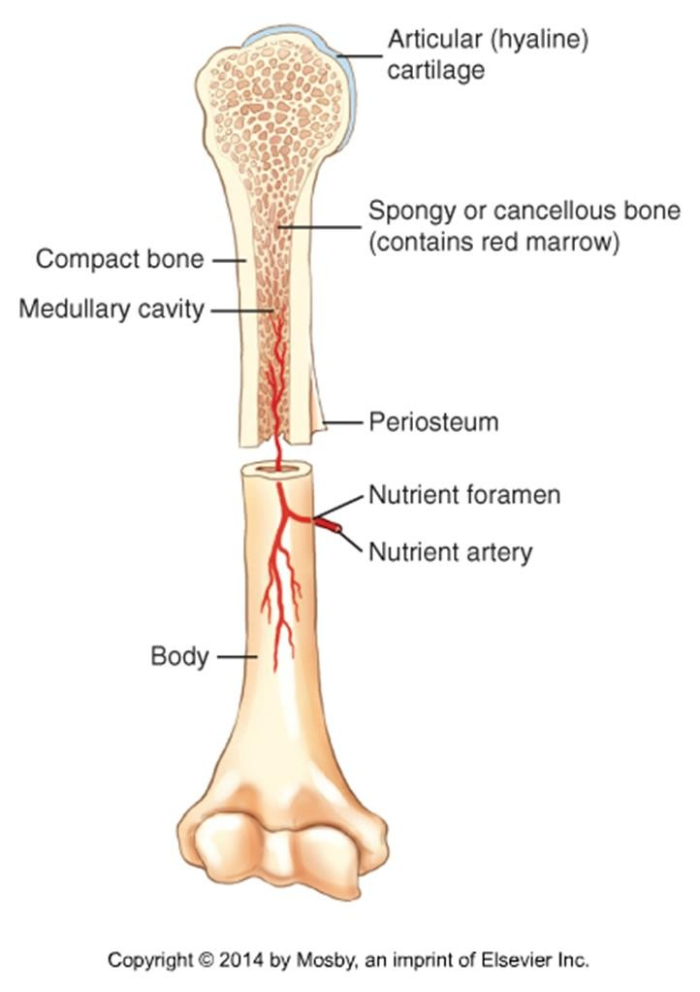
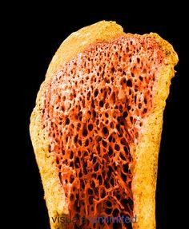
Bony Anatomy of the Hand
Radiographic Appearance
“darker” inner portion
of the long bone
“white” o portion o long bon
https://www.pinterest.co.uk/pin/ 176766354100884818/
Bontrager pg. 9 Fig. 1.17
Bontrager 9th Ed. pg. 150 Fig. 4.68
Density differences within long bones creates different radiographic “shades”

Slide 9
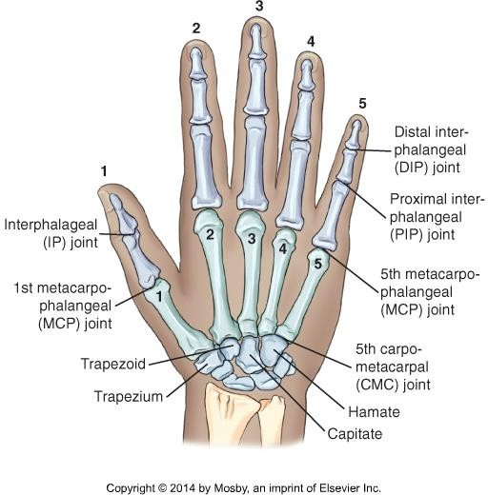
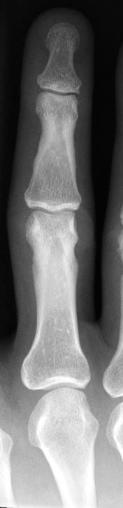
Hand Joints
When naming: always identify the proximal bone first
*Note: phalangeal joints must be numbered
Example: Metacarpals articulate with phalanges
= MCP joints & carpals =
CMC joints
Note: the Thumb (aka. 1st
Digit) only has 2 phalanges
Bontrager pg. 127 Fig. 4.3

Slide 10
Phalangeal Joints
2
Fingers (2nd→5th digit)
Each have three joints
  DIP
Aka. Distal interphalangeal joint
  PIP
Aka. proximal interphalangeal joint
  MCP
Aka. Metacarpophalangeal joint
THUMB (aka. 1st digit)
Only has one phalangeal joint
  IP
Aka. Interphalangeal joint
I = Inter
P = Phalangeal
1

Slide 11
Metacarpal Joints
*Note: metacarpal joints must be numbered
Metacarpal heads articulate with a phalanx base to form MCP joints
Metacarpal bases articulate with carpals to form CMC joints
Bontrager pg. 127 Fig. 4.3

Slide 12
Carpometacarpal joints
2nd Metacarpal articulates with the Trapezoid
3rd Metacarpal articulates with the Capitate
4th & 5th Metacarpal articulate with the Hamate
Thumb articulates with the trapezium
*Note: carpometacarpal joints must be numbered
Bontrager 9th Ed. pg. 150 Fig. 4.68

Slide 13
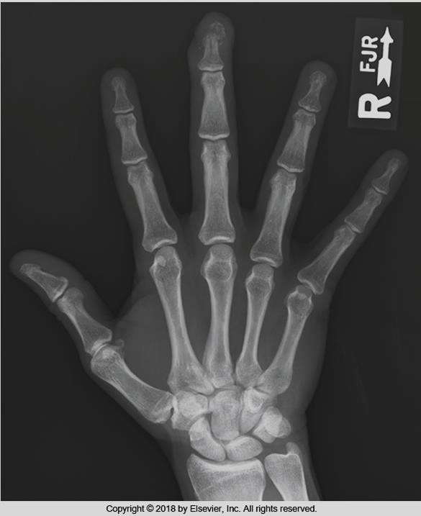
Hand Joints
Radiographic Appearance
*Note:
All IP, MCP, and CMC joints must be numbered
Bontrager 9th Ed. pg. 150 Fig. 4.68
Bontrager pg. 127 Fig. 4.3

Slide 14
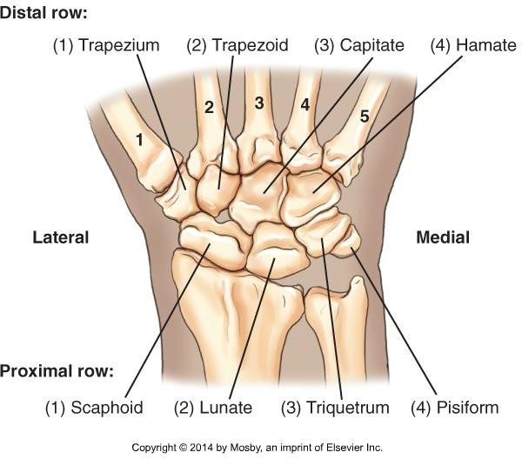
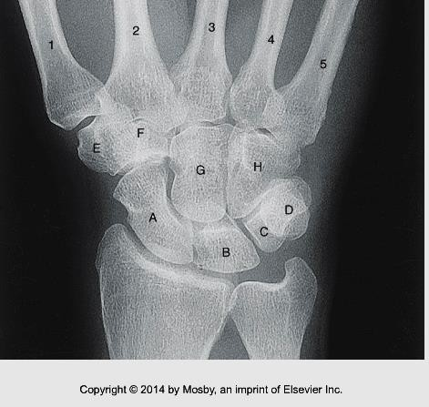
Carpal Bones
Distal row:
2
1
4
3
Proximal row:
1
4
2
3
Bontrager pg. 128 Fig. 4.5
Bontrager pg. 129 Fig. 4.8

Slide 15
Carpal Bones
Proximal Row
Scaphoid:
Distal Row
Trapezium:
Articulates with the 1st metacarpal
Trapezoid:
Smallest in distal row
Capitate:
Largest in proximal row
Most frequently fractured carpal
Articulates with the radius
Lunate:
Moon-shaped
Triquetrum:
Articulates anteriorly with pisiform
Pisiform:
Smallest carpal
Largest carpal
Centrally located
Hamate:
Hook-like process (Hamulus) projects from the palmar surface

Slide 16
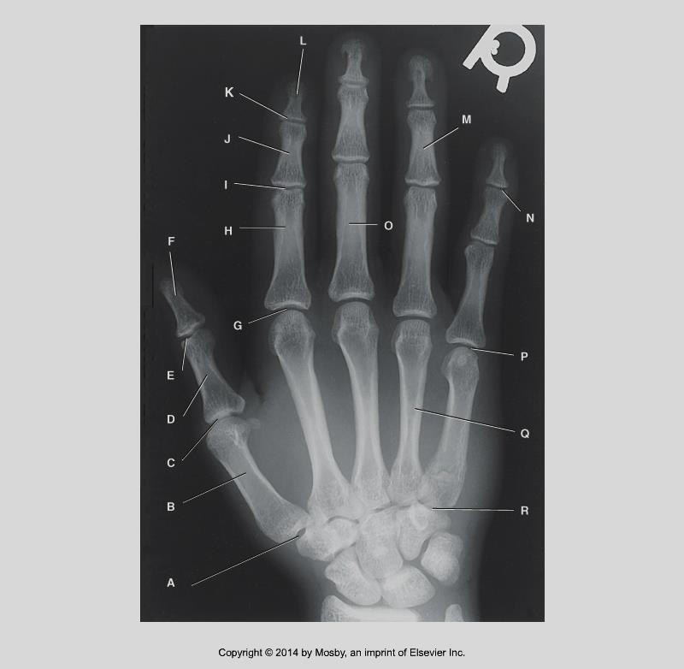
Labelling
Bontrager 9th Ed. pg. 129 Fig. 4.4

Slide 17
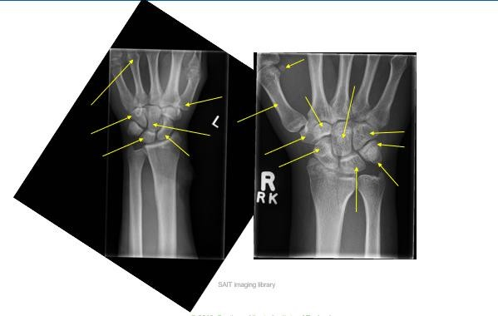
Labelling

Slide 18
Helpful Resources
Sketchfab: https://sketchfab.com/3d-models/bones-of-the-hand- d4f204eefe6f4b07b8c94c8b6aedddae
  Access to 3D anatomy images
  Labelling
  *Images can be rotated, to view bones at different angles
  *Can type what you want to view in the search bar
Wikicommons: https://commons.wikimedia.org
  Access to images and animations seen in instructor PowerPoints

