Slide 1


Laser Chapter 1- Part 1

Slide 2
OUR JOURNEY TODAY
Understanding Lasers, Light Sources, and Other Energy-Based Technology

Slide 3
What is LASER?
L = Light
A = Amplification
S = Stimulated
E = Emission
R = Radiation

Slide 4

Let's Start with Radiation
In physics, radiation is the emission or transmission of energy in the form of waves or particles through space or through a material medium.
This includes:
Electromagnetic radiation, such as radio waves, microwaves, infrared, visible light, ultraviolet, x-rays, and gamma radiation
Particle radiation, such as alpha radiation, beta radiation, proton radiation and neutron radiation (particles of non-zero rest energy)
Acoustic radiation, such as ultrasound, sound, and seismic waves (dependent on a physical transmission medium)
Gravitational radiation, that takes the form of gravitational waves, or ripples in the curvature of spacetime
But…What does it mean?

Slide 5
The word "radiation" arises from the phenomenon of energy waves radiating (i.e., traveling outward in all directions) from a source.
This aspect leads to a system of measurements and physical units that are applicable to all types of radiation.
Radiation expands as it passes through space, and as its energy is conserved (in vacuum)
The intensity of all types of radiation are measured in wavelengths

Slide 6

So now we understand!
LASERS are use in many different fields for a specific purpose ( target ) using a controlled energy source to create a stimulus or for a specific outcome

Slide 7
Medical Esthetic lasers use electromagnetic radiation to generate a concentrated steam of photons capable of providing a specific therapeutic benefit.
Photons are tiny particles of waves of electromagnetic radiation. photons are just electric fields traveling through space in a vacuum.
Photons have no charge, no resting mass, and travel at the speed of light.

Slide 8
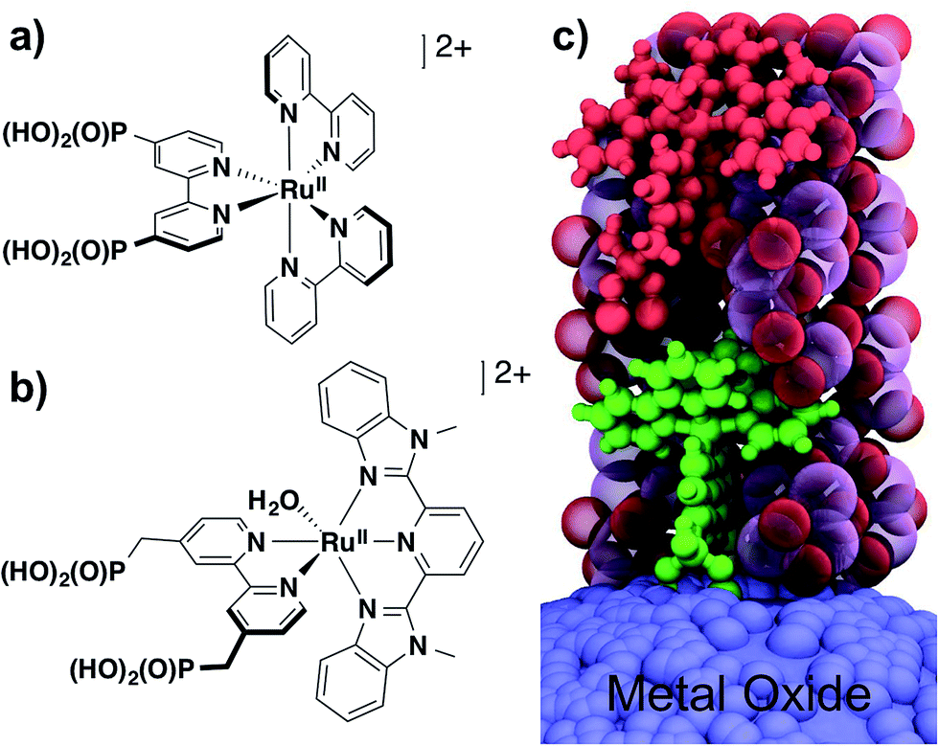
Chromophores
A chromophore is the part of a molecule responsible for its color. The color that is seen by our eyes.

Slide 9
Chromophores Targeted by LASER Light
Medical esthetic lasers target 3 types of chromophores:
Melanin
Hemoglobin
Tattoo pigments
Providers are able to target specific chromophores in the skin because each chromophore absorbs laser light within a range of wavelengths

Slide 10

What is a wavelength ???
Let’s See!

Slide 11
OK! That was a lot…let’s review
What does LASER stand for?
What is Radiation
What is Electromagnetic Radiation?
What Type of Radiation is used in Esthetic LASERS?
What are photons?
What are chromophores?
What type of chromophores are targeted by LASER
What is a frequency ?
What is a wavelength ?

Slide 12
How does this apply to our knowledge?
Again…A laser uses electromagnetic radiation to generate a concentrated steam of photons that is capable of providing therapeutic benefit. Substances that absorb laser light, such as melanin, hemoglobin, and tattoo pigment, are called chromophores.
Providers are able to target specific chromophores in the skin because each chromophore absorbs laser light within a range of wavelengths. This concept is called selective photo-thermolysis

Slide 13

Ok Gotcha! ….
But wait…what is selective photo-thermolysis ?
Photo = Light
Thermolysis = Heat

Slide 14
The Process
In a bundle, how a LASER works is by using a specific Wavelength
The specific frequency of wave light will use a specific amount of electromagnetic radiation ( photons ) to be discharge in pulses of milliseconds using “heat” or “acoustic waves “
This specific heat will create a selective photo-thermolysis effect which will selectively target a specific group of chromophores within the skin without affecting the surrounding tissue !

Slide 15
So Let’s Review Again
Light is a form of energy that is made up of photons.
Photons are particles that travel in space as electromagnetic waves.
Photons will eventually come into contact with atoms, which exist in nature in their lowest state of energy, the “ground state.”
When atoms absorb photons, they are propelled into higher energy states because their orbiting electrons are displaced further from the nucleus.
When photons stop hitting atoms, the atoms instantaneously fall back toward their ground states, and in so doing, release energy in the form of photons.
The process of energy transfer from energized atoms back to their resting states via the emission of photons is called electromagnetic radiation. It was originally described by Albert Einstein in “The Quantum Theory of Radiation.”

Slide 16
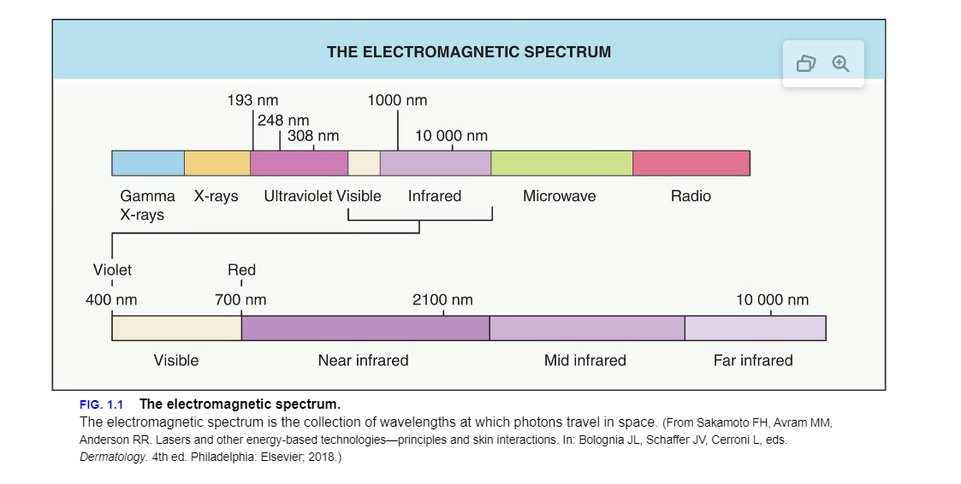
The electromagnetic spectrum is the range of frequencies at which photons travel in nature. It encompasses low-frequency radio waves, visible light, ultraviolet radiation, and high-frequency gamma rays.

Slide 17
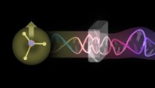

Slide 18

QUESTIONS?

