Slide 1


Medical Esthetics
Tissues and Organs

Slide 2
Tissues
When cells of same genetic makeup are grouped together, the resulting structure is called tissue

Slide 3
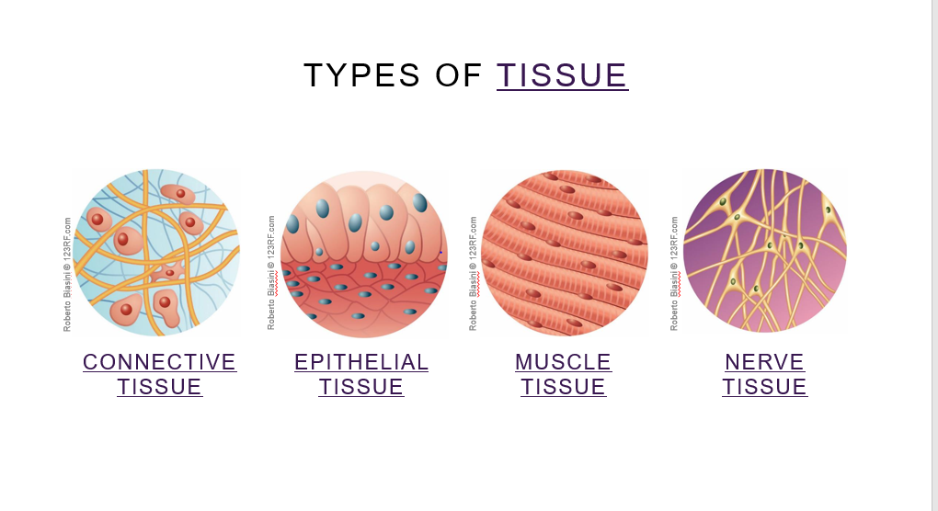

Slide 4

Check-in
List and describe the functions of the four types of tissue found in the human body.

Slide 5
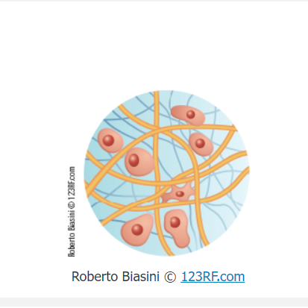
Let’s Review
Connective tissue supports, protects, and binds together other tissues of the body. Examples of connective tissue are bone, cartilage, ligaments, tendons, fascia (which separates muscles), blood, and fat, which is also called adipose tissue . Adipose stores energy and gives smoothness and contour to the body. Collagen and elastin are protein fibers, and also a part of connective tissue.

Slide 6
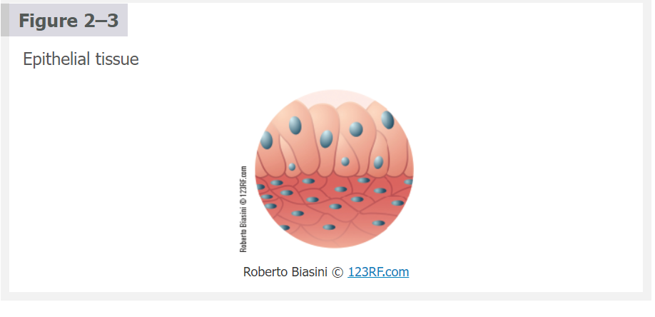
Epithelial tissue is a protective lining on cavities of the body and surfaces of organs. Examples are skin, mucous membranes, the lining of the heart, digestive and respiratory organs, and the glands

Slide 7
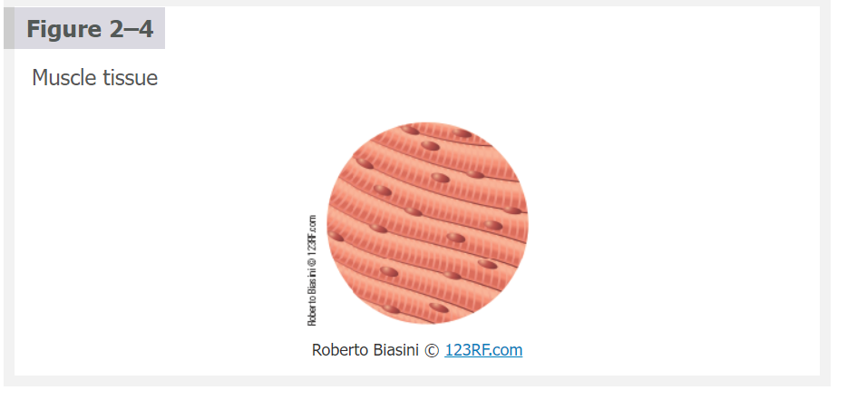
Muscle tissue contracts and moves the various parts of the body (Figure 2–4).

Slide 8
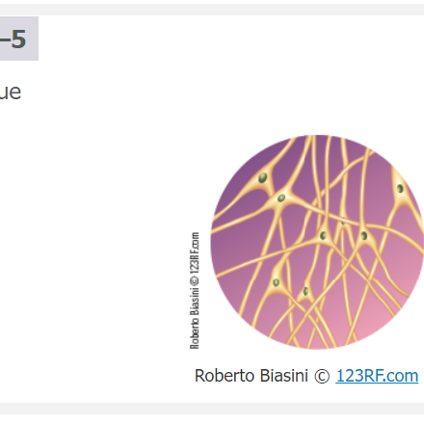
Nerve tissue carries messages through the central nervous system to control and coordinate all bodily functions. Nerve tissue is composed of special cells known as neurons, which make up the nerves, brain, and spinal cord

Slide 9
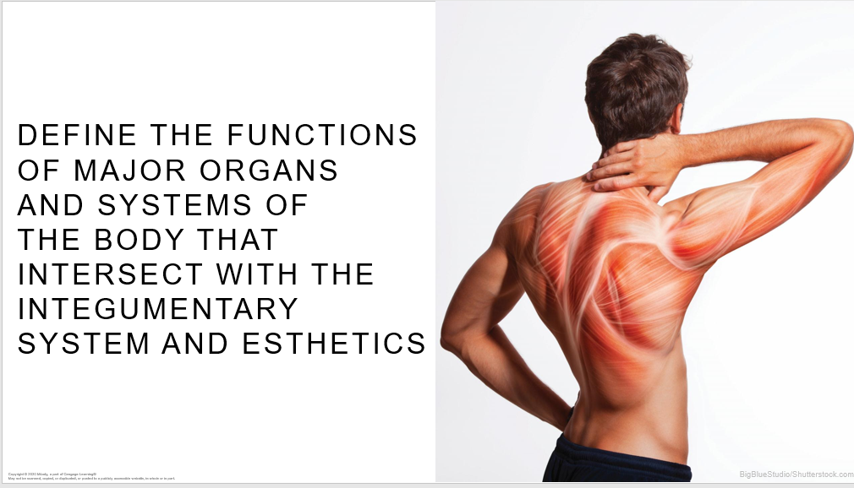

Slide 10
How it Works
The same type of cells form tissues
Tissues form Organs
Organs form body systems

Slide 11
Functions of Major Organs and Systems
Functions in the body are carried out by organs. Organs are a collection of tissues that have an identifiable structure and that perform specific functions . For example, the heart has muscle tissue that pumps blood, fibrous tissue that comprise the heart valves, and special tissue that maintains the rhythm of the heart beating.

Slide 12
Body systems are groups of organs acting together for one or more functions. Table 2–1 lists the body systems as well as some of the most important organs of the body whose functioning affects the integrity of the skin.

Slide 13
Organs and Organ Systems
An organ is a combination of two or more kinds of tissue that together perform one or more functions. As an example, the stomach contains all four of the tissue types you have read about in previous sections . Its wall is mainly muscle, and nerves help regulate muscle contractions that mix and move food. Connective tissue provides support, while the stomach lining is epithelium.

Slide 14
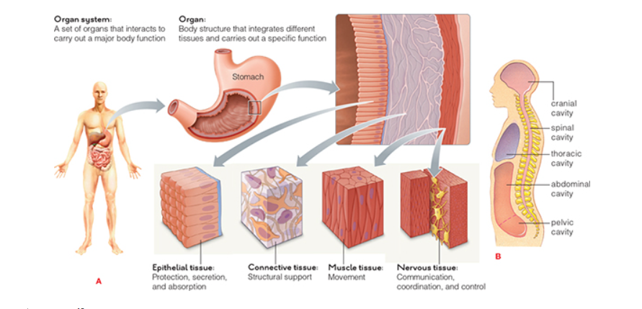

Slide 15
In an organ system, two or more organs “cooperate” to carry out a major body function. For example, interactions between your skeletal and muscular systems allow you to move about. Blood in the cardiovascular system rapidly carries nutrients and other substances to cells and transports products and wastes away from them. Your respiratory system delivers oxygen from air to your cardiovascular system and takes up carbon dioxide wastes from it—and so it goes, throughout the entire body.

Slide 16
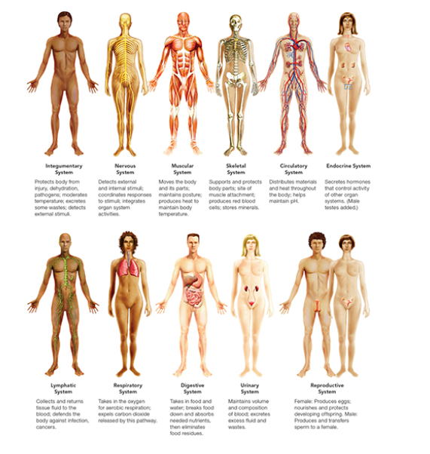


Slide 17
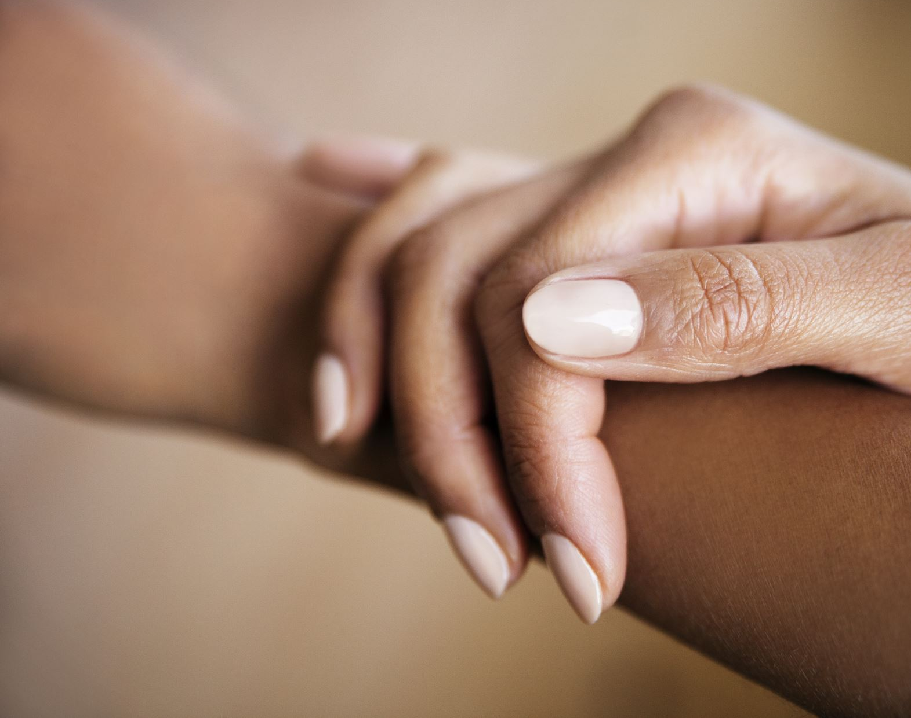
Now that we have learn how body systems are formed, why do you think is important for the esthetician to learn anatomy and physiology?

