Slide 1


Medical Esthetics
Vascular Lesions

Slide 2
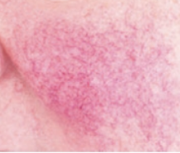
Vascular Conditions or Disorders
Vascular conditions and disorders can be hard for a client to deal with, so it is important to understand the types to better help your clients. As mentioned earlier, these types of vascular lesions may be considered tertiary lesions.

Slide 3
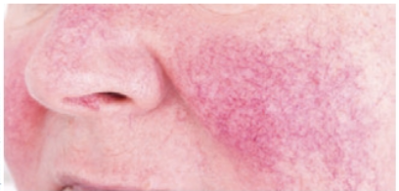

Rosacea

Slide 4
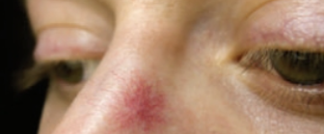
Telangiectasia

Slide 5
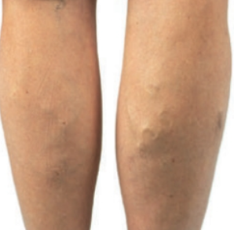
Varicose Veins

Slide 6


Slide 7
Cell Protection
The health of skin cells depends on the cellular membrane and the water-holding capacity of the stratum corneum. Phospholipids, glycolipids, cholesterol, triglycerides, squalene, and waxes are all different types of lipids found in the stratum corneum and cell membranes.
Intercellular lipids and proteins surround cells and provide protection, hydration, and nourishment to the cells.
Ceramides are a group of waxy lipid molecules such as glycolipids that are important to barrier function and water-holding capacity.
Fifty percent of the lipids in the stratum corneum are ceramides.
Fatty acids are also components of the intercellular substances.
Lipids are reduced if the skin is dry, damaged, or mature.

Slide 8
Cell Replacement Facts
The body replaces billions of cells daily. The cells of organs such as the skin, heart, liver, and kidneys are replaced every six to nine months. Cells of the bones are replaced every seven years. Unfortunately, elastin and collagen are not easily replaced by the body, and the skin does not regain its once pliable shape after being stretched or damaged by UV radiation and environmental pollution; however, research shows that certain skin care treatments and ingredients, such as vitamin A, alpha hydroxy acids (AHAs), alpha lipoeic acid, and other growth fac-tors stimulate skin cell turnover and reduce visible signs of aging. Regular cell turnover is necessary to keep skin healthy.

Slide 9
The Sun and the Skin
UV Radiation
The sun and your skin

Slide 10
Free Radical Damage
Oxidation and Antioxidants

Slide 11
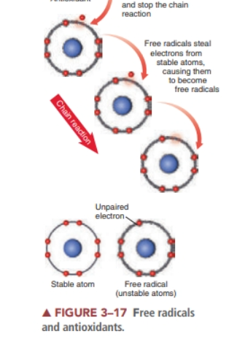
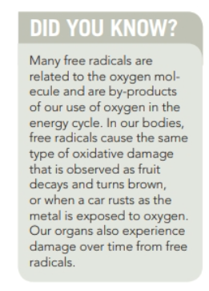

Slide 12

Skin Health and the Environment
Climate, humidity levels, and other environmental factors also affect the skin
Routine cleansing at night helps to remove the buildup of pollutants that have settled on the skin’s surface throughout the day
Applying daily moisturizers, antioxidants, growth factor serums, pep-tides, sunscreen, and even foundation products helps to protect the skin from airborne pollutants and the environment.

Slide 13
Skin Health and Lifestyle Choices
What we choose to put into our bodies significantly affects our overall health.
The impact of poor choices can be seen most visibly on the skin. Smoking, drinking, drugs, and an unbalanced diet with heavily processed foods all greatly influence the aging process.

Slide 14
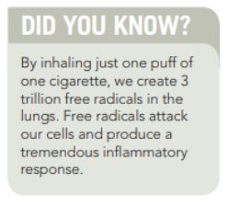

Slide 15
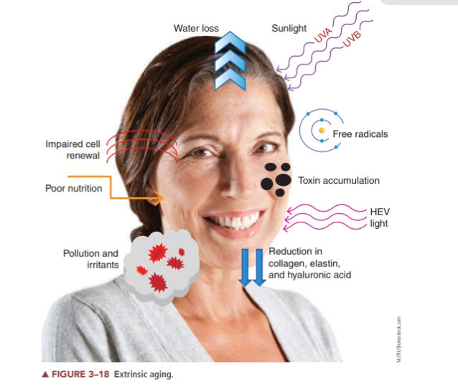

Slide 16
Using some prescription or illegal drugs also affects the skin.
Certain drugs have been shown to interfere with the body’s intake of oxygen, thus affecting healthy cell growth.
Some drugs can even aggravate serious skin conditions, such as acne. Other effects include dryness and allergic reactions on the skin’s surface.
The effects of inhaled cannabis should be a consideration in the skin’s aging processes as well.

Slide 17
Drinking and smoking
Both smoking and drinking contribute to the aging process on their own, but the combination of the two can be even more damaging to the tissues. The constant dilation and contraction of the tiny capillaries and other blood vessels, as well as the constant deprivation of oxygen and water to the tissues, quickly makes the skin appear lifeless and dull. It is very difficult for the skin to adjust and repair itself from this assault. Damage done by our habits can be hard to reverse or even diminished

Slide 18
Glycation
Recent research indicates that an intrinsic part of the aging process involves damaged structures and tissues that gradually accumulate in the body through a destructive process called glycation
Glycation is the binding of a protein molecule to a glucose molecule ( sugar ), resulting in the formation of damaged, nonfunctioning structures known as advanced glycation end products.
Glycation contributes to the aging of skin, contributing to wrinkles and hyperpigmentation.
Many age-related diseases such as arterial stiffening, cataracts, and neurological impairment are partially attributed to glycation.
Scientists have established that anything that causes a rise in our blood sugar results in inflammation on a cellular level. When blood sugar goes up rapidly and continually, the sugar can actually attach to the collagen in the skin, making it stiff and inflexible. This is glycation. When collagen is cross-linked by sugar, it leads to stiff and sagging skin.

Slide 19
Other Factors that Age Skin
Too much cortisol ( stress hormone)
Lack of sleep
Hormonal imbalances
Poor diet
Poor Microcirculation in the blood vessels

Slide 20
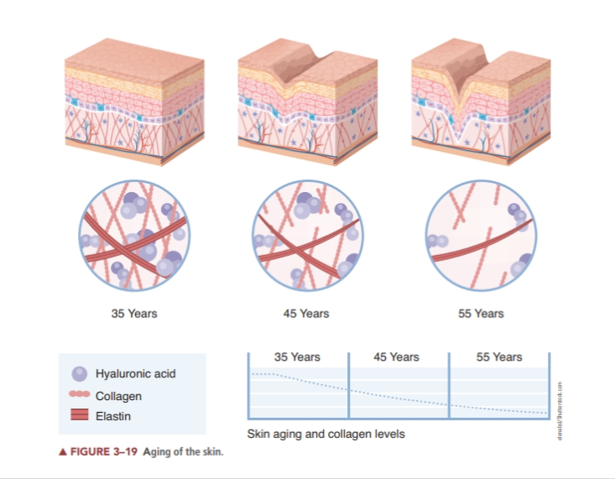

Slide 21
Hormone Replacement Therapy
Hormone replacement therapy (HRT) is often suggested to balance estrogen for women experiencing menopause; however, some HRT may be linked to breast cancer.
It is not within the scope of practice of an esthetician to make recommendations.
In addition to hormone balancing, sustaining good nutrition, the use of good skin care products and treatments, exercise, and a positive outlook can help keep skin looking radiant at any age.

Slide 22
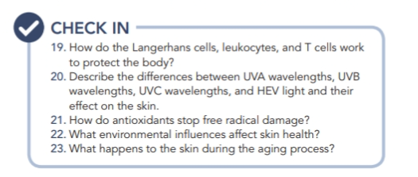
Research Time

Slide 23
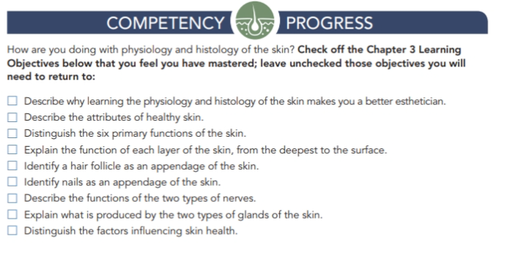

Slide 24

QUESTIONS?

