Slide 1
Patient Care
Body Temperature

Slide 2
Body Temperature
Body Temperature is the physiologic balance between heat produced in the body (by chemical processes that result from metabolic activity) and heat lost to the environment.
A patient whose body temperature is elevated above normal limits is said to have a fever or pyrexia.
A patient whose body temperature is below normal limits is said to have hypothermia.

Slide 3
Factors that Affect Body Temperature
Environment – slightly higher in hot environment
Time of day – lower in the morning
Infection/disease/injury
Age – decreases slightly with age
Emotional status – increases with stress
Menstrual cycle – higher during time of ovulation
Physical activity – slight increase but plateaus
Site of measurement – oral vs. rectal

Slide 4
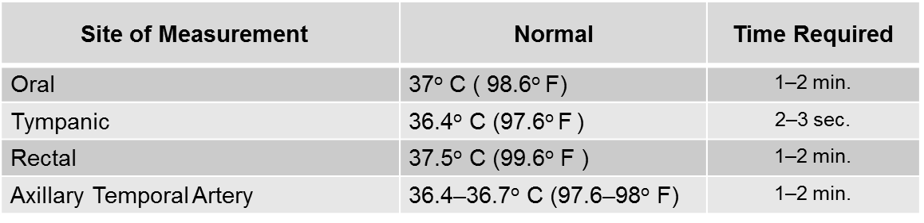
Normal Body Temperature
Normal oral temperature range for adults is 36–38 degrees Celsius or 96.8–99.8 degrees Fahrenheit (Allow + or - 0.5–1º variation in temp for normal ranges)
Table 1.1: Normal Adult Temperatures by Site

Slide 5
Normal Body Temperature (cont’d)
Table 1.2: Normal Temperature Range for Children
Death can occur above and below normal temp!
Age | Normal Range
3 months–3 yrs | 37.2–37.7º C (99–99.7º F)
5–13 yrs | 36.7–37º C (97.8–98.6º F)

Slide 6
Body Temperature Locations
Oral – not always appropriate. Depends on patient and their condition. WHY?
Axillary – patient preferred, but it’s slower and less accurate.
Rectal – accurate and faster but has patient contraindications.
Tympanic and Temporal artery – common for children and confused patients.

Slide 7
Oral Temperature
Easily accessible site
Should not be used for patients who:
  May be injured during the procedure by biting down on the thermometer
  Are unable to hold the thermometer under the tongue with closed lips for the specified period of time

Slide 8
Axillary Temperature
Safest method
Non-invasive
Commonly used for infants
Somewhat unreliable
  Time and placement precision needed to be accurate
Electronic, disposable or glass thermometer with a blunt tip may be used

Slide 9
Rectal Temperature
Provides the most reliable reading
Should not be used if the patient is restless or has rectal pathology
Use thermometer with a blunt tip
Least preferred method by the patient

Slide 10
How to Chart Temperature
When recording patient’s temperature, take the reading and then record that reading followed by O, AX, T or R to indicate site at which the temperature was taken.
  Oral – O
  Axillary – AX
  Tympanic – T
  Rectal – R
    E.g., a tympanic temperature of 97.6° F is written as 97.6 T
It is important to chart the time at which the temperature was taken!

Slide 11
Types of Thermometers
Digital/electronic – used to take oral, axillary and rectal temperatures
Tympanic
Temporal artery
Disposable

Slide 12
Taking a Rectal Temperature-Theroy
Wash your hands and put on clean gloves.
Obtain a thermometer with a blunt tip.
Place the patient in the Sim’s position and cover with a sheet. Ensure the patient’s privacy.
Lubricate the thermometer tip.
Separate the patient’s buttocks with the heel of the hand so that the rectum is clearly visible.
Gently insert the tip of the thermometer into the rectum 1–1.5 inches and hold in place for 1–2 minutes. Do not leave patient unattended.
Remove and wipe the thermometer. Return the patient to a comfortable position.
Record the reading and alert radiologist of abnormalities.
Dispose of the thermometer as appropriate.
Remove your gloves and wash your hands.

Slide 13
Disposable Thermometers
Used primarily for children, ICU and isolation patients
They consist of a “strip of temperature”-sensitive paper with adhesive backing that may be attached to the forehead

