Slide 1


Outline Electrical Theory

Slide 2
Electricity​
Why study the basics of electricity as an esthetician?​
​
Electricity does not occupy space or have physical or chemical properties so it is not matter. It is a form of energy that, when in motion, exhibits (displays/shows) magnetic, chemical, or thermal effects.

Slide 3
Electric Current
This is the flow/movement of electricity along a conductor
All substances can be classified as either conductors or insulators, depending on how easily an electric current can be transmitted through them

Slide 4
Conductor
This is any substance or material that conducts electricity . Or any type of material through which electric current can pass
Most metals are good conductors
EX: Copper is used in electric wiring and electric motors
Water makes a good conductor. This is why we should not swim in a lake during a lightning storm, since electrical current can pass through the water and electrocute the swimmer. Another example is your blow-dryer you must keep it away from a wet sink as when its on it can spark electricity that can also electrocute you.

Slide 5
Insulator
Also known as a non-conductor, it is a substance that does not easily transmit electricity
Rubber, silk, wood, glass, and cement are good insulators.
When someone is going through an electrical shock, this is why we use wood to either remove them from harm, or let them step on rubber to reduce the electrical flow through their body.

Slide 6
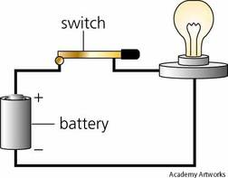
Complete Electric Circuit
This is the path of negative and positive electric currents moving from the generating source to the conductors and back to the generating original source or to the ground

Slide 7
Types of Electric Current
Direct Current (DC)
Alternating Current (AC)
Converters
Rectifiers

Slide 8
Direct Current (DC)
Constant even-flowing current, travelling in one direction. It produces a chemical reactions
Ex: flashlights, cellphones, any cordless devices that use batteries is a form of “DC”

Slide 9
Alternating Current (AC)
Rapid, interrupted current flowing in one direction then another
It produces a mechanical action
These are all devices that use a plug, and is connected to an outlet electric wall. It can be a 2 pin plug or 3 pin plug
Ex: magnifying lamps, flat irons.

Slide 10
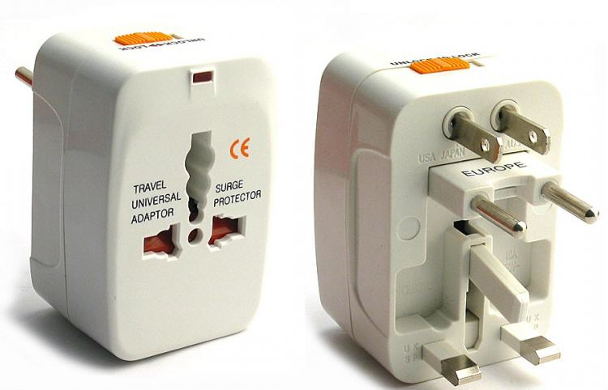
Converters
This is an apparatus/equipment/gadget used to change direct current into alternating current

Slide 11
Rectifiers
This is an apparatus used to change alternating current into direct current.
Ex: your cell phone charger uses a rectifier to convert the AC from the wall outlet in a building to the DC current to recharge the battery

Slide 12
Electrical Measurements
Volt (V)
Ampere (A)
Milliampere (mA)
Ohm (O)
Watt (W)
Kilowatt (kW)

Slide 13
Volt
This measures the pressure that forces electric current forward.
Higher voltage increases strength of current because more electrons are moving; lower is weaker.
Ex: An air condition uses a great deal more power than a table fan. Hence why the air-con can cause a power failure in your house.

Slide 14
Ampere (A)
Also called Amp. This measures the strength of current running through a wire (the number of electrons flowing through a wire)
The amp capability of the cord must be compatible with the amps put out by the appliance
If the current is too strong for the cord, the appliance can be ruined

Slide 15
Milliampere (mA)
This is one-thousandth (1/1000) of an ampere
The current for facial and scalp treatments is measured in milliamperes
An ampere current would be too strong and would damage the skin or body

Slide 16
Ohm (O)
This measures resistance of an electric current
The force or voltage must be stronger than the resistance of ohms for electricity to flow through a wire

Slide 17
Watt (W)
This measures how much electric energy is used in one second
Ex: a 40-watt light bulb uses 40 watts of energy per second

Slide 18
Kilowatt (kW)
This equals 1000 watts
Our electric bills are measured in kilowatt hours (KWH)

Slide 19


