Slide 1
CT Theory
Thoracic Anatomy
© 2016, SAIT Polytechnic

Slide 2
CT Imaging of the Chest
Module Objectives
Review anatomy of the chest
Label anatomical structures on a CT image
Scanning protocols including:
  Positioning
  Indications & Contraindications
  Exposure Factors
Most common CT Chest exams done

Slide 3
CT Imaging of the Chest
Review Anatomy
Kelley textbook goes into a lot of detail!
Focus on:
  Bony Thorax
  Pleural Cavity
  Lungs, Bronchi
  Mediastinum
  Great Vessels
Complete anatomy ID exercises on D2L Brightspace

Slide 4
CT Imaging of the Chest
Review bony thorax
  Thoracic Vertebrae
  Sternum – 3 segments
    Manubrium:
    Body:
    Xiphoid:
  Ribs – facet / demi-facet articulates posteriorly with T-spine
    Costovertebral jts
    Costotransverse jts

Slide 5
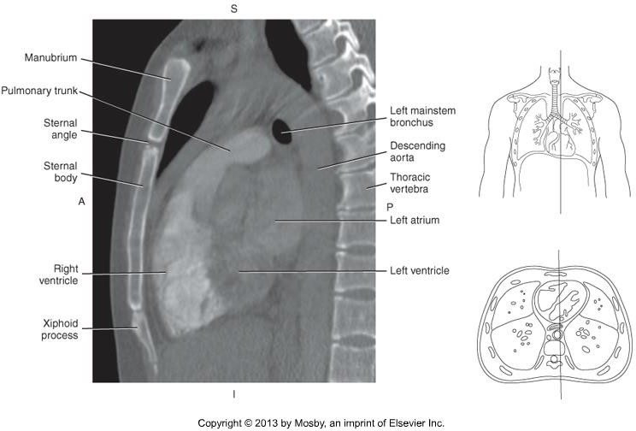
CT Imaging of the Chest

Slide 6
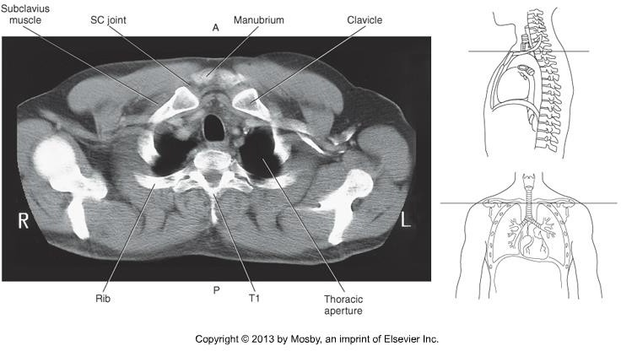
CT Imaging of the Chest

Slide 7
CT Imaging of the Chest
Pleural Cavities
  Pleura is the serous membrane that lines the pleural cavity, containing each lung.
  2 layers:
    Parietal layer
    Visceral layer
  What is pleural effusion?

Slide 8
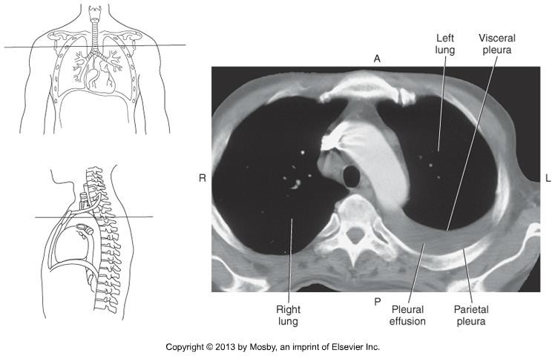
CT Imaging of the Chest

Slide 9
CT Imaging of the Chest
Lungs
Extend from the level of the 1st rib (apex) to the dome of the diaphragm (base).
Right lung
  3 lobes: superior, middle, inferior
  Oblique (major) fissure separates:
  Horizontal (minor) fissure separates:
Left lung
  2 lobes: superior, inferior
  Oblique fissure separates lobes

Slide 10
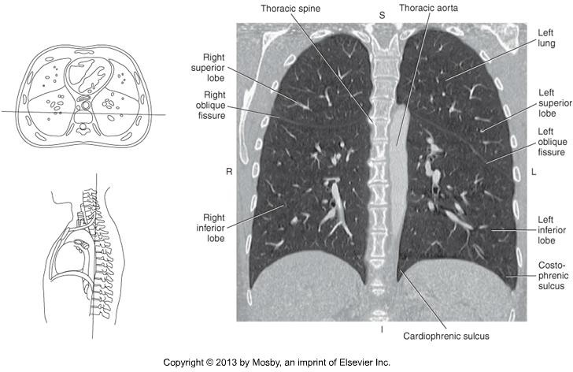
CT Imaging of the Chest

Slide 11
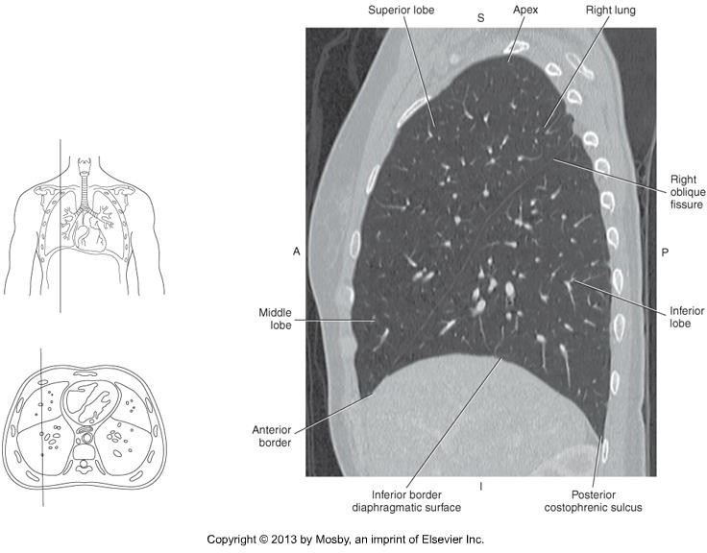
CT Imaging of the Chest

Slide 12
CT Imaging of the Chest
Hilum
  Opening on the medial surface of lung
  Passage for mainstem bronchi, vessels and nerves

Slide 13
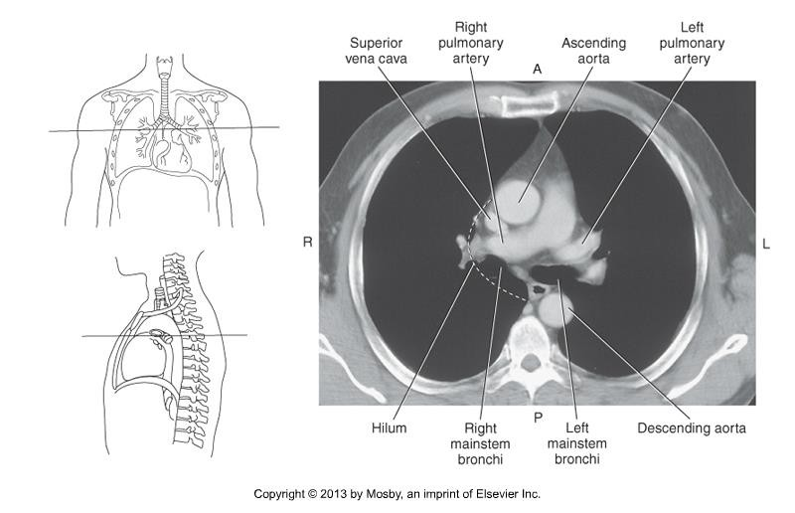
CT Imaging of the Chest

Slide 14
CT Imaging of the Chest
Bronchi
Trachea bifurcates at the level of _.
Bifurcation is called the:
Bronchial tree segments when it enters the lung via the hilum, and these secondary bronchi segments correspond to the lobe of the lung.

Slide 15
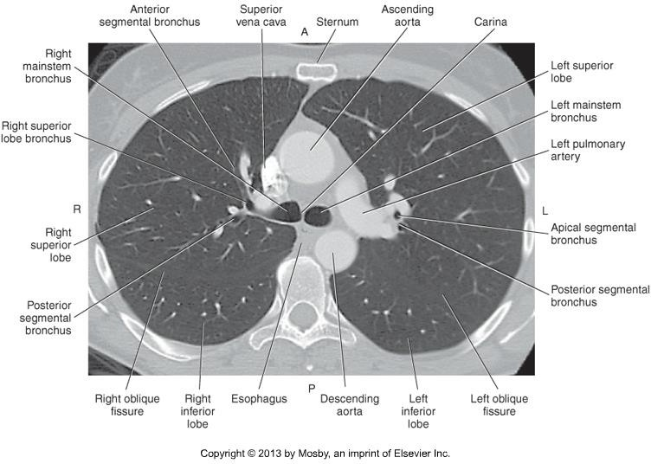
CT Imaging of the Chest

Slide 16
CT Imaging of the Chest
Mediastinum
Midline region of the thorax, between the pleural cavities of the lungs.
Superior Compartment
  Contains the gland
Inferior Compartment
  Divided into anterior, middle, and posterior compartments

Slide 17
CT Imaging of the Chest
Mediastinum
Inferior Compartment
  Anterior –
  Middle – pericardial sac, heart, roots of great vessels
  Posterior – Posterior to the pericardium and anterior to the vertebrae
Medistinum contains glands, trachea, esophagus, blood vessels, lymphatic structures, nerves, etc.

Slide 18
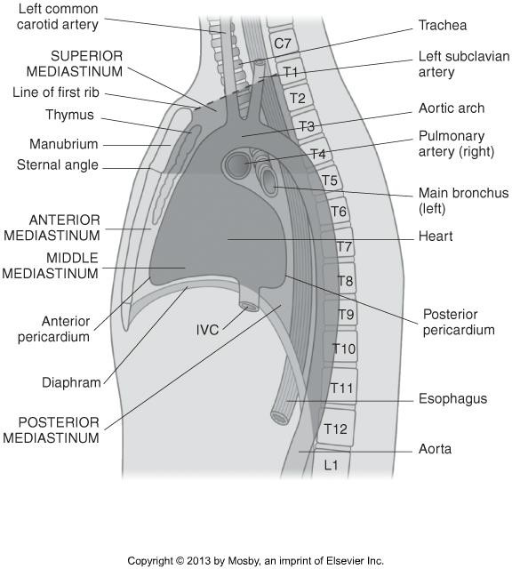
CT Imaging of the Chest

Slide 19
CT Imaging of the Chest
Thymus Gland
Triangular shaped on CT
Sits just posterior to:
Gland responsible for development of cellular immunity
Large in children, can be bigger than the heart.
Easily demonstrated on axial CT

Slide 20
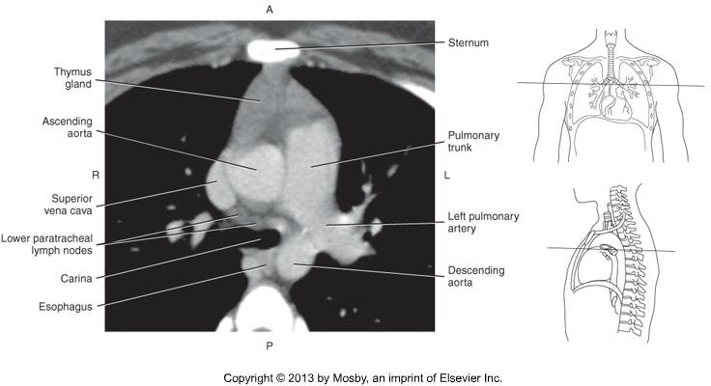
CT Imaging of the Chest

Slide 21
CT Imaging of the Chest
Trachea & Esophagus
Trachea is _ __ to the esophagus
Trachea is air filled.
Esophagus is oval-shaped structure, remains unenhanced unless:

Slide 22
CT Imaging of the Chest
Review chambers of the heart
  Right atrium
  Right ventricle
  Left atrium
  Left ventricle
Should be able to identify chambers on CT chest
Review blood flow through the heart = matches flow of contrast!
Myocardium on left ventricle is up to 3x thicker than that of right ventricle.

Slide 23
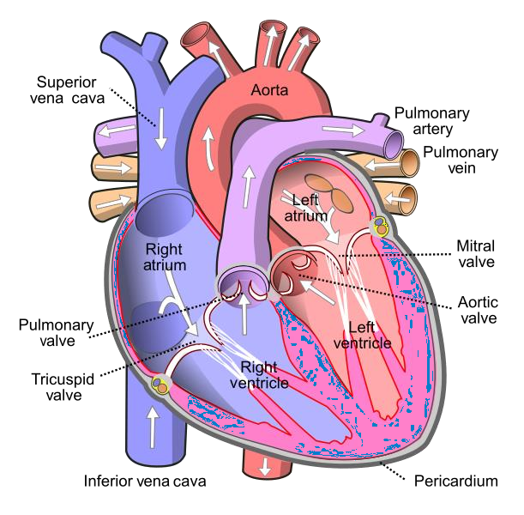
CT Imaging of the Chest
Image Source: https://en.wikipedia.org/wiki/File:Diagram_of_the_human_heart_(cropped).svg

Slide 24
CT Imaging of the Chest
Chambers of the Heart on CT

Slide 25
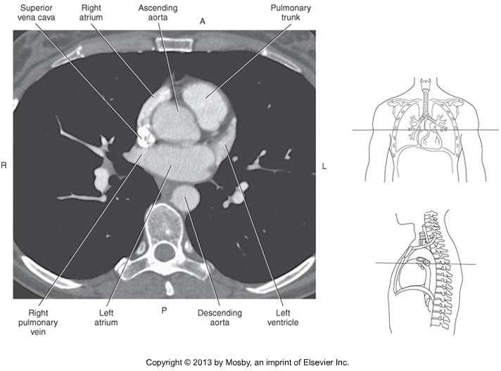
CT Imaging of the Chest

Slide 26
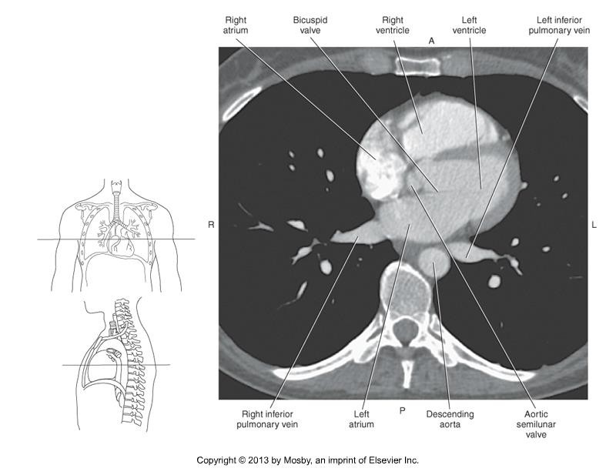
CT Imaging of the Chest

Slide 27
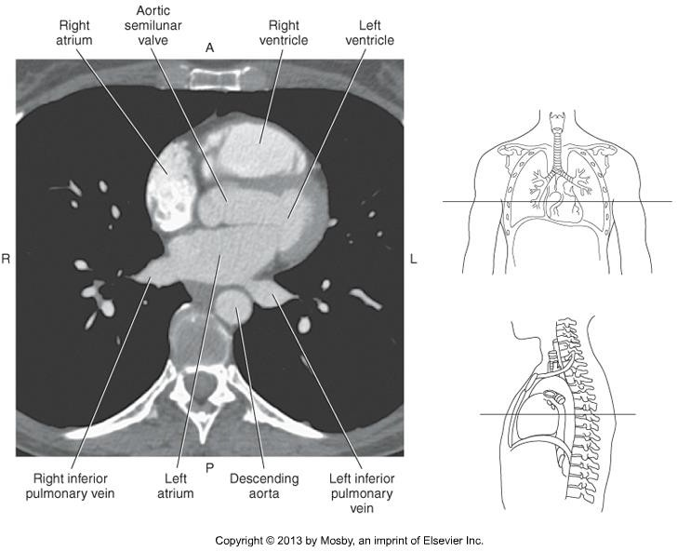
CT Imaging of the Chest

Slide 28
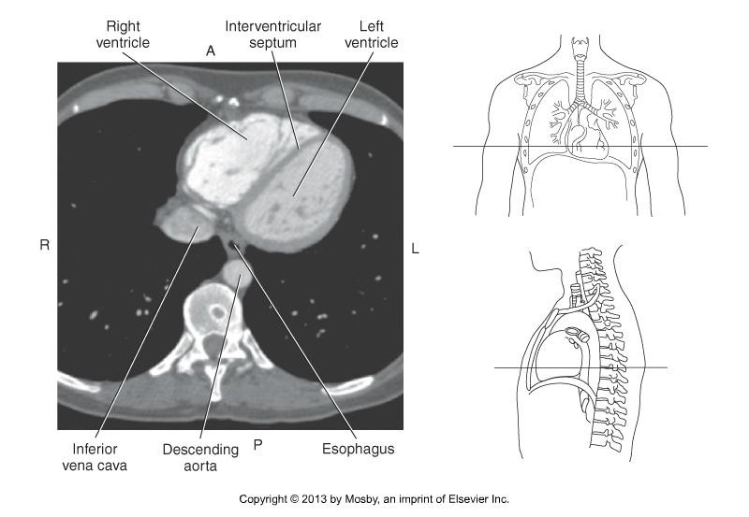
CT Imaging of the Chest

Slide 29
CT Imaging of the Chest
Great vessels
Aorta
  Ascending
•
  Descending
Pulmonary Trunk
  Divides into right and left pulmonary arteries

Slide 30
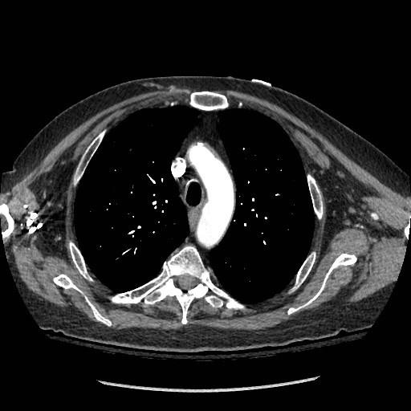
CT Imaging of the Chest

Slide 31
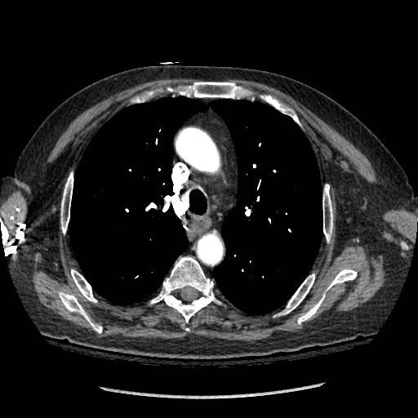
CT Imaging of the Chest

Slide 32
CT Imaging of the Chest
Branches off the aortic arch
  Brachiocephalic trunk
  Left common carotid artery
  Left subclavian artery
Brachiocephalic trunk extends to level of right SC joint and bifurcates into the:
•
•
Left Common Carotid – level of:
Left Subclavian – posterior to the left common carotid, and arches laterally

Slide 33
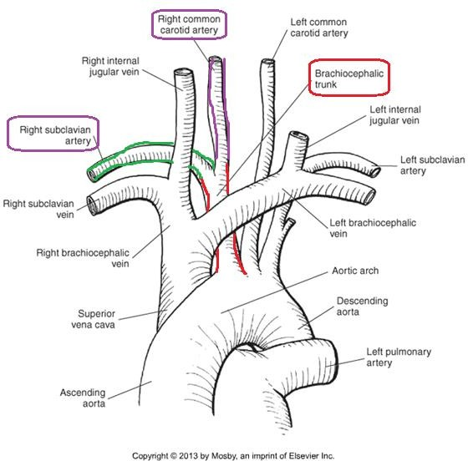
CT Imaging of the Chest

Slide 34
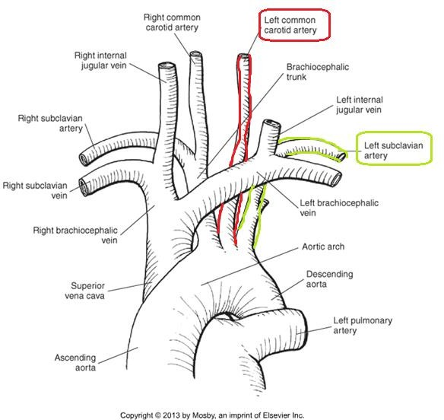
CT Imaging of the Chest

Slide 35
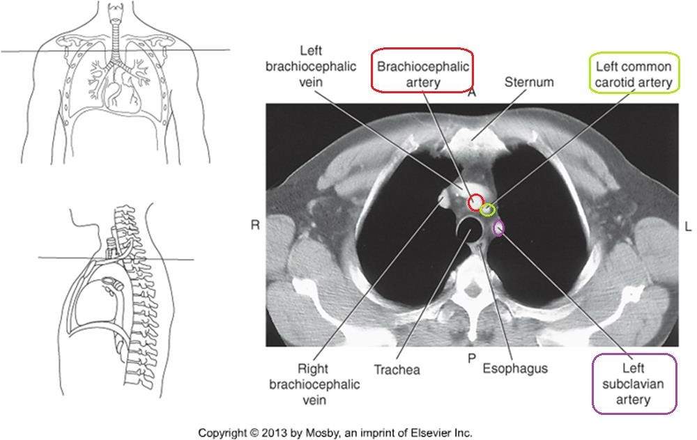
CT Imaging of the Chest

Slide 36
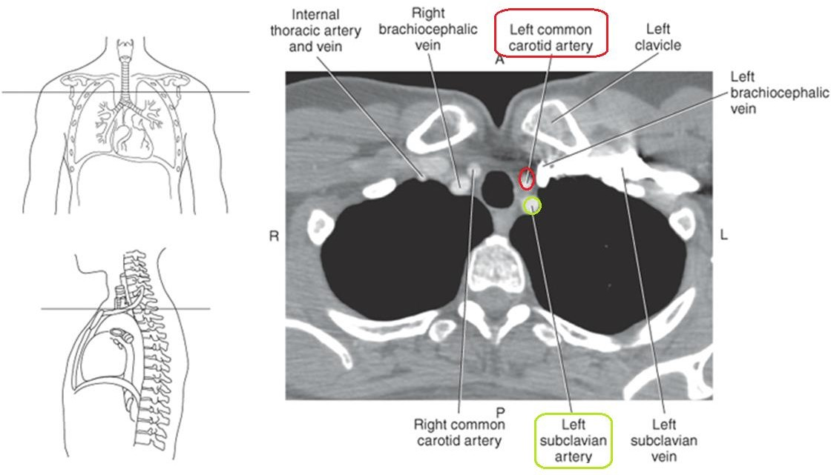
CT Imaging of the Chest

Slide 37
CT Imaging of the Chest
Tributaries of the SVC
  Internal Jugular Veins
  Subclavian Veins – run along the posterior aspect of the clavicles
  Brachiocephalic veins – junction of
, posterior to the SC joints.
  SVC – junction of the right and left brachiocephalic veins, just posterior to the 1st rib

Slide 38
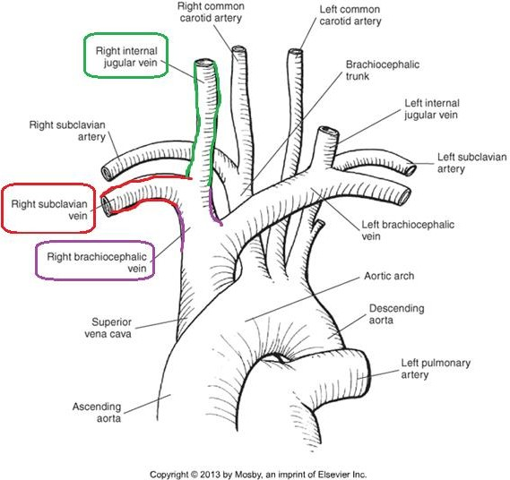
CT Imaging of the Chest

Slide 39
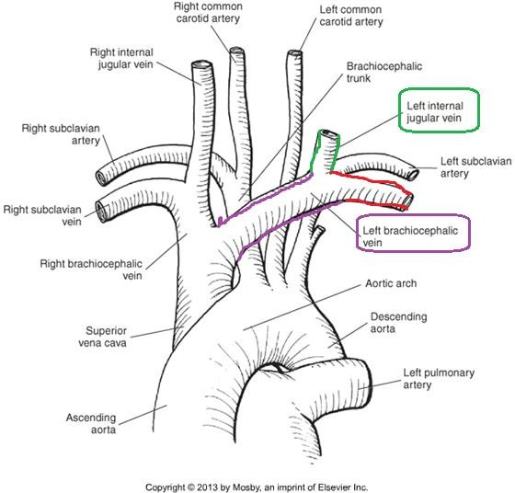
CT Imaging of the Chest

Slide 40
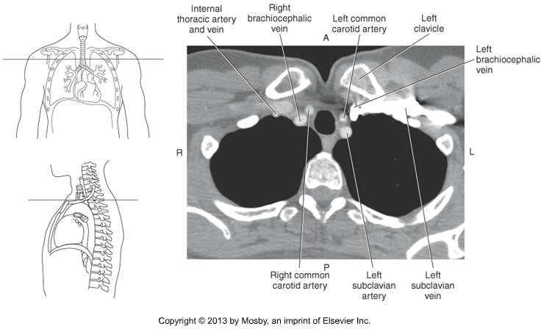
CT Imaging of the Chest

Slide 41
CT Imaging of the Chest
General TIPS!
  Veins are big & fat. Arteries are smaller and rounder.
  Brachiocephalic veins will not be seen on the same axial slices are the subclavian &
internal jugular veins.
  When looking at an axial slice through the superior chest, from medial to lateral:
    Common Carotid arteries
    Internal jugular veins
    Subclavian vein & arteries
  Subclavian veins are anterior to subclavian arteries
  Subclavian veins are horizontal, BELOW the level where subclavian arteries are
horizontal
  Left subclavian artery is most posterior off the aortic arch

Slide 42
CT Imaging of the Chest
Summary
Review anatomy of the chest, and its vasculature.
The lymphatic system, coronary circulation, off-axis cardiac imaging, muscles, and breast will not be tested on.
Use knowledge of relational anatomy to find structures when given a single CT image.

