Slide 1


Radiofrequency Microneedling

Slide 2
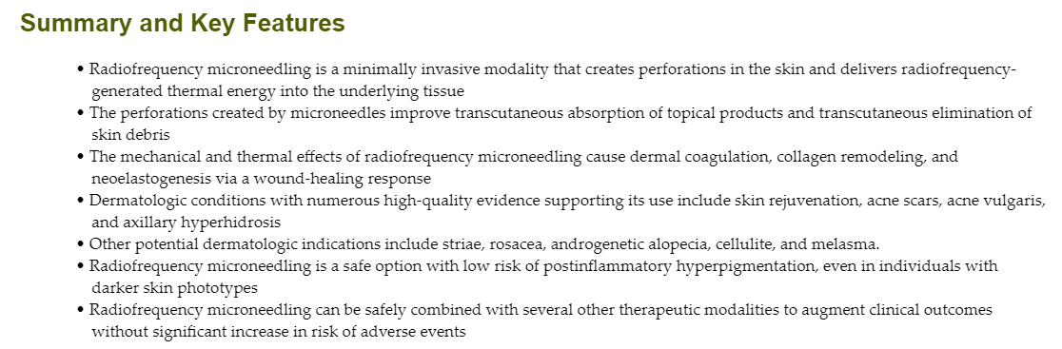

Slide 3
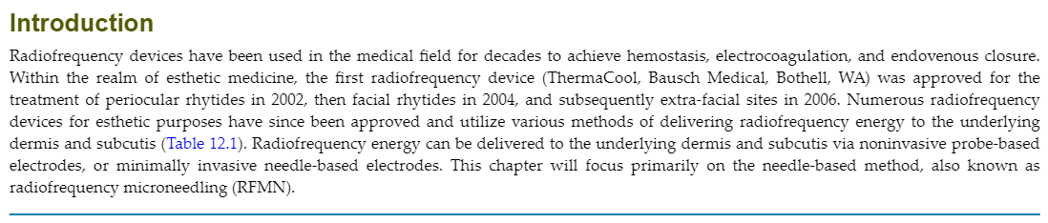

Slide 4
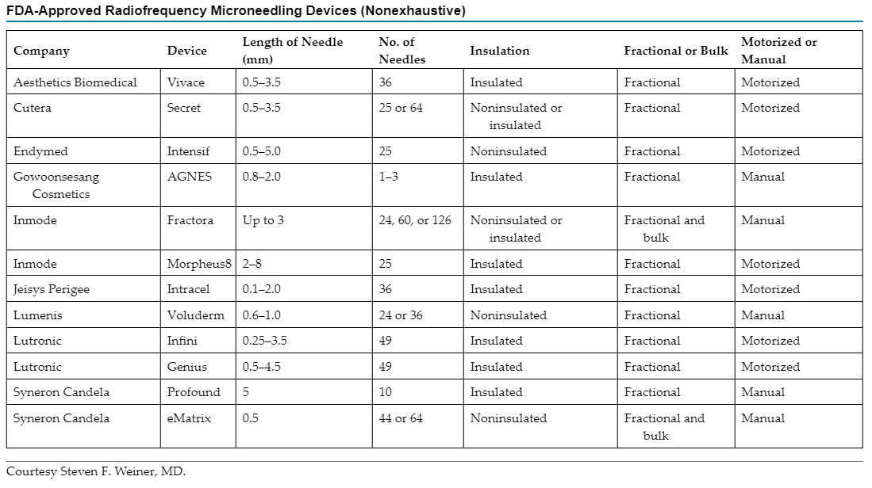

Slide 5
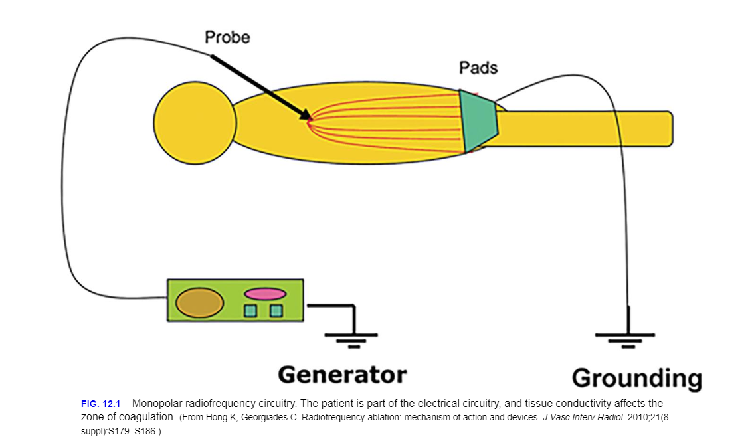

Slide 6
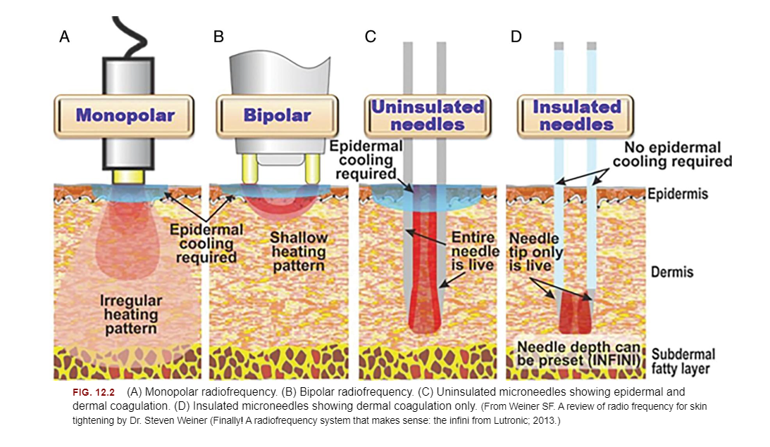

Slide 7
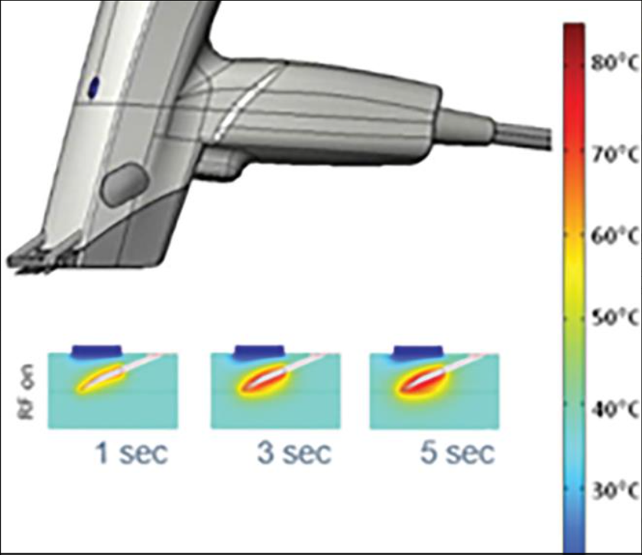
Collagen Remodeling

Slide 8
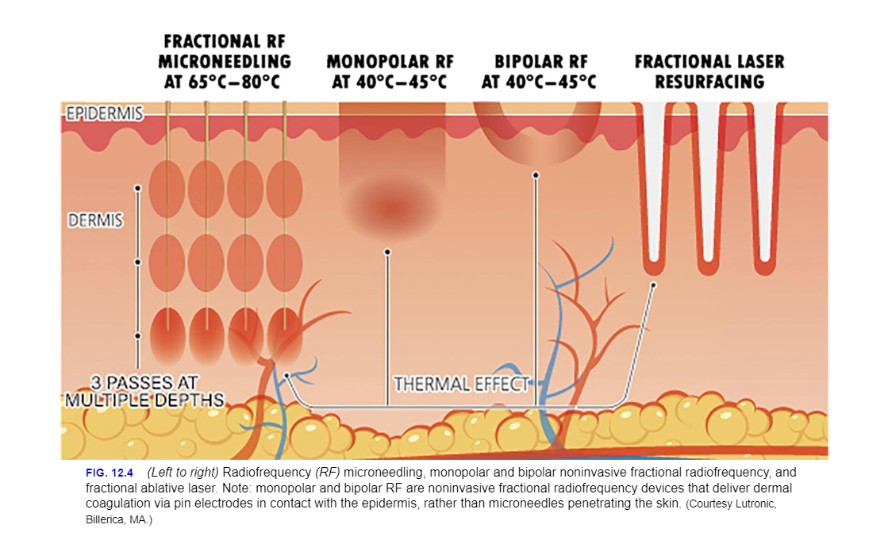
Epidermal Protection

Slide 9
Radiofrequency Versus Lasers
Lasers function on the theory of selective photothermolysis,
Radiofrequency energy is directly delivered to the target depth through the microneedle electrodes, thus creating a temperature gradient that is highest in the deeper structures and cooler at the superficial structures. This results in less epidermal heating and reduces the risk of PIH. Compared to lasers, radiofrequency energy can also be delivered to deeper structures of the skin through increasing the depth of penetration or length of microneedle electrodes.

Slide 10
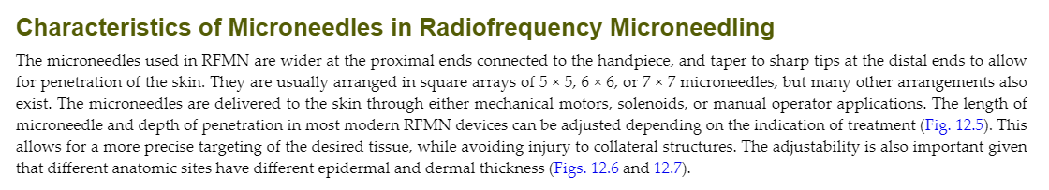

Slide 11
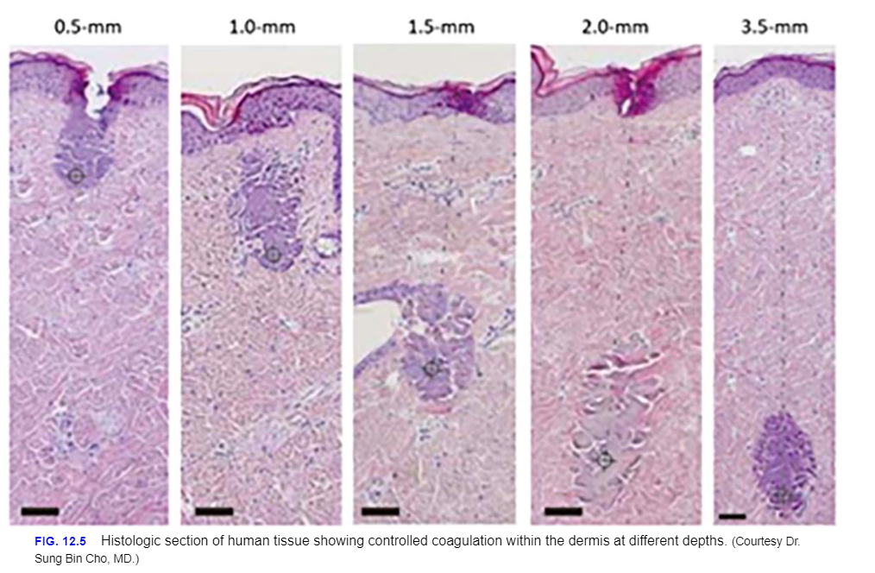

Slide 12
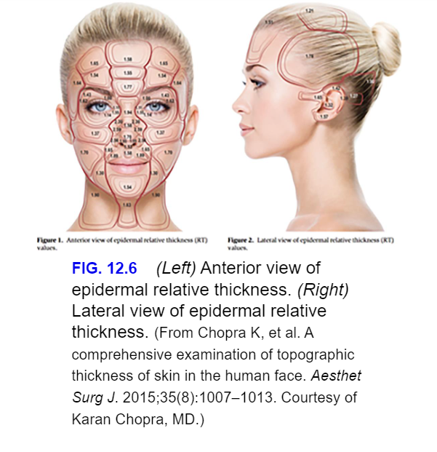

Slide 13
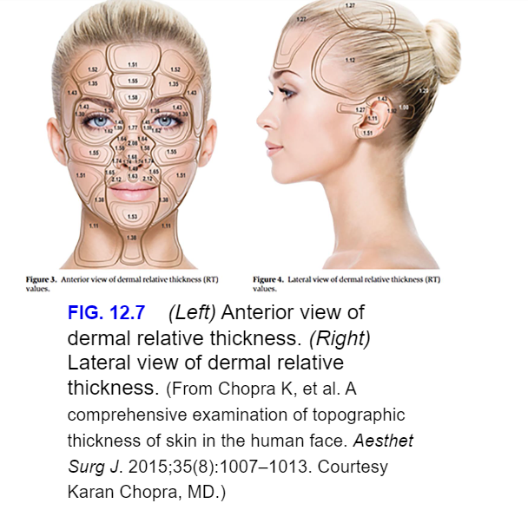

Slide 14
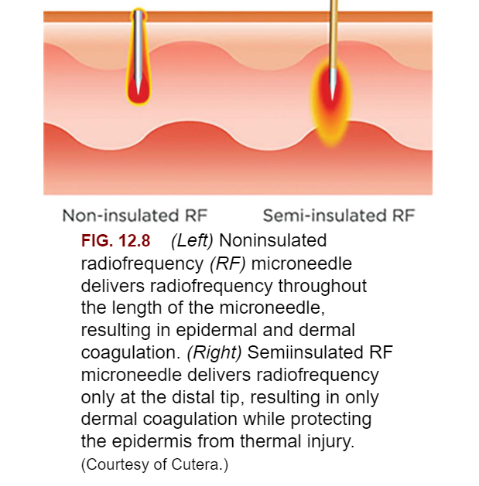

Slide 15
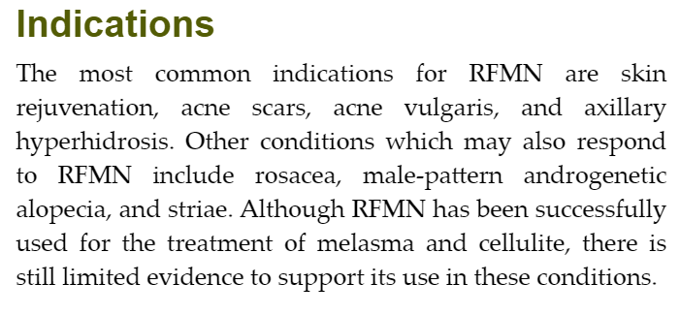

Slide 16
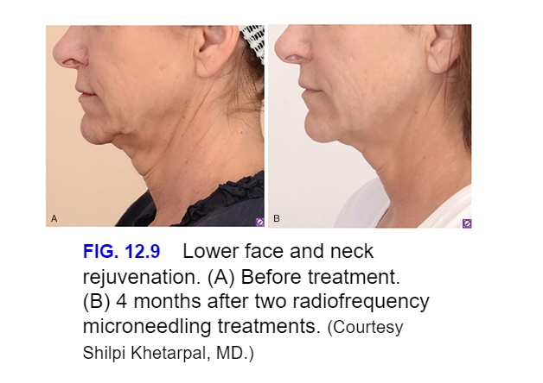

Slide 17
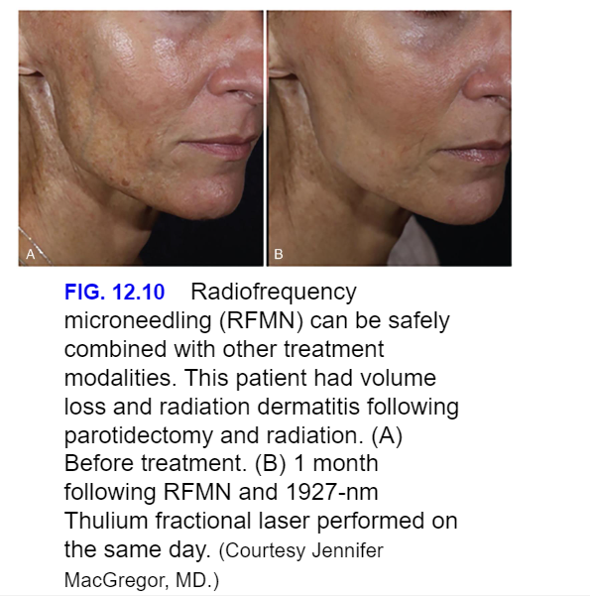

Slide 18
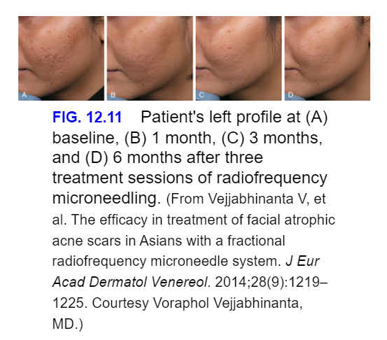

Slide 19
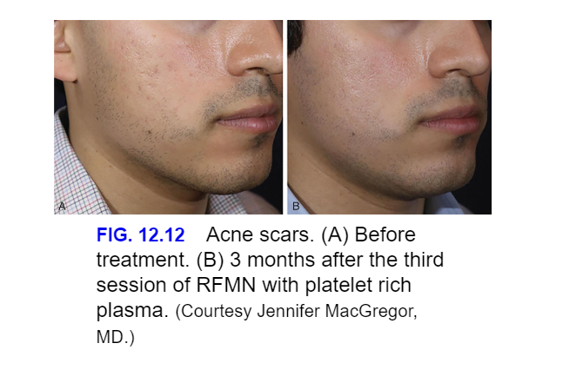

Slide 20
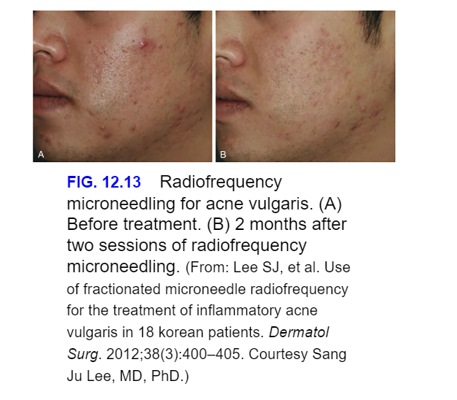

Slide 21
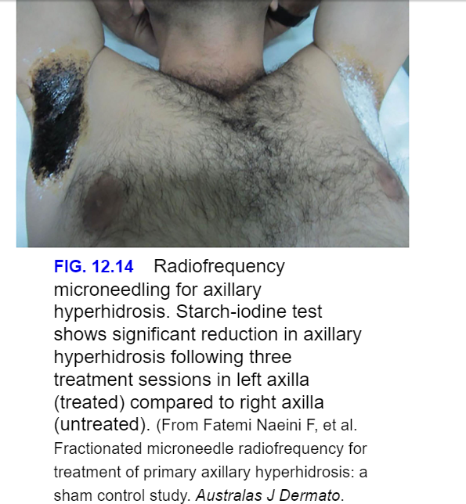

Slide 22
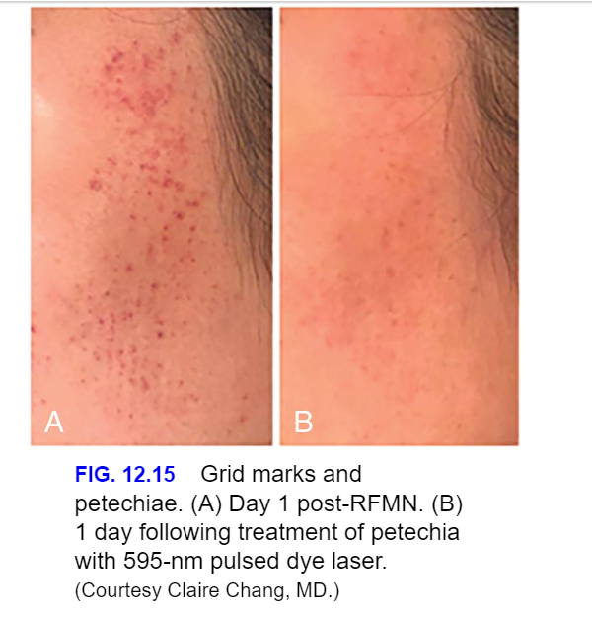

Slide 23
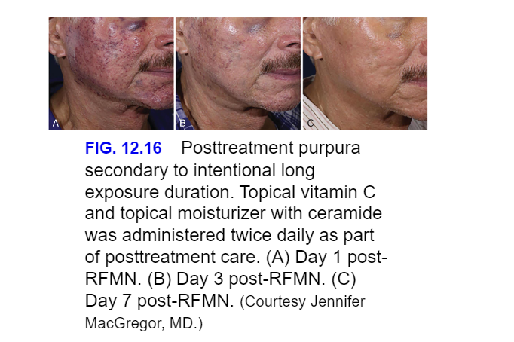

Slide 24
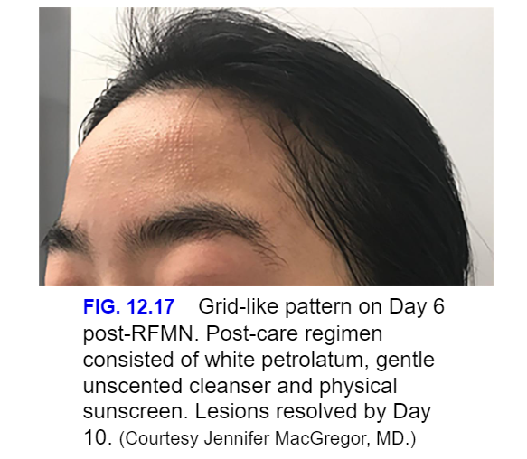

Slide 25
Absolute Contraindications
Active infection
Pregnancy lactation
Cardiac Pacemaker and Cardiac Defibrillator
Metal Implants

Slide 26
Relative Contraindications
Unrealistic Patient Expectations
History of Keloid or Significant Scarring
History of Orolabial Herpes
Previous Deep Chemical Peels, Deep Laser Resurfacing, Prior Surgery, or Skin Grafts
Isotretinoin Use
Dermatologic Diseases That Exhibit Koebner Phenomenon

Slide 27
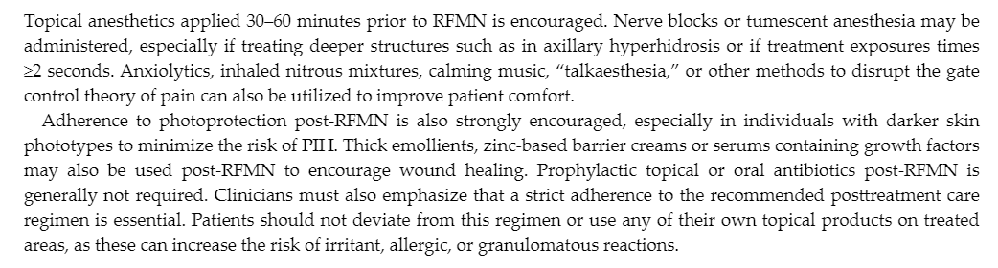
Pretreatment and Posttreatment
Regimens

Slide 28
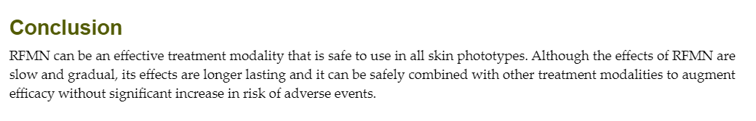

Slide 29

QUESTIONS?

