Slide 1


Peels in Men

Slide 2
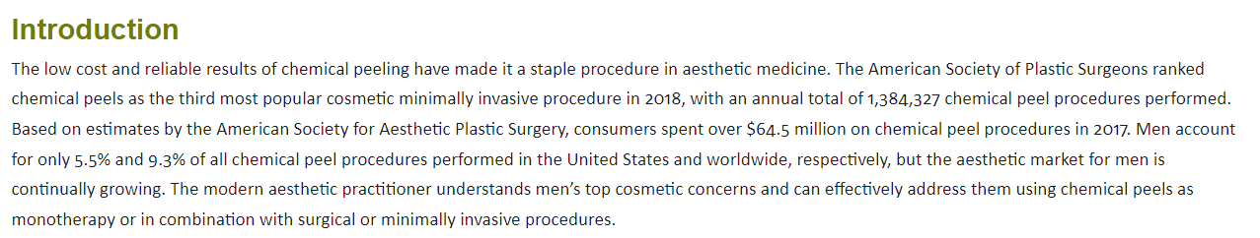
Peels in Men

Slide 3
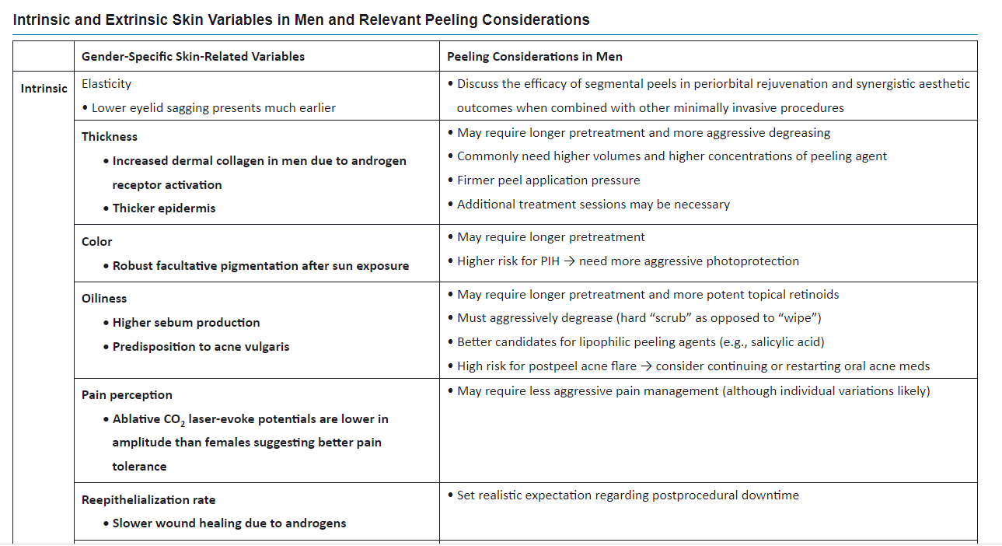
Intrinsic Gender-Linked Skin Differences Relevant to Chemical Peeling

Slide 4
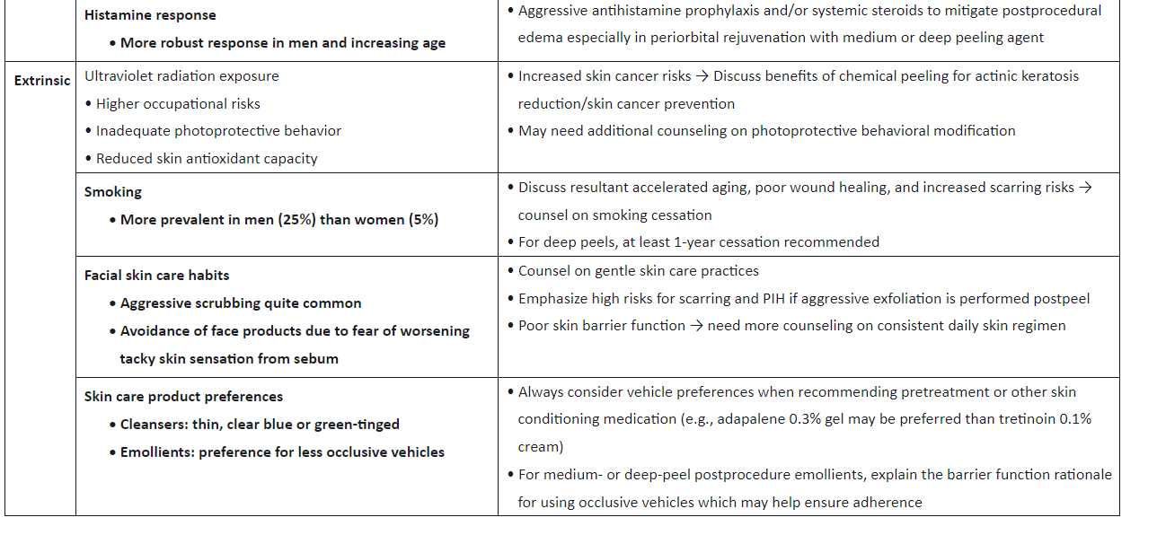

Slide 5
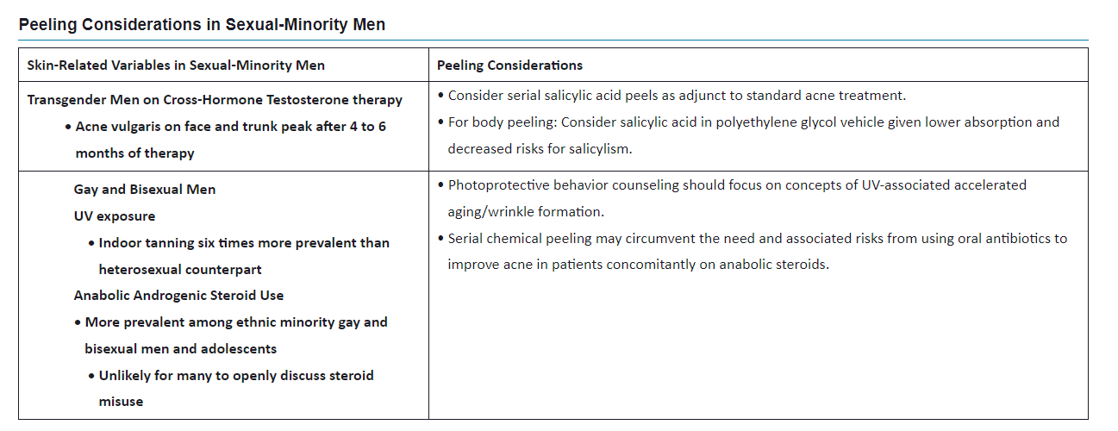
Extrinsic Gender-Linked Skin Differences Relevant to Chemical Peeling

Slide 6
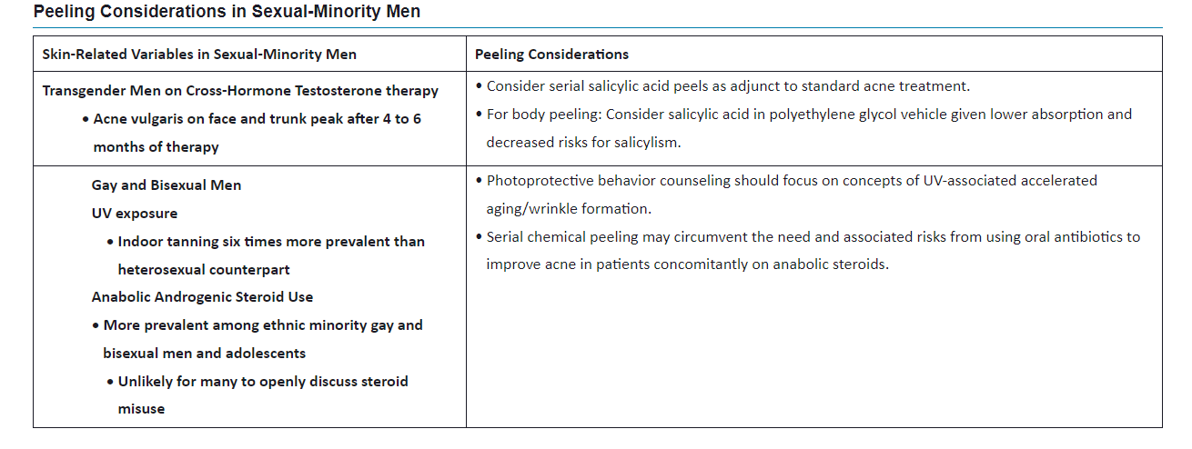
Peeling Considerations in Sexual-Minority Men

Slide 7
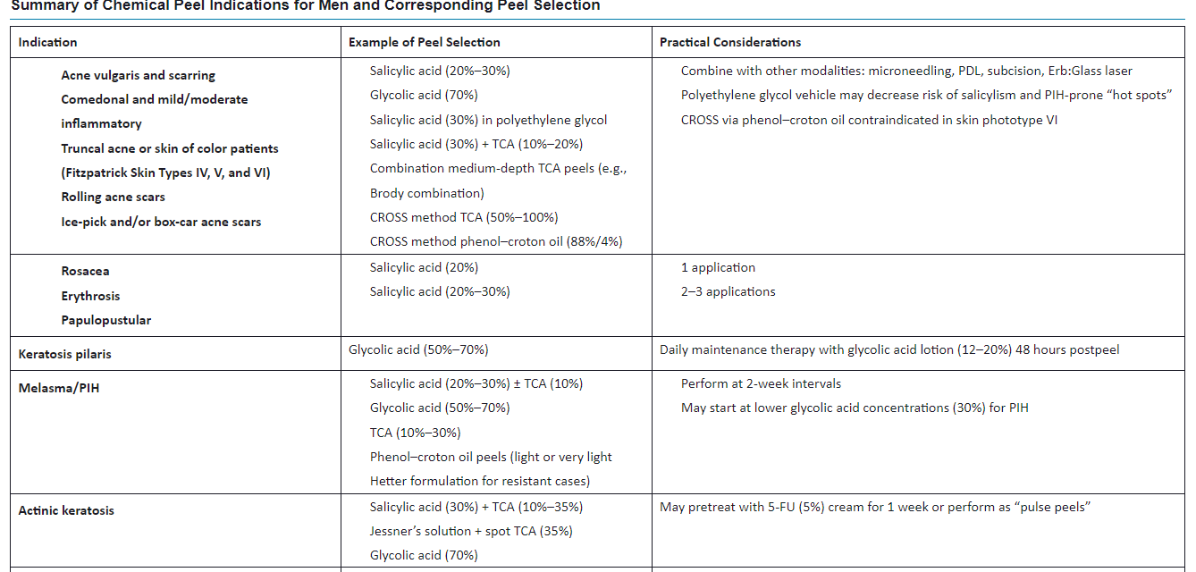
Overview of Treatment Strategy Indications

Slide 8
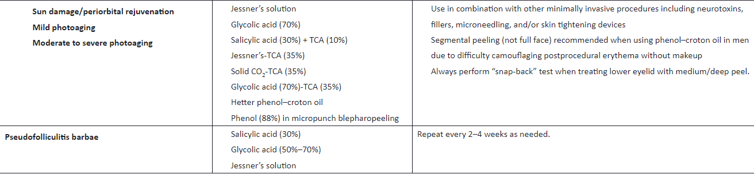

Slide 9
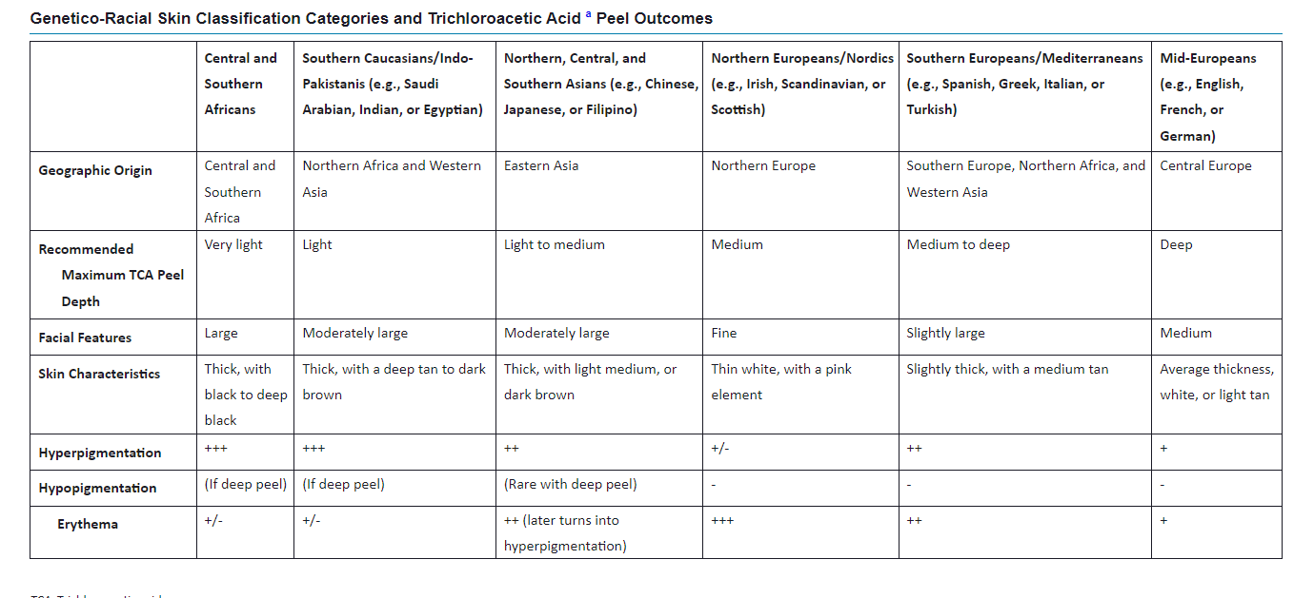

Slide 10
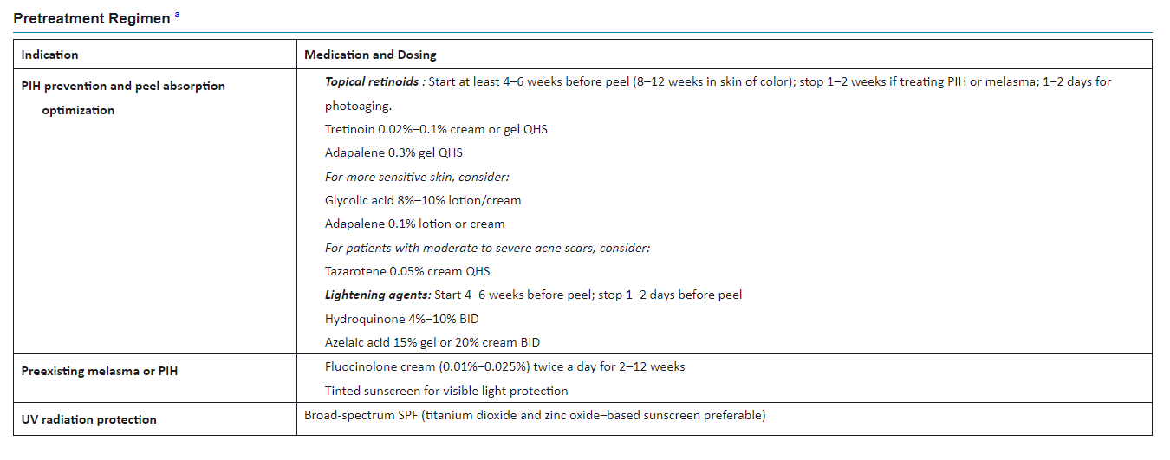

Slide 11
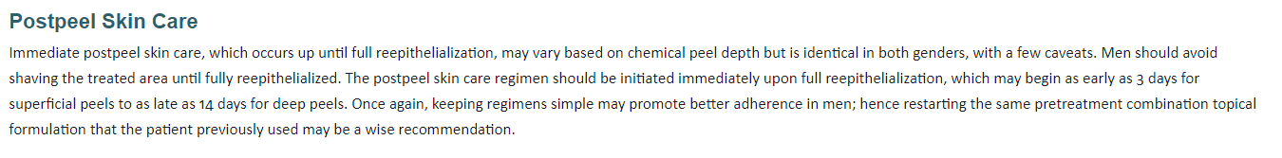

Slide 12
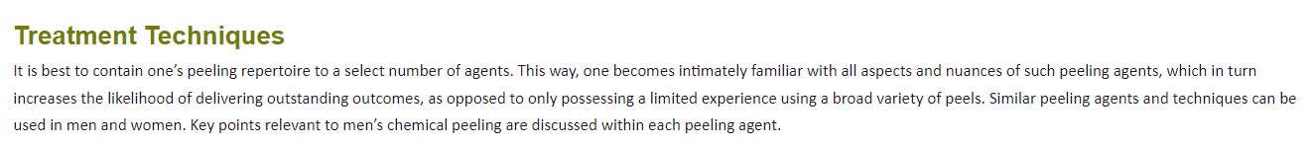

Slide 13
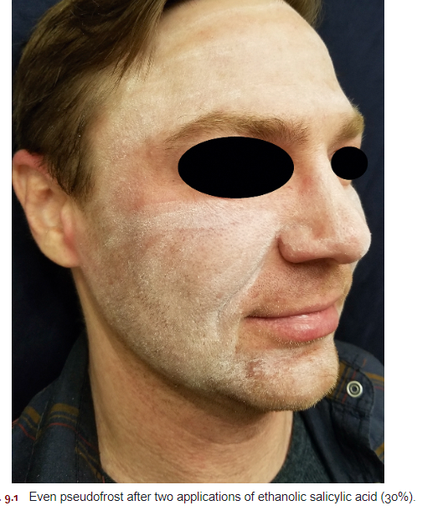
Salicylic Acid Peel

Slide 14
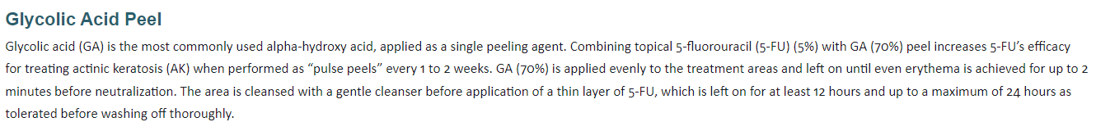

Slide 15
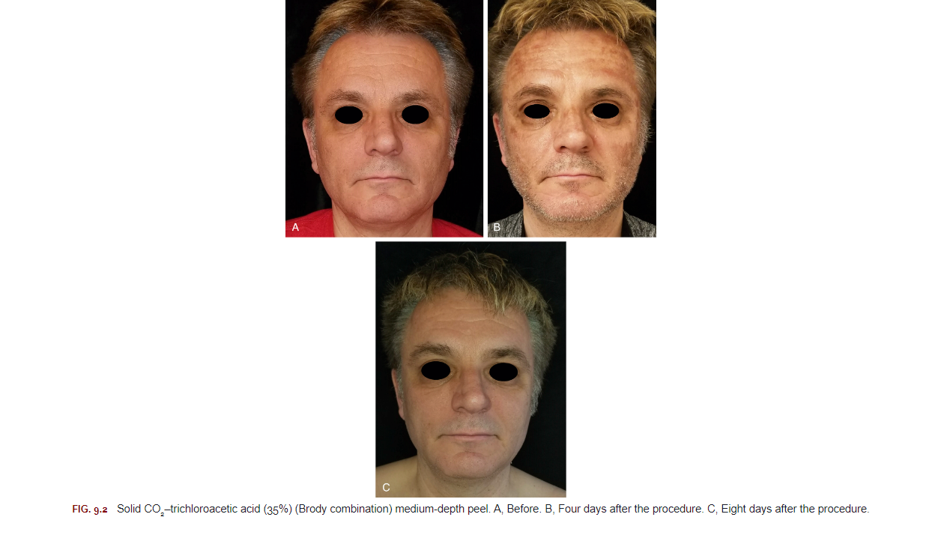
Trichloroacetic Acid, Combination Medium-Depth Peels, and Chemical Reconstruction of Skin Scars Technique
Phenol-Croton Oil Peel

Slide 16
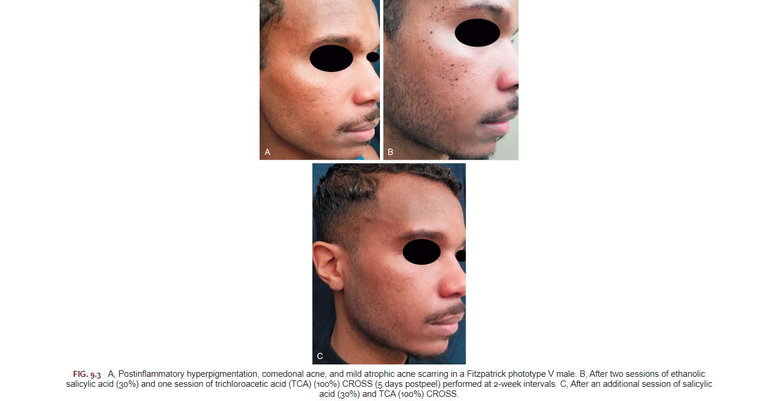

Slide 17
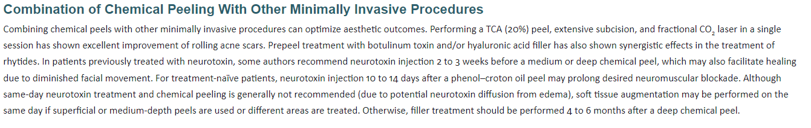

Slide 18
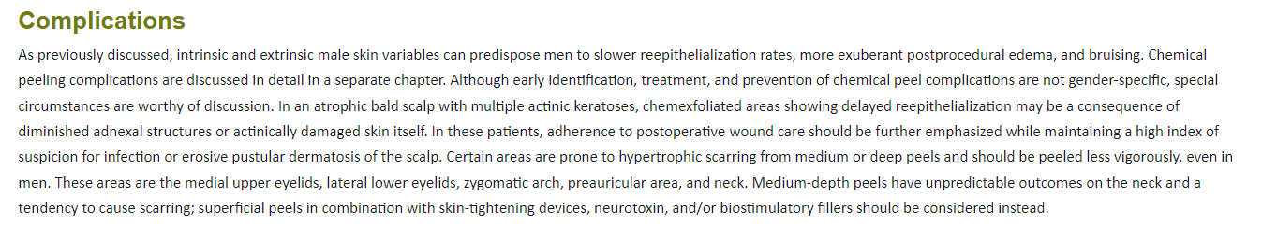

Slide 19
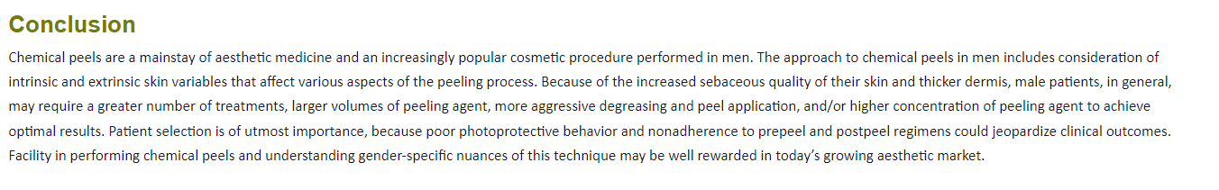

Slide 20

QUESTIONS?

