Slide 1
MRAD 256
Radiographic Technique 2
Positioning of the Lumbar Spine

Slide 2
Lumbar spine protocols
Hospital Routine
AP
Lateral
Lateral L5- S1 /spot
Clinic Routine
AP
Lateral
Lateral L5- S1 /spot
Bilateral obliques

Slide 3
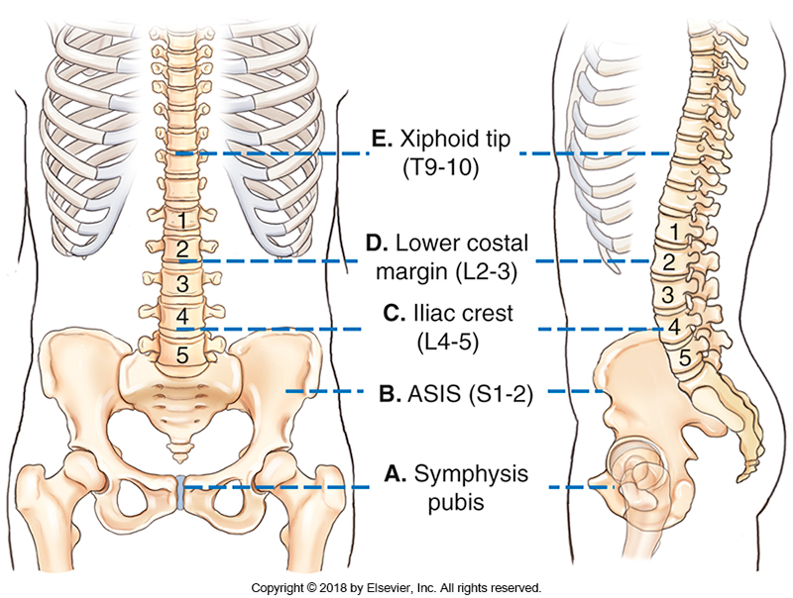
External Landmarks

Slide 4
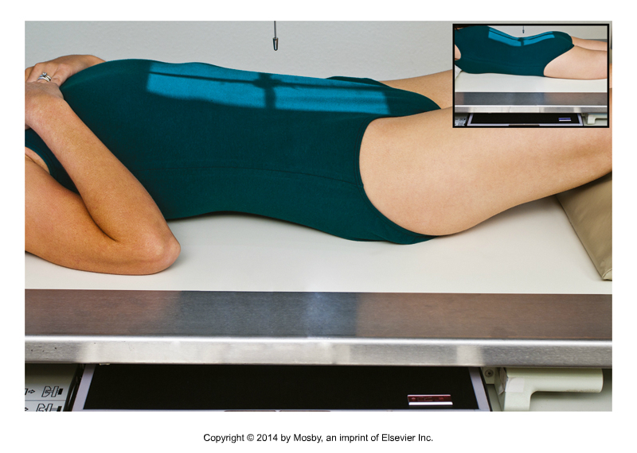
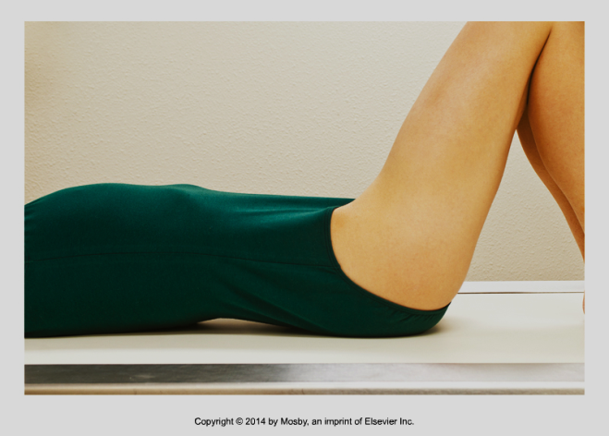
AP Projection
110 cm SID
Patient is supine, ensure they are not tilted or rotated on the table
Patient’s knees are flexed
Center at a point between the LCM (L2-3) and TOP of iliac crests (L4-5)
Collimate lengthwise to include all anatomy from T12/L1 to inferior margin of SI joints, using the diverging rays
Side to side collimation on the patient is 5 cm (2 inches) medial to the ASIS
Expose at end of expiration
Flex knees to reduce lordotic curve
Bontrager 9th ed. 9-28 and 9-25

Slide 5
Check Diverging Rays
Note: The inferior aspects of the SI joints are just below the inferior margins of the ASIS’s
T12/L1
SI joint
Bontrager 9th ed. 9-28

Slide 6
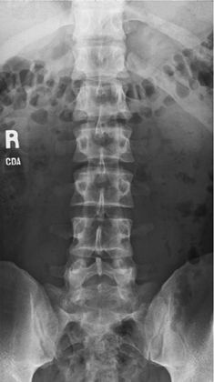
Structures Shown
T12/L1 joint-spaces
L1 thru L5
SI joints

Slide 7
Evaluation Criteria
sacroiliac joints equidistant to vertebral column
R and L transverse processes equal in length
Spinous processes centered to spine
No rotation of pelvis

Slide 8
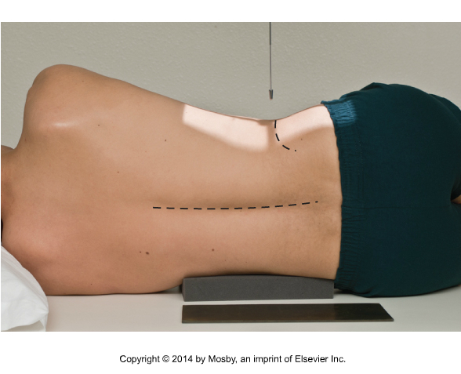
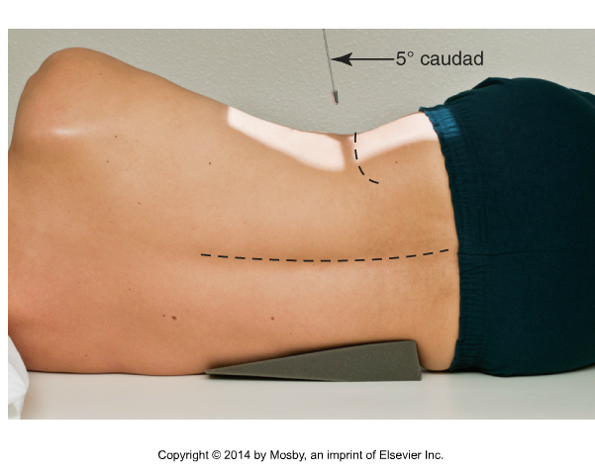
Lateral Lumbar Spine
CR must be ┴ to the spine
If the spine is not parallel to the table place a sponge under the waist as shown
angle 5-8˚caudad if necessary to compensate for angle of lumbar spine
Bontrager 9-34, 9-35
Notes:
May do upright
Place a small sponge between knees

Slide 9
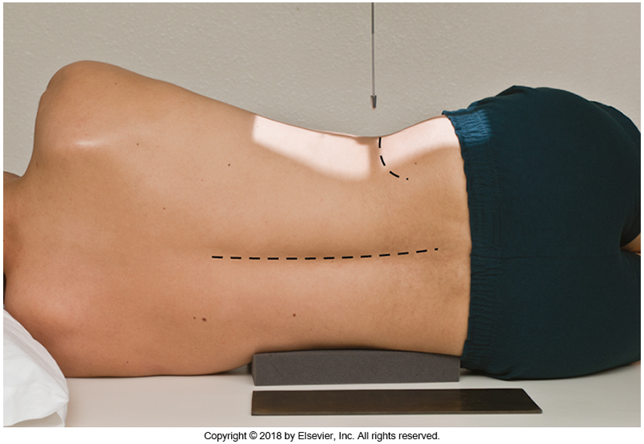
Lateral lumbar spine
SID - 110cm
Place patient in left lateral and flex knees and arms to 90 degrees from body
Ensure that CR is ┴ to the spine
Center at a point between the LCM (L2-3) and TOP of iliac crests (L4-5) and just posterior to MCP
Collimate to ensure inclusion of T12 and ASIS in diverging rays lengthwise and to include tips of spinous processes posteriorly and all of the vertebral bodies anteriorly, where the edge of the light is 2cm posterior to the ASIS
Suspend at end of expiration
T12/L1
ASIS
L3
Bontrager 9th ed. 9-34
Notes:
May do upright
Place a small sponge between knees

Slide 10
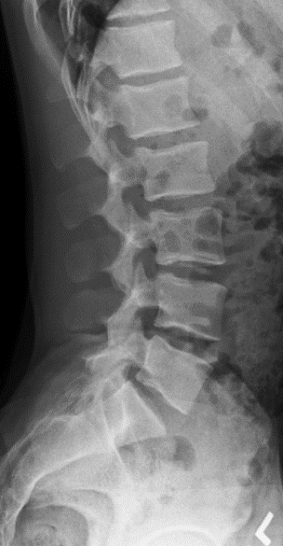
Evaluation Criteria: Structures Shown
All lumbar vertebrae
Intervertebral disc spaces T12 to S1
Intervertebral foramina L1 to L4

Slide 11
Evaluation Criteria: Positioning
No tilt: Open intervertebral disk spaces
No rotation: posterior edges of vertebral bodies superimposed
Nearly superimposed iliac crests (if no angle on the tube)

Slide 12
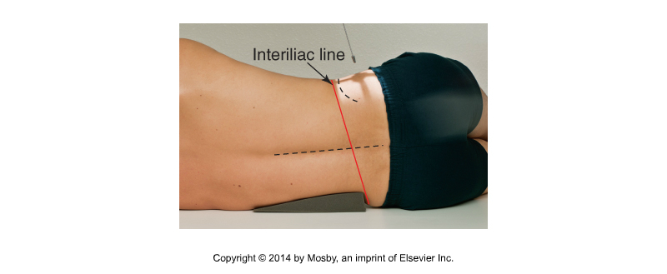
L5-S1 Spot
To demonstrate an open L5/S1 joint space, the central ray must be oriented to the joint. This will require a tube angle on some patients, but not others.

Slide 13
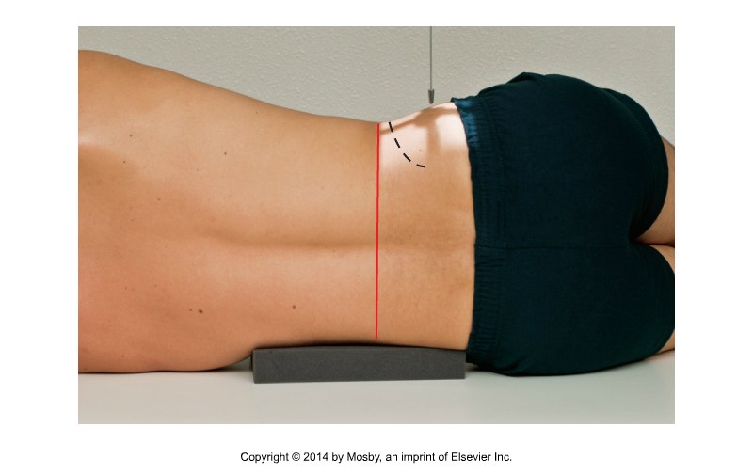
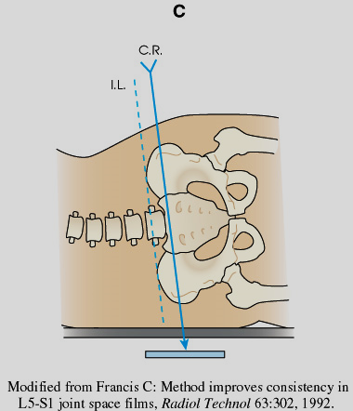
L5-S1 Spot (Lumbosacral Junction)
Find the interiliac line and place the CR parallel to the joint space:
Fig 8-93 Frank, Eugene D., Long, Bruce W., Smith, Barbara J., (2016). Merrill's Atlas of Radiographic Positioning and Procedures (13th ed.). St. Louis, MO: Elsevier Mosby. pg. 419
Bontrager 9-38, 9-39
Notes:
May do upright
Place a small sponge between knees

Slide 14
L5-S1- Lumbosacral Junction (Spot)
Center ~ 4-5 cm inferior to crest and 4-5 cm posterior to ASIS
Collimate to the size of the joint, 10 x 10 cm will be our standard
Suspend respiration
Each instructor has their own trick for finding the L5 S1 joint. Use the method that best suits you, but the measurement method is mentioned in Bontrager
Bontrager 9-38, 9-39
Notes:
Extend hips if possible

Slide 15
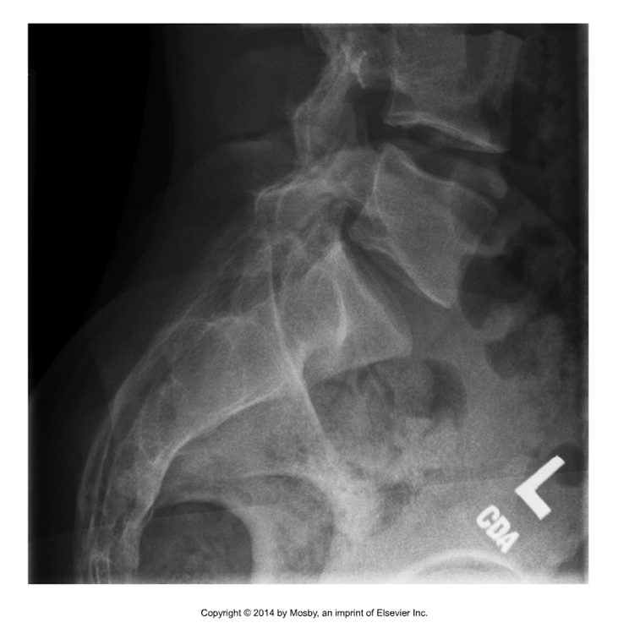
Evaluation Criteria
L5/S1 centered in image
Open L4/L5 and L5/S1 joint spaces
No rotation
Close collimation
Bontrager 9th ed. 9-40

Slide 16
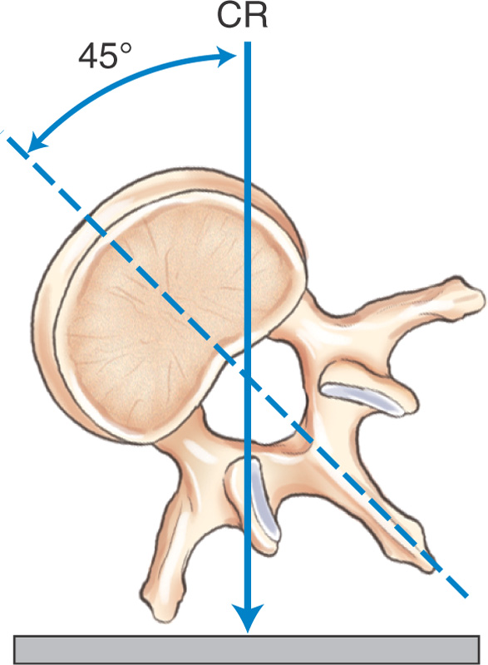
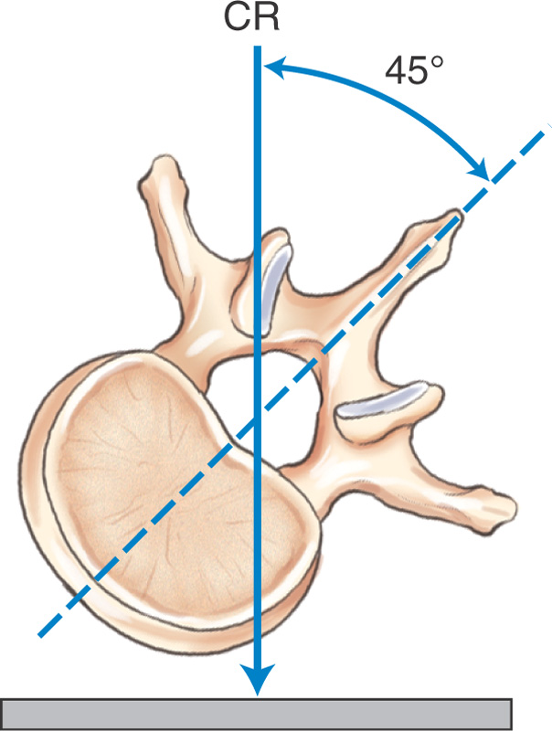
Lumbar obliques are taken to demonstrate zygapophyseal joints
Oblique Projections
Anterior oblique – upside joints visualized
Posterior oblique – downside joints
visualized
Bontrager 9-18

Slide 17
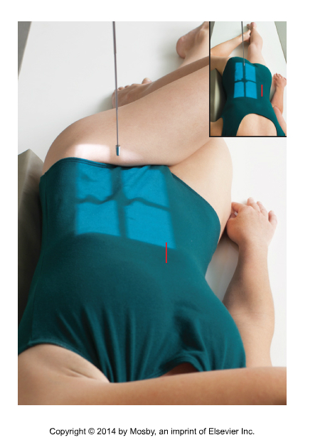
AP Oblique Projection- RPO
ASIS (in corner of light field)
SID – 110 cm
Average rotation of MCP - 45
Center over lumbar spine, using a point between the LCM (L2-3) and TOP of iliac crests (L4-5) for horizontal line and about 5 cm medial to the upside ASIS, such that it is a point midway between mid sagittal plane and mid coronal plane
The bottom of the lateral light field is on the ASIS
The top of the light field will include T12 in diverging rays
Expose on expiration
Support hips and shoulders on a 45˚ sponge
Cross upside arm to opposite shoulder to get 50° rotation of MCP
Bontrager 9th ed. 9-31
Notes:
may do erect)
Place upper arm across chest
Flex lower knee

Slide 18
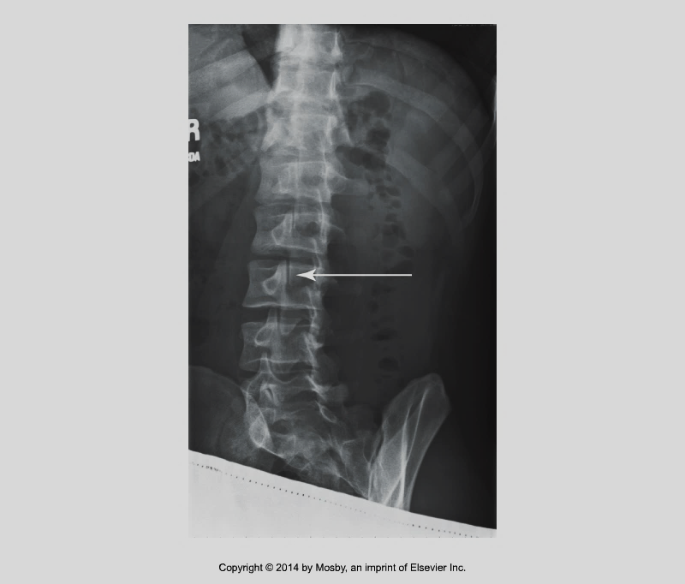
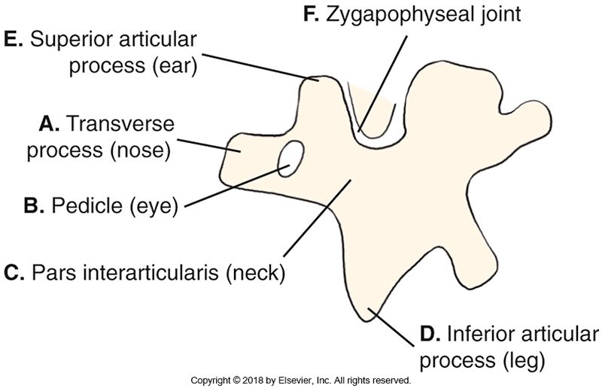
AP oblique- RPO
Bontrager 9th ed. 9-15, and 9-19

Slide 19
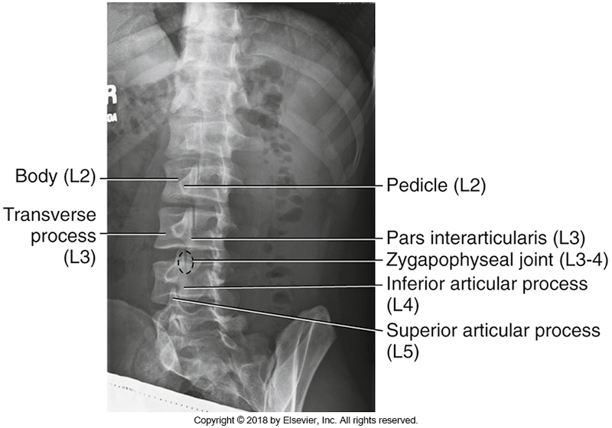
Evaluation Criteria
Unilateral zygapophyseal joints from L1 to L5
Pedicles centered in vertebral body
No tilt
Bontrager 9th ed. Fig. 9.33

Slide 20
Special Request Lumbar Spine positions
Hyperflexion lateral
Hyperextension lateral

Slide 21
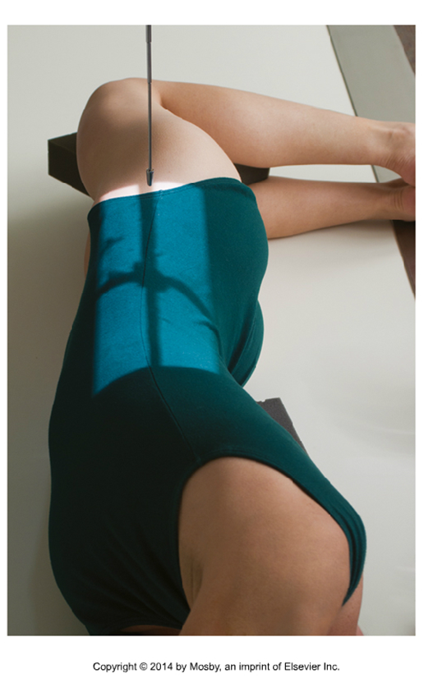
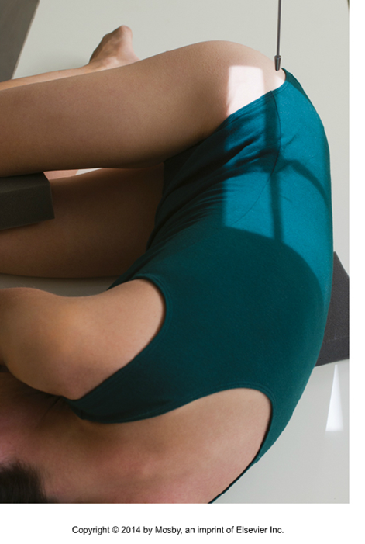
Flexion and Extension Laterals
Hyperflexion
Hyperextension
Bontrager 9-60 and 9-61

Slide 22
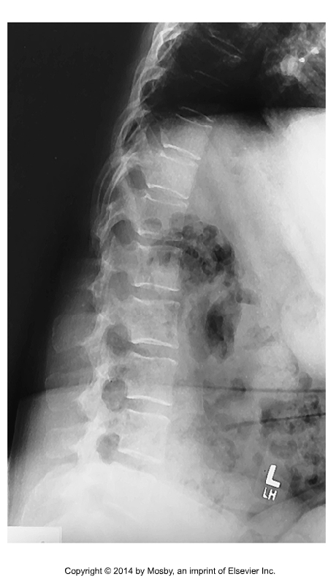
Flexion/Extension
Used to determine degree of movement in the area of a spinal fusion
Used to localize a herniated disk
Bontrager 9-62

Slide 23

Hyperflexion
(CR ┴ to spinal fusion)
Have patient lean forward and draw the thighs up to forcibly flex the spine as much as possible
Remember: use an arrow marker or annotation

Slide 24

Extension
(CR ┴ to spinal fusion)
Have patient lean the thorax backward and posteriorly extend the thighs and limbs as much possible
Remember: use an arrow marker or annotation

Slide 25
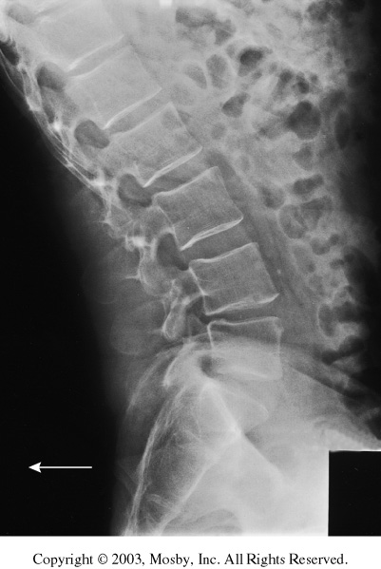
Extension
L

