Slide 1
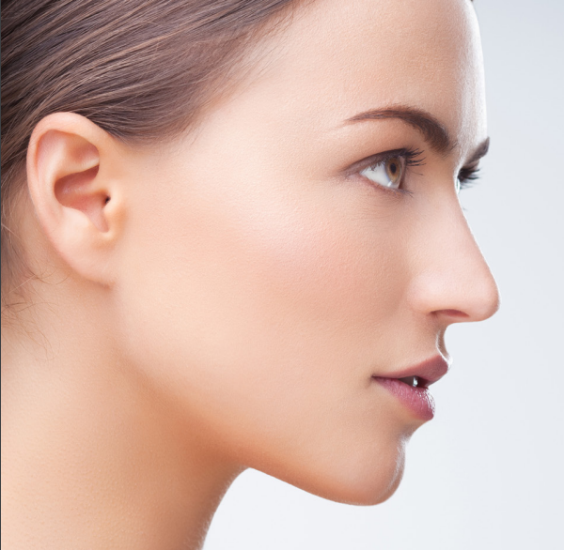
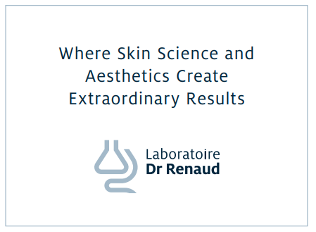

Slide 2
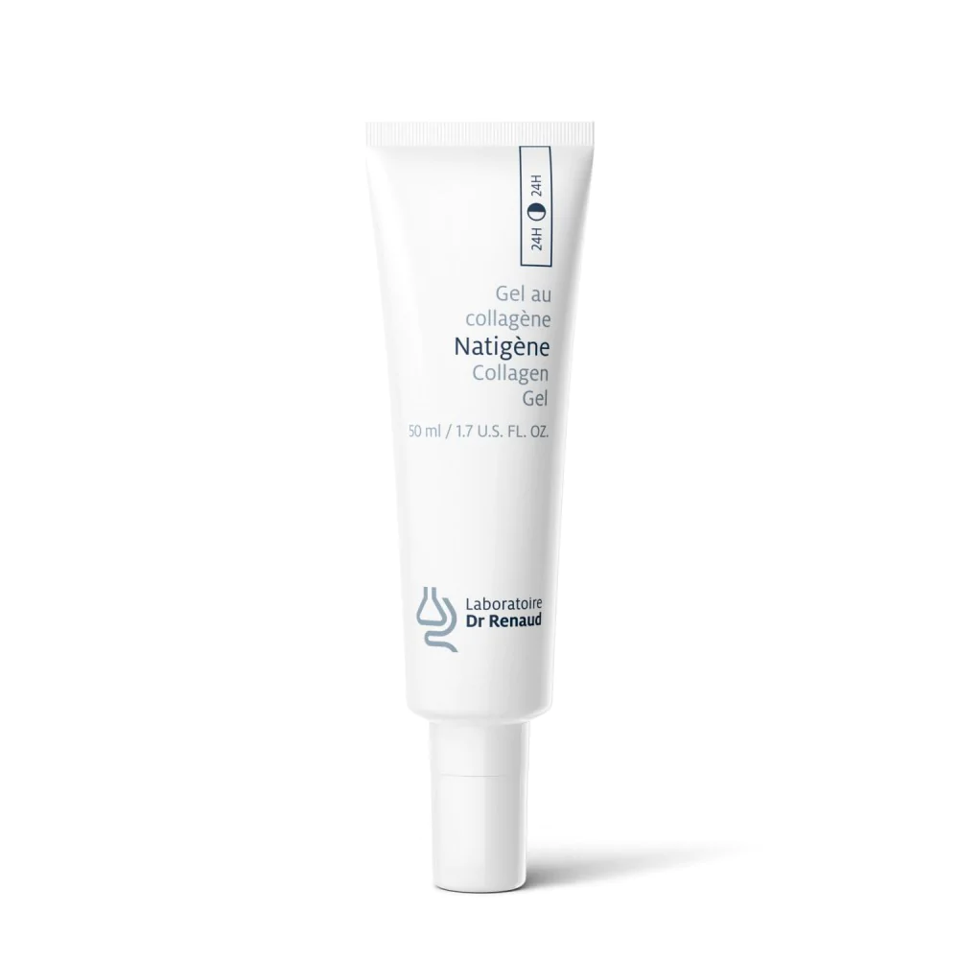
Natigène Gel
Texture:
Gel
Skin Types:
All
Benefits:
Delays cutaneous ageing signs
Smoothes and brightens the complexion
Attenuates skin flaws owing to its healing properties
Gives the skin new suppleness and softness

Slide 3
Natigène Collagen Gel Ingredients
Water, PEG-8, Carbomer, Triethanolamine, Soluble Collagen, Sodium Lactate, Lactic Acid, Glycerin, Serine, Sorbitol, Tea-Lactate, Urea, Sodium Chloride, Allantoin, Phenoxyethanol, Ethylhexylglycerin

Slide 4
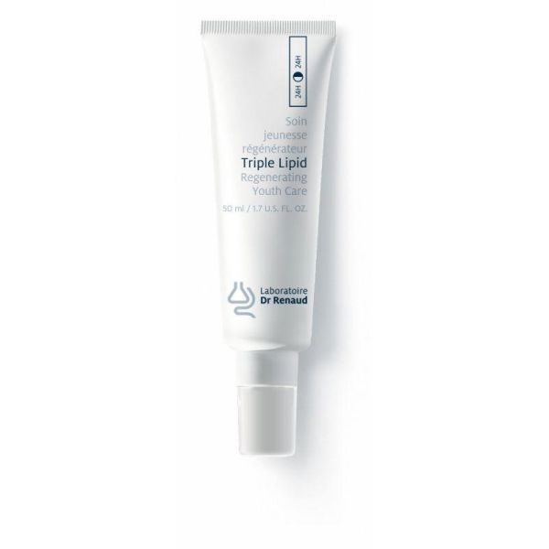
Triple Lipid Regenerating Youth Care
Skin Types:
Dry, Mature, Dehydrated, Normal
Benefits:
Restores the skin's essential lipids : ceramides, natural cholesterol and fatty acids
Improves elasticity and skin texture; diminishes the appearance of pores, decreases the look of wrinkles
Helps reduce the appearance of discoloration; evens skin tones; restores radiance

Slide 5
Ingredients
contains a precise 1:2:1 ratio of the skin's three essential lipids, namely ceramides, cholesterol and fatty acids. Cholesterol is dominant, allowing the kin barrier to restore instantly.
The formula also includes a key ingredient bio-inspired by the regulatory power of flower nectar microbiota, which contributes to the balance of the skin's microbiata.
The niacinamide helps the skin to recover an optimal level of cutaneous lipids while providing in-depth nutrition in order to slow the visible signs of ageing.

Slide 6
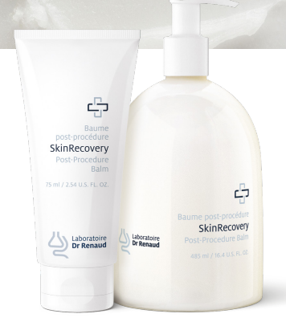
SkinRecovery Post-Procedure Balm
Skin Types:
Damaged, scared, oily, dehydrated , normal
Benefits:
Its unique formula places the skin in optimal conditions to induce and speed up healing. It supports the skin’s natural recovery process and helps prevent the appearance of scars.

Slide 7
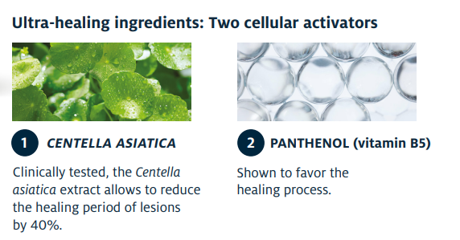
SkinRecovery Post-Procedure Balm Ingredients

Slide 8

Questions?

