Slide 1

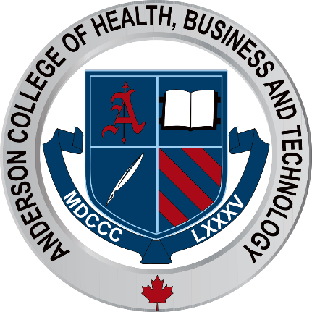
Medical Esthetics
LDR Introduction

Slide 2
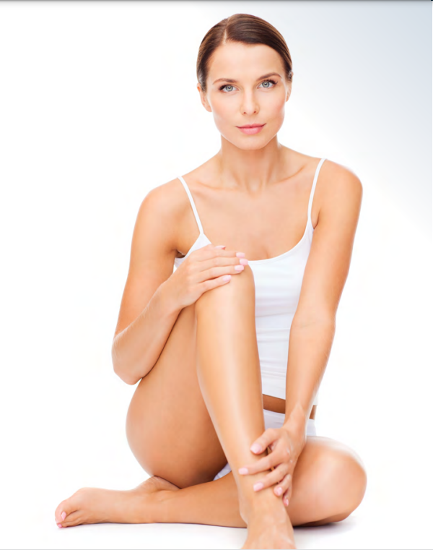
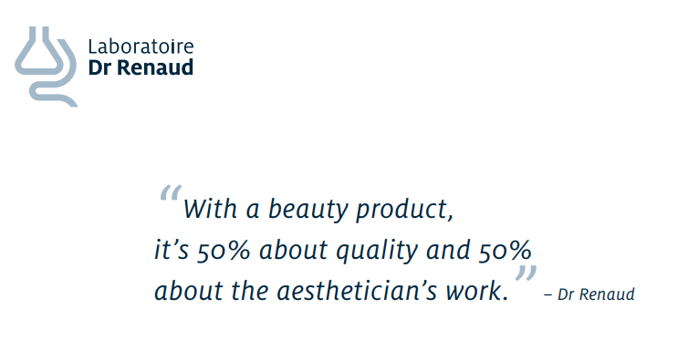

Slide 3
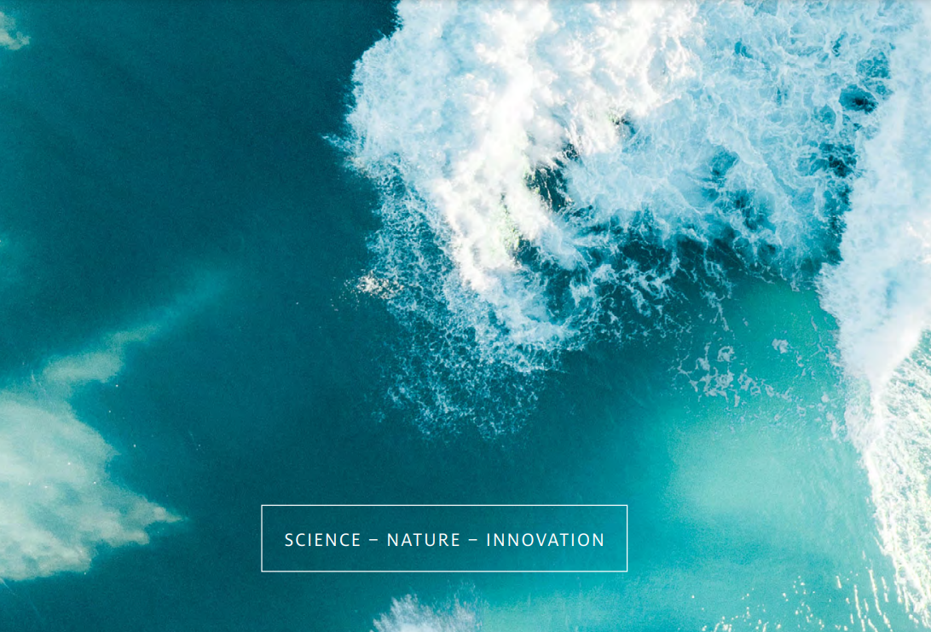
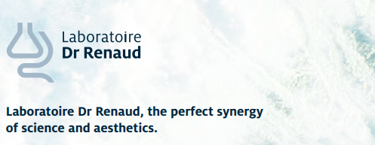

Slide 4
What Differentiates Laboratoire Dr Renaud
The Core of Our Business
Passion for Innovation and Industry Recognition
LDR's Loyalty Program, Simple and Beneficial
Training
Brand Awareness and Recognition
Communication Material
Promotions

Slide 5
Home Skin Care
CLEANSING
Cleansers and Make-Up Removers
SKIN PREPARATION
Exfoliants – Masks – Serums
ANTI-AGEING
PURE Program 15 Prevention Program – Correction Program – Regeneration Program
SPECIFIC SKIN CONDITIONS
Sensitive, Reactive Skin-Sensitive -Skin with Redness-Dehydrated Skin-Hyperpigmentation and Brown Spots
OILY SKIN
Oily Skin – Acne-Prone Skin
CORAL-REEF FRIENDLY SUN PROTECTION!
Sun Care
UNIVERSAL SKIN CARE
For eyes – For hands and body 21 To enjoy the sun outside and inside

Slide 6
Professional Skin Care
Fundamental Treatments
Optimal Treatments
Express Treatments
Chemical Peels

Slide 7
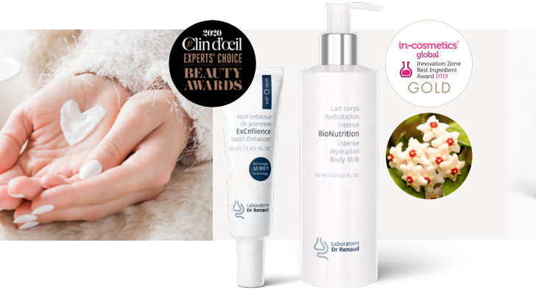
Professional
Skin Care

Slide 8
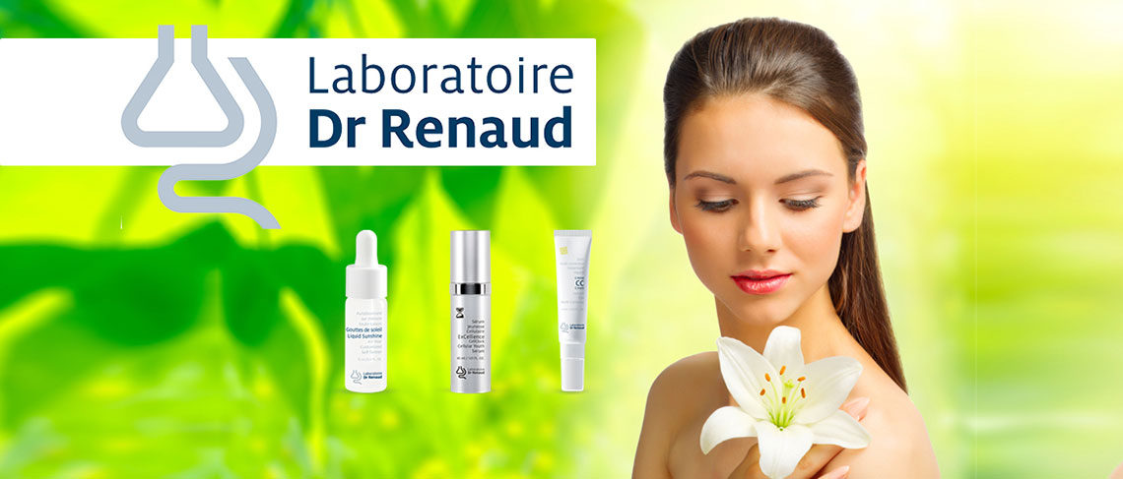
Proudly developed and manufactured in Canada
For nearly 60 years, Laboratoire Dr Renaud has been designing and manufacturing a complete line of innovative, highquality skin care products in Canada.

Slide 9
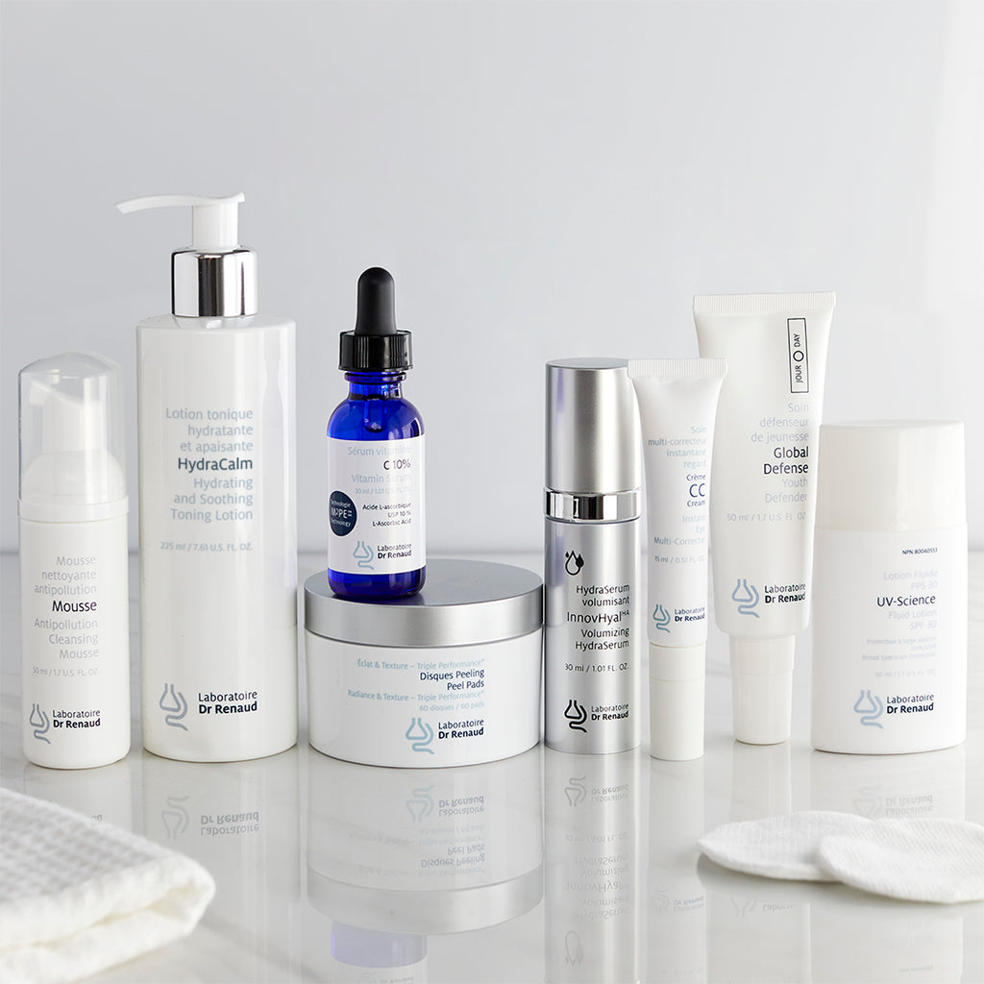
Passion for innovation and industry recognition
In a constant quest for innovation, our research and development team is dedicated to advancing the study of the skin. Scientific breakthroughs in the field are quickly integrated into our portfolio, whether by revising an existing formula or launching a new product. Numerous industry recognition awards attest to this expertise

Slide 10
Collaboration, commitment, and support
Laboratoire Dr Renaud provides you with a complete range of tools to build customer loyalty. You benefit from training on our products and on our most avant-garde skin care techniques. Throughout the year, our marketing and communication initiatives support you in building your brand awareness and increasing your profitability.

Slide 11
Ldr’s Loyalty Program, Simple and Beneficial
At Laboratoire Dr Renaud, we believe it is important to reward loyalty. Your loyalty and commitment are important to us. That is why we have developed one of the best loyalty programs in the industry. Simple and beneficial, this program allows you to earn valuable rewards when you reach a certain purchase threshold.

Slide 12
Personalized Service
As an ambassador for Laboratoire Dr Renaud, your representative listens and supports you in offering excellence to your customers. He or she is your best ally, so take advantage of it!

Slide 13
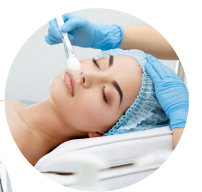


Slide 14
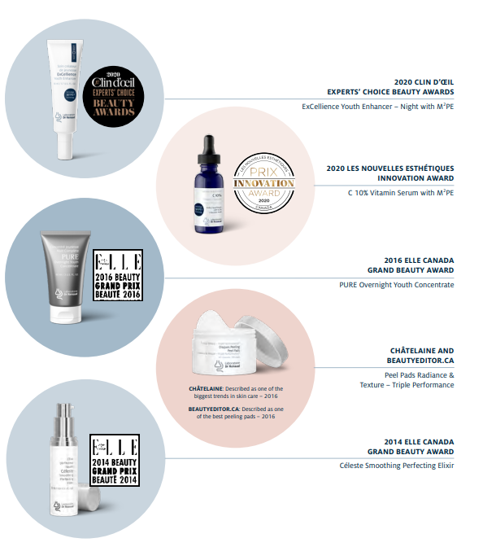
Brand Awareness and Recognition
Laboratoire Dr Renaud's brand awareness continues to grow, as shown by the increase in our market share in the various age groups. Laboratoire Dr Renaud continues to invest in increasing its visibility and brand awareness among consumers through advertising campaigns, digital campaigns, social media and contests. Laboratoire Dr Renaud is proud to have received numerous public and industry recognition awards. Our ability to innovate is not by chance: It is a result of both our tireless passion and our dedication.

Slide 15
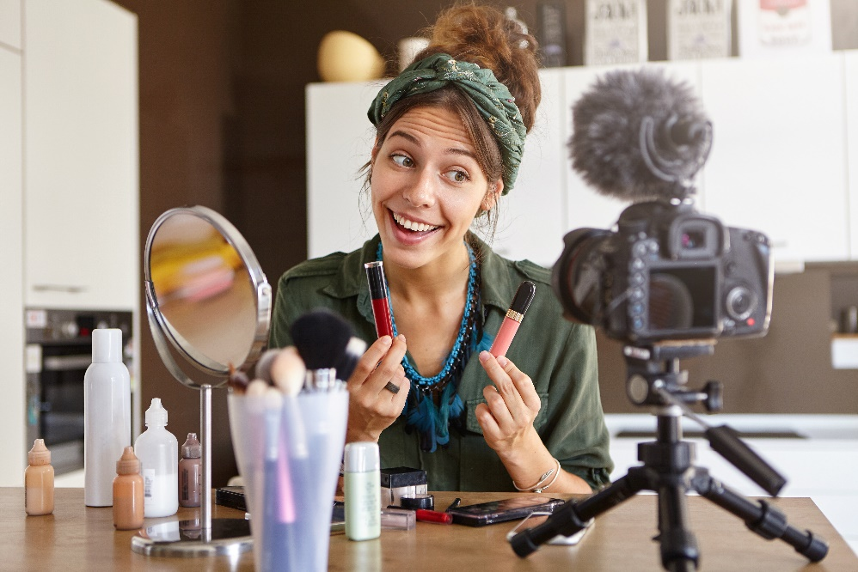



Slide 16
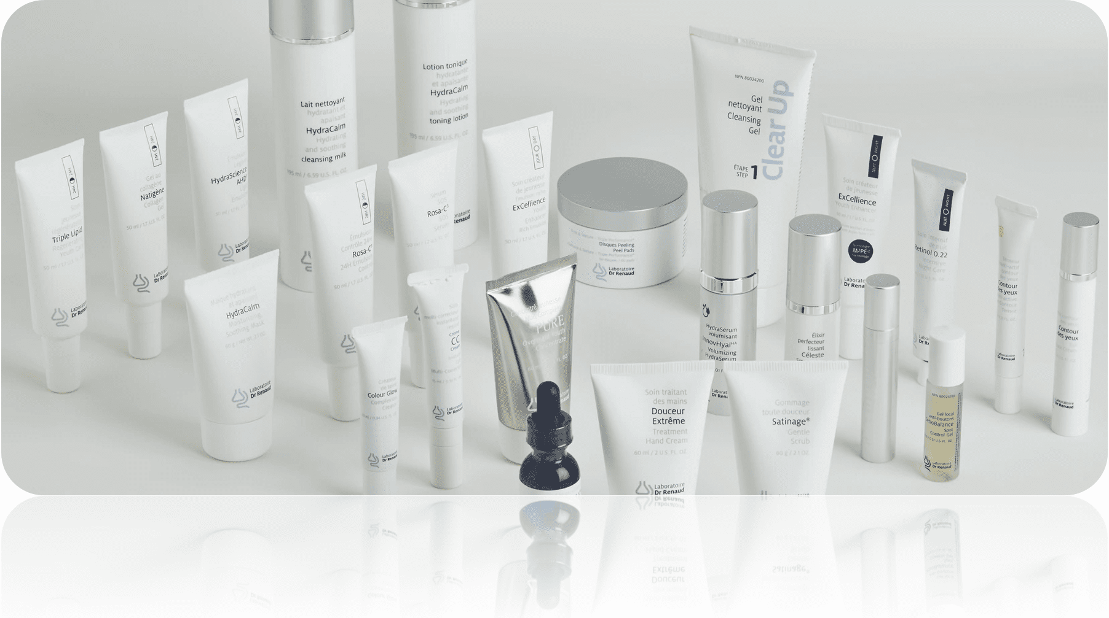
First steps to learn the line is to learn the professional skin care we will have in cabin. Also called or known as Cabin products
Your Journey will start with the Essential Line, and then we will move to the Optimal Treatments

Slide 17
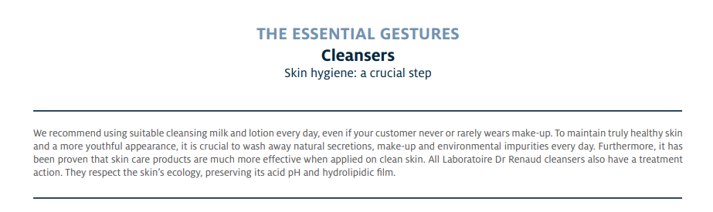

Slide 18
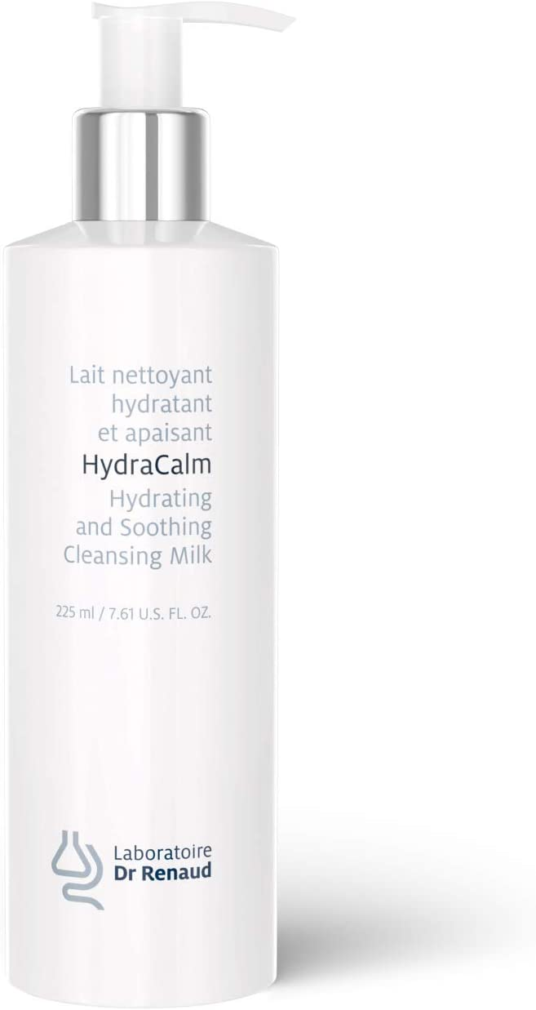
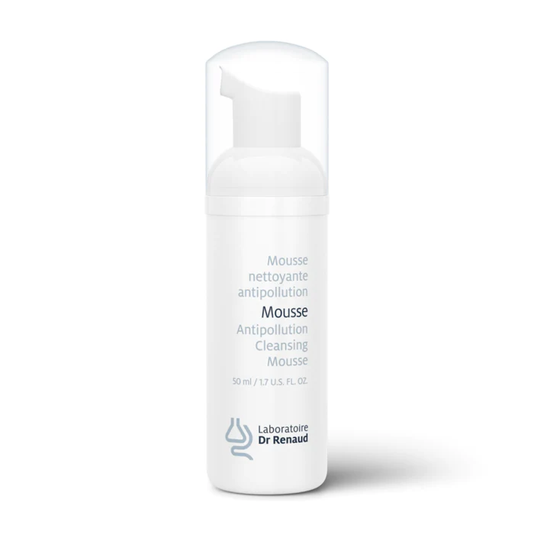
Essential Cleansers
HydraCalm Cleansing Milk - Normal, dehydrated, fragilized, alipic and/or sensitive skin - Removes make-up and dissolves impurities
Antipollution Cleansing Mousse - Normal to oily skin, combination skin and acne-prone skin - Cleanses and removes make-up

Slide 19
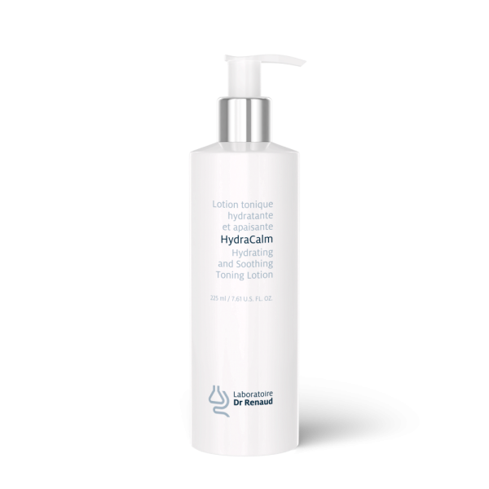
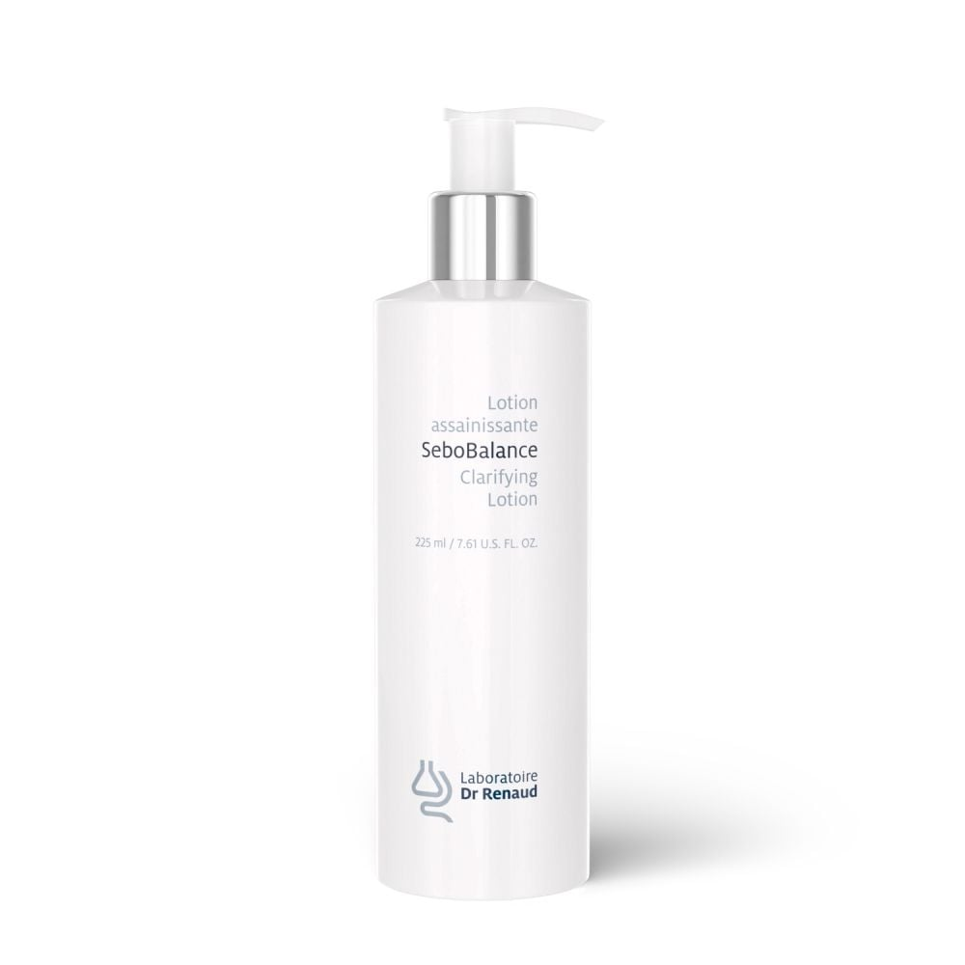
Toners
HydraCalm Toning Lotion - Normal, dehydrated, fragilized, alipic and/or sensitive skin - Soothes skin and provides immediate and lasting hydration
SeboBalance Clarifying Lotion - Oily skin - Purifies, calms, refreshes - Controls the presence of sebum

Slide 20
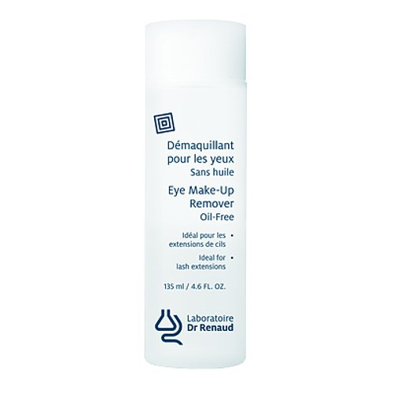
Oil Free Eye Makeup Remover
A makeup remover that removes all traces of makeup without irritating the eyes
Good for sensitive eyes

Slide 21
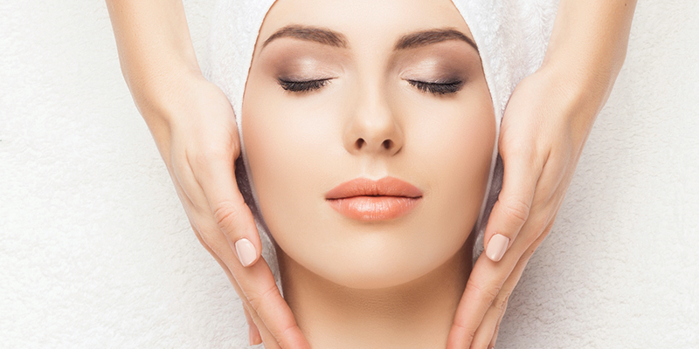
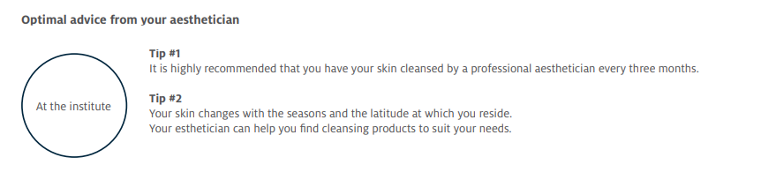

Slide 22
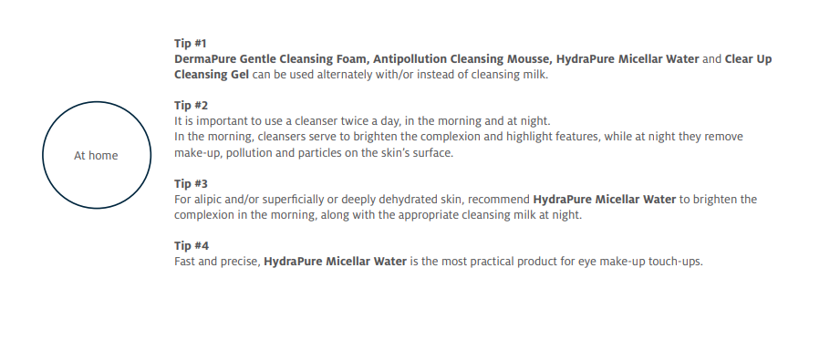
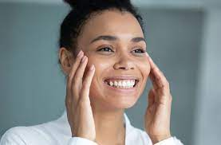

Slide 23
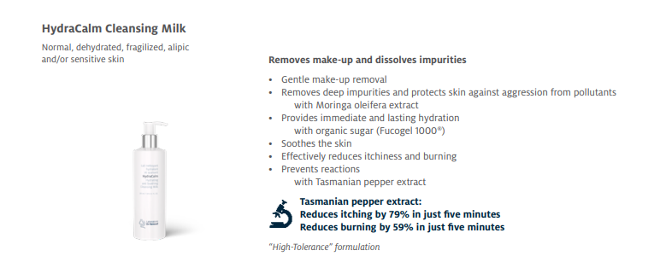
Ingredients
The antioxidants in black pepper fight against free radicals that cause aging and damage your skin. Black pepper prevents premature aging, including wrinkles, fine lines, and dark spots. Black pepper for skin pigmentation gives better results as it also helps to maintain the original color of the skin.

Slide 24
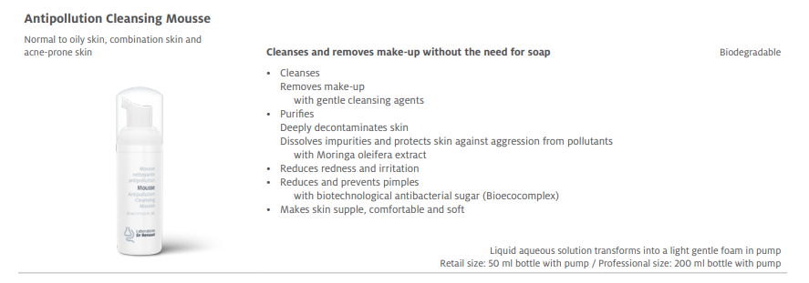

Slide 25
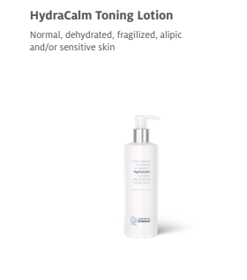
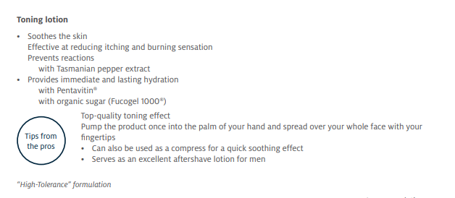

Slide 26
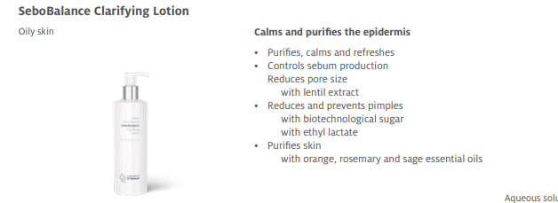

Slide 27
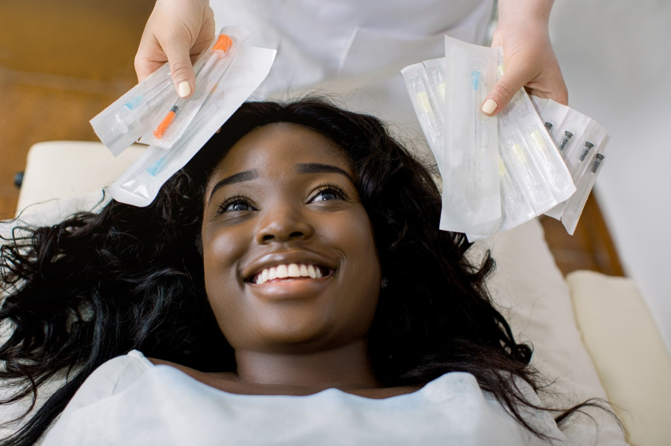
Lab Time!

