Slide 1


Business Operations
Unit 3

Slide 2

Types of Business Ownership

Slide 3
Individual Ownership
The sole proprietor is the individual owner and, most often, the manager of the business, who determines policies and has the last say in decision making, as well as assumes expenses, receives profits, and bears all losses

Slide 4

Partnership
In a partnership business structure, two or more people share ownership—although not necessarily equally. One reason for going into a partnership arrangement is to have more capital Partners can pool their skills and talents, making it easier to share work, responsibilities, and decision making. Keep in mind that partners must assume one another’s liability for debts.
Partnerships may mean more opportunity for increased investment and growth. They can be fantastic if the right chemistry exists; they can be disastrous if you find yourself legally linked to the wrong person. Your partner can incur losses or debts that you may not even be aware of unless you use a third-party accountant. Trust is just one of the requirements for this arrangement.

Slide 5

Corporation
Is an ownership structure controlled by one or more stockholders. Incorporating is one of the best ways that a business owner can protect their personal assets. Most people choose to incorporate solely for this reason, but there are other advantages as well. For example, the corporate business structure saves you money in taxes, provides greater business flexibility, and makes raising capital easier. It also limits your personal financial liability if your business accrues unmanageable debts or otherwise runs into financial trouble.

Slide 6
Characteristics of Corporations
Corporations raise capital by issuing stock certificates or shares.
Stockholders (people or companies that purchase shares) have an ownership interest in the company. The more stock they own, the bigger that interest becomes.
You can be the sole stockholder (or shareholder), or you can have many stockholders.
Corporate formalities, such as director and stockholder meetings, are required to maintain a corporate status.
Income tax is limited to the salary that you draw and not the total profits of the business.
Corporations cost more to set up and run than a sole proprietorship or partnership. For example, there are the initial formation fees, filing fees, and annual state fees.
A stockholder of a corporation is required to pay unemployment insurance taxes on their salary, whereas a sole proprietor or partner is not

Slide 7

Your accountant may suggest that your business become an S corporation (small business corporation), which is a business elected for S corporation status through the Internal Revenue Service (IRS). This status allows the taxation of the company to be similar to a partnership or sole proprietor, as opposed to paying taxes based on a corporate tax structure. Or your accountant may suggest that your business become registered as a limited liability company (LLC), which is a type of business ownership combining several features of corporation and partnership structures. Owners of an LLC also have the liability protection of a corporation. An LLC exists as a separate entity, much like a corporation. Members cannot be held personally liable for debts unless they have signed a personal guarantee.

Slide 8
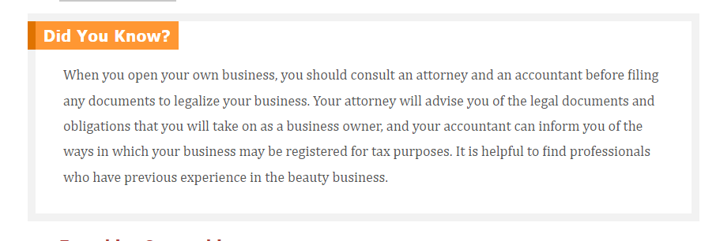

Slide 9
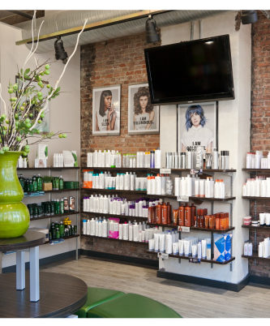
Franchise Ownership
A franchise is a form of business organization in which a firm that is already successful (the franchisor) enters into a continuing contractual relationship with other businesses (franchisees) operating under the franchisor’s trade name in exchange for a fee

Slide 10
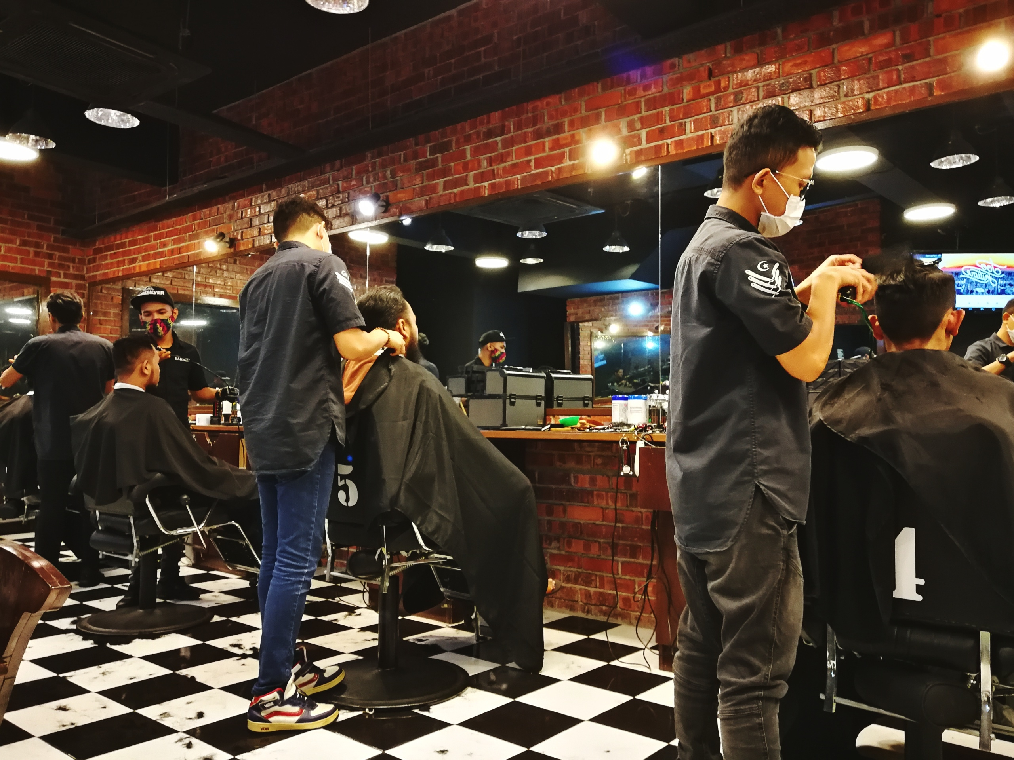
Purchasing an Established Business
Could be an excellent opportunity, but, as with anything else, you must look at all sides of the picture

Slide 11
Financial audit to determine the actual value of the business once the current owner’s bookings are taken out of the equation — often, the owner of a salon, spa, or barbershop brings in the bulk of the business income, and it is unlikely you will retain all the former owner’s clients without a lot of support and encouragement from that former owner
Written purchase and sale agreement to avoid any misunderstandings between the contracting parties
Complete and signed statement of inventory (goods, fixtures, and the like) indicating the value of each article
If applicable, a transfer of a note, mortgage, lease, or bill of sale, including an investigation by the buyer to determine whether there are defaults in the payment of debts
Confirmed identity of owner
Use of the business’s name and reputation for a definite period of time
Disclosure of all information regarding the shop’s clientele and its purchasing and service habits
Disclosure of the conditions of the facility—if you are buying the actual building, a full inspection is in order; many other legalities also apply, as noted by your realtor and attorney
Non-compete agreement stating that the seller will not work in or establish a new salon, spa, or barbershop within a specified distance from the present location
Employee agreement, either formal or informal, that lets you know if the employees will stay with the business under its new ownership—existing employee contracts should be transferable

Slide 12


