Slide 1
CT Theory
Abdomen & Pelvis Anatomy

Slide 2
CT Imaging of the Abdomen & Pelvis
Module Objectives
Review anatomy of the abdomen & pelvis
Label anatomical structures on a CT image
Scanning protocols including:
  Positioning
  Indications & Contraindications
  Exposure Factors
Most common CT Abdomen & Pelvis exams done
Pathology

Slide 3
CT Imaging of the Abdomen & Pelvis
Review Anatomy
Kelley textbook goes into a lot of detail!
Focus on:
  Organs
  Abdominal Aorta & its branches
  IVC and its tributaries
Complete anatomy ID exercises on D2L Brightspace

Slide 4
CT Imaging of the Abdomen & Pelvis
Liver
Sits within the __
Bordered superiorly, laterally, and anteriorly by the right hemidiaphragm
Left lobe – most lobe
Right lobe – largest lobe

Slide 5
CT Imaging of the Abdomen & Pelvis
Liver
Rt & Lt lobes divided by
Caudate lobe – smallest lobe, on the inferior and posterior liver surface between the _ and the ligament venosum
Quadrate lobe - on the anteroinferior surace of the left lobe, between the _ _ _ _ and the round ligament.

Slide 6
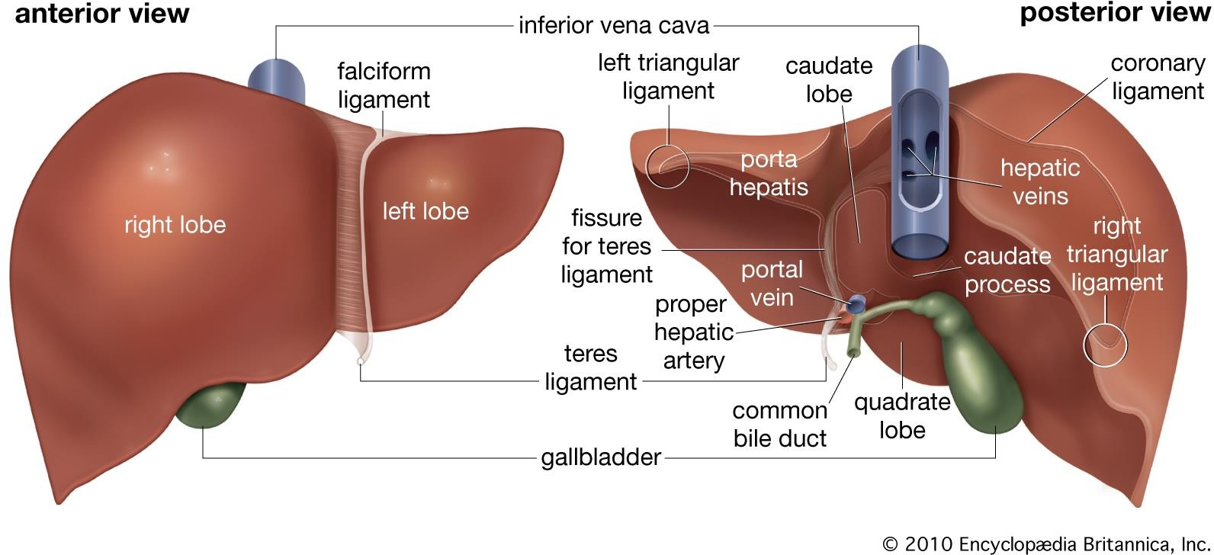
CT Imaging of the Abdomen & Pelvis

Slide 7
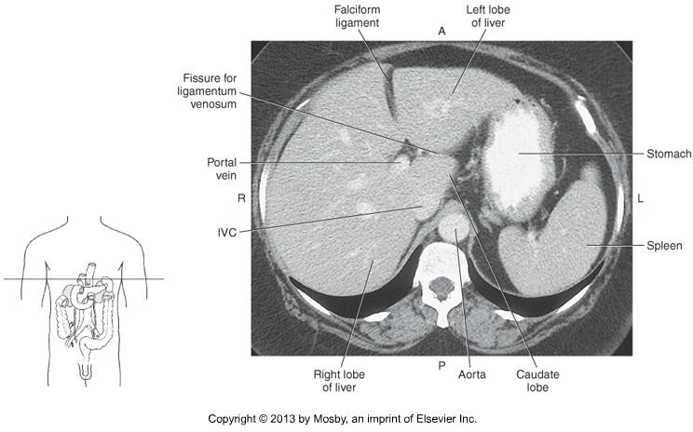
CT Imaging of the Abdomen & Pelvis

Slide 8
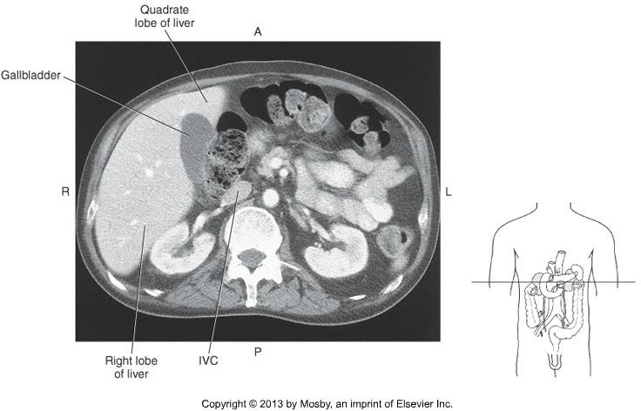
CT Imaging of the Abdomen & Pelvis

Slide 9
CT Imaging of the Abdomen & Pelvis
Portal Hepatic System
  Portal Vein – union of the
and veins.
  Posterior to the pancreas
  Runs to the hepatic artery
  Enters the liver at the porta hepatis

Slide 10
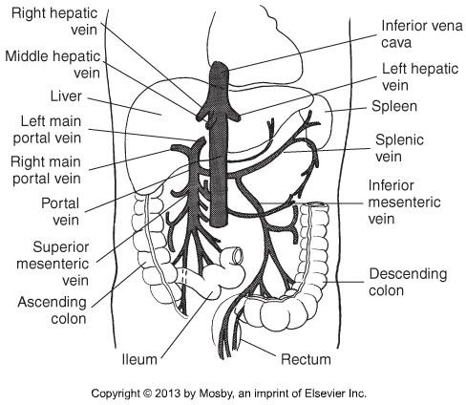
CT Imaging of the Abdomen &Pelvis

Slide 11
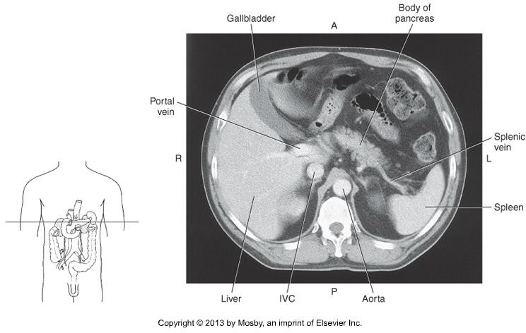
CT Imaging of the Abdomen & Pelvis

Slide 12
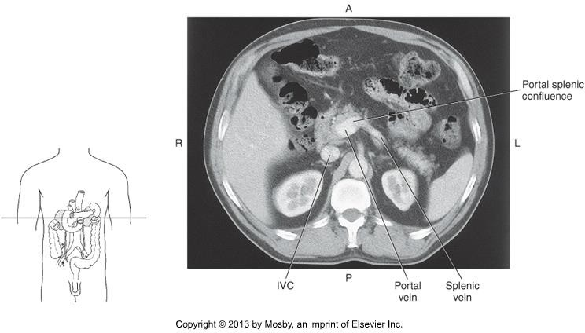
CT Imaging of the Abdomen & Pelvis

Slide 13
CT Imaging of the Abdomen & Pelvis
At the porta hepatis, the portal vein branches into the right and left main portal veins
The portal veins follow the course of the hepatic arteries.

Slide 14
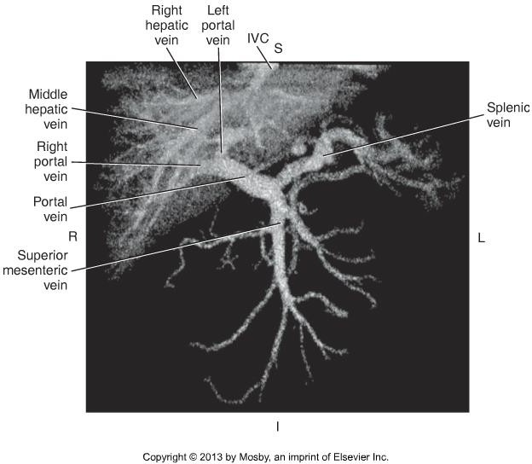
CT Imaging of the Abdomen & Pelvis

Slide 15
CT Imaging of the Abdomen & Pelvis
Arterial Blood Supply
  Common hepatic artery – one of the branches of the
artery/trunk
  Sits to the portal vein
  Branches into the gastroduodenal artery (travels inferiorly), and the proper
hepatic artery (travels superiorly)
  At, or just before the porta hepatis, it divides into the left and right hepatic arteries

Slide 16
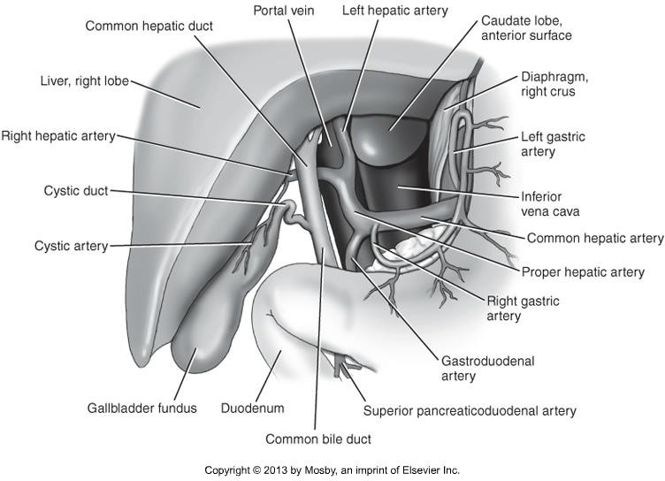
CT Imaging of the Abdomen & Pelvis

Slide 17
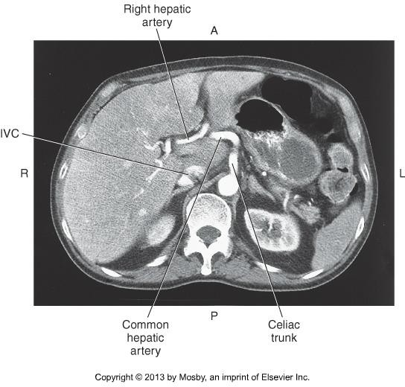
CT Imaging of the Abdomen & Pelvis

Slide 18
CT Imaging of the Abdomen & Pelvis
Gall Bladder & Bile Ducts
Gall bladder sits on the _ _ __ portion of the right lobe of the liver
Fundus (distal, rounded portion)
Body (widest portion)
Neck (narrow, directly to the right of the porta hepatis, continues as the _ __)

Slide 19
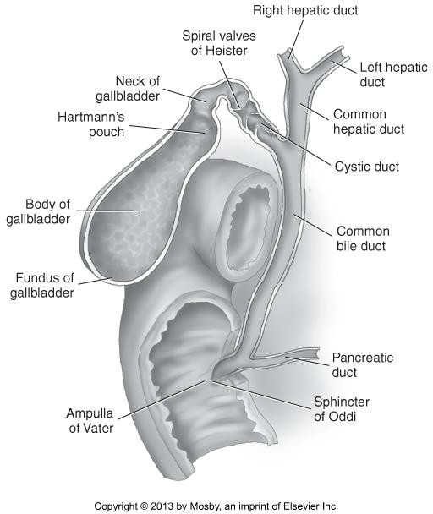
CT Imaging of the Abdomen & Pelvis

Slide 20
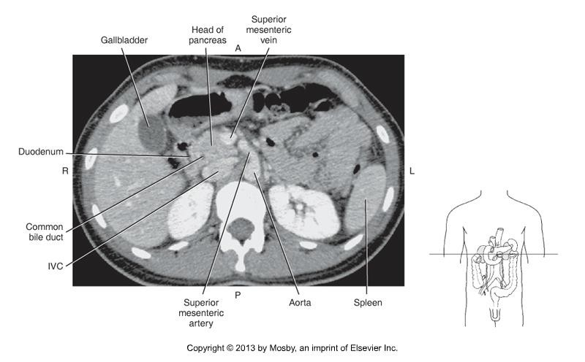
CT Imaging of the Abdomen & Pelvis

Slide 21
CT Imaging of the Abdomen & Pelvis
Pancreas
Long, narrow, retroperitoneal organ
Sits _ _ _ _ to the stomach
Extends obliquely and transversely across the midline
Extends between the duodenum and the _ _ _ _.

Slide 22
CT Imaging of the Abdomen & Pelvis
Pancreas
Head sits within the duodenal bulb, at approx .
Head is _ _ _ __ to the IVC
The common bile duct runs through the head of the pancreas
Neck is the constricted portion, not as broad as the head

Slide 23
CT Imaging of the Abdomen & Pelvis
Pancreas
Body runs transversely, _ _ __ to the aorta and SMA
Tail is the tapered end, anterior to the left kidney, ends at the spleen.

Slide 24
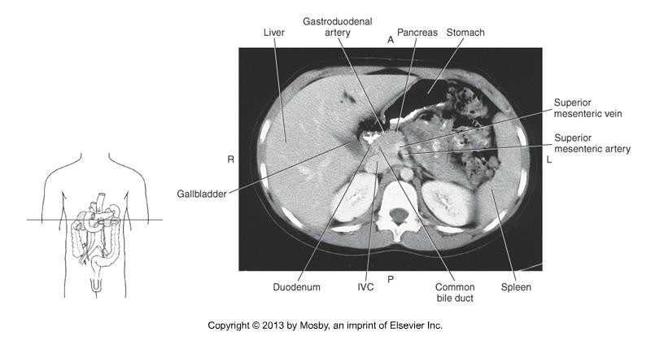
CT Imaging of the Abdomen & Pelvis

Slide 25
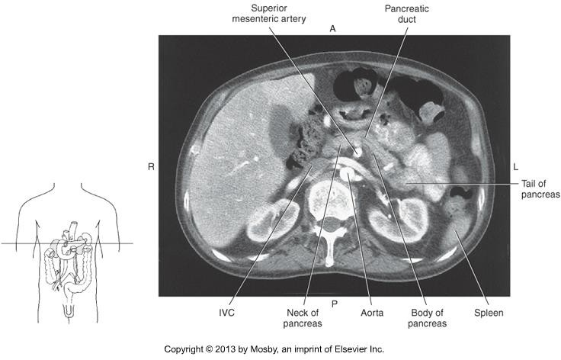
CT Imaging of the Abdomen & Pelvis

Slide 26
CT Imaging of the Abdomen & Pelvis
TIPS!
  Use pancreas as landmarks for some vasculature
  Splenic vein
  SMA
  Portal Vein

Slide 27
CT Imaging of the Abdomen & Pelvis

Slide 28
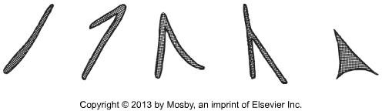
CT Imaging of the Abdomen & Pelvis
Adrenal Glands
Paired glands, sit superiorly to each kidney
Appears as an inverted “V” in cross section, or inverted “Y”
Right appears:
Right sits just _ _ _ to the IVC
Left sits anteromedially to the upper pole of the left kidney

Slide 29
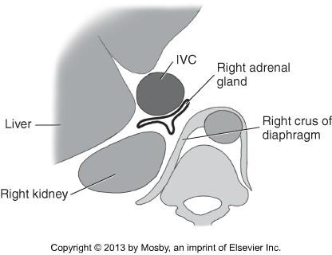
CT Imaging of the Abdomen & Pelvis

Slide 30
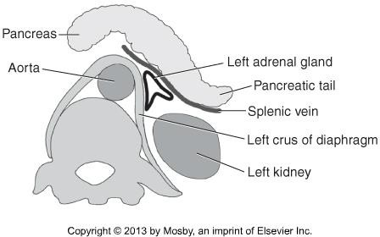
CT Imaging of the Abdomen & Pelvis

Slide 31
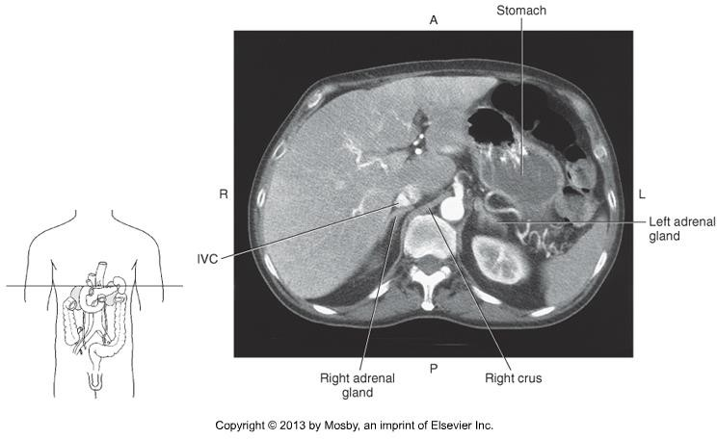
CT Imaging of the Abdomen & Pelvis

Slide 32
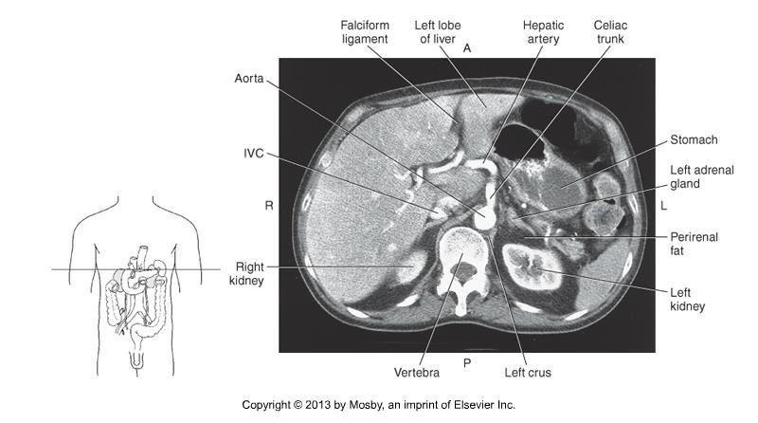
CT Imaging of the Abdomen & Pelvis

Slide 33
CT Imaging of the Abdomen & Pelvis
Spleen
Largest lymph organ in the body
Located _ _ _ __ to the stomach in the LUQ
Bordered on the medial side by the left kidney, splenic flexure of the colon and the pancreatic tail.
Bordered posteriorly by the diaphragm and left lung.
Received blood from the splenic artery
Blood is drained via the splenic vein

Slide 34
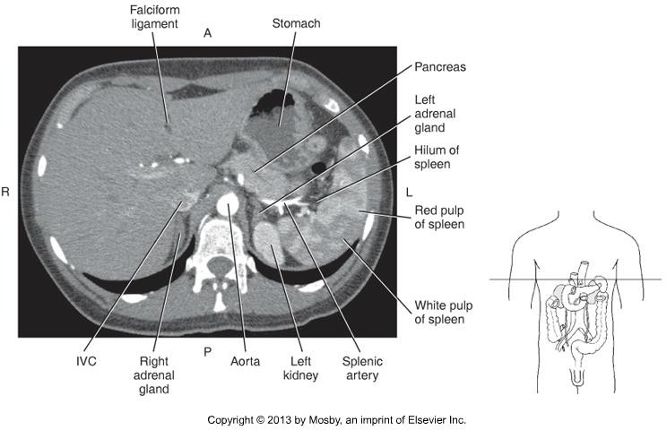
CT Imaging of the Abdomen & Pelvis

Slide 35
CT Imaging of the Abdomen & Pelvis
Kidneys, Ureters, Bladder
Kidneys are bean-shaped organs, in the posterior abdomen.
Lateral to the spine, between the levels of T12 – L4.
Sit at an oblique orientation, the upper poles are more and
than the lower poles.

Slide 36
CT Imaging of the Abdomen & Pelvis
Kidneys, Ureters, Bladder
Ureters are paired muscular tubes, descending to the bladder.
Ureters descend medially towards the psoas muscles, just anterior to the transverse processes of the L-spine
Not seen well without contrast enhancement

Slide 37
CT Imaging of the Abdomen & Pelvis
Kidneys, Ureters, Bladder
Bladder is a pyramid-shaped organ, rests on the pelvic floor.
Immediately _ _ _ _ _ _ to symphysis pubis.

Slide 38
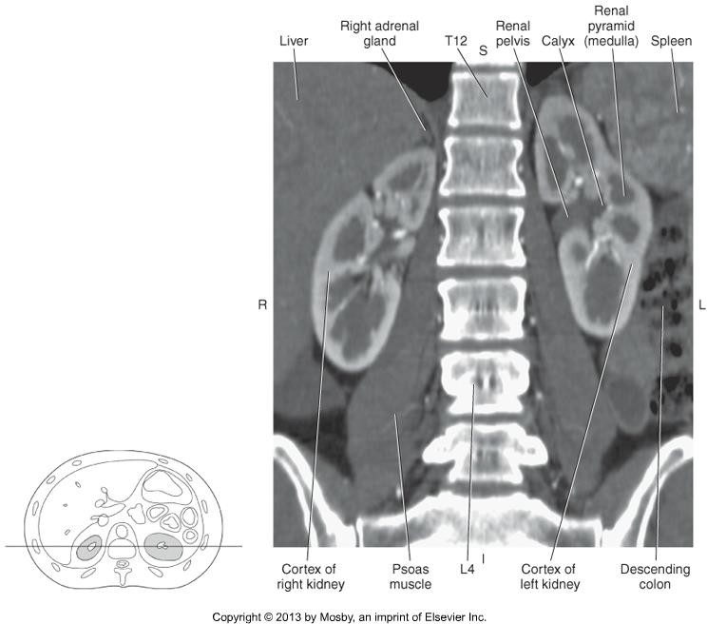
CT Imaging of the Abdomen & Pelvis

Slide 39
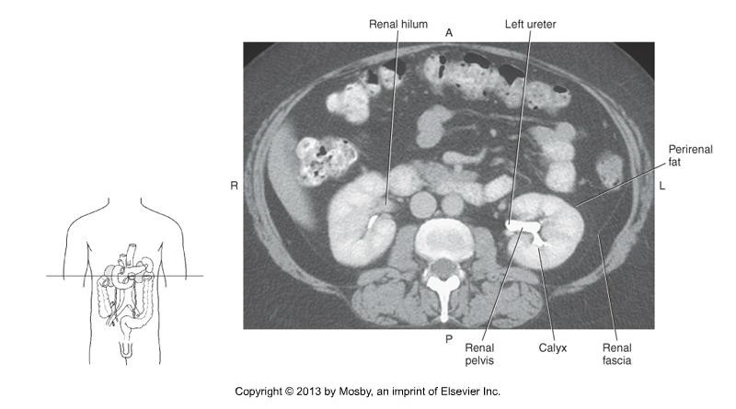
CT Imaging of the Abdomen & Pelvis

Slide 40
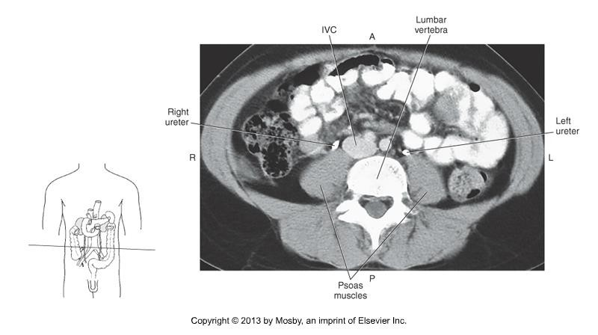
CT Imaging of the Abdomen & Pelvis

Slide 41
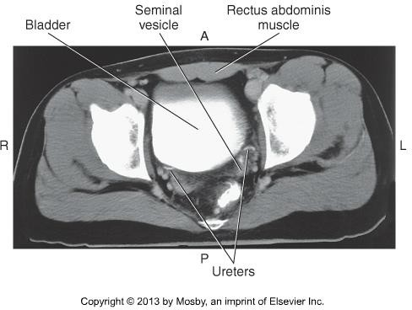
CT Imaging of the Abdomen & Pelvis

Slide 42
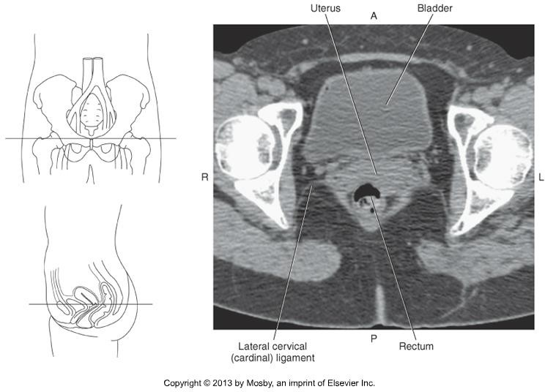
CT Imaging of the Abdomen & Pelvis

Slide 43
CT Imaging of the Abdomen & Pelvis
Digestive Tract
Stomach sits under the left dome of the diaphragm
Recall – what are the parts of the stomach?
Anterior portion in contact with the anterior abdominal wall & left lobe of liver
Posterior portion borders the spleen, left adrenal gland, tail of the
pancreas.
Made distinct by the appearance of _ _ _ __.

Slide 44
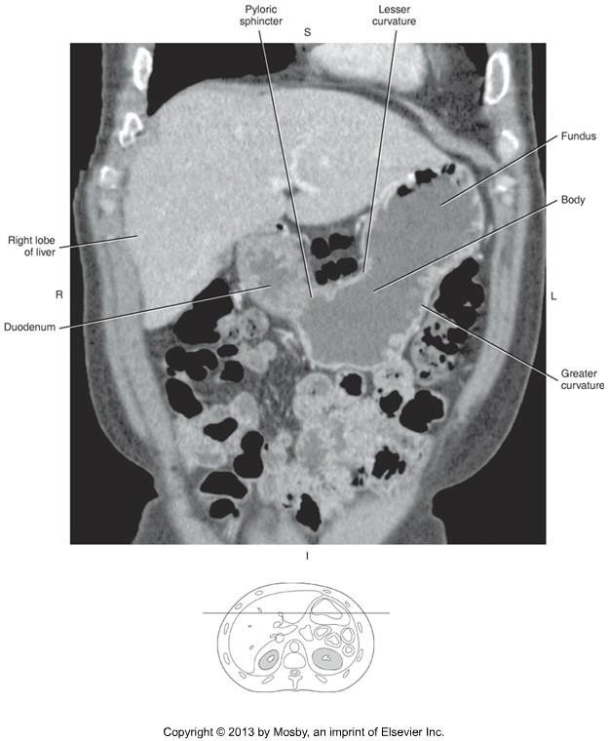
CT Imaging of the Abdomen & Pelvis

Slide 45
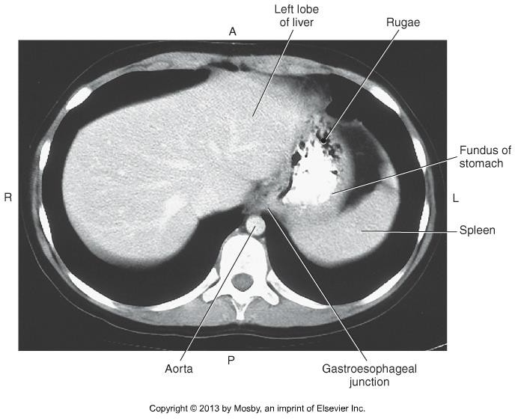
CT Imaging of the Abdomen & Pelvis

Slide 46
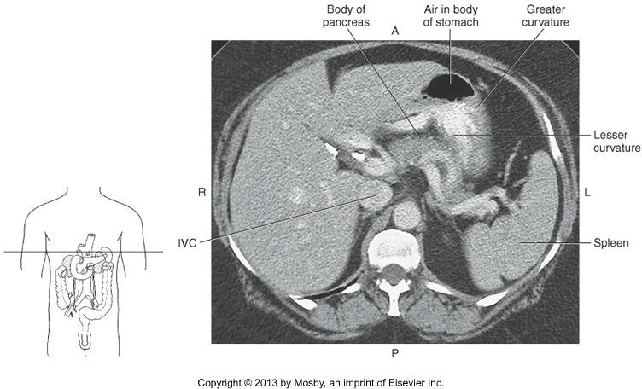
CT Imaging of the Abdomen & Pelvis

Slide 47
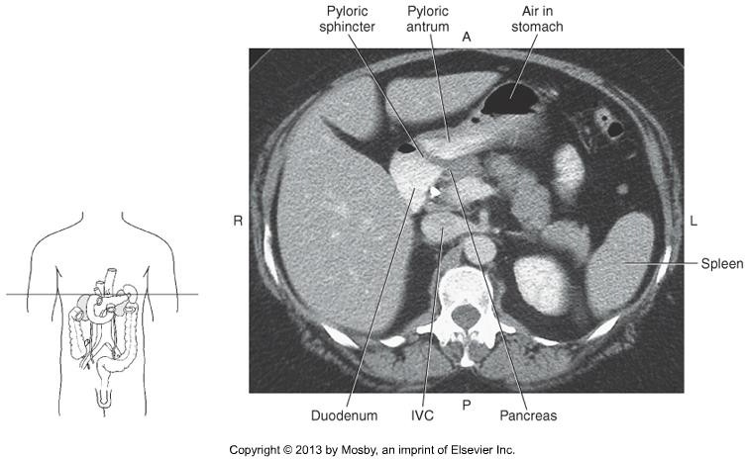
CT Imaging of the Abdomen & Pelvis

Slide 48
CT Imaging of the Abdomen & Pelvis
Small intestine vs. large intestine
Recall the parts of the small intestine
Large intestine lies inferior to the stomach and liver and “frames” the
small intestine
How to differentiate on CT?
  Small bowel = circular folds called
  Large bowel = folds called
Sigmoid colon moves toward the midline, sits
to the bladder.

Slide 49
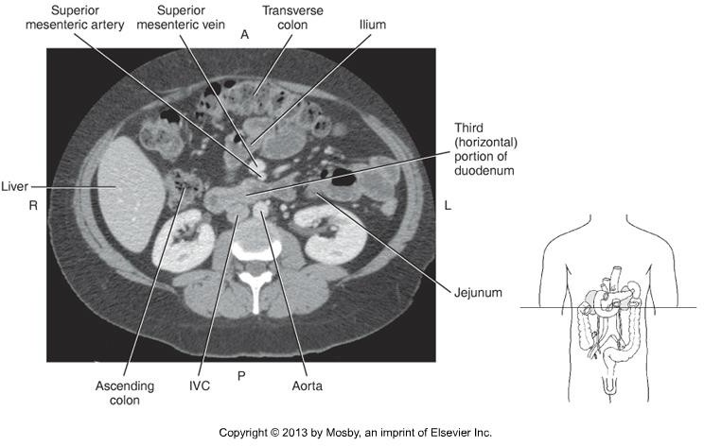
CT Imaging of the Abdomen & Pelvis

Slide 50
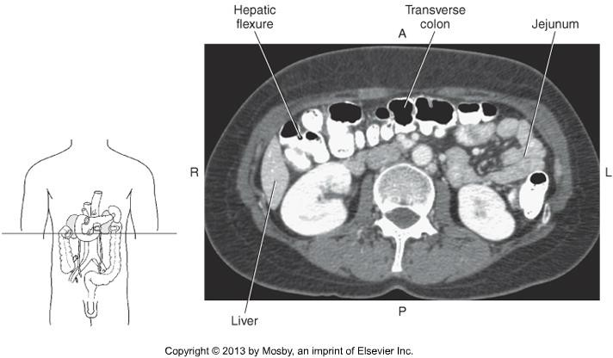
CT Imaging of the Abdomen & Pelvis

Slide 51
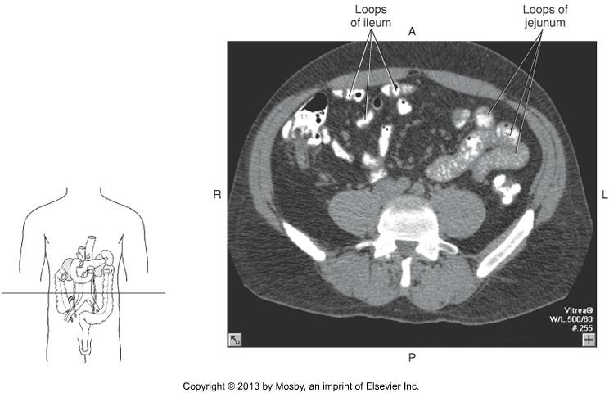
CT Imaging of the Abdomen & Pelvis

Slide 52
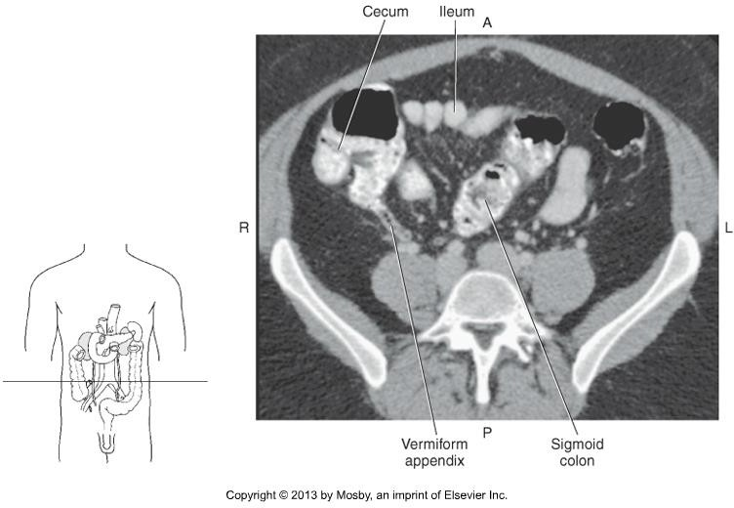
CT Imaging of the Abdomen & Pelvis

Slide 53
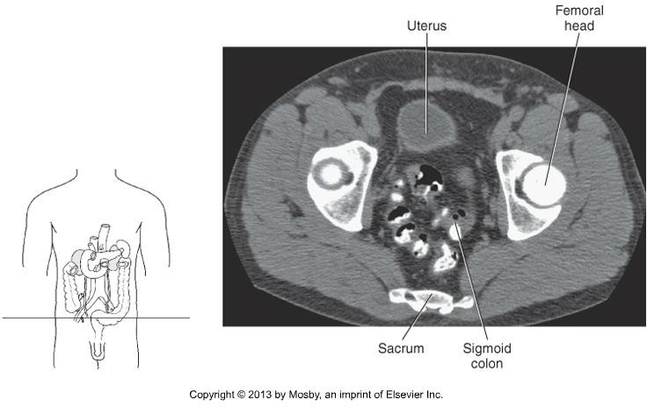
CT Imaging of the Abdomen & Pelvis

Slide 54
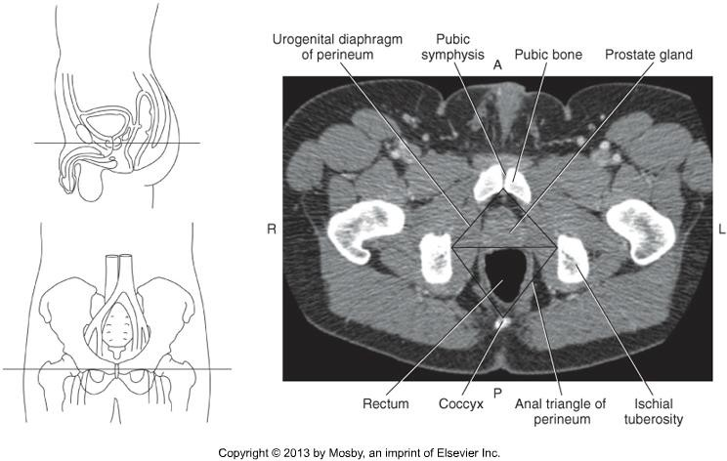
CT Imaging of the Abdomen & Pelvis

Slide 55
CT Imaging of the Abdomen & Pelvis
Female Reproductive Organs
Uterus
  Pear-shaped, muscular organ
  Anterior portion of the abdomen
  Sits between the and the
.
Ovaries
  Paired
  Almond shaped, located on either side of the uterus

Slide 56
CT Imaging of the Abdomen & Pelvis

Slide 57
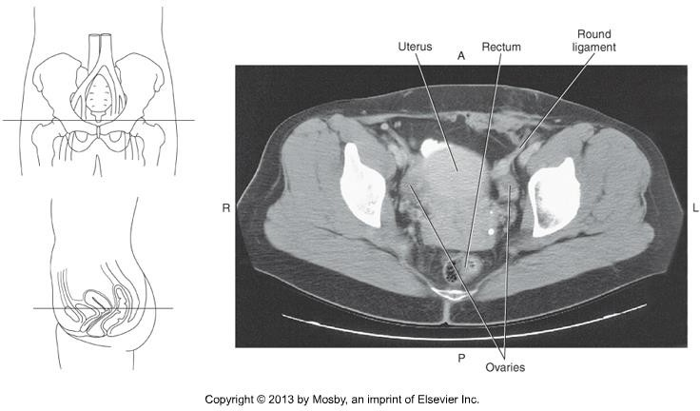
CT Imaging of the Abdomen & Pelvis

Slide 58
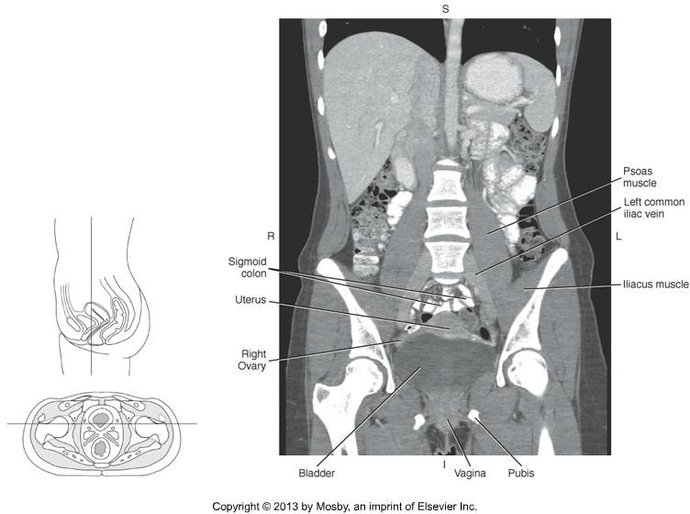
CT Imaging of the Abdomen & Pelvis

Slide 59
CT Imaging of the Abdomen & Pelvis
Male Reproductive Organs
Prostate Gland
  to the bladder
  Base of gland is adjacent to the neck of the bladder
  Composed of glandular and muscular tissue
  Central zone is hyperdense, HU
  Peripheral zone is hypodense, HU

Slide 60
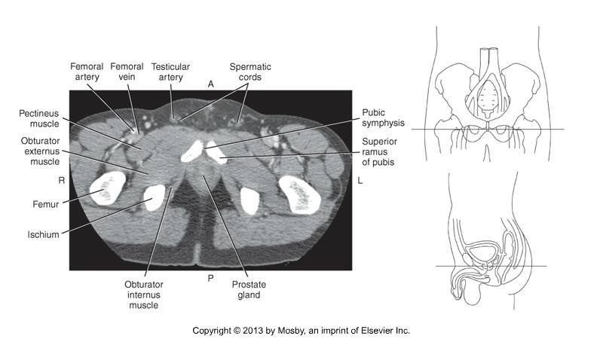
CT Imaging of the Abdomen & Pelvis

Slide 61
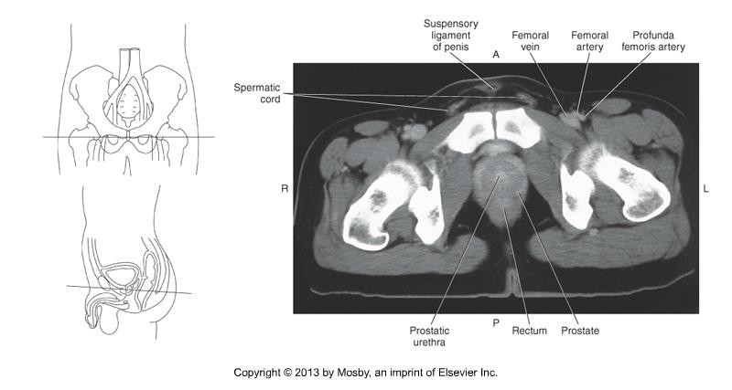
CT Imaging of the Abdomen & Pelvis

Slide 62
CT Imaging of the Abdomen & Pelvis
Abdominal Aorta & Branches
Large, retroperitoneal artery descending between diaphragm and it’s
bifurcation at _.
In order, from superior – inferior:
  Inferior phrenic artery (Rt & Lt)
  Celiac trunk
➢
➢
➢
  Superior mesenteric artery
  Renal artery (Rt & Lt)
  Gonadal artery (Rt & Lt)
  Inferior mesenteric artery
  Lumbar arteries (Rt & Lt)

Slide 63
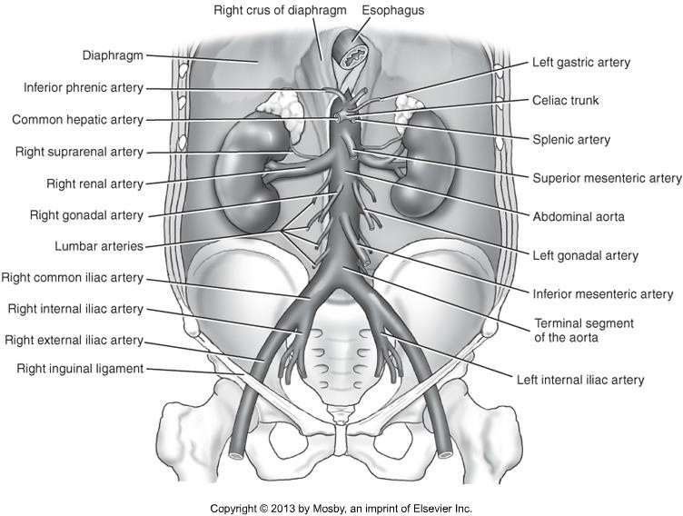
CT Imaging of the Abdomen & Pelvis

Slide 64
CT Imaging of the Abdomen & Pelvis
TIPS!
Important to note that patient anatomy varies!
Use this as a general guideline
Presence of pathology changes anatomy!
Some vessels are within 1 mm of the next – not always captured on
“thick” slices.
Some vessels sit in the same slice as others
General rule – paired arteries arise off lateral surface of aorta & unpaired arteries arise off anterior surface of aorta.
Goal: ID vessels as they come off aorta

Slide 65
CT Imaging of the Abdomen & Pelvis
Inferior Phrenic Artery (Rt & Lt)
  Arise from the lateral surface of the aorta
  Directly under the diaphragm
  Supply the .

Slide 66
CT Imaging of the Abdomen & Pelvis
Celiac Trunk
  Celiac trunk (sometimes called artery) itself is short!
  3 vessels:
    Left gastric artery –
    Splenic artery –
    Common Hepatic –
  Splenic artery is the largest branch, and courses along the upper border of the
pancreas towards the spleen.
  Easily identified, but not to be confused with splenic vein!

Slide 67
CT Imaging of the Abdomen & Pelvis
Superior Mesenteric Artery
  Just below celiac trunk, at approximately .
  Branches off the anterior surface of the aorta, and drops inferiorly, almost
immediately.

Slide 68
CT Imaging of the Abdomen & Pelvis
Renal artery (Rt & Lt)
  Just below the SMA
  Travel very horizontally towards the kidneys = often seen within 1 or just a
few axial slices (if demonstrated)
  Large!
  Right renal artery passes to the IVC on it’s way to the
kidney

Slide 69
CT Imaging of the Abdomen & Pelvis
Gonadal artery (Rt & Lt)
  Arise off the anterolateral surface of the aorta
  Just inferior to the renal arteries
  Descend along the psoas muscles to the reproductive organs

Slide 70
CT Imaging of the Abdomen & Pelvis
Inferior Mesenteric artery
  3-4 cm above the abdominal aortic bifurcation
  Approx .
  Descends in front of the aorta and then curves to the left
  Much smaller than the SMA

Slide 71
CT Imaging of the Abdomen & Pelvis
Lumbar artery (Rt & Lt)
  Actually 4 pairs, at various levels.
  May see superior to IMA, at IMA, and inferior to IMA.
  Branch off the surface of the aorta

Slide 72
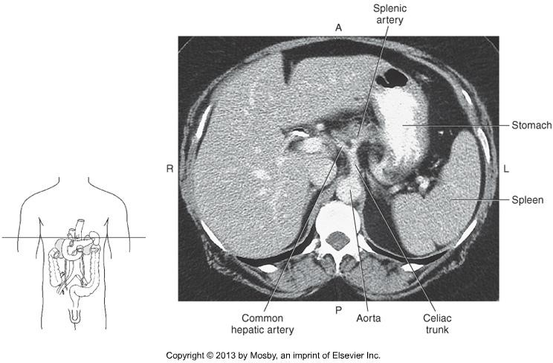
CT Imaging of the Abdomen & Pelvis

Slide 73
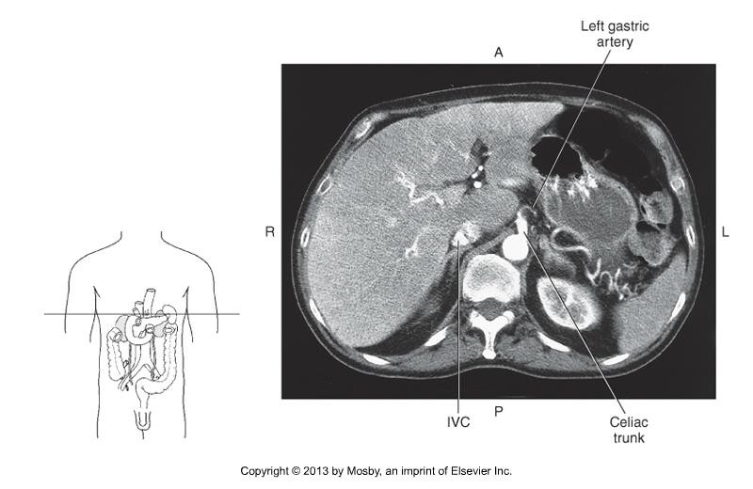
CT Imaging of the Abdomen & Pelvis

Slide 74
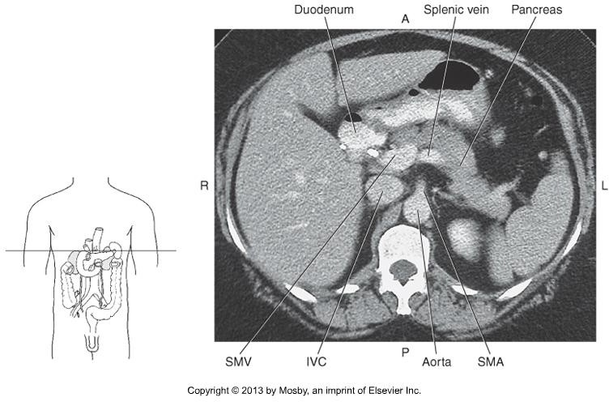
CT Imaging of the Abdomen & Pelvis

Slide 75
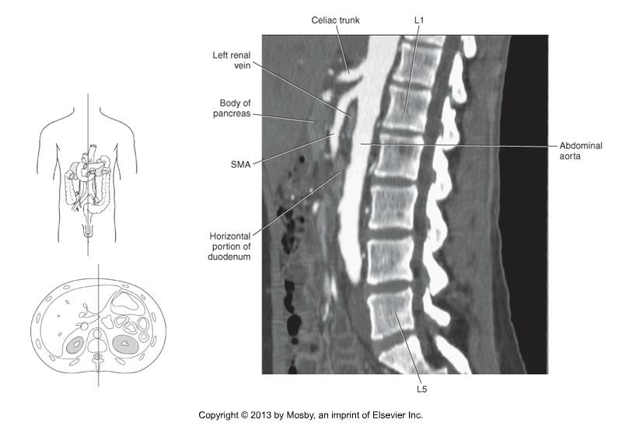
CT Imaging of the Abdomen & Pelvis

Slide 76
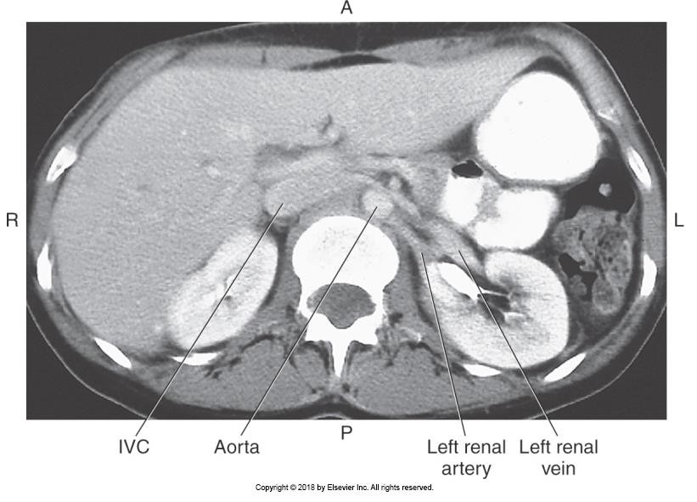
CT Imaging of the Abdomen & Pelvis

Slide 77
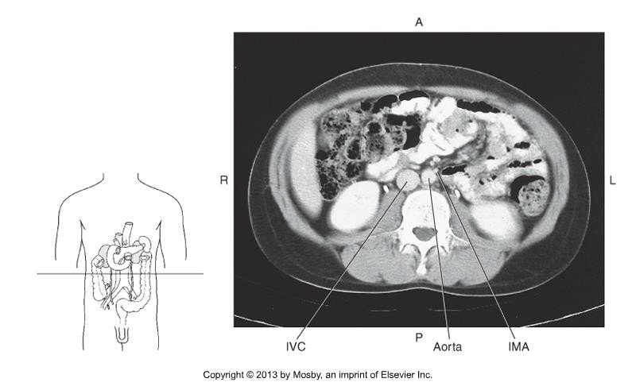
CT Imaging of the Abdomen & Pelvis

Slide 78
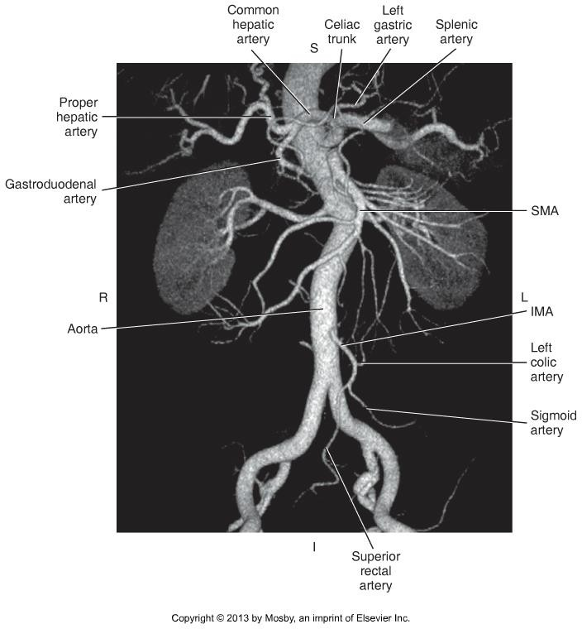
CT Imaging of the Abdomen & Pelvis

Slide 79
CT Imaging of the Abdomen & Pelvis
Abdominal Aorta bifurcates:
  Level of .
  Right and Left common iliac artery
Common iliac artery bifurcates:
  Level of the _.
  Internal and External iliac artery (Rt & Lt)
Internal Iliac artery
  Smaller
•
External Iliac artery
  Larger
•

Slide 80
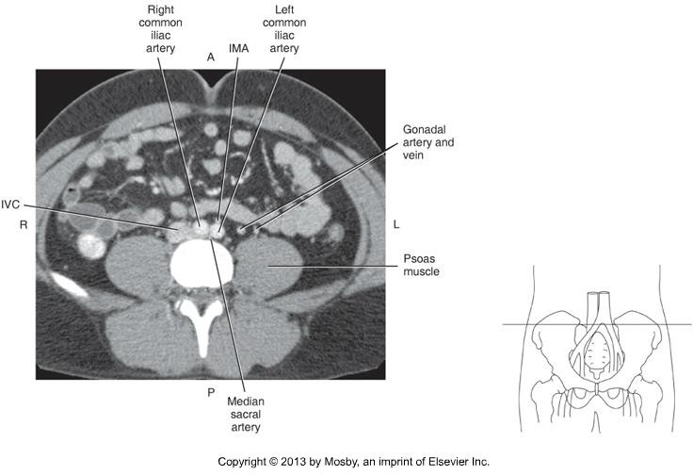
CT Imaging of the Abdomen & Pelvis

Slide 81
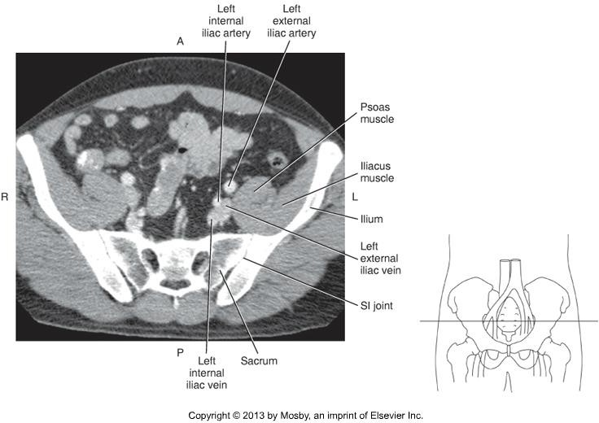
CT Imaging of the Abdomen & Pelvis

Slide 82
CT Imaging of the Abdomen & Pelvis
IVC and Branches
IVC is the largest vein in the body
Formed by the union of the _ _ _ _ _ _ _ _ .
Tributaries include:
  Inferior phrenic
  Lumbar
  Right Gonadal
  Renal
  Right Suprarenal
  Hepatic

Slide 83
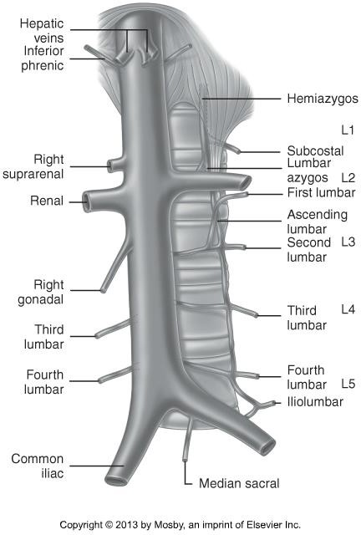
CT Imaging of the Abdomen & Pelvis

Slide 84
CT Imaging of the Abdomen & Pelvis
The major, identifiable tributary of the IVC is the paired renal veins.
Level of L2
Left renal vein passes _ _ _
to the SMA, and _ _ to the aorta.
Differentiate from renal arteries
  Larger
  Anterior

Slide 85
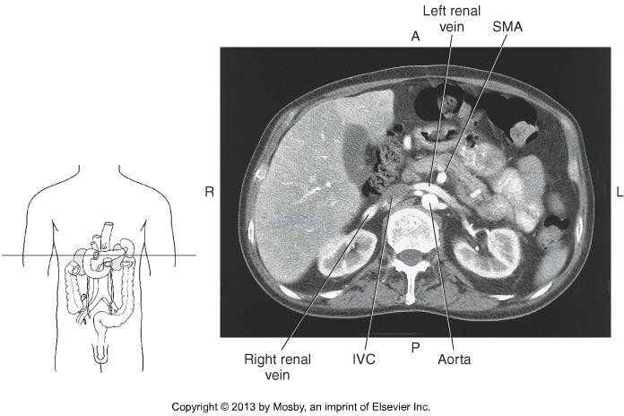
CT Imaging of the Abdomen & Pelvis

Slide 86
CT Imaging of the Abdomen & Pelvis
IVC is formed by:
  Right and Left common iliac vein
  Level of .
Common iliac veins are formed by:
  Internal and External iliac veins (Rt & Lt)
  Level of the .
  Posterior to the Common iliac artery
Internal Iliac vein
  Posterior to the external iliac vein
  Medial to the internal iliac artery
External Iliac vein
  Anterior to the internal iliac vein
  Medial to external iliac artery, then moves posteriorly

Slide 87

CT Imaging of the Abdomen & Pelvis

Slide 88
CT Imaging of the Abdomen & Pelvis
Summary
Review anatomy of the abdomen, pelvis, and its vasculature.
The segmental anatomy of the liver, lymph nodes, and muscles will not be tested on.
Use knowledge of relational anatomy to find structures when given a single CT image.
Next class – scanning procedures of the abdomen & pelvis!

