Slide 1


Makeup Color Selection

Slide 2
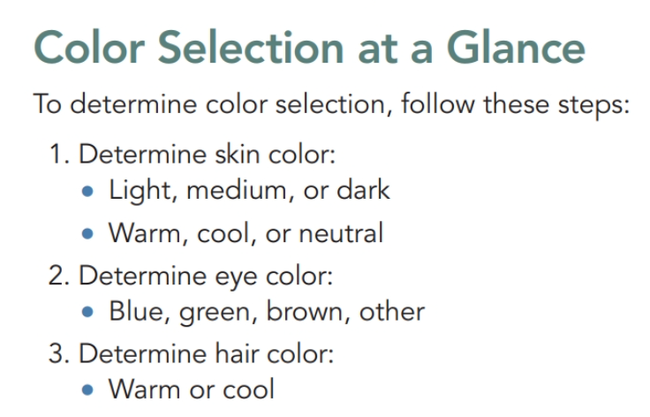
OUR JOURNEY TODAY

Slide 3
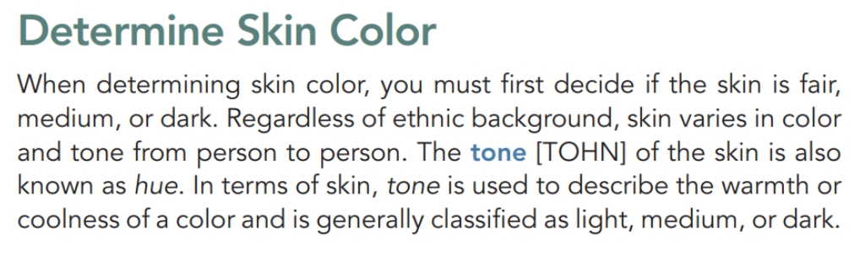

Slide 4

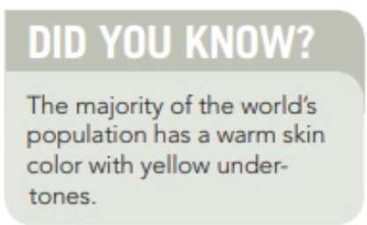
Undertones
Warm or Cool?
There are three general undertones:
· Cool colors (pink, red, or bluish undertones)
· Warm colors (yellow, peachy, or golden undertones)
· Neutral colors (a mix of warm and cool undertones).

Slide 5


Slide 6

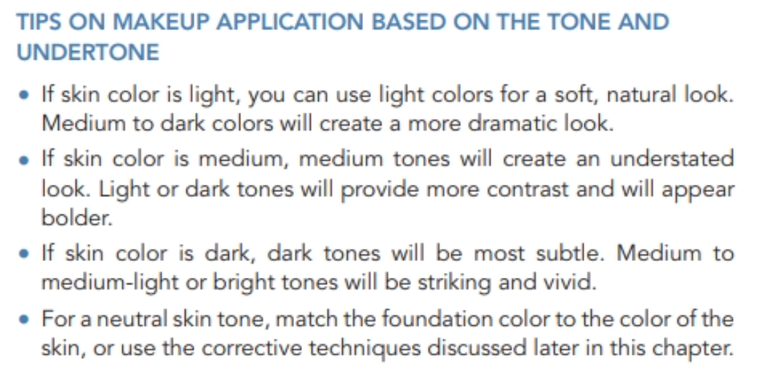

Slide 7
CONSIDERATIONS FOR ALTERING SKIN TONE
For various reasons, some clients may wish to alter their skin tone.
In terms of corrective makeup, you will be dealing with two basic skin tones: ruddy and sallow.
For ruddy skin (skin that is unnaturally red, wind burned, or affected by rosacea), apply a yellow-or green-tinted foundation to affected areas, blending carefully.
A yellow-based foundation will neutralize excess red in skin.
A green-based foundation (an opposite color to red) will block out excess redness but may impart a flat look

Slide 8
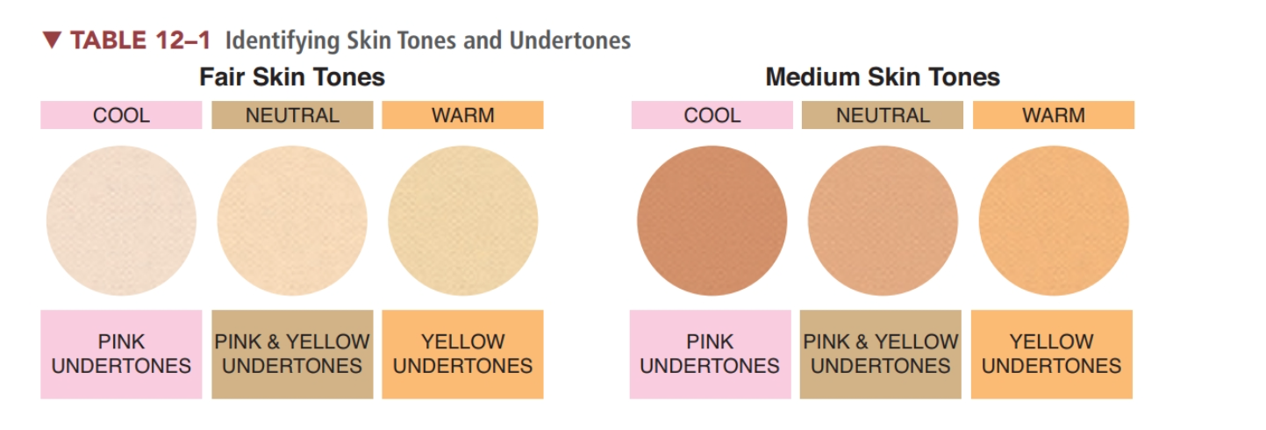

Slide 9
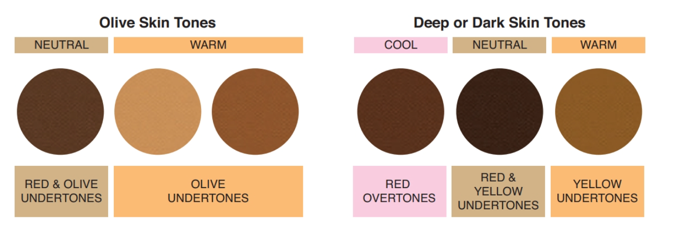

Slide 10
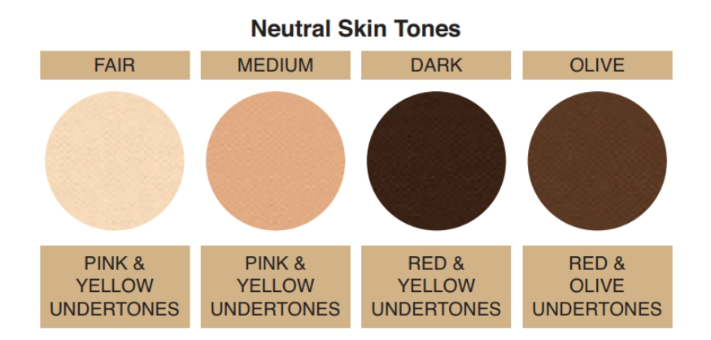

Slide 11
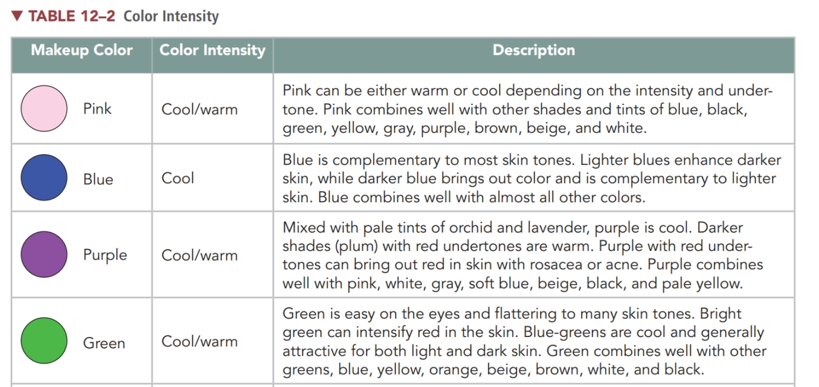

Slide 12
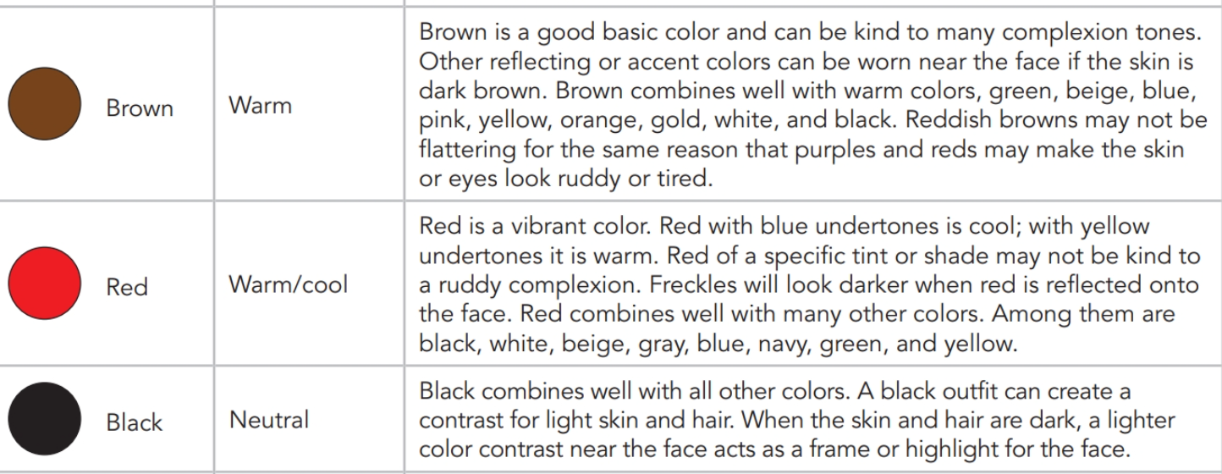

Slide 13
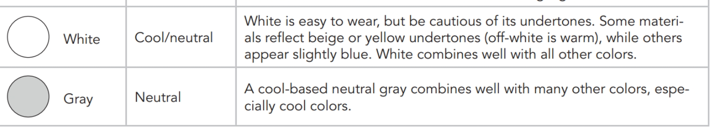

Slide 14
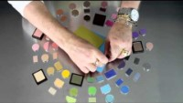
Eye Color

Slide 15
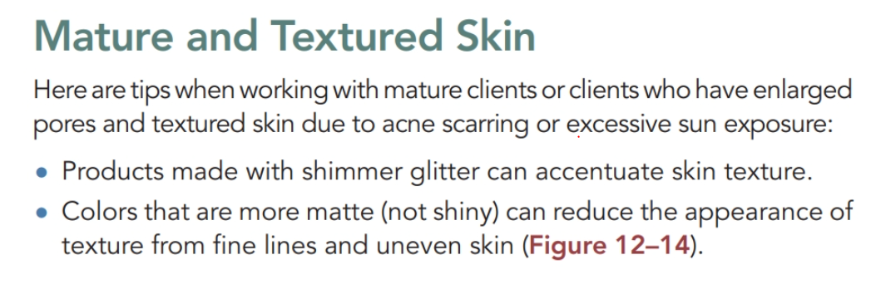
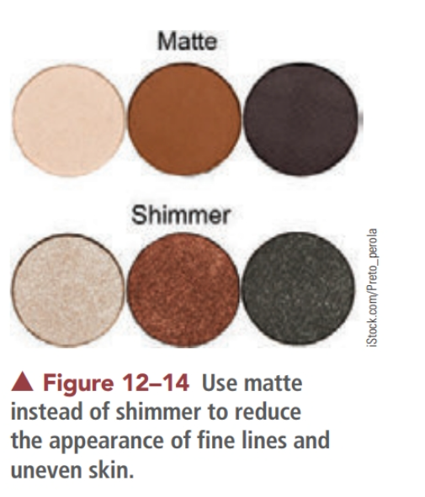

Slide 16
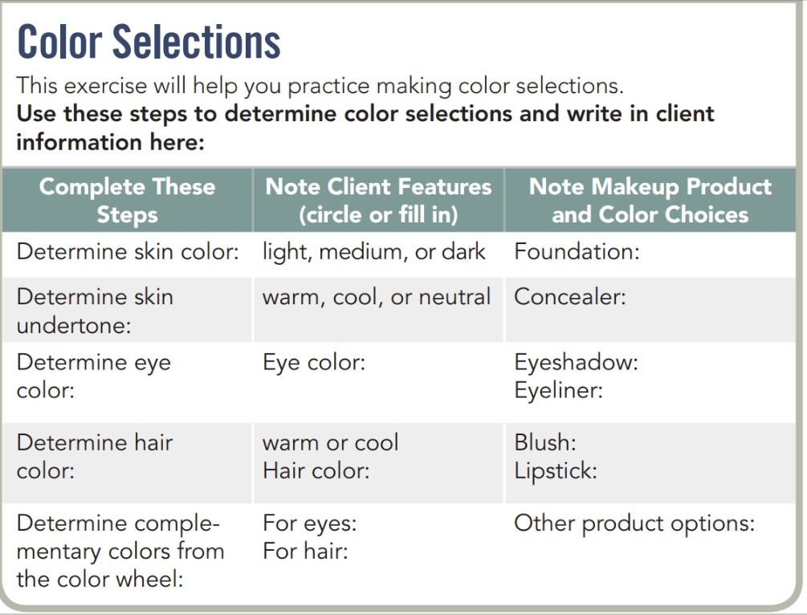
Activity !

Slide 17

QUESTIONS?

