Slide 1
INFC 215 Infection Prevention and Control
DONNING/DOFFING
Procedure/ Surgical Mask
Yellow “Duck bill”

Slide 2
Donning
Putting ON

Slide 3
Select procedure / surgical mask
– use type supplied
When?
As part of Routine Practice
(if anticipating splashes)
or if patient requires droplet isolation precautions

Slide 4
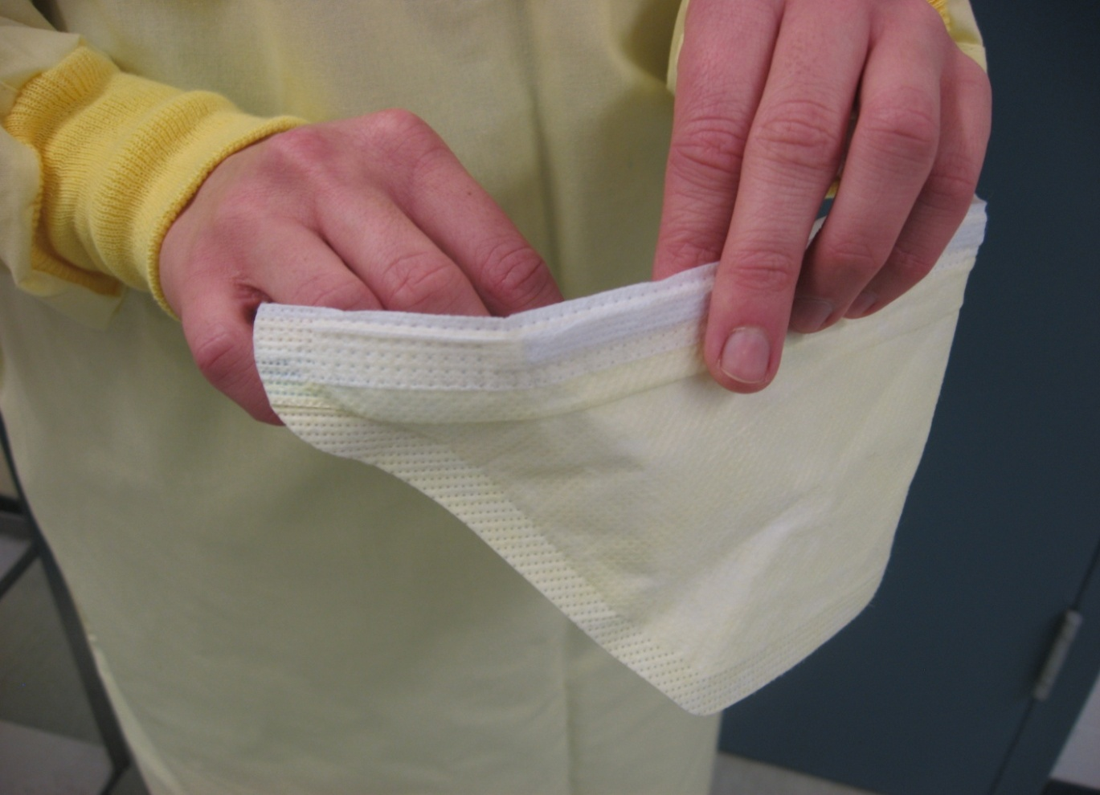
2. Open mask by touching edges only

Slide 5
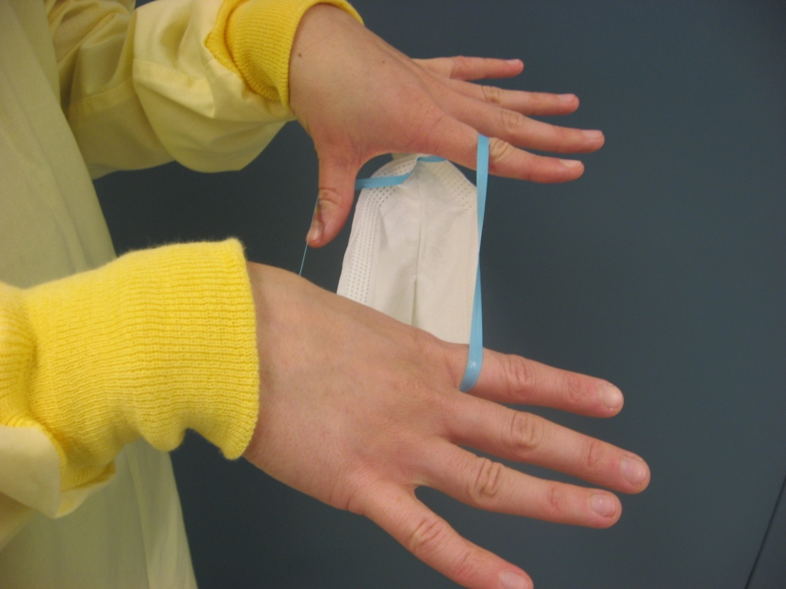
3. Pull the elastics apart with your fingers

Slide 6
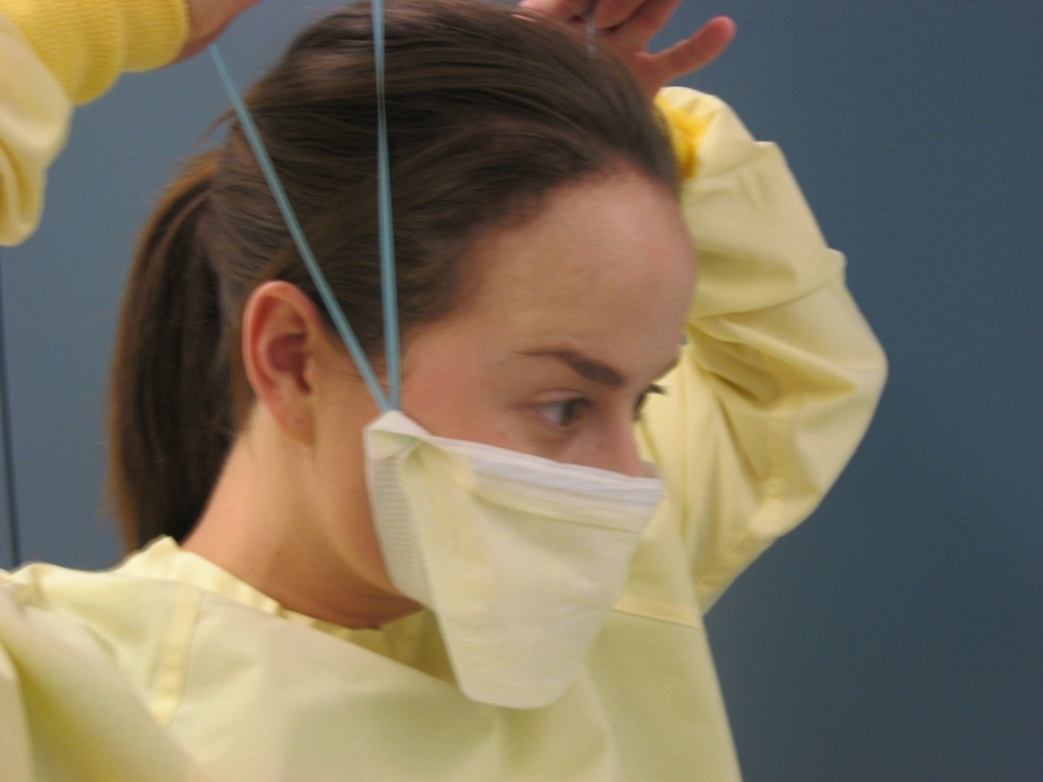
4. Place bottom of the mask under your chin and pull the elastics over your head

Slide 7
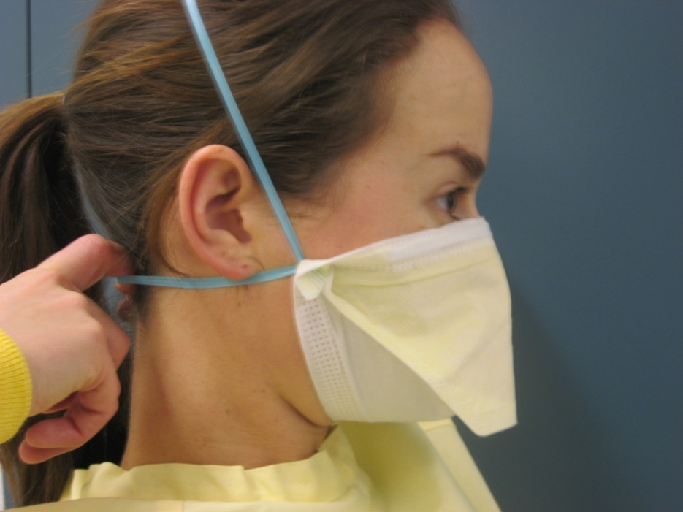
5. Separate the elastics and adjust mask to fit your face
Ensure that your mouth and chin are covered

Slide 8

5. Ensure a snug fit over your nose and cheeks
Use fingers of both hands to press the metal strip

Slide 9
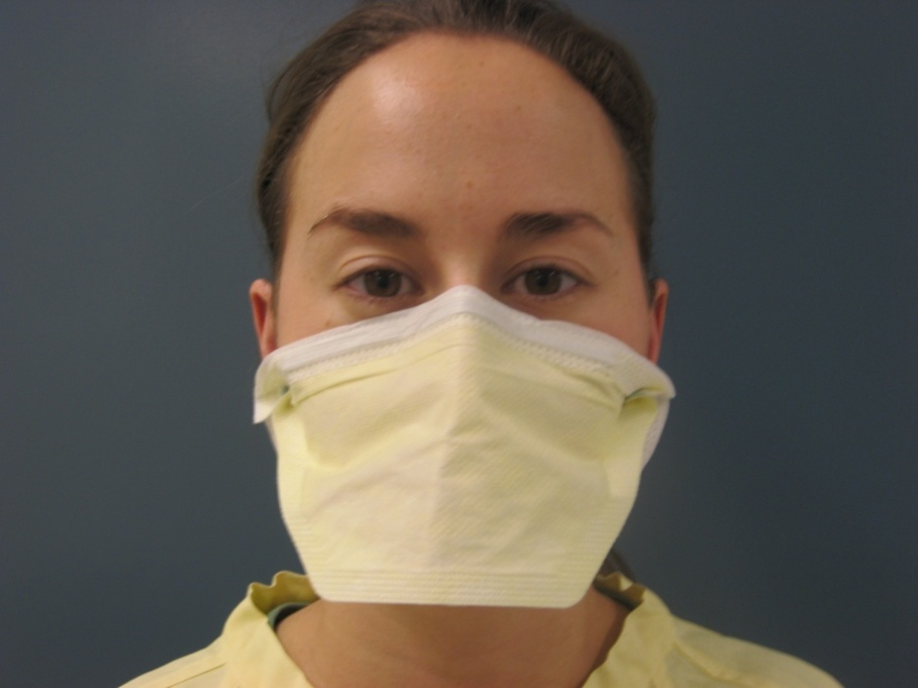
6. Check appearance
Is the mask properly adjusted?

Slide 10
Doffing
Taking OFF

Slide 11
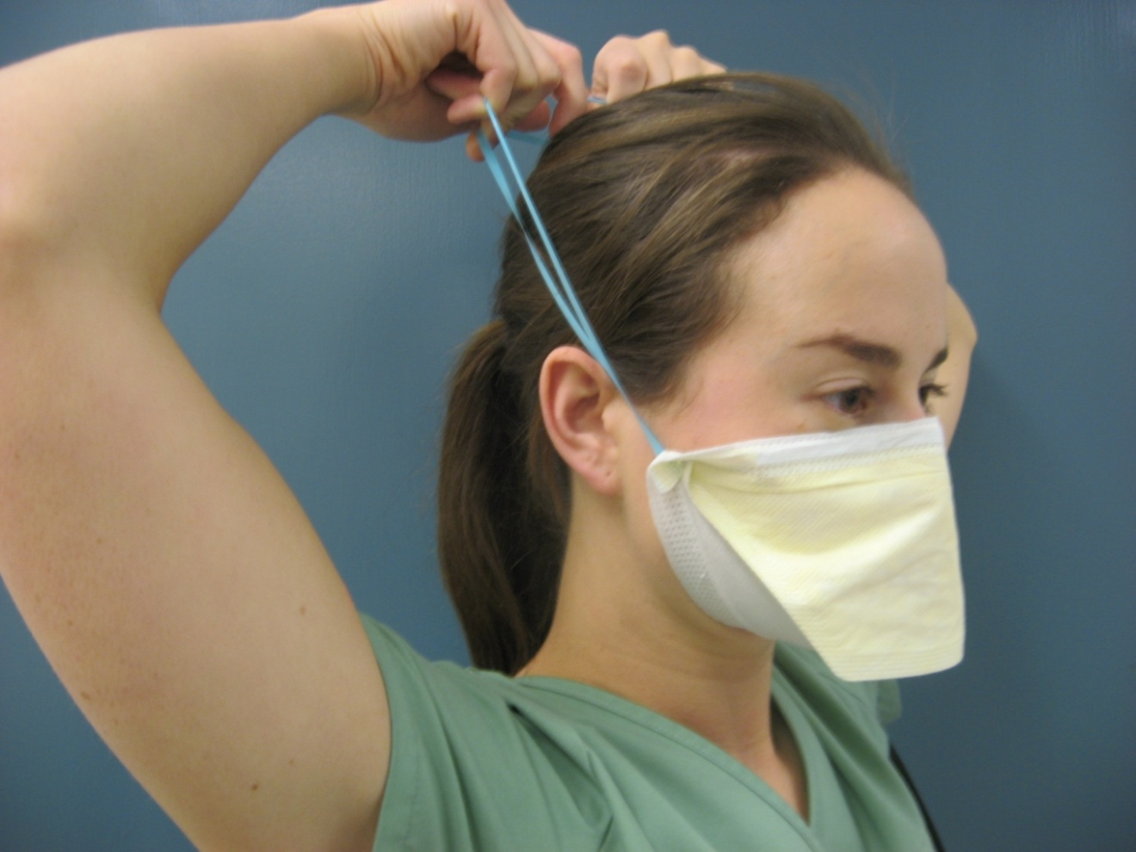
1. Grasp elastics with clean hands

Slide 12
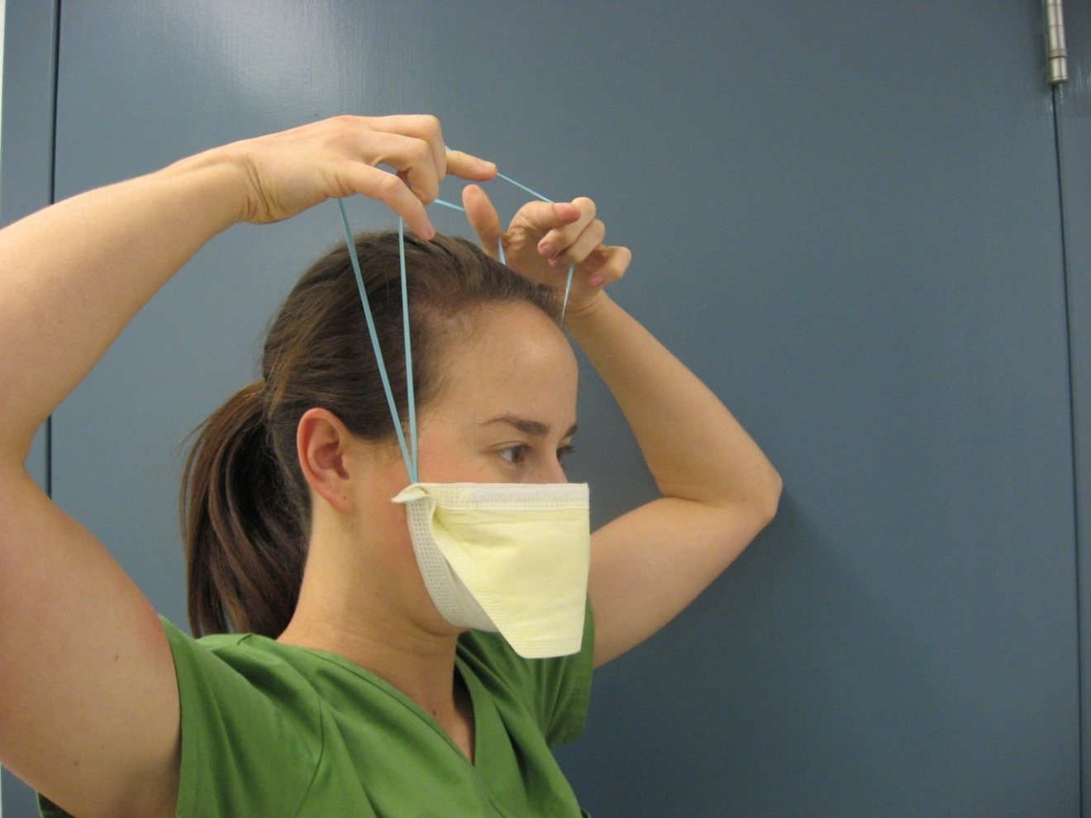
2. Pull elastics over the head and mask away from face

Slide 13
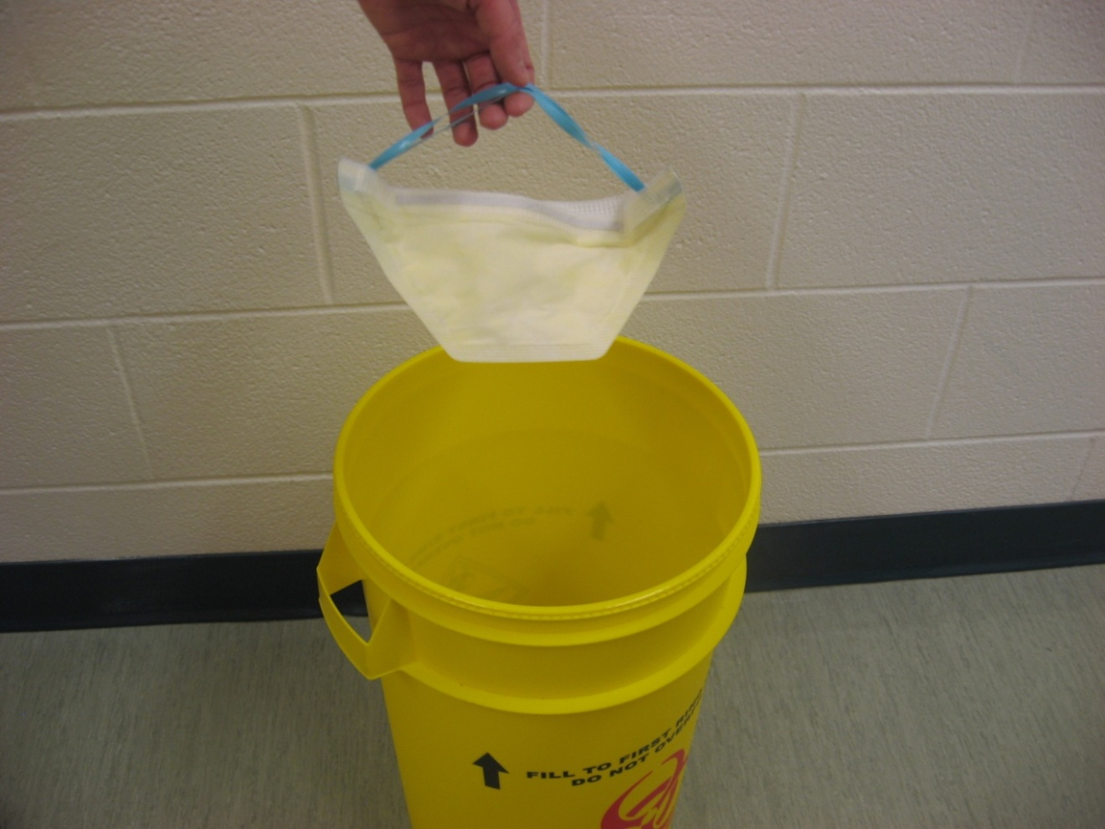
3. Discard into disposal container

