Slide 1

MRAD 240: Specialized
Imaging 1
Bariatric Imaging

Slide 2
Objectives
List the technical issues associated with bariatric patients
Outline modifications used when X-raying bariatric patients

Slide 3
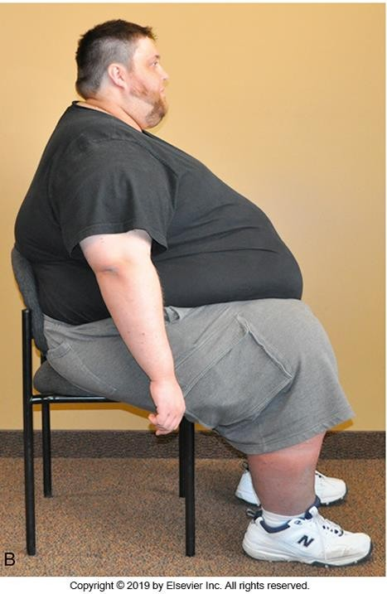
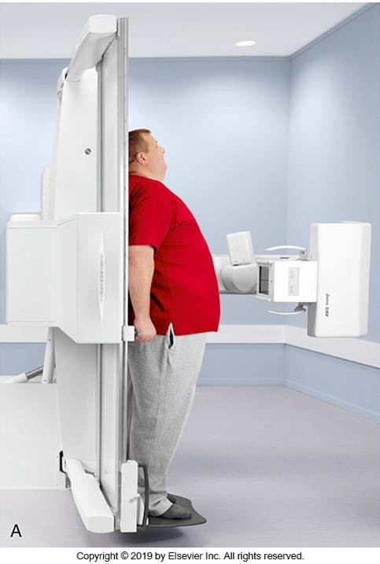
Obesity – What Is It?
Body Mass Index (BMI) of 30-39.9 is classified as obesity
BMI of 40+ is morbid obesity
Obesity
Morbid obesity

Slide 4
Obesity cont.
26.8% of Canadians classified as obese
x/2019001/article/00005-eng.pdf
https://www150.statcan.gc.ca/n1/pub/82-625-
No Canadian data on morbid obesity
Obese individuals are more likely to have accompanying medical issues
(comorbidities)
Often have a higher need of medical imaging
Present unique challenge to radiographers

Slide 5
Bariatric Imaging Challenges
Transportation can be difficult
Equipment is often not designed to handle the increased weight
  This is being addressed by equipment manufacturers
  Extended Capacity (EC) wheelchairs and lifts now available
  Refer to It’s Your Move module in Pt Care for more information
Slides and log rolls require more staff for safety
  Proper body mechanics even more important
  Higher rate of staff injuries during transfers

Slide 6
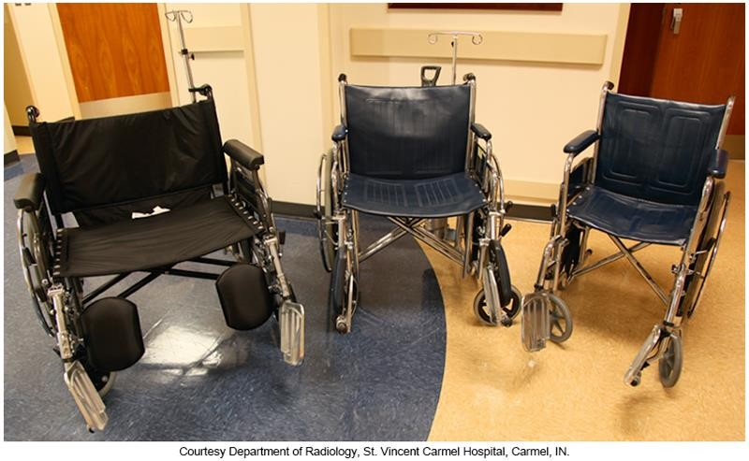
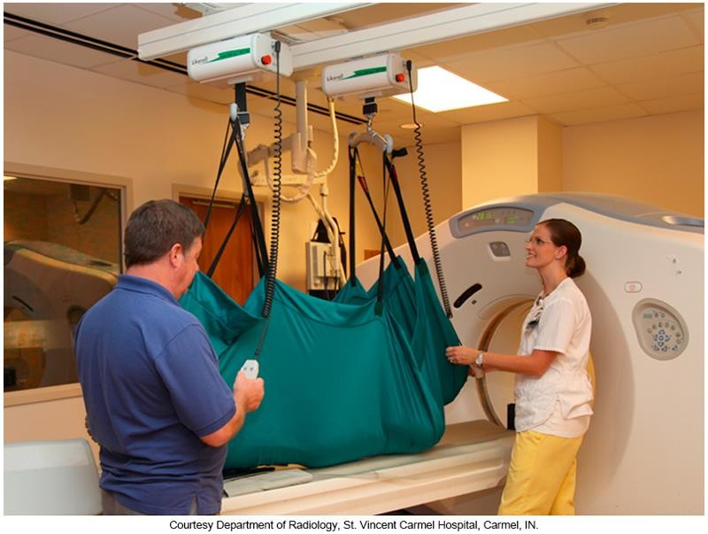
Extended Capacity Equipment
Wheelchairs: extra-large for morbidly obese patients (left), large for obese patients (center), and standard for smaller patients. (Courtesy Department of Radiology, St. Vincent Carmel Hospital, Carmel, IN.)
Twin 500-lb capacity power lifts, attached to a ceiling-mounted rail system, allow very large patients to be safety lifted from a bed or a stretcher to the 650-lb capacity CT table.
Interdepartmental cooperation is essential because the hoist sling is usually positioned under the patient before transport to the CT suite. (Courtesy Department of Radiology, St. Vincent Carmel Hospital, Carmel, IN.)

Slide 7
Table Weight Limits
Modern equipment is made with higher weight limits
  May still find clinics with old equipment and low weight limits
X-ray tables usually have a limit between 500-650lbs
  Older tables may be as low as 350lbs
Fluoro tables vary from 350-500lbs
  Often have two weight limits.
    Static (no bed movements or table rotation) is often higher
    Movement weight limit is usually lower to avoid stress on the motor
Perform as much fluoro imaging upright as possible
  Remove the footboard and have patient stand on the floor
  Step the patient away while you lay the bed down
  Shift the patient on the bed or move the tube rather than using the motor

Slide 8
Unable to Accommodate?
Patient over the table limit? You have 2 options
  Call other facilities and attempt to find a place that can accommodate
    Hospitals usually have higher limits than clinics*
  Refer the patient back to their physician to find another facility or test
    Be extremely diplomatic when doing this!
Rumours of patients being sent to the zoo
  This has happened at least once, but I’ve never heard of it in Calgary
  Deeply embarrassing
*CDC has the highest table limits of all clinics (fluoro tables up to 500lbs. X-ray up to 650). Hospital (South Health
Campus) has fluoro tables up to 640lbs. I won’t test you on this, it’s just nice to know.

Slide 9
Challenges - Techniques
Bariatric patients often get up to 4x the radiation dose over their lifetime
  Carelessness on a tech’s part will definitely add to this
Cannot rely on preprogrammed techniques
  You will constantly run into the backup timer
  AEC will increase the time of the exposure to attempt to reach an appropriate
density level
  Substantially increases dose
Increasing kVp will make the beam more penetrative to adjust for the increased soft tissue
  Less absorbed dose
  Can still use AEC

Slide 10
Techniques cont.
You have the option to set a manual technique
Resist the urge to increase mAs by a large amount (small adjustments are necessary and ok)
  Increases skin dose
  Increases the time of the exposure
  Longer exposure = more motion artifact = repeats!
Always consider ALARA!

Slide 11
Scatter
Increasing kVp = more scatter
More matter = more scatter
More scatter = lower contrast resolution and a general fog on the image
Ways to combat the scatter
  Use a grid for everything except distal extremities
  Tight collimation = less matter = less scatter

Slide 12
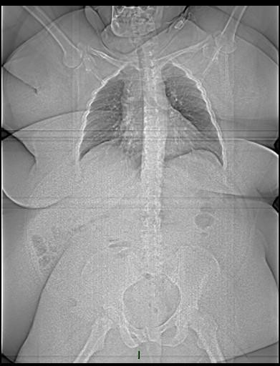
More on Collimation
A patient’s bones and internal organs do not grow as their weight increases
Resist the urge to open your collimation!
The light will look really small on the patient (especially on abdomen and spine images)
Case courtesy of Dr Sajoscha Sorrentino, Radiopaedia.org, rID: 15656

Slide 13
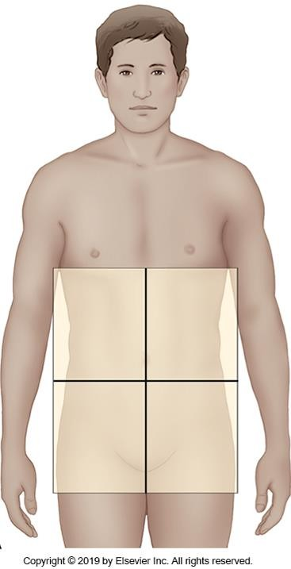
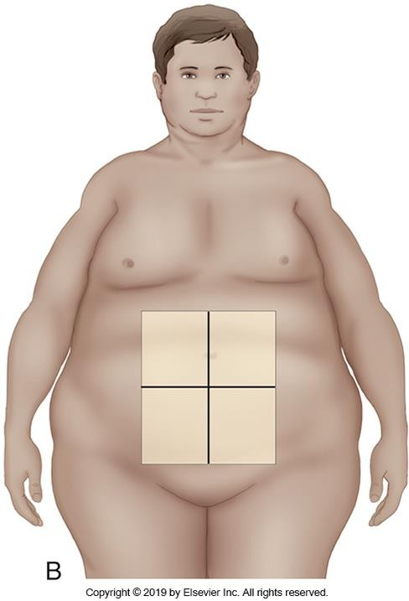
Collimation cont.
Diverging rays cause the light field to look much smaller on a larger person
  Very deceiving
  Use the numbers on the collimator for guidance
Be certain you’re not collimating larger than your IR
  Some equipment will still expose if you are too open

Slide 14
Challenges – Holding Positions
Patients with obesity may have difficulty reaching or maintaining some positions due to a lack of flexibility or strength
Provide sponges and sandbags to help hold obliques or keep legs internally rotated
Be prepared to adjust your approach if the patient is struggling
  Example: prone or sitting skyline knee depending on the patient’s
abilities

Slide 15
Challenges - Landmarks
Landmarks may be difficult or impossible to palpate
  Your biggest challenge working with bariatric patients
Landmarks that may be hard/impossible to find
  Crests
    You can sometimes use lower costal margin
    The inferior aspect of a bent elbow is usually close to the level of crests
  ASIS
    Lies under the panniculus*
    Panniculus can be too heavy to lift in some patients
    Skin under the panniculus is often moist and delicate so you don’t want to reach under there (wear gloves if you must!)
*Panniculus Adiposus (pannus) “fatty apron”: Anterior abdominal tissue that hangs down on patients with obesity

Slide 16
Landmarks cont.
Greater trochanter
  Ease of location depends on fat distribution
  Much harder to find on obese women
Lower costal margin
  Can be easier to find than crests, but digging for it can be very painful for the patient
Inferior angle of the scapula
  Depends greatly on body composition and fat distribution
  May be easy to find or very difficult
Xiphoid process
  T10/11
  Easier to find than some others, but can still be difficult to locate
  Sensitive region. Ask the patient to locate it for you if in doubt

Slide 17
Palpable Landmarks
Some landmarks are almost always palpable
Jugular notch
  May be the only palpable landmark on the morbidly obese
  Corresponds to T2/3
  T1 is approx. 2 inches (5cm) above jugular notch
C7 spinous process (vertebra prominens)
  Corresponds to T1 and the apex of the lungs
  T7 (inferior angle of the scapula) is usually approx. 7 inches below vertebra prominens in women and 8 inches in men

Slide 18
Chest Imaging - PA
Use vertebra prominens to determine the top of the light field
  Do not be fooled by the extra tissue above the light field.
Centering should be 7-8 inches inferior to this point depending on patient height
Use AC joints if palpable to determine side to side collimation
Resist the urge to open your collimation!
  Check the numbers on your collimator and make sure they’re reasonable

Slide 19
Chest Imaging - Lateral
Use centering of PA to guide you
  Do not raise or lower centering unless necessary
Center immediately below shoulder joint
Do not be fooled by extra tissue on anterior of the body
Close your collimation side to side
Trust yourself!

Slide 20
Spine Imaging - C&T Spine
C-spine
  C-spine is normally business as usual
  Ensure you lift chin on the AP to prevent soft tissue overlap on upper vertebrae
T-spine
  Use jugular notch as your landmark
  Xyphoid can help locate bottom of T-spine

Slide 21
Spine Imaging – L-spine
Finding crests may be impossible
Do not use bellybutton as it can shift in any direction with the size and shape of the panniculus
Use elbow and xiphoid as benchmarks
Center to the C-spine side to side so you’re not thrown off by the belly leaning to one side or the other
Close collimation a must!
  Can turn into a supine abdomen very easily

Slide 22
Abdomen Imaging
The most challenging of all bariatric imaging
Must stick to your fundamentals and trust your positioning skills
It is unlikely you will get all abdominal contents on one image
How do you know you’ve got it all?
  The abdominal fat stripes!

Slide 23
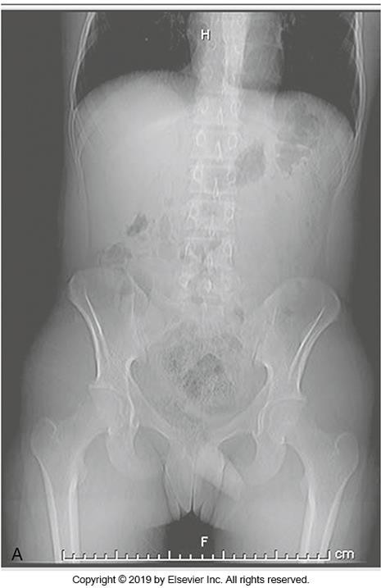
Abdominal Fat Stripes
Border the lateral walls of the abdomen
Fat stripes
No bowel contents beyond
  If you have the fat stripes, you’ve got all abdominal contents

Slide 24
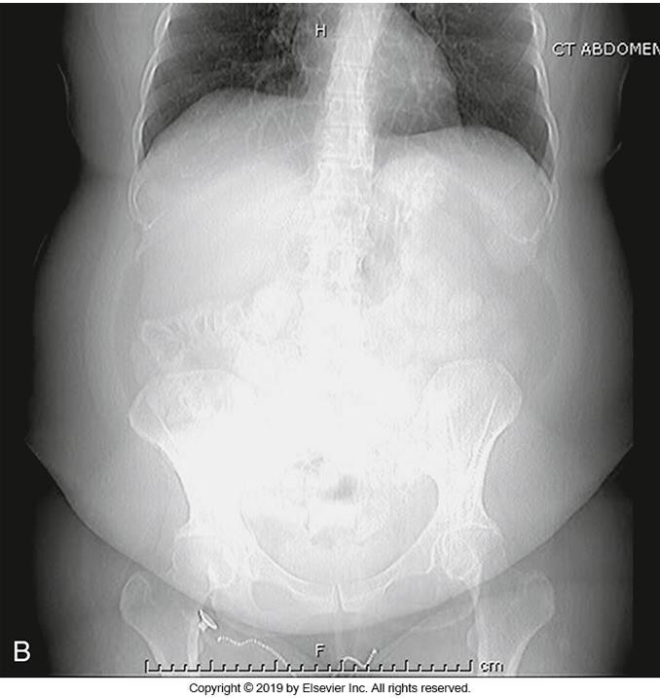
Abdominal Fat Stripes cont.
Along with extra superficial fat, fatty tissue is also deposited between the organs (visceral fat)
Fat stripes
This causes the fat stripes to “bow” laterally
Becomes too wide to get on one portrait image

Slide 25
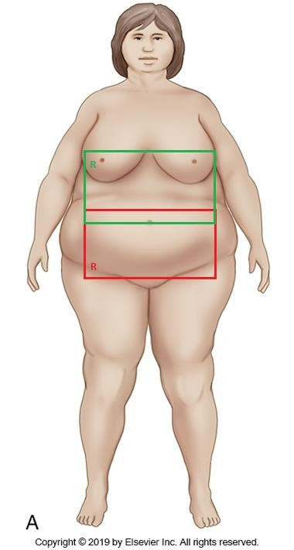
Abdominal Imaging – The solution!
2 images in a landscape orientation
Much like a femur, you just have to prove overlap
  Internal organs can help with this
Top image
  Top of light at xiphoid
  Marker in the top corner
Bottom image
  Bottom of light at greater trochanter
  If you can’t find trochanter, just ensure 3-5cm overlap (will usually sort itself out)
  Marker in the bottom corner
This marker placement avoids obscuring required anatomy

Slide 26
Communication and Attitude
The most important part of the exam!
You can repeat an image for poor centering or technique choice
You cannot take back being unkind or making judgemental comments
Whatever your personal feelings about this person or their reason for being in the department, they’re your patient and deserve your best.

Slide 27
How Do You Do This?
Don’t make comments about their weight
  Seems obvious, but isn’t always
  Palpate respectfully and seek assistance when necessary. Example- “can you put your hands on your hips?”
If you are finding the exam challenging, do not complain in the room or
tech area where patient can hear you.
Consult coworkers for help, but keep conversation constructive. Review the requisition to ensure the most important anatomy is included.

Slide 28
How To cont.
If you are having trouble locating landmarks, explain to the patient why you need their help. Don’t just go poking around.
Explain the importance of breathing instructions
  Ensure they are being followed before exposing!
Your attitude can make or break a difficult day!

