Slide 1
MRAD 256 – Radiographic Technique 2
Chest and Abdomen Critique
MRT Program

Slide 2
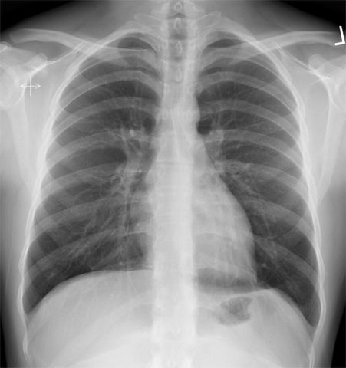
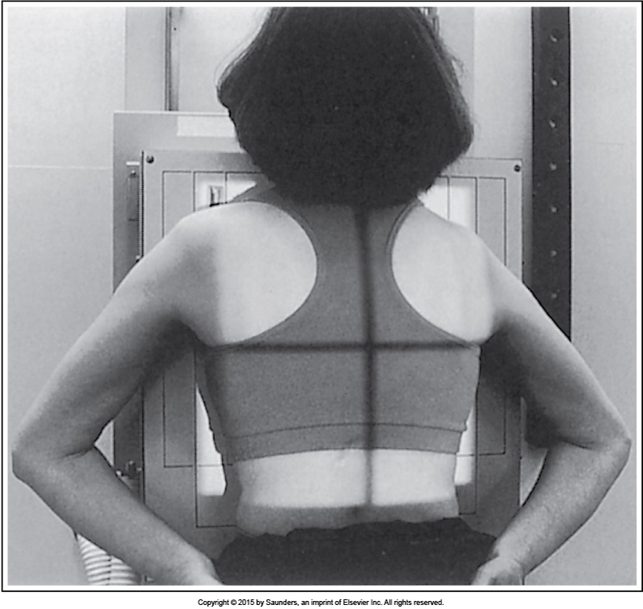
Chest: PA Projection
PA chest projection with accurate positioning
Proper patient positioning for PA chest projection

Slide 3
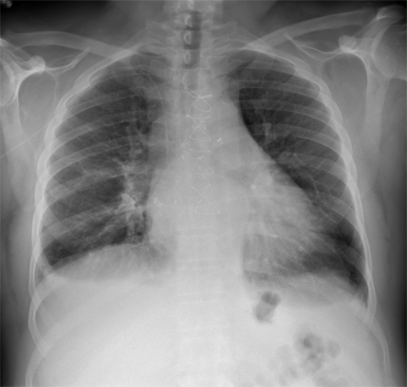
PA Chest Analysis Practice (1 of 3)
Analysis
The manubrium is situated at the level of the third thoracic vertebra, and less than 1 inch (2.5 cm) of the apices is demonstrated superior to the clavicles.

Slide 4
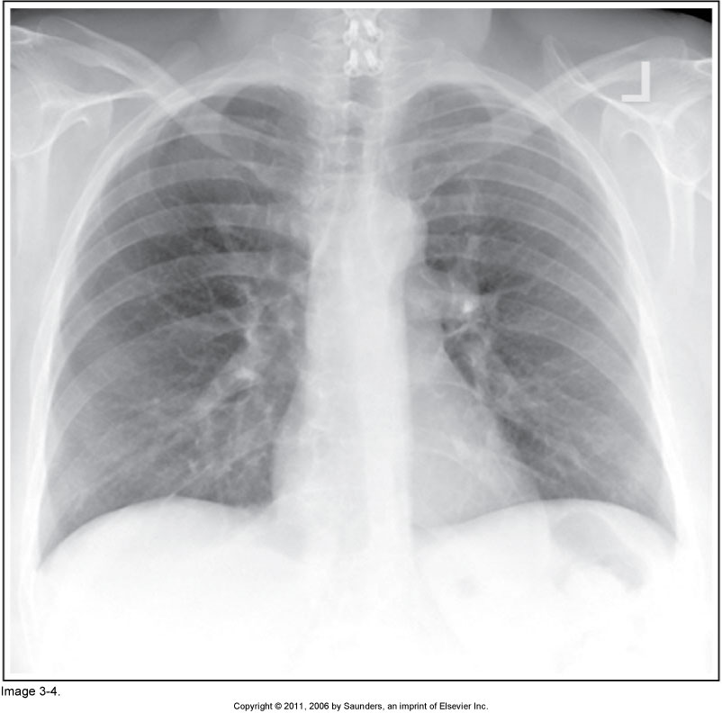
PA Chest Analysis Practice (2 of 3)
Analysis
The manubrium is situated at the level of the fifth thoracic vertebra, and more than 1 inch (2.5 cm) of the apices is demonstrated superior to the clavicles.

Slide 5
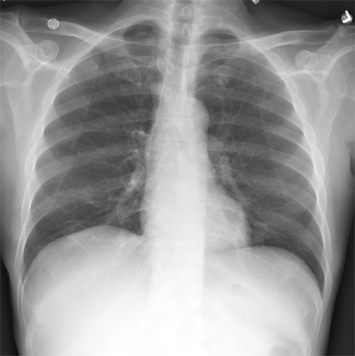
PA Chest Analysis Practice (3 of 3)
Analysis
The right sternal clavicular end is demonstrated farther from the vertebral column than the left.
The right side of the chest was situated farther from the IR than the left side.
The scapulae are in the lung fields.

Slide 6

Chest
Lateral Projection
(Left Lateral Position)

Slide 7
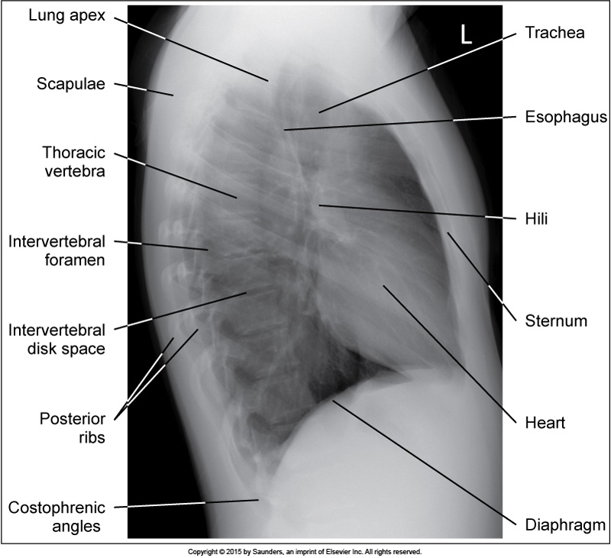
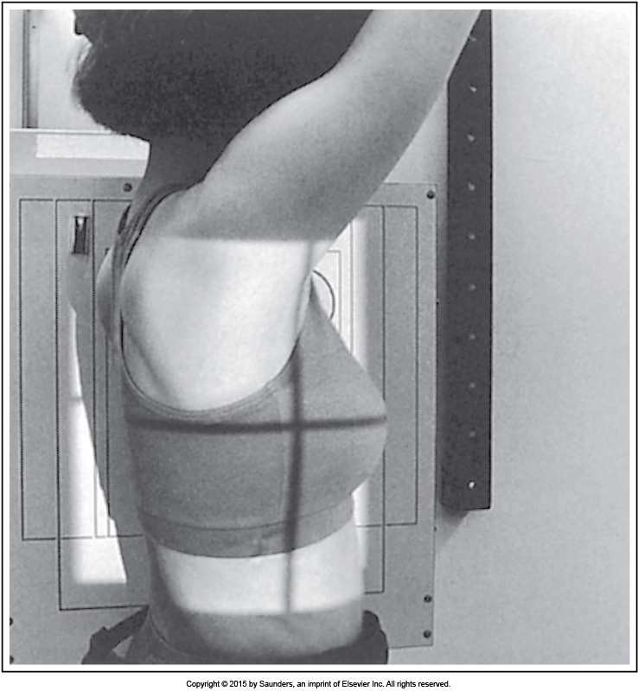
Chest: Lateral Projection
(Left Lateral Position)
Lateral chest projection with accurate positioning
Proper patient positioning for lateral chest projection

Slide 8
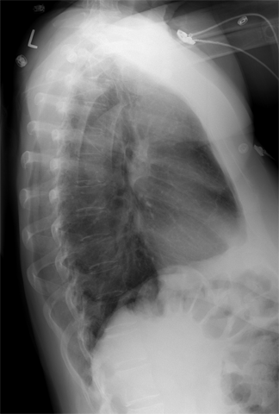
Lateral Chest Analysis Practice (1 of 3)
Analysis
The right and left posterior ribs are separated by more than 0.5 inch
(1.25 cm).
Lung tissue is not demonstrated anterior to the sternum.

Slide 9
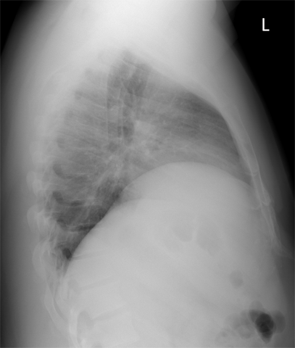
Lateral Chest Analysis Practice (2 of 3)
Analysis
The hemidiaphragms demonstrate an exaggerated cephalic bow.

Slide 10
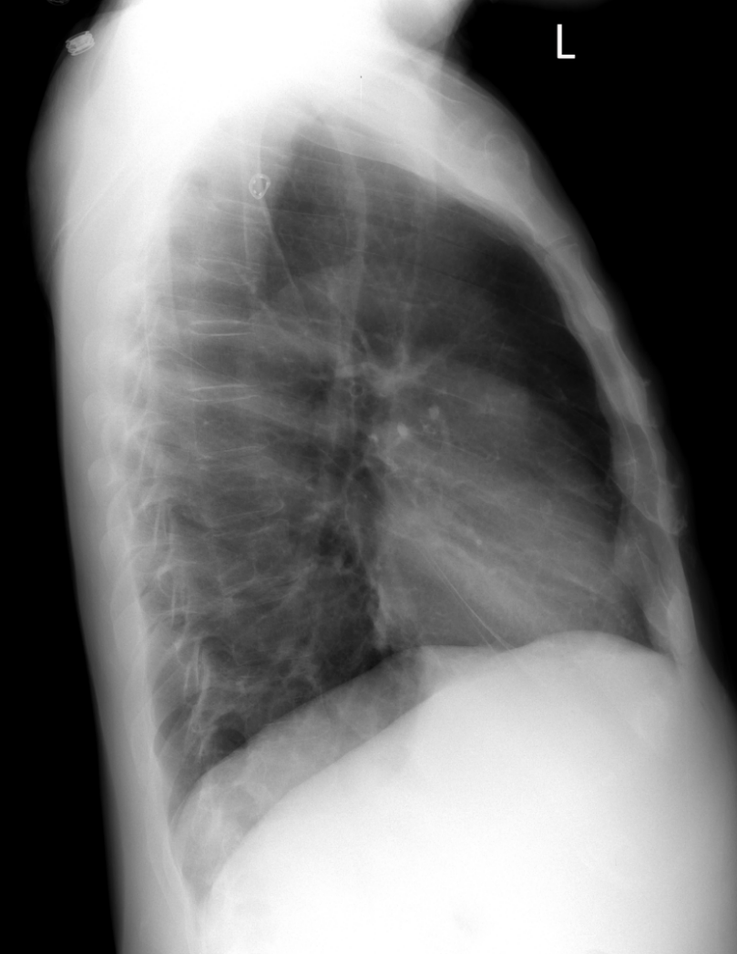
Lateral Chest Analysis Practice (3 of 3)
Analysis
The hemidiaphragms are not superimposed.

Slide 11
Abdomen
AP Projection
(Supine and Upright)

Slide 12
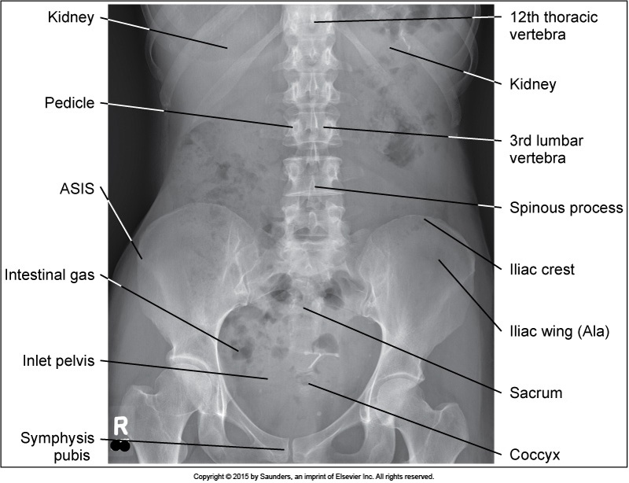
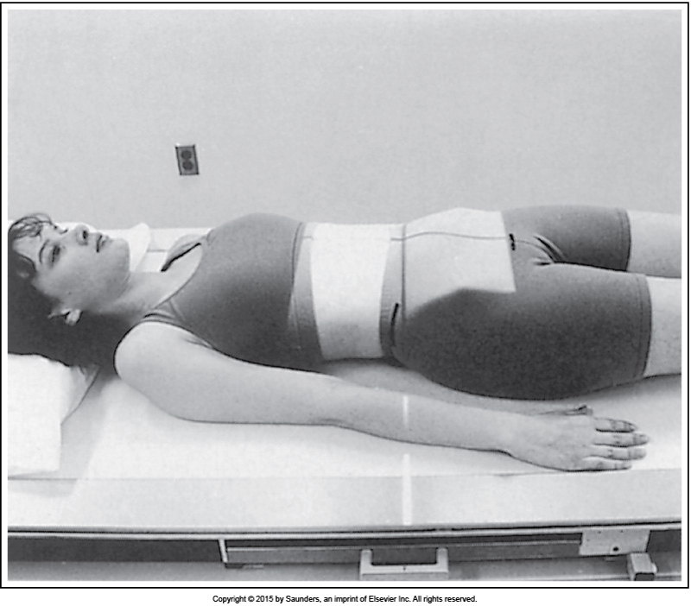
Abdomen: AP Projection
(Supine)
Supine AP abdomen projection with accurate positioning
Proper patient positioning for supine AP abdomen projection

Slide 13
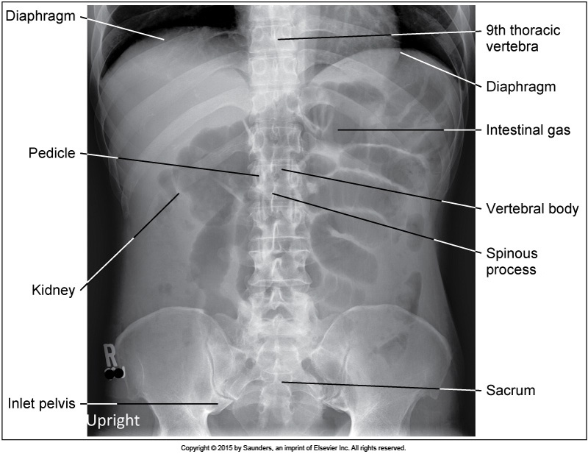
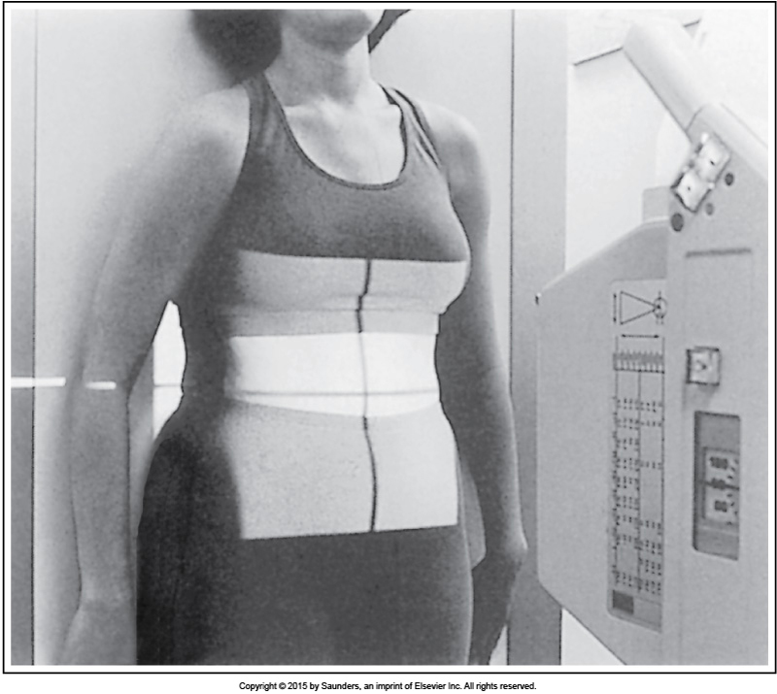
Abdomen: AP Projection
(Upright)
Upright AP abdomen projection with accurate positioning
Proper patient positioning for upright AP abdomen projection

Slide 14
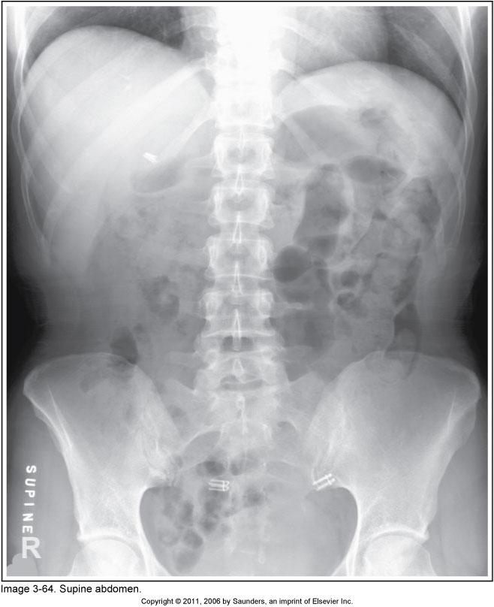
AP Supine Abdomen Analysis Practice
Analysis
The symphysis pubis is not included on the projection.

Slide 15
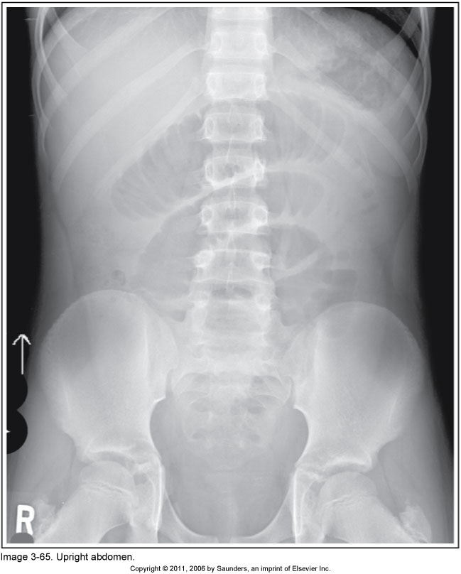
AP Upright Abdomen Analysis Practice (1 of 2)
Analysis
The domes of the diaphragm are not included on the projection.

Slide 16
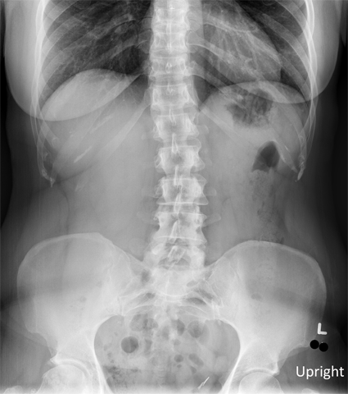
AP Upright Abdomen Analysis Practice (2 of 2)
Analysis
The diaphragm is at the level of the eleventh thoracic vertebra.

Slide 17

QUESTIONS?

