Slide 1


Create Makeup Looks for Special Occasions

Slide 2
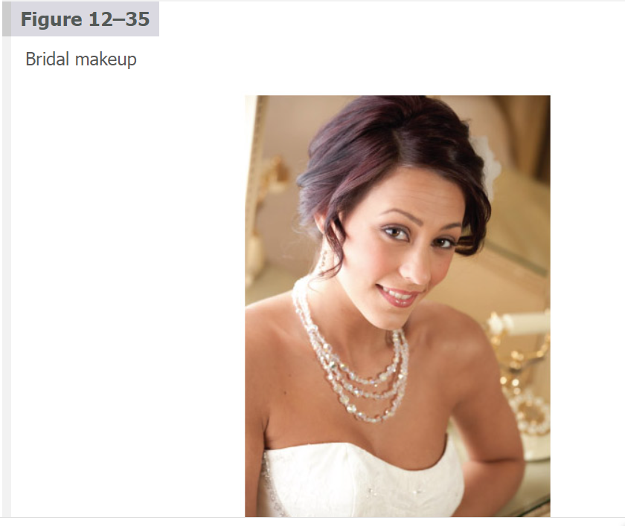

Slide 3
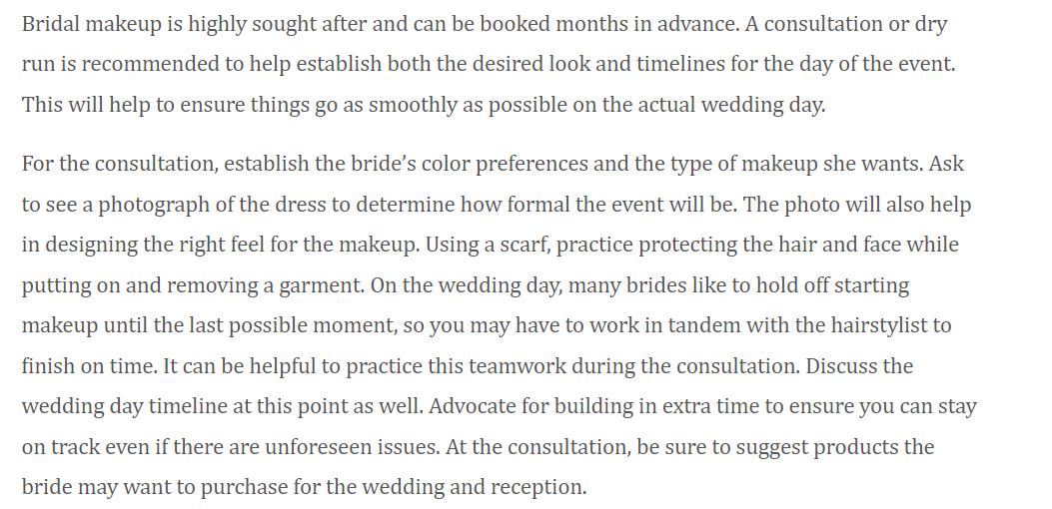

Slide 4



Slide 5
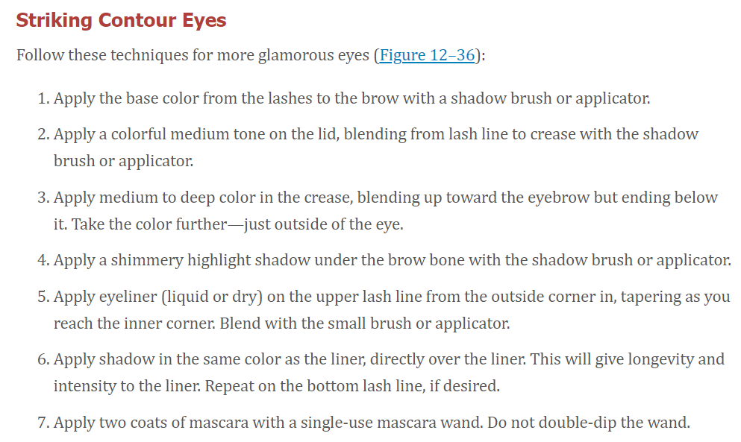

Slide 6
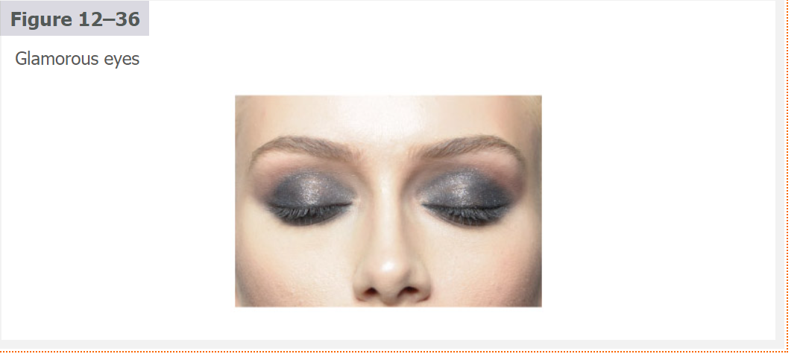

Slide 7
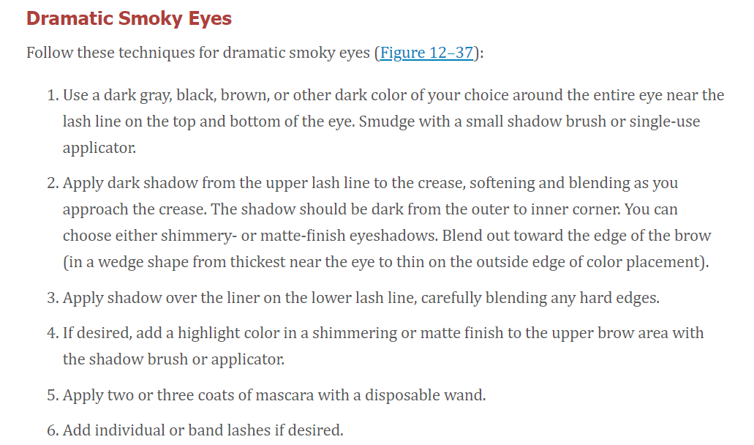

Slide 8
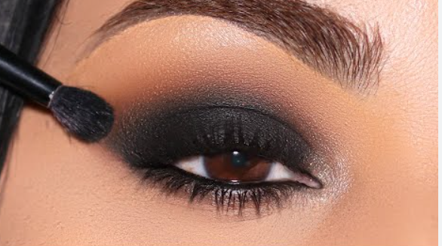

Slide 9


Slide 10

QUESTIONS?

