Slide 1


Combination Therapy in Acne

Slide 3
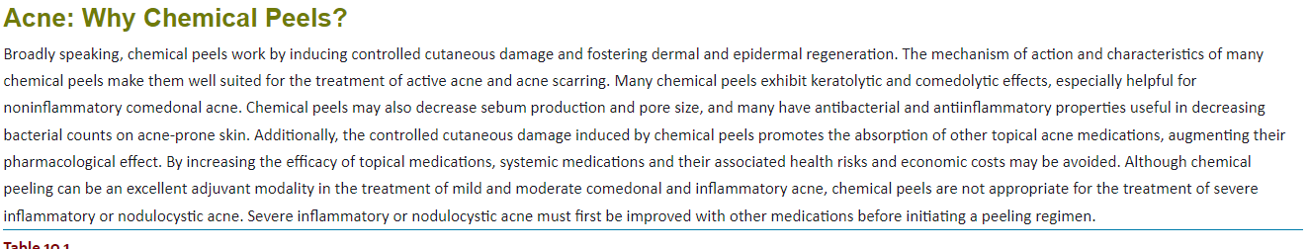

Slide 4
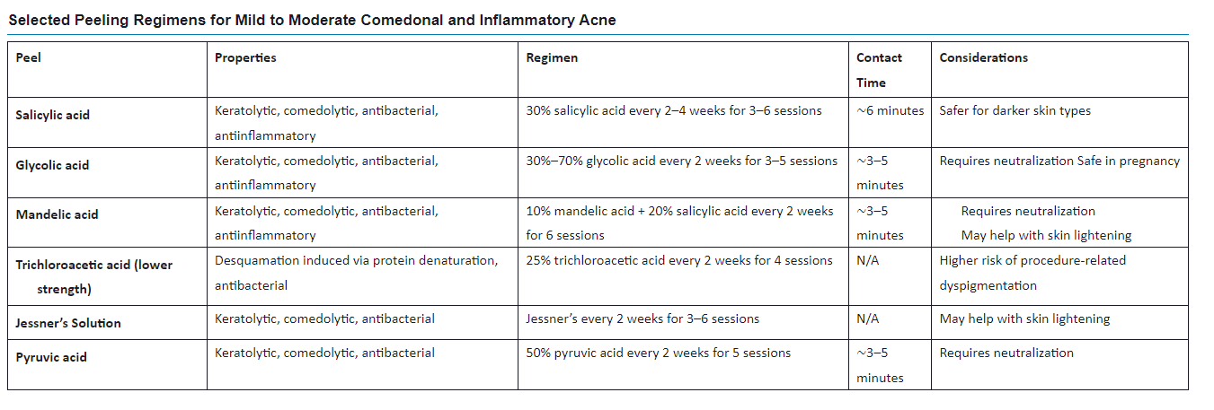

Slide 5
Salicylic Acid
Glycolic Acid
Trichloroacetic Acid
Jessner’s Solution
Lactic Acid
Mandelic Acid
Pyruvic Acid
Commercially Available Peeling Blends

Slide 6
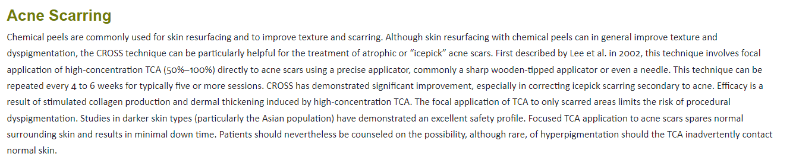

Slide 7
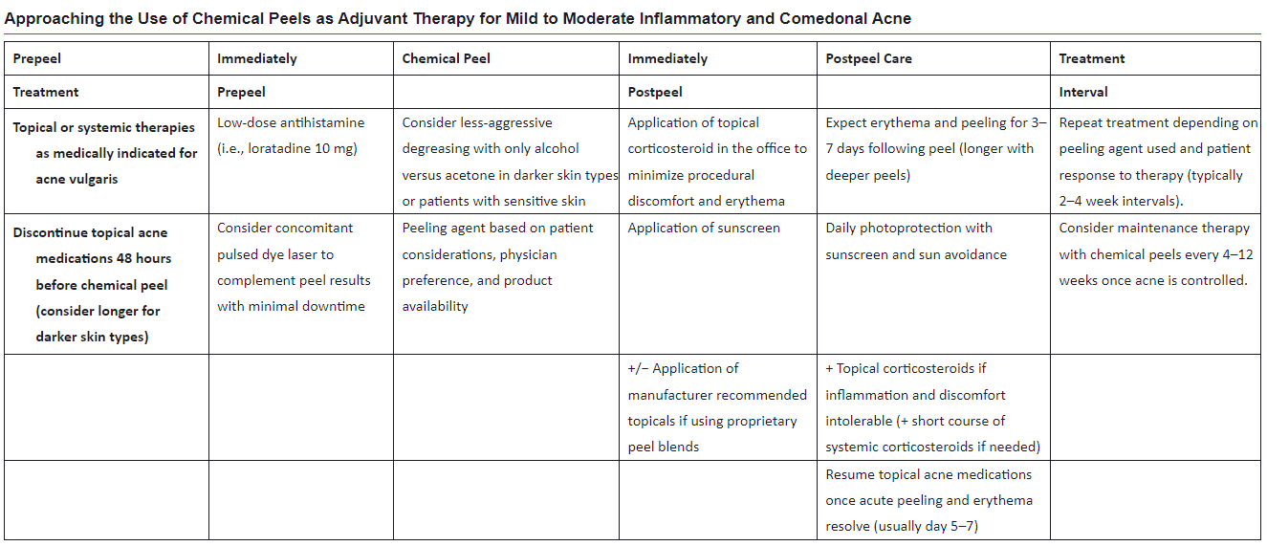

Slide 8
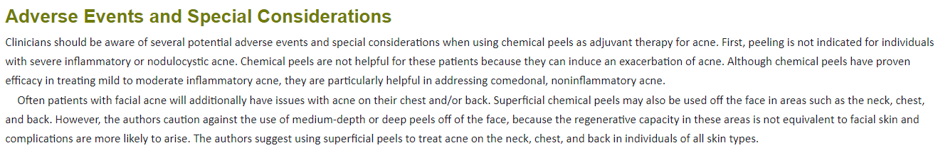

Slide 9
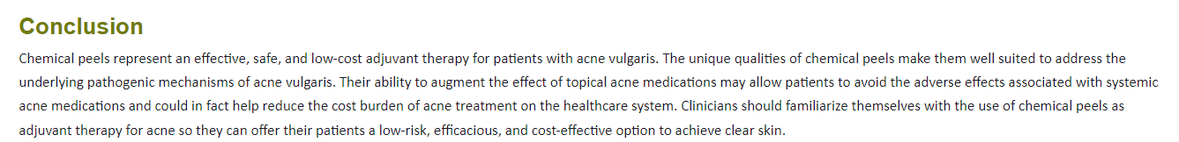

Slide 10

QUESTIONS?

