Slide 1

Pathogens

Slide 2
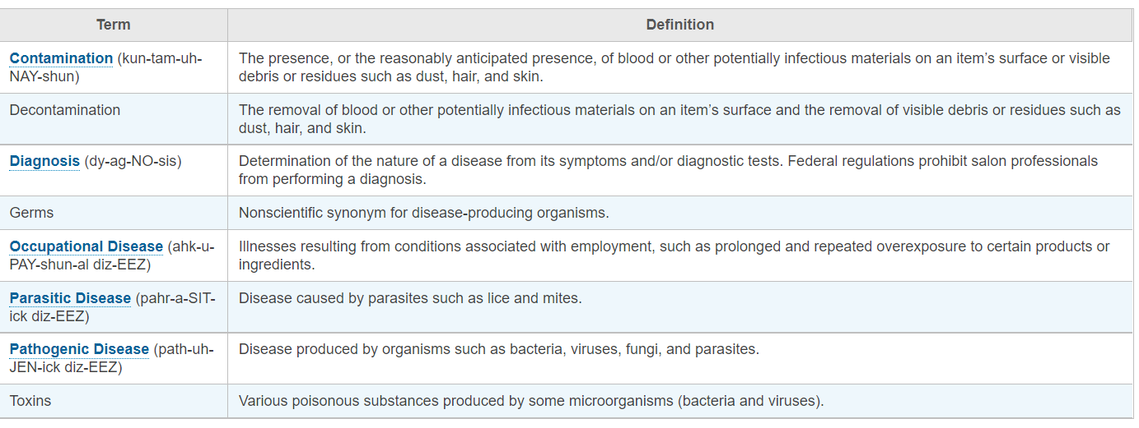


Slide 3
Let’s Play a Game
Click the box to start the game

Slide 4
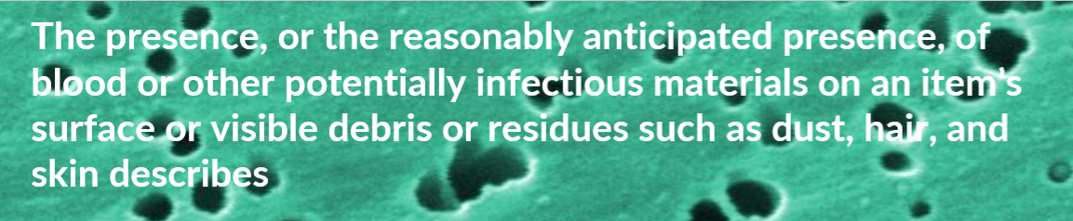
Contamination
Sanitation
Diagnosis
Parasites
Bacteria
Virus

Slide 5
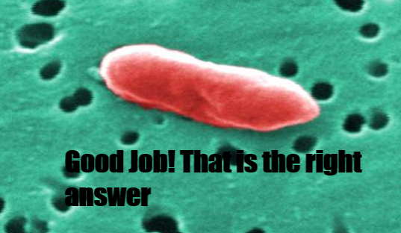

Slide 6
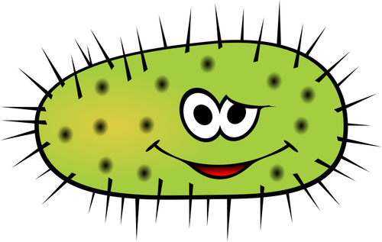

Slide 7
When it comes to preventing the spread of infectious disease, beauty professionals must understand and be prepared to deal with five types of potentially harmful organisms
BACTERIA
Virus
Parasites
Biofilms
Fungi
END

Slide 8
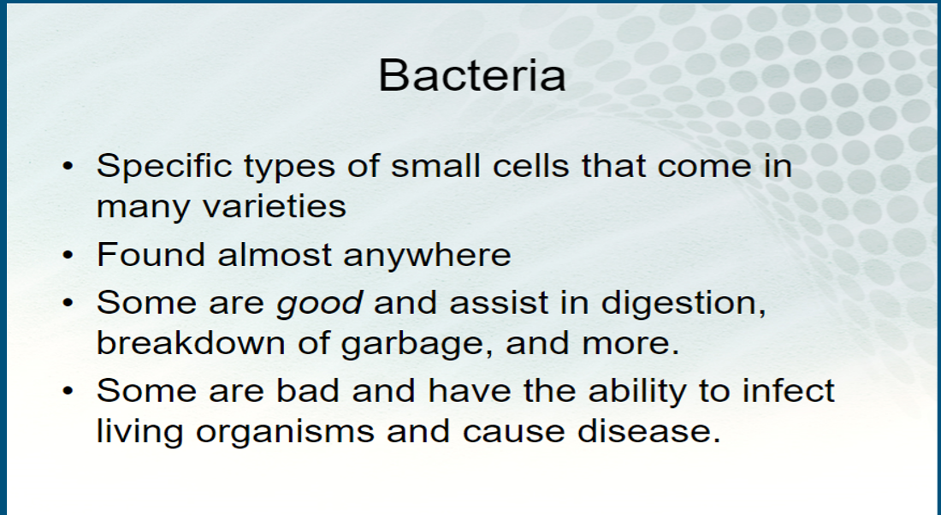

Slide 9
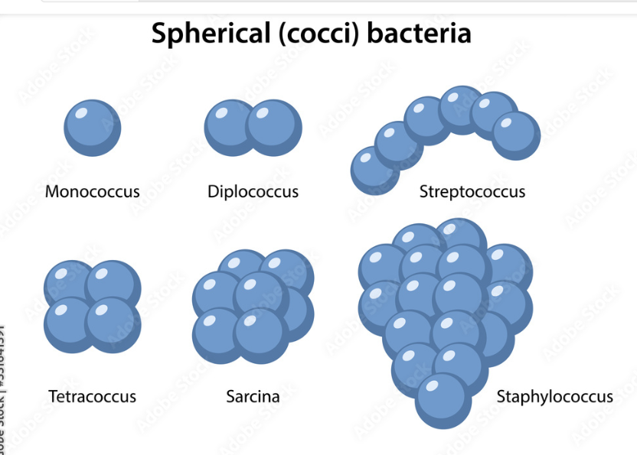

Classification of pathogenic bacteria
Spherical (cocci)

Slide 10
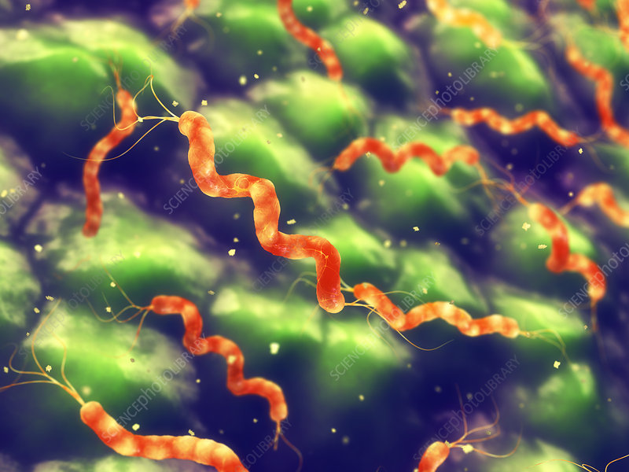
Spiral (spirilla) spiral shaped bacteria

Slide 11
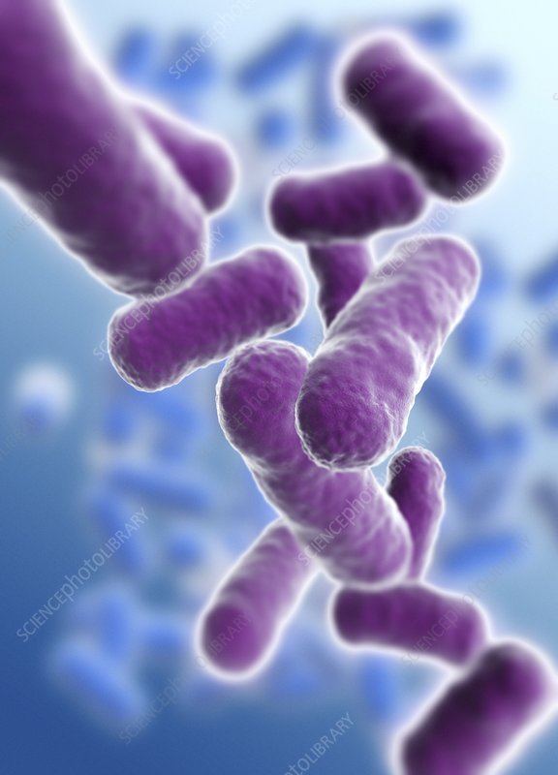
Rod (bacilli) rod shaped bacteria

Slide 12
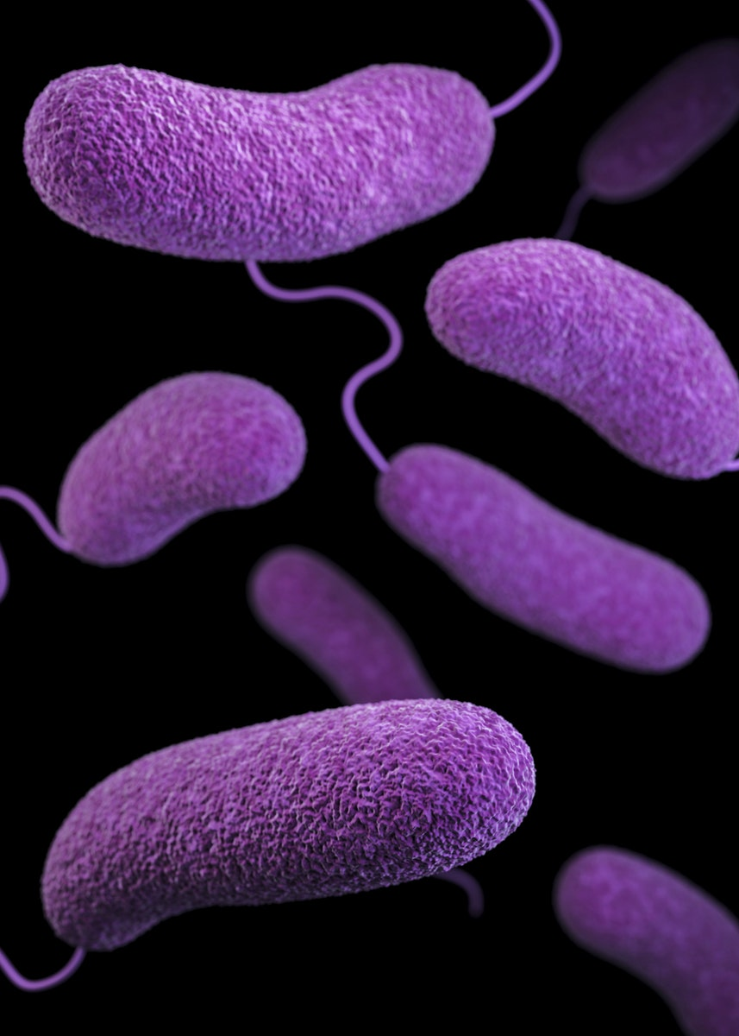
Comma (vibrios) or corkscrew (spirochaetes)

Slide 13
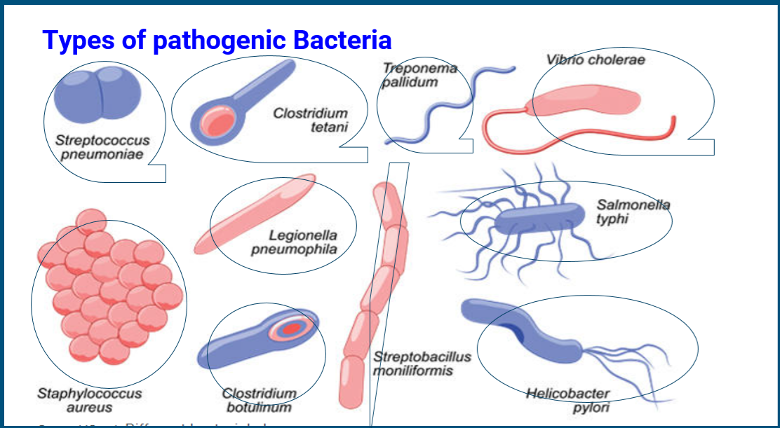

Slide 14
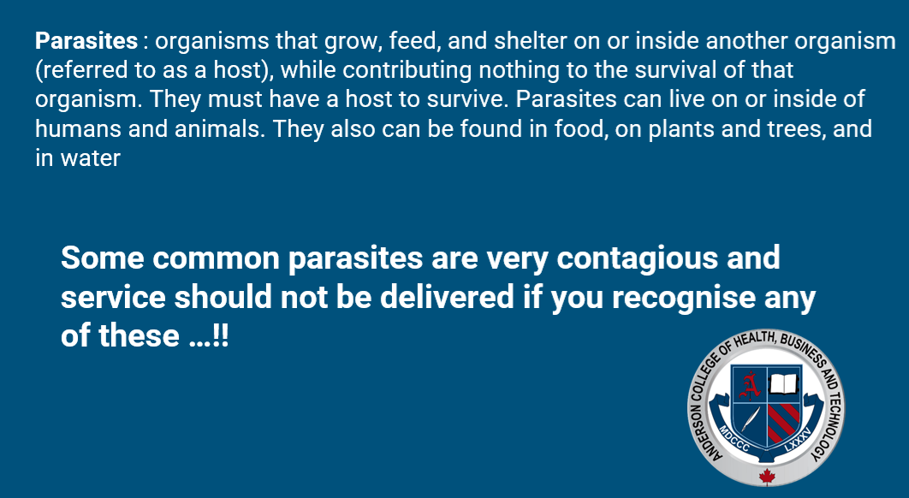

Slide 15
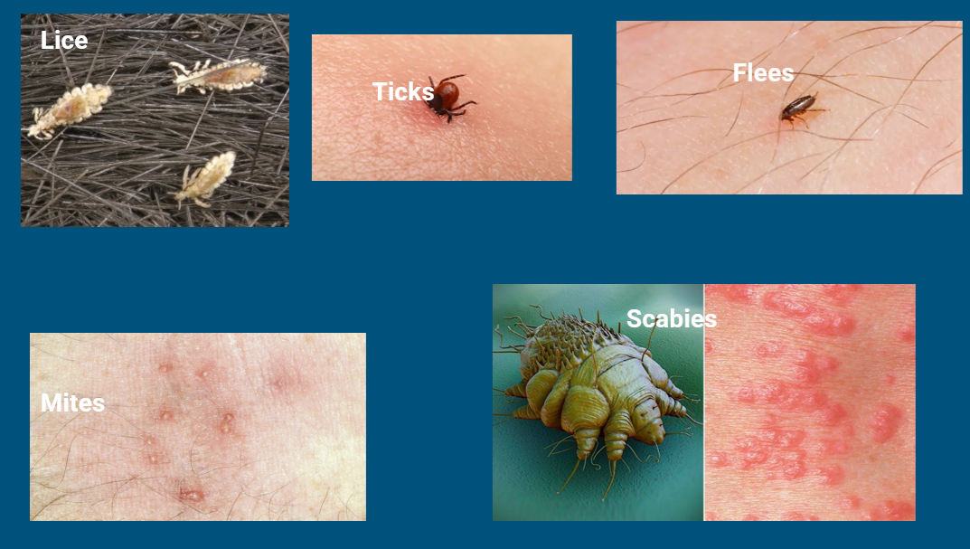

Slide 16
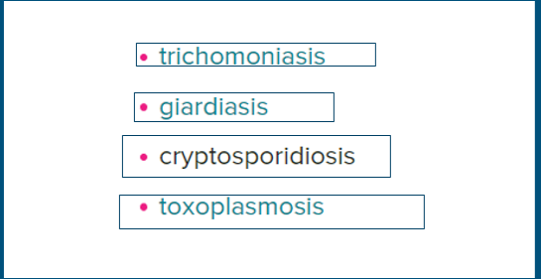

Slide 17
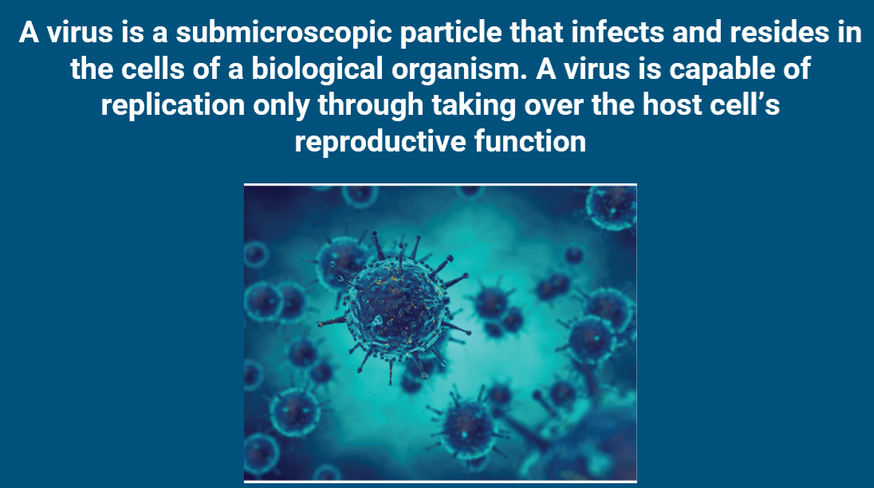

Slide 18
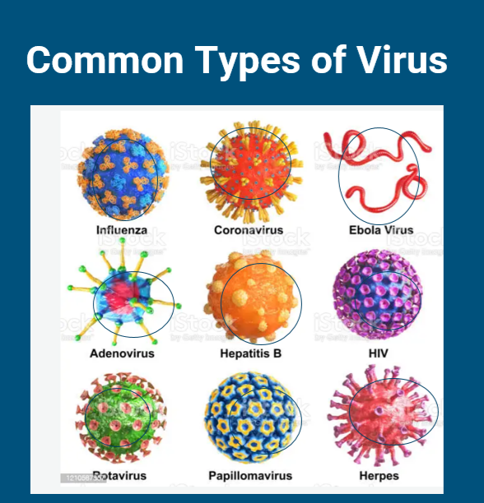

Slide 19
There is no cure for virus but we can prevent them through :
-Prevention through proper cleaning, disinfection and sterilization process
-Prevention through properly following all procedures
-Preventions through hand washing and safe handling
- Prevention through vaccination
- Class exercise:
Make a list of viruses that can be easily transmitted on a Spa or salon setting

Slide 20
Types of bacteria that can be found on Medical Spa settings and Salons
-Staphylococcus
-Streptococcus
-Pseudomonas

Slide 21
Groups Exercise and Research Time!
-Form 3 different groups
- Each group should represent the following
Group 1 Staphylococcus
Group 2 Pseudomonas
Group 3 Streptococcus
Each subgroup should research what are the most contagious channels that can be found on the workplace
Each group should draw the research findings and present to class

Slide 22


Slide 23
End of lesson group discussion
Why you think is important to understand Infection control?
What new information have you learned?
Why you think is important to chose wisely when going to a Spa or Salon
Why you think is important you understand all the different contagious pathogens?

Slide 24

QUESTIONS?

