Slide 1
CT Theory
Outcome 1 – Explain CT imaging for an examination of the Abdomen & Pelvis
Abdomen & Pelvis Anatomy

Slide 2
CT Imaging of the Abdomen & Pelvis
Module Objectives
Review anatomy of the abdomen & pelvis
Label anatomical structures on a CT image
Scanning protocols including:
  Positioning
Indications & Contraindications
Exposure Factors
Most common CT Abdomen & Pelvis exams done
Pathology

Slide 3
CT Imaging of the Abdomen & Pelvis
Review Anatomy
Kelley textbook goes into a lot of detail!
Focus on:
  Organs
  Abdominal Aorta & its branches
  IVC and its tributaries
Complete anatomy ID exercises on D2L Brightspace

Slide 4
CT Imaging of the Abdomen & Pelvis
Liver
Sits within the RUQ
Bordered superiorly, laterally, and anteriorly by the right hemidiaphragm
Left lobe – most anterior lobe
Right lobe – largest lobe

Slide 5
CT Imaging of the Abdomen & Pelvis
Liver
Rt & Lt lobes divided by interlobar fissure
Caudate lobe – smallest lobe, on the inferior and posterior liver surface between the IVC and the ligament venosum
Quadrate lobe - on the anteroinferior surface of the left lobe, between the gall bladder and the round ligament.

Slide 6
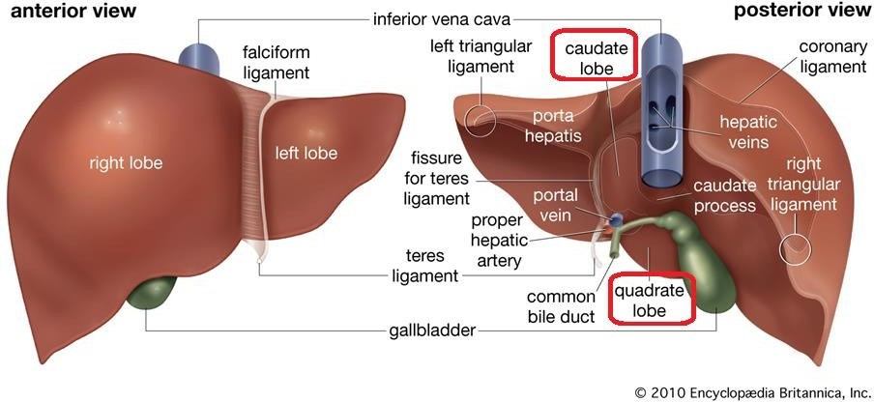
CT Imaging of the Abdomen & Pelvis

Slide 7
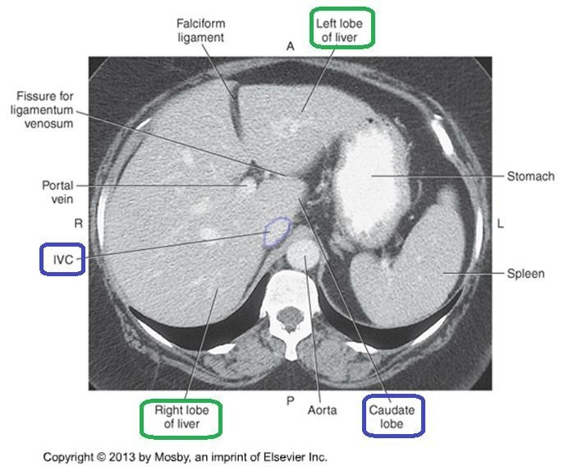
CT Imaging of the Abdomen & Pelvis

Slide 8
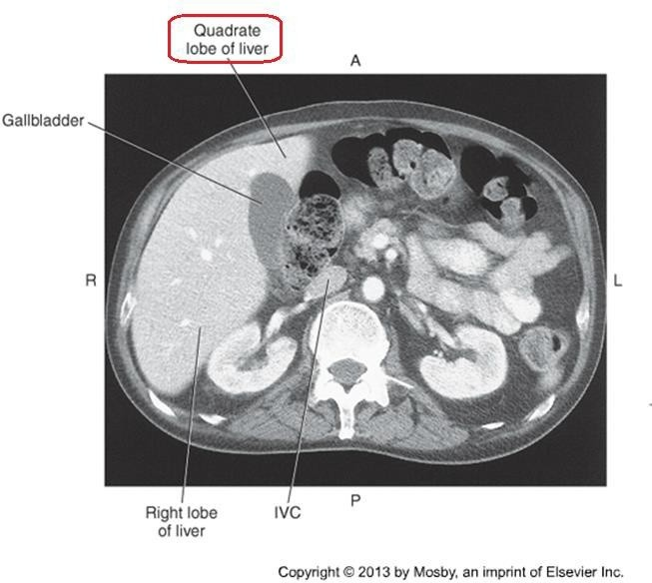
CT Imaging of the Abdomen & Pelvis

Slide 9
CT Imaging of the Abdomen & Pelvis
Portal Hepatic System
  Portal Vein – union of the superior mesenteric and splenic veins.
  Posterior to the pancreas
  Runs posterior to the hepatic artery
  Enters the liver at the porta hepatis

Slide 10
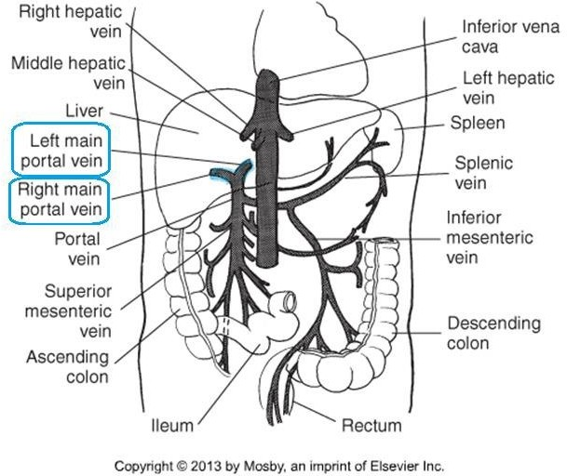
CT Imaging of the Abdomen &Pelvis

Slide 11
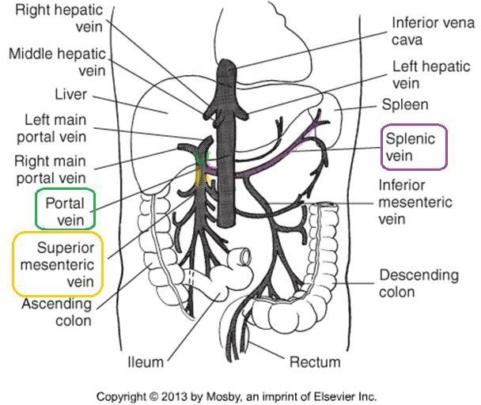
CT Imaging of the Abdomen & Pelvis

Slide 12
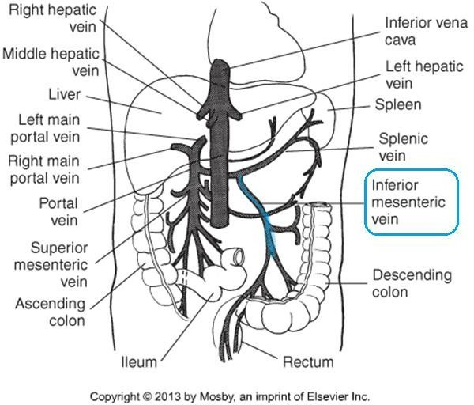
CT Imaging of the Abdomen & Pelvis

Slide 13
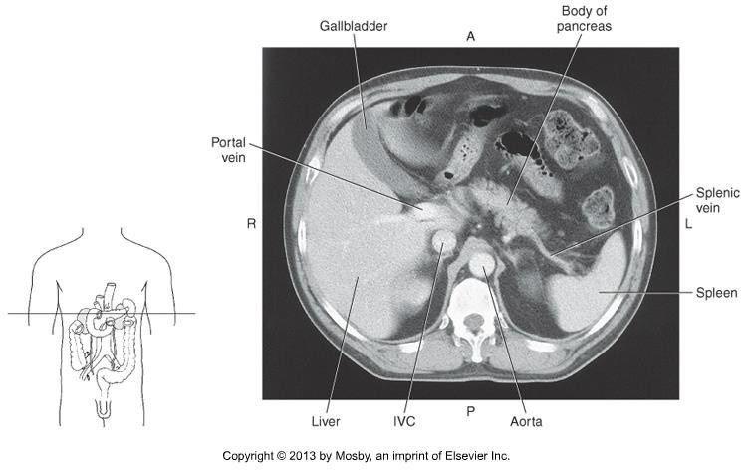


CT Imaging of the Abdomen & Pelvis

Slide 14
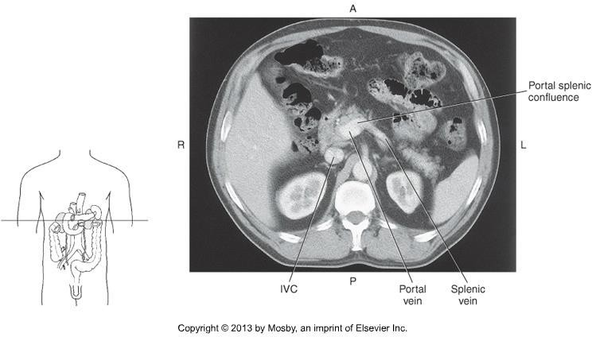





CT Imaging of the Abdomen & Pelvis

Slide 15
CT Imaging of the Abdomen & Pelvis
At the porta hepatis, the portal vein branches into the right and left main portal veins
The portal veins follow the course of the hepatic arteries.

Slide 16
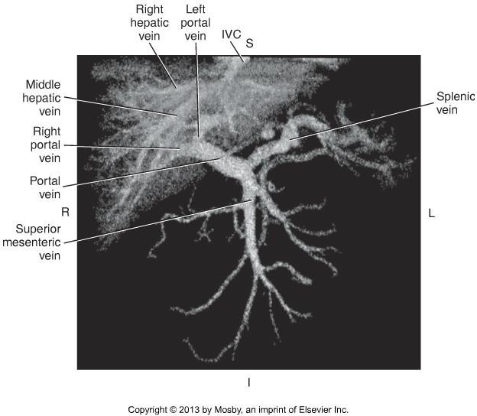

CT Imaging of the Abdomen & Pelvis

Slide 17
CT Imaging of the Abdomen & Pelvis
Arterial Blood Supply
  Common hepatic artery – one of the branches of the celiac artery/trunk.
  Sits anterior to the portal vein
  Branches into the gastroduodenal artery (travels inferiorly), and the proper hepatic artery (travels superiorly)
  At, or just before the porta hepatis, it divides into
    the left and right hepatic arteries

Slide 18
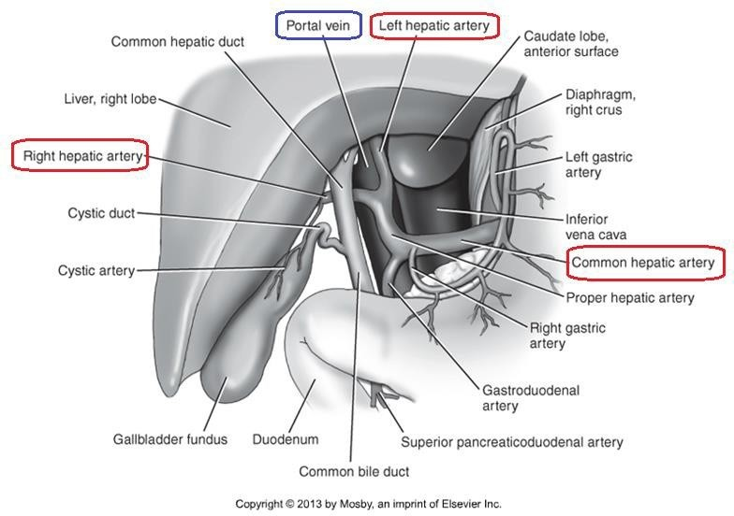
CT Imaging of the Abdomen & Pelvis

Slide 19
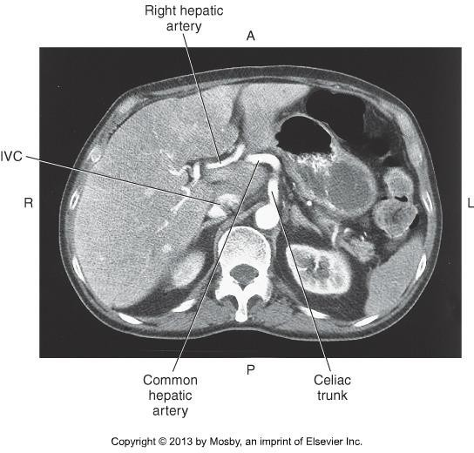

CT Imaging of the Abdomen & Pelvis

Slide 20
CT Imaging of the Abdomen & Pelvis
Gall Bladder & Bile Ducts
Gall bladder sits on the anteroinferior portion of the right lobe of the liver
Fundus (distal, rounded portion)
Body (widest portion)
Neck (narrow, directly to the right of the porta hepatis, continues as the cystic duct)

Slide 21
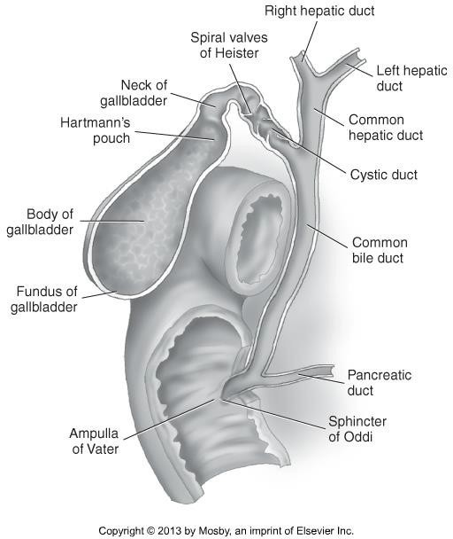
CT Imaging of the Abdomen & Pelvis

Slide 22
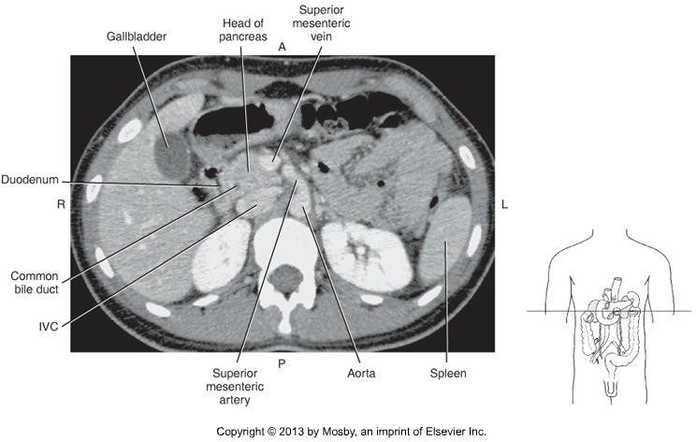
CT Imaging of the Abdomen & Pelvis

Slide 23
CT Imaging of the Abdomen & Pelvis
Pancreas
Long, narrow, retroperitoneal organ
Sits posterior to the stomach
Extends obliquely and transversely across the midline
Extends between the duodenum and the spleen

Slide 24
CT Imaging of the Abdomen & Pelvis
Pancreas
Head sits within the duodenal bulb, at approx L2-L3.
Head is anterior to the IVC
The common bile duct runs through the head of the pancreas
Neck is the constricted portion, not as broad as the head

Slide 25
CT Imaging of the Abdomen & Pelvis
Pancreas
Body runs transversely, anterior to the aorta and SMA
Tail is the tapered end, anterior to the left kidney, ends at the spleen.

Slide 26
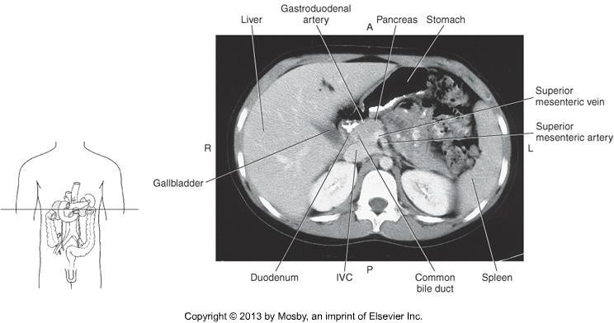

CT Imaging of the Abdomen & Pelvis

Slide 27
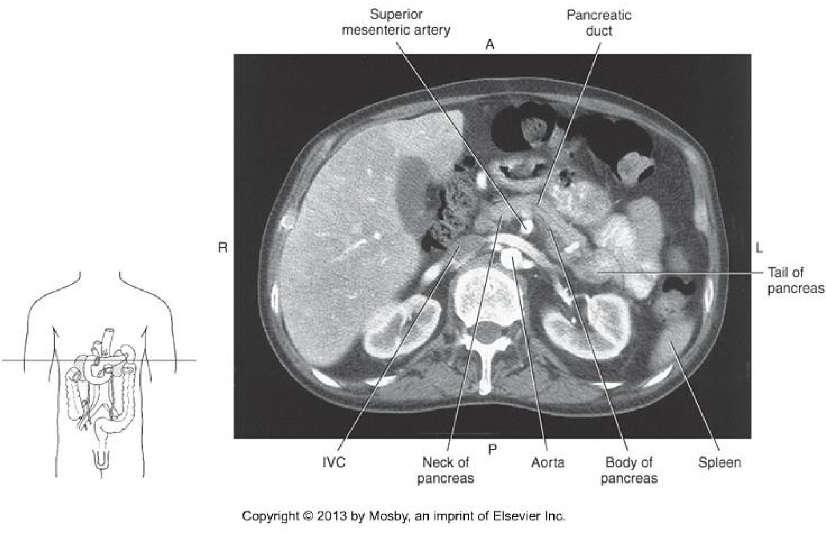

CT Imaging of the Abdomen & Pelvis

Slide 28
CT Imaging of the Abdomen & Pelvis
TIPS!
  Use pancreas as landmarks for some vasculature
  Splenic vein
  SMA
  Portal Vein

Slide 29
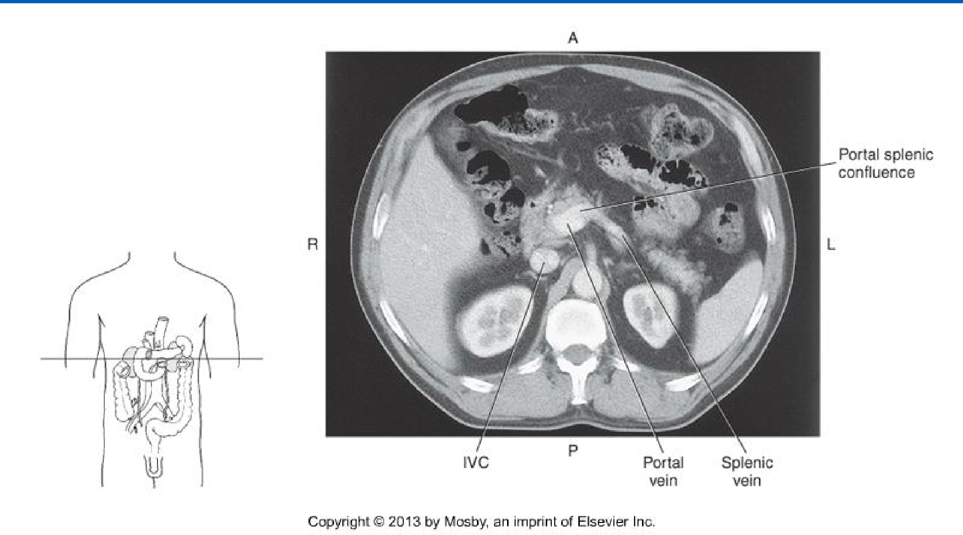


CT Imaging of the Abdomen & Pelvis

Slide 30
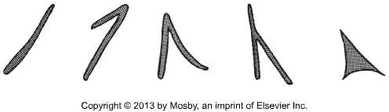
CT Imaging of the Abdomen & Pelvis
Adrenal Glands
Paired glands, sit superiorly to each kidney
Appears as an inverted “V” in cross section, or inverted “Y”
Right appears lower, and more medial than the left.
Right sits just posterior to the IVC
Left sits anteromedially to the upper pole of the left kidney

Slide 31
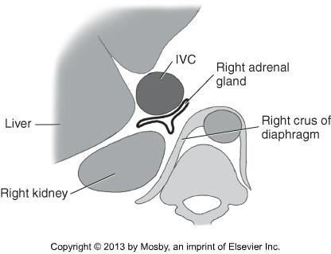
CT Imaging of the Abdomen & Pelvis

Slide 32
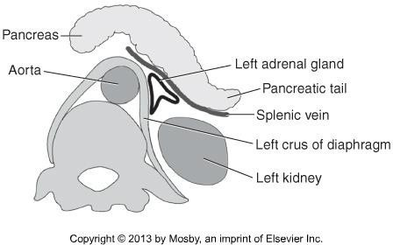
CT Imaging of the Abdomen & Pelvis

Slide 33
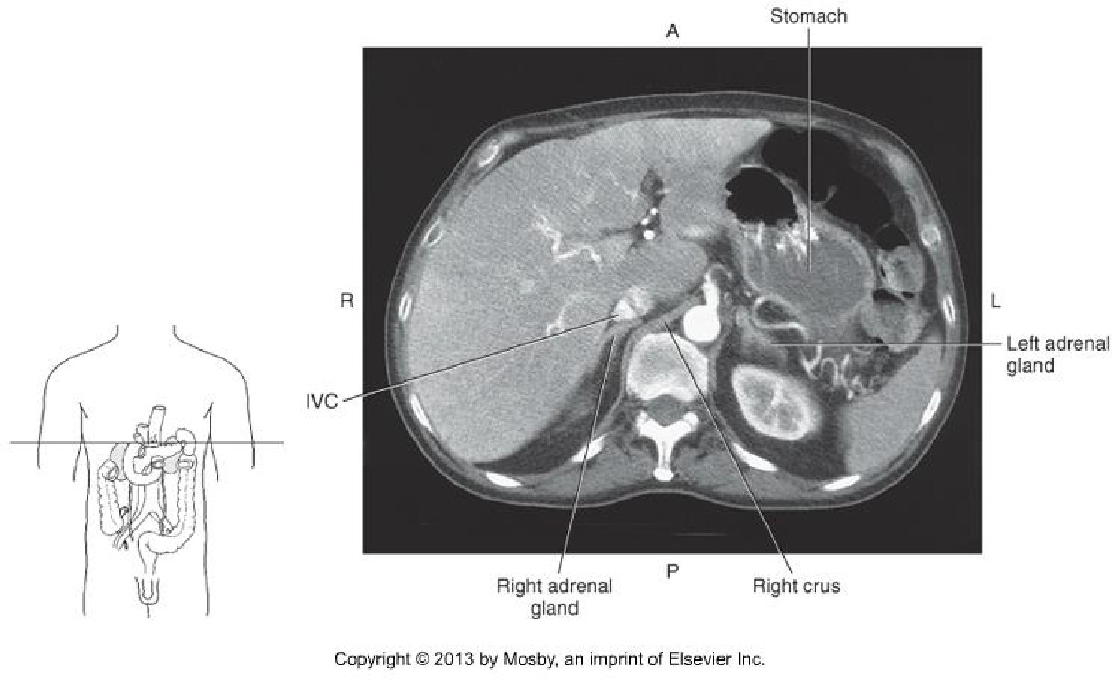
CT Imaging of the Abdomen & Pelvis

Slide 34
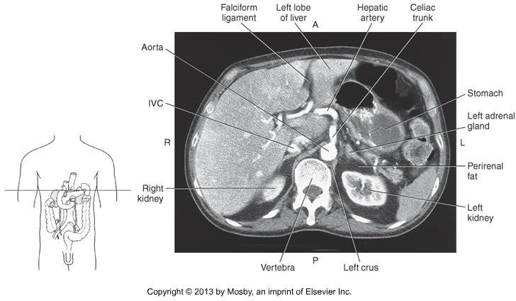

CT Imaging of the Abdomen & Pelvis

Slide 35
CT Imaging of the Abdomen & Pelvis
Spleen
Largest lymph organ in the body
Located posterior to the stomach in the LUQ
Bordered on the medial side by the left kidney, splenic flexure of the colon and the pancreatic tail.
Bordered posteriorly by the diaphragm and left lung.
Received blood from the splenic artery
Blood is drained via the splenic vein

Slide 36
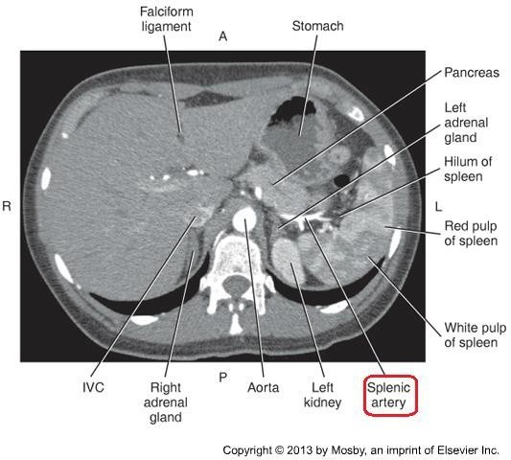

CT Imaging of the Abdomen & Pelvis

Slide 37
CT Imaging of the Abdomen & Pelvis
https://radiopaedia.org/cases/normal-arterial- phase-ct- appearance-of-the-spleen?lang=us

Slide 38
CT Imaging of the Abdomen & Pelvis
Kidneys, Ureters, Bladder
Kidneys are bean-shaped organs, in the posterior abdomen.
Lateral to the spine, between the levels of T12 – L4.
Sit at an oblique orientation, the upper poles are more medial and posterior than the lower poles.

Slide 39
CT Imaging of the Abdomen & Pelvis
Kidneys, Ureters, Bladder
Ureters are paired muscular tubes, descending to the bladder.
Ureters descend medially towards the psoas muscles, just anterior to the transverse processes of the L-spine
Not seen well without contrast enhancement

Slide 40
CT Imaging of the Abdomen & Pelvis
Kidneys, Ureters, Bladder
Bladder is a pyramid-shaped organ, rests on the pelvic floor.
Immediately posterior to symphysis pubis.

Slide 41
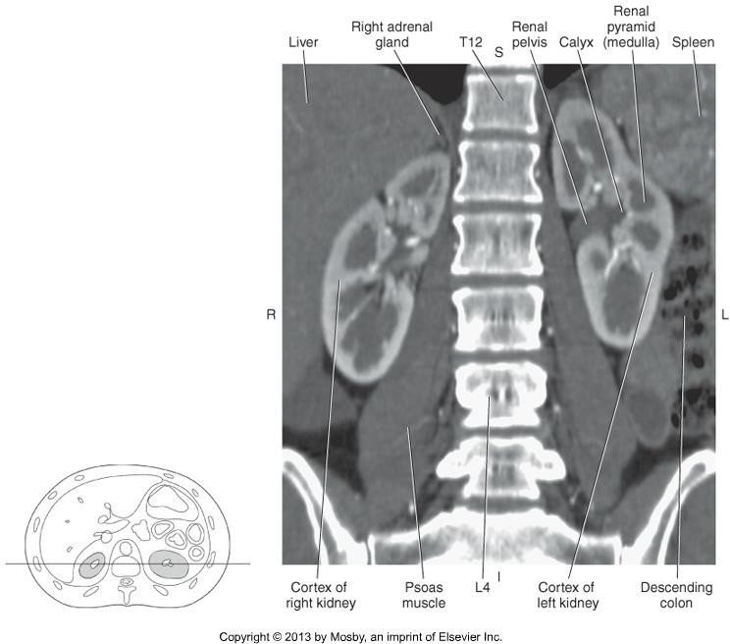
CT Imaging of the Abdomen & Pelvis

Slide 42
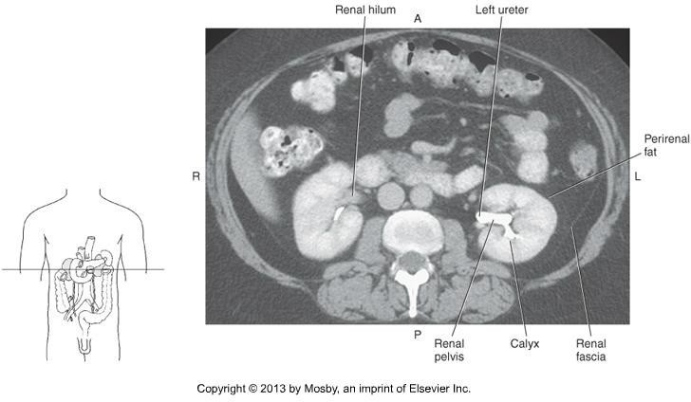


CT Imaging of the Abdomen & Pelvis

Slide 43
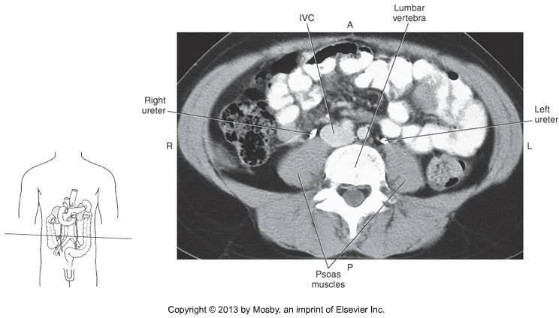
CT Imaging of the Abdomen & Pelvis

Slide 44
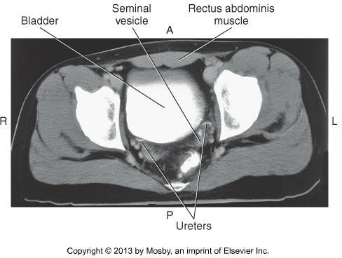
CT Imaging of the Abdomen & Pelvis

Slide 45
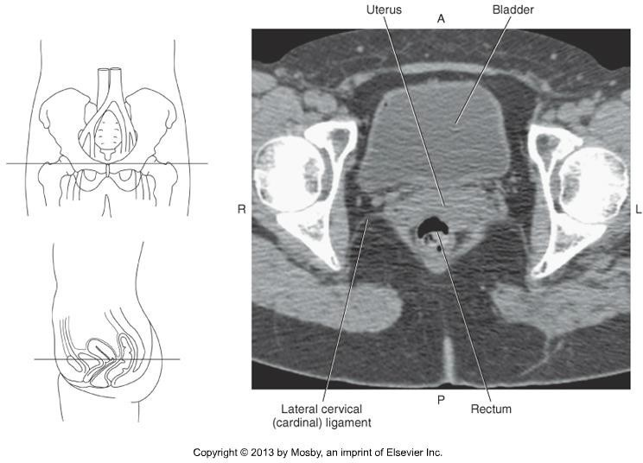
CT Imaging of the Abdomen & Pelvis

Slide 46
CT Imaging of the Abdomen & Pelvis
Digestive Tract
Stomach sits under the left dome of the diaphragm
Recall – what are the parts of the stomach?
Anterior portion in contact with the anterior abdominal wall & left lobe of liver
Posterior portion borders the spleen, left adrenal gland, tail of the pancreas.
Made distinct by the appearance of rugae.

Slide 47
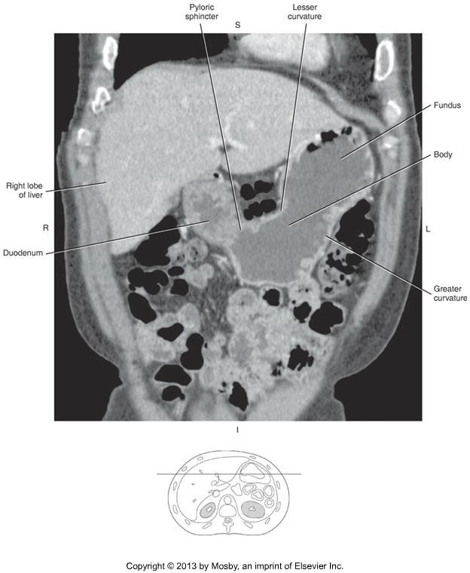

CT Imaging of the Abdomen & Pelvis

Slide 48
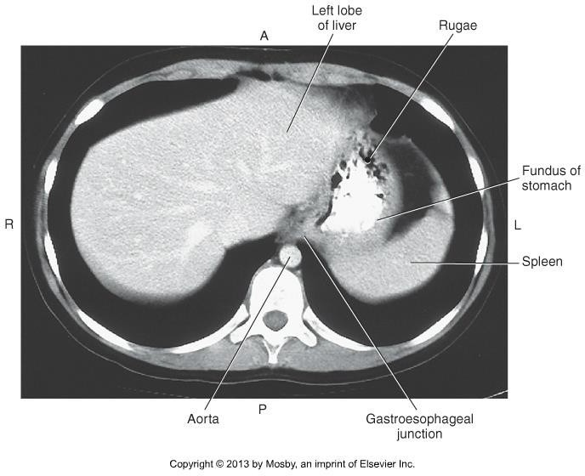

CT Imaging of the Abdomen & Pelvis

Slide 49
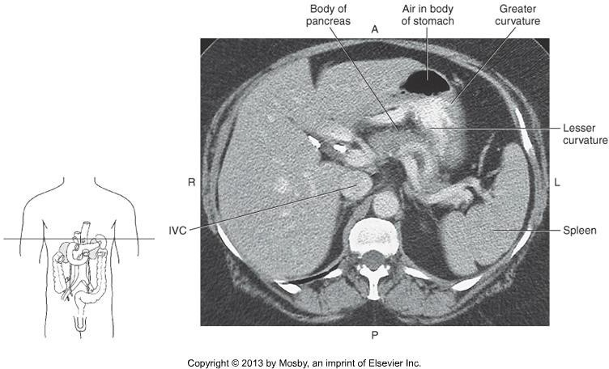
CT Imaging of the Abdomen & Pelvis

Slide 50
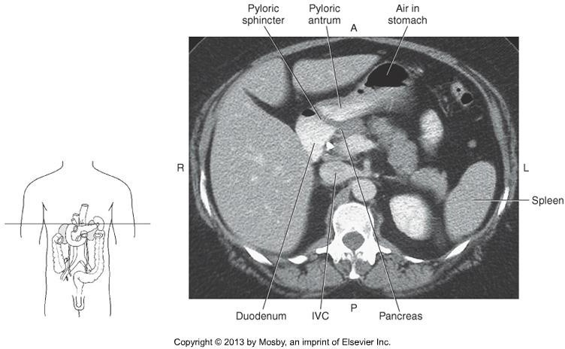


CT Imaging of the Abdomen & Pelvis

Slide 51
CT Imaging of the Abdomen & Pelvis
Small intestine vs. large intestine
Recall the parts of the small intestine
Large intestine lies inferior to the stomach and liver and
“frames” the small intestine
How to differentiate on CT?
  Small bowel = circular folds called plicae circulares
  Large bowel = haustra
Sigmoid colon moves toward the midline, sits posterior to the bladder.

Slide 52
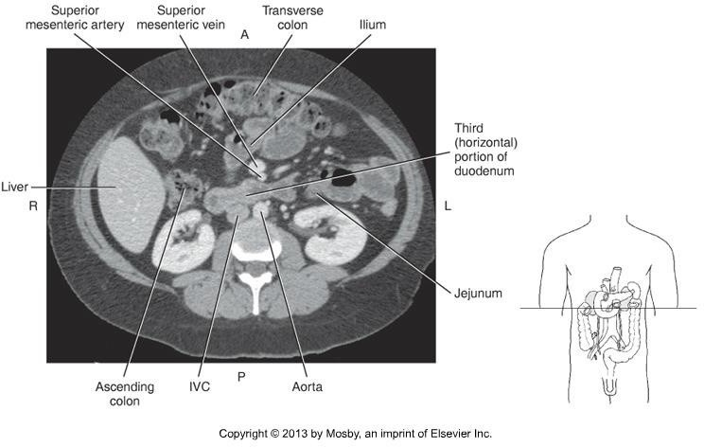


CT Imaging of the Abdomen & Pelvis

Slide 53
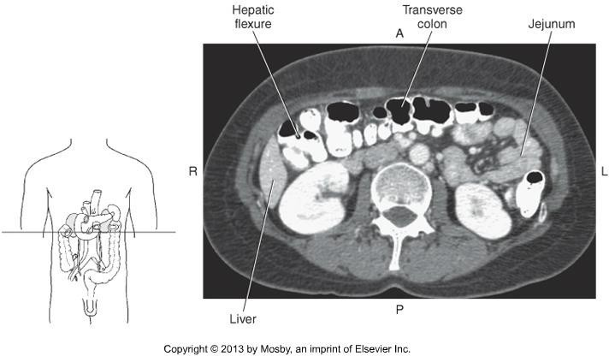

CT Imaging of the Abdomen & Pelvis

Slide 54
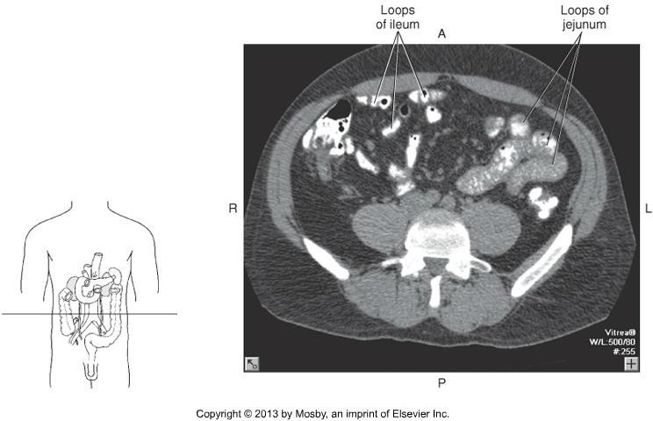


CT Imaging of the Abdomen & Pelvis

Slide 55
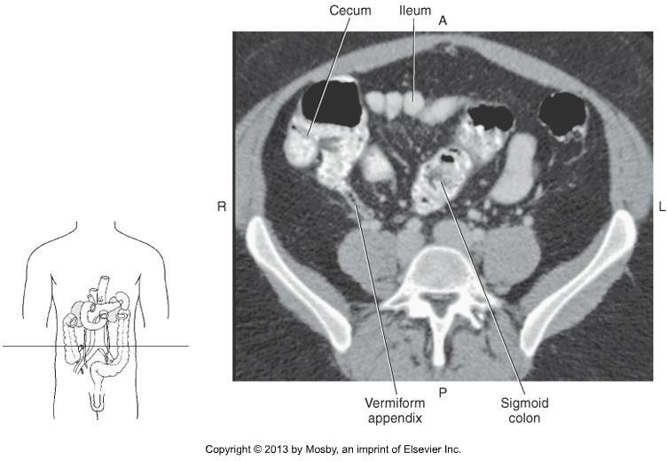

CT Imaging of the Abdomen & Pelvis

Slide 56
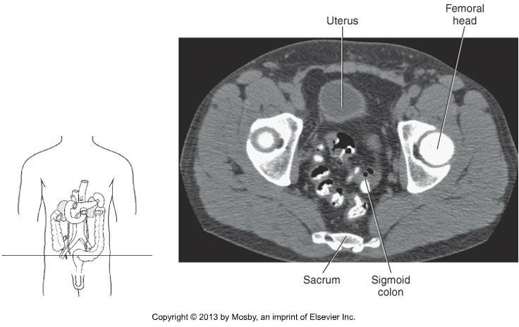
CT Imaging of the Abdomen & Pelvis

Slide 57
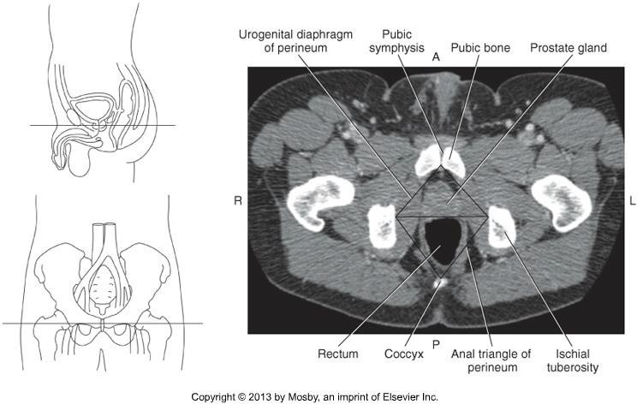
CT Imaging of the Abdomen & Pelvis

Slide 58
CT Imaging of the Abdomen & Pelvis
Female Reproductive Organs
Uterus
  Pear-shaped, muscular organ
  Anterior portion of the abdomen
  Sits between the bladder and the rectum
    Ovaries
      Paired
  Almond shaped, located on either side of the uterus

Slide 59

CT Imaging of the Abdomen & Pelvis

Slide 60
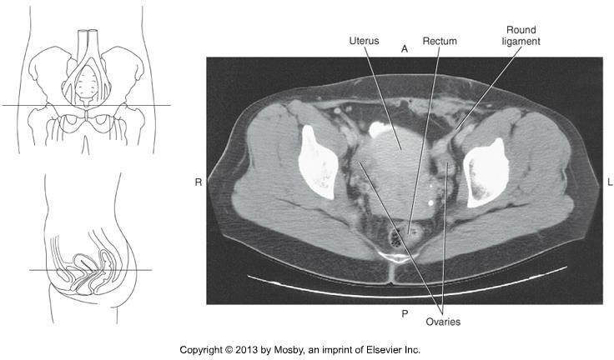
CT Imaging of the Abdomen & Pelvis

Slide 61
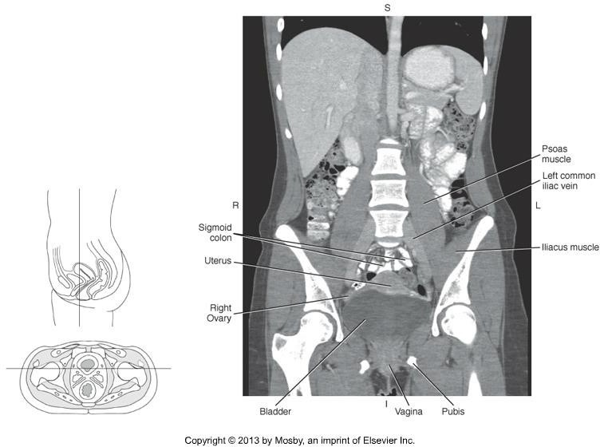

CT Imaging of the Abdomen & Pelvis

Slide 62
CT Imaging of the Abdomen & Pelvis
Male Reproductive Organs
Prostate Gland
  Inferior to the bladder
  Base of gland is adjacent to the neck of the bladder
  Composed of glandular and muscular tissue
  Central zone is hyperdense, 40-60 HU
  Peripheral zone is hypodense, 10-25 HU

Slide 63
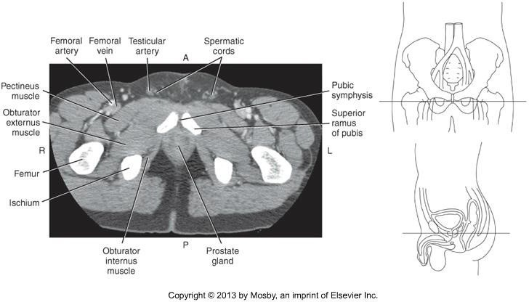
CT Imaging of the Abdomen & Pelvis

Slide 64
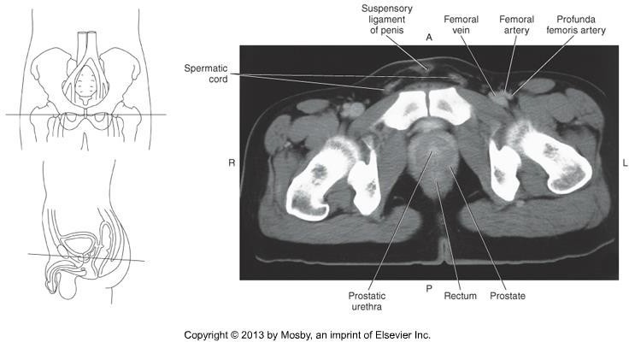
CT Imaging of the Abdomen & Pelvis

Slide 65
CT Imaging of the Abdomen & Pelvis
Abdominal Aorta & Branches
Large, retroperitoneal artery descending between diaphragm and it’s
bifurcation at L4.
In order, from superior – inferior:
Inferior phrenic artery (Rt & Lt)
Celiac trunk
  Left gastric
  Common hepatic
  Splenic
Superior mesenteric artery
Renal artery (Rt & Lt)
Gonadal artery (Rt & Lt)
Inferior mesenteric artery
Lumbar arteries (Rt & Lt)

Slide 66
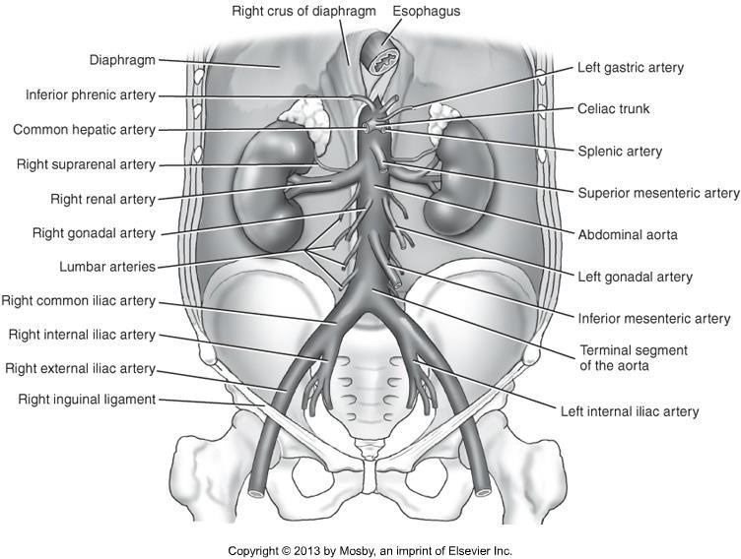
CT Imaging of the Abdomen & Pelvis

Slide 67
CT Imaging of the Abdomen & Pelvis
TIPS!
Important to note that patient anatomy varies!
Use this as a general guideline
Presence of pathology changes anatomy!
Some vessels are within 1 mm of the next – not always captured on “thick” slices.
Some vessels sit in the same slice as others
General rule – paired arteries arise off lateral surface of aorta & unpaired arteries arise off anterior surface of aorta.
Goal: ID vessels as they come off aorta

Slide 68
CT Imaging of the Abdomen & Pelvis
Inferior Phrenic Artery (Rt & Lt)
  Arise from the lateral surface of the aorta
  Directly under the diaphragm
  Supply the diaphragm

Slide 69
CT Imaging of the Abdomen & Pelvis
Celiac Trunk
  Celiac trunk (sometimes called artery) itself is short!
  3 vessels:
    Left gastric artery – passes first anteriorly, then to the left
(towards stomach)
Splenic artery – passes to the left (towards spleen)
Common Hepatic – passes to the right (towards liver)
Splenic artery is the largest branch, and courses along the upper
border of the pancreas towards the spleen.
Easily identified, but not to be confused with splenic vein!

Slide 70
CT Imaging of the Abdomen & Pelvis
Superior Mesenteric Artery
  Just below celiac trunk, at approximately L1
  Branches off the anterior surface of the aorta, and drops inferiorly, almost immediately.

Slide 71
CT Imaging of the Abdomen & Pelvis
Renal artery (Rt & Lt)
  Just below the SMA
  Travel very horizontally towards the kidneys = often seen within 1 or just a few axial slices (if demonstrated)
  Large!
  Right renal artery passes posterior to the IVC on
    it’s way to the kidney

Slide 72
CT Imaging of the Abdomen & Pelvis
Gonadal artery (Rt & Lt)
  Arise off the anterior surface of the aorta
  Just inferior to the renal arteries
  Descend along the psoas muscles to the reproductive organs

Slide 73
CT Imaging of the Abdomen & Pelvis
Inferior Mesenteric artery
  3-4 cm above the abdominal aortic bifurcation
  Approx L3 L4
  Descends in front of the aorta and then curves to the left
  Much smaller than the SMA

Slide 74
CT Imaging of the Abdomen & Pelvis
Lumbar artery (Rt & Lt)
  4 pairs, at various levels between L1 – L4
  Branch off the posterior surface of the aorta

Slide 75
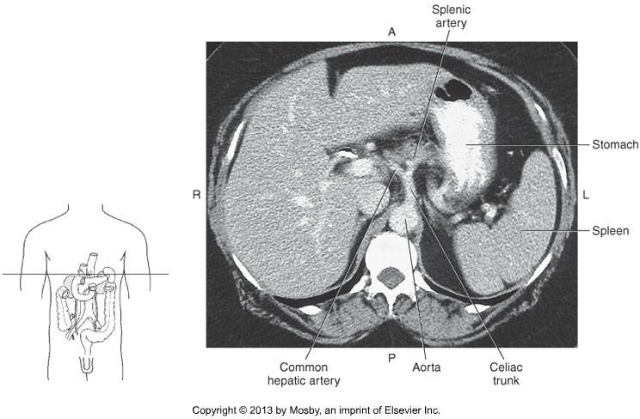

CT Imaging of the Abdomen & Pelvis

Slide 76
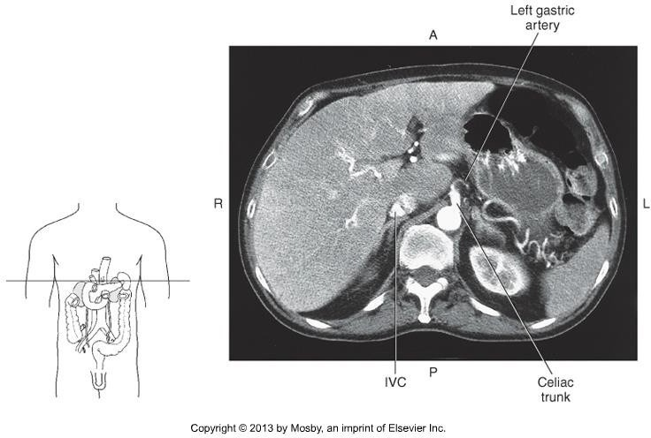

CT Imaging of the Abdomen & Pelvis

Slide 77
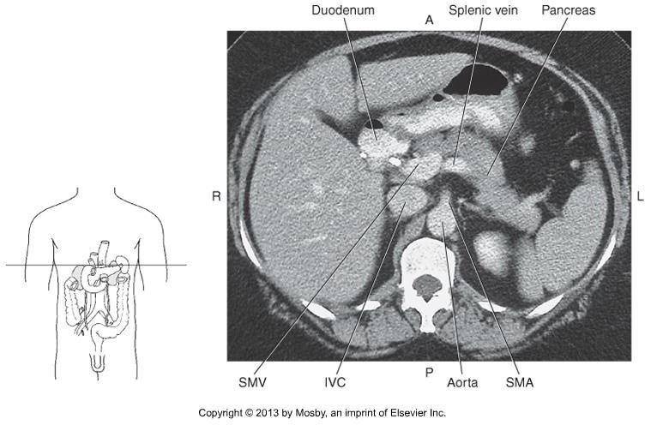

CT Imaging of the Abdomen & Pelvis

Slide 78
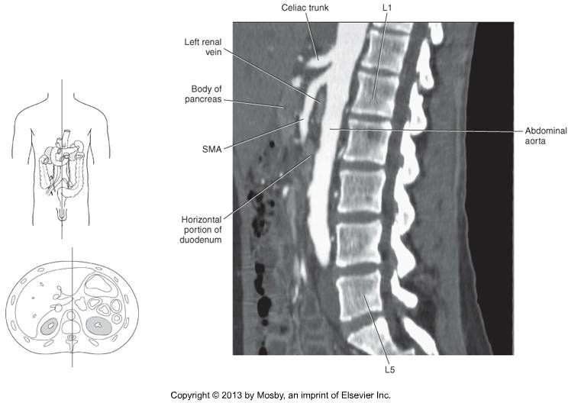
CT Imaging of the Abdomen & Pelvis

Slide 79
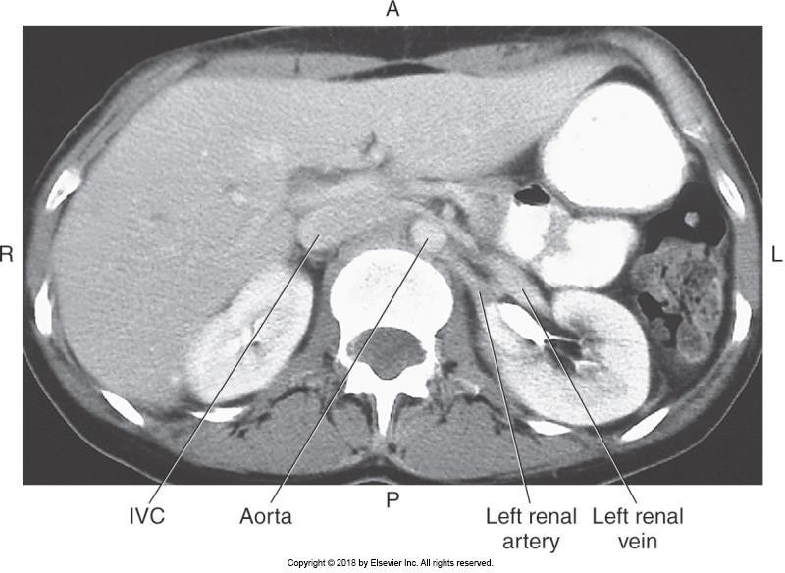
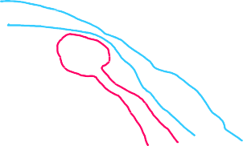
CT Imaging of the Abdomen & Pelvis

Slide 80
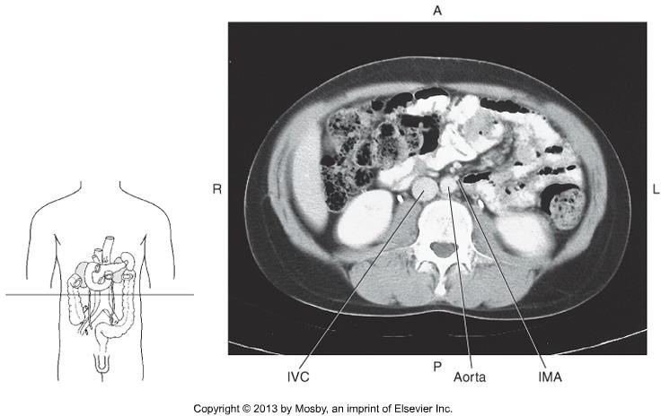

CT Imaging of the Abdomen & Pelvis

Slide 81
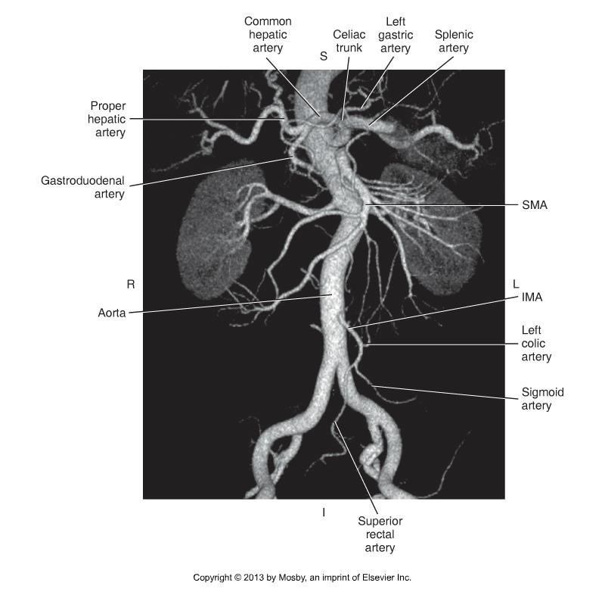

CT Imaging of the Abdomen & Pelvis

Slide 82
CT Imaging of the Abdomen & Pelvis
Abdominal Aorta bifurcates:
  Level of L4 (approx)
  Right and Left common iliac artery
Common iliac artery bifurcates:
  Level of the SI joint (top of joint)
  Internal and External iliac artery (Rt & Lt)
Internal Iliac artery
  Smaller
  Medial
External Iliac artery
  Larger
  Lateral

Slide 83


CT Imaging of the Abdomen & Pelvis

Slide 84


CT Imaging of the Abdomen & Pelvis

Slide 85
CT Imaging of the Abdomen & Pelvis
IVC and Branches
IVC is the largest vein in the body
Formed by the union of the common iliac veins at L5.
Tributaries include:
  Inferior phrenic
  Lumbar
  Right Gonadal
  Renal
  Right Suprarenal
  Hepatic

Slide 86

CT Imaging of the Abdomen & Pelvis

Slide 87
CT Imaging of the Abdomen & Pelvis
The major, identifiable tributary of the IVC is the paired renal veins.
Level of L2
Left renal vein passes posteriorly to the SMA, and anteriorly to the aorta.
Differentiate from renal arteries
  Larger
  Anterior

Slide 88



CT Imaging of the Abdomen & Pelvis

Slide 89
CT Imaging of the Abdomen & Pelvis
IVC is formed by:
  Right and Left common iliac vein
  Level of L5 (approx)
•
Common iliac veins are formed by:
Internal and External iliac veins (Rt & Lt)
Level of the SI joint (top of joint)
Posterior to the Common iliac artery
•
Internal Iliac vein
Posterior to the external iliac vein
Medial to the internal iliac artery
External Iliac vein
  Anterior to the internal iliac vein
  Medial to external iliac artery, then moves posteriorly

Slide 90




CT Imaging of the Abdomen & Pelvis

Slide 91
CT Imaging of the Abdomen & Pelvis
Summary
Review anatomy of the abdomen, pelvis, and its vasculature.
The segmental anatomy of the liver, lymph nodes, and muscles will not be tested on.
Use knowledge of relational anatomy to find structures when given a single CT image.
Next topic – scanning procedures of the abdomen & pelvis!

