Slide 1

Professional Practice

Slide 2
Who are we?
One profession, many titles!

Slide 3
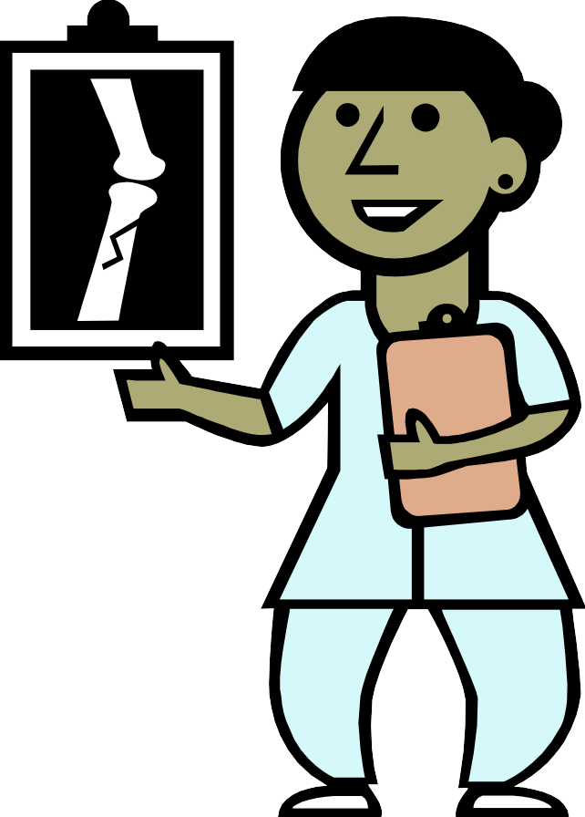
Role of an MRT
Medical Radiation Technologist is:
A member of a regulated professional association
Focused on patient care and safety
An advocate for their patients
An integral member of the health care team
Highly trained and qualified professional

Slide 4
MRT Training
This program will prepare you to become a professional within the Medical Imaging community.
An MRT(R) works in a variety of areas within an Imaging department.

Slide 5

Role of an MRT
What areas of imaging, or specialties could an MRT(R) work in ?

Slide 6
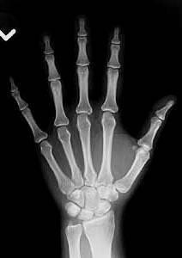
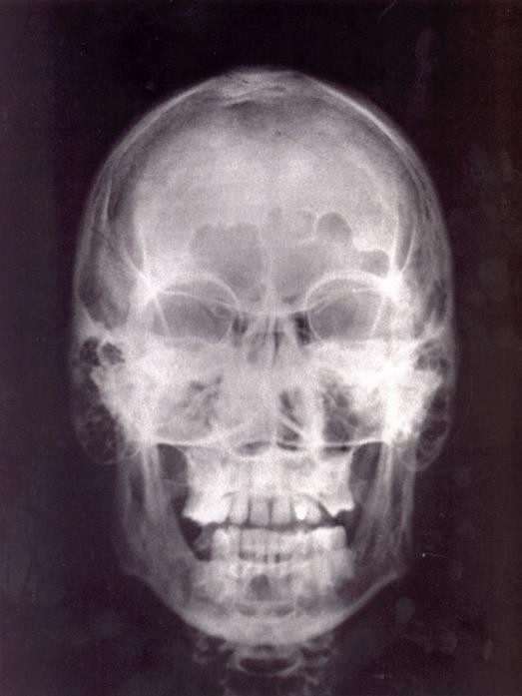
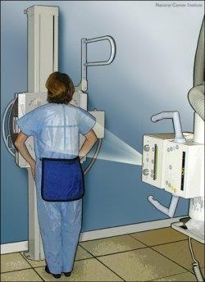
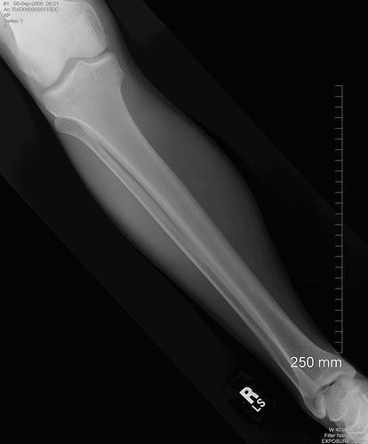
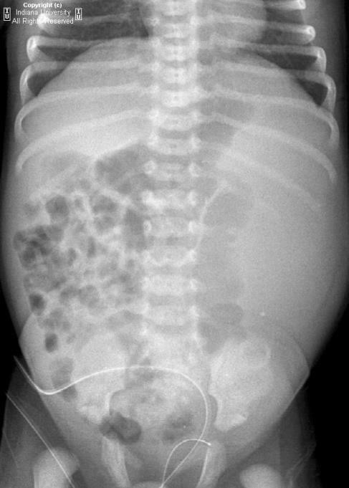
General X-ray

Slide 7
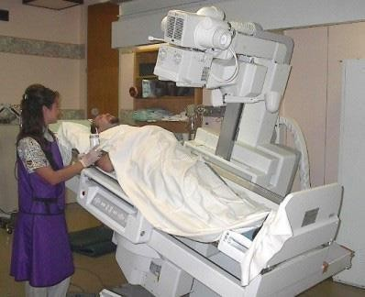
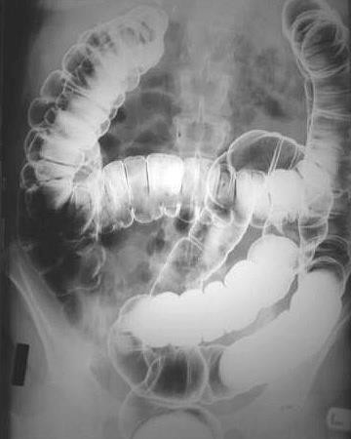
Fluoroscopy

Slide 8
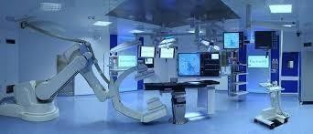
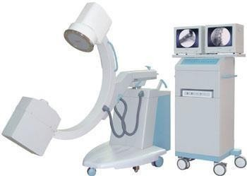
Operating Room

Slide 9
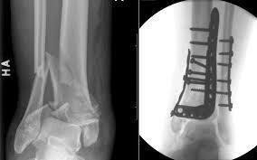
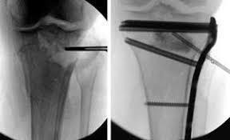
Operating Room

Slide 10
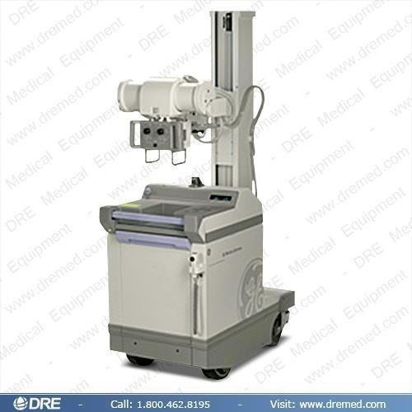
Mobile Radiography

Slide 11
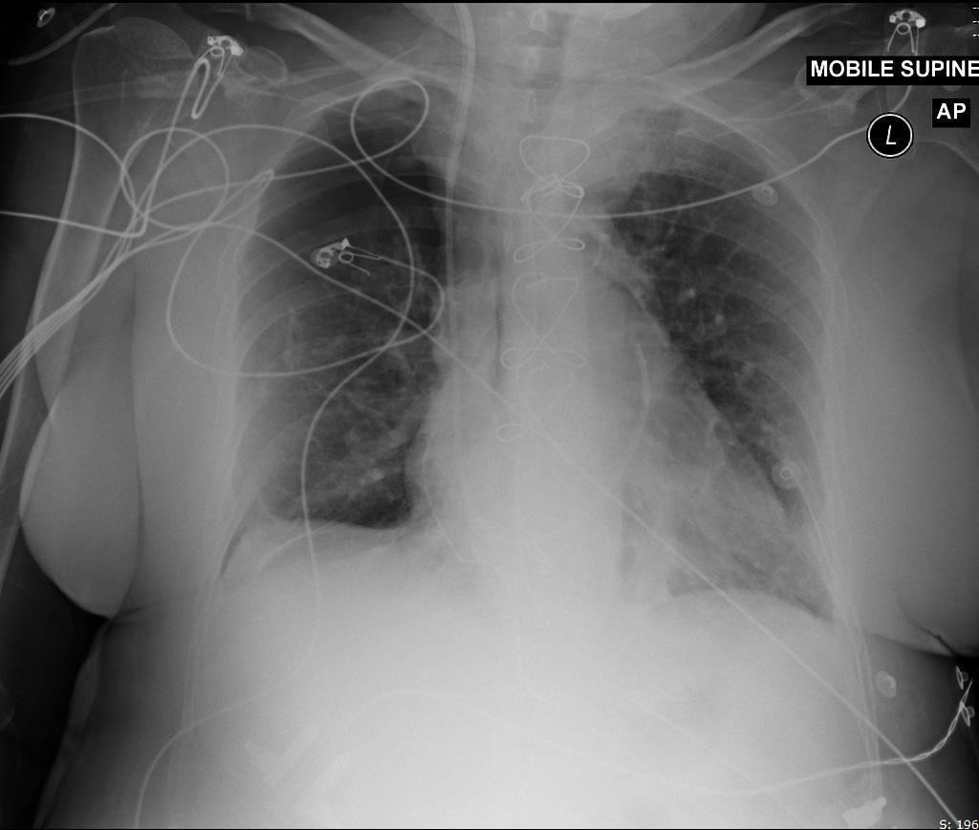
Mobile Radiography

Slide 12
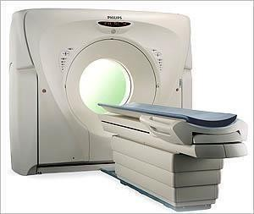
CT scans

Slide 13
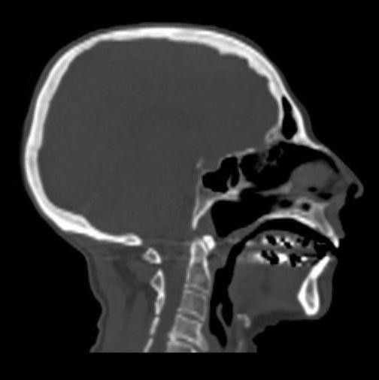
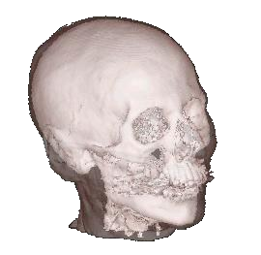
CT Scans

Slide 14
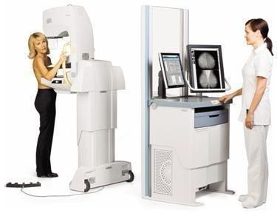
Mammography

Slide 15
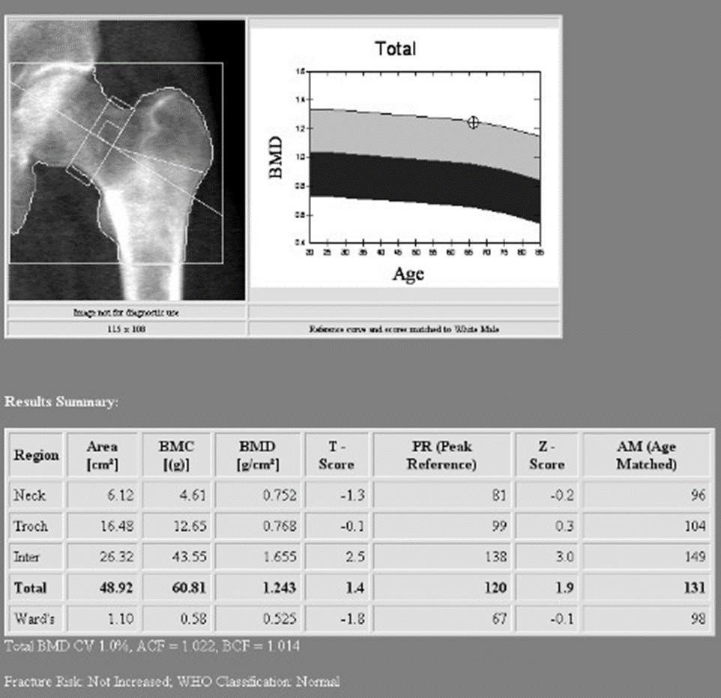
Bone Mineral Densitometry

Slide 16
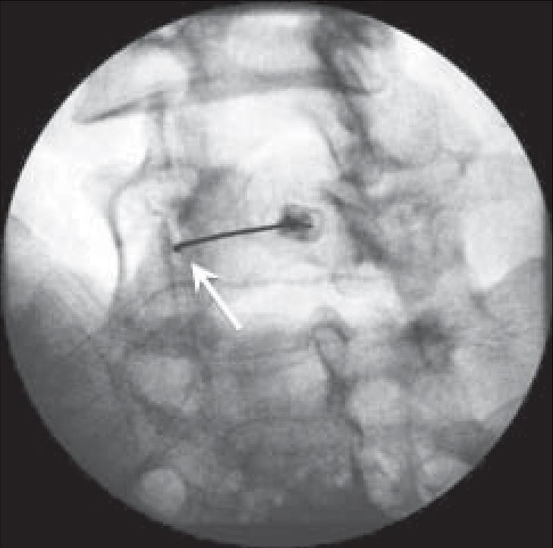
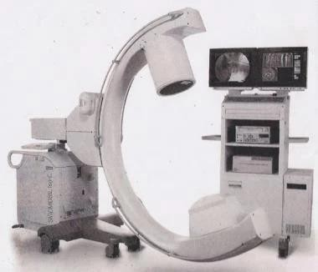
Pain Therapy

Slide 17
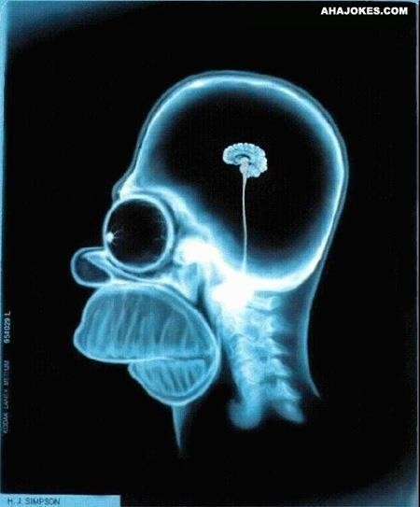
Post-graduate MRT
Hospital
Trauma Centre
Orthopedic Centre
Pediatrics / Geriatrics
Sports Medicine
Community Clinic
Education
Quality Control
Administration
Professional Associations
Volunteer
Research/academics

Slide 18
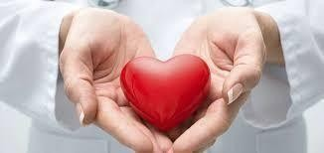
What does it mean to deliver excellent patient care?

Slide 19
What qualities should the MRT possess?

Slide 20
Copyright Information
This learning material is property of .
Any sharing, reproduction or use of this information or material other than educational purposes at is prohibited.

