Slide 1


Muscle Toning and Contouring

Slide 2
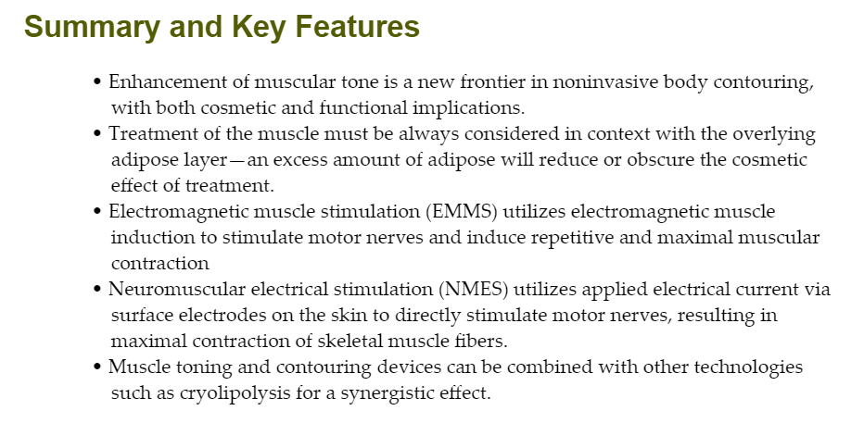

Slide 3
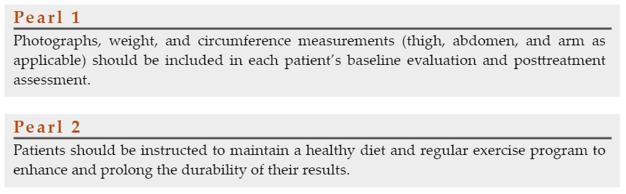

Slide 4

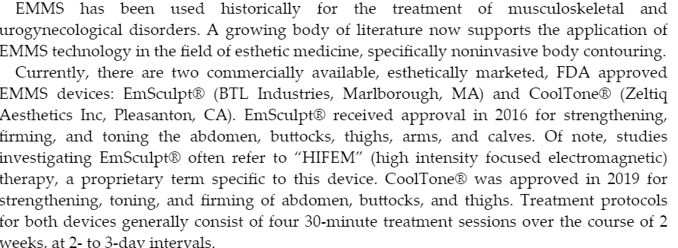

Slide 5
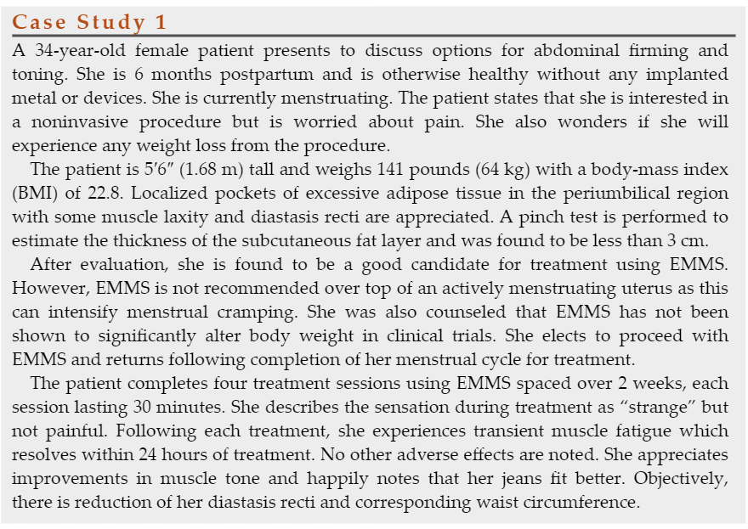

Slide 6
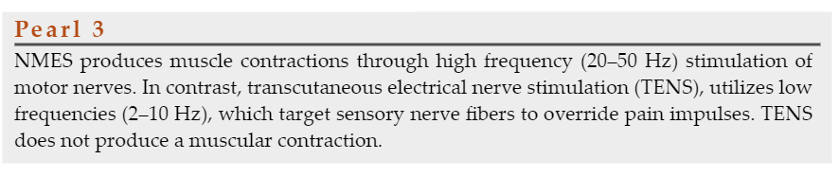

Slide 7
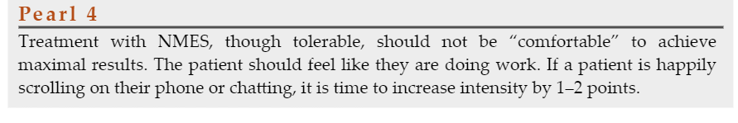

Slide 8
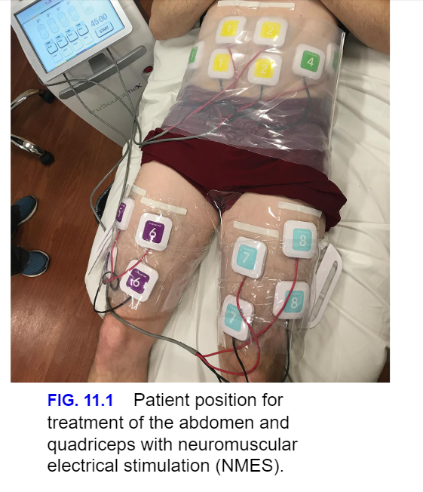

Slide 9
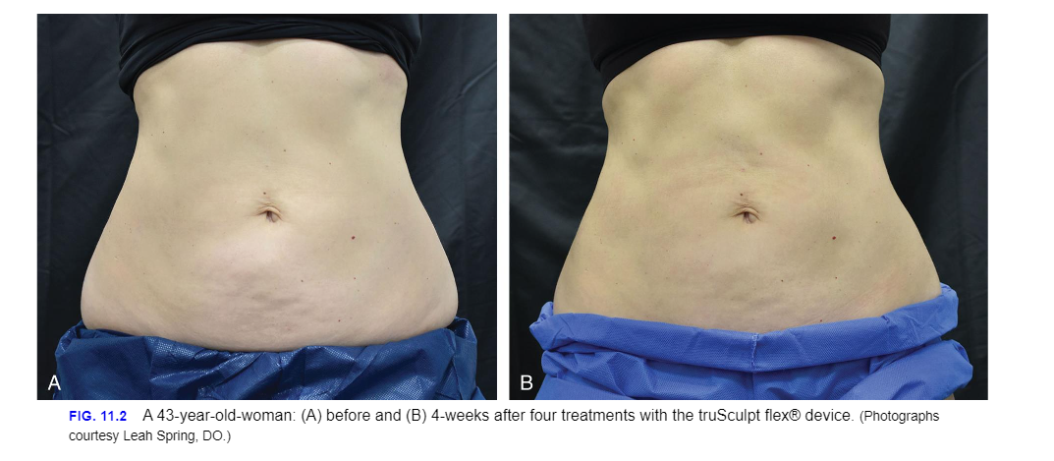

Slide 10
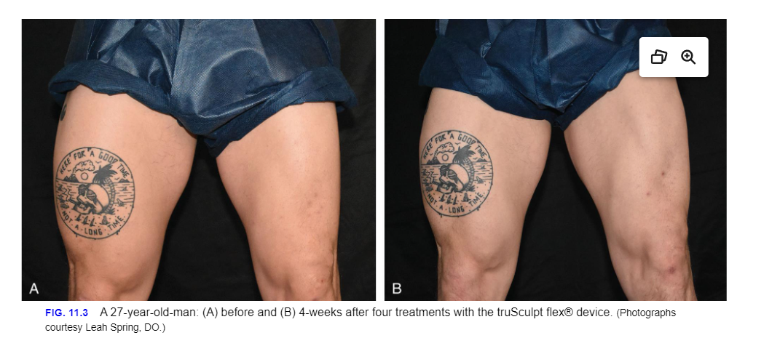

Slide 11
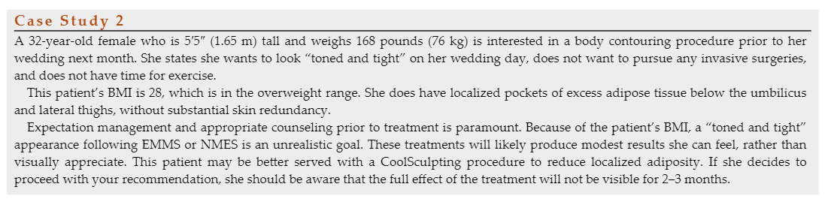

Slide 12
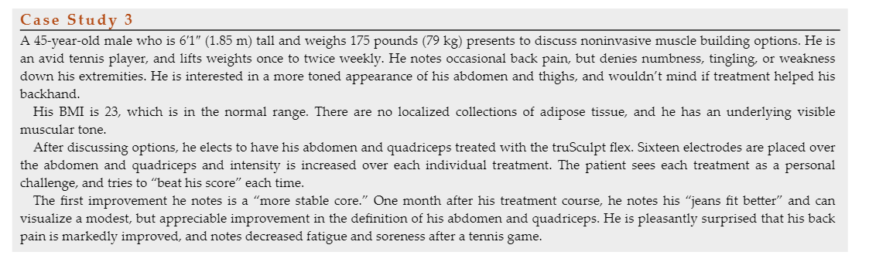

Slide 13
Patent Evaluation Expectation Management
Pre-treatment assessment should include a history of the patient’s current level of physical activity, previous musculoskeletal injuries and surgeries, and their goals of treatment. Body mass index (BMI), a person’s weight in kilograms divided by their square of their height in meters, is a helpful guide to screen patients (and set expectations) prior to treatment; however, as BMI has been shown to remain stable during and after treatment with EMMS or NMES, it is not a particularly useful tool to assess response to therapy. It is our experience that photographs and circumference measurements (waist, thigh, and arm, as applicable) more accurately reflect the patient’s treatment results.
Patients should be counseled that results are transient, with reports suggesting a duration of effect ranging from 8 to 12 weeks. Additional treatments will likely be required to maintain the desired result. The patient’s commitment to a stable diet and regular exercise program should be encouraged.

Slide 14
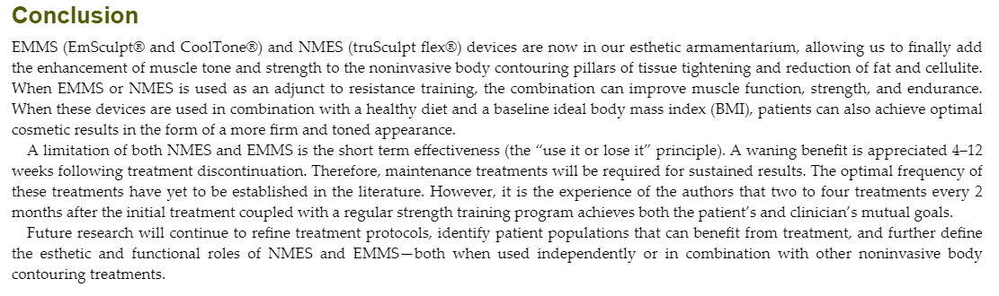

Slide 15

QUESTIONS?

