Slide 1
MRAD 204:
Radiographic Technique 1
Outcome 1-5:
Positioning – Hand & Thumb

Slide 2
Affiliated Readings
Module 2
Bontrager
Pgs: 143→146
Pgs: 148→151

Slide 3
Overview
Guidelines/Considerations
Protocols
Positioning

Slide 4
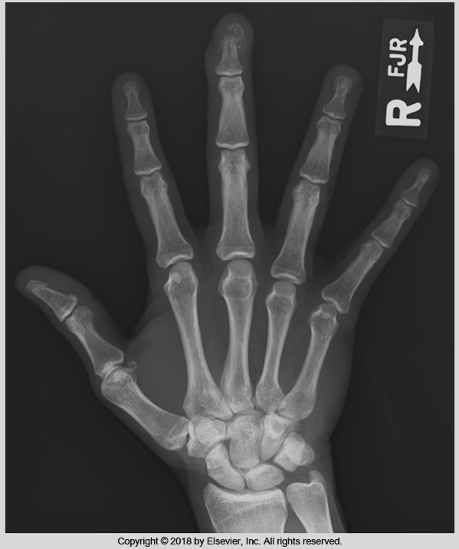
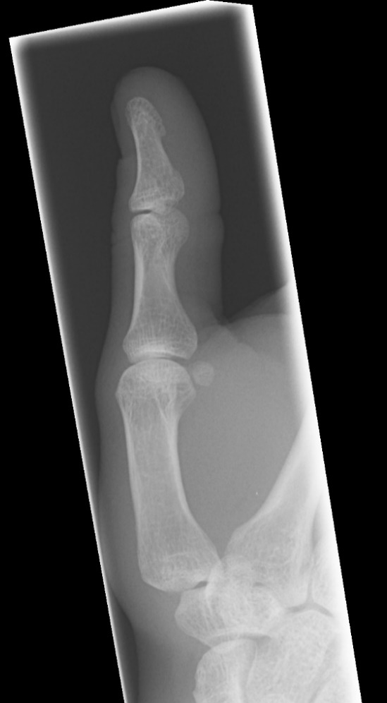
Guidelines/Considerations
Identify required anatomy
R
Bontrager pg. 150 Fig. 4.68
Sait Imaging Library
Hand radiographs require 1’ of distal forearm
Thumb radiographs require entire trapezium

Slide 5
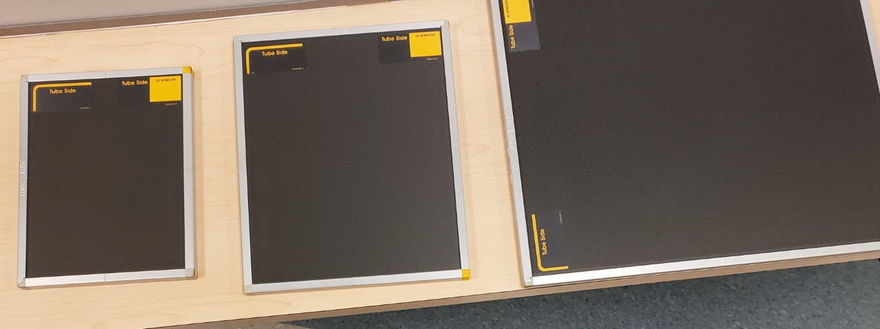
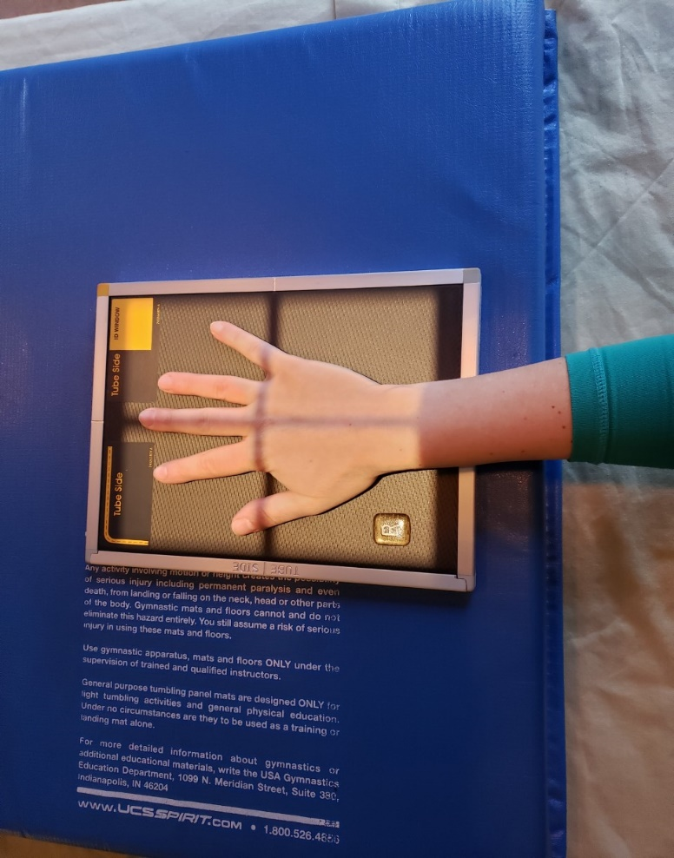
Guidelines/Considerations
2. Select appropriate equipment & technical factors
Hand imaging can be done using DR or CR cassettes
    Set 3 CR cassettes aside for the exam, using 1 per image
*Always use the smallest size cassette possible for CR

Slide 6
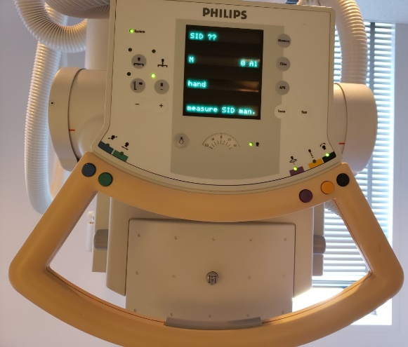
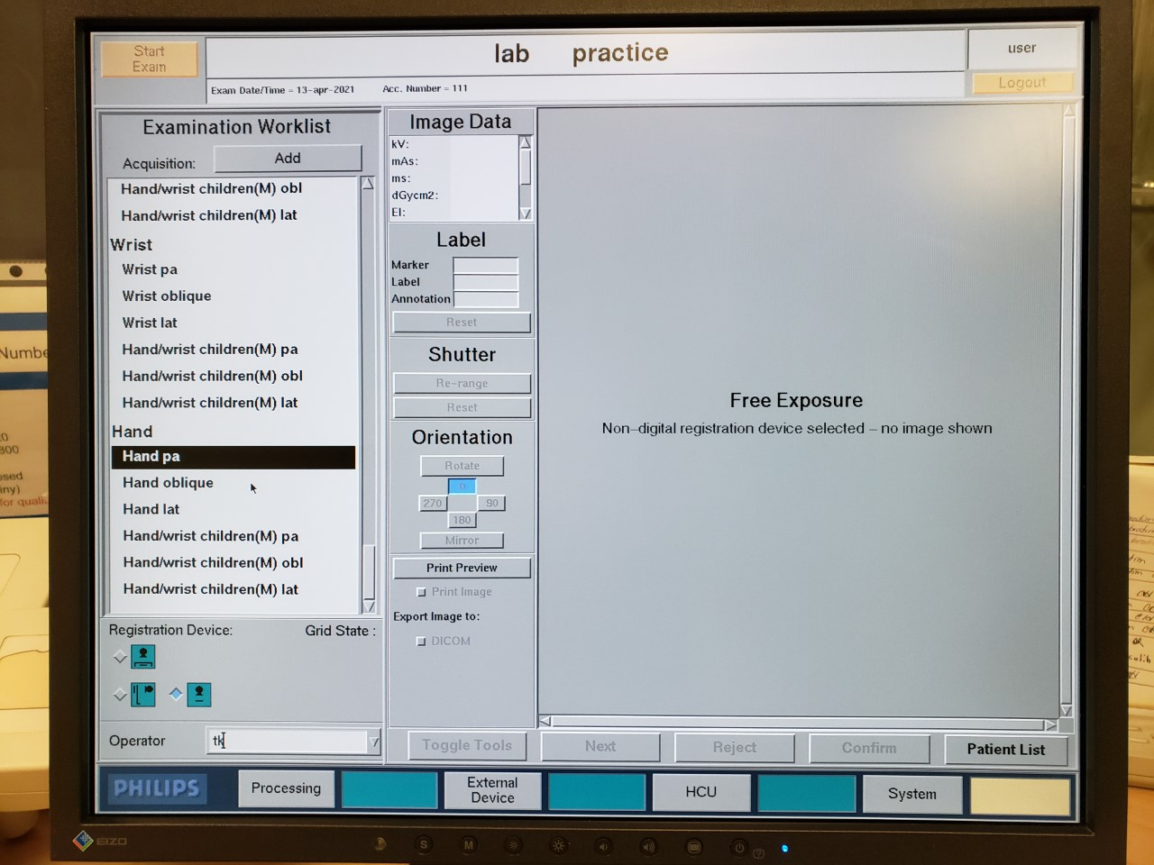
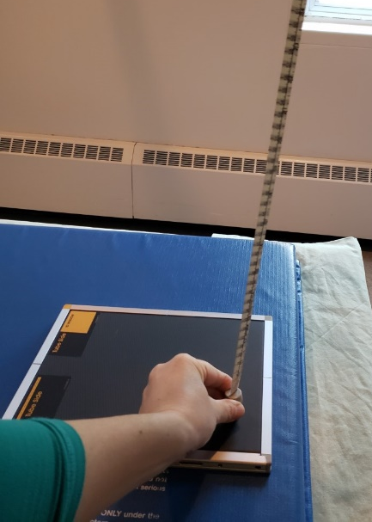
Guidelines/Considerations
2. Select appropriate equipment & technical factors
100cm SID is required
  Must be measured manually
S = source (i.e. x-ray tube)
55→65 kVp
D = distance
I = IR
SAIT Campus 2021

Slide 7
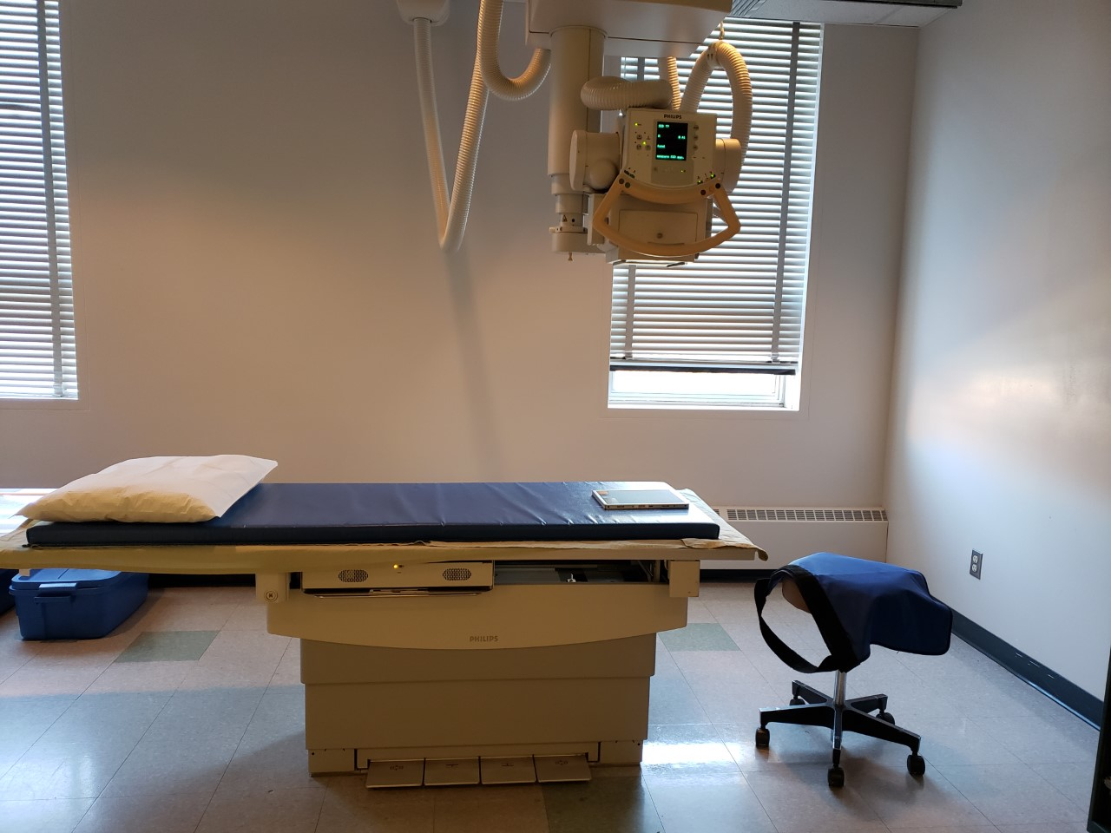
Guidelines/Considerations
2. Select appropriate equipment & technical factors
Setup room before bringing the patient in
  Note: can be done at either end of table
Tube and IR aligned using 100cm SID
Field size matches size of IR
Correct anatomical marker selected
Ensure the table IR is not directly under the cassette if using CR
SAIT Campus 2021

Slide 8
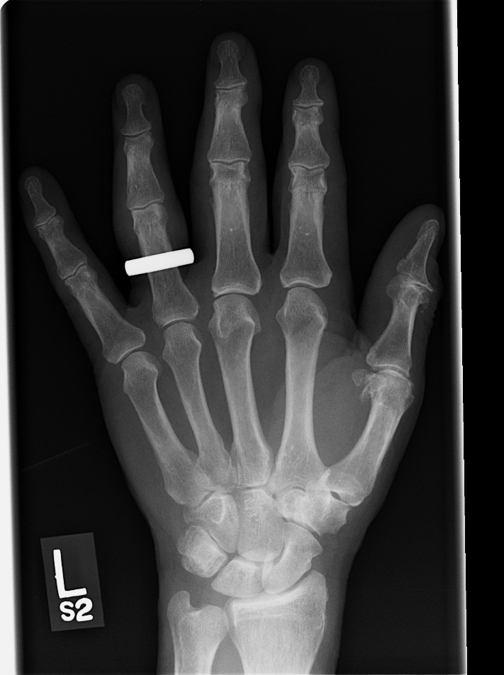

Guidelines/Considerations
3. Artifact removal
Only anatomy of interest should appear in the light field
Ensure the marker is NOT placed under “anatomy shadow”
SAIT Campus 2021
SAIT Imaging Library

Slide 9
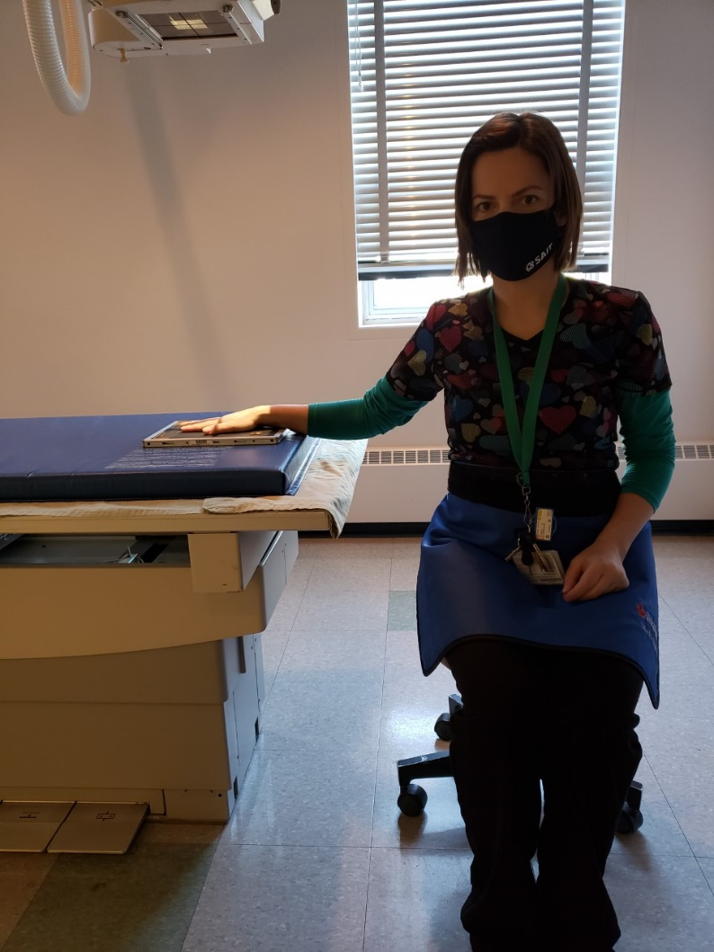
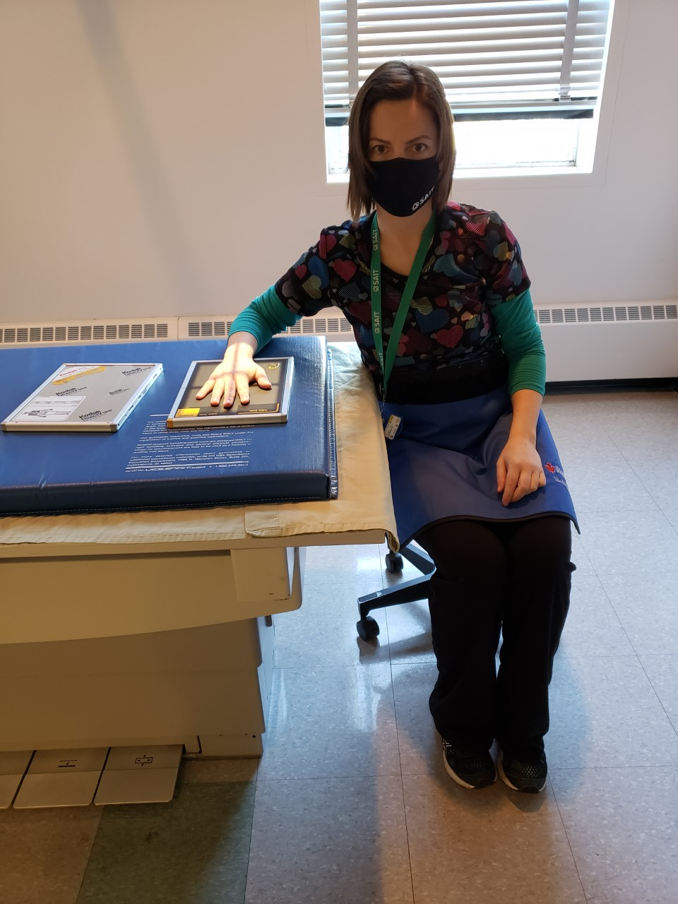
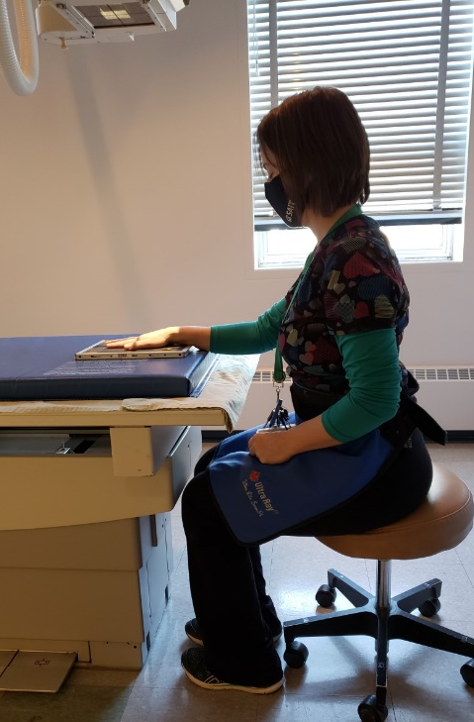
Guidelines/Considerations
Note: best practice to have patient facing you
Have patient sit on the stool (be aware of the wheels)
  Ensure legs are NOT under the IR
VS.
OR
SAIT Campus 2021

Slide 10
Hand Protocols
Routine:
PA
PA Oblique (45º anterior oblique)
Fan lateral
By special request:
Extension lateral
Bilateral oblique hands

Slide 11
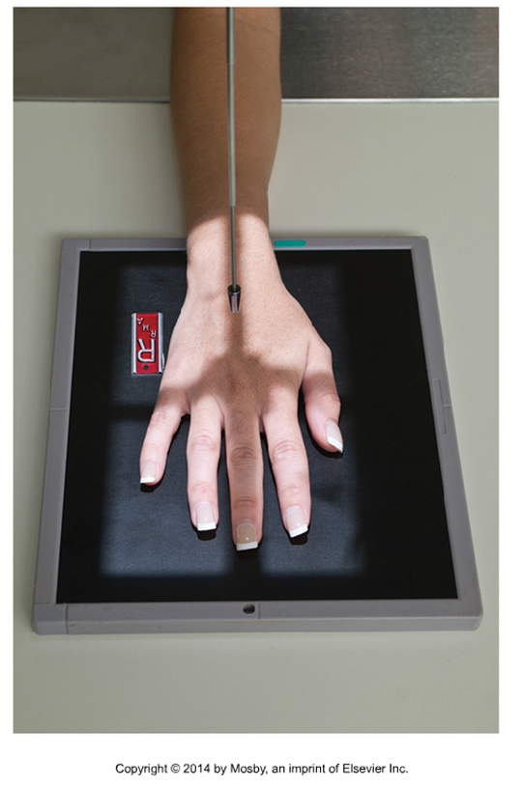
Positioning – PA Hand
Center the anatomy on the IR and/or in the light field
CR is over 3rd MCP and middle of IR
Note: the anatomy is NOT centered in the light field, or on the IR ☹
VS.
*At least ½ inch of anatomy proximal to the ulnar styloid process must be over the active surface of the IR
Bontrager pg. 150 Fig. 4.67

Slide 12
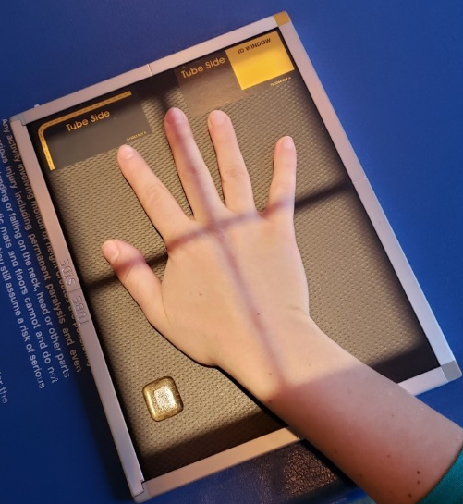
Positioning – PA Hand
Align the length of anatomy with the length of IR
Wrist should also be aligned
VS.
SAIT Campus 2021

Slide 13
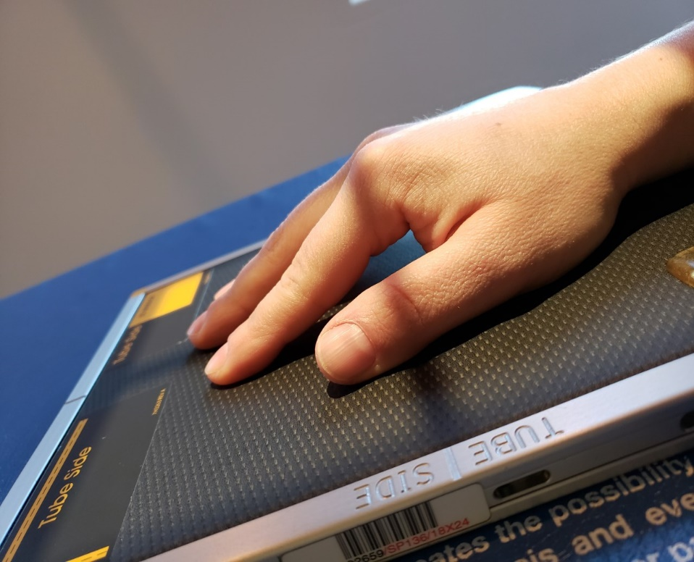
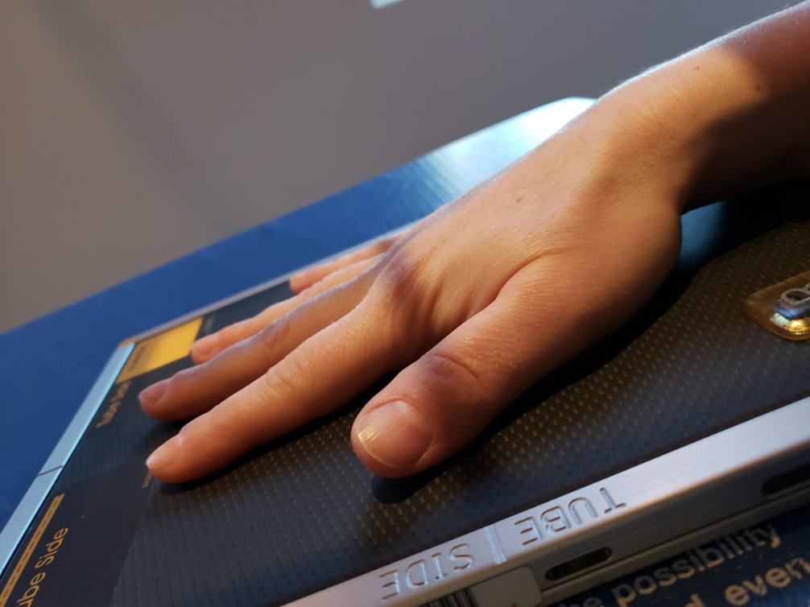
Positioning – PA Hand
Position the hand so the bones will reflect the ideal evaluation criteria
Fingers fully extended with entire palmar surface of hand, flat against IR
VS.
SAIT Campus 2021

Slide 14
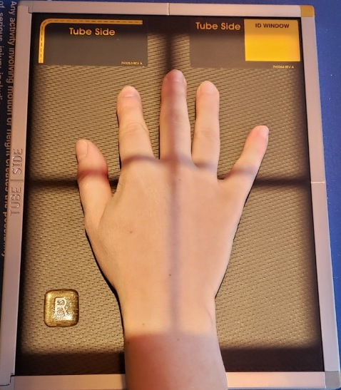
Positioning – PA Hand
Position the hand so the bones will reflect the ideal evaluation criteria
No soft-tissue overlap (i.e. fingers cannot touch)
SAIT Campus 2021

Slide 15
Positioning – PA Hand
Use external landmarks to set an appropriate field size
Place an anatomical marker (using Anderson Marker Rules)
*At least 1/2inch of light beyond required anatomy*
Radiograph must include entire hand & 1 inch of distal forearm

Slide 16
Positioning – PA Oblique Hand
Switch out the exposed cassette for CR, keeping the patient in the same position as the PA Hand
Immediately remove the exposed CR cassette from the room
OR
Flip the exposed CR cassette upside down, and remove just before the next exposure
Used
New

Slide 17
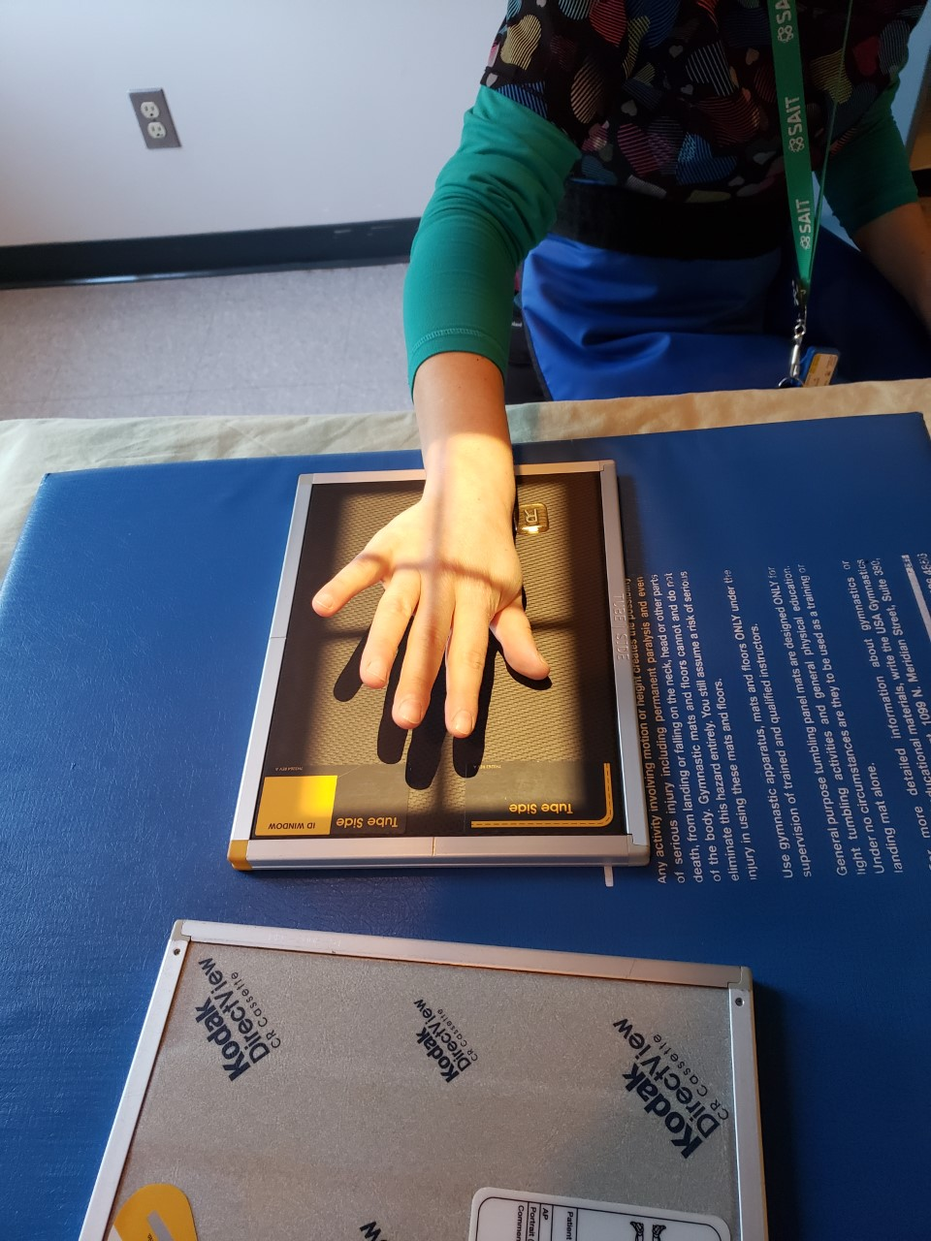
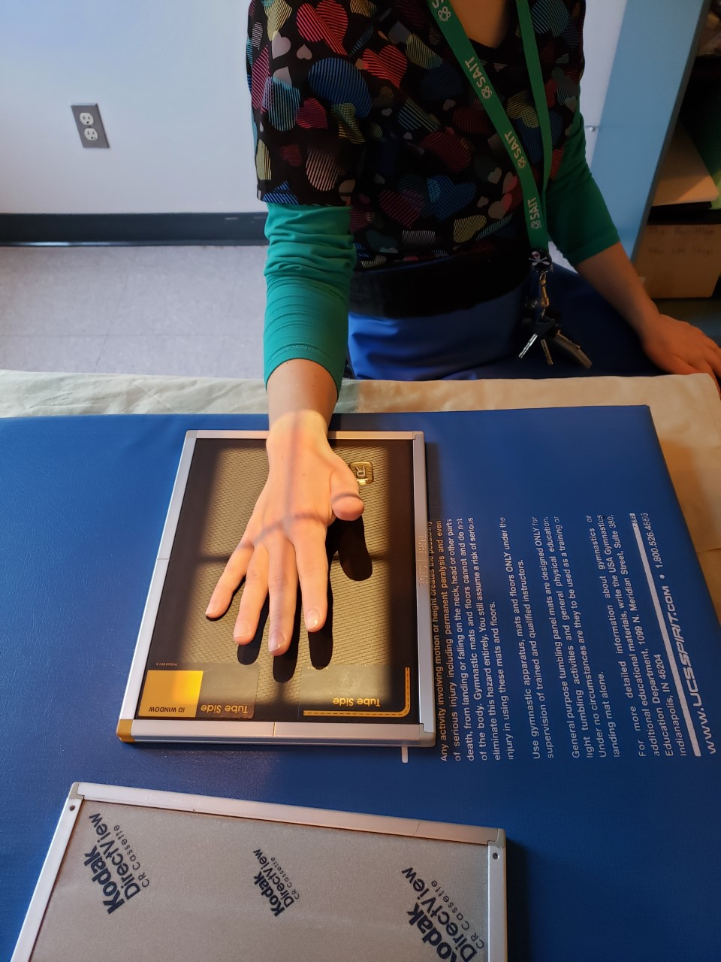
Positioning – PA Oblique Hand
Rotate entire hand laterally, until the metacarpal heads form a 45º angle with the IR
VS.
SAIT Campus 2021

Slide 18
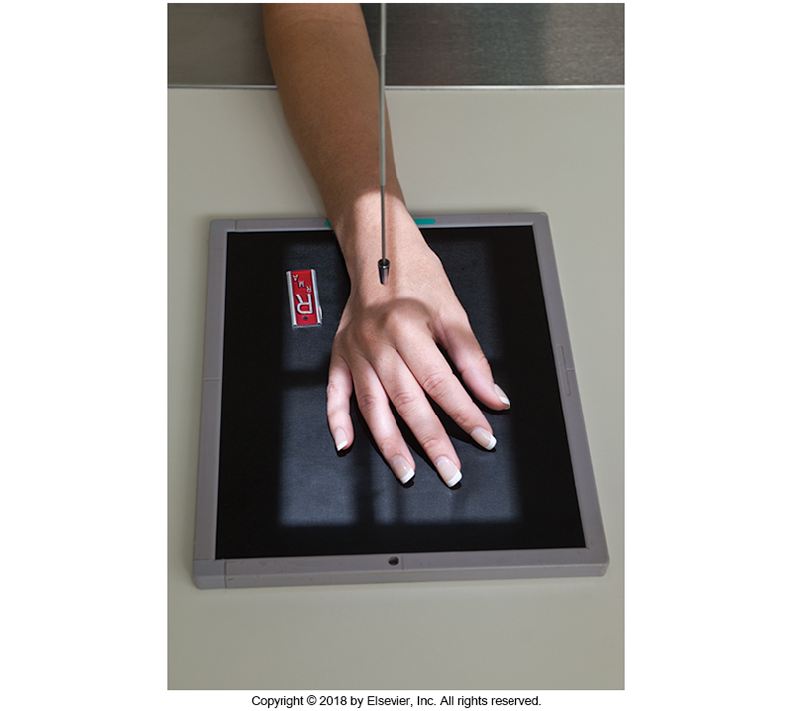
Positioning – PA Oblique Hand
Center the anatomy on the IR and/or in the light field
Note: the anatomy is NOT centered in the light field, or on the IR ☹
Central Ray is around 3rd MCP and middle of IR
VS.
*At least ½ inch of anatomy proximal to the ulnar styloid process must be over the active surface of the IR
Bontrager Fig. 4.71

Slide 19
Positioning – PA Oblique Hand
Align the length of anatomy with the length of IR
Wrist should also be aligned
VS.
Bontrager Fig. 4.71
SAIT Campus 2021

Slide 20
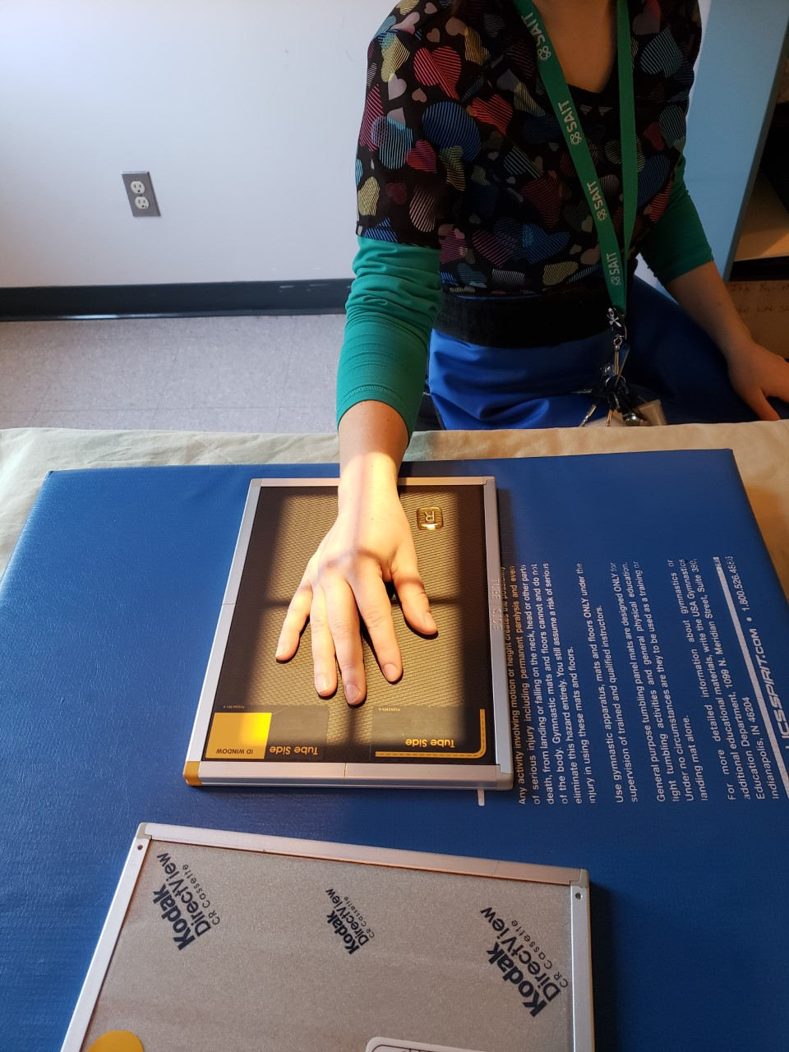
Positioning – PA Oblique Hand
Ensure the phalanges remain fully extended (i.e. fingers cannot rest against IR)
Position the hand so the bones will reflect the ideal evaluation criteria
VS.
SAIT Campus 2021

Slide 21
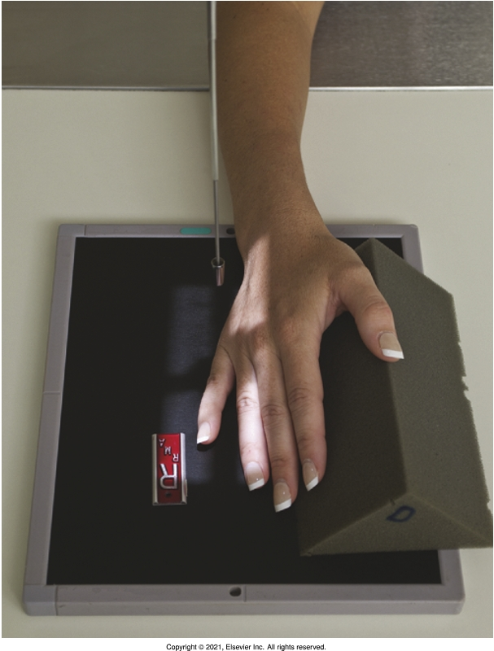
Positioning – PA Oblique Hand
Position the hand so the bones will reflect the ideal evaluation criteria
Avoid soft-tissue overlap (i.e. should see space between finger shadows)
VS.
Bontrager Fig. 4.42
Ensure distal phalanx is not hyperextended
SAIT Campus 2021

Slide 22
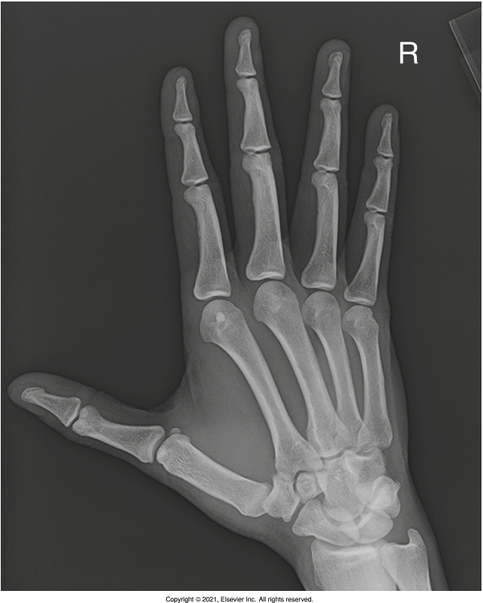
Positioning – PA Oblique Hand
Use external landmarks to set an appropriate field size
Place an anatomical marker (using Anderson Marker Rules)
R
*At least 1/2inch of light beyond required anatomy* Pro Tip: check anatomy “shadows”
Radiograph must include entire hand & 1 inch of distal forearm
Bontrager Fig. 4.72

Slide 23
Positioning – Lateral Hand
Switch out the exposed cassette for CR
Immediately remove the exposed CR cassette from the room
OR
Flip the exposed cassette upside down, and remove just before the next exposure
Used
New

Slide 24
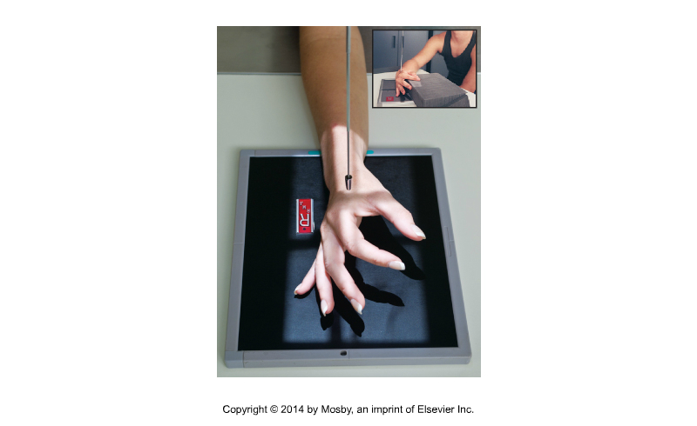
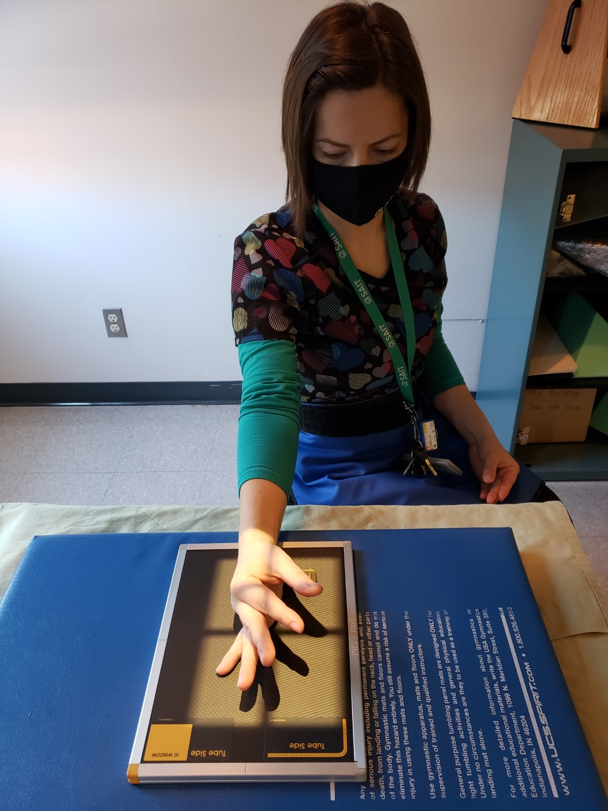
Positioning – Fan Lateral Hand
Center the anatomy on the IR and/or in the light field
Note: the anatomy is NOT centered in the light field ☹
Central Ray is by the 2nd MCP and middle of IR
VS.
*At least ½ inch of anatomy proximal to the ulnar styloid process must be over the active surface of the IR
Bontrager pg. 150 Fig. 4.75

Slide 25
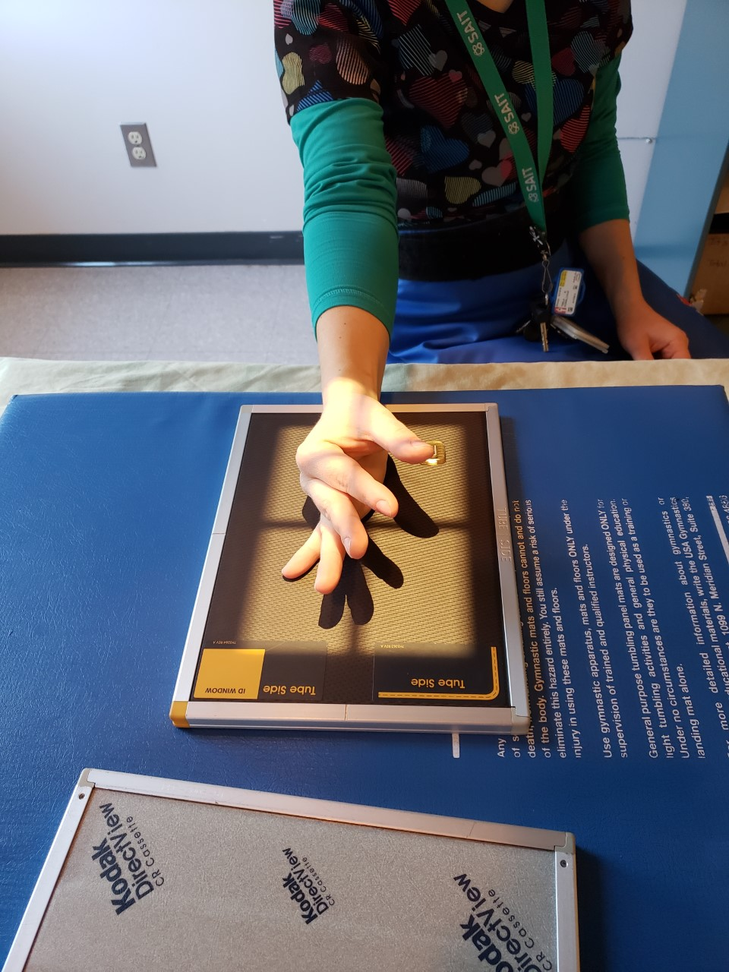
Positioning – Fan Lateral Hand
Metacarpal heads & wrist must be aligned
Align the length of anatomy with the length of IR
VS.
SAIT Campus 2021

Slide 26
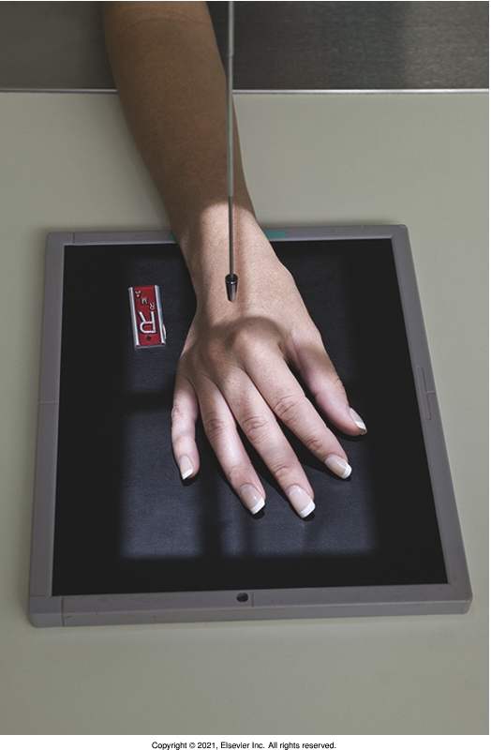
Positioning – Fan Lateral Hand
Position the hand so the bones will reflect the ideal evaluation criteria
Metacarpal heads and styloid processes perpendicular to IR
VS.
Bontrager pg. 149 Fig. 4.71
SAIT Campus 2021

Slide 27
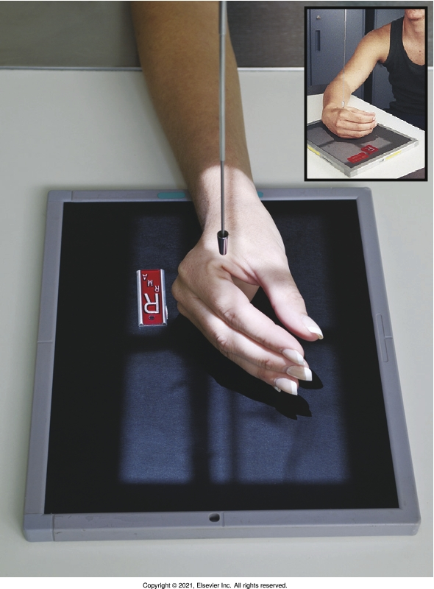
Positioning – Fan Lateral Hand
Position the hand so the bones will reflect the ideal evaluation criteria
Digits separated and parallel to IR
VS.
Bontrager pg. 151 Fig. 4.79

Slide 28
Positioning – Fan Lateral Hand
Use external landmarks to set an appropriate field size
Place an anatomical marker (using Anderson Marker Rules)
*At least 1/2inch of light beyond required anatomy* Pro Tip: check anatomy “shadows”
Radiograph must include entire hand & 1 inch of distal forearm
Sait Imaging Library

Slide 29
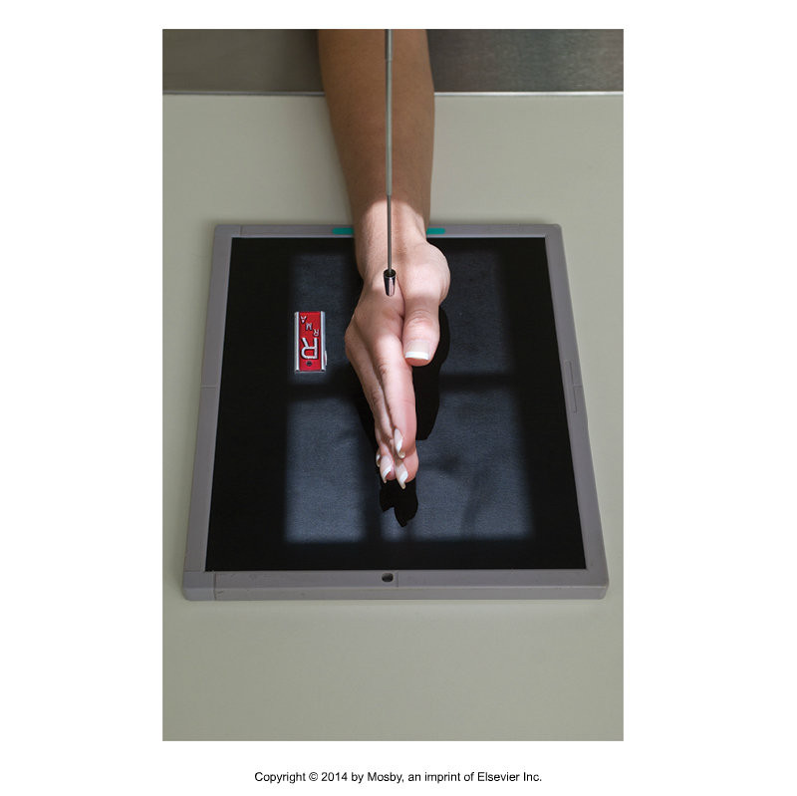
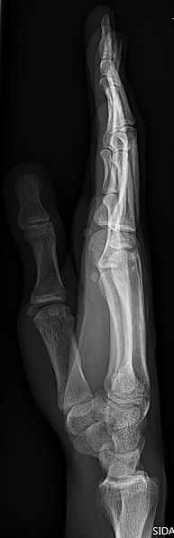
By Special Request – Extension Lateral
For foreign object or displacement
https://en.wikipedia.org/wiki/File:X-ray_of_normal_hand_by_lateral_projection.jpg
Bontrager pg. 153 Fig. 4.78

Slide 30
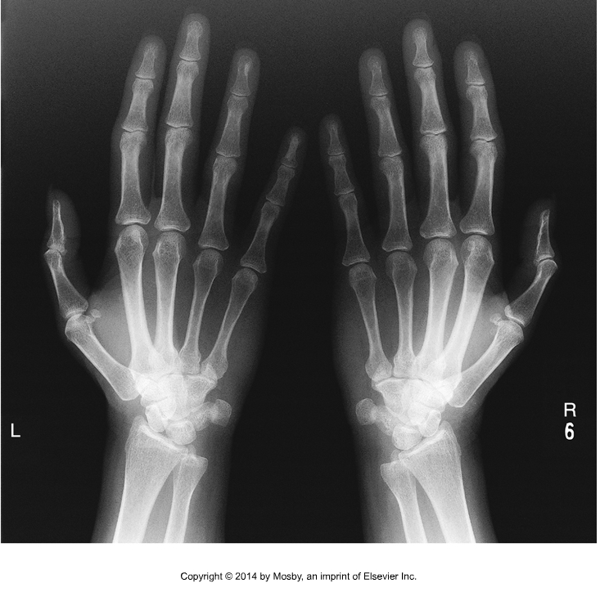
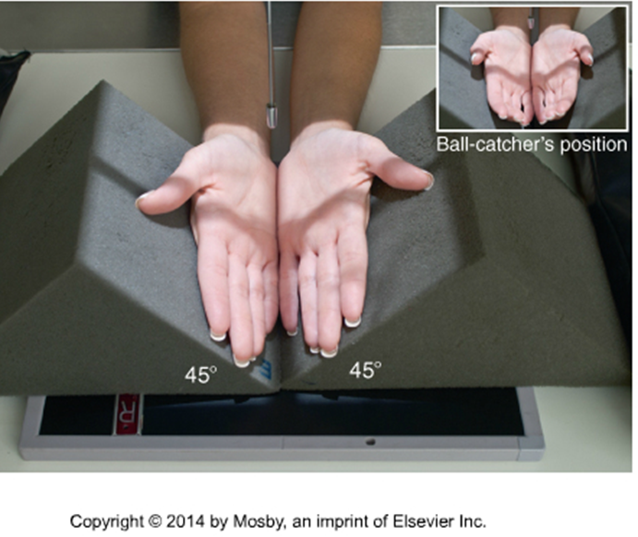
By Special Request – AP Oblique Hands
The “ball-catcher’s position” assists in detecting early radiographic changes indicative of rheumatoid arthritis
Bontrager 9th Ed. pg. 154 Fig. 4.83 & 4.84

Slide 31
Thumb Protocol
Routine:
AP
PA Oblique (45º anterior oblique)
Lateral
Adaptive:
PA

Slide 32
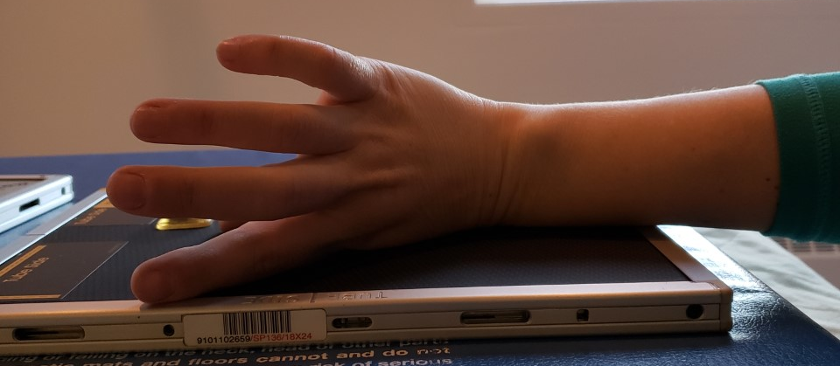
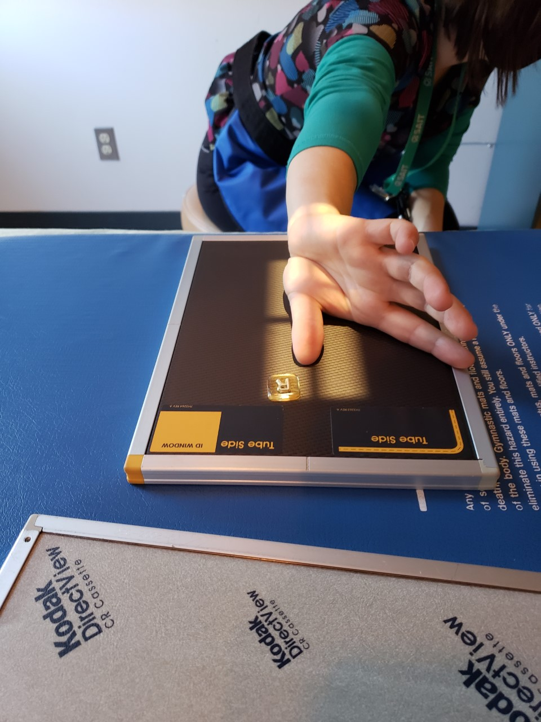
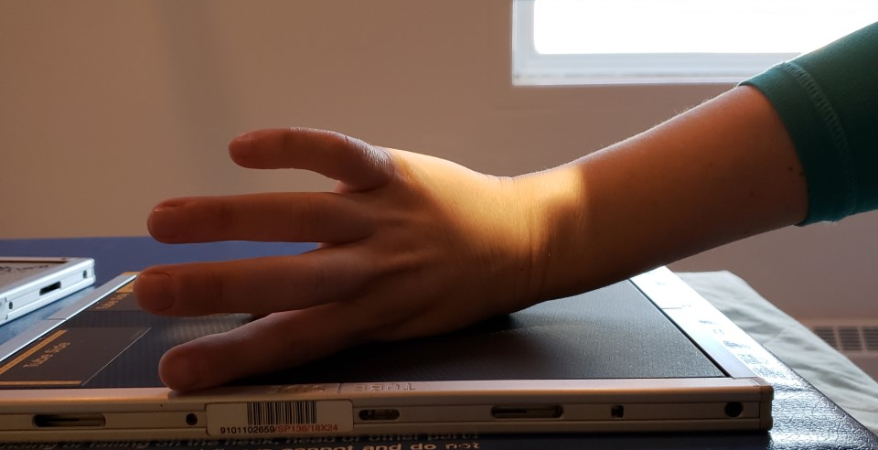
Positioning – AP Thumb
Align the length of anatomy with the length of IR
Center the anatomy on the IR and/or in the light field
Central Ray is over 1st MCP and middle of IR
Wrist should be aligned and flat against IR
VS.
SAIT Campus 2021

Slide 33
Positioning – AP Thumb
Position the hand so the bones will reflect the ideal evaluation criteria
Use external landmarks to set an appropriate field size
Place an anatomical marker (using Anderson Marker Rules)
Ensure the head of the proximal phalanx is parallel to the IR
*At least 1/2inch of light beyond required anatomy*
Radiograph must include entire Thumb & trapezium
SAIT Campus 2021
SAIT Image Critique Handbook

Slide 34
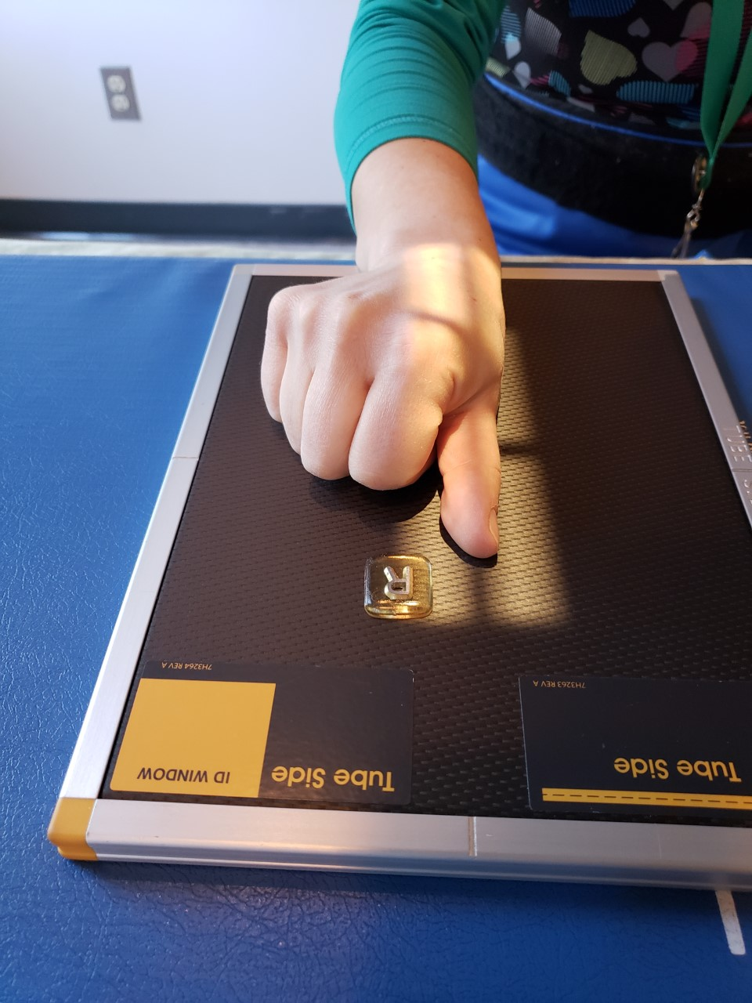
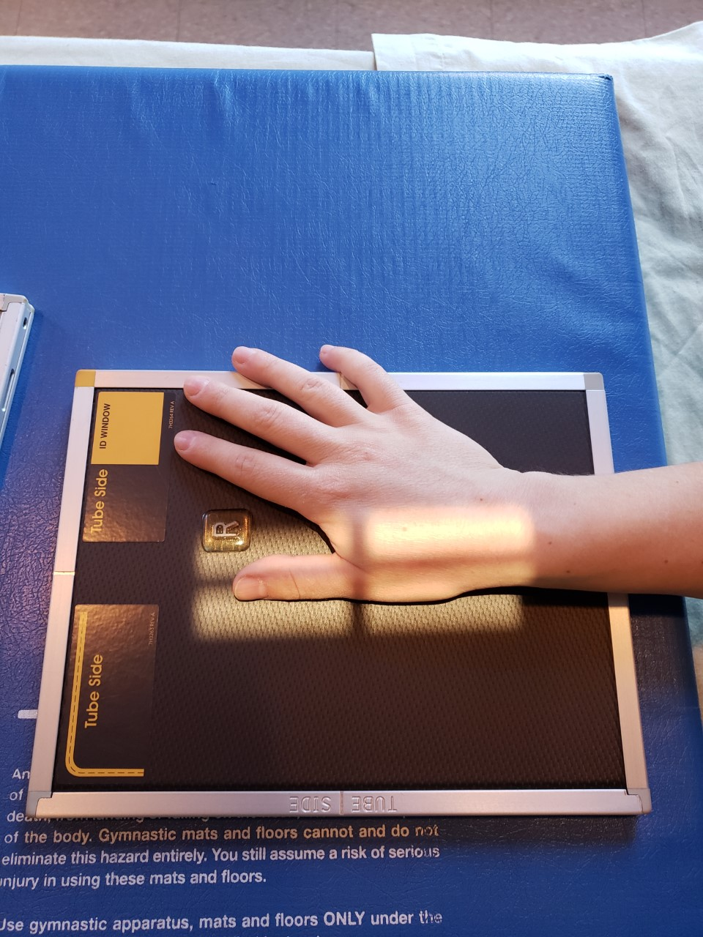
Positioning – PA Oblique Thumb
Remember to change cassettes
Center the anatomy on the IR and/or in the light field
Align the length of anatomy with the length of IR
CR is over 1st MCP and middle of IR
Note: curled fingers will superimpose anatomy of interest☹
VS.
Wrist should be aligned and flat against IR
SAIT Campus 2021

Slide 35
Positioning – PA Oblique Thumb
Position the hand so the bones will reflect the ideal evaluation criteria
Use external landmarks to set an appropriate field size
Place an anatomical marker (using Anderson Marker Rules)
L
Ensure the head of the proximal phalanx is 45⁰ to the IR
*At least 1/2inch of light beyond required anatomy*
Radiograph must include entire Thumb & trapezium
SAIT Campus 2021
SAIT Image Critique Handbook

Slide 36
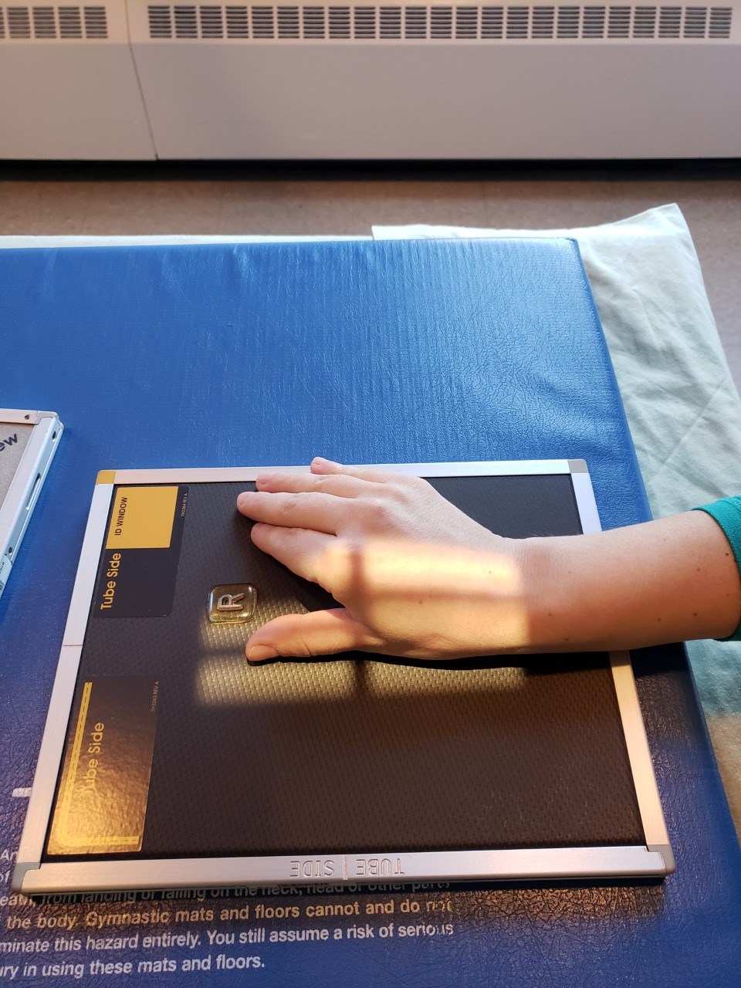
Positioning – Lateral Thumb
Remember to change cassettes
Center the anatomy on the IR and/or in the light field
Align the length of anatomy with the length of IR
CR is over 1st MCP and middle of IR
Wrist should be aligned and flat against IR
SAIT Campus 2021

Slide 37
Positioning – Lateral Thumb
Position the hand so the bones will reflect the ideal evaluation criteria
Use external landmarks to set an appropriate field size
Place an anatomical marker (using Anderson Marker Rules)
Ensure the head of the proximal phalanx is perpendicular to the IR
L
*At least 1/2inch of light beyond required anatomy*
Radiograph must include entire Thumb & trapezium
SAIT Image Critique Handbook

