Slide 1
MRAD 204:
Radiographic Technique 1
Outcome 1-5:
Positioning – Elbow & Humerus

Slide 2
Affiliated Readings
Module 4
Bontrager
Pgs: 164→170
Pgs: 187→188

Slide 3
Overview
Guidelines/Considerations
Protocols
Positioning

Slide 4
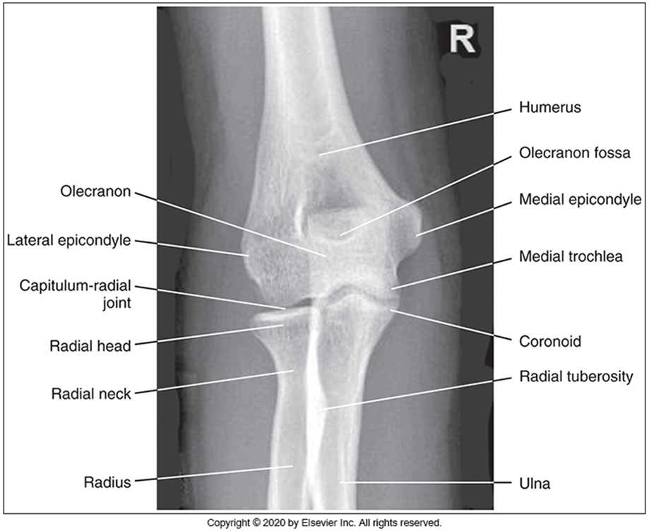
Guidelines/Considerations - Elbow
Identify required anatomy
McQuillen Martensen 5th Ed. 224 Fig. 4.144
Elbow radiographs require ~1/3rd of the proximal forearm (to include the radial tuberosity) AND ~1/4 of the distal humerus

Slide 5
Guidelines/Considerations - Elbow
2. Select appropriate equipment/technical factors
100cm SID, measured manually
On the console, select:
  “free cassette”
  the projection you will begin positioning
*Elbow technique = *65→75 kVp

Slide 6
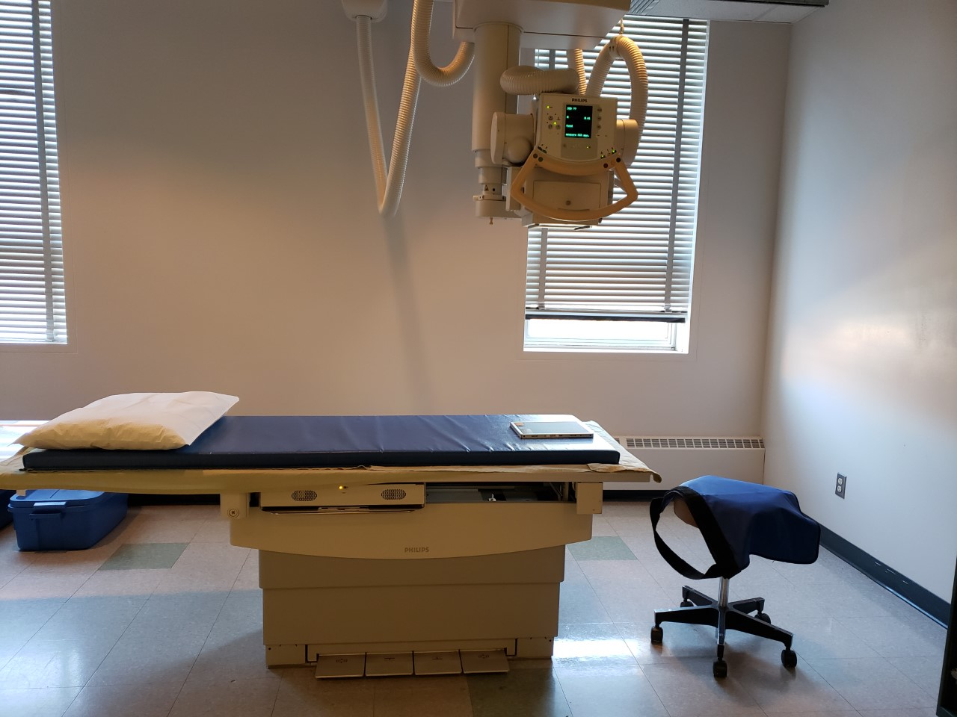
Guidelines/Considerations - Elbow
Setup room before bringing the patient in
  Note: can be done at either end of table
Tube and IR aligned using 100cm SID
Field size matches size of IR
Correct anatomical marker selected
Ensure the table IR is not directly under the CR cassette if applicable
SAIT Campus 2021

Slide 7
Guidelines/Considerations - Elbow
3. Artifact Removal
Any clothing or objects over the distal ½ of the humerus or proximal ½ of the forearm
  Ensure the marker is NOT placed under “anatomy shadow”
Notes: when the patient is in the room:
Use external landmarks when positioning
  *Position of the elbow is determined by the epicondyles NOT the hand
  Best practice to have patient facing you
  Do NOT let the patient's legs go under the IR/table

Slide 8
Elbow Protocol
Routine:
AP
Lateral
AP Oblique with Medial Rotation (45º)
AP Oblique with Lateral Rotation (45º)
Non-Routine:
Partial Flexion
Acute Flexion
Lateral radial head views

Slide 9
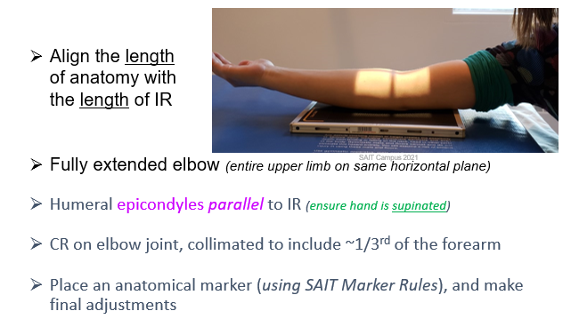
Positioning – AP Elbow
Anderson Marker Rules

Slide 10
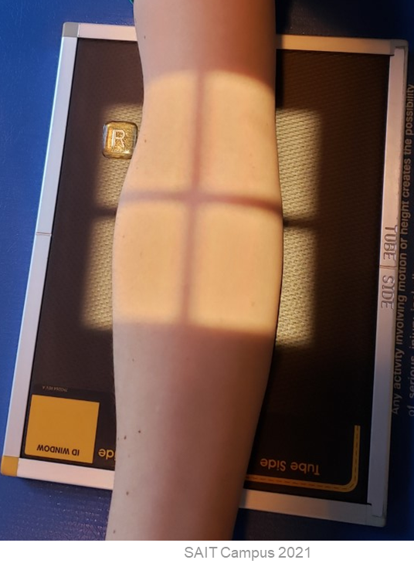
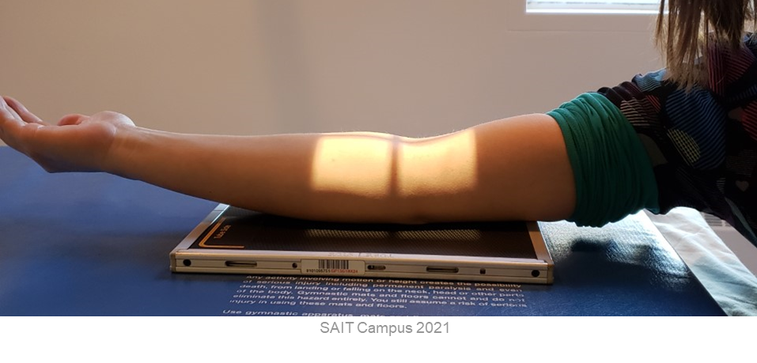
Positioning – AP Elbow
CR is over the elbow “crease” (aka. Elbow joint)
Entire upper limb “flat” against IR/table surface
Marker on lateral side *note orientation*
Humeral epicondyles parallel to IR
*At least 1/2inch of light beyond all soft-tissue*
Hand supinated
Radiograph must include @ least 1/3rd proximal forearm & ¼ distal humerus
Humerus & Forearm parallel to length of IR
*Center elbow joint over the center of the IR, to ensure all required anatomy will be on top of the IR’s active surface

Slide 11
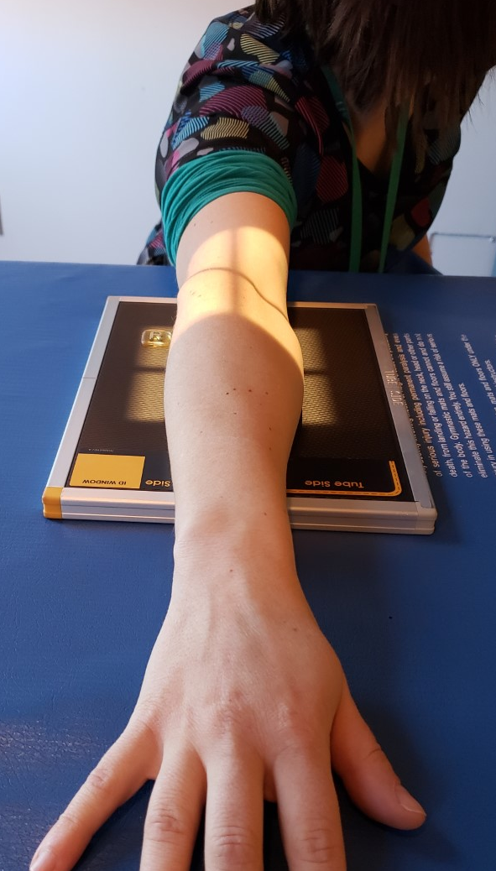
Positioning – AP Oblique with Medial Rotation
Position the entire upper limb on the same horizontal plane
Arm fully extended
Pronate hand
Rotate arm medially until the epicondyles form a 45º angle to the IR
*Center elbow joint over the center of the IR, to ensure all required anatomy will be on top of the IR’s active surface

Slide 12
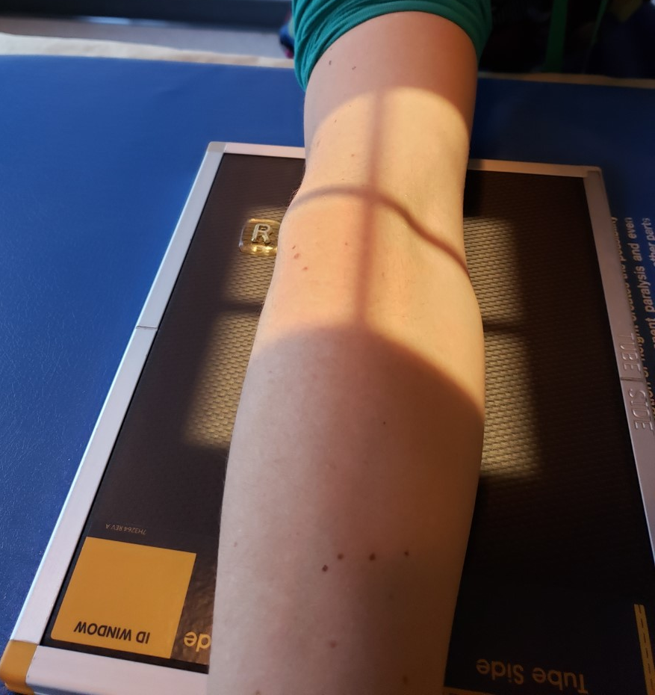
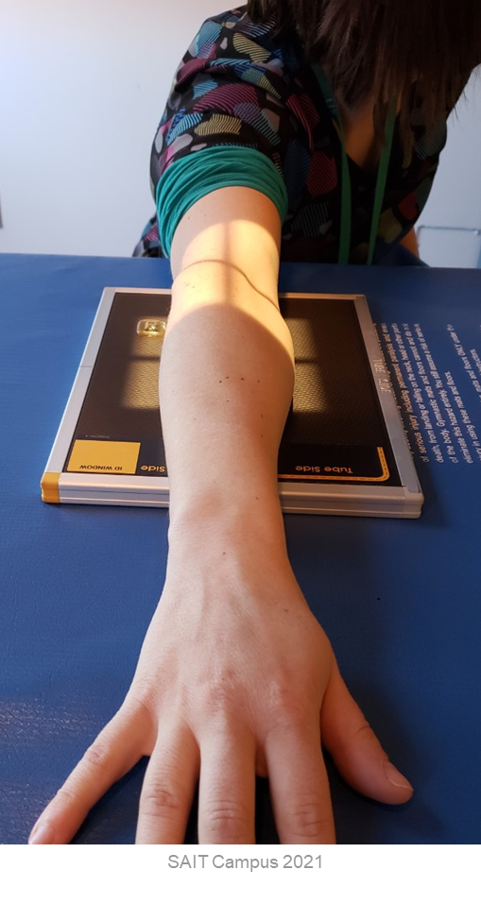
Positioning – AP Oblique with Medial Rotation
CR is over the elbow “crease” (aka. Elbow joint)
Entire upper limb “flat” against IR/table surface
Marker on lateral side (NOT thumb side) *note orientation*
Humeral epicondyles 45⁰ to IR
Humerus & Forearm parallel to length of IR
*At least 1/2inch of light beyond all soft-tissue*
Hand pronated
Radiograph must include @ least 1/3rd proximal forearm & ¼ distal humerus

Slide 13
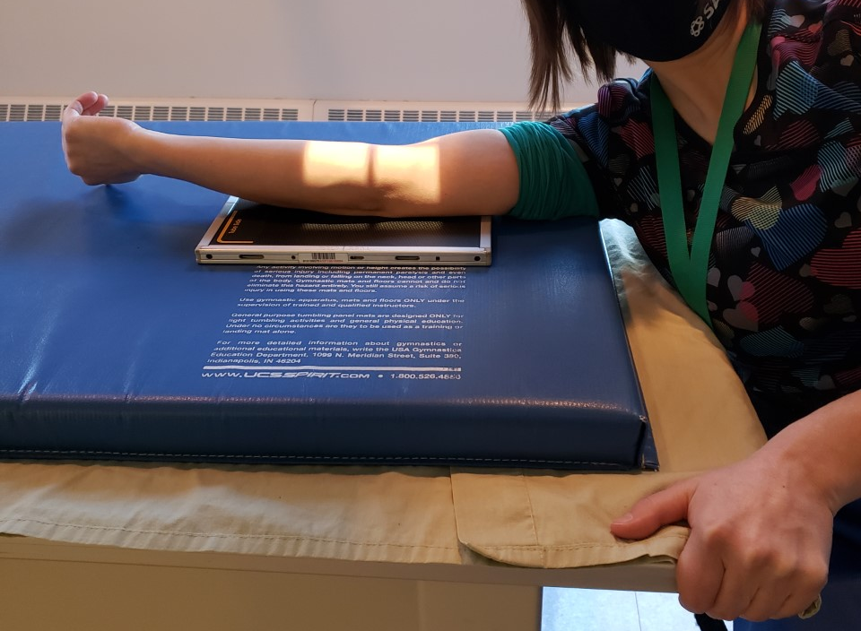
Positioning – AP Oblique with Lateral Rotation
Remember to change CR cassette
*Center elbow joint over the center of the IR, to ensure all required anatomy will be on top of the IR’s active surface
Position the entire upper limb on the same horizontal plane
Arm fully extended
Supinate hand
Rotate arm laterally until the epicondyles form a 45º angle to the IR

Slide 14
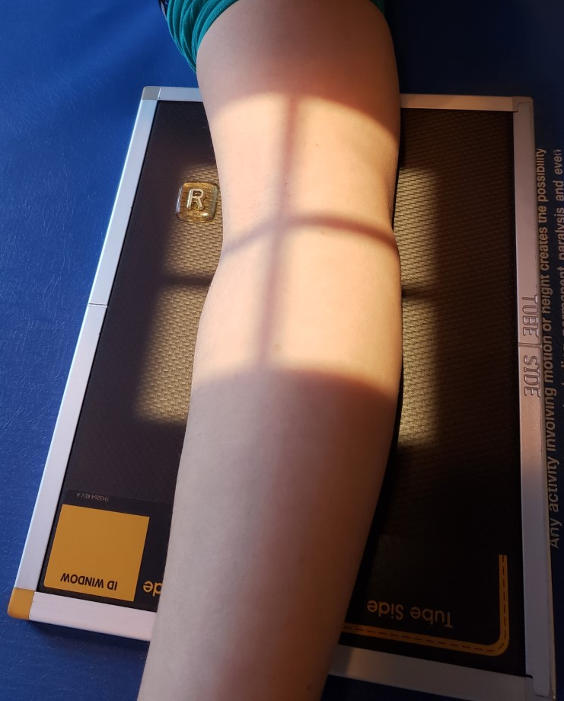
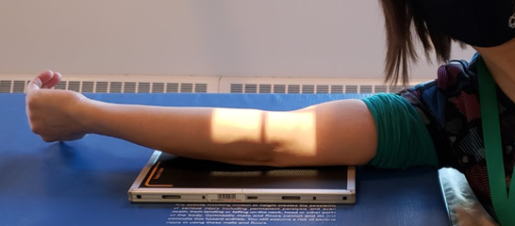
Positioning – AP Oblique with Lateral Rotation
CR is over the elbow “crease” (aka. Elbow joint)
Entire upper limb “flat” against IR/table surface
Marker on lateral side *note orientation*
Humeral epicondyles 45⁰ to IR
Hand “supinated”
Forearm parallel to length of IR
*At least 1/2inch of light beyond all soft-tissue*
Radiograph must include @ least 1/3rd proximal forearm & ¼ distal humerus

Slide 15
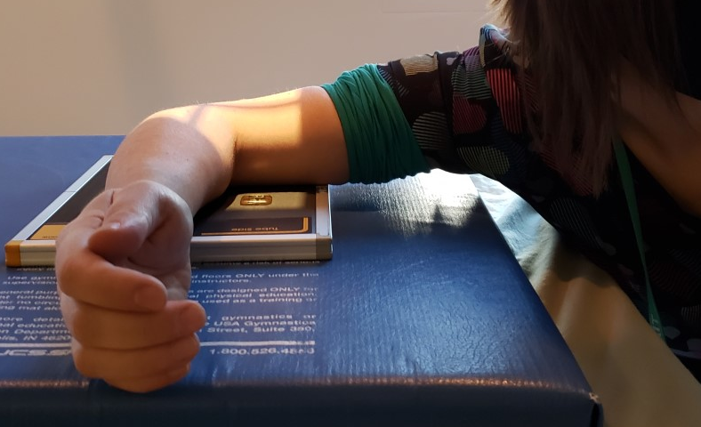
Positioning – Lateral Elbow
Position the entire upper limb on the same horizontal plane
Rotate hand and wrist into a true lateral
Elbow flexed 90º

Slide 16
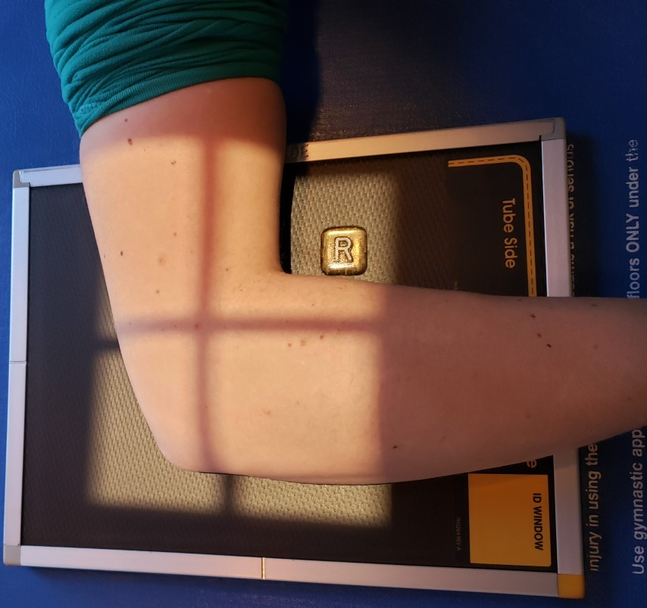
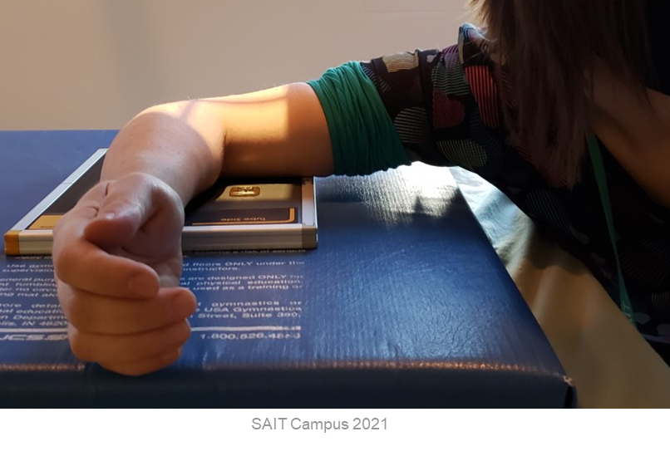
Positioning – Lateral Elbow
CR is ~½ inch proximal and anterior to lateral epicondyle
Marker on anterior side *note orientation*
Entire upper limb “flat” against IR/table surface
Light-field extends:
Distally: ½ inch beyond body of ulna
Posteriorly: ½ inch beyond olecranon process
Hand & Wrist in lateral position
Elbow flexed 90⁰ (aka. Humerus parallel to “short” edge & Forearm parallel to “long” edge of IR)
Humeral epicondyles perpendicular to IR
Radiograph must include @ least 1/3rd proximal forearm & ¼ distal humerus
SAIT Campus 2021

Slide 17
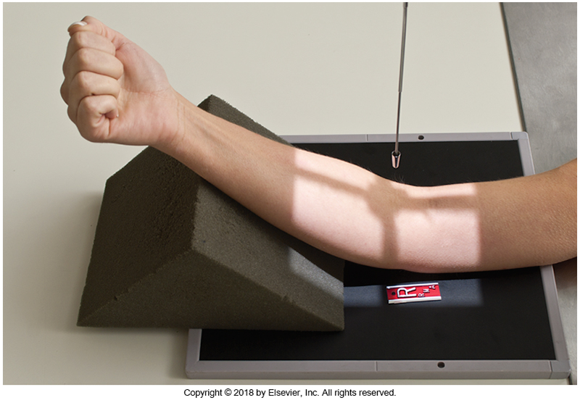
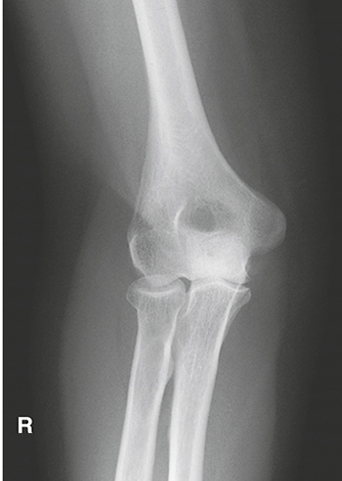
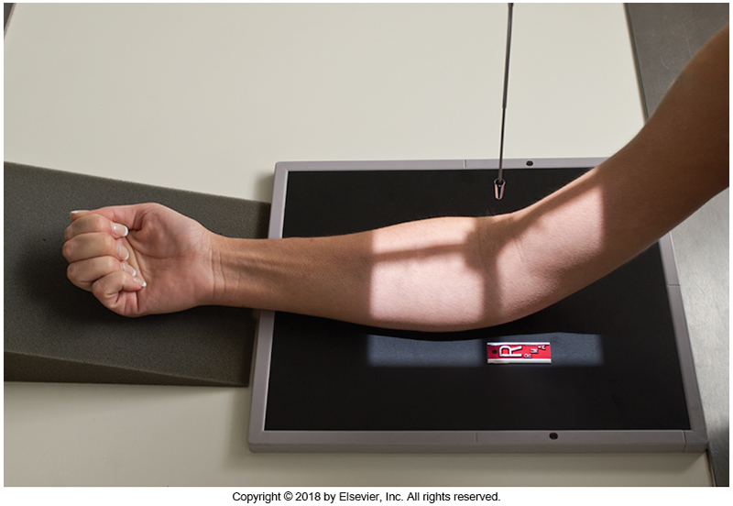
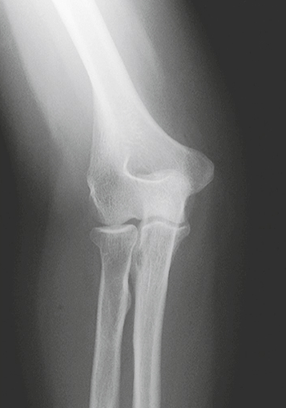
Non-Routine: Partial Flexion
When the patient is unable to fully extend their arm
Humerus parallel
Forearm parallel
Bontrager pg. 165 Fig. 4.123-4.126

Slide 18
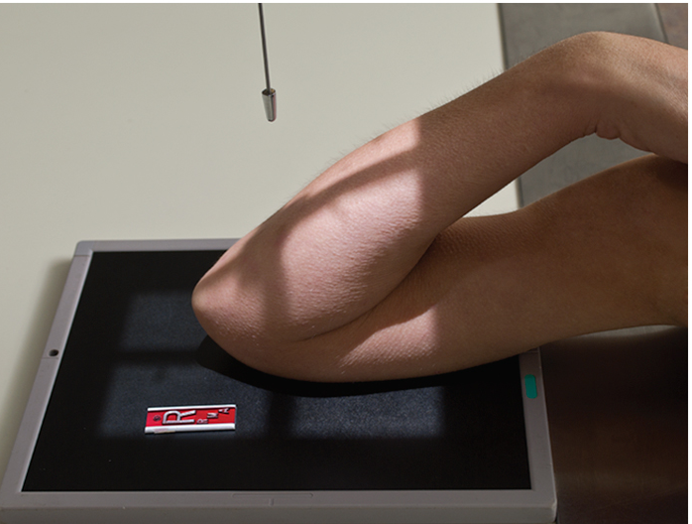
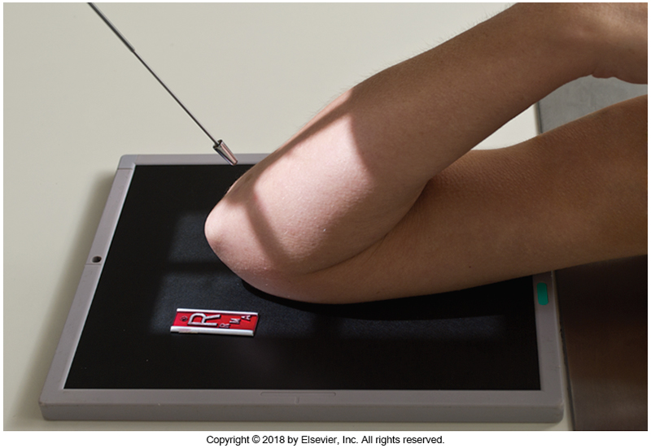
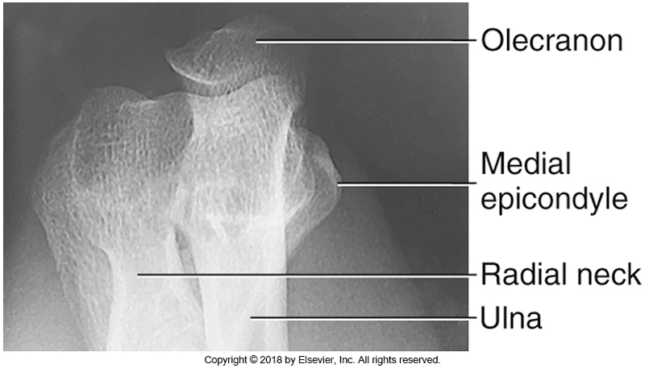
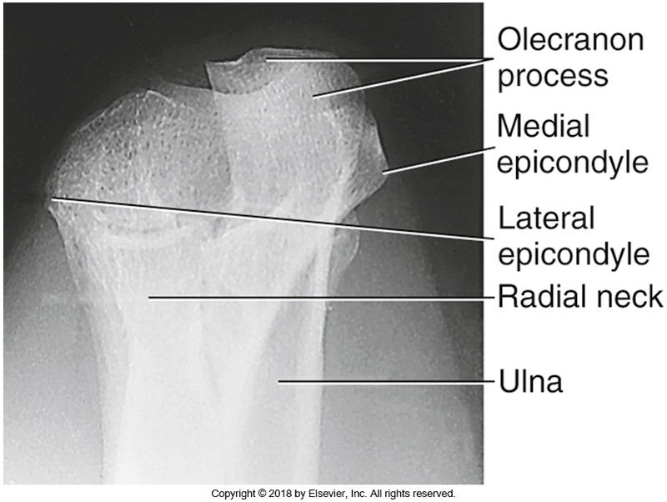
Non-Routine: Acute Flexion
When flexion is greater than 90º
For distal humerus
For proximal forearm
Bontrager pg. 166 Fig. 4.127-4.128 & 4.131-4.132

Slide 19
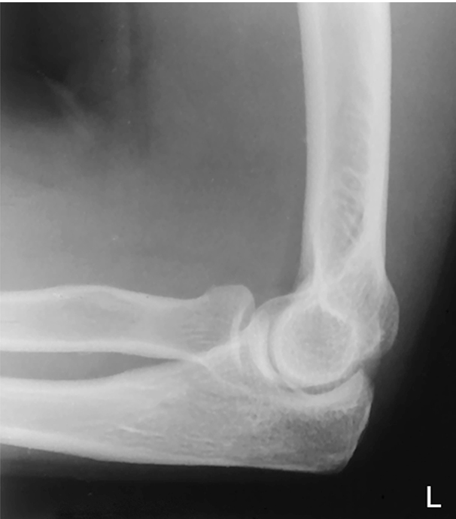
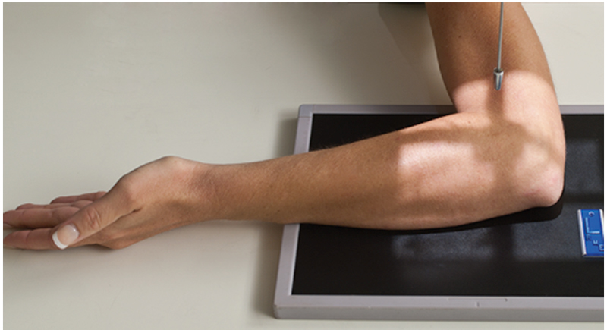
Non-Routine: Radial Head Views
Four images required to determine if the radius is rotating properly around the ulna
Assists in locating “occult” (hidden) fractures of the radial head and neck
Image #1: Radial Head: maximum external rotation
(aka. supinated)
Slightly anterior
Bontrager pg. 124 Fig. 4.152 & 4.153

Slide 20
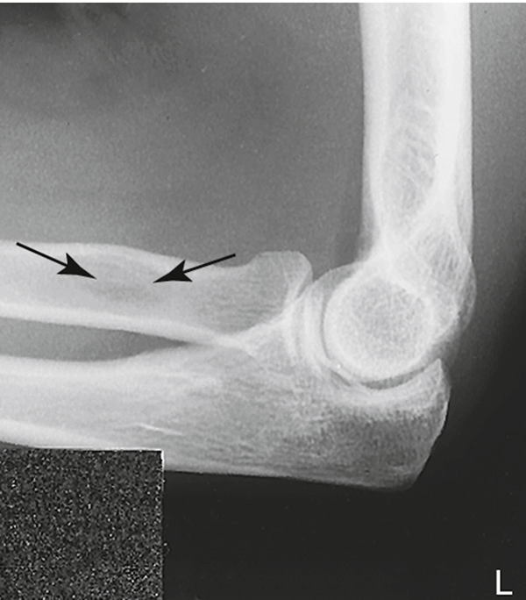
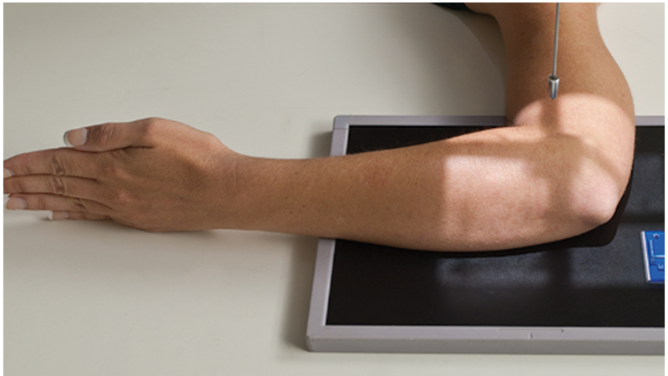
Non-Routine: Radial Head View
Image #2: Radial Head: hand lateral
Superimposed over radial shaft
Bontrager pg. 172 Fig. 4.154 & 4.155

Slide 21
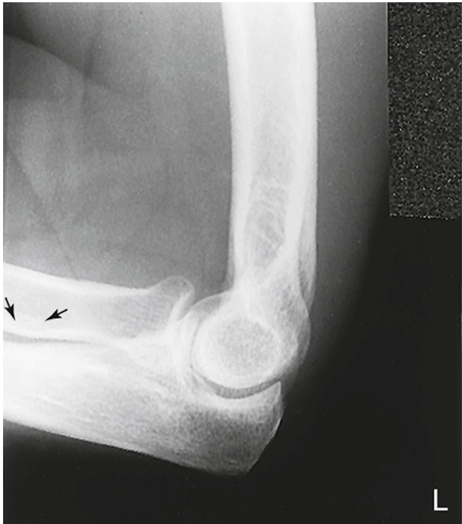
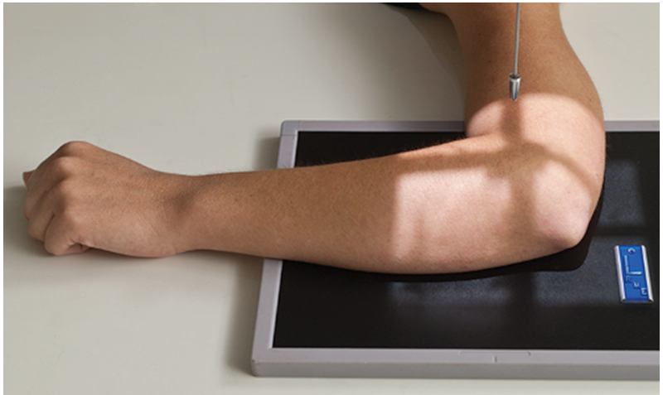
Non-Routine: Radial Head View
Image #3: Radial Head: hand pronated
Slightly posterior
Bontrager pg. 172 Fig. 4.156 & 4.157

Slide 22
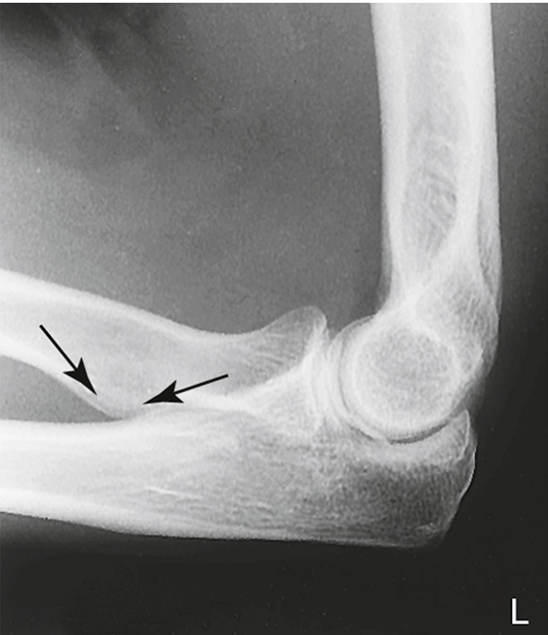
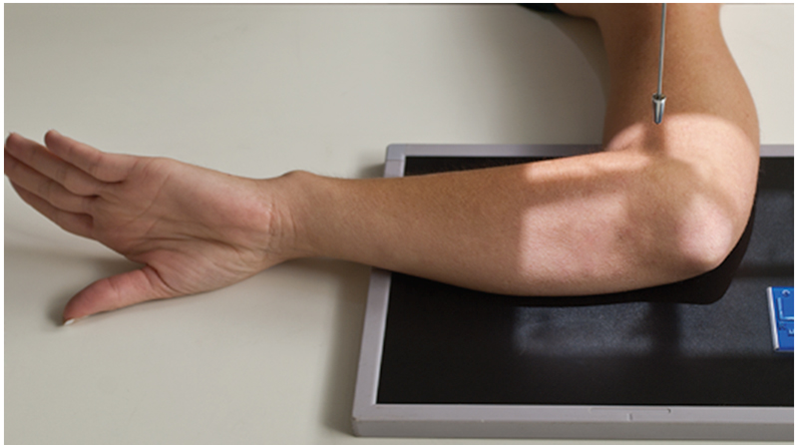
Non-Routine: Radial Head View
Image #4: Radial Head: maximum internal rotation
Posterior
Bontrager pg. 172 Fig. 4.158 & 4.159

Slide 23
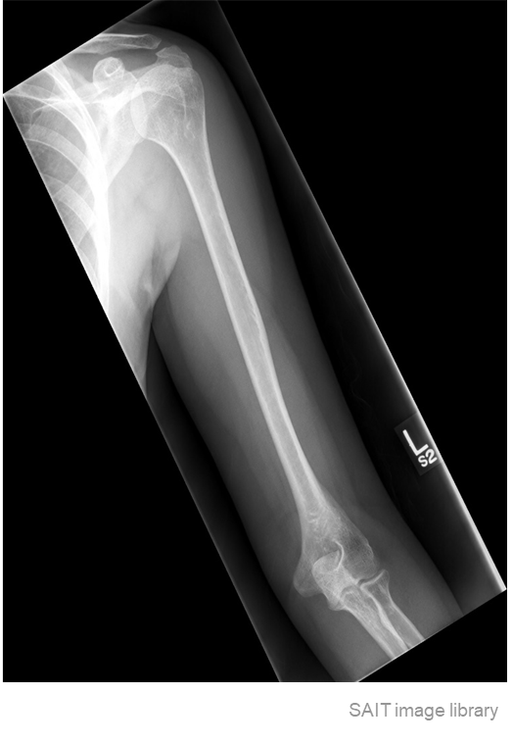
Guidelines/Considerations - Humerus
Identify required anatomy
Humerus radiographs require the elbow AND shoulder joint

Slide 24
Guidelines/Considerations - Humerus
2. Select appropriate equipment/technical factors
Wall IR
110cm SID, measured electronically using détentes
On the console, select:
  “Wall IR”
  the projection you will begin positioning
*Humerus technique = *70→85 kVp

Slide 25
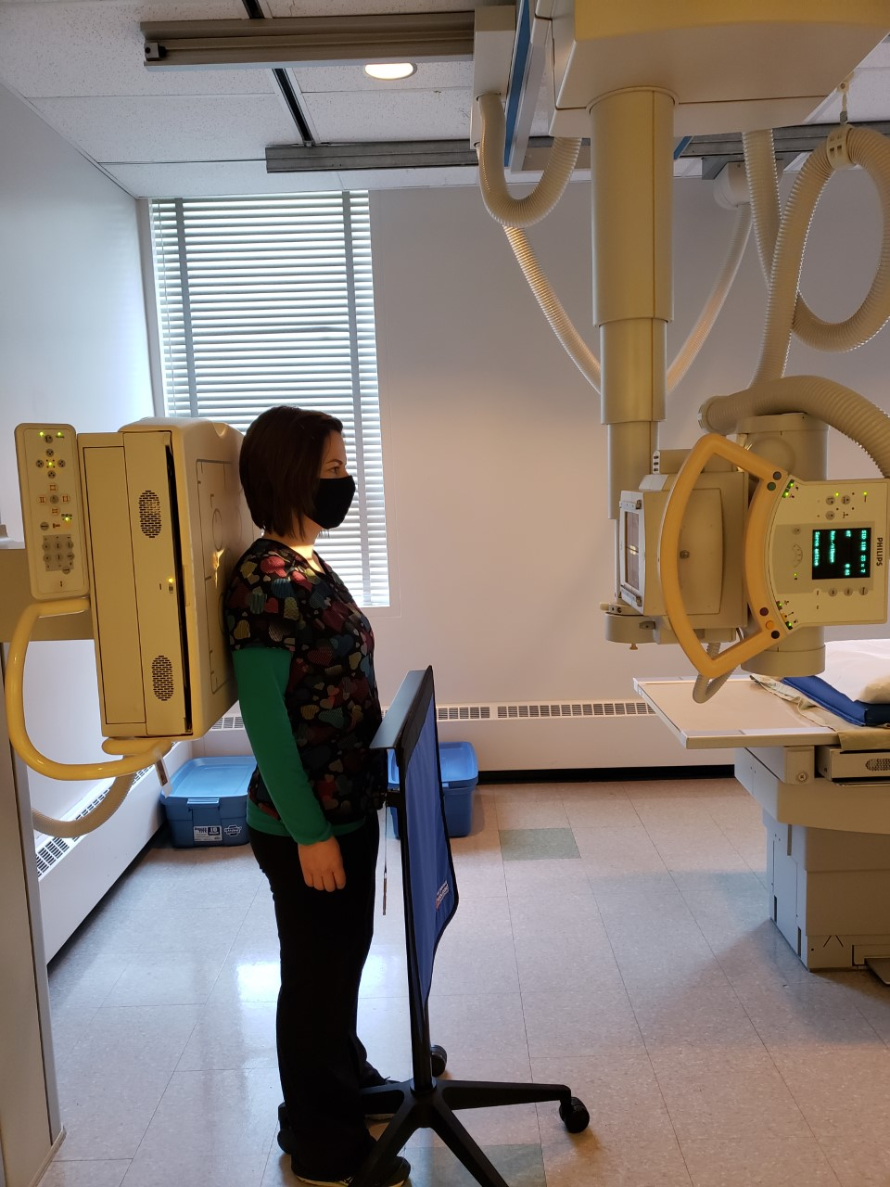
Guidelines/Considerations - Humerus
For humerus imaging: All locks must be “on” except yellow
Setup room before bringing the patient in
Tube and IR aligned @ 110cm SID
  Green lock: sets SID
  Blue lock: centers tube to IR laterally/medially
  Laser light: centers tube to IR superiorly/inferiorly
  Above colours may vary - site dependant
Correct anatomical marker selected
Ensure the correct détente (alignment) is used
SAIT Campus 2021

Slide 26
Guidelines/Considerations - Humerus
3. Artifact Removal
    *Patient must be given gowning instructions*
“Everything from the waist up”
  Tops (i.e. shirt/sweaters), bra, necklace(s), long earrings, wet or braided hair
Ensure the marker is NOT placed under “anatomy shadow”
Notes:
Upright or seated position is best
Humeral epicondyles are used as external landmarks
  i.e. position of the elbow determines position of the humerus
Patient must be asked to suspend respiration

Slide 27
Humerus Protocol
Routine:
AP
Lateral

Slide 28
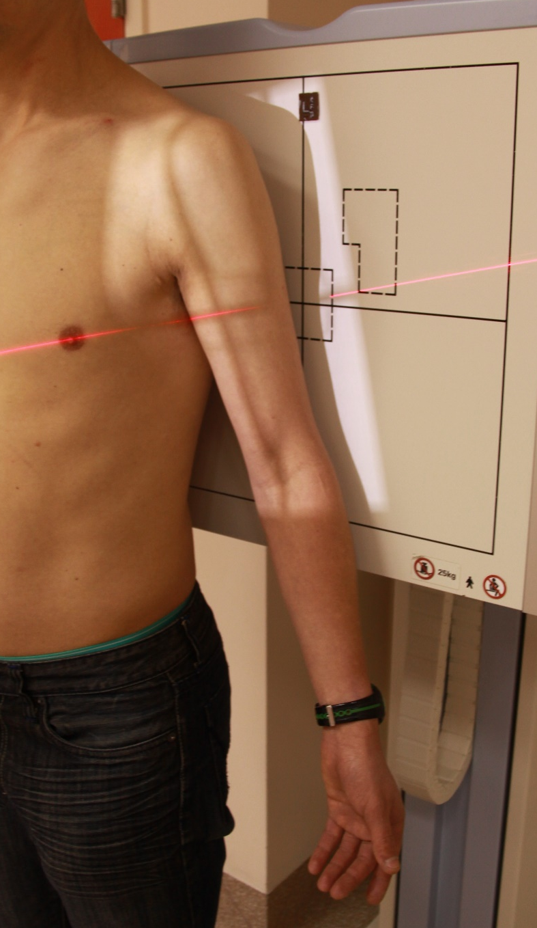
Positioning – AP Humerus
Abduct the patient’s arm to prevent soft tissue overlap
Align collimator light to the length of required anatomy
Center the anatomy on the IR and/or in the light field
Position entire humerus & epicondyles parallel to the IR
Place an anatomical marker (using Anderson Marker Rules), and make final adjustments
Note: suspend respiration
https://radiopaedia.org/articles/humerus-ap-view-3?lang=us

Slide 29
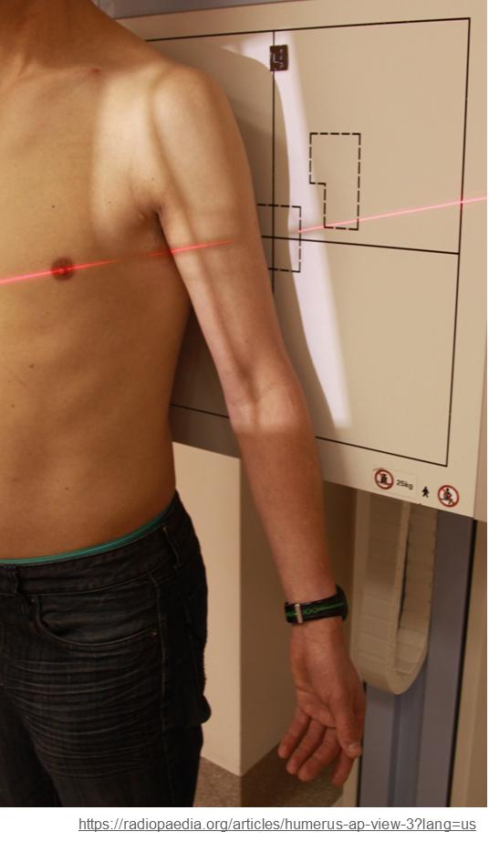
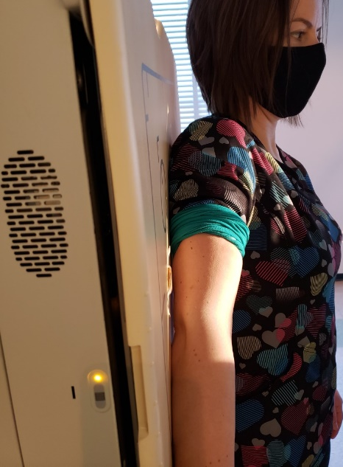
Positioning – AP Humerus
Entire upper limb on same horizontal level
Marker on lateral side
CR is ~mid humerus
SAIT Campus 2021
Light-field extends:
Distally: ~ ½ inch inferior to elbow joint
Proximally: ~ ½ inch superior to AC joint
Medially: ~ ½ inch medial to scapulohumeral joint
Laterally: ~ ½ inch beyond soft-tissue margins
Arm abducted, with
collimator tilted parallel to length of humerus
Humeral epicondyles parallel to IR

Slide 30
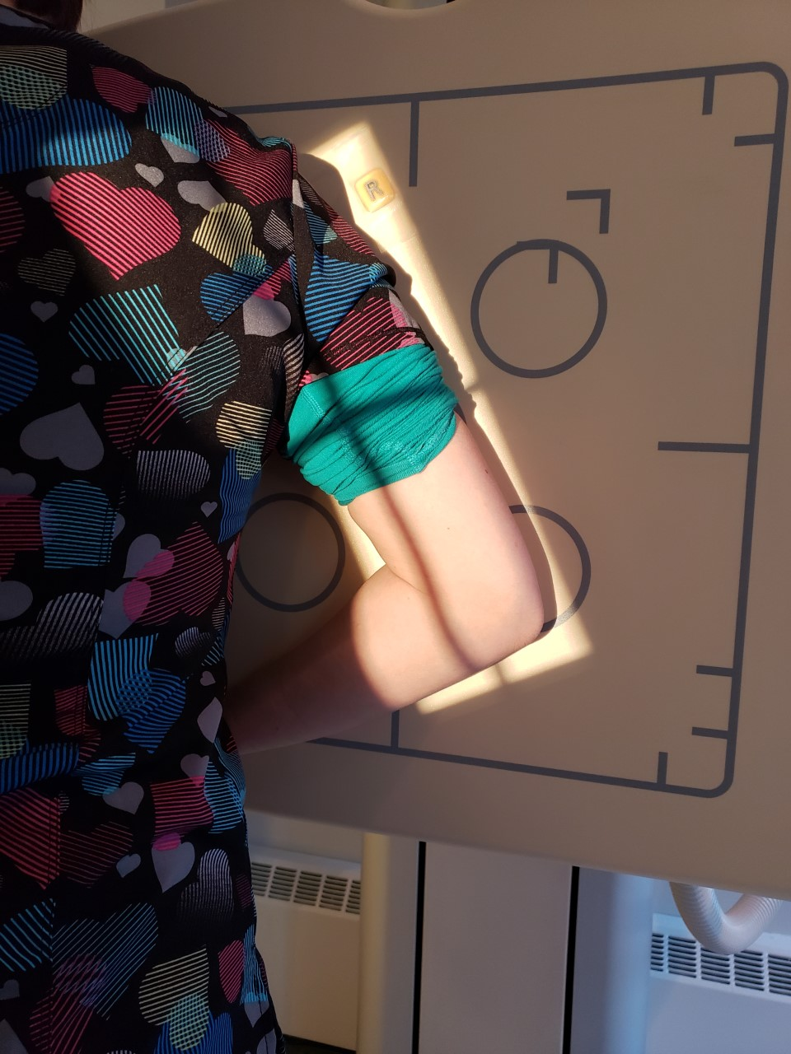
Positioning – Lateral Humerus (mediolateral)
Turn patient to face IR
Abduct the patient’s arm to prevent soft tissue overlap
Align collimator light to length of anatomy
Position the entire humerus parallel to the IR
Ensure epicondyles are perpendicular to the IR
Flex elbow 90º
Place an anatomical marker (using Anderson Marker Rules), and make final adjustments
Note: suspend respiration

Slide 31
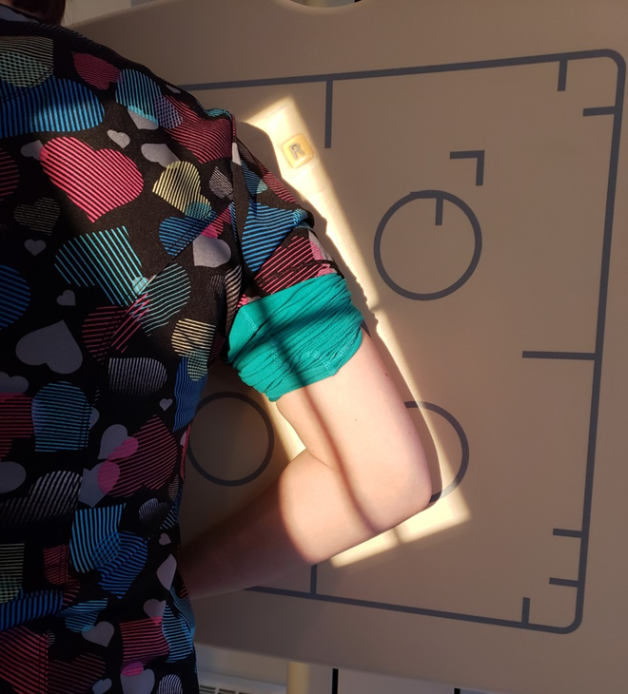
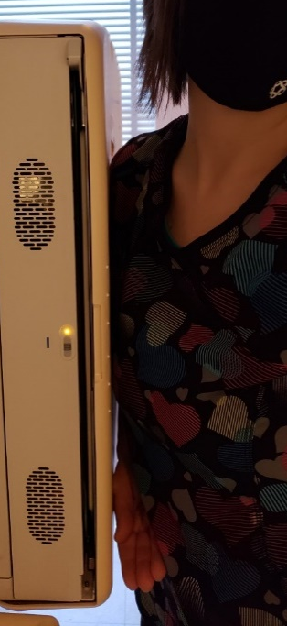
Positioning – Lateral Humerus
Entire upper limb on same horizontal level, with elbow flexed 90⁰
Marker on *posterior side
Central Ray is ~mid humerus
Note: Collimation is NOT ½ inch beyond soft-tissue = clipped anatomy
Light-field extends:
Distally: ~ ½ inch inferior to body of ulna
Proximally: ~ ½ inch superior to AC joint
Medially: ~ ½ inch medial to scapulohumeral joint
Laterally: ~ ½ inch beyond soft-tissue margins
Arm abducted, with
collimator tilted parallel to length of humerus
Humeral epicondyles perpendicular to IR

