Slide 1


FDA Cosmetic Regulations

Slide 2
The Food and Drug Administration (FDA) is responsible for ensuring the safety of cosmetics which includes
makeup
skin care products.
The two most important laws pertaining to cosmetics marketed are
The Federal Food, Drug, and Cosmetic Act (FD&C Act)
The Fair Packaging and Labeling Act (FPLA)
The FDA regulates cosmetics under the authority of these two laws. The law does not require cosmetic products and ingredients (other than color additives) to have FDA approval before they go on the market. In fact, no cosmetic may be labeled or advertised with statements suggesting that FDA has approved the product.

Slide 3
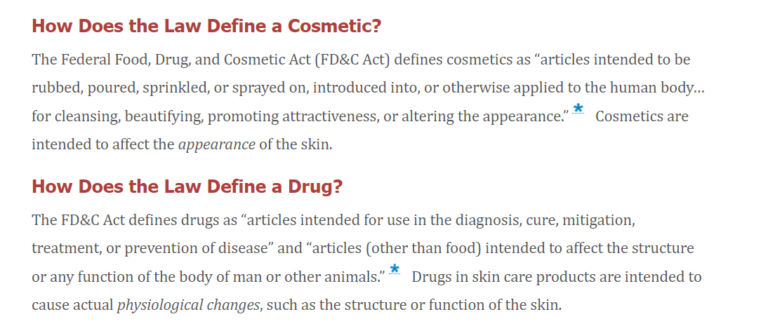

Slide 4
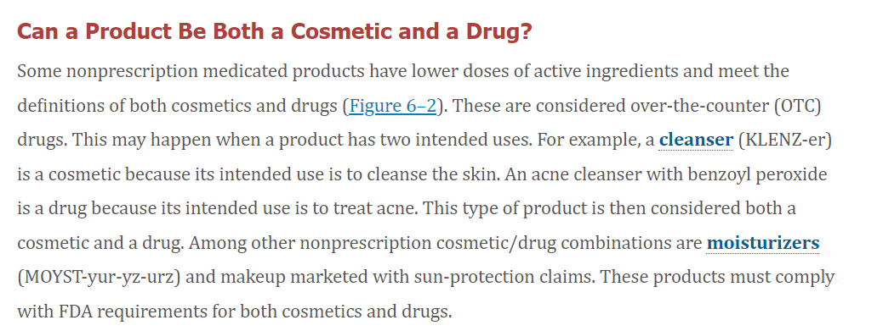

Slide 5
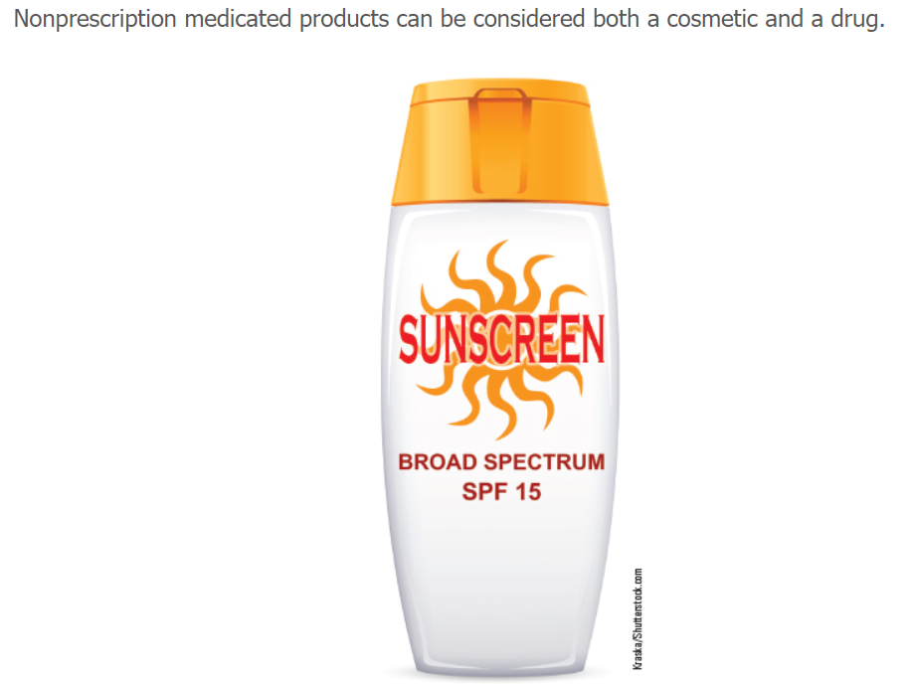

Slide 6
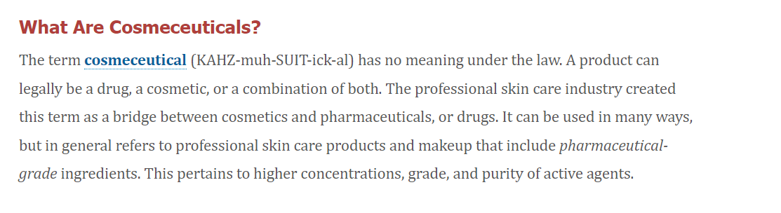

Slide 7
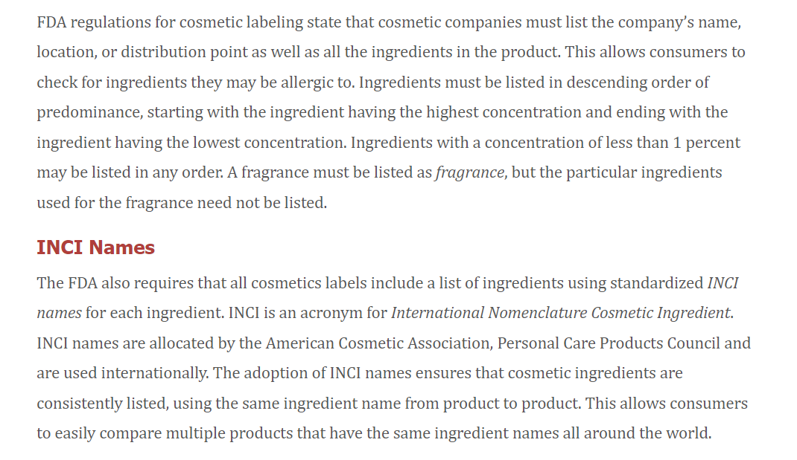
Product Labeling Laws and Regulations

Slide 8
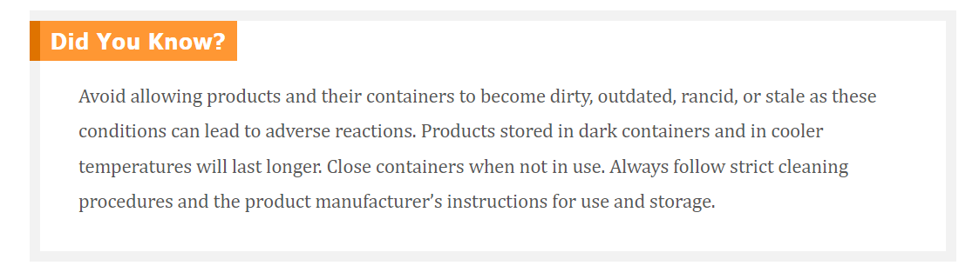
Product Labeling Laws and Regulations

Slide 9
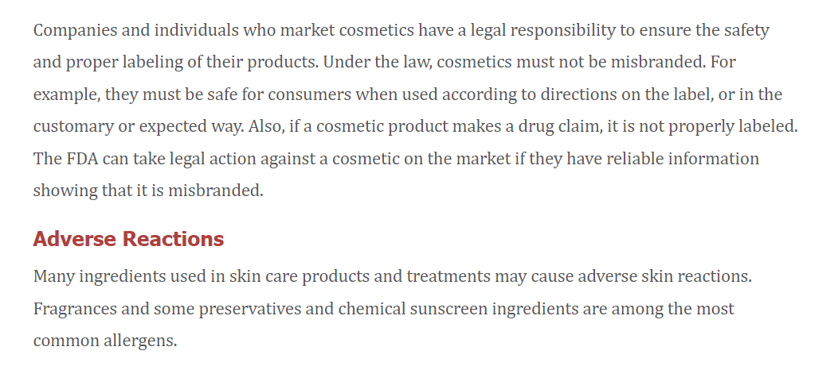
Product Safety

Slide 10
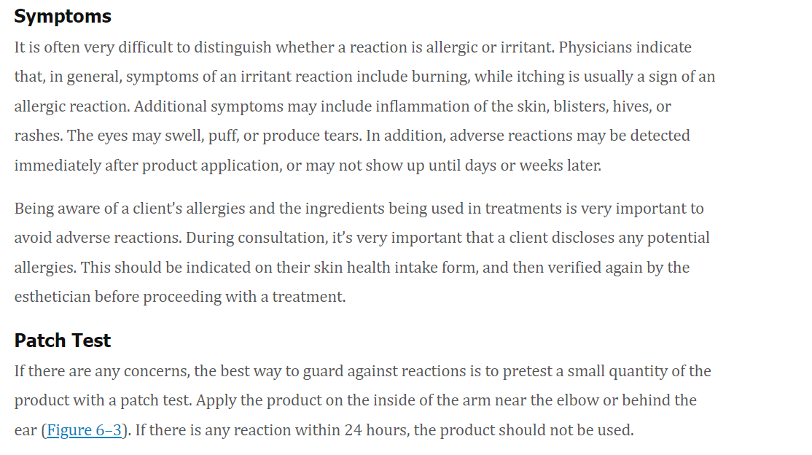
Product Safety

Slide 11
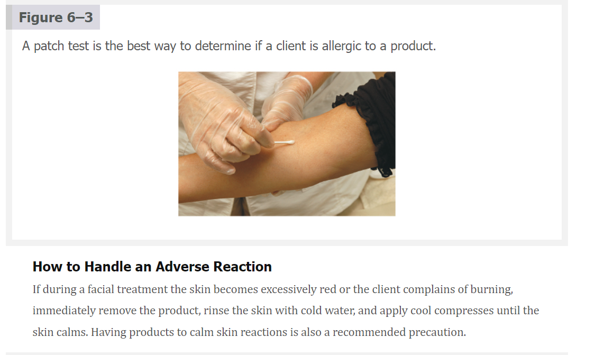
Product Safety

Slide 12
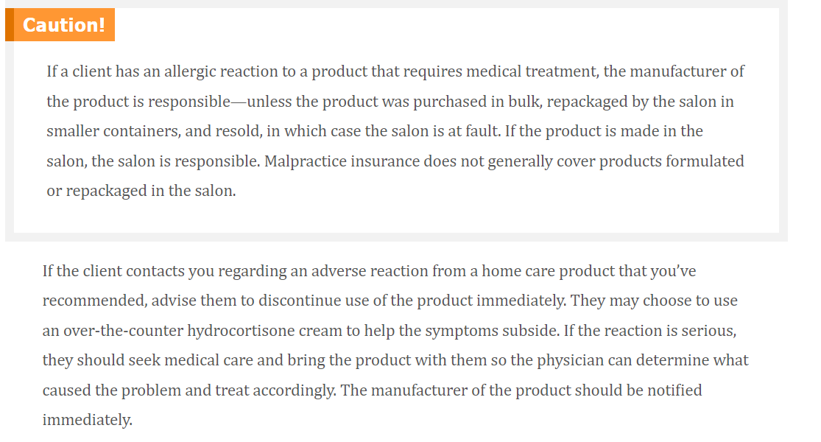
Product Safety

Slide 13
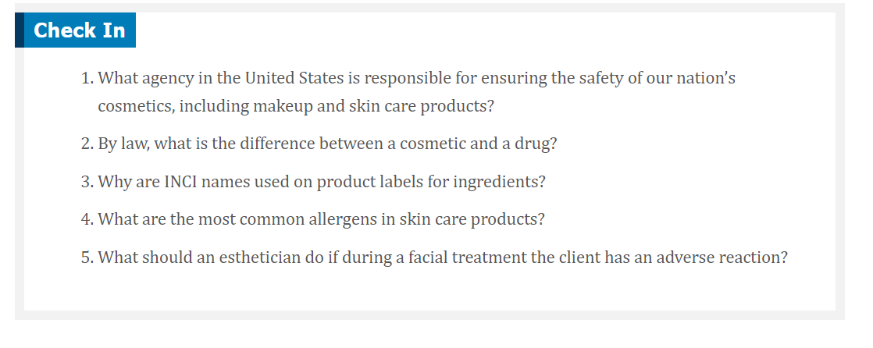
Product Safety

Slide 14

QUESTIONS?

