Slide 1


Laser Chapter 3 part 2 Tattoo Removal

Slide 2
Lesion Selection
Appropriate evaluation of the lesion to be treated is just as important as the patient evaluation.
Evaluation of a pigmented lesion using a Wood’s lamp may be helpful to determine the depth of the pigment (i.e., epidermal, dermal, or mixed), as this will guide laser selection and provide implications for treatment outcomes.
Prior to treatment of any pigmented lesion, it is critical that the lesion be accurately diagnosed.
If any question or doubt exists regarding the nature of the lesion, a biopsy should be performed to confirm the diagnosis and to evaluate for and rule out malignancy.
Lasers should never be used to treat any lesion concerning for melanoma or melanoma in situ.
Additionally, the removal of dysplastic nevi with laser therapy is not recommended, despite studies showing no evidence of malignant transformation in laser-treated nevi

Slide 3
Prior to treating any tattoo with a laser device, it is important to classify the tattoo as different types of tattoos have implications for the appropriate laser device as well as the number of treatments required.
Tattoos can be classified as amateur, professional, cosmetic, medical, or traumatic.
Amateur tattoos often contain lower concentrations of pigment and are located in various levels of the dermis.
Professional tattoos generally contain dense pigment at the junction of the papillary and reticular dermis.
Amateur tattoos typically contain pigment of unknown sources including ash, coal, or india ink, while professional tattoos are often composed of several ink pigments mixed together to create unique colors and shading.
Commonly used pigments include cinnabar and cadmium red (red), cadmium sulfide (yellow), chromium salts (green), cobalt salts (dark blue), titanium dioxide (white), and iron oxide (red-brown or rust-colored)
Professional tattoos are often more difficult to remove with laser therapy due to the deeper and denser placement of the pigment and greater number of ink colors mixed together.
Multiple laser modalities and several treatment sessions may be required for optimal clearance.
Cosmetic tattoos, created using skin-colored tones typically contain iron oxide or titanium dioxide, are important to distinguish because of the unique risk of paradoxical darkening after QS or PS laser treatment (discussed below).

Slide 4
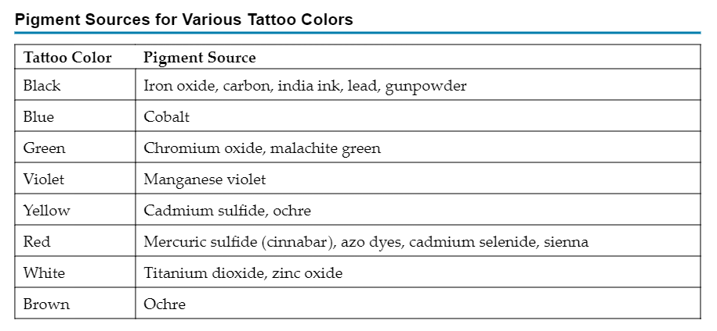

Slide 5
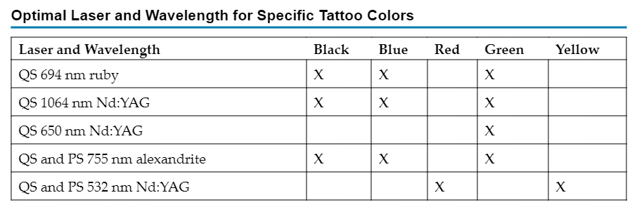

Slide 6
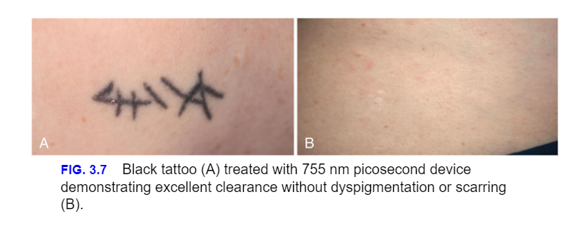
Dark Blue or Black Tattoos
Dark blue or black tattoos are often the most responsive to laser therapy. The laser modality of choice should be based on the patient’s skin type to limit risk of adverse effects. Recent studies suggest that the PS lasers may be superior in safety and efficacy with fewer treatments required

Slide 7
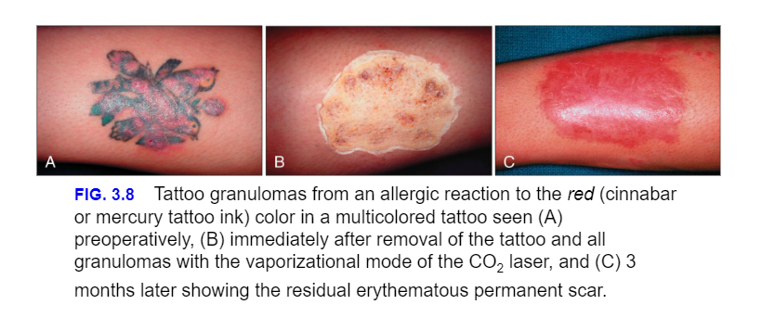
Red and Yellow Tattoos
Red and yellow tattoo ink can be challenging to treat. Caution should be taken when using the 532 nm wavelength in darker skin patients given an increased risk of post-procedural pigmentary alteration due to greater epidermal melanin absorption at the shorter wavelength.

Slide 8
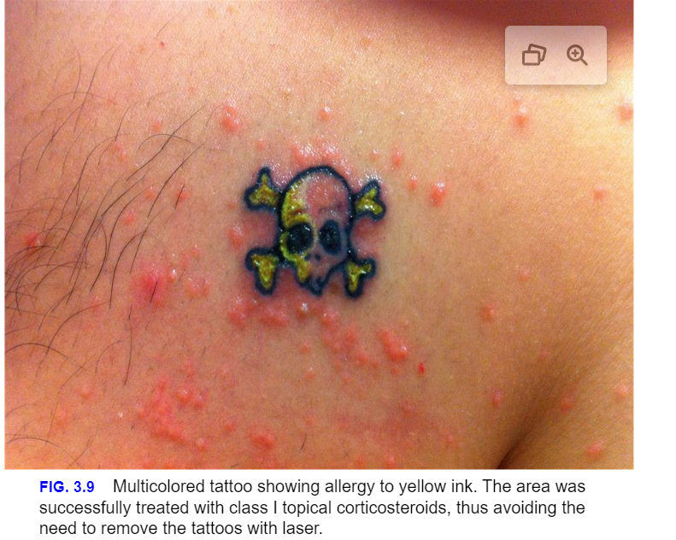

Slide 9
Green Tattoos
The QS 694 nm ruby laser has been considered the wavelength of choice for the treatment of green tattoo ink
Cosmetic Tattoos
Some recommend treating cosmetic tattoos with ablative lasers to eliminate risk of paradoxical darkening. Ablative lasers do have a greater risk of adverse effects and prolonged recovery time, which should be discussed with the patient prior to treatment.
Multi-Colored Tattoos
When treating tattoos containing multiple colors, more than one laser is often required for optimal clearance. In these settings, the individual ink colors should be treated with the optimal corresponding wavelength as discussed in the prior sections

Slide 10
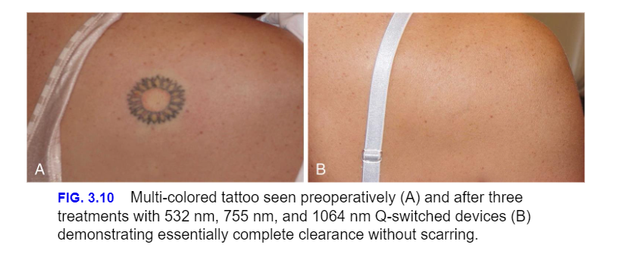

Slide 11
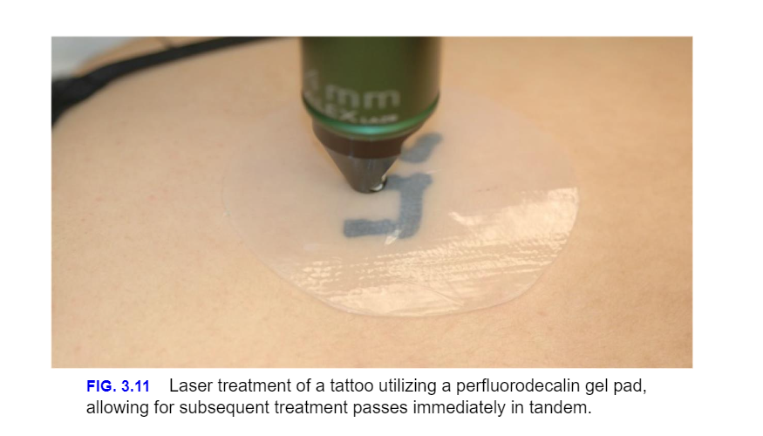
Enhancing Tattoo Removal Outcomes
Increasing fluences are often required with subsequent treatment as ink particle density decreases. One pass over the treatment area with minimal overlap (<10%) minimizes untreated areas and the development of “honey-combing”

Slide 12
Postoperative Care
Cool compresses
Emollient application, and/or the use of occlusive dressings can be soothing and provide pain relief.
No specific wound care is generally needed after treatment of epidermal lesions. A subtle crusting over the treated area may form and slough off within the first 7–10 days after treatment. Patients should be instructed to gently clean the treated areas daily followed by application of occlusive emollients to hasten healing. Crusts should be allowed to slough off on their own.

Slide 13
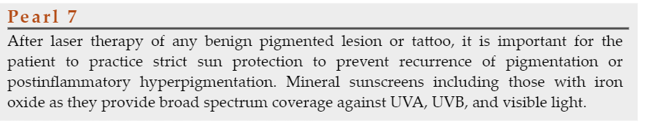

Slide 14

QUESTIONS?

