Slide 1


Medical Esthetics
Skin Conditions

Slide 2
Skin types vs. Skin conditions

Slide 3
Skin types
Dry
Oily
Combination
Normal

Slide 4
Skin Conditions….the difference
While skin types are genetic and determined at birth , Skin conditions are acquired
Skin conditions is what the Medical Esthetician will be focusing on

Slide 5
Many internal and external factors affect the condition of a person’s skin.
Some of the most common skin conditions estheticians
Adult acne
Extrinsic aging (from sun exposure and the environment)
hormonal fluctuations
Dehydration
Pigmentation disorders
Comedones
Hyperkeratinization, and erythema (redness).

Slide 6
We can improve some of these conditions through regularly scheduled skin treatments, by using specialized products, and by avoiding the factors that affect the conditions. On the client’s chart, you will want to note other conditions that may not be listed in Table 5–3 and that you learn about here and in Chapter 4, Disorders and Diseases of the Skin

Slide 7
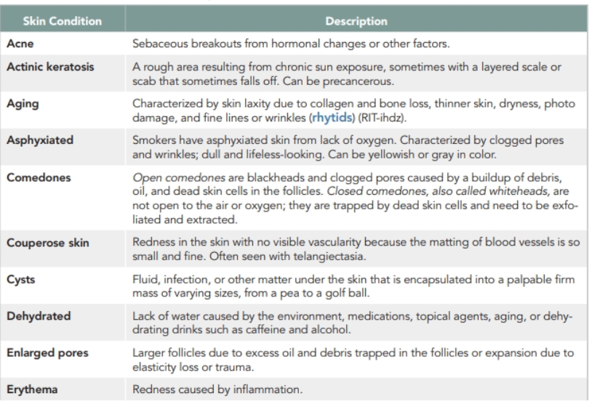

Slide 8
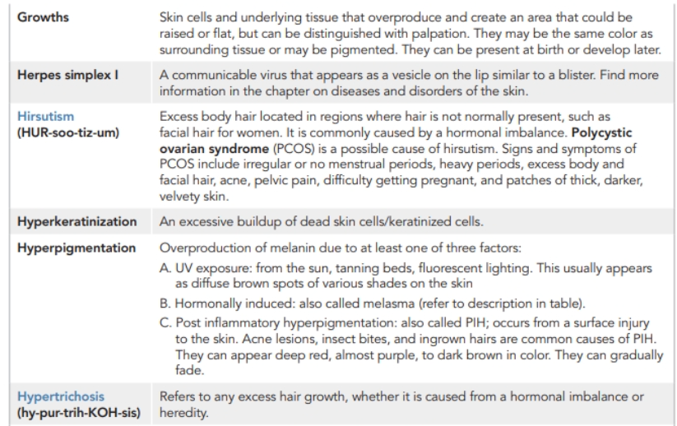

Slide 9
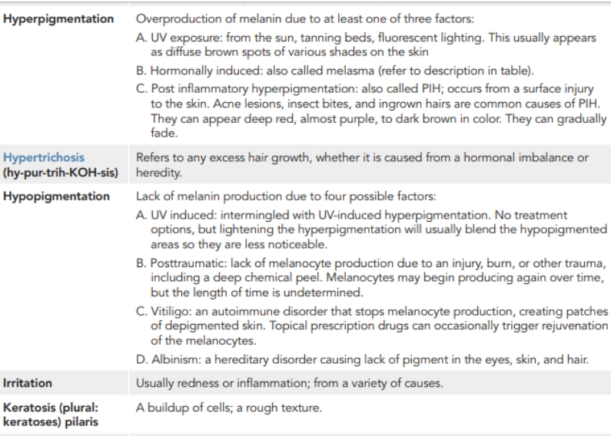

Slide 10
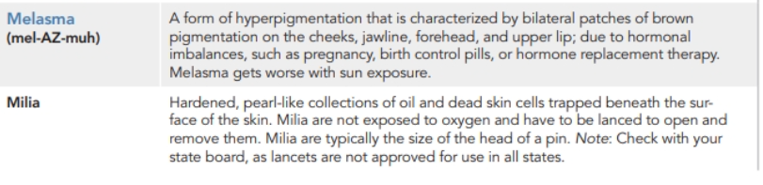

Slide 11
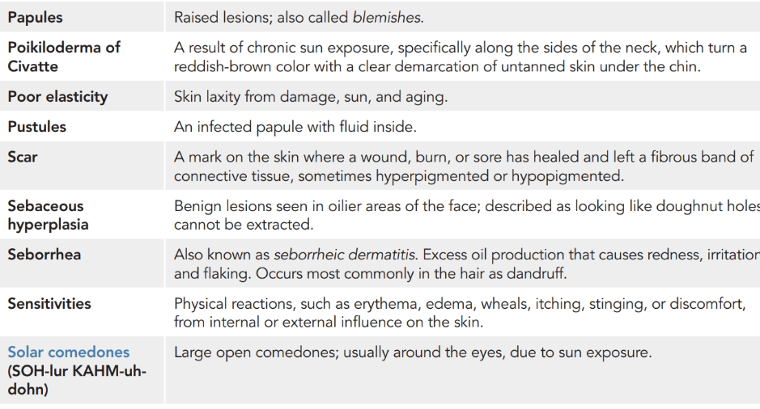

Slide 12
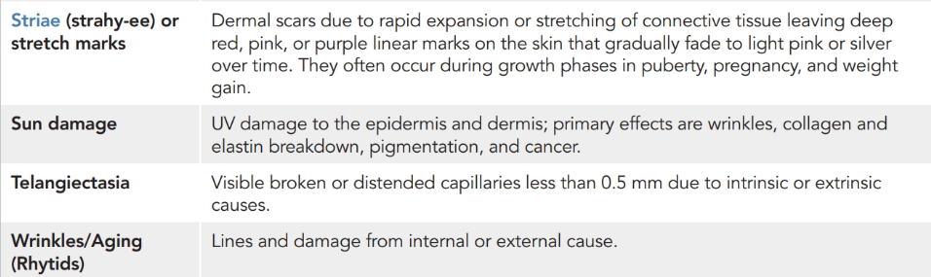

Slide 13
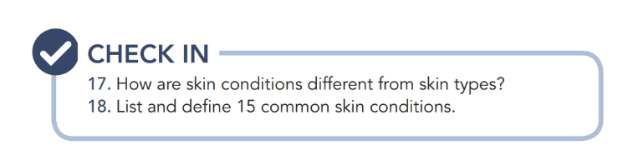

Slide 14

QUESTIONS?

