Slide 1


The Role of Priming the Skin for Peels

Slide 2
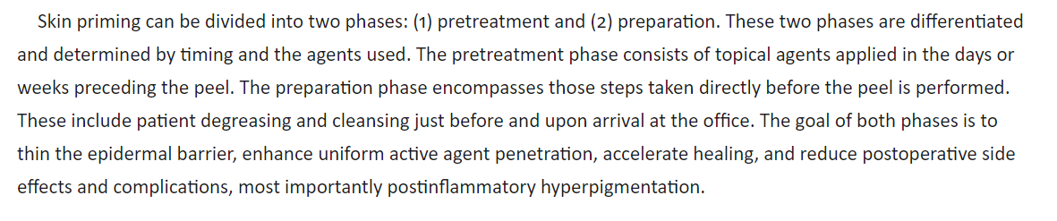

Slide 3
Pretreatment
Pretreatment refers to the period before the actual peel.
A well-planned and executed regimen will enhance any chemical peel.
The three major goals are thinning of the stratum corneum, reduction of postinflammatory hyperpigmentation, and faster wound healing.
Agents commonly used during the pretreatment phase are hydroquinone, retinoids (tretinoin, retinol, adapalene, tazarotene), glycolic acid, and Kojic acid.
Lactic acid, salicylic acid, and azelaic acid are rarely used.
Aggressive sun protection may be the most important step in reducing the likelihood of postinflammatory pigment deposition and should accompany all agents.
Most practitioners will pretreat for 2 weeks to 3 months before the peel, with a longer pretreatment time for patients at risk for postinflammatory hyperpigmentation.

Slide 4
Reflection
Approximately 4% to 7% of light is reflected off skin.2 The amount of light reflected increases with increasing angle of incidence with the least reflection occurring when the laser beam directed perpendicular to the tissue. If enough reflection occurs to create a high-intensity beam, damage to unintended targets could occur. For example, an errant 10,600-nm beam can cause damage to the cornea because of its water content whereas a reflected 595-nm pulsed dye laser beam can damage the retina because of its pigment content. Protective eye wear guards against reflected and direct exposure to laser light.

Slide 5
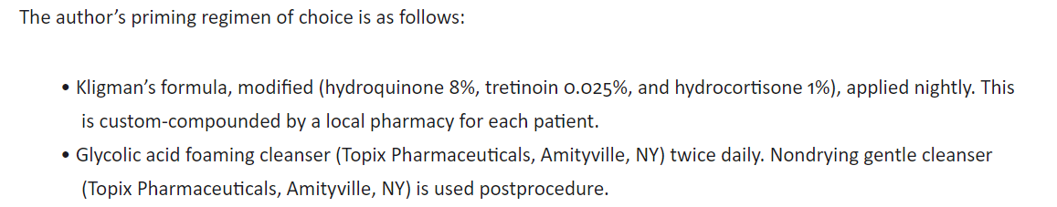
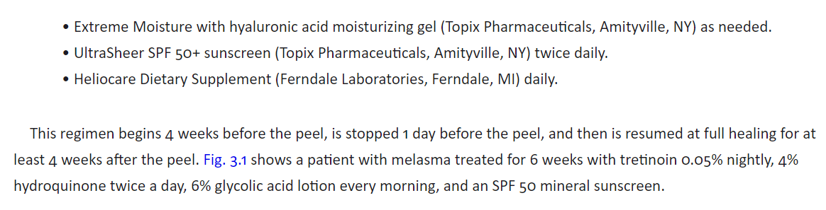

Slide 6
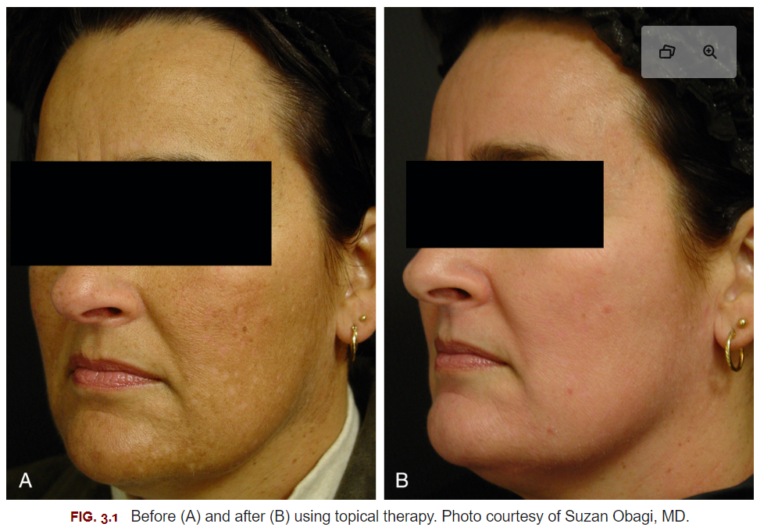

Slide 7
Preparation
Most dermatologic surgeons will use alcohol, acetone, or a combination of both to degrease the skin before the peel.
The use of different applicators will also have an impact on depth of peel. Cotton-tipped applicators, obstetrical swabs, and gauze squares have all been used to apply peeling agents.
The search for the ideal degreasing agent prompted an examination of alcohol, acetone, chlorhexidine gluconate, and Freon Degreaser (trichlorotrifluoroethane) in 35% TCA peeling of the scalp.
No differences between the various compounds were found, but the authors cautioned against the use of acetone in conjunction with possible igniters such as electrosurgical units.

Slide 8
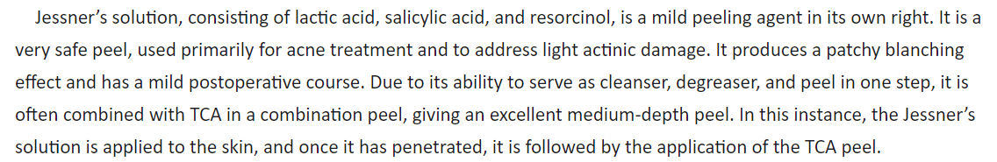

Slide 9
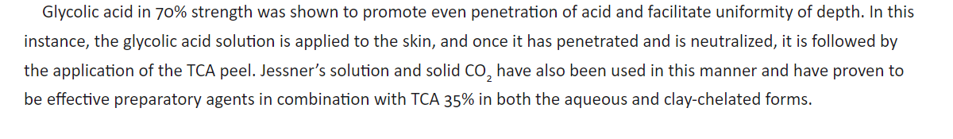

Slide 10
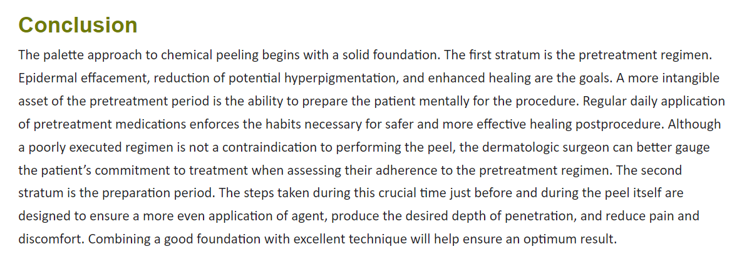

Slide 11

QUESTIONS?

