Slide 1

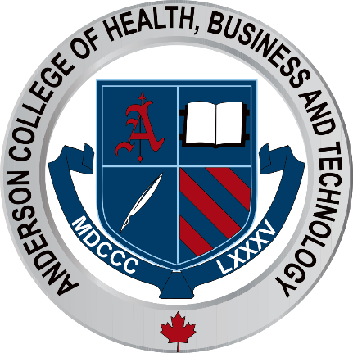
The Individual Importance of Hair Removal Choice

Slide 2
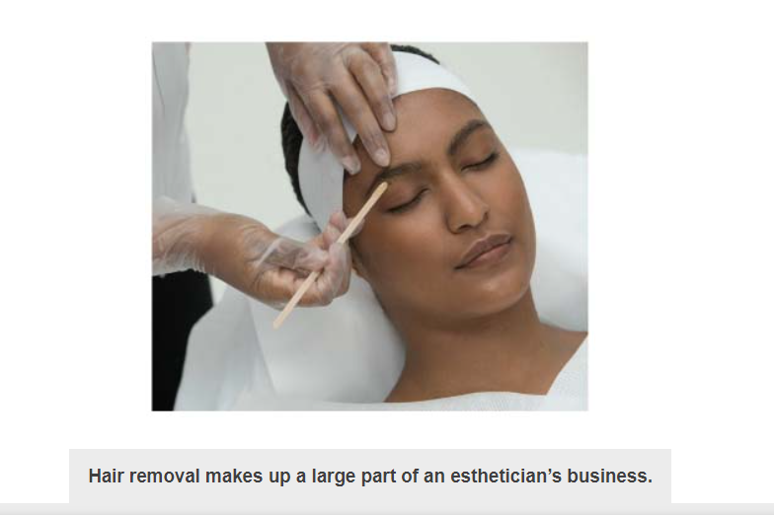
Consumers all over the world spend a lot of money per year on hair removal products and services.
Today hair removal methods range from procedures such as waxing and tweezing, to more advanced techniques that require special training, like electrolysis, laser, and intense pulsed light (IPL). Face and body hair removal has become increasingly popular as evolving technology makes it easier to perform with more effective results for both men and women for esthetic purposes or sport performance.
Estheticians should study and have a thorough understanding of hair removal because:
The growing popularity of hair removal makes up a large part of a salon’s business and is one of the most lucrative services offered.

Slide 3
Waxing is the most common method of hair removal in salons, making it an important service to learn, become proficient in, and provide.
Understanding the benefits, the risks, and how to perform various techniques is vital to an esthetician’s success in this profitable market.
Knowing what methods are used, room preparation, safety, and infection control procedures are an important part of hair removal procedures.

Slide 4
Structure of Hair
The scientific study of hair and its diseases is called trichology.
The average human is born with skin that houses approximately 5 million pilosebaceous units capable of producing hair.
It is important to understand all aspects of hair, including its structure, its appendages, and the types of hair found on the body.
This will help you to suggest and provide the best hair removal services to your client.

Slide 5
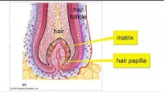

Slide 6
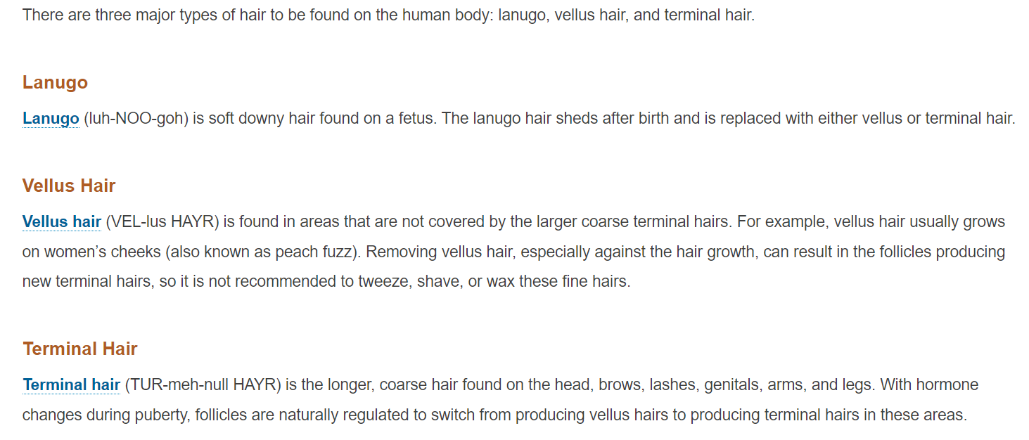
Types of Hair

Slide 7
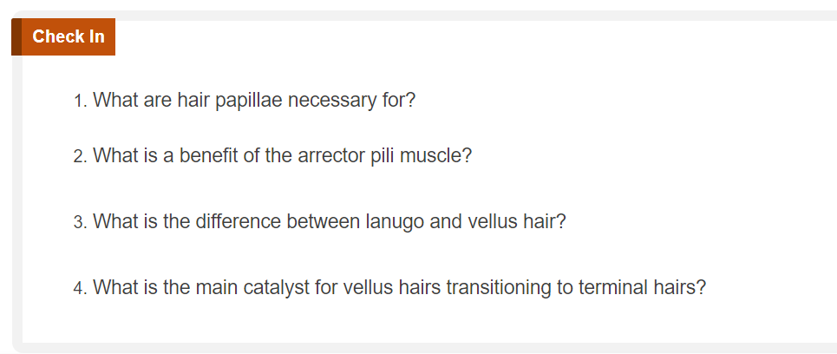

Slide 8

QUESTIONS?

